Slide 1


The Innovation Urban | A proposed sister journal of The Innovation
The Innovation Urban
Background
Vision
Mission
Topics
SEE THE CITY · CHANGE THE CITY
The
The Innovation Urban
Innovation
URBAN
Linking Infrastructure, Technology, Governance, and Climate Action
01
Infrastructure
02
Technology
03
Governance
04
Climate Action
Open access
An interdisciplinary journal for scientific innovation in cities
副标题，是否后面加一个 urban transformation？
Linking Infrastructure, Technology, Governance, and Climate Action for Urban Transformation
批注

Slide 2




The Innovation Urban | A proposed sister journal of The Innovation
02
The Innovation Urban
Background
Vision
Mission
Topics
WHY A NEW JOURNAL
Background
Cities are among humanity’s most complex creations and a critical frontier for scientific and technological innovation, yet face the urgent imperative to respond to infrastructure failures, disruptive technologies, climate change, and geopolitical and economic polycrises worldwide.
Infrastructure failures
Disruptive technologies
Ageing networks under rising demand
AI, sensing and automation reshaping cities
Climate change
Polycrises
Heat, flooding and the need to decarbonize
Geopolitical and economic shocks worldwide
批注
这里是否需要对比基本类似期刊？比如相比 Nature Cities – 更加聚焦 scientific innovation for cities

Slide 3



The Innovation Urban | A proposed sister journal of The Innovation
03
The Innovation Urban
Background
Vision
Mission
Topics
WHERE WE AIM TO BE
Vision
A world-class international journal based in China, led by an international, interdisciplinary, and intergenerational team of leading scholars, and dedicated to advancing scientific discovery and technological innovation to diagnose and dissect urban challenges and devise innovative solutions for cities worldwide.
FROM DISCOVERY TO SOLUTIONS
01
Diagnose urban challenges
International
Interdisciplinary
Intergenerational
02
Dissect their causes and interactions
Editors and authors from leading institutions worldwide
Engineering, technology, governance and climate science
Leading scholars together with emerging researchers
03
Devise innovative solutions for cities

Slide 4
The Innovation Urban | A proposed sister journal of The Innovation
04
The Innovation Urban
Background
Vision
Mission
Topics
WHAT WE WILL DO
Mission
The journal’s mission is to establish a distinctive and authoritative international forum for pioneering interdisciplinary scholarship on the interdependent challenges of urban infrastructure, technological transformation, governance, and climate action.
01
02
03
04
Advance interdisciplinary scientific understanding of cities
Promote innovation in urban infrastructure and engineering
Enable technological transformation of urban systems
Advance urban climate action and environmental resilience
05
06
07
08
Understand how governance enables or constrains urban innovation
Generate comparative evidence and contextually responsive solutions
Accelerate translation from discovery to application
Build a global community for urban innovation

Slide 5
The Innovation Urban | A proposed sister journal of The Innovation
05
The Innovation Urban
Background
Vision
Mission
Topics
WHAT WE PUBLISH
Topics of Interest
Topics | Examples
Urban Infrastructure and Engineering | Renewal of aging urban infrastructure; engineering solutions for dense urban environments; coordinated design and operation of urban infrastructure networks
Urban Technologies and Intelligent Systems | City-scale sensing and digital twins; AI and robotics for urban services and infrastructure operations; development and validation of technologies in urban settings
Climate Action and Urban Resilience | Urban heat and flood risks; adaptation through urban design, infrastructure, and nature-based solutions; decarbonization pathways for cities
Buildings, Energy, and the Built Environment | Effects of urban form and climate on building energy use; Building–neighbourhood–city energy interactions; urban retrofits; urban indoor–outdoor environmental quality
Urban Mobility and Transportation | Interactions between urban form and mobility; integration of multimodal urban transport networks; effects of mobility innovations on accessibility, energy use, and emissions
Urban Environment, Resources, and Health | Urban water–energy–waste linkages; circular resource flows within and across cities; relationships between urban form, environmental exposure, and health
Urban Systems, Complexity, and Transformation | Urban scaling and metabolism; cascading failures across interconnected urban networks; technological and infrastructural pathways of urban transformation
Governance, Planning, and Policy for Urban Innovation | Planning and regulation for urban technology deployment; governance of integrated infrastructure systems; evaluation and adaptation of innovations across diverse cities

Slide 6
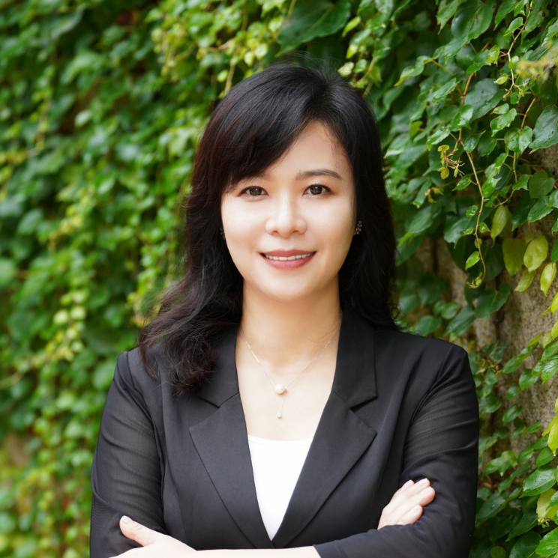
Editor-in-Chief & Working group
??
大部分Innovation子刊都有两个主编
Prof. Shenjing He
Prof. Xiang Yan
Prof. Tianzuo Wen
Dr. Yutian Lu

Slide 7
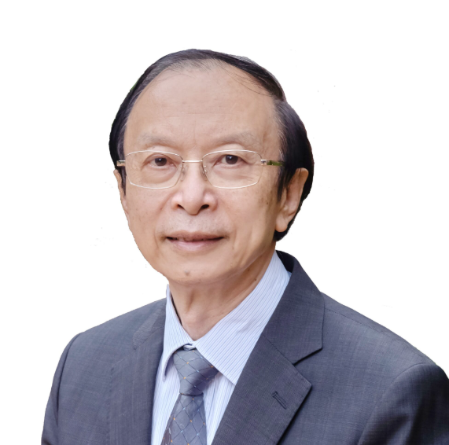
Editorial Board members
 | Institute | 研究领域
叶嘉安 Anthony G. O. Yeh | 香港大学 | 城市规划、GIS、智慧城市 | 中国科学院院士 发展中国家科学院（TWAS）院士 英国社会科学院院士（FAcSS） 香港科学院院士
William C. Clark | 哈佛大学 Harvard University | 可持续性科学、生态学、人类与环境系统 | 美国国家科学院院士 美国人文与科学院院士 美国科学促进会会士（AAAS Fellow）
吴缚龙 | 伦敦大学学院 University College London | 城市转型、城市规划、住房与治理 | 英国社会科学院院士（FAcSS）
傅伯杰 | 中国科学院生态环境研究中心 | 景观生态、生态系统服务、环境与地理科学 | 中国科学院院士 TWAS院士 美国人文与科学院外籍院士 英国爱丁堡皇家学会外籍院士 英国皇家地理学会荣誉会士
樊杰 | 中国科学院地理科学与资源研究所 中国科学院大学 | 国土空间规划、区域发展、空间资源与可持续发展 | 中国科学院院士（2025年当选）
宫鹏 | 香港大学 | 遥感、全球环境变化、城市化与健康 | 欧洲科学院（Academia Europaea）外籍院士 国际欧亚科学院院士
Patrick Roberts | 马克斯·普朗克地球人类学研究所 Max Planck Institute of Geoanthropology | 考古科学、古生态、土地利用与城市化协同演化
Luis Bettencourt Luís M. A. Bettencourt | 芝加哥大学 University of Chicago | 城市复杂系统、网络、城市尺度理论
Rebecca Bentley | 墨尔本大学 University of Melbourne | 住房与建成环境、流行病学、城市健康
Emma Baker | 阿德莱德大学 Adelaide University | 住房研究、住房质量、城市健康与居住环境
filip biljecki | NUS 新加坡国立
Orlando Woods | SMU 新加坡管理
叶嘉安
香港大学，中科院院士
智慧城市，GIS
（做成这种带头像的展示页面）

Slide 8



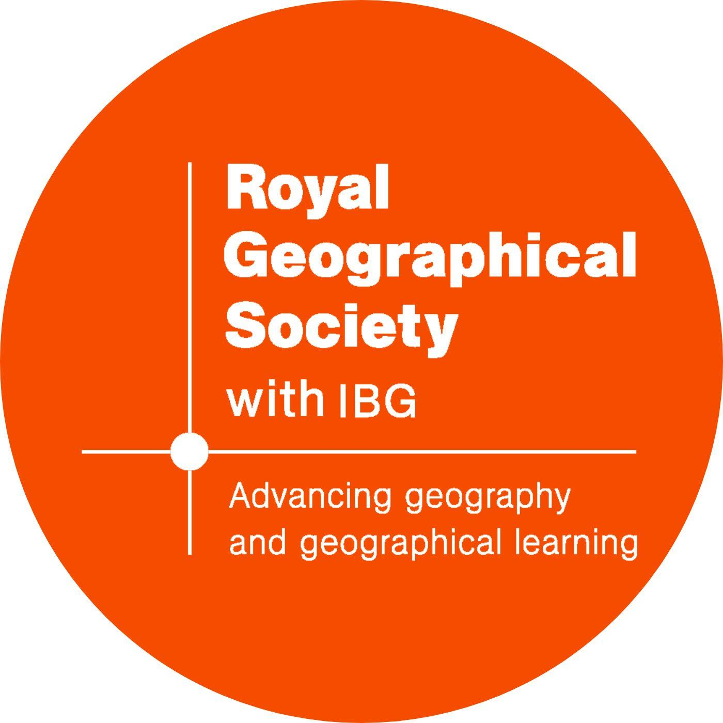



International Academic Leadership & Networks

Slide 9
Timeline
November–December 2026 | Editorial Board Formation & Strategic Planning
Convene the inaugural Editorial Board meeting.
Finalize the journal’s vision, scope, editorial structure, and launch strategy.
February 2027 | APNHR–AHRC Conference, Melbourne
Introduce the journal to international research networks.
Engage potential editors, contributors, and institutional partners.
April 2027 | UAA Conference, New York
Expand international networking and raise awareness of the journal.
Invite prospective submissions and explore special issue opportunities.
August 2027 | IGU Urban Commission Meeting
Official Launch of The Innovation Urban.
Announce the editorial team, journal scope, and call for papers.

