Slide 1
2PC Completeness
A General Characterization Information Theoretic Two Party Games
Peter Rindal

Slide 2
Source
A Review of Joe Kilian's works
  A general completeness theorem for two party games (1991)
  More general completeness theorems for secure two-party computation (2000)

Slide 3






Malicious Symmetric $f$
2 party Active/Malicious cryptographic games of the form:
Give the sufficient and necessary conditions on $f$ and $D$ under which one can implement Oblivious transfer and there by 2 party computation.
Alice
$$x_{a}∈D$$
Bob
$$x_{b}∈D$$
$$f$$
$$f(x_{a},x_{b})$$

Slide 4
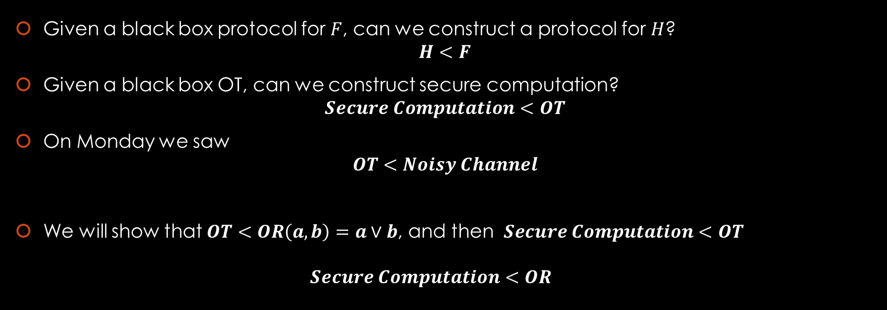
Protocol Reduction
Given a black box protocol for $F$, can we construct a protocol for $H$?
$H<F$
Given a black box OT, can we construct secure computation?
$Secure Computation<OT$
On Monday we saw
$OT<Noisy Channel$
We will show that $OT<OR\left(a,b\right)=a∨b$, and then $Secure Computation<OT$
$Secure Computation<OR$

Slide 5




Oblivious Transfer
Alice
$$m_{0},m_{1}∈\{0,1\}$$
Oblivious Transfer is a ubiquitous cryptographic primitive designed to transfer specific data based on the receivers choice.
No other information can be learned by any party.
Bob
$$c∈\{0,1\}$$
$OT$
$$m_{c}$$

Slide 6



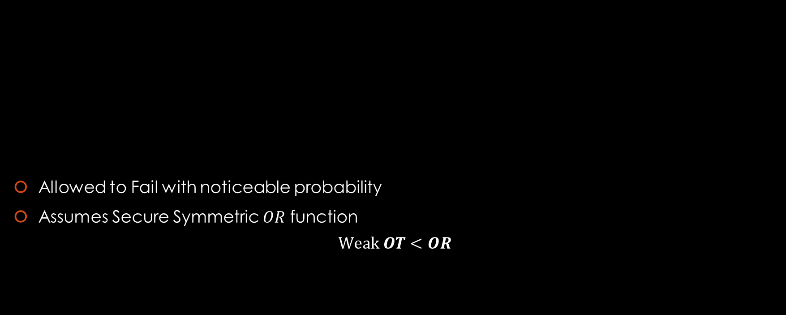





Weak $OT$
Alice
$$m_{0},m_{1}∈\{0,1\}$$
Allowed to Fail with noticeable probability
Assumes Secure Symmetric $OR$ function
$$Weak OT<OR$$
Bob
Weak $OT$
$$c←\{0,1\}$$
$${c, m}_{c}$$
$$x_{a}$$
$$x_{b}$$
$$OR$$
$$x_{a}∨x_{b}$$

Slide 7









Warm up
A motivating example (insecure)
Alice
Bob
$$a_{1},…,a_{k}←\{0,1\}$$
$OR$
$$b_{1},…,b_{k}←\{0,1\}$$
$$c_{1},…,c_{k} s.t. c_{j}=a_{j}∨b_{j}$$
Ex:
$$r←\{0,1\}$$
$$c_{1},… ,c_{x_{\overline{r}}},… ,c_{x_{r}}, … ,c_{k}$$
$$x_{0}, x_{1}←\left\{1,…,k\right\} s.t. \\ c_{x_{0}}=c_{x_{1}}=1 \\ b_{x_{r}}=0 \\ b_{x_{\overline{r}}}=1$$
$$c_{x_{\overline{r}}}=1 c_{x_{r}}=1$$
$$b_{x_{\overline{r}}}=1 b_{x_{r}}=0$$
$$a_{x_{\overline{r}}}=? a_{x_{r}}=1$$

Slide 8




Warm up
A motivating example (insecure)
Alice
Bob
$$a_{1},…,a_{k}←\{0,1\}$$
$OR$
$$b_{1},…,b_{k}←\{0,1\}$$
$$c_{1},…,c_{k} s.t. c_{j}=a_{j}∨b_{j}$$
$$r←\{0,1\}$$
$$x_{0}, x_{1}$$
$$x_{0}, x_{1}←\left\{1,…,k\right\} s.t. \\ c_{x_{0}}=c_{x_{1}}=1 \\ b_{x_{r}}=0 \\ b_{x_{\overline{r}}}=1$$
$$q_{0}=m_{0}⊕a_{x_{0}}$$
$$q_{1}=m_{1}⊕a_{x_{1}}$$
$$a_{x_{\overline{r}}}=? a_{x_{r}}=1$$
$$m_{r}=a_{x_{r}}⊕q_{r} \\ =1⊕q_{r}$$

Slide 9



Warm up
What could go wrong?
Alice
Bob
$$a_{1},…,a_{k}←\{0,1\}$$
$$b_{1},…,b_{k}←\{0,1\}$$
Honest Alice learn $r$…
$$r←\{0,1\}$$
$$x_{0}, x_{1}$$
$$x_{0}, x_{1}←\left\{1,…,k\right\} s.t. \\ c_{x_{0}}=c_{x_{1}}=1 \\ b_{x_{r}}=0 \\ b_{x_{\overline{r}}}=1$$
$$b_{x_{\overline{r}}}=1$$
$$r=j s.t. a_{x_{j}}=1$$
$$q_{0}=m_{0}⊕a_{x_{0}}$$
$$q_{1}=m_{1}⊕a_{x_{1}}$$
$$m_{r}=a_{x_{r}}⊕q_{r} \\ =1⊕q_{r}$$
$$a_{x_{\overline{r}}}=0 a_{x_{r}}=1$$

Slide 10
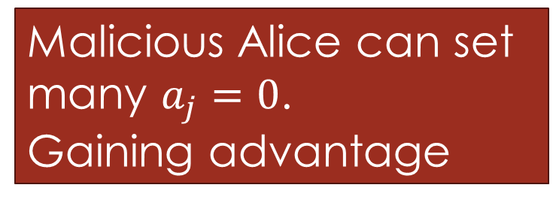
Warm up
What could go wrong?
Alice
Bob
$$a_{1},…,a_{k}←\{0,1\}$$
$$b_{1},…,b_{k}←\{0,1\}$$
Malicious Alice can set many $a_{j}=0$.
Gaining advantage
$$r←\{0,1\}$$
$$x_{0}, x_{1}$$
$$x_{0}, x_{1}←\left\{1,…,k\right\} s.t. \\ c_{x_{0}}=c_{x_{1}}=1 \\ b_{x_{r}}=0 \\ b_{x_{\overline{r}}}=1$$
$$q_{0}=m_{0}⊕a_{x_{0}}$$
$$q_{1}=m_{1}⊕a_{x_{1}}$$
$$m_{r}=a_{x_{r}}⊕q_{r} \\ =1⊕q_{r}$$
$$a_{x_{\overline{r}}}=0 a_{x_{r}}=1$$

Slide 11



Warm up
What could go wrong?
Alice
Bob
$$a_{1},…,a_{k}←\{0,1\}$$
$$b_{1},…,b_{k}←\{0,1\}$$
Malicious Bob learn both $m_{0},m_{1}$…
$$r←\{0,1\}$$
$$x_{0}, x_{1}$$
$$x_{0}, x_{1}←\left\{1,…,k\right\} s.t. \\ c_{x_{0}}=c_{x_{1}}=1 \\ b_{x_{r}}=0 \\ b_{x_{\overline{r}}}=1$$
$$q_{0}=m_{0}⊕a_{x_{0}}$$
$$q_{1}=m_{1}⊕a_{x_{1}}$$
$$b_{x_{\overline{r}}}=0$$
$$m_{r}=a_{x_{r}}⊕q_{r} \\ =1⊕q_{r}$$
$$a_{x_{\overline{r}}}=1 a_{x_{r}}=1$$

Slide 12







Weak $OT$
Alice
Bob
$$a_{1,1 },…,a_{1,k} \\ … \\ a_{k^{10},1},…, a_{k^{10},k}$$
$$c_{1,1 },…,c_{1,k} \\ … \\ c_{k^{10},1},…, c_{k^{10},k}$$
$$b_{1,1 },…,b_{1,k} \\ … \\ b_{k^{10},1},…,b_{k^{10},k}$$
$if\left(\left|\left\{(i,j):c_{i,j}=0\right\}\right|>\frac{k^{11}+k^{6}}{4}\right)$, abort
$if\left(∃i :\left|\left\{j:c_{i,j}=0\right\}\right|>\frac{k}{3}\right)$, abort
Stops Bob from setting too many $b_{i,j}=0$
Stops Alice from setting too many $a_{i,j}=0$

Slide 13






Weak $OT$
Alice
Bob
$$a_{1,1 },…,a_{1,k} \\ … \\ a_{k^{10},1},…, a_{k^{10},k}$$
$$c_{1,1 },…,c_{1,k} \\ … \\ c_{k^{10},1},…, c_{k^{10},k}$$
$$b_{1,1 },…,b_{1,k} \\ … \\ b_{k^{10},1},…,b_{k^{10},k}$$
$$r_{1},…,r_{k^{10}}←\{0,1\}$$
$$x_{i,0}, x_{i,1}$$
$$x_{i,0}, x_{i,1}←\left\{1,…,k\right\} s.t. \\ c_{x_{i,0}}=c_{x_{i,1}}=1 \\ b_{x_{i,r}}=0 \\ b_{x_{i,\overline{r}}}=1$$
$$s.t. |I|≈\frac{k^{10}}{32}$$
$$I⊂\left\{1,…,k^{10}\right\}$$
Now Bob is committed to his choices.
We will open some over the rows.
$$a_{{i,x}_{i,\overline{r}}}=? a_{{i,x}_{i,r}}=1$$

Slide 14






Weak $OT$
Alice
Bob
$$a_{1,1 },…,a_{1,k} \\ … \\ a_{k^{10},1},…, a_{k^{10},k}$$
$$c_{1,1 },…,c_{1,k} \\ … \\ c_{k^{10},1},…, c_{k^{10},k}$$
$$b_{1,1 },…,b_{1,k} \\ … \\ b_{k^{10},1},…,b_{k^{10},k}$$
$$r_{1},…,r_{k^{10}}←\{0,1\}$$
$$x_{i,0}, x_{i,1}$$
$$x_{i,0}, x_{i,1}←\left\{1,…,k\right\} s.t. \\ c_{x_{i,0}}=c_{x_{i,1}}=1 \\ b_{x_{i,r}}=0 \\ b_{x_{i,\overline{r}}}=1$$
$$s.t. |I|≈\frac{k^{10}}{32}$$
$$I⊂\left\{1,…,k^{10}\right\}$$
$b_{i,1},…,b_{i,k} , r_{i}$ for $i∈I$
$if(inconsistent)$, abort
$if\left(\left|\left\{\left(i,j\right):i∈I,b_{i,j}=0\right\}\right|<\frac{k^{11}}{64}−k^{7}\right)$, abort
Forces Bob to have $b_{i,j}=0$ in enough spots so that $a_{i,j}, c_{i,j}$ will disagree with high probability if he lies.
$⇒$ Bob told the truth in ~1/2 of the remaining rows with high probability

Slide 15










Weak $OT$
Alice
Bob
$$a_{1,1 },…,a_{1,k} \\ … \\ a_{k^{10},1},…, a_{k^{10},k}$$
$$c_{1,1 },…,c_{1,k} \\ … \\ c_{k^{10},1},…, c_{k^{10},k}$$
$$b_{1,1 },…,b_{1,k} \\ … \\ b_{k^{10},1},…,b_{k^{10},k}$$
$$r_{1},…,r_{k^{10}}←\{0,1\}$$
$$x_{i,0}, x_{i,1}$$
Jointly pick $s_{1},…,s_{k}←\left\{1,…,k^{10}\right\}−I$
$$x_{i,0}, x_{i,1}←\left\{1,…,k\right\} s.t.$$
$$z_{1},…,z_{k}←\{0,1\}$$
$$For i∈\left\{s_{1},…,s_{k}\right\}:$$
$$For i∈\left\{s_{1},…,s_{k}\right\}:$$
$$v_{i}=a_{i,x_{i,r}}⊕q_{i,r_{i}} \\ =1⊕q_{i,r_{i}} \\ =z_{i}⊕r_{i}(m_{0}⊕m_{1})$$
$q_{i,0}=z_{i}⊕a_{i,x_{i,0}}$
$${\left\{q_{j,0}, q_{j,1}\right\}}_{j}, Q$$
$$q_{i,1}=z_{i}⊕a_{i,x_{i,1}}⊕m_{0}⊕m_{1}$$
$$Q=m_{0}⊕z_{1}⊕…⊕z_{k}$$
$$c=⊕_{i}r_{i} \\ m_{c}=Q⊕_{i}v_{i} \\ =m_{0}⊕c(m_{0}⊕m_{1})$$
$$a_{{i,x}_{i,\overline{r}}}=? a_{{i,x}_{i,r}}=1$$

Slide 16







Weak $OT$
Alice
$$m_{0},m_{1}∈\{0,1\}$$
Bob
Allowed to Fail with noticeable probability
  Bob may learn $m_{1−c}$ with some probability
  Aborts with probability $o\left(\frac{1}{k}\right)$
Assumes Secure $OR$ function
Weak $OT$
$$c←\{0,1\}$$
$$c,$$
$$m_{c}$$
$$m_{1−c}$$

Slide 17


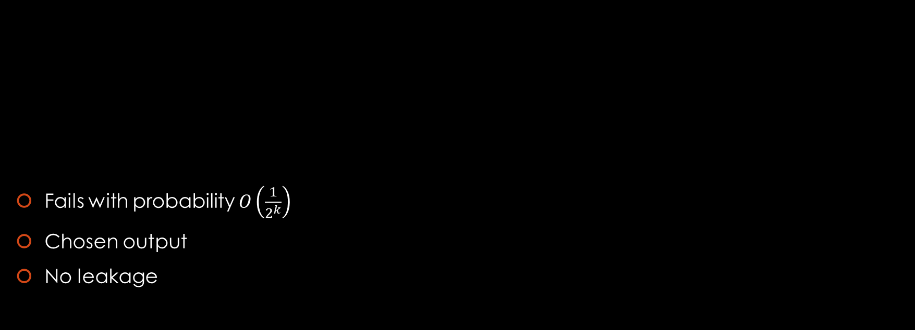
From Weak to Strong $OT$
Fails with probability $O\left(\frac{1}{2^{k}}\right)$
Chosen output
No leakage
Alice
$$m_{0},m_{1}∈\{0,1\}$$
Bob
$$OT$$
Weak OT
$$c←\{0,1\}$$
$$c,$$
$$m_{c}$$

Slide 18






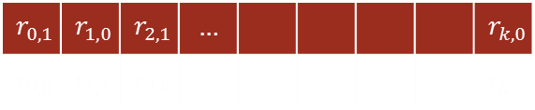
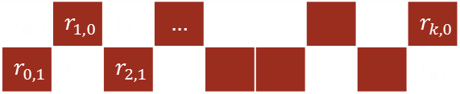








From Weak to Strong $OT$
Alice
$$m_{0},m_{1}∈\{0,1\}$$
Bob
$$c∈\{0,1\}$$
$$r_{1,0},r_{1,1},…, r_{k,0},r_{k,1}←\{0,1\}$$
Weak $OT$
$$c←\{0,1\}$$
$$k$$
$$c_{i},r_{{i,c}_{i}} For i∈I$$
$If\left(\left|I\right|<\frac{k}{2}\right)$ Abort
$${\left\{d_{i}\right\}}_{i}$$
$$d_{i}=c⊕c_{i}$$
$$q_{0}=m_{0}⊕_{i∈I}r_{i,d_{i}}$$
$$q_{1}=m_{1}⊕_{i∈I}r_{i,\overline{d_{i}}}$$
$$m_{c}=q_{c}⊕_{i∈I}r_{i,c_{i}}$$
$$r_{0,0}$$ | $$r_{1,0}$$ | $$r_{2,0}$$ | $$…$$ |  |  |  |  | $$r_{k,0}$$
$$r_{0,1}$$ | $$r_{1,1}$$ | $$r_{2,1}$$ | $$…$$ |  |  |  |  | $$r_{k1}$$
$$c=0$$
$$r_{0,1}$$ | $$r_{1,0}$$ | $$r_{2,1}$$ | $$…$$ |  |  |  |  | $$r_{k,0}$$
$$r_{0,0}$$ | $$r_{1,1}$$ | $$r_{2,0}$$ | $$…$$ |  |  |  |  | $$r_{k1}$$

Slide 19





From $OR$ to $OT$
We constructed $OT$ from black box secure $OR$
$OR$ is sufficient
Can we generalize the black box?
  Secure $AND?$
  Secure $XOR?$
What is necessary for $OT?$
$$<$$
$$OT$$
$$OR$$

Slide 20










Embedded $OR$
We say a function $F(i,j)$ possesses an embedded $OR$ if there exists $i_{0},i_{1},j_{0},j_{1}$
such that for all $a,b∈\{0,1\}$, $F\left(i_{a},j_{b}\right)=x_{a∨b}$
We called this non decomposable.
$$j_{1}$$
$$x_{1}$$
$$x_{1}$$
$$j_{0}$$
$$x_{0}$$
$$x_{1}$$
$$i_{0}$$
$$i_{1}$$

Slide 21
Embedded $OR$
We called this non decomposable.
$$x_{1}$$
$$x_{1}$$
$$x_{0}$$
$$x_{1}$$

Slide 22





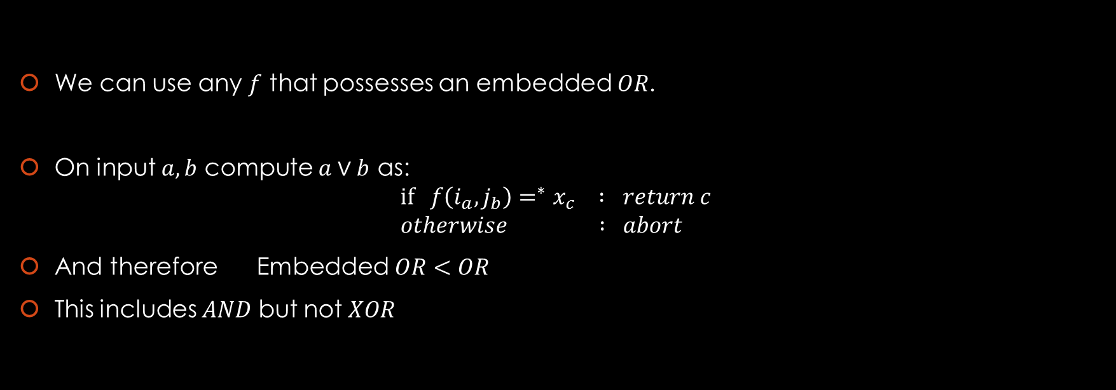






Sufficient
$$\{$$
We can use any $f$ that possesses an embedded $OR$.
On input $a,b$ compute $a∨b$ as:
$if f\left(i_{a},j_{b}\right)=^{∗}x_{c} : return c$
$otherwise : abort$
And therefore Embedded $OR<OR$
This includes $AND$ but not $XOR$
$$j_{1}$$
$$x_{1}$$
$$x_{1}$$
$$f\left(i,j\right):$$
$$j_{0}$$
$$x_{0}$$
$$x_{1}$$
$$i_{0}$$
$$i_{1}$$
$$f\left(i,j\right)$$
$∗$ make sure it makes sense…

Slide 23
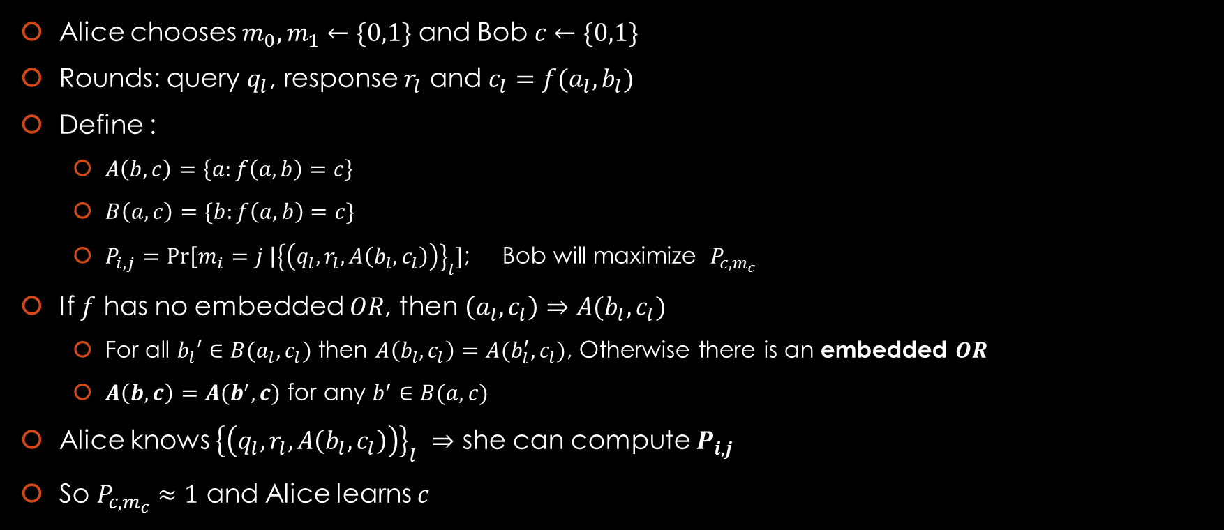
Necessary
$$\{$$
Alice chooses $m_{0},m_{1}←\{0,1\}$ and Bob $c←\{0,1\}$
Rounds: query $q_{l}$, response $r_{l}$ and $c_{l}=f(a_{l},b_{l})$
Define :
  $A\left(b,c\right)=\left\{a:f\left(a,b\right)=c\right\}$
  $B\left(a,c\right)=\{b:f\left(a,b\right)=c\}$
  $P_{i,j}=\operatorname{Pr}\left[m_{i}=j \right|{\left\{\left(q_{l},r_{l},A\left(b_{l},c_{l}\right)\right)\right\}}_{l}]$; Bob will maximize $P_{c,m_{c}}$
If $f$ has no embedded $OR$, then $\left(a_{l},c_{l}\right)⇒A(b_{l},c_{l})$
  For all $b_{l}′∈B(a_{l},c_{l})$ then $A\left(b_{l},c_{l}\right)=A(b_{l}^{′},c_{l})$, Otherwise there is an embedded $OR$
  $A\left(b,c\right)=A(b^{′},c)$ for any $b^{′}∈B(a,c)$
Alice knows ${\left\{\left(q_{l},r_{l},A\left(b_{l},c_{l}\right)\right)\right\}}_{l}$ $⇒$ she can compute $P_{i,j}$
So $P_{c,m_{c}}≈1$ and Alice learns $c$
$$j_{1}$$
$$x_{1}$$
$$x_{1}$$
$$f\left(i,j\right):$$
$$j_{0}$$
$$x_{0}$$
$$x_{1}$$
$$i_{0}$$
$$i_{1}$$
$$f\left(i,j\right)$$

Slide 24





Restriction: Asymmetric
Alice
$$x_{a}∈D$$
Active (Malicious) parties
Is embedded $OR$ sufficient?
  No ☹
Bob
$$x_{b}∈D$$
$$f$$
$$f(x_{a},x_{b})$$

Slide 25
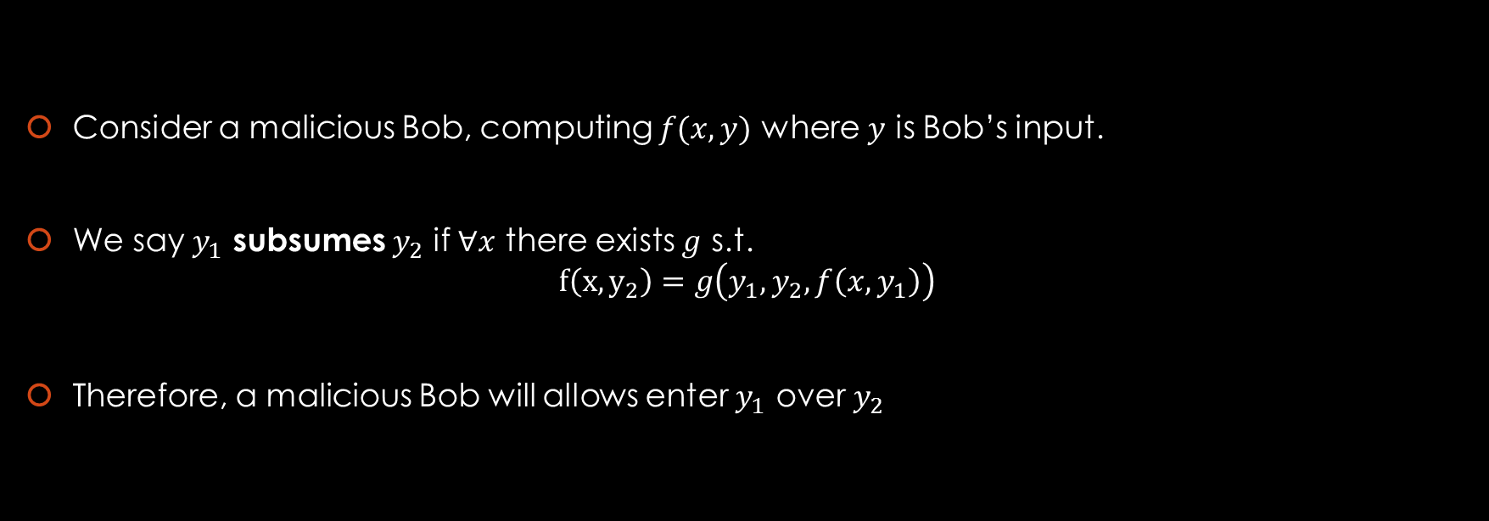
Subsuming Strategy
Consider a malicious Bob, computing $f(x,y)$ where $y$ is Bob’s input.
We say $y_{1}$ subsumes $y_{2}$ if $∀x$ there exists $g$ s.t.
$f\left(x,y_{2}\right)=g\left(y_{1},y_{2},f\left(x,y_{1}\right)\right)$
Therefore, a malicious Bob will allows enter $y_{1}$ over $y_{2}$

Slide 26
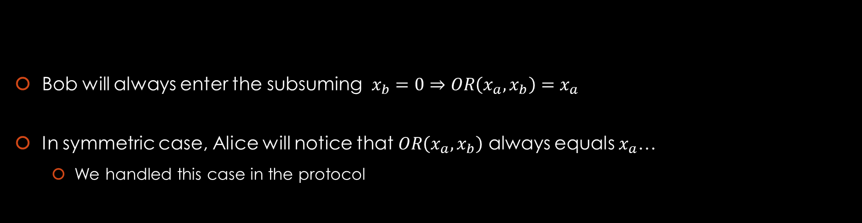





Insufficient Embedded $OR$
Alice
$$x_{a}∈\{0,1\}$$
Bob
$$x_{b}∈\{0,1\}$$
$$OR$$
Bob will always enter the subsuming $x_{b}=0⇒OR\left(x_{a},x_{b}\right)=x_{a}$
In symmetric case, Alice will notice that $OR\left(x_{a},x_{b}\right)$ always equals $x_{a}$…
  We handled this case in the protocol
$$x_{a}∨x_{b}$$

Slide 27

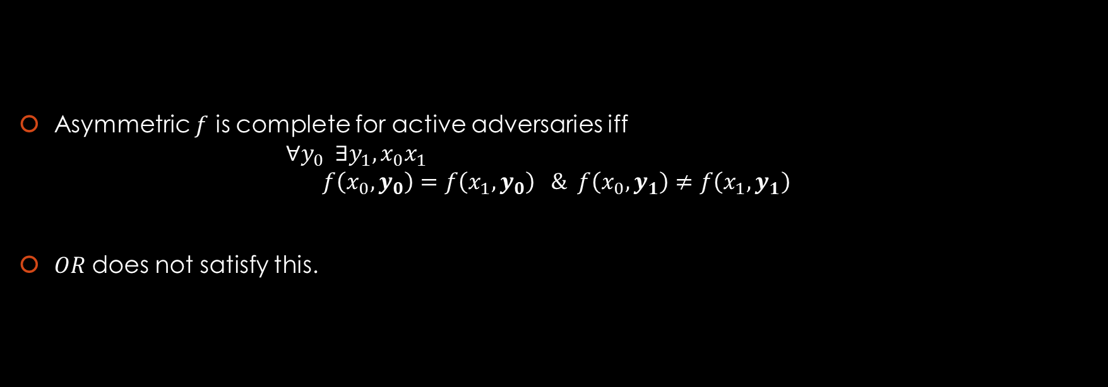
Claim
Asymmetric $f$ is complete for active adversaries iff
$∀y_{0} ∃y_{1},x_{0}x_{1}$
$f\left(x_{0},y_{0}\right)=f\left(x_{1},y_{0}\right) \& f\left(x_{0},y_{1}\right)≠f\left(x_{1},y_{1}\right)$
$OR$ does not satisfy this.
$$f$$

Slide 28














Impossibility
Suppose there exists some $y_{0}$ s.t.
$∀y_{1},x_{0}x_{1}$
$f\left(x_{0},y_{0}\right)=f\left(x_{1},y_{0}\right)⇒f\left(x_{0},y_{1}\right)=f\left(x_{1},y_{1}\right)$
Alice
$$x$$
$$f$$
Eve
Bob
$$y$$
$$y_{0}$$
$$f\left(x,y_{0}\right)$$
$\text{Finds} x^{′} \text{s}\text{.}\text{t}\text{.}$
$f\left(x,y_{0}\right)=f(x^{′},y_{0})$
$\text{Finds} x^{′} \text{s}\text{.}\text{t}\text{.}$
$f\left(x,y_{0}\right)=f(x^{′},y_{0})$
$$f\left(x,y \right)$$
$$f\left(x,y_{0}\right)$$
$$⇒f\left(x,y\right)=f(x^{′},y)$$
$$⇒f\left(x,y\right)=f(x^{′},y)$$
$⇒$ Passively secure $OT$from ordinary channels, a contradiction $∎$
$$f(x,y)$$

Slide 29










$OT<p−OT$
$p−OT:$ Alice inputs $m∈\{0,1\}$ and Bob receives $m$ with probability $p$
  Erasure channel with $⊥$probability $p$.
  We saw on Monday that $OT<p−OT$
$$1−p$$
$$0$$
$$0$$
$$p$$
$$⊥$$
$$1$$
$$1−p$$
$$1$$

Slide 30
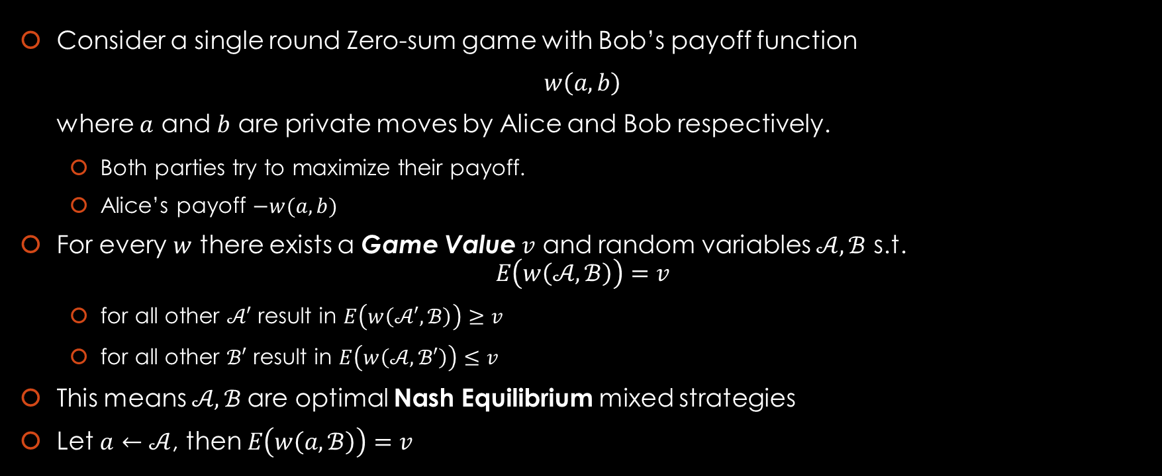
Nash Equilibrium
Consider a single round Zero-sum game with Bob’s payoff function
$w\left(a,b\right)$
where $a$ and $b$ are private moves by Alice and Bob respectively.
  Both parties try to maximize their payoff.
  Alice’s payoff $−w(a,b)$
For every $w$ there exists a Game Value $v$ and random variables $𝒜,ℬ$ s.t.
$E\left(w\left(𝒜,ℬ\right)\right)=v$
  for all other $𝒜′$ result in $E\left(w\left(𝒜′,ℬ\right)\right)≥v$
  for all other $ℬ′$ result in $E\left(w\left(𝒜,ℬ′\right)\right)≤v$
This means $𝒜,ℬ$are optimal Nash Equilibrium mixed strategies
Let $a←𝒜$, then $E\left(w\left(a,ℬ\right)\right)=v$

Slide 31
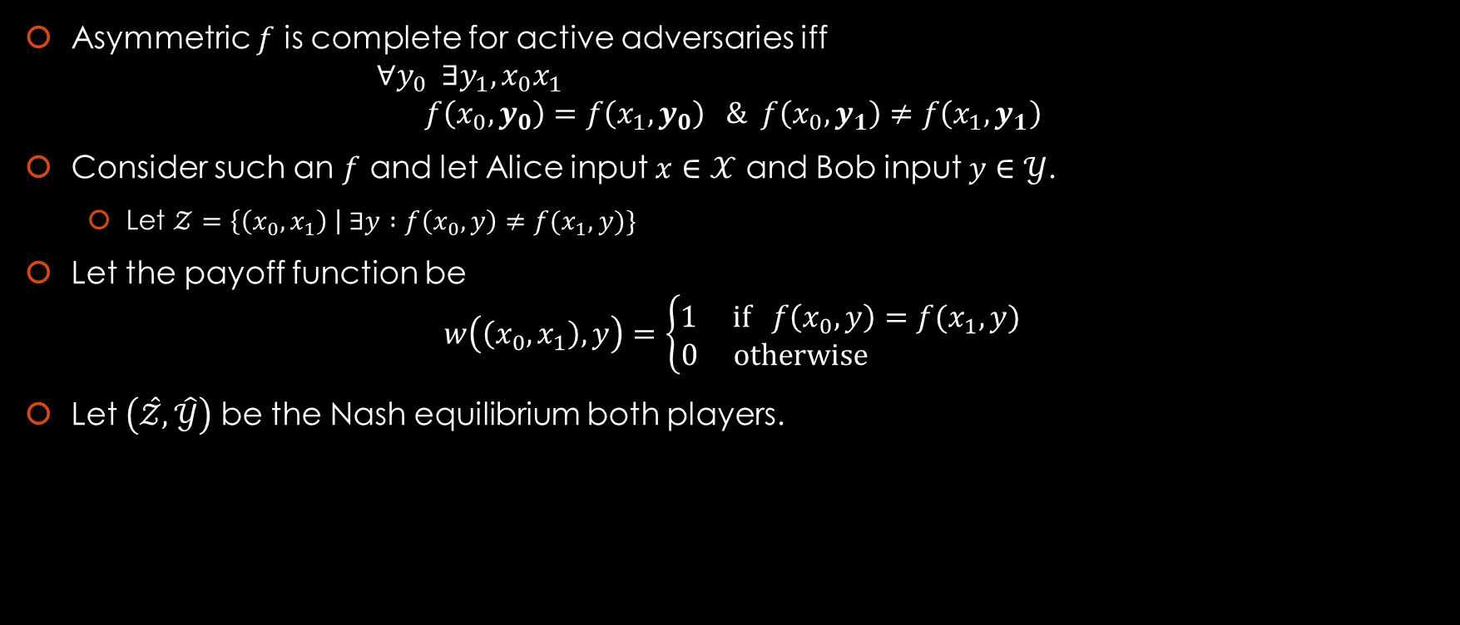

Reduction from $p−OT$
Asymmetric $f$ is complete for active adversaries iff
$∀y_{0} ∃y_{1},x_{0}x_{1}$
$f\left(x_{0},y_{0}\right)=f\left(x_{1},y_{0}\right) \& f\left(x_{0},y_{1}\right)≠f\left(x_{1},y_{1}\right)$
Consider such an $f$ and let Alice input $x∈𝒳$ and Bob input $y∈𝒴$.
  Let $𝒵=\left\{\left(x_{0},x_{1}\right) \right| ∃y :f\left(x_{0},y\right)≠f(x_{1},y)\}$
Let the payoff function be
$w\left(\left(x_{0},x_{1}\right),y\right)=\left\{\begin{aligned}1 if f\left(x_{0},y\right)=f(x_{1},y) \\ 0 otherwise \end{aligned}\right.$
Let $\left(\hat{𝒵},\hat{𝒴}\right)$ be the Nash equilibrium both players.

Slide 32







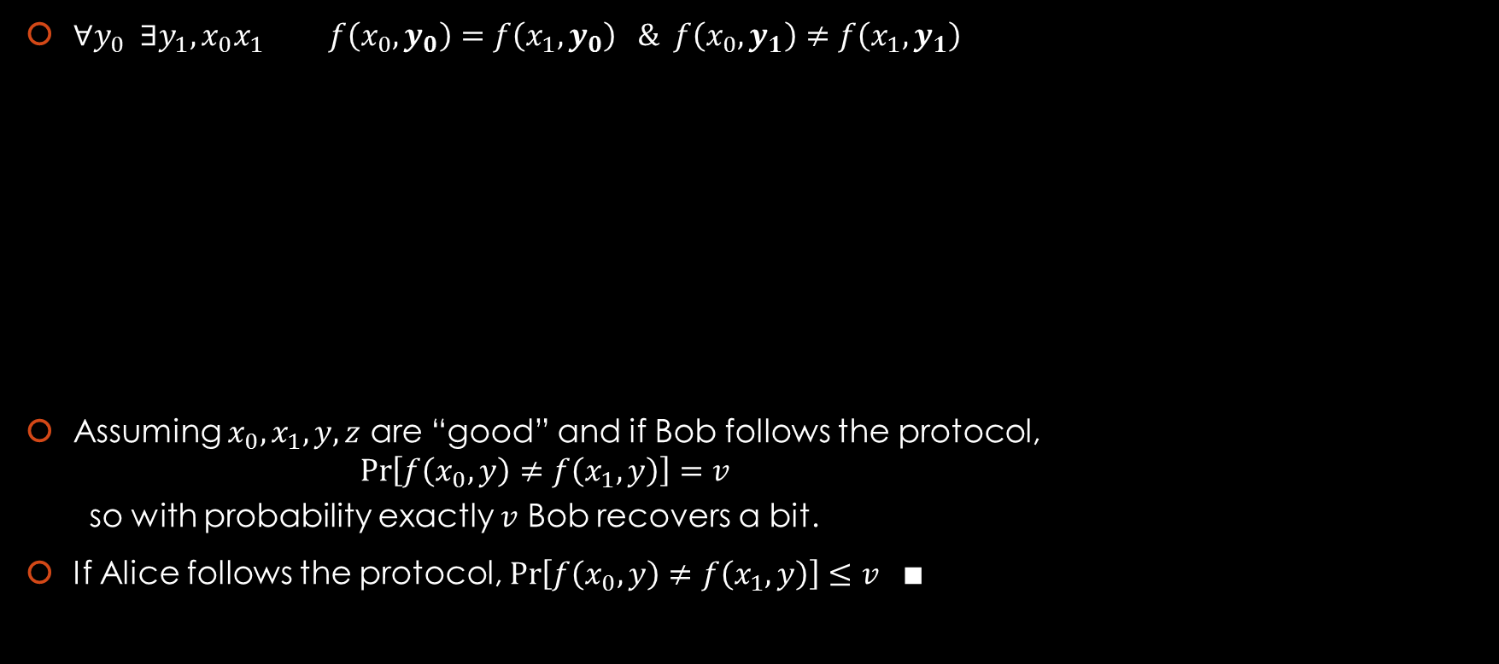





Reduction from $p−OT$
$∀y_{0} ∃y_{1},x_{0}x_{1} f\left(x_{0},y_{0}\right)=f\left(x_{1},y_{0}\right) \& f\left(x_{0},y_{1}\right)≠f\left(x_{1},y_{1}\right)$
Assuming $x_{0},x_{1}, y, z$ are “good” and if Bob follows the protocol,
$\operatorname{Pr}\left[f\left(x_{0},y\right)≠f\left(x_{1},y\right)\right]=v$
so with probability exactly $v$ Bob recovers a bit.
If Alice follows the protocol, $\operatorname{Pr}\left[f\left(x_{0},y\right)≠f\left(x_{1},y\right)\right]≤v ∎$
$$⊥$$
$0$
$1$
Alice
$b∈\left\{0,1\right\}$
Bob
$$x_{b}$$
$$f$$
$$y←\hat{𝒴}$$
$$\left(x_{0},x_{1}\right)←\hat{𝒵}$$
$$z$$
Abort if $x_{0},x_{1}, y, z$ are “bad.”
$$\left(x_{0},x_{1}\right)$$
$$b=\left\{\begin{aligned}⊥, f\left(x_{0},y\right)=f\left(x_{1},y\right) \\ &0, f\left(x_{0},y\right)=z \\ 1, otherwise \end{aligned}\right.$$

Slide 33

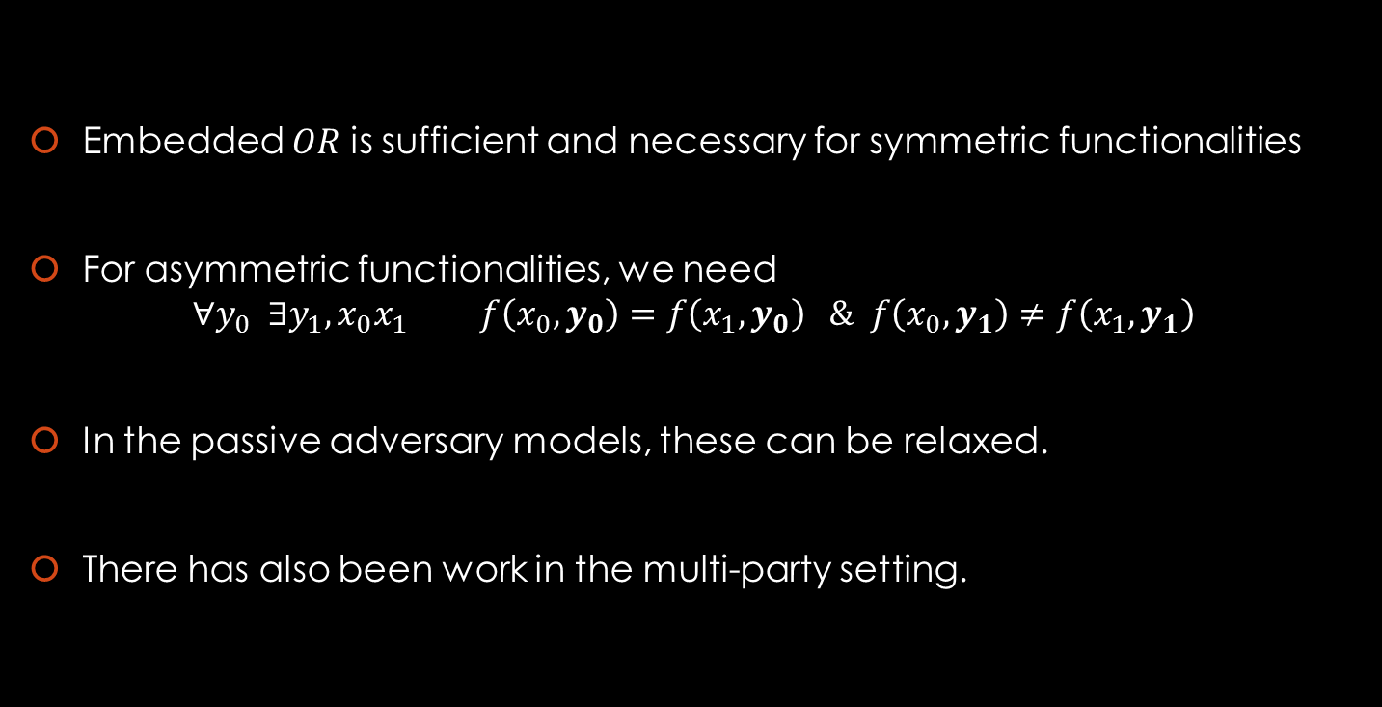
Take Away
Embedded $OR$ is sufficient and necessary for symmetric functionalities
For asymmetric functionalities, we need
$∀y_{0} ∃y_{1},x_{0}x_{1} f\left(x_{0},y_{0}\right)=f\left(x_{1},y_{0}\right) \& f\left(x_{0},y_{1}\right)≠f\left(x_{1},y_{1}\right)$
In the passive adversary models, these can be relaxed.
There has also been work in the multi-party setting.
$$OR$$
$$f$$

Slide 34
The End

