Slide 1
Speaker Recognition System Based on Machine Learning
Team 8 Sparks

Slide 2
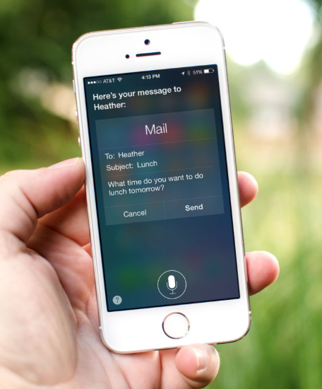
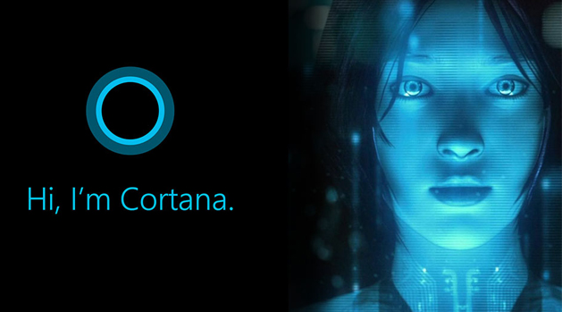
Idea
In this project, our goal is to build a system, which could realize a voiceprint recognition and speech recognition

Slide 3
Research
The voiceprint recognition has two key parts, one is feature extraction and the other one is pattern identification
Way for feature extraction:
MFCC
Algorithm for pattern identification:
Gaussian Mixture Model
Hidden Markov Models
Vector Quantization

Slide 4
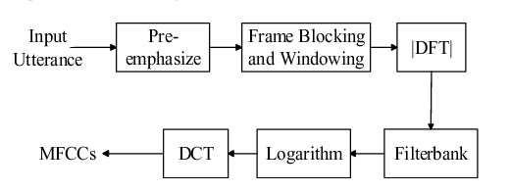
Research
MFCC(Mel-frequency cepstral coefficient)
The basic MFCC extraction process:

Slide 5
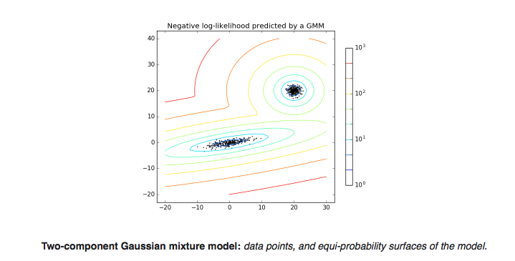
Research
The model we use for pattern identification:
GMM(Gaussian Mixture Model)
A Gaussian mixture model is a probabilistic model that assumes all the data points are generated from a mixture of a finite number of Gaussian distributions with unknown parameters. One can think of mixture models as generalizing k-means clustering to incorporate information about the covariance structure of the data as well as the centers of the latent Gaussians.

Slide 6
Approach
1. Build a speaker voice database
2. Use mfcc(Mel-frequency cepstral coefficient) to deal with wav file
3. Build a Gaussian mixture model
4. Use voice database to train the model
5. Use a new wav file to test the model
6. Add speech recognition api to the system
7. Design a UI

Slide 7
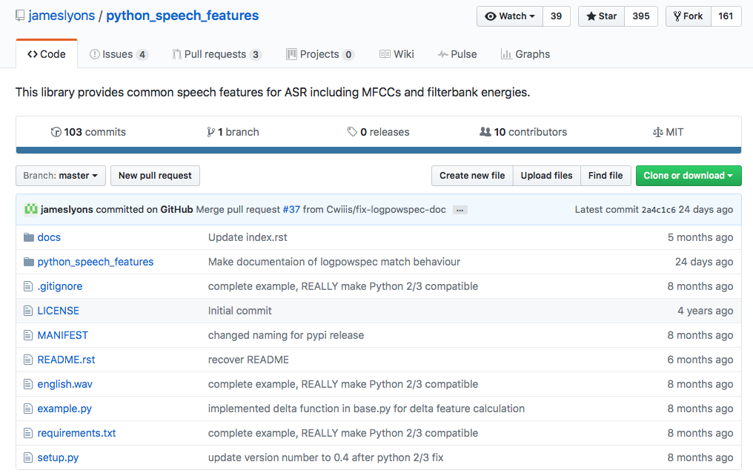
Approach
We use python_speech_features for mfcc process
This library provides common speech features for ASR including MFCCs and filterbank energies.

Slide 8
Approach
In our program, we import GaussianMixture from sklearn.mixture
The Gaussian Mixture object implements the expectation-maximization (EM) algorithm or fitting mixture-of-Gaussian models. It can also draw confidence ellipsoids for multivariate models, and compute the Bayesian Information Criterion to assess the number of clusters in the data. A GaussianMixture.fit method is provided that learns a Gaussian Mixture Model from train data. Given test data, it can assign to each sample the Gaussian it mostly probably belong to using the GaussianMixture.redict method.

Slide 9
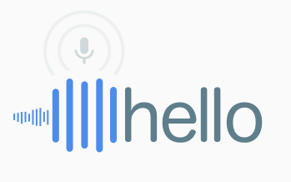
Approach
Speech Recognition API:
Google Speech Recognition
Google CLOUD SPEECH API
Google has a great Speech Recognition API. This API converts spoken text (microphone) into written text (Python strings), briefly Speech to Text. You can simply speak in a microphone and Google API will translate this into written text. The API has excellent results for English language.

Slide 10
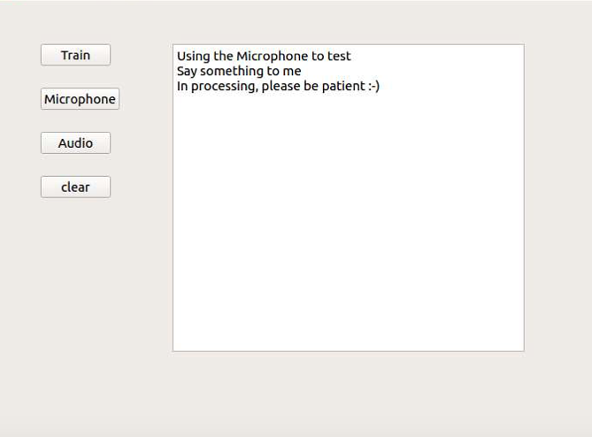
Approach
Gui:
Train for model training
Microphone for recognizing speaker from microphone
Audio for recognizing speaker from audio file
Clear for emptying the window

Slide 11
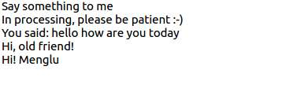
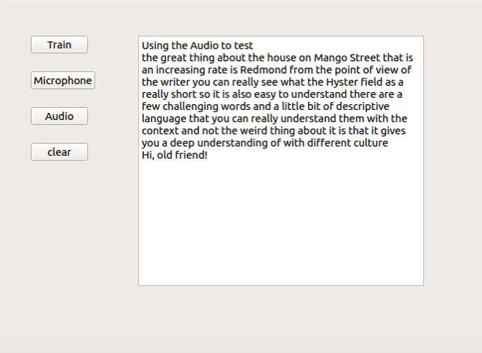
Approach
When speaking to the system, the window will show your name, the words you just said and its answer to you

Slide 12
Thanks!

