Slide 1
Cyber security
SPRINT 4
Youssef Taib, Mendel Lion Sjin Tjoe, Boyoung Han
Jorge Edmundo Ortiz Durán, Jaekyu Lee, Petri Pellinen
Notes:
Hi Thank you for attention, I am Boyoung from Cybersecurity team.

Slide 2
content
Overview
Approach
Progress
Next step
Notes:
Presentation content consists about overview of our project, progress that we’ve made, problems that we have and next step for our project.

Slide 3

overview
Objective
“Collecting twitter feeds and
making Classifier & Sentiment analysis
Specified for CyberSecurity”
Notes:
It seems like there are no external guest. As all of you know, our goal is collect twitter feed of hacktivists and make risk analysis to a profile through machine learning and neural network.

Slide 4

approach
Mining twitter data
Text pre-processing
Terms frequencies
Data analysis
Data visualization
Sentiment analysis
Machine learning

Slide 5
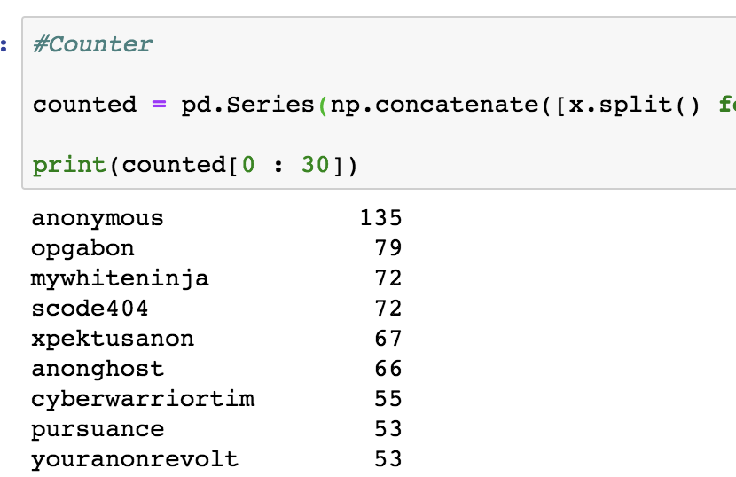

OUR WEEK
Made classifier with keywords
using word count function
from 70 Hacktivist list
Sum frequency of keywords
(best 20 list of keywords)
Notes:
For next sprint, we will going to make individual profile for each user. And we need another input from product owner so we will going to meet our product owner next week.
We are start to scan possible sources such as users website, blog or news site and extract data from them.
We already start to search about neural networking and writing project report.

Slide 6
OUR WEEK
Made classifier with keywords
find average & range about frequency of keywords from 70 hacktivists
use this range for distinguishing whether new user is a hacktivist or not
train it with machine learning again to make it perfect
Notes:
For next sprint, we will going to make individual profile for each user. And we need another input from product owner so we will going to meet our product owner next week.
We are start to scan possible sources such as users website, blog or news site and extract data from them.
We already start to search about neural networking and writing project report.

Slide 7
OUR WEEK
Make new sentiment analysis for new dataset
Using 14000 tweets (70user * 200tweets)
Review & label tweets with our hand
Negative = 0 , Neutral = 2 , Positive = 4
Train it with machine learning again
Notes:
For next sprint, we will going to make individual profile for each user. And we need another input from product owner so we will going to meet our product owner next week.
We are start to scan possible sources such as users website, blog or news site and extract data from them.
We already start to search about neural networking and writing project report.

Slide 8
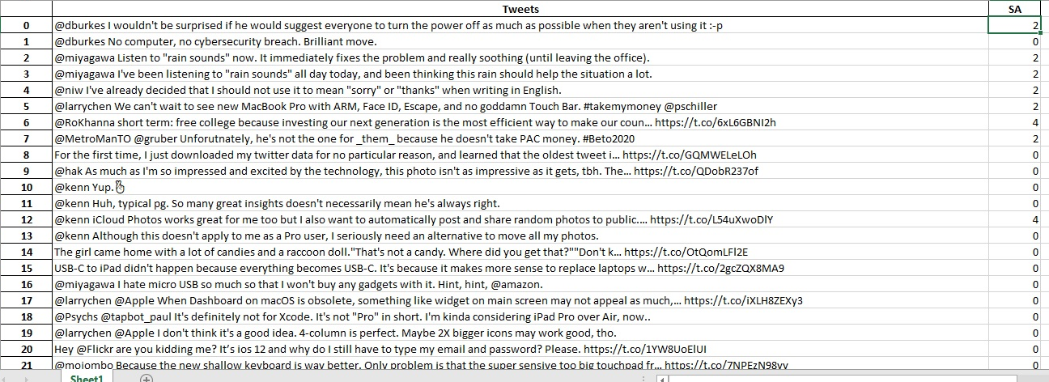
OUR WEEK
Improve sentiment analysis
Project report
Use new keywords to analyze
Notes:
For next sprint, we will going to make individual profile for each user. And we need another input from product owner so we will going to meet our product owner next week.
We are start to scan possible sources such as users website, blog or news site and extract data from them.
We already start to search about neural networking and writing project report.

Slide 9
Next step
Review & score tweets with our hand
Making classfier again
Notes:
For next sprint, we will going to make individual profile for each user. And we need another input from product owner so we will going to meet our product owner next week.
We are start to scan possible sources such as users website, blog or news site and extract data from them.
We already start to search about neural networking and writing project report.

Slide 10
Q&A
Notes:
Thank you for listening and is there any questions?

Slide 11
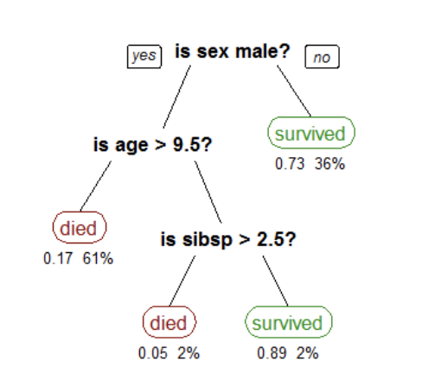
Decision tree
Data recovery algorithm that creates prediction models,
What characteristics do these users belong to?
The figures below the leaf of the tree show the probability of survival and percent of the observations in each leaf.e
Notes:
For next sprint, we will going to make individual profile for each user. And we need another input from product owner so we will going to meet our product owner next week.
We are start to scan possible sources such as users website, blog or news site and extract data from them.
We already start to search about neural networking and writing project report.

