Slide 1
Cyber security

Slide 2
content
Objective
Last week
Week 5
Problems
Next step

Slide 3

objective
“Collecting twitter feeds and making a risk analysis
to a profile through machine learning”

Slide 4
Last week
Write code for extracting data
Make profile for twitter users
Username, Screen name, Tweets, URL, Favourites etc.
Revise research plan
Datacamp

Slide 5
Week 5
Write code
Extracting data in live
Extracting all of twitter data from specific user
Counting words, hashtags(#) (for extracting keywords)
Revise research plan

Slide 6
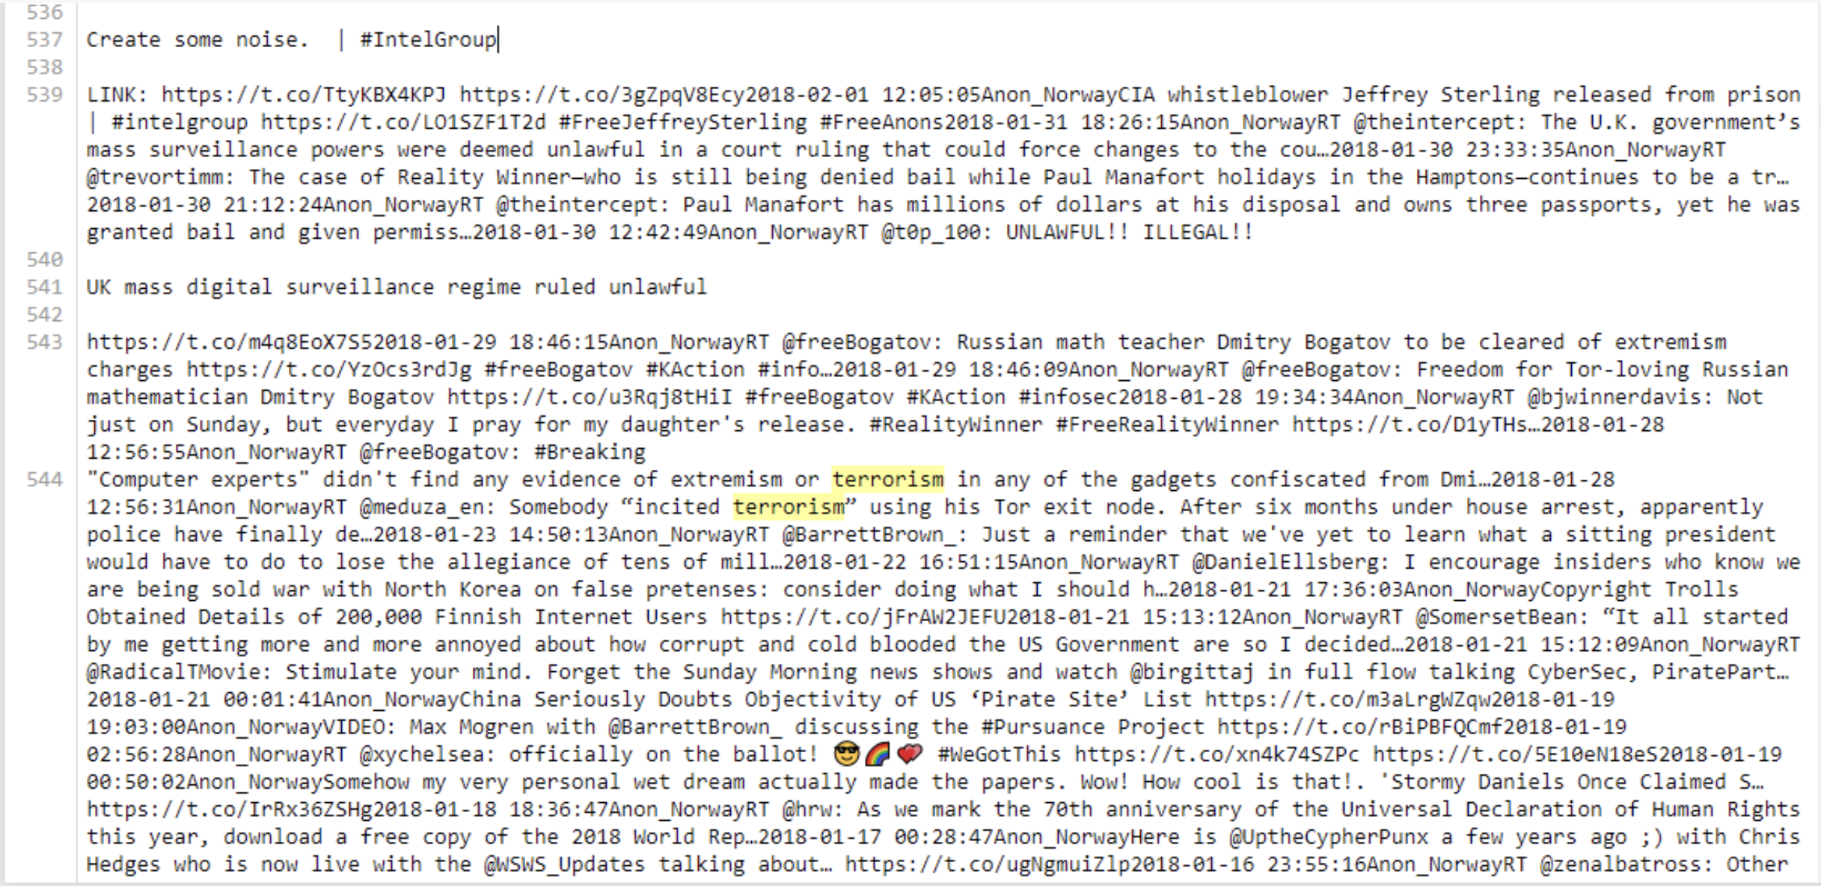
Week 5

Slide 7
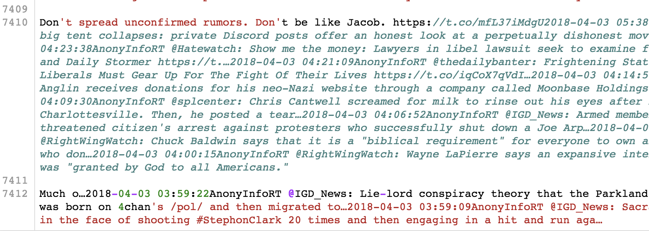
Week 5

Slide 8
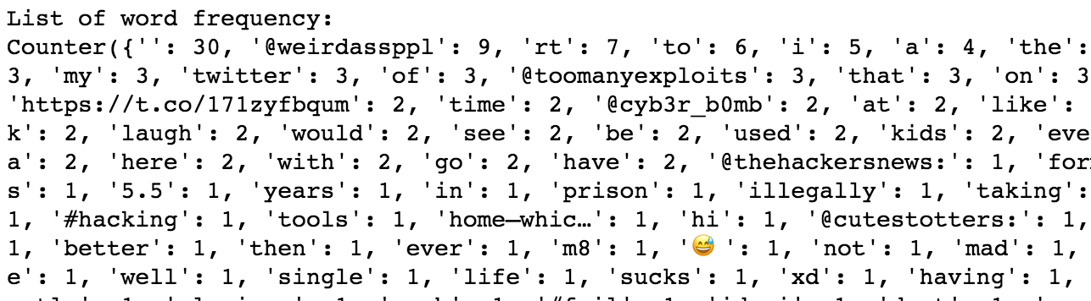
Week 5

Slide 9
problems
Find way for handling the extracted data (huge&big)
Distinguish unrelated keyword (the, a, is)
Limited frequency for requests from twitter server (every 15 mins)

Slide 10
Next step
Meet product owner to check progress
Specify sprint
Revise research plan

Slide 11
Q&A

