Slide 1
vm1
vm2
vm3
ovs
NIC
Server

Slide 2
vm1
vm2
vm3
ovs
SmartNIC
Server

Slide 3
vm
1. 报文填入缓冲区
Shared memory
定制化驱动
SRIOV
ovs
bond
tap
3. SmartNIC DMA数据报文
4. 数据报文没匹配到卸载流表，upcall到ovs
2. 这里就没有映射的过程，定制化驱动要将Hpa写到SmartNIC VF提供的Tx queue中
VF
SmartNIC
PF
Tx queue
Rx queue
VF
4. SmartNIC数据报文匹配到硬件卸载流表

Slide 4
vm
1. 报文填入缓冲区
Shared memory
2. Vhost轮询到有报文或者vm kick vhost有报文
ovs
vhost
3. 如果需要vhost touch报文，则将vm看到的地址gpa映射成vhost看到的vva
如果不需要，则直接将gpa映射成SmartNIC看到的hpa
bond
tap
5. SmartNIC DMA数据报文
4. Hpa写到SmartNIC VF提供的Tx queue中
6. 数据报文没匹配到卸载流表，upcall到ovs
VF
SmartNIC
PF
Tx queue
Rx queue
VF
6. SmartNIC数据报文匹配到硬件卸载流表

Slide 5
x86 Baremetal
1. 报文填入缓冲区
Shared memory
定制化驱动
SRIOV
ovs
aarch64 (A-57)
bond
tap
3. SmartNIC DMA数据报文
4. 数据报文没匹配到卸载流表，upcall到ovs
2. 这里就没有映射的过程，定制化驱动要将Hpa写到SmartNIC VF提供的Tx queue中
VF
SmartNIC
Multi-Host
PF
Tx queue
Rx queue
VF
4. SmartNIC数据报文匹配到硬件卸载流表

Slide 6
virtio/vhost-net/vhost-user
user space
virtio是qemu的半虚拟化驱动，guest使用virtio driver将请求发送给virtio-backend。guest发出中断信号退出kvm，从kvm退出到用户空间的qemu进程。然后由qemu开始对tap设备进行读写。 可以看到这里从用户态进入内核，再从内核切换到用户态，进行了2次切换。
virtio的io路径：
guest设置好tx;
kick host;
guest陷出到kvm；
kvm从内核切换到用户态的qemu进程；
qemu将tx数据投递到tap设备；
qemu
guest OS
virtio driver
3
1
device driver
2
kvm.ko
kernel
user space
qemu
guest OS
guest发出中断信号退出kvm，kvm直接和vhost-net.ko通信，然后由vhost-net.ko访问tap设备。 这样网络数据只需要经过从用户态到内核态的一次切换，就可以完成数据的传输。大大提高了虚拟网卡的性能。 由于这个技术中vhost-backend在内核中，所以也被叫做vhost-kernel。
vhost的io路径：
guest设置好tx;
kick host;
guest陷出到kvm；
vhost-net将tx数据投递到tap设备;
vhost将部分virio驱动的操作从用户态移到内核态，减少了用户态/内核态切换时间和包的拷贝次数，从而更进一步的提升了性能。
virtio driver
1
device driver
3
vhost-net.ko
2
kvm.ko
kernel
user space
vhost-user
qemu
guest OS
guest发出中断信号退出kvm，kvm直接和vhost-backend通信，然后网络数据将交由vhost-backend 进行处理。
vhost-user的io路径
guest设置好tx;
kick host;
guest陷出到kvm；
kvm将通知vhost-backend；
vhost-backend将tx数据直接发送到nic设备。
virtio driver
1
3
device driver
2
kvm.ko
kernel

Slide 7
virtio/vhost-net/vhost-user
user space
vhost-user
qemu
guest OS
virtio driver
vhost-user的转发线程绑定固定的cpu核，轮训队列进行首发包，无需由guest发送中断通知vhost-user
vhost-user的io路径：guest设置好tx → vhost-user轮询到数据变化，将tx数据直接发送到nic设备。
1
2
device driver
kvm.ko
kernel

Slide 8
struct virtq_avail
#define VIRTQ_AVAIL_F_NO_INTERRUPT 1
le16 flags; /* 限制host向客户机注入中断 */
le16 idx; /* driver下一个描述符要放在ring中的位置 */
le16 ring[/* Queue Size*/] /* 每个元素存着buffer的head，一个buffer可能由多个desc组成*/
le16 used_event; /* Only if VIRTIO_F_EVENT_IDX */
driver通过available ring向device提供buffers，avail ring由driver写，device读。idx表明客户机驱动下次添加buffer使用的ring下标
device通过used ring向driver返回它已经用过了的buffers，used ring由device写，driver读。
idx表明qemu下次添加vritq_used_elem_ring使用的ring下标。
struct virtq_used
#define VIRTQ_USED_F_NO_NOTIFY 1
le16 flags; /* 限制客户机使用完buffer通知host */
le16 idx; /* device下一个描述符要放在ring中的位置 */
struct virtq_used_elem ring[/* Queue Size*/]
le16 avail_event; /* Only if VIRTIO_F_EVENT_IDX */
struct virtq_used_elem
le32 id; /* idx of start of used descriptor chain */
le32 len; /* total length of the descriptor chain which has used */
avail ring中的ring数组记录的是可用buffer的head index.
virtqueue中的last_avail_idx记录ring[]数组中首个可用的buffer头部。即根据last_avail_idx查找ring[],根据ring[]数组得到desc表的下标。然后last_avail_idx++。
每次host向客户机发送数据就需要从这里获取一个buffer head。
当host完成数据的写入，可能会产生多个virtq_used_elem，即使用多个逻辑buffer，每个virtq_used_elem的信息记录到virtq_used的ring[]数组中，一个元素对应一个virtq_used_elem结构，其中id记录对应buffer的head，len记录长度。

Slide 9
virito内核代码
linux设备模型是由总线、设备、驱动三大数据结构来描述。所有设备都通过总线连接。即使有些设备没有连接到物理总线上，linux也会设置一个虚拟的总线，来维持总线、设备、驱动三者之间的关系。
内核里，就存在pci总线和virtio总线。物理上virtio设备连接在pci总线上，逻辑上virtio设备由virtio虚拟总线管理。
pci总线上设备对应的是struct pci_dev结构，对于pci总线上的virtio设备，virtio提供struct pci_driver virtio_pci_driver。当virtio设备挂到pci总线上，或者注册到pci总线时，会调用virtio_pci_probe探测函数，这个函数会通过struct virtio_pci_device把pci_dev转换成virtio_device，然后挂到virtio总线上。
virtio总线对应的就是struct virtio_device，virtio-net提供自己的驱动struct virtio_net_driver。当挂到virtio总线时，或virtio_net_driver注册到virtio总线上，会调用virtio bus的探测函数virtio_dev_probe找到驱动探测函数virtnet_probe，最终通过register_netdev注册linux网络协议栈
struct pci_dev
struct list_head bus_list; /* Node in per-bus list */
struct pci_bus *bus; /* Bus this device is on */
…
struct pci_driver *driver; /* Driver bound to this device */
…
struct device dev; /* Generic device interface */
struct device
struct device *parent;
struct device_private *p;
…
struct device_driver *driver; /* which driver has allocated this device */
void *platform_data; /* Platform specific data, device core doesn't touch it */
void *driver_data; /* Driver data, set and get with dev_set/get_drvdata */
struct virtio_pci_device
struct virtio_device vdev;
struct pci_dev *pci_dev;
…
struct virtio_device
…
struct device dev;
…
struct list_head vqs;
…

Slide 10
virito内核代码
struct virtio_driver virtio_net_driver
…
.probe = virtnet_probe,
.remove = virtnet_remove,
…
struct bus_type virtio_bus
…
.probe = virtio_dev_probe,
.remove = virtio_dev_remove,
…
struct virtio_device
…
struct device dev;
struct bus_type *bus;
struct list_head vqs;
…
register
virtio bus
struct virtio_pci_device
struct virtio_device vdev;
struct pci_dev *pci_dev;
…
register
pci bus
struct pci_dev
struct list_head bus_list; /* Node in per-bus list */
struct pci_bus *bus; /* Bus this device is on */
…
struct pci_driver *driver; /* Driver bound to this device */
…
struct device dev; /* Generic device interface */
struct pci_driver virtio_pci_driver
…
.probe = virtio_pci_probe,
.remove = virtio_pci_remove,
…
struct device
struct device *parent;
struct device_private *p;
…
struct device_driver *driver; /* which driver has allocated this device */
void *platform_data; /* Platform specific data, device core doesn't touch it */
void *driver_data; /* Driver data, set and get with dev_set/get_drvdata */

Slide 11
virito内核代码
分配网络设备，并做初始化
…
netif_alloc_netdev_queues()
alloc_etherdev_mq()
alloc_netdev_mqs()
netif_alloc_rx_queues()
dev->netdev_ops = &virtnet_netdev;
dev->ethtool_ops = &virtnet_ethtool_ops;
读取设置各种features
/* MTU range: 68 - 65535 */
dev->min_mtu = MIN_MTU;
dev->max_mtu = MAX_MTU;
eth_hw_addr_random()
如果没有配置mac，则随机设置mac
初始化virtnet_info
初始化发送/接受队列
vi->sq = kzalloc(sizeof(*vi->sq) * vi->max_queue_pairs, GFP_KERNEL);
vi->rq = kzalloc(sizeof(*vi->rq) * vi->max_queue_pairs, GFP_KERNEL);
启动一个工作队列为接收队列填充empty buffer
INIT_DELAYED_WORK(&vi->refill, refill_work);
virtnet_probe()
vi = netdev_priv(dev)
virtnet_alloc_queues()
netif_napi_add(vi->dev, &vi->rq[i].napi, virtnet_poll, napi_weight);
netif_tx_napi_add(vi->dev, &vi->sq[i].napi, virtnet_poll_tx, napi_tx ? napi_weight : 0);
/* Allocate/initialize parameters for send/receive virtqueues */
vqs = kzalloc(total_vqs * sizeof(*vqs), GFP_KERNEL);
callbacks[rxq2vq(i)] = skb_recv_done; /* do something after receive packets */
callbacks[txq2vq(i)] = skb_xmit_done; /* do something after send packets */
vi->vdev->config->find_vqs(vi->vdev, total_vqs, vqs, callbacks, names, ctx, NULL);
vi->rq[i].vq = vqs[rxq2vq(i)];
vi->sq[i].vq = vqs[txq2vq(i)];
virtnet_find_vqs()
init_vqs()
virtnet_set_affinity()
register_netdev()
virtio_device_ready()

Slide 12
/* This marks a buffer as continuing via the next field. */
#define VRING_DESC_F_NEXT 1
/* This marks a buffer as write-only (otherwise read-only). */
#define VRING_DESC_F_WRITE 2
/* This means the buffer contains a list of buffer descriptors. */
#define VRING_DESC_F_INDIRECT 4
/* Virtio ring descriptors: 16 bytes. These can chain together via "next". */
struct vring_desc {
/* Address (guest-physical). */
__virtio64 addr;
/* Length. */
__virtio32 len;
/* The flags as indicated above. */
__virtio16 flags;
/* We chain unused descriptors via this, too */
__virtio16 next;
};
struct vring_avail {
/* The flags as indicated above */
__virtio16 flags;
/* Where the driver would put the next descriptor entry in the ring (% queue size) */
__virtio16 idx;
__virtio16 ring[];
};
/* u32 is used here for ids for padding reasons. */
struct vring_used_elem {
/* Index of start of used descriptor chain. */
__virtio32 id;
/* Total length of the descriptor chain which was used (written to) */
__virtio32 len;
};
struct vring_used {
/* The flags as indicated above */
__virtio16 flags;
/* Where the device would put the next descriptor entry in the ring (% queue size) */
__virtio16 idx;
struct vring_used_elem ring[];
};

Slide 13
virito内核代码（vm rx and vm tx）
vq->last_used_idx != vq->vring.used->idx说明接收到报文
last_used = (vq->last_used_idx & (vq->vring.num - 1));
i = vq->vring.used->ring[last_used].id;
*len = vq->vring.used->ring[last_used].len;
virtqueue_get_buf_ctx()
Vring_unmap_one()
detach_buf()
vq->vq.num_free++
virtnet_poll()
virtnet_receive()
receive_buf()
vq->free_head = head
vq->last_used_idx++
try_fill_recv()
virtqueue_add_inbuf()
virtqueue_add()
rq->vq->num_free > virtqueue_get_vring_size(rq->vq) / 2
Head = vq->free_head
desc = vq->vring.desc
i = head
foreach sg
dma_addr_t addr = vring_map_one_sg(vq, sg, DMA_TO_DEVICE);
desc[i].flags = VRING_DESC_F_NEXT;
desc[i].addr = addr;
desc[i].len = sg->length;
i = desc[i].next;
Xmit_skb()
Virtqueue_add()
Start_xmit()
Virtqueue_add_outbuf()
Desc[prev].flags &= VRING_DESC_F_NEXT
Vq->vq.num_free -= descs_used;
Vq->free_head = I;
/* Put entry in avail array (but don't update avail->idx until they do sync). */
avail = vq->avail_idx_shadow & (vq->vring.num - 1);
vq->vring.avail->ring[avail] = head;
/* Descriptors and available array need to be set before we expose the
new available array entries. */
virtio_wmb(vq->weak_barriers);
vq->avail_idx_shadow++;
vq->vring.avail->idx = vq->avail_idx_shadow;
vq->num_added++;

Slide 14
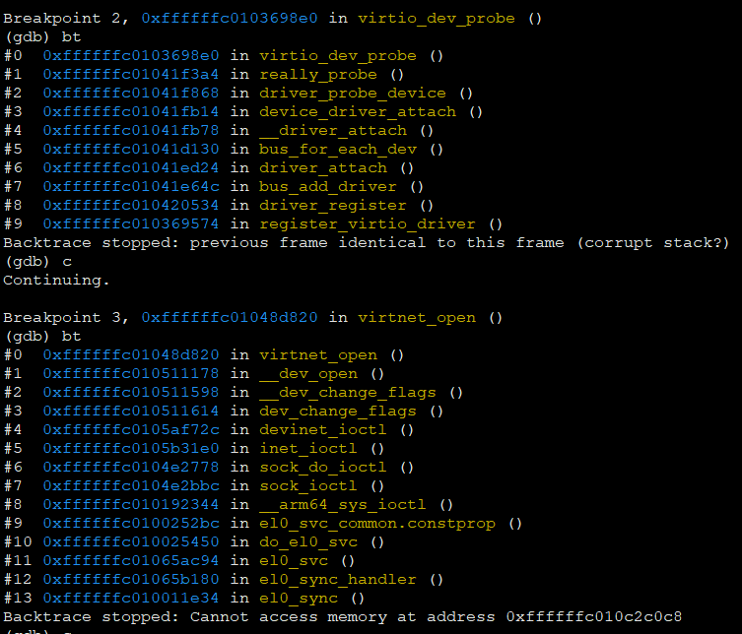

Slide 15
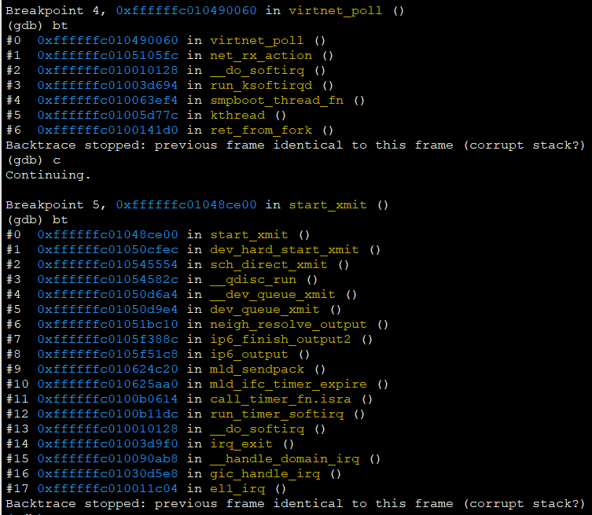

Slide 16
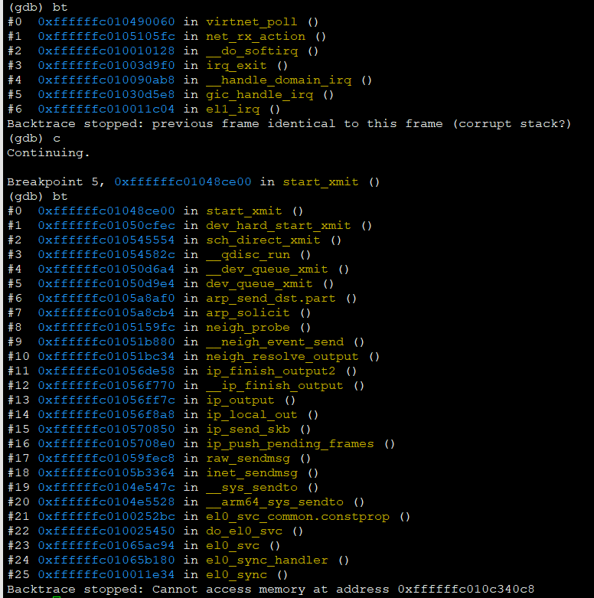

Slide 17
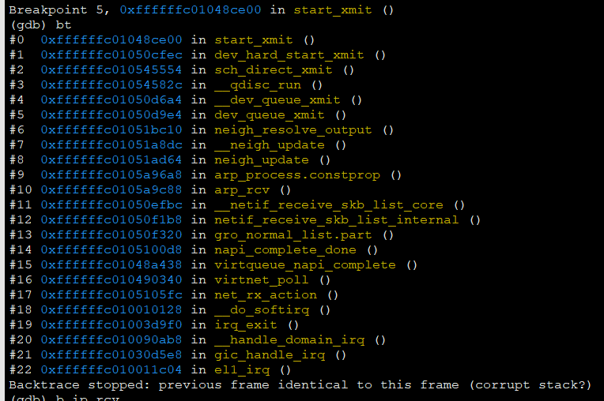

Slide 18
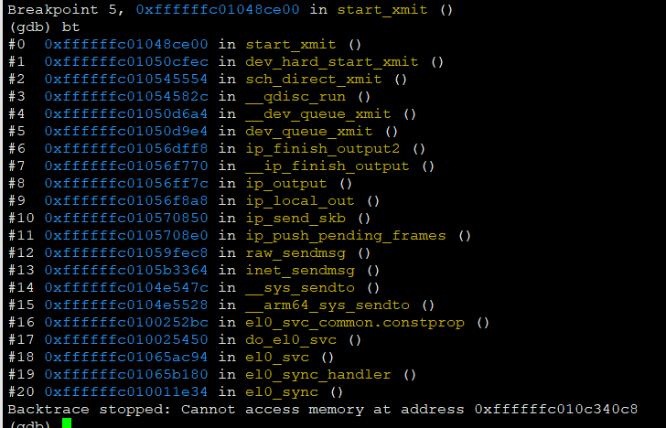

Slide 19
vhost-user/Qemu之间的消息解析：
VHOST_USER_GET_FEATURES：vhost-user收到此消息，需要将自己所支持的特性，用”|”组成u64的值，放在VhostUserMsg里面的u64回复给Qemu，这里面的features包含GSO/GRO等信息
VHOST_USER_SET_FEATURES：vhost-user收到此消息，消息体中带有u64的前端支持的features，前后端都支持的features生效
VHOST_USER_SET_MEM_TABLE: 主要做共享内存的映射
1. 判断nregions是否超过最大值，目前是8片
2. 如果dev->mem已经映射过，判断是否跟之前一致，若一致则关闭每个region的fd
3. 如果映射过，且与之前不一致，则free掉旧的，重新映射
4. 清空iotlb
5. 分配dev->guest_pages在普通堆上
6. 开始填充memory regions：对于每一片内存，一一对应
struct rte_vhost_mem_region
uint64_t guest_phys_addr; /* gpa of region */
uint64_t guest_user_addr; /* hva in qemu process */
uint64_t host_user_addr; /* hva in vhost-user = mmap_addr + mmap_offset*/
uint64_t size; /* region size*/
void *mmap_addr; /* mmap base address */
uint64_t mmap_size; /* size + mmap_offset */
int fd; /* relative fd of region */
struct VhostUserMemoryRegion
uint64_t guest_phys_addr; /* gpa of region*/
uint64_t memory_size; /* region size */
uint64_t userspace_addr; /* hva in qemu process */
uint64_t mmap_offset; /* region starts in the mmaped memory */
结构体成员含义如图中所示，因此:
mmap_addr = mmap(…, (size + mmap_offset), …, fd, …);
host_user_addr = mmap_addr + mmap_offset;
mmaped memory
mmap_addr returned by mmap()
mmap_size
mmap_offset
host_user_addr
size
region[i]
如果virtqueue里面的desc/avail/used vring是空，则后面VHOST_USER_SET_VRING_ADDR会做vring地址从qva_to_vva()的转换。
如果virtqueue里面的desc/avalil/used vring非空，就说明之前初始化过，这次memory table更新，需要重新更新virtqueue。
根据上面从qemu得到的内存信息，更新virtqueue, 需要将qemu发送下来的desc vring/avail vring/used vring的地址通过qva_to_vva()转换成vhost-user看到的地址

Slide 20
根据上面从qemu得到的内存信息，更新virtqueue, 需要将qemu发送下来的desc vring/avail vring/used vring的地址通过qva_to_vva()转换成vhost-user看到的地址.
这里重新做了一遍VHOST_USER_SET_VRING_ADDR做的事情？
struct vhost_virtqueue
struct vring_desc *desc; /* desc vring addr in vhost-user. */
struct vring_avail *avail; /* avail vring addr in vhost-user. */
struct vring_used *used; /* used vring addr in vhost-user */
…
uint32_t size;
uint16_t last_avail_idx;
uint16_t last_used_idx;
…
int callfd; /* host notify guest. */
int kickfd; /* guest kick host, unused in polling. */
…
struct vhost_vring_addr ring_addrs;
…
/* Converts QEMU virtual address to Vhost virtual address. */
static uint64_t
qva_to_vva(struct virtio_net *dev, uint64_t qva, uint64_t *len)
{
struct rte_vhost_mem_region *r;
uint32_t i;
if (unlikely(!dev || !dev->mem))
goto out_error;
/* Find the region where the address lives. */
for (i = 0; i < dev->mem->nregions; i++) {
r = &dev->mem->regions[i];
if (qva >= r->guest_user_addr &&
qva < r->guest_user_addr + r->size) {
if (unlikely(*len > r->guest_user_addr + r->size - qva))
*len = r->guest_user_addr + r->size - qva;
return qva - r->guest_user_addr +
r->host_user_addr;
}
}
out_error:
*len = 0;
return 0;
}
对于qva_to_vva()也比较好理解，根据qemu传下来的vring地址，和memory regions的地址，找到在哪一片region；
然后在region的偏移量offset = qva - guest_user_addr;
在vhost-user中看到的地址就是这一片region的起始地址host_user_addr + offset;
至此，VHOST_USER_SET_MEM_TABLE就结束了。
VHOST_USER_SET_VRING_NUM：队列深度，desc数量
VHOST_USER_SET_VRING_ADDR：将qemu空间的desc/avail/used vring的地址转换成vhost-user空间中的virtual memory
VHOST_USER_SET_VRING_BASE：qemu告诉vhost-user，avail vring让vhost-user开始使用的位置。index是rx queue or tx queue，num是idx
VHOST_USER_SET_VRING_ENABLE：enable队列，同样是使用vhost_vring_state的数据结构,index代表rx queue还是tx queue，num代表enable/disable

Slide 21
/* Converts QEMU virtual address to Vhost virtual address. */
static uint64_t
qva_to_vva(struct virtio_net *dev, uint64_t qva, uint64_t *len)
{
struct rte_vhost_mem_region *r;
uint32_t i;
if (unlikely(!dev || !dev->mem))
goto out_error;
/* Find the region where the address lives. */
for (i = 0; i < dev->mem->nregions; i++) {
r = &dev->mem->regions[i];
if (qva >= r->guest_user_addr &&
qva < r->guest_user_addr + r->size) {
if (unlikely(*len > r->guest_user_addr + r->size - qva))
*len = r->guest_user_addr + r->size - qva;
return qva - r->guest_user_addr +
r->host_user_addr;
}
}
out_error:
*len = 0;
return 0;
}

Slide 22
struct vhost_vring_state
unsigned int index; /* rx queue or tx queue */
unsigned int nun; /* value depends on msg type */
struct vhost_vring_addr
unsigned int index; /* rx queue or tx queue */
unsigned int flags;
uint64_t desc_user_addr;
uint64_t avail_user_addr;
uint64_t used_user_addr;
uint64_t log_guest_addr;
struct VhostUserMemory
uint32_t nregions;
uint32_t padding;
VhostUserMemoryRegion regions[VHOST_MEMORY_MAX_NREGIONS];
struct VhostUserMsg
VhostUserRequest request; /* message types */
uint32_t flags;
uint32_t size;
union {
uint64_t u64; /* used in get/set features… */
struct vhost_vring_state state;
struct vhost_vring_addr addr;
VhostUserMemory memory; /* used in set mem table */
VhostUserLog log;
struct vhost_iotlb_msg iotlb;
};
struct VhostUserMemoryRegion
uint64_t guest_phys_addr; /* gpa of region*/
uint64_t memory_size; /* region size */
uint64_t userspace_addr; /* hva in qemu process */
uint64_t mmap_offset; /* region starts in the mmaped memory */
struct rte_vhost_mem_region
uint64_t guest_phys_addr; /* gpa of region */
uint64_t guest_user_addr; /* hva in qemu process */
uint64_t host_user_addr; /* hva in vhost-user = mmap_addr + mmap_offset*/
uint64_t size; /* region size*/
void *mmap_addr; /* mmap base address */
uint64_t mmap_size; /* mmap size */
int fd; /* relative fd of region */
struct rte_vhost_memory
uint32_t nregions;
struct rte_vhost_mem_region regions[];

Slide 23
struct vhost_virtqueue
struct vring_desc *desc; /* desc vring addr in vhost-user. */
struct vring_avail *avail; /* avail vring addr in vhost-user. */
struct vring_used *used; /* used vring addr in vhost-user */
…
uint32_t size;
uint16_t last_avail_idx;
uint16_t last_used_idx;
…
int callfd; /* host notify guest. */
int kickfd; /* guest kick host, unused in polling. */
…
struct vhost_vring_addr ring_addrs;
…
/* VirtIO ring descriptors: 16 bytes.
* These can chain together via "next". */
struct vring_desc {
uint64_t addr; /* Address (guest-physical). */
uint32_t len; /* Length. */
uint16_t flags; /* The flags as indicated above. */
uint16_t next; /* We chain unused descriptors via this. */
};
struct vring_avail {
uint16_t flags;
uint16_t idx;
uint16_t ring[0];
};
/* id is a 16bit index. uint32_t is used here for ids for padding reasons. */
struct vring_used_elem {
/* Index of start of used descriptor chain. */
uint32_t id;
/* Total length of the descriptor chain which was written to. */
uint32_t len;
};
struct vring_used {
uint16_t flags;
volatile uint16_t idx;
struct vring_used_elem ring[0];
};
struct vhost_vring_addr {
unsigned int index;
/* Option flags. */
unsigned int flags;
/* Flag values: */
/* Whether log address is valid. If set enables logging. */
#define VHOST_VRING_F_LOG 0
/* Start of array of descriptors (virtually contiguous) */
uint64_t desc_user_addr;
/* Used structure address. Must be 32 bit aligned */
uint64_t used_user_addr;
/* Available structure address. Must be 16 bit aligned */
uint64_t avail_user_addr;
/* Logging support. */
/* Log writes to used structure, at offset calculated from specified
* address. Address must be 32 bit aligned.
*/
uint64_t log_guest_addr;
};
为什么avail vring和used vring的结构体中，used vring的ring[]是一个id/len的元素？

Slide 24
struct netsock
char name;
int epolllfd;
struct epoll_event events[MAX_EPOLL_EVENTS];
struct netsock_class *class;
struct list_head conn_list;
struct netsock_class
int type;
int (*init)(void);
int (*open)(void)
int (*run)(void);
int (*recv)(void);
int (*send)(void);
buffer ring/queue
struct netsock_conn
int fd;
struct list_head conn_node;
int (*handler)(void)
read idx ring
write idx ring
struct netsock_buf
int idx;
int size;
void *data;
struct netsock_buf *next;

Slide 25
create_socket_path()
path = /var/run/dpdk/…/mp_socket_*
mp_filter = mp_socket_*
strlcpy(mp_filter, basename(path), sizeof(mp_filter));
create_socket_path()
path = /var/run/dpdk/…/mp_socket_*
mp_dir_path = /var/run/dpdk/.../
strlcpy(mp_dir_path, dirname(path), sizeof(mp_dir_path));
rte_mp_channel_init()
secondary mp_socket
primary mp_socket_pid_rdtsc
open_socket_fd()
socket()
create_socket_path()
bind()
rte_ctrl_thread_create(“rte_mp_handle”)
hugepage_info_init()
eal_hugepage_info_init()
path = /var/run/dpdk/…/hugepage_info
rte_eal_init()
create_shared_memory()
open()
path = /var/run/dpdk/…/hugepage_info
map_shared_memory()
mmap()
eal_hugepage_info_read()
open_shared_memory()
eal_get_virtual_area()
no_shconf
rte_fbarray_init(“memzone”)
mmap()
rte_eal_memzone_init()
open()
path = /var/run/dpdk/…/fbarray_memzone
rte_fbarray_attach()
resize_and_map()
rte_eal_memory_init()
rte_eal_malloc_heap_init()

Slide 26
简历内容
virtio前后端数据包转发
vhost/qemu之间消息
ovs/dpdk中关于virtio/vhost-user
ovs netdev/port/interface等端口管理概念
ovs pmd代码
ovs 队列调度
ovs datapath框架流程
dpdk内存初始化
dpdk多进程支持热替换
网络数据包vxlan/vlan
卸载框架
分布式裸机网关
热替换框架
pmd调度框架
典型问题：
virtio收发包，如virtio not a head问题
vhost-user/qemu消息
ovs/dpdk热替换
pmd调度/队列调度
数据结构与算法

Slide 27
openvswitch-2.9.2/lib/dpif-netdev.c
pmd_thread_main()
dp_netdev_process_rxq_port()
netdev_rxq_recv()
dp_netdev_input()
emc_processing()
dp_netdev_pmd_flush_output_packets()
fast_path_processing()
packet_batch_per_flow_execute()
为什么recv有rxq，而send没有txq，以及整个alloc/construct/destruct/dealloc周期？
因为rx需要Poll去接收数据包，需要提前分配一些空间，而tx有数据包就直接发送了。

Slide 28
guest
host
br-dpdk
tapx
bond
dpdk-lib
NIC
ethx

Slide 29
struct VhostUserMsg
VhostUserRequest request;
uint32_t flags;
uint32_t size;
union {
uint64_t u64;
struct vhost_vring_state state;
struct vhost_vring_addr addr;
VhostUserMemory memory;
VhostUserLog log;
struct vhost_iotlb_msg iotlb;
};
VHOST_USER_GET_FEATURES
VHOST_USER_SET_FEATURES
VHOST_USER_GET_PROTOCOL_FEATURES
VHOST_USER_SET_PROTOCOL_FEATURES
VHOST_USER_SET_OWNER
VHOST_USER_RESET_OWNER
VHOST_USER_SET_MEM_TABLE
VHOST_USER_SET_LOG_BASE
VHOST_USER_SET_LOG_FD
VHOST_USER_SET_VRING_NUM
VHOST_USER_SET_VRING_ADDR
VHOST_USER_SET_VRING_BASE
VHOST_USER_GET_VRING_BASE
VHOST_USER_SET_VRING_KICK /* guest kick host fd */
VHOST_USER_SET_VRING_CALL /* host kick guest fd */
VHOST_USER_SET_VRING_ERR
VHOST_USER_GET_QUEUE_NUM
VHOST_USER_SET_VRING_ENABLE /* 1 enable, 0 disable */
VHOST_USER_SEND_RARP
VHOST_USER_NET_SET_MTU
…

Slide 30
struct ofproto
struct hmap_node hmap_node; /* all ofproto*/
const struct ofproto_class *ofproto_class;
char *type;
char *name;
…
struct hmap ports; /* struct ofport */
…
struct oftable *tables;
…
struct bridge
struct hmap_node node; /* all bridges*/
char *name;
char *type;
struct eth_addr ea;
struct eth_addr default_ea;
const struct ovsrec_bridge *cfg;
struct ofproto *ofproto; /* openflow switch*/
struct hmap ports; /* ports indexed by name */
struct hmap ifaces; /* iface indexed by ofp_port */
struct hmap iface_by_name; /* iface indexed by name */
…
struct ofport
struct hmap_node hmap_node;
struct ofproto *ofproto;
struct netdev *netdev;
struct ofputil_phy_port pp;
ofp_port_t ofp_port; /* port no */
uint64_t change_seq;
long long int created;
int mtu;
struct port
struct hmap_node hmap_node;
struct bridge *bridge;
char *name;
const struct ovsrec_port *cfg;
struct ovs_list ifaces;
const struct ovsrec_bridge *cfg;
struct iface
struct ovs_list port_elem;
struct hmap_node name_node;
struct hmap_node ofp_port_node;
struct port *port;
char *name;
struct netdev *netdev
ofp_port_t ofp_port;
uint64_t change_seq;
const char *type;
const char *netdev_type;
const struct overec_interface *cfg;

Slide 31
bridge_init_ofproto()
ofproto_init()
ofproto_dpif_class注册
class->alloc()
dpif_create()
dpif_create_and_open()
bridge_run()
ofproto_create()
dpif_open()
ofproto->ofproto_class->construct()
open_dpif_backer()
bridge_reconfigure()
iface_do_create()
bridge_add_ports()
bridge_add_ports__()
iface_create()
port_create()
netdev_initialize()
netdev_open()
rc->class->alloc()
/* By default enable one tx and rx queue per netdev. */
netdev->n_txq = netdev->netdev_class->send ? 1 : 0;
netdev->n_rxq = netdev->netdev_class->rxq_alloc ? 1 : 0;
rc->class->construct()
iface_do_create()
iface_set_netdev_config()
netdev_set_config()
iface_set_netdev_mtu()
netdev_set_mtu()
ofproto_port_add()
ofproto->ofproto_class->port_add()
dpif_port_add()
dpif->dpif_class->port_add()

Slide 32
struct dpif_netdev
struct dpif dpif;
struct dp_netdev *dp;
uint64_t last_port_seq;
struct dp_netdev_port
odp_port_t port_no;
…
struct netdev *netdev;
struct hmap_node node;
…
struct dp_netdev_rxq *rxqs;
unsigned n_rxq;
…
char *rxq_affinity_list
struct dp_netdev
const struct dpif_class *const class;
const char *const name;
struct dpif *dpif;
struct ovs_refcnt ref_cnt;
…
struct hmap ports;
…
struct cmap poll_threads;
…
struct dpif
const struct dpif_class *dpif_class;
char *base_name;
char *full_name;
uint8_t netflow_engine_type;
uint8_t netflow_engine_id;
struct dp_netdev_rxq
struct dp_netdev_port *port;
struct netdev_rxq *rx;
unsigned core_id;
unsigned intrvl;
struct dp_netdev_pmd_thread *pmd;
…
struct dp_netdev_pmd_thread
struct dp_netdev *dp;
struct ovs_refcnt ref_cnt;
struct cmap_node node;
…
struct hmap poll_list;
struct hmap tx_ports;
…
struct rxq_poll
struct dp_netdev_rxq *rxq;
struct hmap_node node;

Slide 33
dp_initialize()
dp_register_provider()
dpif_netdev_class注册
port_create()
dpif_open()
do_open()
create_dp_netdev()
do_add_port()
registered_class->dpif_class->open()
reconfigure_datapath()
create_dpif_netdev()
reconfigure_pmd_threads()
for each dp->ports
netdev_set_tx_multiq()
for each dp->poll_threads
pmd_remove_stale_ports()
reload_affected_pmds()
netdev_request_reconfigure() trigger
reconfigure_datapath()
netdev_reconfigure()
for each dp->ports
alloc port->rxqs
port_reconfigure()
for each rxq
netdev->netdev_class->alloc()
netdev_rxq_open()
netdev->netdev_class->construct()
rxq_scheduling()
dpif_netdev_port_set_rxq_affinity()
for each dp->poll_threads, for each pmd->poll_list
dp_netdev_del_rxq_from_pmd()
reload_affected_pmds()
for each dp->port, for each port->rxq
dp_netdev_add_rxq_to_pmd()
reload_affected_pmds()

Slide 34
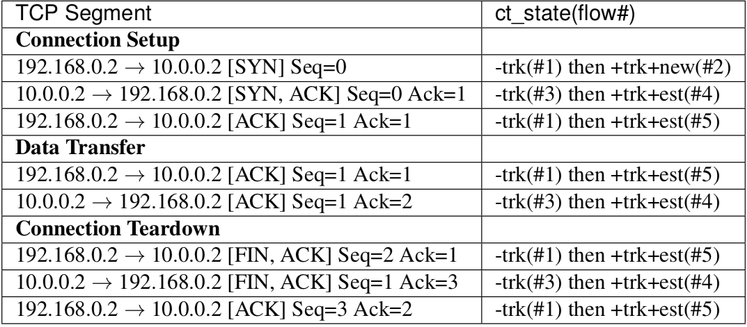
conntrack
ovs-ofctl add-flow br0 "table=0, priority=10, in_port=veth_l0, actions=veth_r0”
ovs-ofctl add-flow br0 "table=0, priority=10, in_port=veth_r0, actions=veth_l0"
#1 ovs-ofctl add-flow br0 "table=0, priority=50, ct_state=-trk, tcp, in_port=veth_l0, actions=ct(table=0)”
#2 ovs-ofctl add-flow br0 "table=0, priority=50, ct_state=+trk,+new, tcp, in_port=veth_l0, actions=ct(commit),veth_r0”
#3 ovs-ofctl add-flow br0 "table=0, priority=50, ct_state=-trk, tcp, in_port=veth_r0, actions=ct(table=0)"
#4 ovs-ofctl add-flow br0 "table=0, priority=50, ct_state=+trk,+est, tcp, in_port=veth_r0, actions=veth_l0”
#5 ovs-ofctl add-flow br0 "table=0, priority=50, ct_state=+trk,+est, tcp, in_port=veth_l0, actions=veth_r0"
ovs
br0
veth_l1
veth_l0
veth_r0
veth_r1

Slide 35
pthread_getspecific(perthread_key)
ovsrcu_quiesce_start()
pthread_setspecific(perthread_key, NULL)
ovsrcu_flush_cbset()
ovsrcu_unregister__()
ovs_list_remove(perthread)
seq_change(global_seqno)
pthread_getspecific(perthread_key)
perthread->seqno = seq_read(global_seqno)
ovsrcu_quiesce_end()
ovsrcu_perthread_get()
ovs_list_push_back(perthread)
pthread_setspecific(perthread_key, NULL)
ovsrcu_perthread_get()
ovsrcu_quiesce()
perthread->seqno = seq_read(global_seqno)
ovsrcu_flush_cbset()
seq_change(global_seqno)

Slide 36
tcmalloc (thread-cache malloc)
概述：
每个线程都有本地的cache，如果是small object就从本地的cache中分配内存，large object就从central heap中分配内存
本地cache内存不够时，会从central heap中拆分内存到本地cache
有定期的内存回收机制，会处理从本地cache回收内存到central heap中
Thread-local cache
…
Thread-local cache
Central Heap
实现层次：thread_cache/central_cache/pageheap
分配内存和释放内存的时候都是按从前到后的顺序，在各个层次中去进行尝试。
前面的层次分配内存失败，则从下一层分配一批补充上来；
前面的层次释放了过多的内存，则回收一批到下一层次。
Thread_cache
…
Thread_cache
从这里分配small objects
Central_cache
从pageheap中拿内存，生成多种size-class的freelist
供所有thread cache共用
Pageheap
以page为单位管理内存

Slide 37
tcmalloc (thread-cache malloc)
small objects allocation: thread-cache的管理，size-class的方式，每个级别有一个freelist，list元素是object
class0
8B
8B
…
8B
实际代码实现，不是按严格的2的次幂来实现。因为那样，会出现比如64B->128B，如果是65B就需要分配128B，浪费空间接近50%
计算方式： size在(0, 16)之间时，以8字节对齐分配内存，size在[16,128)之间，按16字节对齐来分配内存，size在[128,256*1024),按(2^(n+1)-2^n)/8字节对齐来分配内存(n的值为log2(size)取整，见函数AlignmentForSize())
class1
16B
16B
…
16B
…
classn
256KB
256KB
…
256KB
thread-cache
small object的分配，大小为size
根据映射表计算出size对应的sizeclass；
根据sizeclass中 list_[kNumClasses]对应的链表中查找是否有Object存在，如果有则将头部的第一个从链表中取出返回给用户；
如果没有，则从sizeclass对应的Central Cache的CentralFreeList中申请一定数量的Object插入到ThreadCache对应的链表中，并将第一个Object返回给用户
一定数量：TCMalloc为了提高内存分配的效率，一次从Central Cache申请一定数量的Object到ThreadCache中，一次申请的数量由映射表num_objects_to_move_[kNumClasses]确定。
内存释放，指针为ptr
计算出ptr在系统内存的哪页，通过映射关系计算该页被哪个sizeclass的所使用的；
将ptr放到了ThreadCache的 list_[kNumClasses]对应的链表头部；
如果ptr对应的sizeclass的链表长度已经超过了链表设定的最大长度，则将num_objects_to_move_[kNumClasses]个Object归还给对应的Central Cache。
如果整个ThreadCache缓存的内存大于本ThreadCache设定的最大缓存，即启动内存回收机制
映射关系：这个映射关系会在一开始central cache从page heap中申请时，就对sizeclass/pageid建立映射关系。
这里涉及单个sizeclass的链表的内存回收和thread-cache的内存回收

Slide 38
tcmalloc (thread-cache malloc)
thread-cache的回收策略
classx
object
object
object
classx
object
object
两次回收周期之间free list变化
…
周期内从未被用到
classx
object
object
…
object
thread cache 单个sizeclass 链表长度的确定算法-slow-start算法：
每个FreeList初始时长度限额为1，在限额为1~batch_size之间时，为慢启动状态。
慢启动状态时，不管是alloc遇到空FreeList、还是free遇到长度超限，都给限额加1。这样做可以给不常用或者使用很规律的object确定一个合适的限额，而如果object的使用抖动较大的话，应该给它一个更大的buffer。
如果限额增加达到batch_size，则慢启动状态结束。此时，如果alloc遇到空FreeList，限额会按batch_size的整数倍进行扩展。而如果free超限，则限额将按照batch_size的整数倍进行缩减。
thread cache单个size-class链表长度超限后回收处理：
直接回收batch_size个object，不足batch_size个，则有多少回收多少。处于慢启动状态下的FreeList限额超限，将导致FreeList被清空。
慢启动状态下free超限还给限额做加1递增，一方面可以应对抖动，另一方面递增限额的目的是使之能够达到batch_size（如果free确实远多于alloc话），从而在回收object时可以按batch_size批量回收。
thread cache容量限额：
每一个ThreadCache初始化一个比较小的限额，然后每当ThreadCache由于cache超限而触发object到CentralCache的回收时，就增大该ThreadCache的限额
tcmalloc预设了一个所有ThreadCache的总容量，当ThreadCache需要增大容量时，如果总容量尚有余额，则使用这些余额。否则需要增大的容量就从其他线程的ThreadCache里面去收，具体从收刮哪个线程的容量，简单采用了轮询的方式。
内存需求大的线程总是收别人的容量，而内存需求低的线程则总是被收。这个容量会有一个最大值最小值的限制，比如128字节~4M。
thread cache超过容量限额后回收处理：
到达ThreadCache的容量限额时，会对它下面的每一个FreeList进行回收，回收的数目是该Freelist.lowator_的一半。
lowator_：就是该Freelist在ThreadCache超限的两次回收周期之间内，FreeList的最小长度。
回收过程其实只是对每一个FreeList的保守回收，回收完成之后ThreadCache的容量可能还会继续高于限额，不过随着这次回收，ThreadCache的容量限额也会被抬高

Slide 39
tcmalloc (thread-cache malloc)
central-cache的管理，size-class的方式，每个级别有一个freelist，list元素是span
object
…
object
struct span
PageID start; /* starting page number*/
Length length; /* number of pages in span */
Span *next; /* used when in link list */
Span *prev; /* used when n link list */
void *objects; /* link list of free objects */
…
tc_slots
noempty_
empty_
class0
span
…
span
管理连续页内存
object
…
…
管理由这个span切分出来的objects
object
…
每个span挂的是由这个span切分出来的object的链，这样做便于在span内的object是否都已经free的情况下，将span整体回收。
CentralFreeList里面还设计一个cache（tc_slots_），回收回来的一批object先往cache里面塞，塞不下了再回收进span的objects链。分配object给ThreadCache时也是先尝试在cache里面拿，没了再去span里面分配。
CentralFreeList里的span链表其实是有两个：nonempty_和empty_，根据span的objects链是否有空闲，放入对应链表。这样就避免了在分配时去判断span是否为空，只需要在由空变非空、或者由非空变空时移动一下span。
当centralfreelist缓存不够时，会从pageheap中申请申请span，这些span申请过来就是挂在noempty_上
central-cache是所有线程共享，访问时需要加锁
classn
…
central-cache
CentralFreeList内存分配：
ThreadCache向Central Cache申请内存，Central Cache根据sizeclass选择一个CentralFreeList；
CentralFreeList首先查看tc_slots_[kMaxNumTransferEntries]中是否还有未使用的空闲内存，有则直接返回给ThreadCache；
否则从Span nonempty_中获取空闲内存，如果对应的Span下的Objects分配完了，则将Span移到Spen empty_中；
如果 Span nonempty_也没有空闲内存，则从PageHeap中申请一定数量页的内存放到Span nonempty_中，同时会将获取的页在PageMap pagemap_中注册(接口是RegisterSizeClass)，并且在pagemap_cache_中注册每页的sizeclass(接口是CacheSizeClass())；
对申请到的大块内存划分成本CentralFreeList对应的size的Objects。然后CentralFreeList再从Span nonempty_中获取空闲内存。
CentralFreeList内存释放
当ThreadCache释放内存给Central Cache时，Central Cache根据sizeclass选择相应的CentralFreeList；
如果释放的Object的数量正好等于映射表num_objects_to_move_[kNumClasses]中本CentralFreeList的sizeclass对应的数量, 并且tc_slots_[kMaxNumTransferEntries]还有空闲的节点, 则将释放的Objects链表挂载tc_slots_[kMaxNumTransferEntries]的某个节点下。如果没有空闲节点了, 则将内存返给Span nonempty_
返回span nonempty_时，Objects是一个一个返回对应的Span
如果Span原来管理的所有的Objects都返回到了Span中，则需要将这个Span管理的内存归还给PageHeap。

Slide 40
tcmalloc (thread-cache malloc)
large objects allocation: pageheap的管理
normal
returned
span
…
span
小于1M的页内存管理
free_
1page
span
…
span
2pages
…
normal: 未释放给系统
returned: 已经调用madvise(MADV_DONTNEED)还给系统，但是虚拟内存还在，仍然可以访问，如果已经释放，会产生缺页中断，重新申请内存
…
npages
…
normal
returned
span
…
span
大于1M的页内存管理
large_
span
…
span
page-heap
PageHeap内存分配
当CentralFreeList向PageHeap申请n页内存时，PageHeap首先在free_[n].normal的队列中查找，如果找到则返回，否则到free_[n].returned查找，如果找到则返回，否则在free_[n＋1]中以相同的方法查找。
在大于n的队列中找到(假设在大小为m页的队列中找到)，即将这块内存分成两块，分别是n和(m-n)，将含n页的Span返回给CentralFreeList，而将含有(m-n)页的Span插入(m-n)页的SpanList中，插入过程中，还要检查插入的(m-n)页的左右相邻页是否也在这个SpanList中存在，如果存在，则将它们合并，合并后则需要找新的SpanList插入，重复这个过程；
如果在SpanList free_[kMaxPages]中找不到合适的页，则在SpanList large_中查找，查找过程和SpanList free_[kMaxPages]类似，即在large_.normal和large_.returned中查找最合适的Span
如果在上述的SpanList free_[kMaxPages]和SpanList large_中都找不到合适的Span，并且PageHeap中还有大量的空闲页，说明在PageHeap中存在大量的内存碎片，则将Span进行尽可能的合并。然后再从SpanList free_[kMaxPages]或SpanList large_查找合适的页的Span。
如果上述都找不到合适的Span，则从系统申请内存来扩充PageHeap，然后再从PageHeap获取内存。
PageHeap内存释放
当CentralFreeList的某个Span所管理的内存都已经返回给这个Span后，CentralFreeList就将相应的Span管理的内存归还给PageHeap
当这个Span管理的页的前页或后页在相应的Span链表中， PageHeap会将这个Span和 free_[n].normal或larg_.normal中的Span进行合并。
查看是否需要向系统释放内存，如果需要，则以Round Robin的方式将某个SpanList的尾部的Span释放给系统。释放内存是根据配置和PageHeap中累积的Page数量来执行的，具体的算法见函数PageHeap::IncrementalScavenge(Length n)。

Slide 41
tcmalloc (thread-cache malloc)
large objects allocation: pageheap的管理，管理相邻pages的span
32位系统，两层radix tree，以页面8K为例
0 | 1 | 2 | … | 31
0 | 1 | 2 | … | 16383
…
span
span
…
64位系统，三层radix tree，以页面8K为例
0 | 1 | 2 | … | 4095
0 | 1 | 2 | … | 4095
…
0 | 1 | 2 | … | 2047
…
span
span
…
通过radix tree管理pages->span的对应关系。对于任何一个page，就能知道其前后page的span，从而可以判断是否可以进行合并。

Slide 42
tcmalloc (thread-cache malloc)
object的链表节点没有额外的空间，而是复用节点本身：
双重free，程序不会crash，但是会出现未知错误；
free之后还进行操作，会出现链表错误，第二次malloc会造成未知错误
object1
object2
object3
object4
classx
0x7fffabe0
0x7fffab10
0x7ffabf30
NULL
object2
object1
object3
object4
classx
0x7fffab50
0x7fffabe0
0x7ffabf30
NULL
双重free：内存泄漏，以及再次申请时出现申请的地址空间一致
0x7fffabe0 → 0x7fffabcf
object1
object2
object3
object4
classx
0x7fffabcf
0x7fffab10
0x7ffabf30
NULL
free之后还进行如减1操作，会出现链表错误，再次malloc会分配到未知的内存空间

Slide 43
tcmalloc (thread-cache malloc)
每个ThreadCache设置了max_size，它代表一个线程缓存中所有free list占用空间的总大小(初始的的大小为64K)，当一个ThreadCache中总的free list大小超过max_size之后，tcmalloc就会遍历此ThreadCache中所有空闲列表，将空闲列表中的一些对象回收到CentralFreeList
在回收完之后，tcmalloc会检查所有ThreadCache的总max_size是否超过TCMALLOC_MAX_TOTAL_THREAD_CACHE_BYTES(默认为16M)。如果还没有超过，则增加此ThreadCache的max_size值，如果超过，则通过轮询的方式向其他线程要部分配额，每次增加64K。通过这种方式，对缓存需求大的线程会得到更大的配额。
TCMALLOC_MAX_TOTAL_THREAD_CACHE_BYTES的默认值可能不够，如果怀疑应用程序在多线程环境下由于tcmalloc中的锁争用而引发性能问题，可以尝试增加此值；方法有两种，一种是通过环境变量设置，一种是通过MallocExtension::instance()->SetNumericProperty(“tcmalloc.max_total_thread_cache_bytes”, bytes)设置。

Slide 44
tcmalloc (thread-cache malloc)
gperftools自2006年起，最新维护在2019年4月
目前常见用于数据库和nginx处理高并发场景下内存申请
在华为，从3ms上看到的的部门使用的有CloudBU 对象存储项目群/CloudBU CDN项目群/消费者云服务/云核分组核心网数据部/无线基础平台开发部等
thread-cache/central-cache/pageheap三层的核心代码量大概6000行
使用简单：
直接安装libunwind/libgperftools
在应用链接时加上-ltcmalloc即可
替换原理：
glibc是gcc默认在最后链接的动态库，所以链接的时候先链接tcmalloc，最后调到的malloc/free/new/delete等接口都是tcmalloc

Slide 45
tcmalloc init size-map
InitTCMallocTransferNumObjects()
可通过环境变量配置TCMALLOC_TRANSFER_NUM_OBJ，设置一次从central-cache获取多少objects到thread-cache的最大值FLAGS_tcmalloc_transfer_num_objects，默认是32个
size > 256K, alignment = 64K
size = [128, 256K], alignment = LgFloor(size) / 8
size = [16, 128], alignment = 16
alignment = AlignmentForSize()
for (size_t size = kAlignment; size <= kMaxSize; size += alignment)
num = 64K / size
num < 2, return 2
num > FLAGS_tcmalloc_transfer_num_objects,
return FLAGS_tcmalloc_transfer_num_objects
blocks_to_move = NumMoveSize(size) / 4
Init()
class_to_pages_[sc] = my_pages; /* 记录从pageheap去多少pages到该class-size */
class_to_size_[sc] = size; /* 记录该size-class的size值，size-class to size */
class_array_[ClassIndex(s)] = c; /* object size to size-class */
ByteSizeForClass()取自class_to_size_
num_objects_to_move_[c] = NumMoveSize(ByteSizeForClass(cl))
num = 64K / size
num < 2, return 2
num > FLAGS_tcmalloc_transfer_num_objects,
return FLAGS_tcmalloc_transfer_num_objects
objects num to move from central-cache to thread-cache
Avoid bringing too many objects into small object free lists.
If this value is too large:
- We waste memory with extra objects sitting in the thread caches.
- The central freelist holds its lock for too long while building a linked list of objects, slowing down the allocations of other threads.
If this value is too small:
- We go to the central freelist too often and we have to acquire its lock each time.
This value strikes a balance between the constraints above.
Size Expression Index
------------------------------------------
0 (0 + 7) / 8 0
1 (1 + 7) / 8 1
...
1024 (1024 + 7) / 8 128
1025 (1025 + 127 + (120<<7)) / 128 129
...
32768 (32768 + 127 + (120<<7)) / 128 376

Slide 46
tcmalloc allocate small object
ThreadCache *cache = getFastPathCache()
ClassIndexMaybe()
size <= 1K, 按8对齐，idx = ceil[(s + 7) / 8]
size <= 256k, 按128对齐，idx = ceil[(s + 127 + 120 * 128) / 128]
GetSizeClass()
*cl = class_array_[idx]
tc_malloc()
ByteSizeForClass()
class_to_size_[cl]
malloc_fast_path()
cache->TryRecordAllocationFast()
FreeList *list = &list_[c]
SLL_TryPop()
弹出list首个object
cache->Allocate()
list->TryPop()
length_--;
if (length_ < lowater_)
lowater_ = length_;
size_ -= size;
FetchFromCentralCache()
如果没有从thread-cache分配到内存，找central-cache
batch_size = num_objects_to_move(cl)
num_to_move = min(list->max_length(), batch_size)
slot = --used_slots;
TCEntry *entry = &tc_slots_[slot];
*start = entry->head;
*end = entry->tail;
FetchFromCentralCache()
central_cache()[cl].RemoveRange(&start, &end)
从spans里面取batch_size个objects，没有则从pageheap中取spans到central-cache，然后再从spans中取objects
FetchFromOneSpansSafe()
size_ += byte_size * fetch_count
FetchFromOneSpans()
SLL_PushRange()
list->PushRange()
用这个start/end把链表从central-cache移动到thread-cache
慢启动：list->max_length()小于batch_size，则max_length增加1
非慢启动：list->max_length()大于batch_size，则每次增加一个batch_size大小，但是不能超过8192，而且是batch_size的倍数

Slide 47
tcmalloc free small object
ThreadCache *heap = GetCacheIfPresent()
PageID p = reinterpret_cast<uintptr_t>(ptr) >> kPageShift;
cl = GetSizeClass(); /* pageheap()->TryGetSizeClass(p, &cl) or span->sizeclass */
根据size-class取出对应的list
tc_free()
list->Push(ptr)
do_free_with_callback()
heap->Deallocate(ptr, cl)
ListTooLong()
释放到thread-cache中
list长度超过max_length
thread-cache总大小超过max_size
Scavenge()
central_cache()->InsertRange()
ReleaseListToSpans()
释放到spans，可能进一步释放到pageheap，再进一步合并spans，并释放
release to central-cache
list->PopRange()
ReleaseToCentralCache()
ReleaseListToSpans()
central_cache()->InsertRange
把num_objects_to_move(cl)大小的objects移到central-cache中
ListTooLong()
如果list->max_length < batch_size，则继续慢启动，即max_length++
如果list->max_length > batch_size，则当这种情况超过3次，max_length减掉batch_size值
list->lowwatermark()
Scavenge()
ReleaseToCentralCache()
thread-cache size_比max_size_大，启动垃圾回收机制
如果list->max_length > batch_size，则减掉batch_size值，同时设置list->max_length为max(max_length – batch_size, batch_size)

Slide 48
高
愚昧之巅
平稳高原
开悟之坡
自信程度
绝望之谷
不知道自己不知道
知道自己不知道
知道自己知道
不知道自己知道
低
新手
知识+经验
大师

Slide 49
Open Virtual Autosar TestBed (OVAT)
ctl client
parse ctl command
& send it to server
ovat-appctl
ovat-vatctl
ovat-…
Unix socket
Ctl server run
ctl server
Register ctl command
Period thread run
ovat daemon

Slide 50
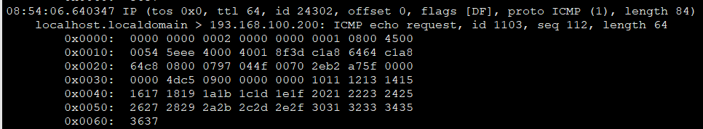
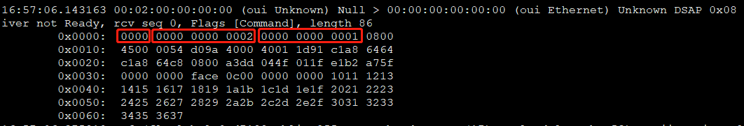
问题场景：
组网vm1 <-> vhost-user-1 <-> ovsdpdkbr <-> vhost-user-2 <-> vm2
创建vm-vm环境，vm-vm可以正常ping通。
service openvswitch-switch restart
vm-vm ping不通
vm1: 193.168.100.100 00:00:00:00:00:01/vm2: 193.168.100.200 00:00:00:00:00:02
1.在vm1设置arp，先让报文从vm1发送出去。在vm1抓包看到发送出去的报文：
2.接着在主机上的vhost端口抓包：
可以看到在目的MAC前面多了2个字节的数据，导致整个数据包错位，这样的Ping报文到达vm2，vm2即便接收也无法给出回应。

Slide 51
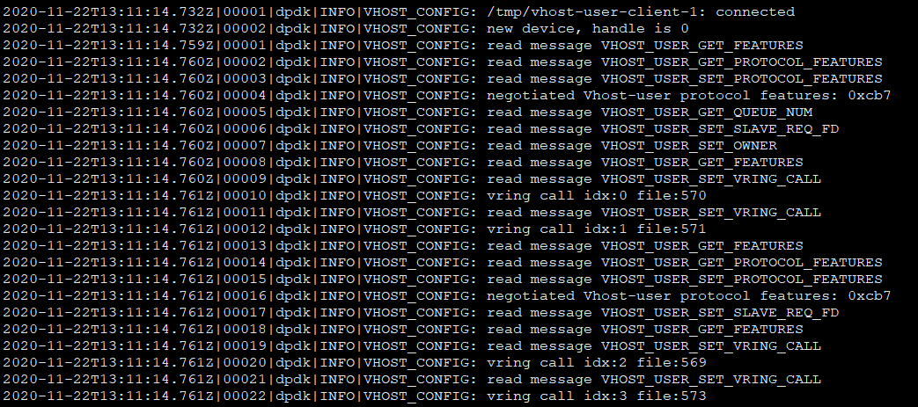

Slide 52
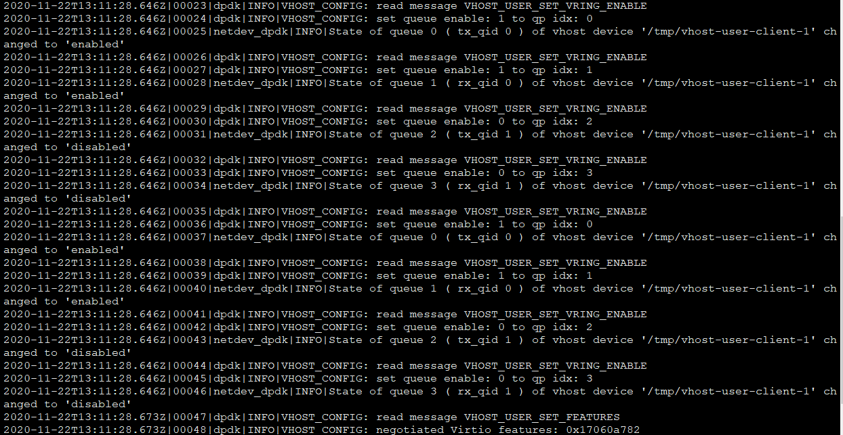

Slide 53
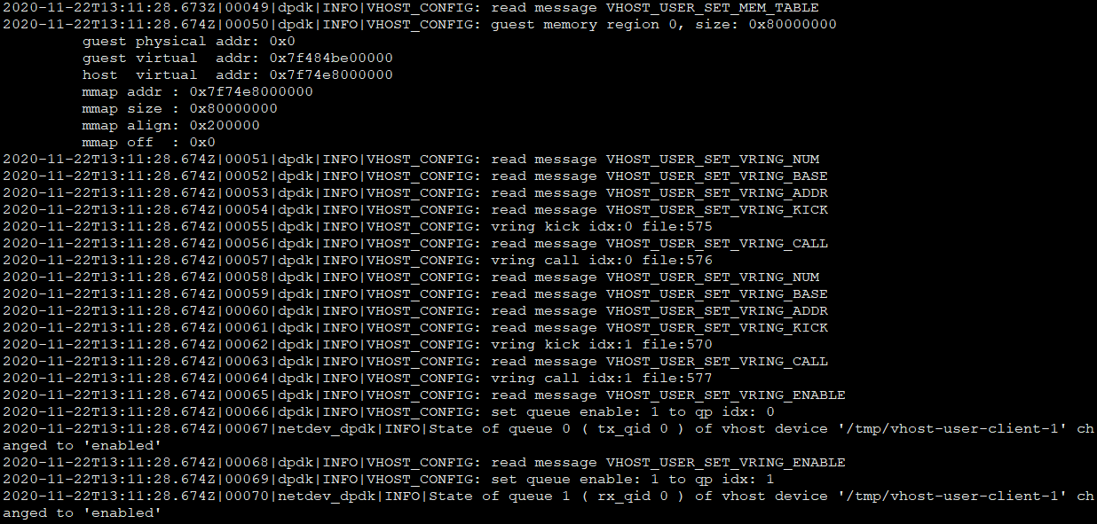

Slide 54
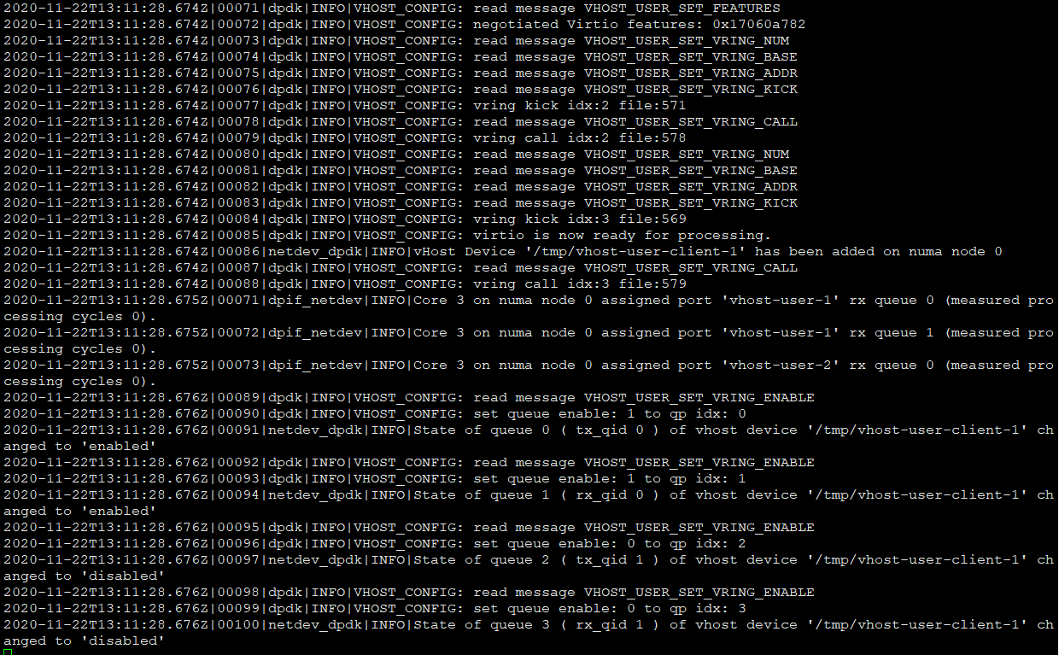

Slide 55
ISR action
ETH Driver
Exception
Guest OS
vcpu
mmio action &&
DMA action
Generic Interrupt Controller
receive/send
PCI interrupt
ETH Device
Net Client
QEMU
br
socket read/write
tap netdev
Host

Slide 56
pci device
qemu_irq_raise()
level == 1
irq->opaque = pci_dev;
irq->n = 0; /* Pin A - 1 */
qemu_set_irq()
irq->handler()
qemu_irq_lower()
level == 0
irq->n == 0
pci_irq_handler(0)
pci_change_irq_level()
pci_bus_change_irq_level()
bus->set_irq(bus->map_irq(pci_dev, 0))
gpex_set_irq(irq_num)
qemu_set_irq(GPEXHost->irq[irq_num])
irq->handler(irq->n)
if (irq < (GIC->num_irq - GIC_INTERNAL)) {
/* The first external input line is internal interrupt 32. */
cm = ALL_CPU_MASK;
irq += GIC_INTERNAL;
target = GIC->irq_target[irq];
} else {
irq -= (GIC->num_irq - GIC_INTERNAL);
cpu = irq / GIC_INTERNAL;
irq %= GIC_INTERNAL;
cm = 1 << cpu;
target = cm;
}
/* Meaning of the 'irq' parameter:
* [0..N-1] : external interrupts
* [N..N+31] : PPI (internal) interrupts for CPU 0
* [N+32..N+63] : PPI (internal interrupts for CPU 1
* ...
*/
gic_set_irq(irq)
pci.irq == [35, 38]
GIC->irq_state[irq].level |= cm;
GIC->irq_state[irq].edge_trigger == true?->GIC->irq_state[irq].pending |= target;
gic_set_irq_generic()
gic_update()
gic_update_internal(GIC, false)
qemu_set_irq()
irq->handler()
arm_cpu_set_irq()
cpu->interrupt_request |= mask;
cpu_interrupt()
generic_handle_interrupt()
level == 1
qemu_cpu_kick(cpu)
cpu_exit(cpu)
thread_cpu != cpu
qatomic_set(&cpu->exit_request, 1)

Slide 57
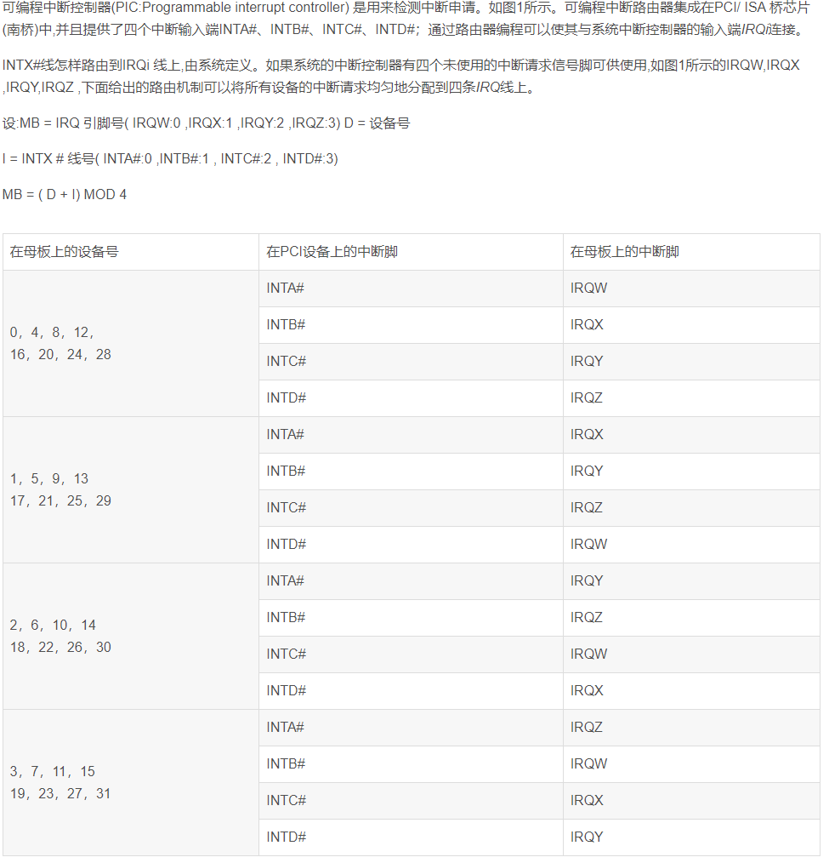

Slide 58
hw/misc/edu.c
if (irq < (GIC->num_irq - GIC_INTERNAL)) {
/* The first external input line is internal interrupt 32. */
cm = ALL_CPU_MASK;
irq += GIC_INTERNAL;
target = GIC->irq_target[irq];
} else {
irq -= (GIC->num_irq - GIC_INTERNAL);
cpu = irq / GIC_INTERNAL;
irq %= GIC_INTERNAL;
cm = 1 << cpu;
target = cm;
}
/* Meaning of the 'irq' parameter:
* [0..N-1] : external interrupts
* [N..N+31] : PPI (internal) interrupts for CPU 0
* [N+32..N+63] : PPI (internal interrupts for CPU 1
* ...
*/
gic_set_irq(irq)
pci.irq == [35, 38]
GIC->irq_state[irq].level |= cm;
GIC->irq_state[irq].edge_trigger == true?->GIC->irq_state[irq].pending |= target;
gic_set_irq_generic()
gic_update()
gic_update_internal(GIC, false)
qemu_set_irq()
irq->handler()
GICState->gic_irq_state:
/* The enable bits are only banked for per-cpu interrupts. */
uint8_t enabled;
uint8_t pending;
uint8_t active;
uint8_t level;
bool model; /* 0 = N:N, 1 = 1:N */
bool edge_trigger; /* true: edge-triggered, false: level-triggered */
uint8_t group;
arm_cpu_set_irq()
cpu->interrupt_request |= mask;
cpu_interrupt()
generic_handle_interrupt()
level == 1
qemu_cpu_kick(cpu)
cpu_exit(cpu)
thread_cpu != cpu
qatomic_set(&cpu->exit_request, 1)

Slide 59
mtttcg_start_vcpu_thread()
mtttcg_cpu_thread_fn()
tcg_cpu_exec()
cpu_exec()
cpu_handle_interrupt()
rr_start_vcpu_thread()
rr_start_vcpu_thread()
cc->cpu_exec_interupt()
arm_cpu_exec_interupt()
cc->do_interupt()
arm_cpu_do_interrupt()
addr = env->cp15.vbar_el[new_el];
add...;
addr += 0x80; /* cs->exception_index == EXCP_IRQ/EXCP_VIRQ */
env->pc = addr; /* GuestOS’s Exception Vector Irq Addr */
arm_cpu_do_interrupt_aarch64()

Slide 60
GPIO Model:
Device.[GPIO_OUT] -> [GPIO_IN].GIC.[GPIO_OUT] -> [GPIO_IN].Core
GPIO_IN IRQ is created by qdev_init_gpio_in()
GPIO_OUT IRQ is initialized by sysbus_init_irq()->qdev_init_gpio_out_named(). Attention, GPIO_OUT IRQ is not created.
Actually it is just a IRQ pointer, and the IRQ pointer will point to the GPIO_IN IRQ which connected.
sysbus_connect_irq() connects GPIO_OUT and GPIO_IN IRQ.

Slide 61
Device.[GPIO_OUT]
pci_allocate_irq()
qemu_allocate_irq()
irq->handler = pci_irq_handler;
irq->n = pci_dev->config[PCI_INTERRUPT_PIN] – 1;
int irq = vms->irqmap[VIRT_PCIE]; /* irqmap[VIRT_PCIE]: 3->6 */
create_pcie()
sysbus_connect_irq(SysBus, i, qdev_get_gpio_in(GIC, irq + i))
for i = 0->GPEX_NUM_IRQS(4)
SysBus->irq_num[i] = irq + i; /* gsi -> irq + i */
pci_register_root_bus()
bus->set_irq = gpex_set_irq;
bus->nirq = 4;
pci_bus_irqs()
gpex_host_realize()
bus->route_intx_to_irq = gpex_route_intx_pin_to_irq;
route.irq = GPEXHost->irq_num[pin]; /* gsi */

Slide 62
/* For the GIC, also expose incoming GPIO lines for PPIs for each CPU.
* GPIO array layout is thus:
* [0..N-1] SPIs
* [N..N+31] PPIs for CPU 0
* [N+32..N+63] PPIs for CPU 1
* ...
*/
n = (GIC->num_irq – GIC_INTERNAL) + (GIC->num_cpu * GIC_INTERNAL)
[GPIO_IN].GIC.[GPIO_OUT]
qdev_init_gpio_in(GIC, gic_set_irq, n)
arm_gic_realize()
gic_init_irqs_and_mmio()
for irq/fiq/virq/vfiq
sysbus_init_irq()
qdev_init_gpio_out_named
(SysBus, GIC->parent_irq, 1)
memory_region_init_io(ops)
.read_with_attrs = gic_dist_read,
.write_with_attrs = gic_dist_write,
[GPIO_IN].ARM.Core.[GPIO_OUT]
init_cpus()->sysbus_connect_irq()
qdev_init_gpio_in(cpu, arm_cpu_set_irq, 4)
irq->handler = arm_cpu_set_irq;
irq->opaque = DEVICE(cpu);
irq->n = 4;
arm_cpu_initfn()
qdev_init_gpio_out(cpu, cpu->gt_timer_outputs)
PIC: Programmable Interrupt Controller

Slide 63
PCI Configuration Space Access Mechanism #1
31 | 30 - 24 | 23 - 16 | 15 - 11 | 10 - 8 | 7 - 0
Enable Bit | Reserved | Bus Number | Device Number | Function Number | Register Offset¹
Register Offset has to point to consecutive DWORDs, ie. bits 1:0 are always 0b00 (they are still part of the Register Offset).
Bus Number : 8bits, 0-255
Device Number : 5bits, 0-31
Function Number: 3bits, 0-7

Slide 64
PCI Configuration Space Header Type 0x00
register | offset | bits 31-24 | bits 23-16 | bits 15-8 | bits 7-0
00 | 00 | Device ID |  | Vendor ID
01 | 04 | Status |  | Command
02 | 08 | Class code | Subclass | Prog IF | Revision ID
03 | 0C | BIST | Header type | Latency Timer | Cache Line Size
04 | 10 | Base address #0 (BAR0)
05 | 14 | Base address #1 (BAR1)
06 | 18 | Base address #2 (BAR2)
07 | 1C | Base address #3 (BAR3)
08 | 20 | Base address #4 (BAR4)
09 | 24 | Base address #5 (BAR5)
0A | 28 | Cardbus CIS Pointer
0B | 2C | Subsystem ID |  | Subsystem Vendor ID
0C | 30 | Expansion ROM base address
0D | 34 | Reserved |  |  | Capabilities Pointer
0E | 38 | Reserved
0F | 3C | Max latency | Min Grant | Interrupt PIN | Interrupt Line

Slide 65
PCI BAR #Memory
Bit 4-31 | Bit 3 | Bit 1-2 | Bit 0
Base Address, naturally 16-bytes aligned | Prefetchable: 0: no 1: yes | Locatable: 0: any 32-bits 1: <= 1MiB 2: any 64-bits | Region Type: 0: Memory 1: I/O
PCI BAR #I/O
Bit 2-31 | Bit 1 | Bit 0
Base Address, naturally 4-bytes aligned | Reserved | Region Type: 0: Memory 1: I/O

Slide 66
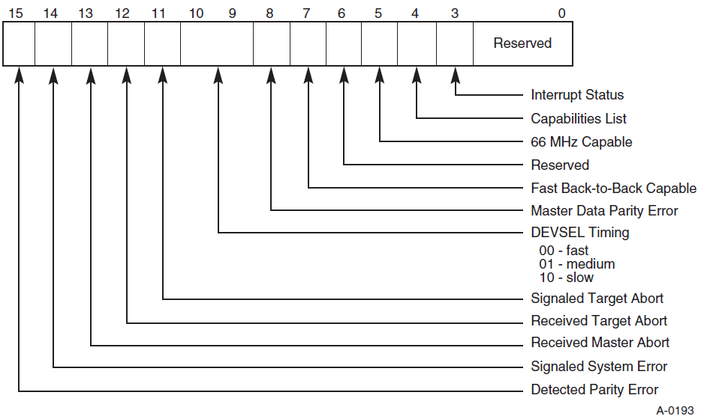
status

Slide 67
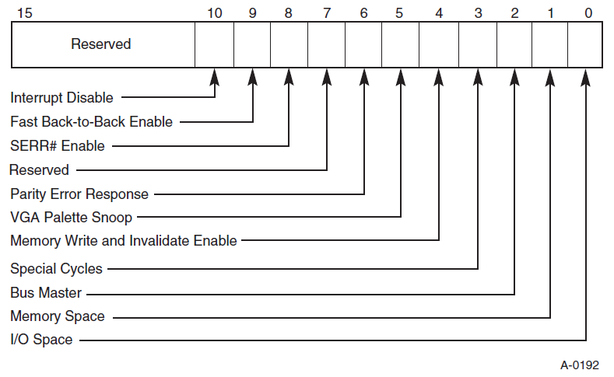
command

Slide 68
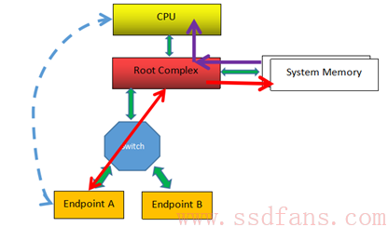
每个PCIe设备，都有自己的内部空间，这部分空间如果开放给Host（软件或者CPU)访问，那么Host怎样才能往这部分空间写入数据，或者读数据呢？
我们知道，CPU只能直接访问Host内存（Memory）空间（或者IO空间，我们不考虑），不对PCIe等外设直接操作。怎么办？记得皇帝身边那个有根的太监吗？Root Complex，RC。RC可以为CPU分忧。
解决办法是：CPU如果想访问某个设备的空间，由于它不能（或者不屑）亲自跟那些PCIe外设打交道，因此叫太监RC去办。比如，如果CPU想读PCIe外设的数据，先叫RC通过TLP把数据从PCIe外设读到Host内存，然后CPU从Host内存读数据；如果CPU要往外设写数据，则先把数据在内存中准备好，然后叫RC通过TLP写入到PCIe设备。完美！
上图例子中，最左边虚线的表示CPU要读Endpoint A的数据，RC则通过TLP（经历Switch）数据交互获得数据，并把它写入到系统内存中，然后CPU从内存中读取数据（紫色箭头所示），从而CPU间接完成对PCIe设备数据的读取。
具体实现就是上电的时候，系统把PCIe设备开放的空间（系统软件可见）映射到内存空间，CPU要访问该PCIe设备空间，只需访问对应的内存空间。RC检查该内存地址，如果发现该内存空间地址是某个PCIe设备空间的映射，就会触发其产生TLP，去访问对应的PCIe设备，读取或者写入PCIe设备。
一个PCIe设备，可能有若干个内部空间（属性可能不一样，比如有些可预读，有些不可预读）需要映射到内存空间，设备出厂时，这些空间的大小和属性都写在Configuration BAR寄存器里面，然后上电后，系统软件读取这些BAR，分别为其分配对应的系统内存空间，并把相应的内存基地址写回到BAR。（BAR的地址其实是PCI总线域的地址，CPU访问的是存储器域的地址，CPU访问PCIe设备时，需要把总线域地址转换成存储器域的地址。）

Slide 69
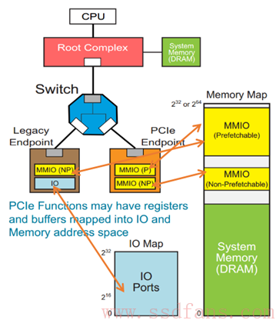
如上图例子，一个Native PCIe Endpoint，只支持Memory Map，它有两个不同属性的内部空间要开放给系统软件，因此，它可以分别映射到系统内存空间的两个地方；还有一个Legacy Endpoint，它既支持Memory Map，还支持IO Map，它也有两个不同属性的内部空间，分别映射到系统内存空间和IO空间。

Slide 70


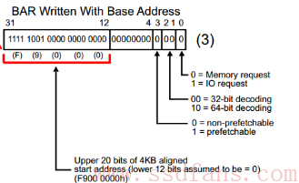
上电时，系统软件首先会读取PCIe设备的BAR0，得到数据：
然后系统软件往该BAR0写入全1，得到：
BAR寄存器有些bit是只读的，是PCIe设备在出厂前就固定好的bit，写全1进去，如果值保持不变，就说明这些bit是厂家固化好的，这些固化好的bit提供了这块内部空间的一些信息：
怎么解读？低12没变，表明该设备空间大小是4KB（2的12次方），然后低4位表明了该存储空间的一些属性（IO映射还是内存映射，32bit地址还是64bit地址，能否预取？做过单片机的人可能知道，有些寄存器只要一读，数据就会清掉，因此，对这样的空间，是不能预读的，因为预读会改变原来的值），这些都是PCIe设备在出厂前都设置好的，提供给系统软件的信息。
然后系统软件根据这些信息，在系统内存空间找到这样一块地方来映射这4KB的空间，把分配的基地址写入到BAR0：

Slide 71
If you're using the old PIC, your life is really easy. You have the Interrupt Line field of the header, which is read/write (you can change it's value!) and it says which interrupt will the PCI device fire when it needs attention.
If you plan to use the I/O APIC, your life will be a nightmare. You have 4 new IRQs called INTA#, INTB#, INTC# and INTD#. You can find which IRQ the device will use in the Interrupt Line field. In the ACPI AML Tables you will find (using ACPICA) that INTA# is connected to a specified interrupt line, INTB# to another, etc...
So far so good. You have, say, 20 devices. 10 of those are using INTA#, 5 for INTB#, 5 for INTC#, and none for INTD#. So when the IRQ number related to #INTC you have to scan the 5 devices to understand who was the interested one. So there is a LOT of IRQ sharing, expecially for INTA#.
With time manufacturers started to use mainly INTA#, forgetting the existence of other pins. So you will likely have 18 devices on INTA# and 2 on INTB#. Motherboard manufacturers decided take the situation in control. So at boot the INTx# are remapped, so that you will have 5 devices for INTA#, 5 for INTB#, 5 for INTC#, and 5 for INTD# (in the best case). That's great! IRQs are balanced and IRQ sharing is reduced. The only problem is that you don't know what devices where mapped. If you read the Interrupt Pin you still get INTA#. You now need to parse the MP Tables or the ACPI ones to solve the mess. Good luck.
Alternatively, you could just use MSI or MSI-X, and skip all that nasty ACPI stuff.

Slide 72
MSI:
First, check that the device has a pointer to the capabilities list (Status register bit 4 set to 1). Then, traverse the capabilities list. The low 8 bits of a capability register are the ID - 0x05 for MSI. The next 8 bits are the offset (in PCI configuration space) of the next capability.
register | offset | bits 31-24 | bits 23-16 | bits 15-8 | bits 7-0
cap+00 | cap+00 | Message Control |  | Next ptr | Capability ID = 05
cap+01 | cap+04 | Message Address [Low]
cap+02 | cap+08 | [Message Address High]
cap+02/03 | cap+08/0C | Reserved |  | Message Data
cap+04 | cap+10 | [Mask]
cap+05 | cap+14 | [Pending]
Here is the layout of the message control register:
Bit 15-9 | Bit 8 | Bit 7 | Bit 6-4 | Bit 3-1 | Bit 0
Reserved | Per-vector masking | 64 bit | Multiple Message Enable | Multiple Message Capable | Enable
In MME, specifies the number of low bits of Message Data that may be modified by the device.
Therefore, the interrupt vector block allocated must be aligned accordingly.
MME / MMI | Interrupts
000 | 1
001 | 2
010 | 4
011 | 8
100 | 16
101 | 32
If capable, you can mask individual messages by setting the corresponding bit (1<<x), in the mask register.
If a message is pending, then the corresponding bit in the pending register is set.

Slide 73
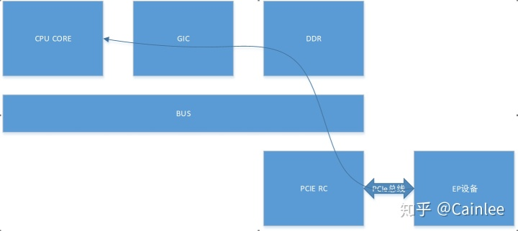
MSI-x中断产生的数据流
下图是ARMv8架构下的主要经过的模块，主要流程如下
HOST枚举到EP PF设备，配置MSI-x table
EP设备通过读取vector table，获取到MSI-x中断对应的message address，构造一个TLP包，往message address地址里面写中断信息。
PCIE RC收到包判断是个TLP写后，将写操作转到总线，并返回ACK
GIC中的ITS检测到对应DDR有变化，则获取设备和中断信息后分发到经GIC分发到各个CPU核上。
pci_alloc_irq_vectors
https://lwn.net/Articles/619788/

Slide 74
Like for MSI, you have to find the MSI-X capability, but the ID for MSI-X is 0x11
The structure is as follows:
register | offset | bits 31-24 | bits 23-16 | bits 15-8 | bits 7-3 | bits 2-0
cap+00 | cap+00 | Message Control |  | Next ptr | Capability ID = 11
cap+01 | cap+04 | Table Offset |  |  |  | BIR
cap+02 | cap+08 | Pending Bit Offset |  |  |  | Pending Bit BIR
Unlike MSI, MSI-X supports 2048 interrupts. This is achieved by maintaining a table of interrupts in the PCI device's address space. The wording of the PCI 3.0 spec indicates that this must be via a Memory BAR.
BIR specifies which BAR is used for the Message Table. This may be a 64 bit BAR, and is zero-indexed (so BIR=0, BAR0, offset 10h into the header).
Table Offset is an offset into that BAR where the Message Table lives. Note that it is 8 byte aligned - so simply mask BIR.
The format of Message Control is as follows:
Bit 15 | Bit 14 | Bit 13-11 | Bit 10-0
Enable | Function Mask | Reserved | Table Size
Table Size is N-1 encoded, and is the number of entries in the MSI-X table. This field is Read-Only.
Now you have all the information you need to find the MSI-X table:
Vector Control is as follows:
Bit 31-1 | Bit 0
Reserved | Masked
Note that Message Address is is DWORD-aligned, so, again, mask the low bits. The interrupt is masked if Masked is set to 1.
Message Address and Data are as they were for MSI - architecture specific. However, unlike with MSI, you can specify independent vectors for all the interrupts, only limited by having the same upper 32 bit message address.
Bit 127-96 | Bit 95-64 | Bit 63-32 | Bit 31-0
Vector Control (0) | Message Data (0) | Message Address High (0) | Message Address Low (0)
Vector Control (1) | Message Data (1) | Message Address High (1) | Message Address Low (1)
... | ... | ... | ...
Vector Control (N-1) | Message Data (N-1) | Message Address High (N-1) | Message Address Low (N-1)

Slide 75
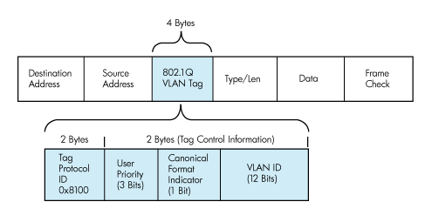
Layer2 -Ethernet

Slide 76
Layer2 -Ethernet
netifapi_netif_add()
netifapi_do_netif_add()
netif_add()
netif_init()
netif_input()
ip4_input()
ethernet_input()
ip_input()
ip6_input()
handle vlan header
handle multicast/broadcast
IPv4
ARP
IPv6
pbuf_remove_header()
pbuf_remove_header()
pbuf_remove_header()
ip4_input()
ip6_input()
etharp_input()

Slide 77
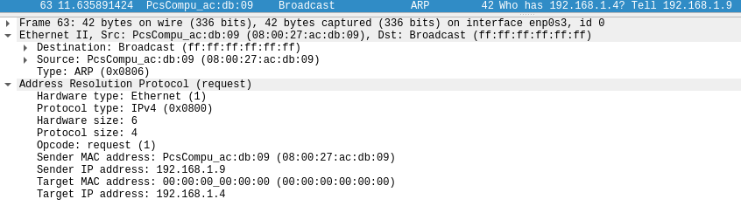
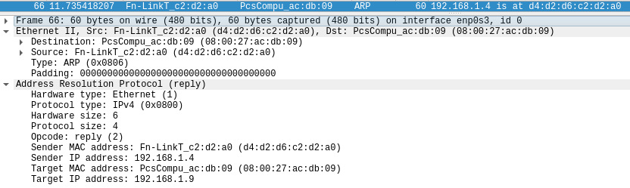
Layer2.5 -ARP

Slide 78
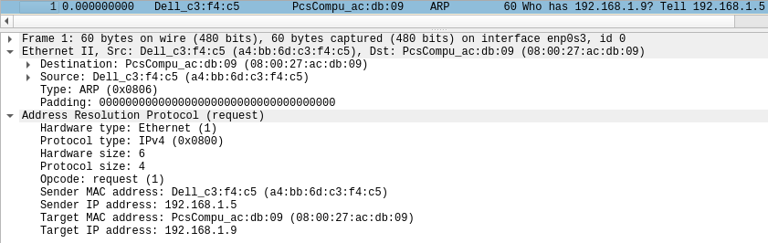
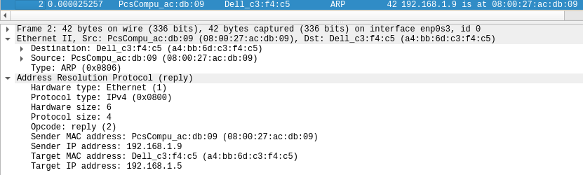
Layer2.5 -ARP

Slide 79
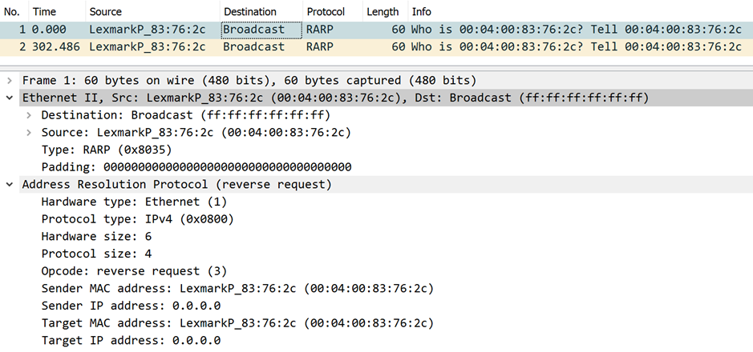
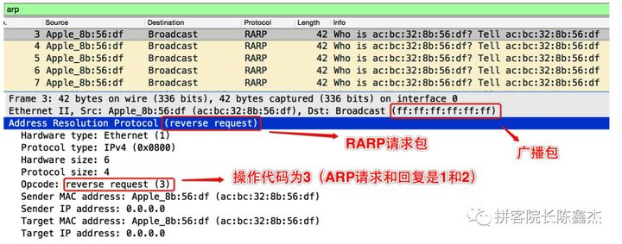
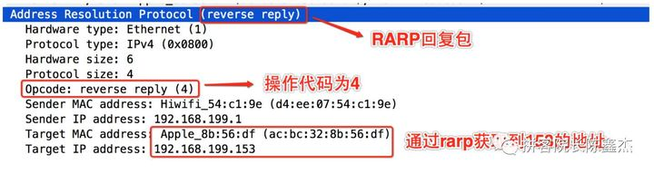
Layer2.5 -RARP

Slide 80
Layer2.5 -ARP
etharp_input()
autoip
autoip_arp_reply()
etharp_find_entry()
search arp entry or create new entry
etharp_update_arp_entry()
ARP_REQUEST
ARP_REPLY
fill arp_table[]
queued packets
etharp_raw()
dhcp_arp_reply()
ethernet_output()
fill arp reply packet
used ip address?
ethernet_output()
dhcp_decline()

Slide 81
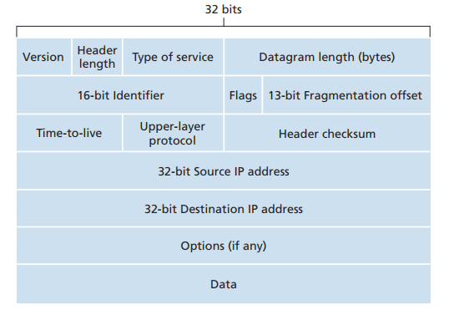
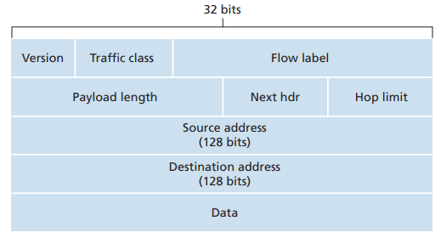
Layer3 –IPv4/IPv6

Slide 82
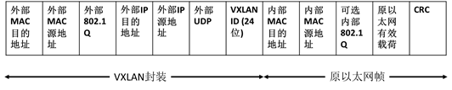
Layer3 –VxLAN

Slide 83
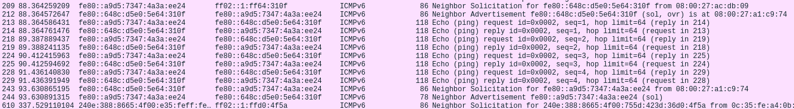
Layer3 –IPv6

Slide 84
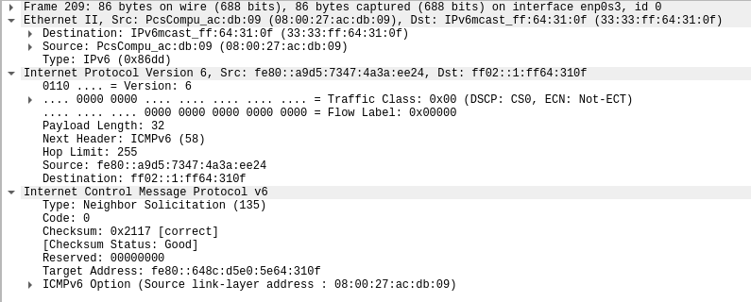
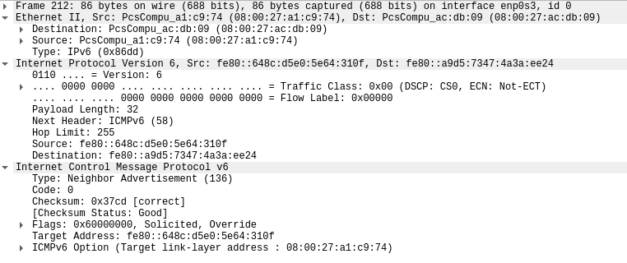
Layer3 –IPv6

Slide 85
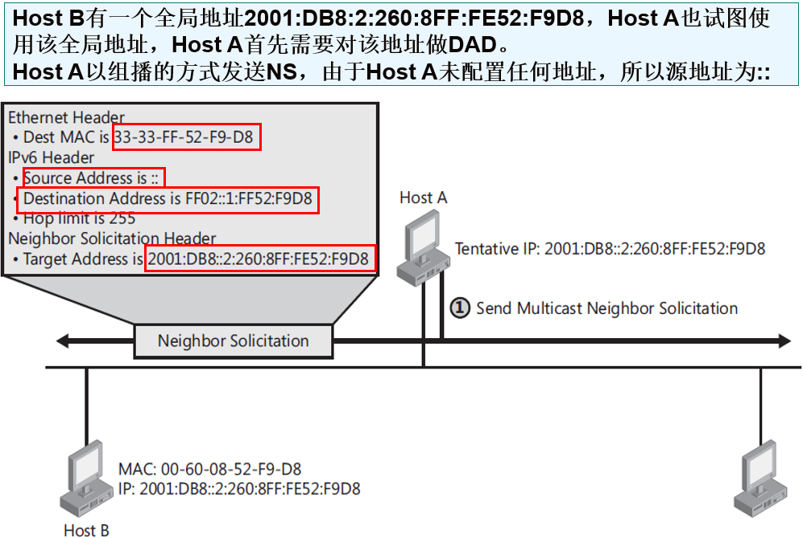

Slide 86
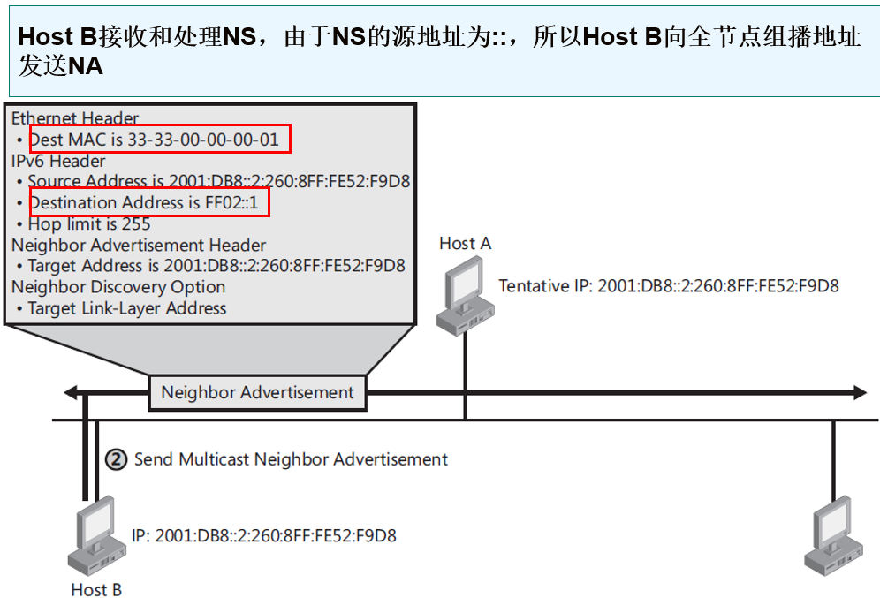

Slide 87
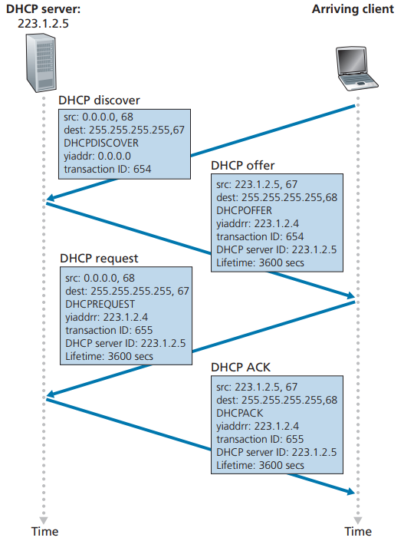
Layer5 –dhcp

Slide 88
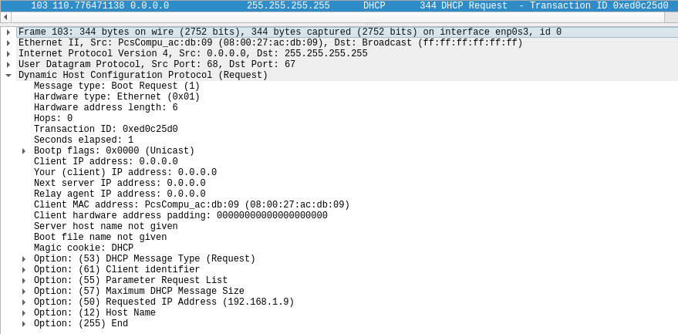
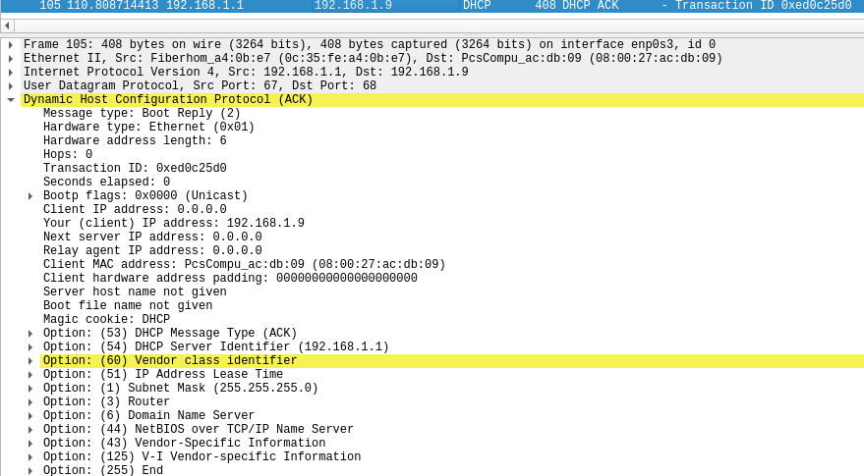
Layer5 –dhcp

Slide 89
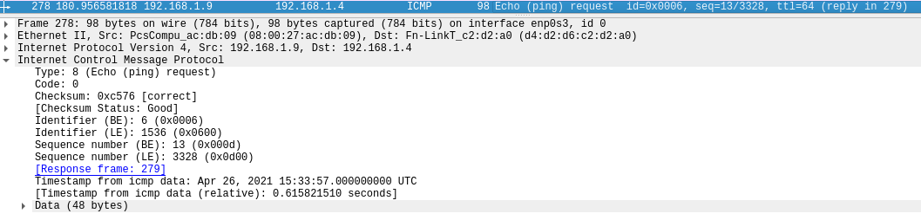
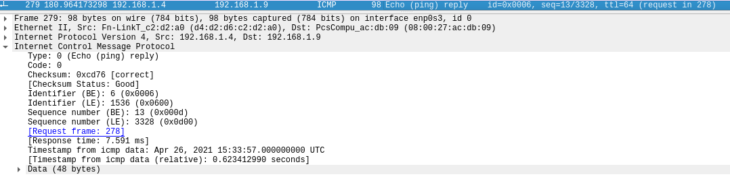
Layer4 –icmp, internet control message protocol

Slide 90
Layer3 –IPv4
ip4_input()

Slide 91
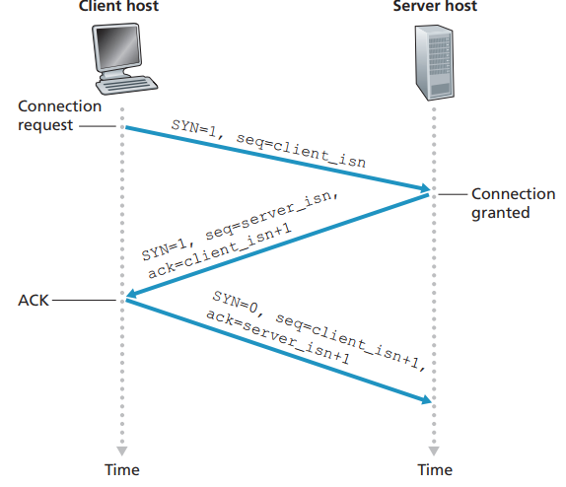
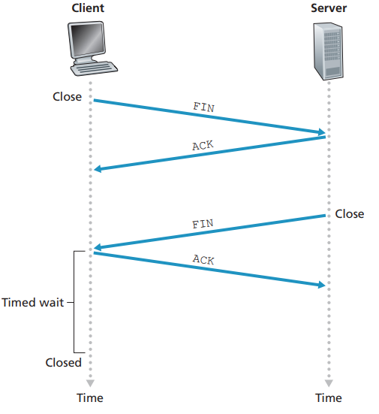
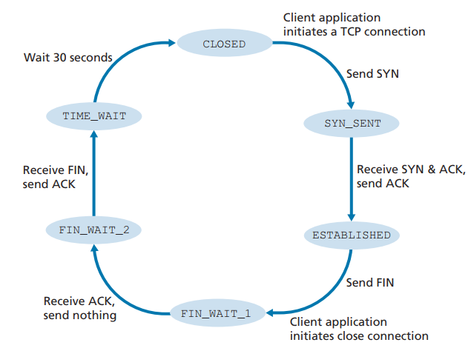
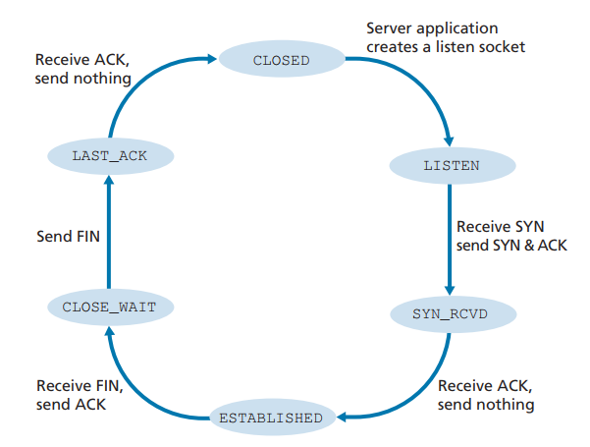
Layer4 –TCP, Transmission Control Protocol

Slide 92
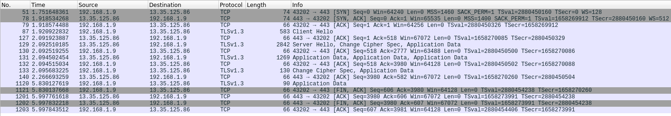

Slide 93
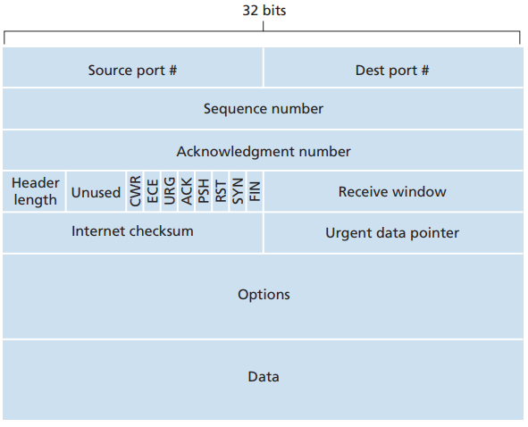
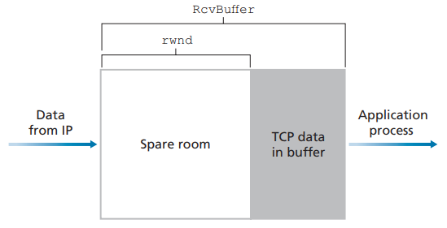
Layer4 –TCP, Transmission Control Protocol
MTU, Maximum Transmission Unit, 46-1500bytes
MSS, Maximum Segment Size
MSS = MTU – TCP/IP header length(typically 40 bytes)
Flow Control Service
Receiver HostB:
rwnd = RcvBuffer – [LastByteRcvd – LastByteRead]
Sender HostA:
LastByteSent – LastByteAcked <= rwnd
If HostB rwnd=0, and Host has nothing to HostA and no ACK to Host A, when HostB empties the buffer, HostA will not be informed about new rwnd of HostB. Solution:
HostA continue to send segments with 1 data byte to HostB when HostB’s rwnd is 0.

Slide 94
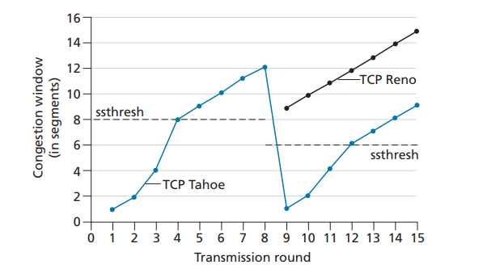
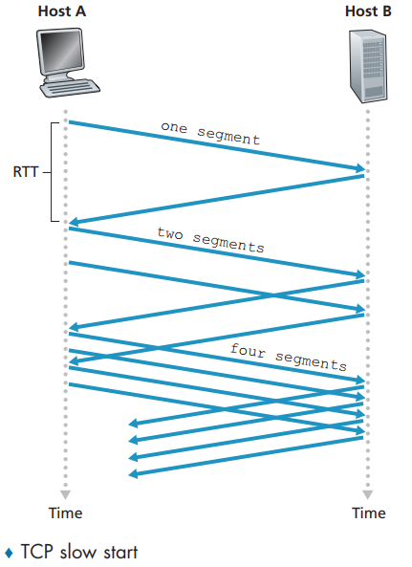
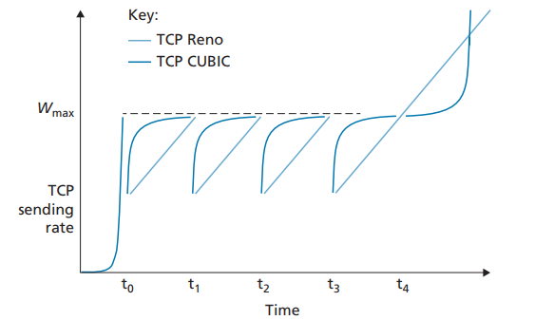
Layer4 –TCP, Transmission Control Protocol
TCP Congestion Control
cwnd, congestion window:
LastByteSent – LastByteAcketd <= min{cwnd, rwnd}
TCP Congestion-control algorithm:
slow start –exponential growth start with 1MSS
Congestion Avoidance
Fast Recovery

Slide 95

Layer4 –TCP, Transmission Control Protocol
TCP Congestion Control

Slide 96

Layer4 –UDP, User Datagram Protocol

Slide 97


Layer4/5 –QUIC, Quick UDP Internet Connections
QUIC: A new application layer protocol designed from the ground up to improve the performance of transport layer services for secure HTTP
Connection-Oriented and Secure
Streams
Reliable, TCP-friendly congestion-controlled data transfer

Slide 98
Layer4 –TCP
tcp_input()
retrieve TCP header to host byte order
find active connection in tcp_active_pcbs with src/dst ip/port
no found
found
find TIME-WAIT connections in tcp_tw_pcbs
handle the TCP segment
no found
peer rwnd == 0
tcp_timewait_input()
find LISTENING connections in tcp_listen_pcbs
tcp_send_empty_ack()
state machine
tcp_listen_input()
tcp_process()
TCP_RST
TCP_SYN
pcb->state
tcp_output()
tcp_ack_now()
SYN_SENT
SYN_RCVD
CLOSE_WAIT
ESTABLISHED
FIN_WAIT_1
FIN_WAIT_2
CLOSING
LAST_ACK

Slide 99
Layer4 –TCP
udp_input()

Slide 100


