Slide 1
Language Describing Films: A Textual Analysis
Maia Petee
11285208

Slide 2
Problem
Among popular films, is there a detectable, consistent relationship between the language used to describe a film and its box office performance?

Slide 3
Motivation
Word frequency is a common measure in linguistic analyses, but creating a salient measure of frequency for free text and discovering relationships among variables using this measure is not easy.
Let’s see how close we can get, and what this teaches us.

Slide 4
Hypothesis 1
Hypothesis 2
Hypothesis 3
Keyword frequency (expressed in our dataset as “group”) is positively correlated to box office performance: the higher the frequency group, the higher the average revenue of that group overall.
Movie genre (expressed in our dataset as “tags”) displays a relationship with box office performance: genres with more mass appeal (e.g. action and comedy) will show the highest average profits.
Movies for which the majority of revenue was made domestically will show higher prevalence in the lowest frequency group (group 3), while movies whose revenue was made primarily overseas will show higher prevalence in Group 1

Slide 5
Input Datasets
Sales data* for top 800 grossing films – from Box Office Mojo
Kaggle Movie Plot Synopses with Tags Corpus: > 13800 values
Kaggle English Word Frequency List: > 1/3 million values
NLTK’s List of English Stopwords: 127 function words (“the,” “of,” etc.)
* Snapshot taken in September 2019 – 800-film dataset has since been removed.

Slide 6
Data Cleaning and Synthesis
Financial data joined to synopsis data: 719 rows
Stopwords filtered out of frequency list
Python script written to assign frequency groups (1-3) to synopses based on keywords
Cleaning and formatting numerical data
Synopsis statistics calculated:
Word count
Average word length

Slide 7
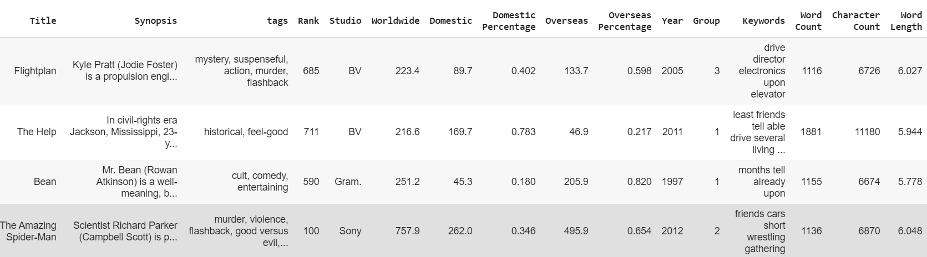
Output Dataset

Slide 8
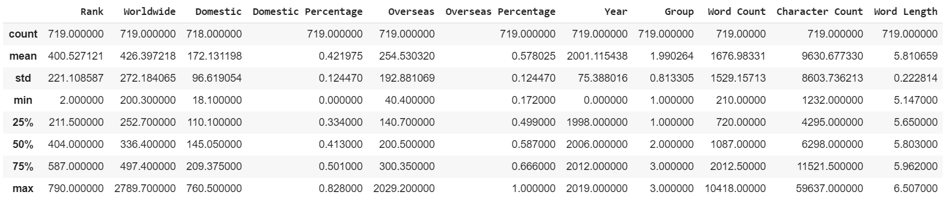
Exploratory Data Analysis (EDA)

Slide 9
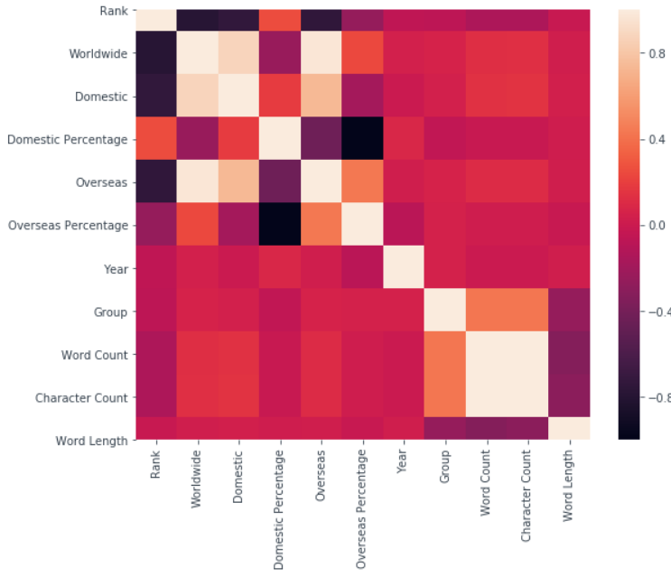
Exploratory Data Analysis (EDA)

Slide 10
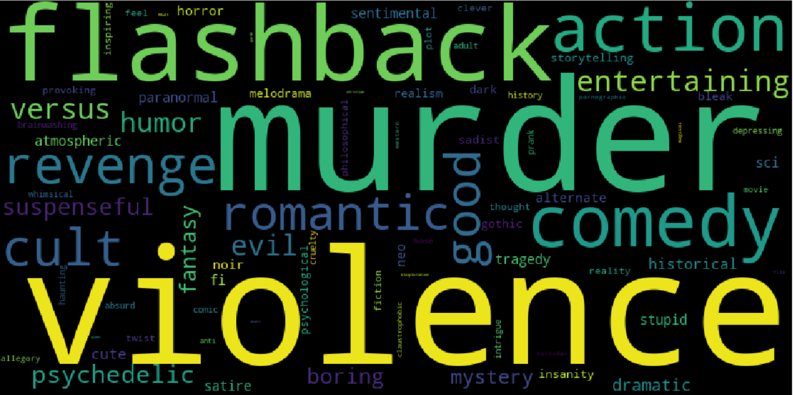
Exploratory Data Analysis (EDA)

Slide 11
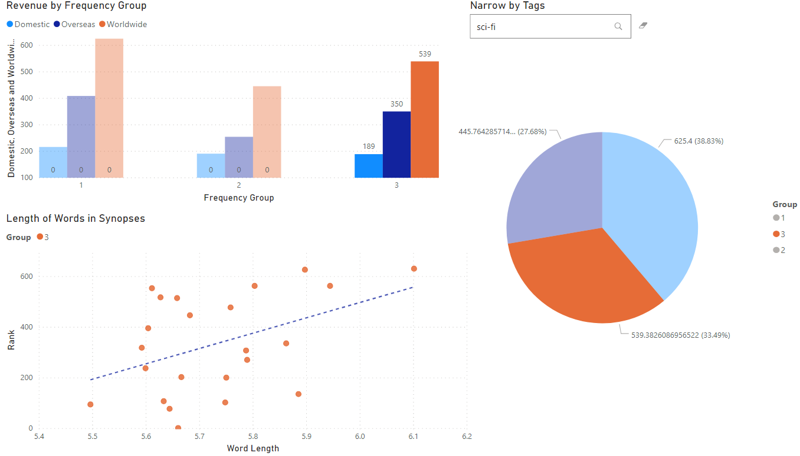
Results

Slide 12
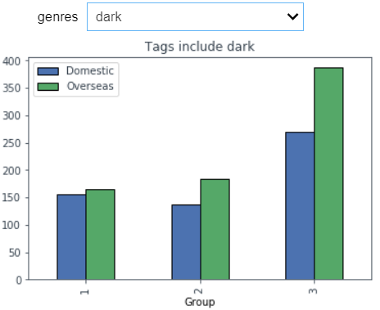
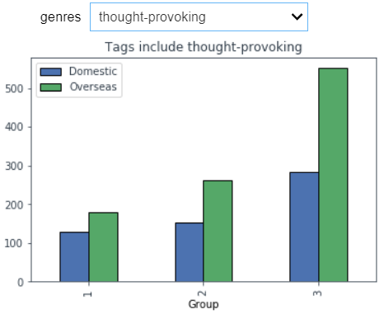
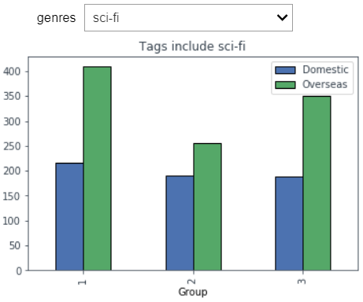
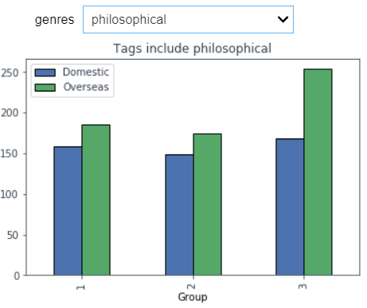
Results
Four samples from an interactive dashboard created with the Python Ipywidgets library
The user can search by genre tag to view average overseas and domestic revenue for each frequency group
Shown are four tags from a lower-frequency group
Transition to Google Colab to view high-frequency tags: 'violence', 'murder', 'flashback', 'comedy', 'action'

Slide 13

Analysis
Results of analysis did not support alternative hypotheses
Genre tags show interesting results, but these can not necessarily be generalized across frequency groups
A more salient measure of word frequency – continuous and not ordinal that takes into account all language in synopsis – needs to be developed to explore relationships

Slide 14
Future Work
Develop a new frequency metric
Explore more free text
Jettison financial data
This metric will be an aggregate of ALL words in a synopsis, including stopwords, so we can get a sense for the entire synopsis.
A corpus of movie reviews exists on Kaggle; these could be analyzed for sentiment and a more purely textual approach taken
This limited dataset to 719 rows; without it, several thousands of films could be analyzed. Any effects present would be heightened by more data.
1
2
3

Slide 15
Thank you!
Any questions?

