Slide 1
Polling in Java (be nice)
Create a program that blocks on some input and sets a flag when input is ready
Run that program in a separate thread
The main thread can now check the flag every now and then without blocking to pick up the input

Slide 2
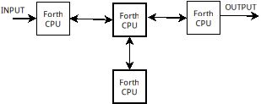
Independent Forth CPUs
Passing data between neighbors, but no direct communication with nodes farther away

Slide 3

56 fully interconnected nodes?
I don’t think the AI understood me correctly

Slide 4
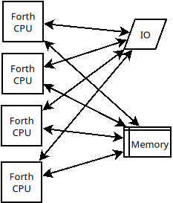
TP-Forth
Every running instance has access to everything, but care must be taken so they don’t mess things up for one another

Slide 5
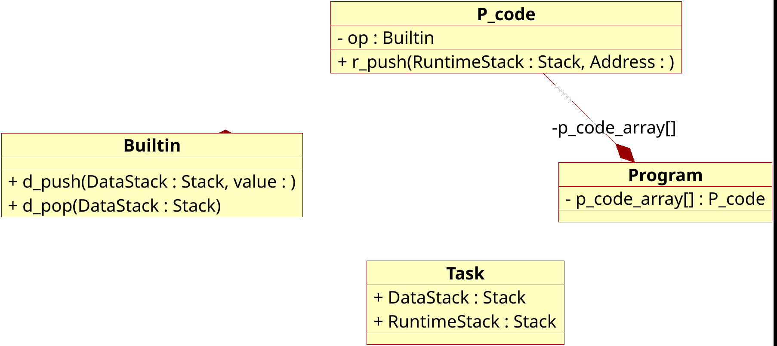
OO but not OO

Slide 6
The Alien approach
Built-ins
How would a space alien approach this?
P-CODES
Forth source

Slide 7
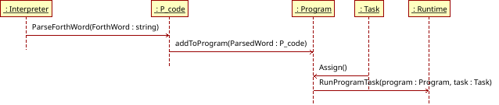
From source to running process
That arrow is going the wrong way!

Slide 8
Limitations
Can’t pass parameters on the stack (each task has its own stack)
Must communicate through Queues to avoid race conditions

Slide 9
OFF TO THE RACES
Try some code

