Slide 1
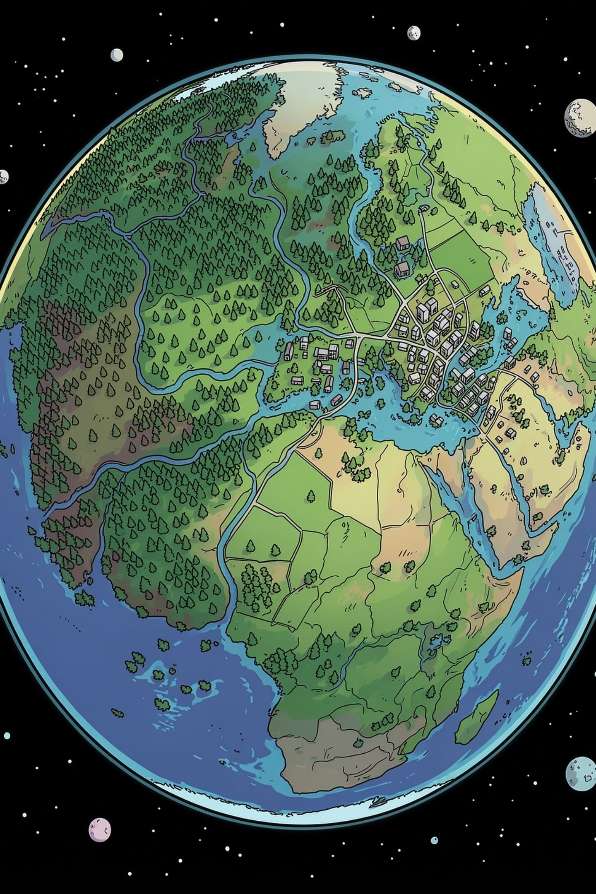

EuroSAT Land Cover Classification

Slide 2
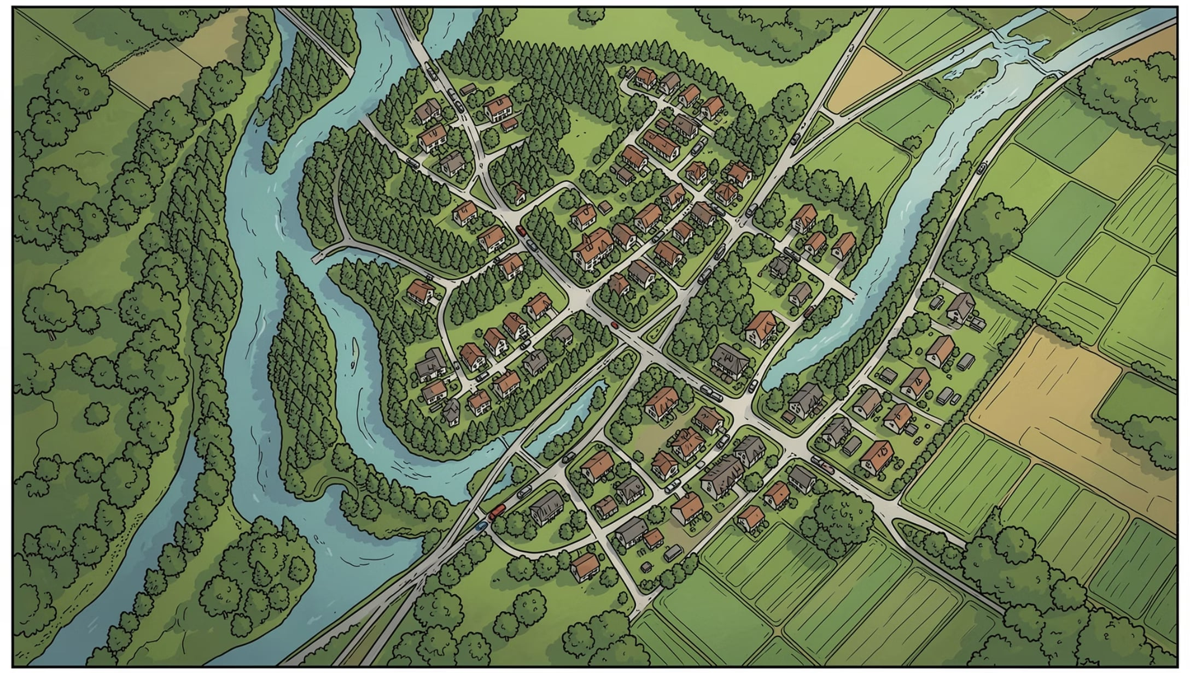
Project Overview
What We're Building
An automated system that classifies satellite images into land cover types: forests, rivers, highways, residential zones, and agricultural fields using deep learning.
Objectives
Automate land cover classification at scale
Eliminate manual interpretation bottlenecks
Build an end-to-end AI pipeline
Deploy the model as a REST API

Slide 3
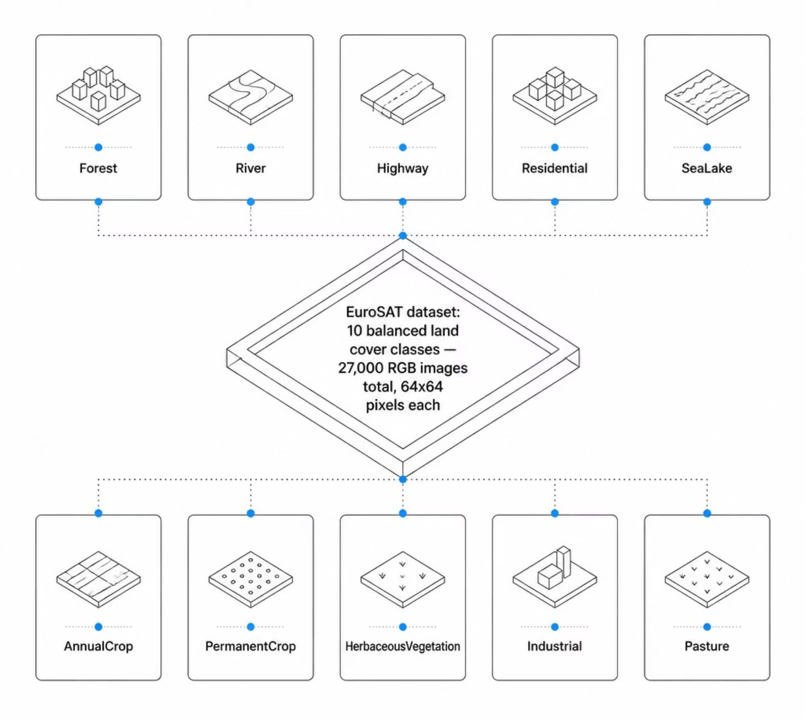

Dataset Details
Kaggle: https://www.kaggle.com/datasets/apollo2506/eurosat-dataset

Slide 4
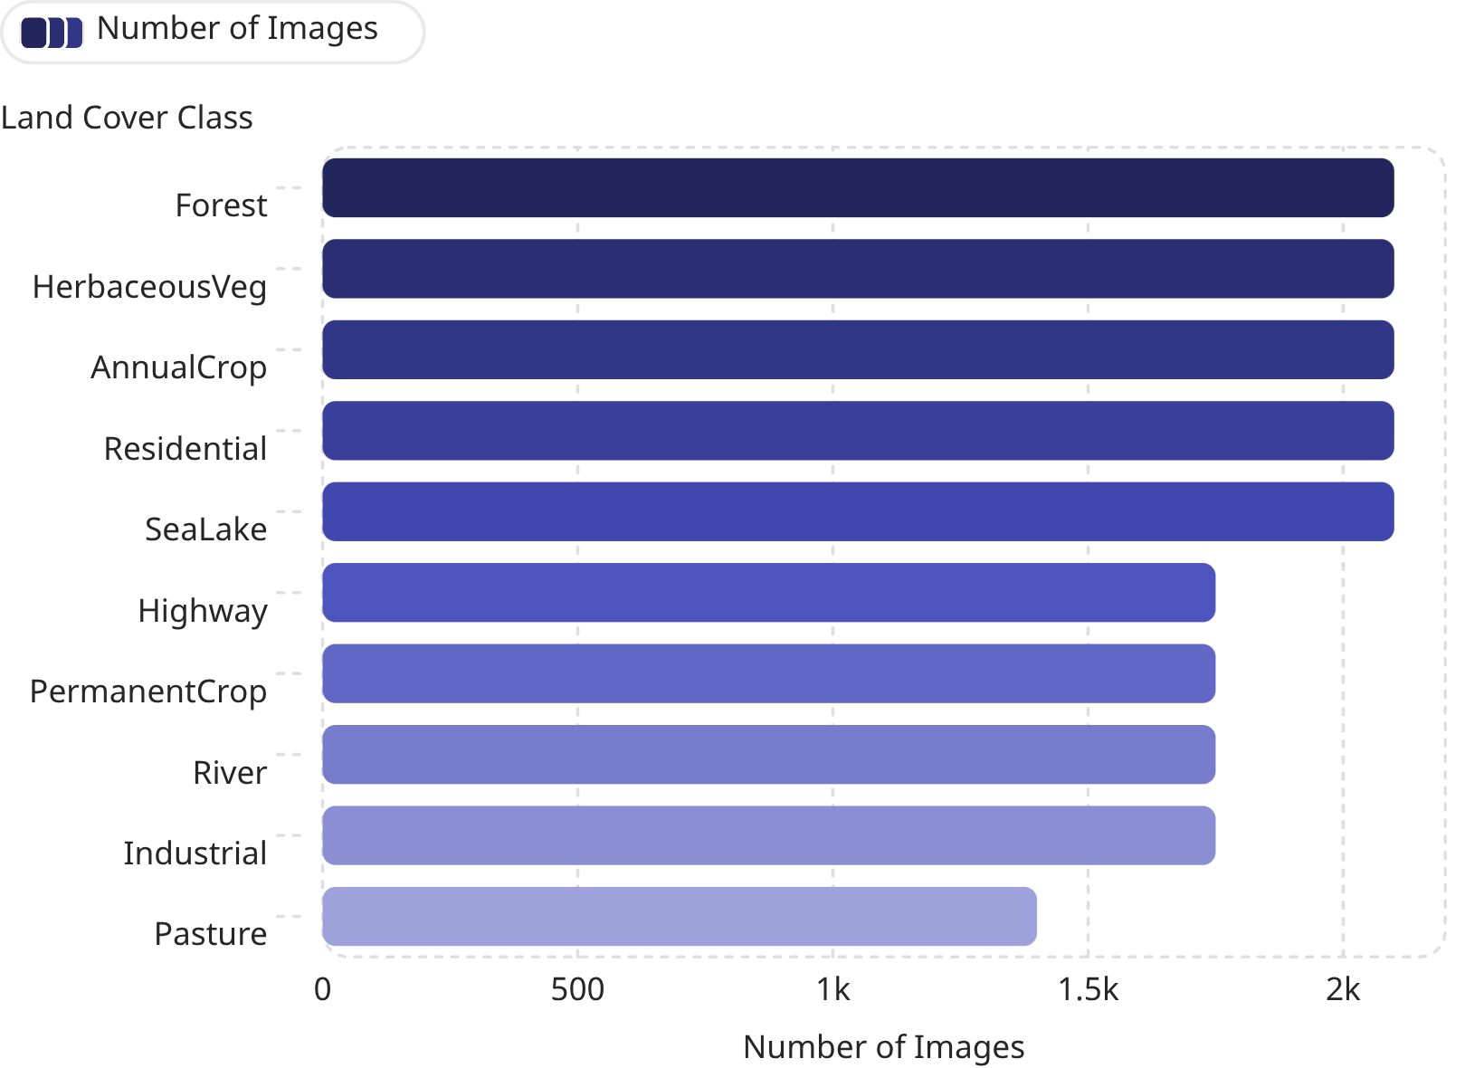

Exploratory Data Analysis
Key Findings
The dataset is nearly perfectly balanced across all 10 classes, minimizing class bias and ensuring reliable model training. Each class has roughly 1750 - 2400 samples, providing sufficient data for robust generalization.
Balanced datasets lead to fairer evaluation metrics and more trustworthy predictions across all land cover types.

Slide 5
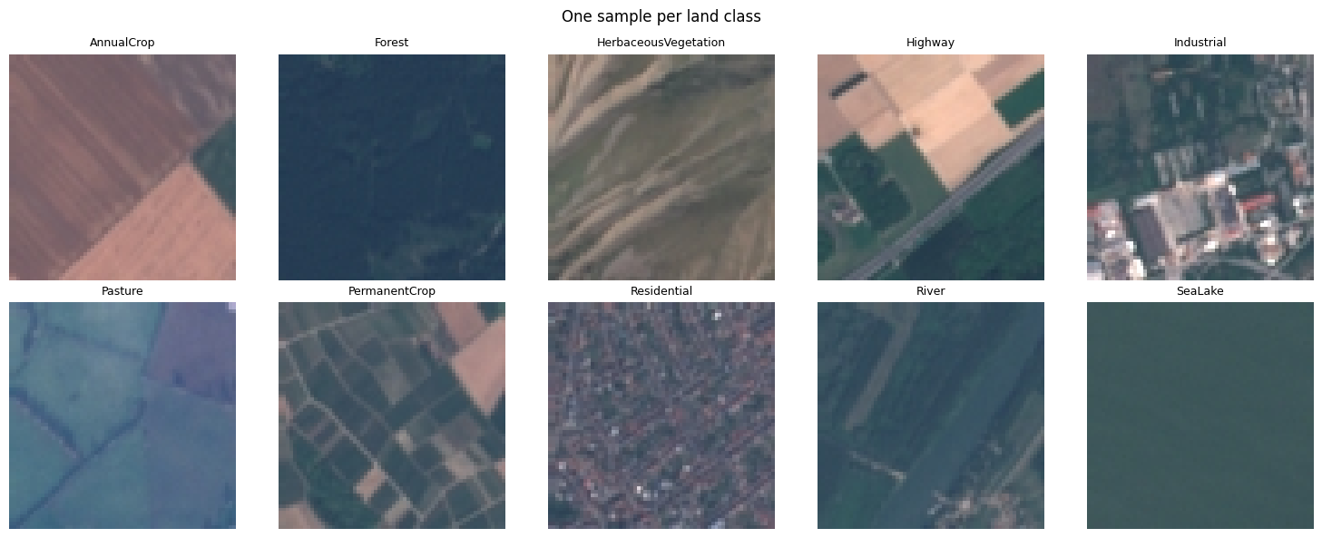
Samples:

Slide 6
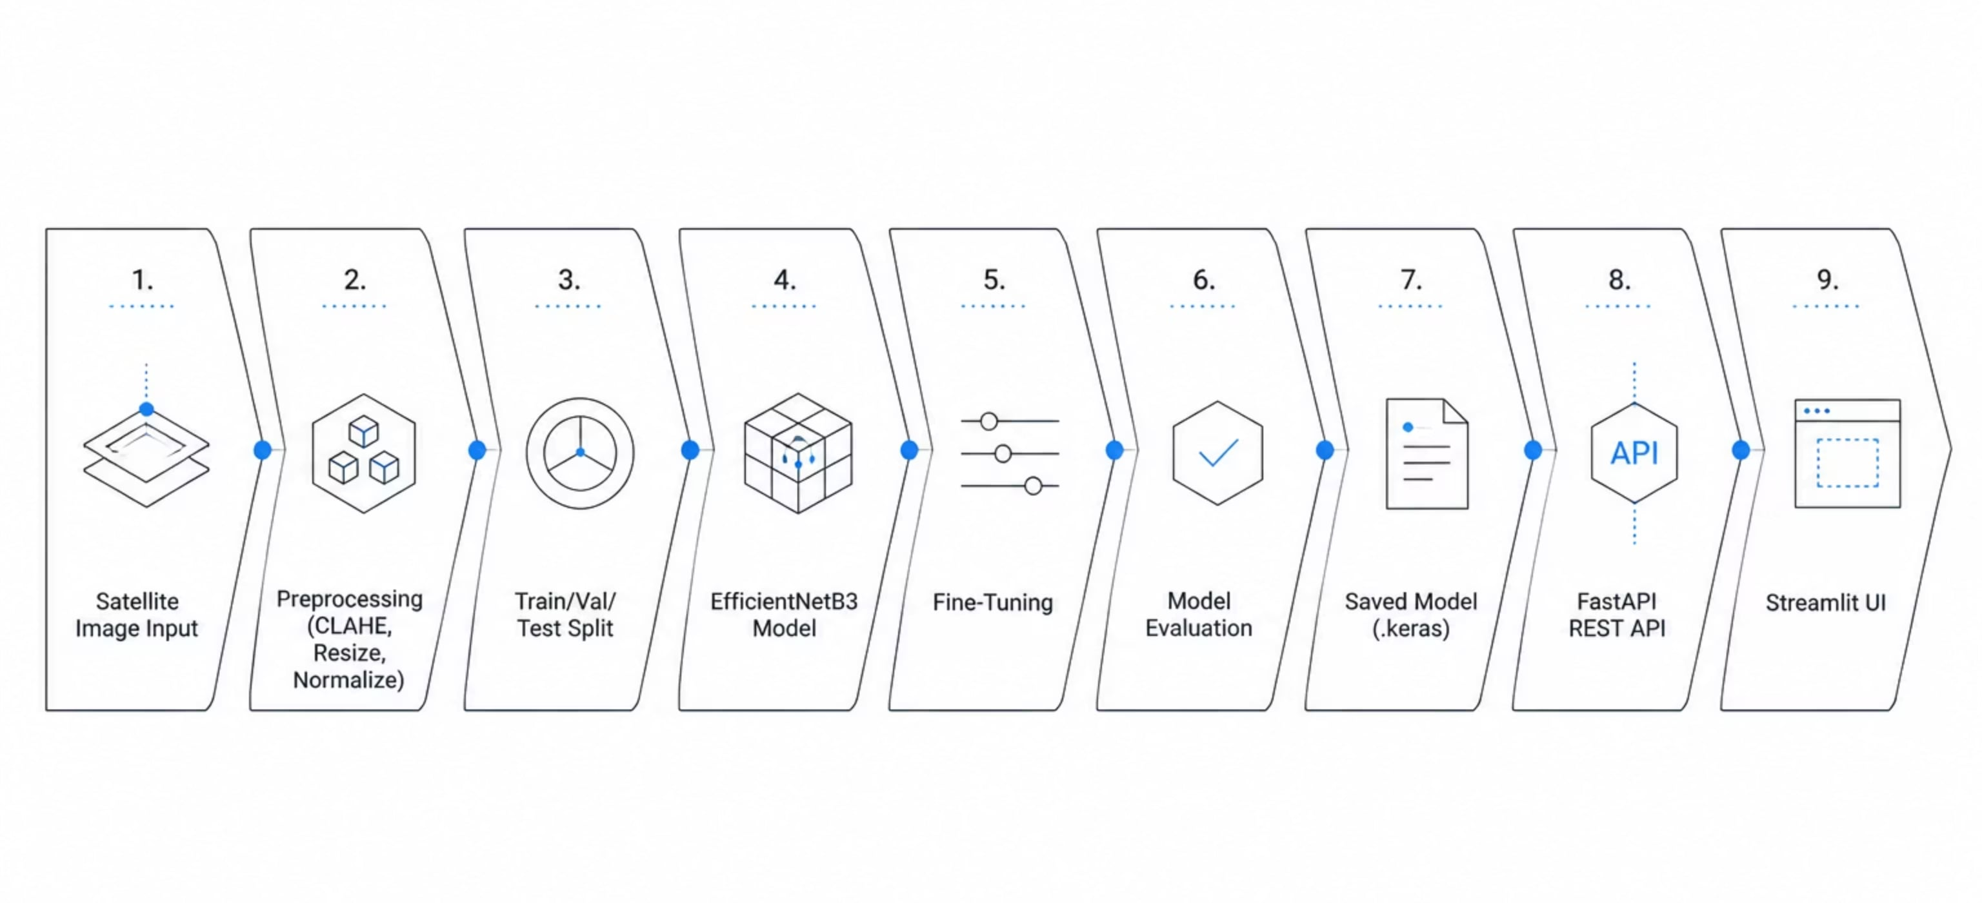
Project Pipeline

Slide 7
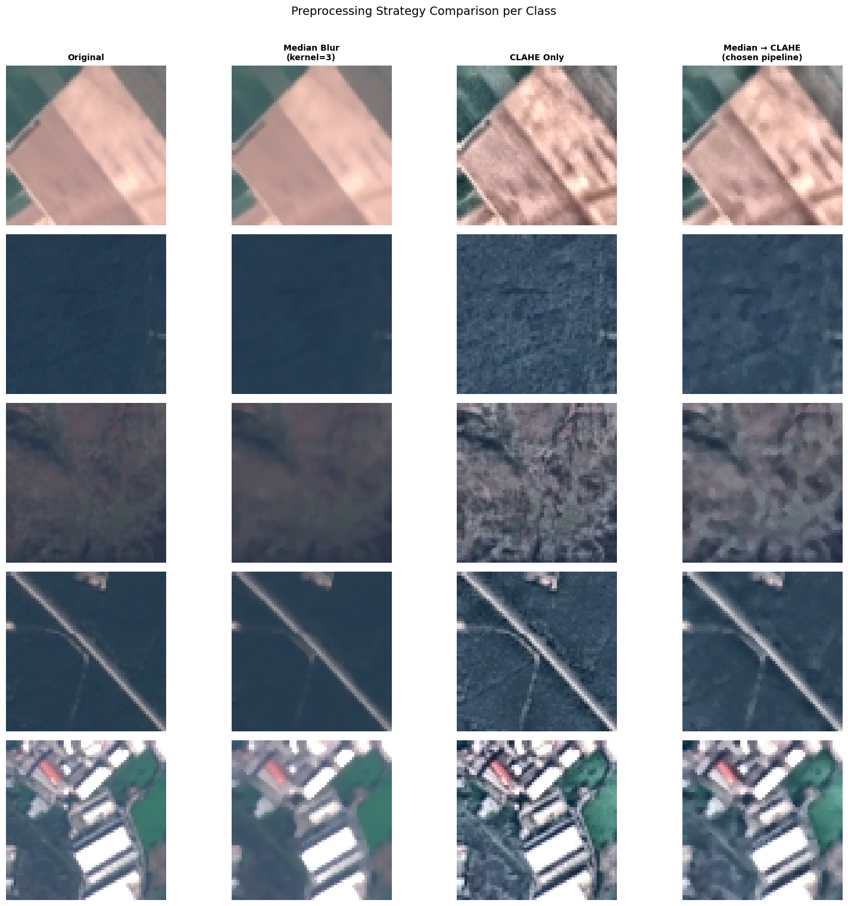

Data Preprocessing
Preprocessing Steps
Resize to 224×224
Median Blur for noise reduction
CLAHE Enhancement for contrast boost
Normalize pixel values
Augmentation: flip, brightness

Slide 8

Training Process
Training Configuration
Two-Phase Training Strategy
Model
Pretrained Model: EfficientNetB3
Optimizer
Adam with adaptive learning rate
Phase 1
Transfer
Phase 2
Fine-Tune
Callbacks
EarlyStopping + ReduceLROnPlateau
Freezing the base first preserves learned features; fine-tuning then adapts them to satellite imagery specifics.

Slide 9
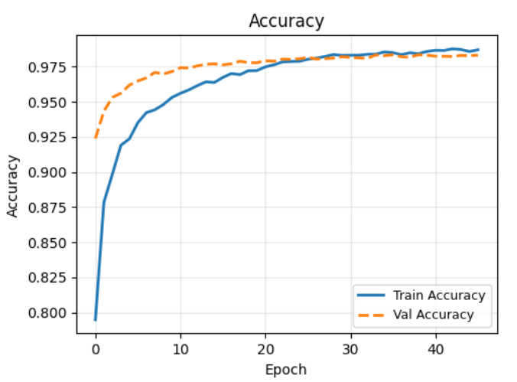
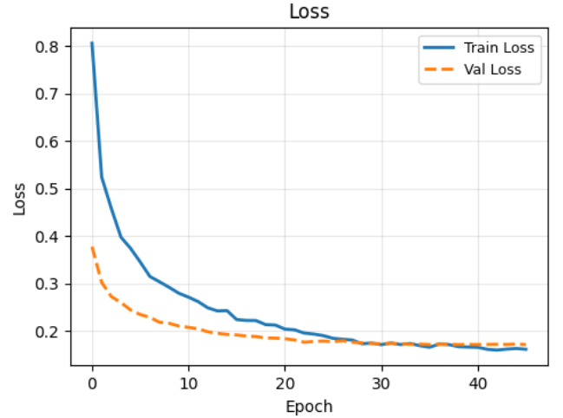
Evaluation Results
Final Test Accuracy: 98.2%
The model achieved near-perfect classification on the held-out test set. Accuracy and loss curves show clean convergence with no significant overfitting validation performance closely tracks training throughout.

Slide 10
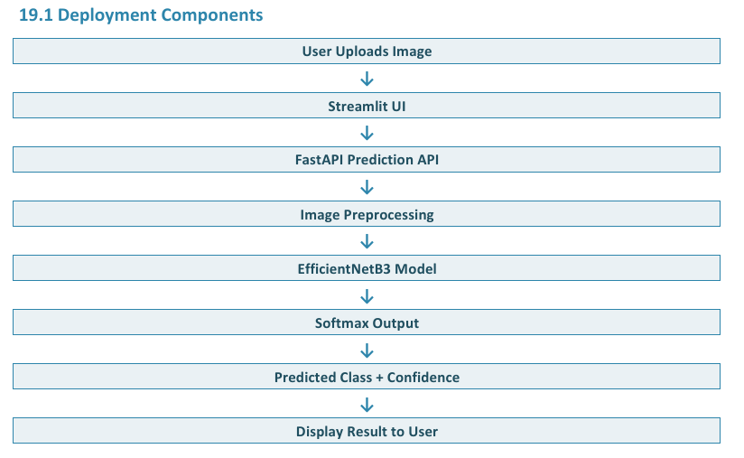
Deployment

