Slide 1

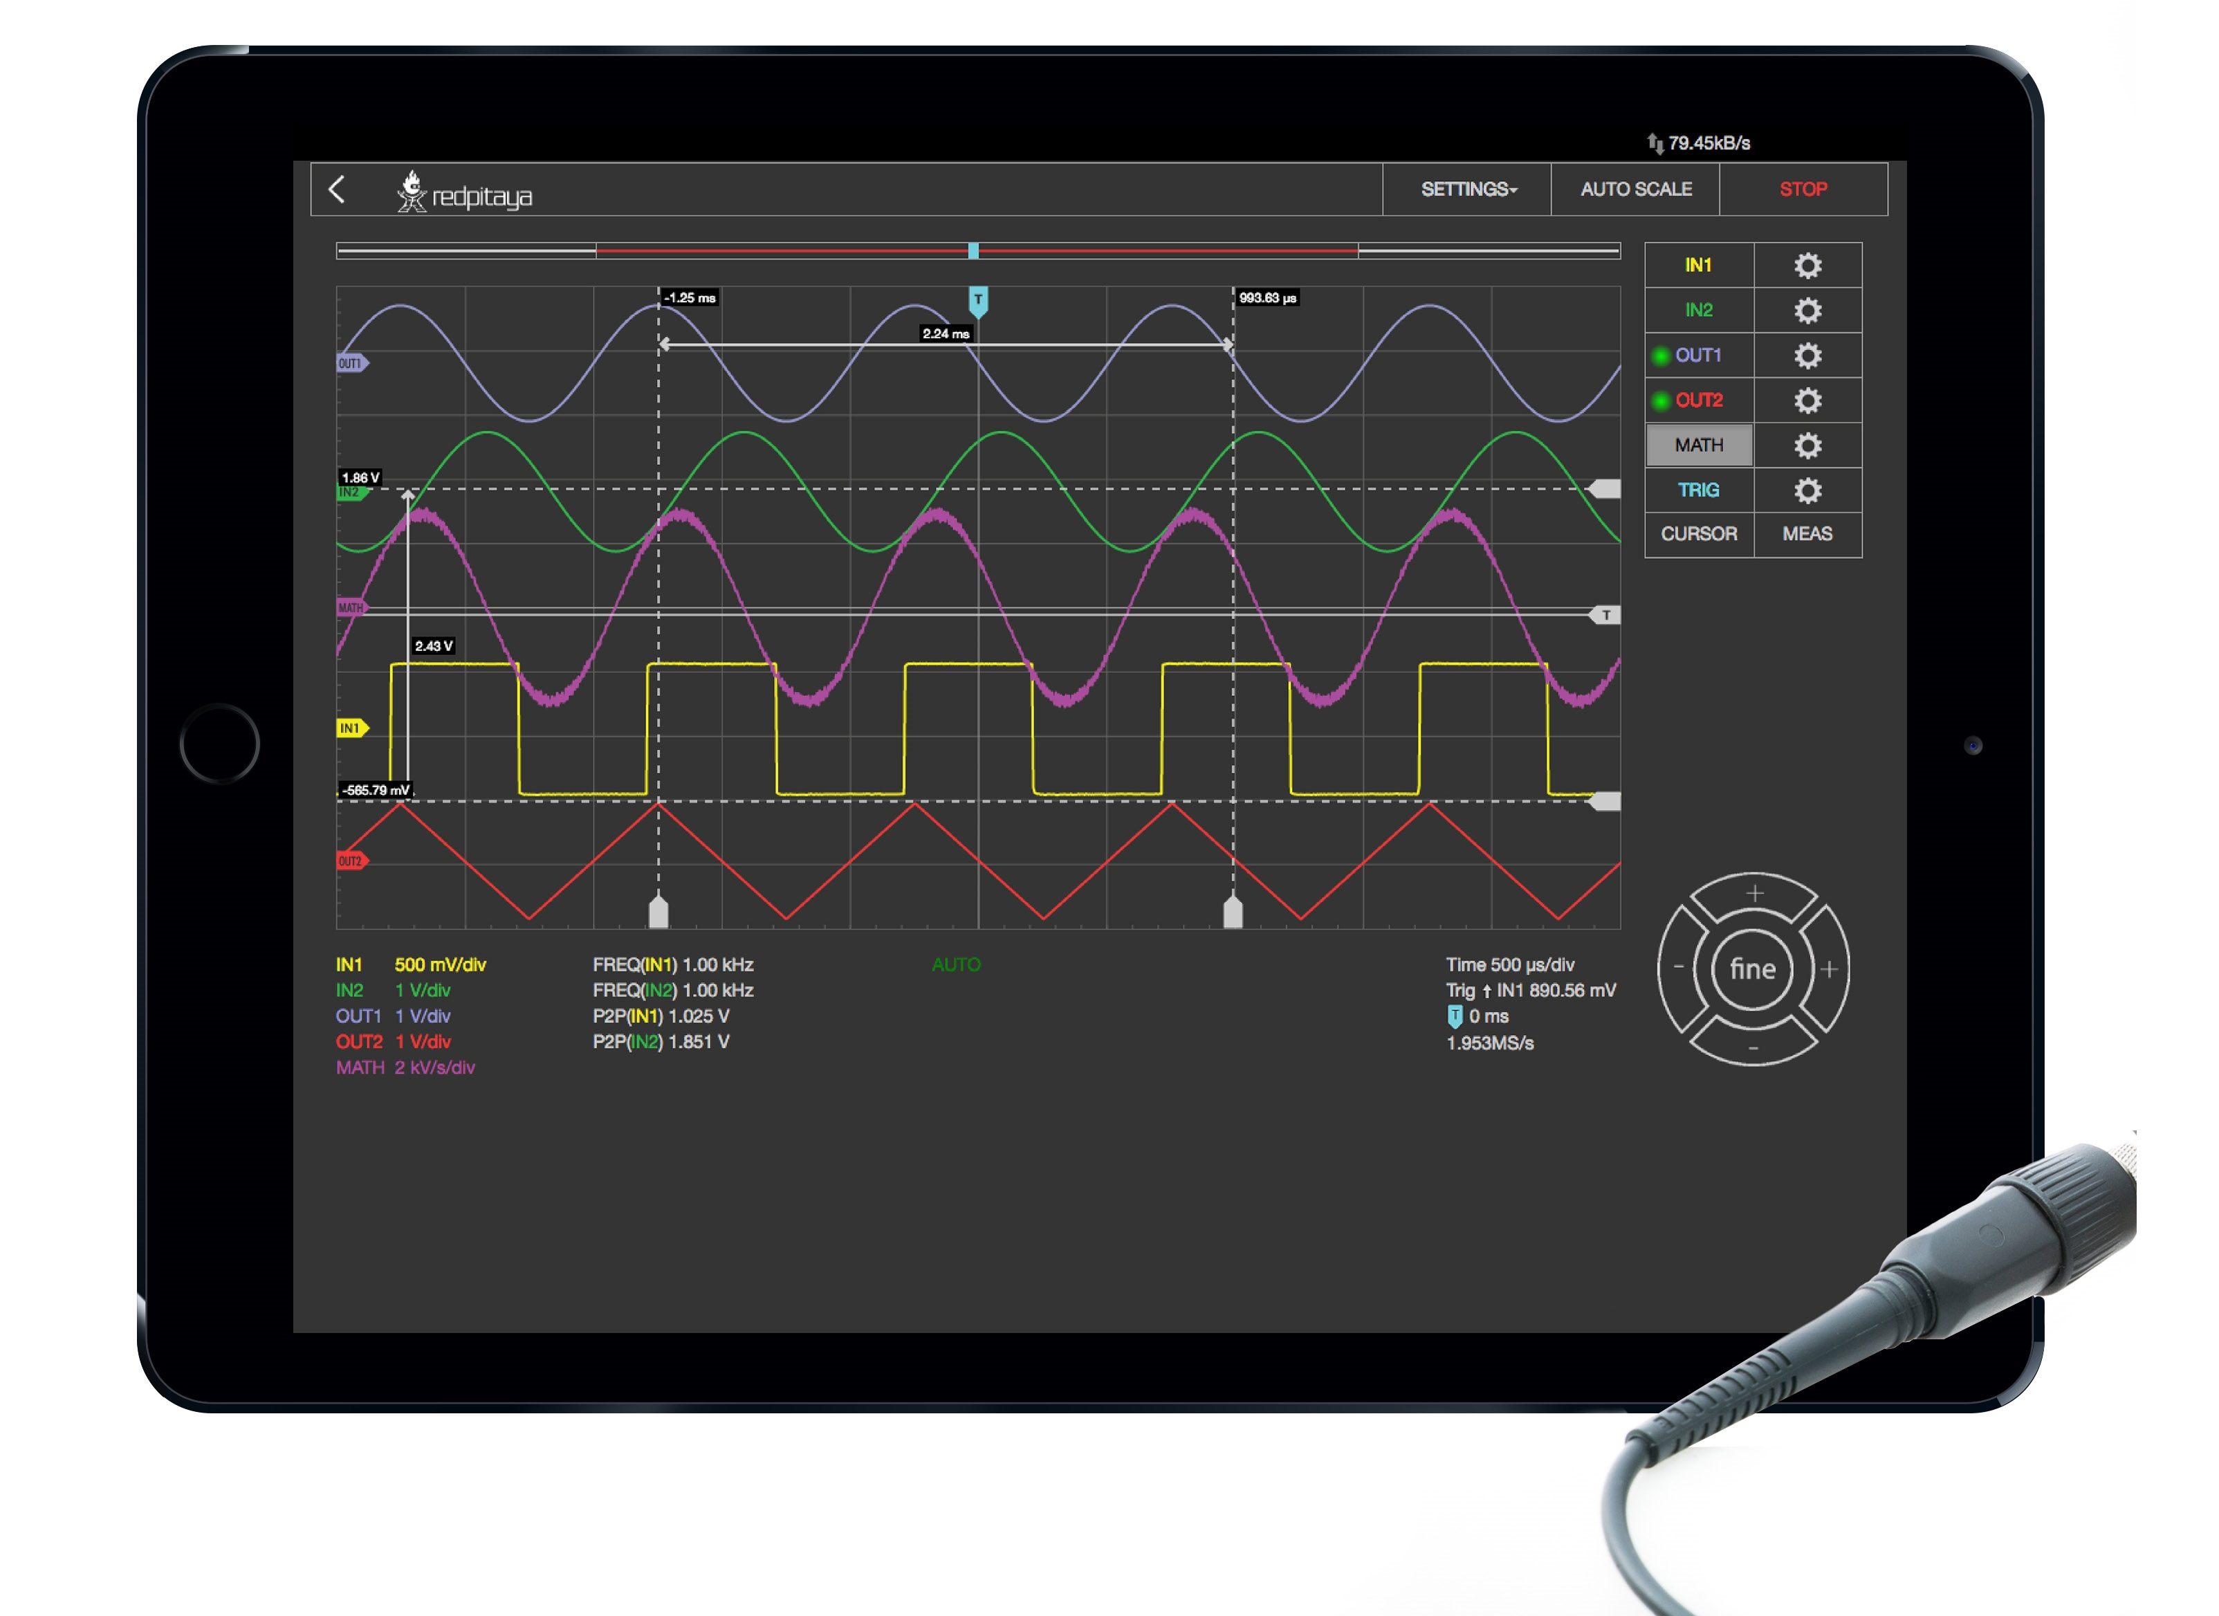
Project Name: Oscilloscope Project ID:
IMT_C20_D133
Presented to: IMT School A project by : Mohamed Hamdy Al-krkary

Slide 2
Oscilloscope
Project Challenges:
Building a system that allows the user to generate signals with different Frequency and different Duty cycle, and draws these signals and calculates the main signals parameters.
Use simple and affordable components to achieve the idea.
write readable and maintainable code, and follow the main coding guideline and basic static design.

Slide 3
Oscilloscope
Idea:
The project has two main parts:
1 Six Channel Oscilloscope that allows the user to select Time per Division and the used channel, to draws the input signal and calculates:
• Frequency
• Periodic Time
• (Minimum, Maximum and Average) Volt

Slide 4
Oscilloscope
2 Signal generator that can generate “32 software PWM signal” with different Frequency and different Duty cycle at the same time.
Although I can generate the signal using:
• “TMU” that refers to Time management unit
• “SOS” that refer to a small OS or non-preemptive scheduler

Slide 5
Oscilloscope
Hardware Components:
Oscilloscope:
• ATMEGA32
• LCD_TFT_ili9486
• Two Potentiometer “10k ohm”
Signal Generator :
• ATMEGA32
• LED

Slide 6
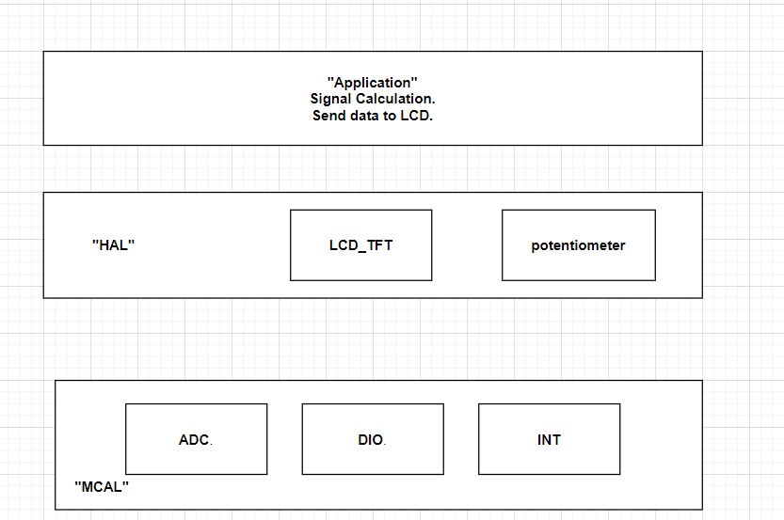
Oscilloscope
Oscilloscope Static design:

Slide 7
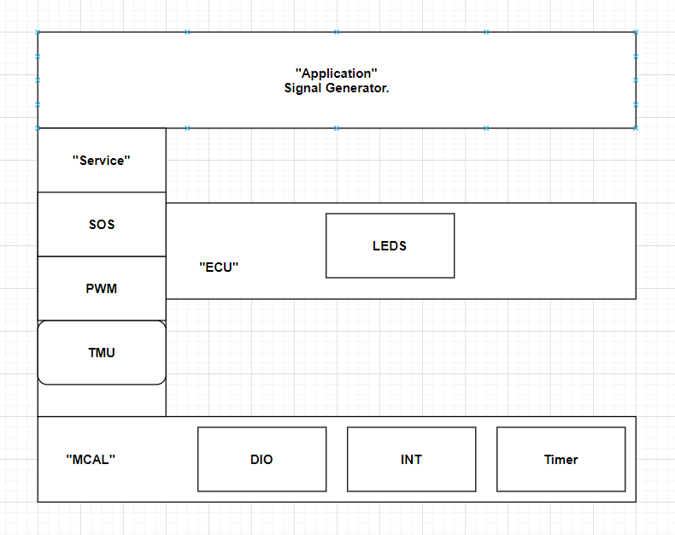
Oscilloscope
Signal generator Static design:

Slide 8
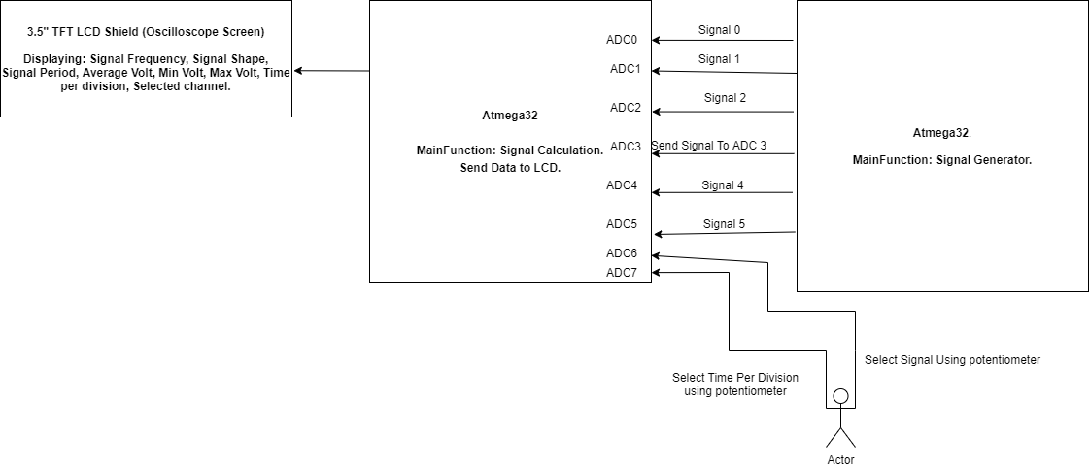
Oscilloscope
Block Diagram:

Slide 9
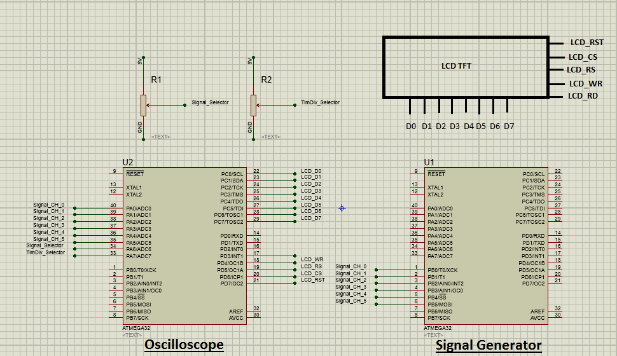
Oscilloscope
Schematic:

Slide 10
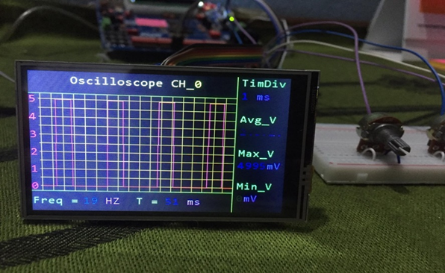
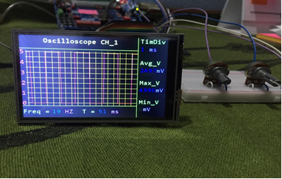
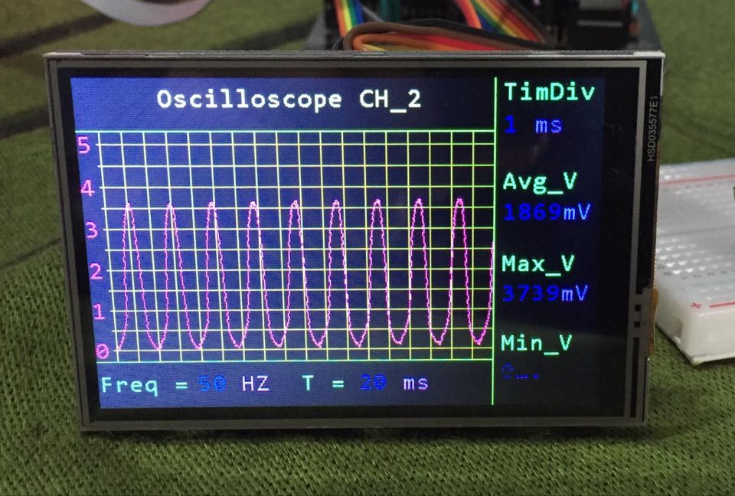
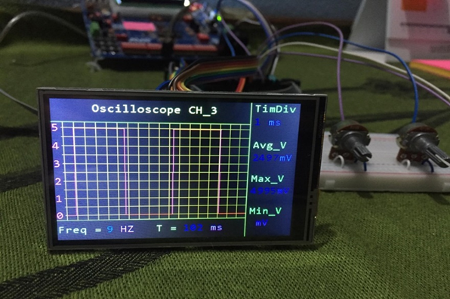
Oscilloscope
Some Output Pictures:

Slide 11
Oscilloscope
References:
Atmega32 datasheet
TFT ILI9486-ILITEK datasheet
https://www.displayfuture.com/Display/Introduction.asp

Slide 12
THANKS!
Any questions ?

