Slide 1
technical interview
Maxim Oweyssi

Slide 2
ABOUT me
Consultant and Data Analyst focusing on data storytelling, software development and problem-solving.
Experience with both private and government work in the UK.
Background in Theoretical Physics.
Passion for web app development and learning machine learning.

Slide 3
Problems
Task 1
Manipulating two dataframes in R to match required database format. Wrangling involves pivots, filtering, column operations.
Task 2
More wrangling two datasets together. Grouping data and creating summary statistics. Writing functional code and using the !! (bang-bang) notation. Plot two bar charts using ggplot2.
Task 3
Develop a simple Shiny app to swap the variables on the x-axis with a simple menu.
discussion
Extras and relevant work since last interview.

Slide 4
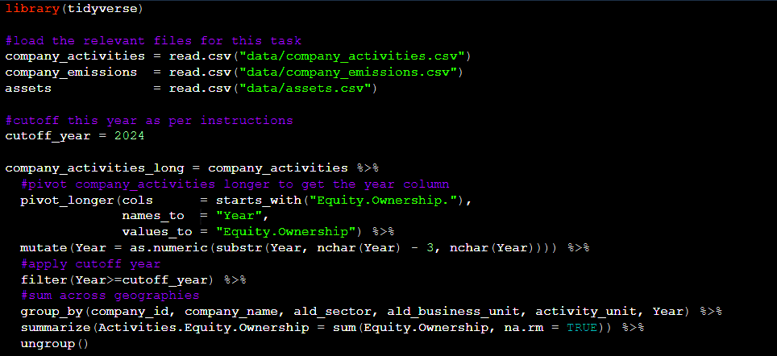
Task 1

Slide 5
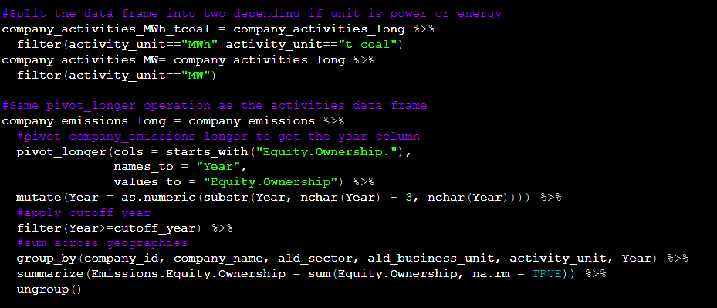
Task 1

Slide 6
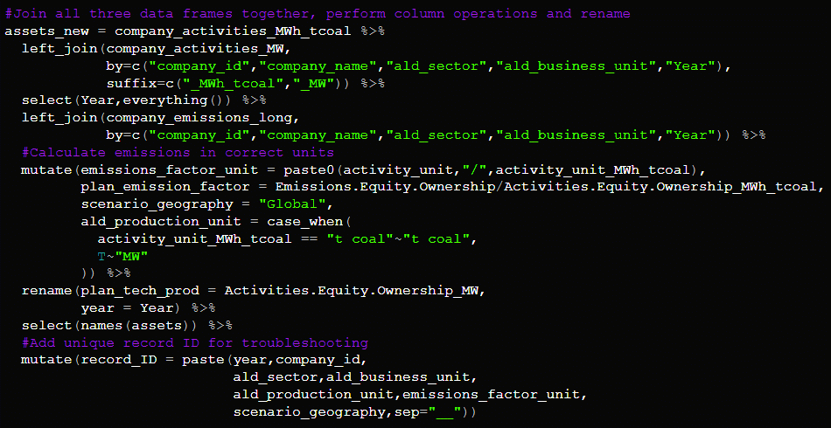
Task 1

Slide 7
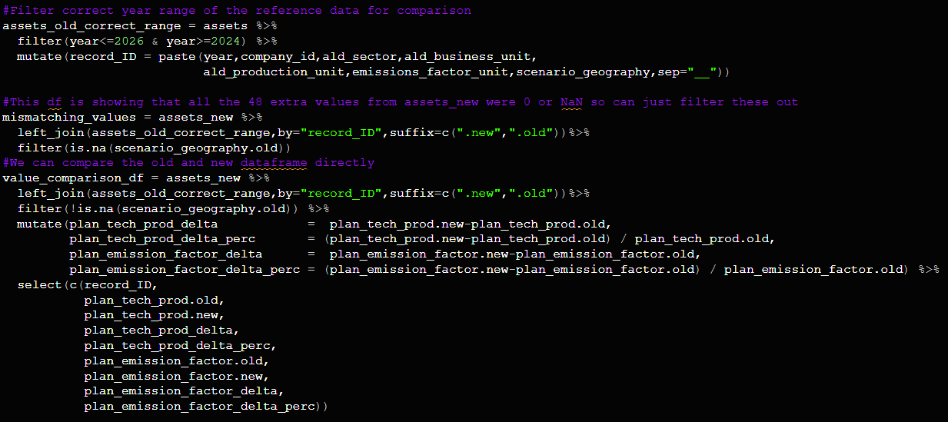
Troubleshooting

Slide 8
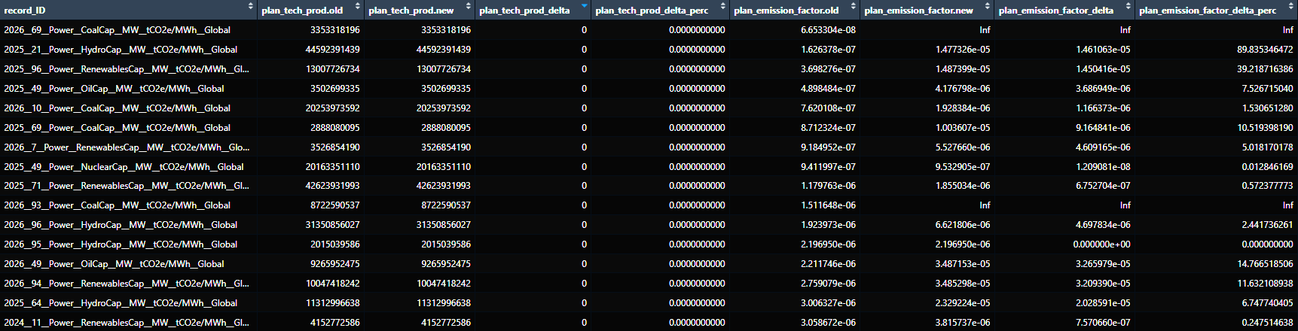
Evaluation

Slide 9
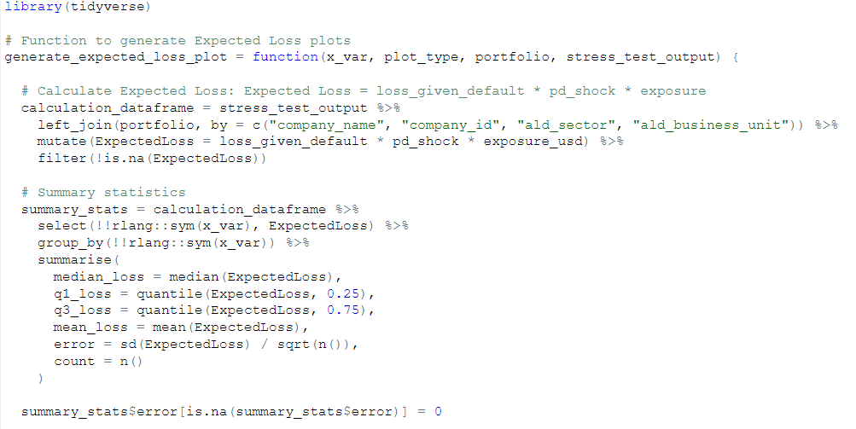
Task 2

Slide 10
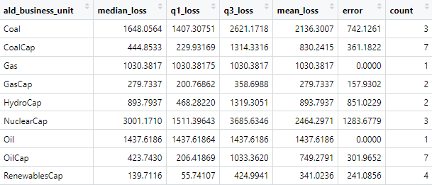
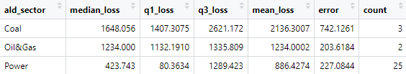
Task 2

Slide 11
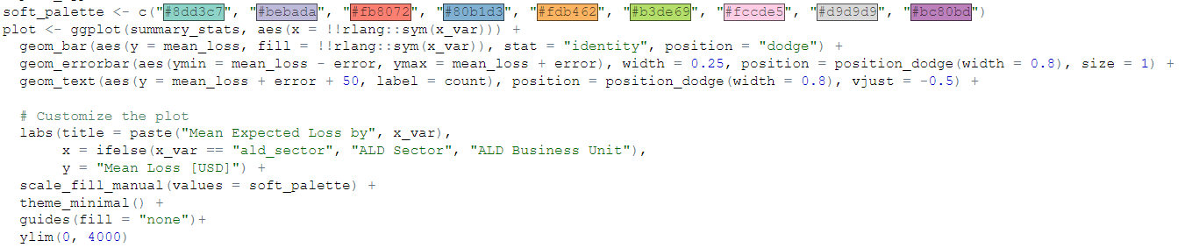
Task 2

Slide 12
Task 3
The shiny app

Slide 13
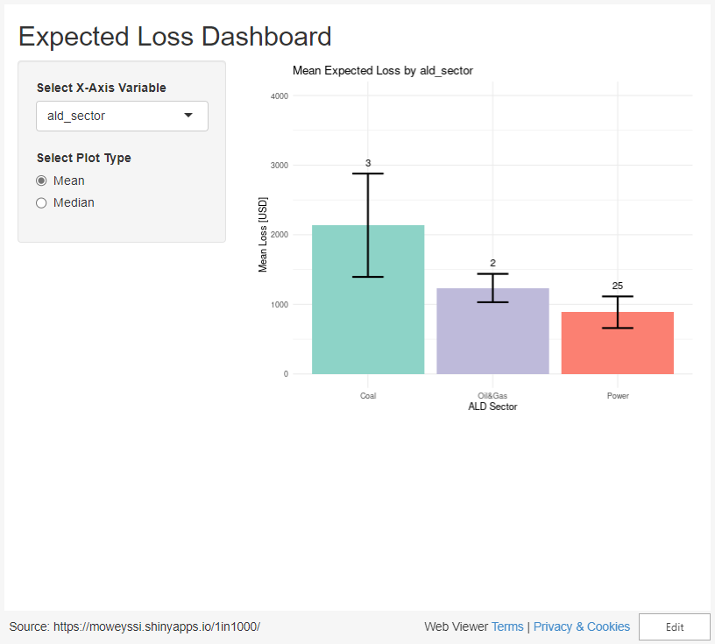

Slide 14
Task 3.5
The plotly upgrade

Slide 15
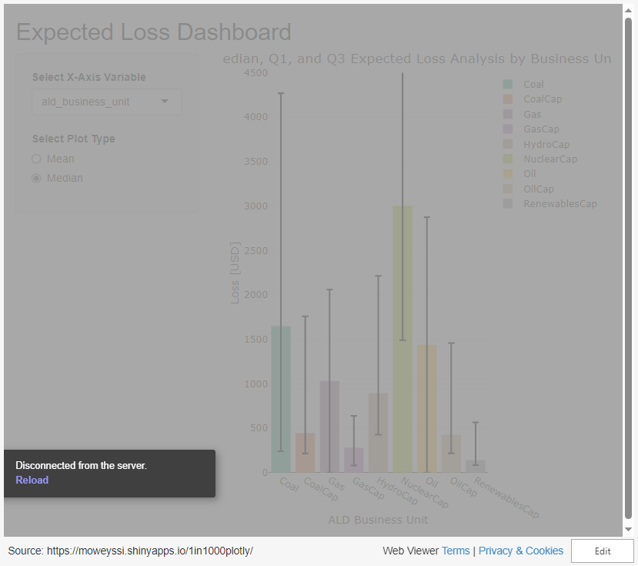

Slide 16
THANK YOU
Maxim Oweyssi​
+44 7340 066 589
maxim.oweyssi@gmail.com

Slide 17
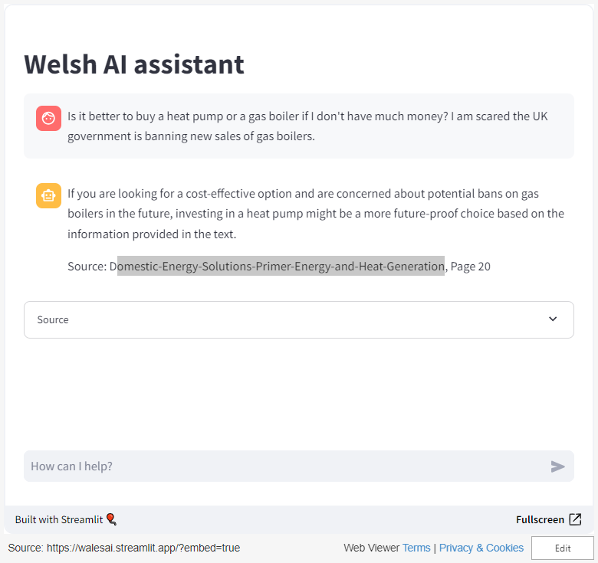
Explainable ai assistant

Slide 18
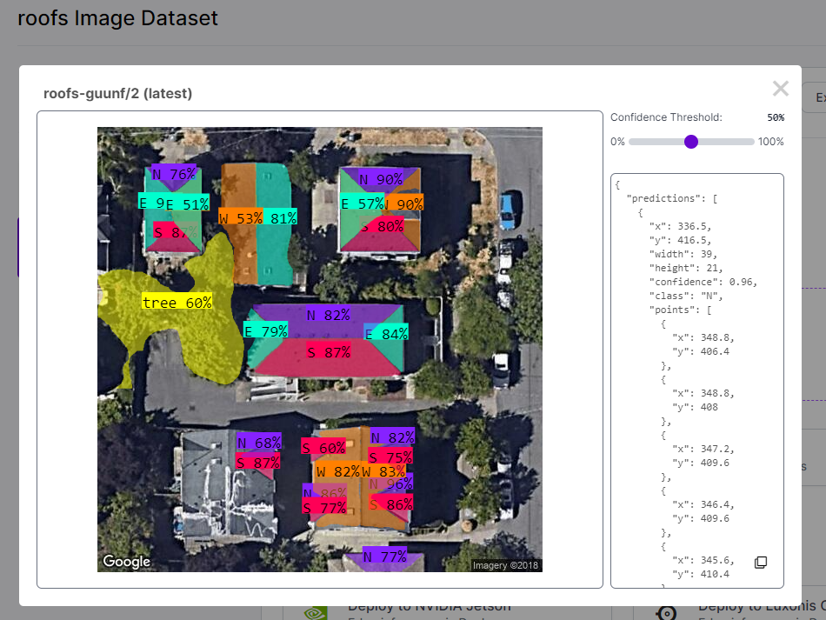
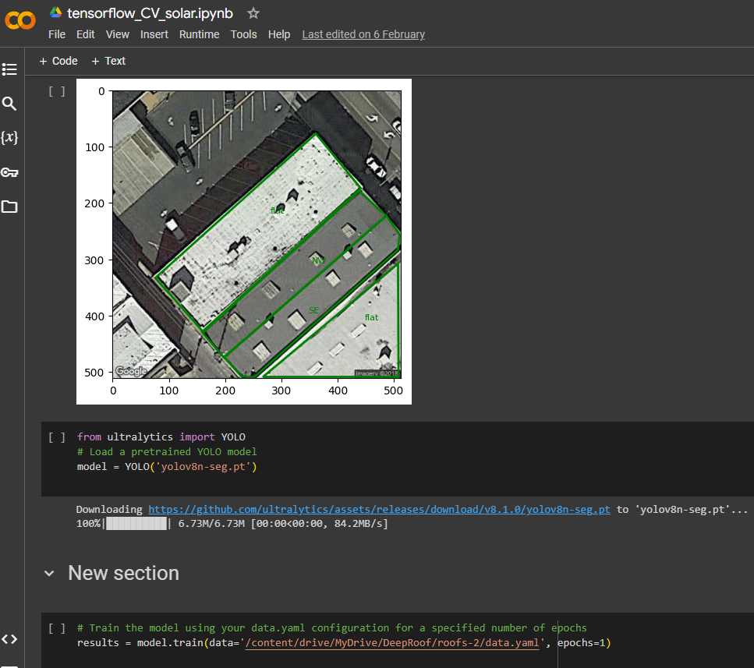
Computer vision & machine learning

