Slide 1
technical interview
Maxim Oweyssi

Slide 2
ABOUT me
Consultant and Data Analyst focusing on data storytelling, software development and problem-solving.
Experience with both private and government work in the UK.
Background in Theoretical Physics.
Passion for web app development and learning machine learning.

Slide 3
Problems
Task 1
Manipulating two data frames in R to match the required database format. Wrangling involves pivots, filtering and column operations.
Task 2
More wrangling two datasets together. Grouping data and creating summary statistics. Writing functional code and using the !! (bang-bang) notation. Plot two bar charts using ggplot2.
Task 3
Develop a simple Shiny app to swap the variables on the x-axis with a simple menu.
discussion
Questions and relevant work since the last interview.

Slide 4
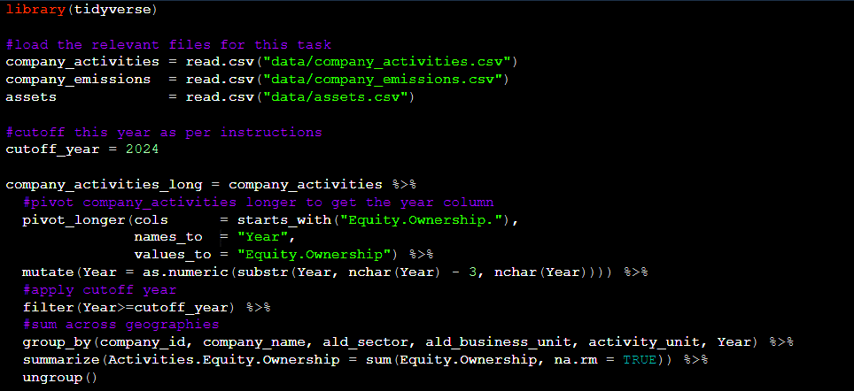
Task 1

Slide 5
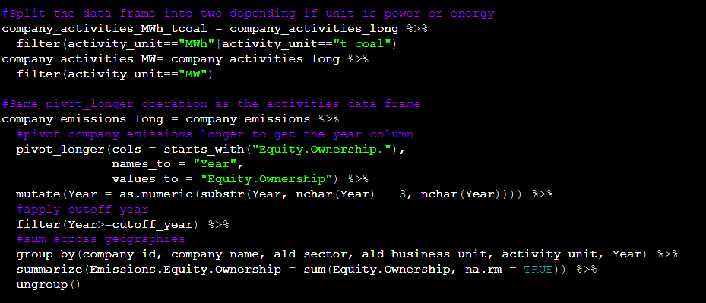
Task 1

Slide 6
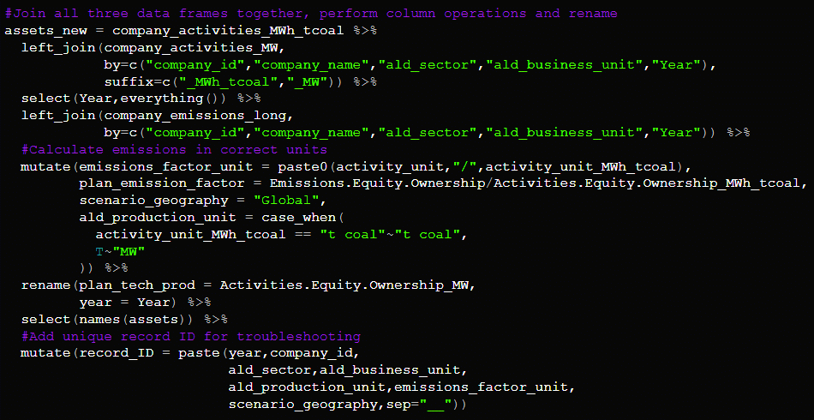
Task 1

Slide 7
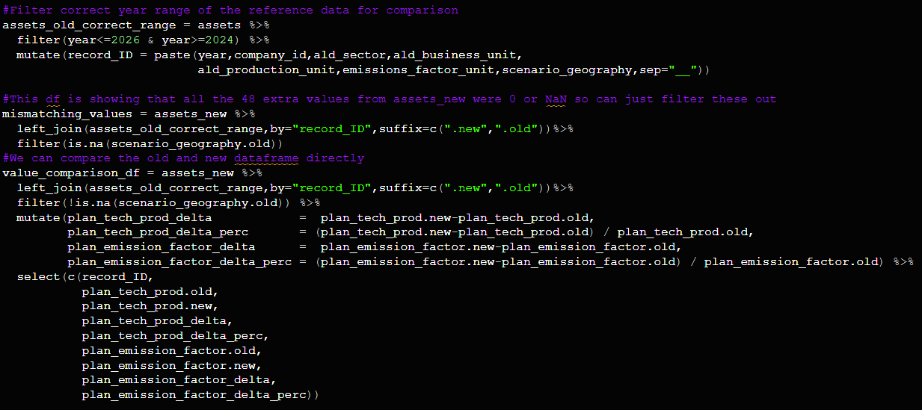
Troubleshooting

Slide 8
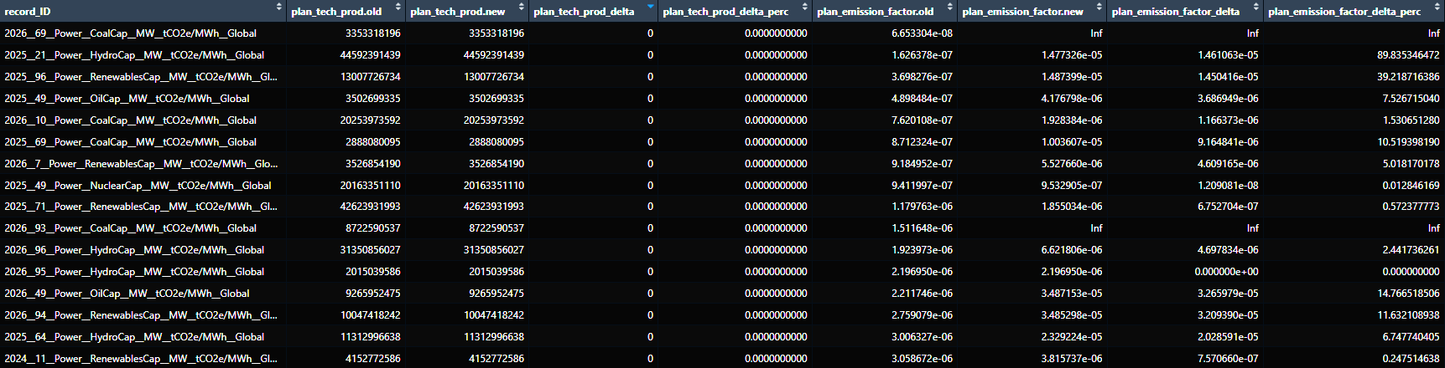
Evaluation

Slide 9
Task 2
Summary statistics

Slide 10
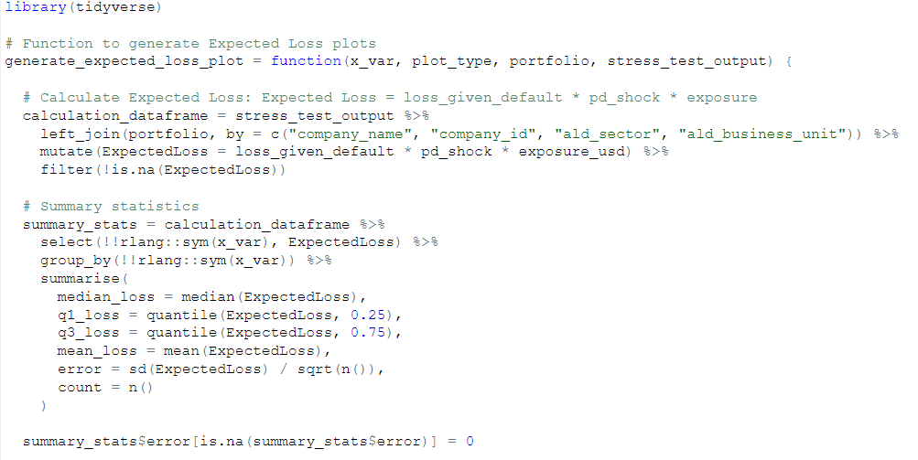
Task 2

Slide 11
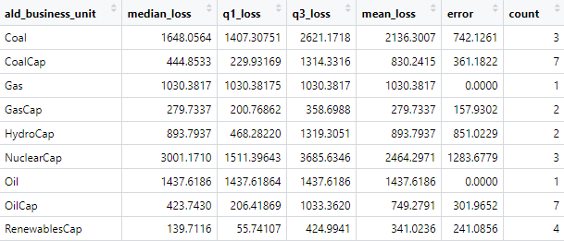
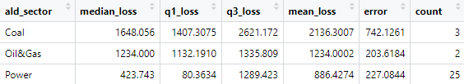
Task 2

Slide 12
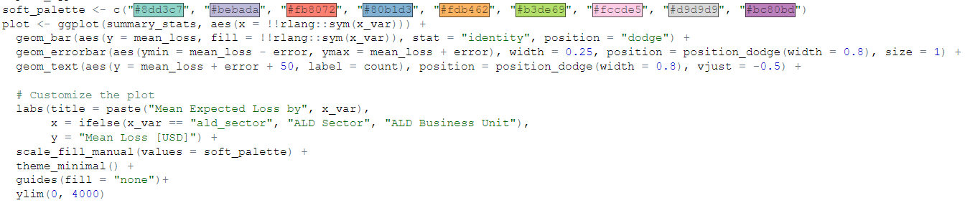
Task 2

Slide 13
Task 3
The shiny app

Slide 14
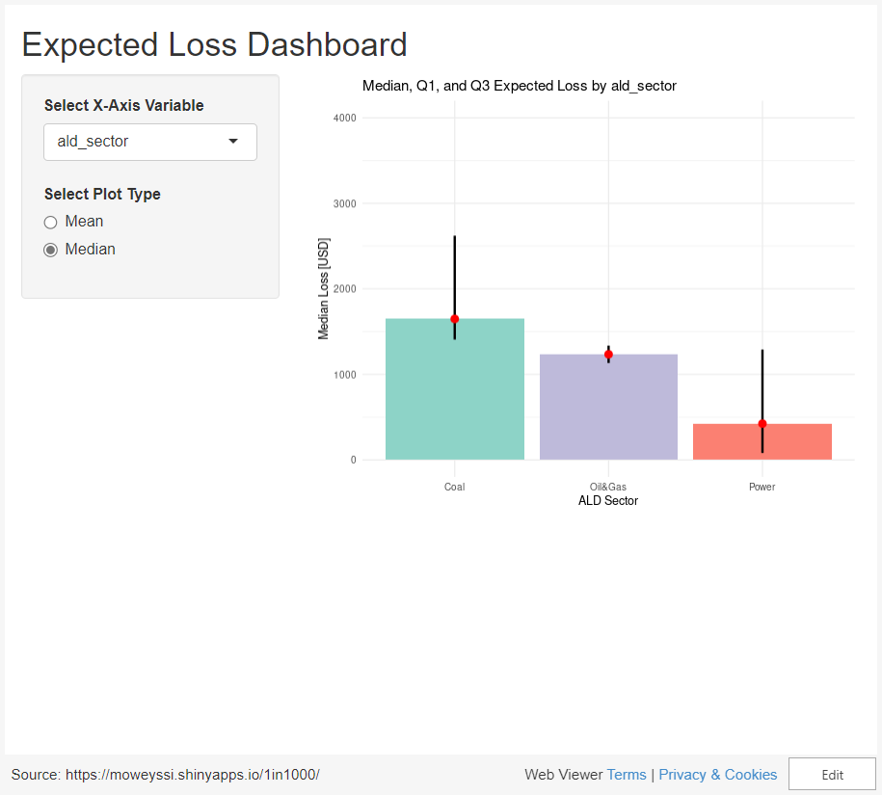

Slide 15
Task 3.5
The plotly upgrade

Slide 16
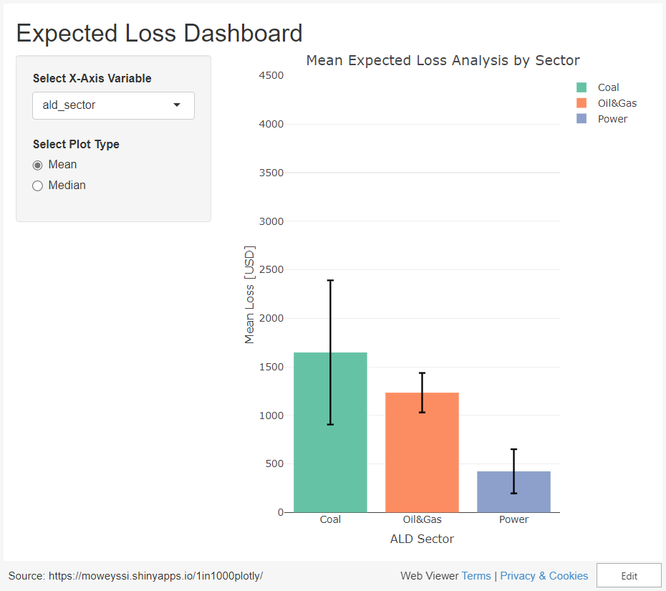

Slide 17
THANK YOU
Maxim Oweyssi​
+44 7340 066 589
maxim.oweyssi@gmail.com
https://github.com/moweyssi/1in1000

Slide 18
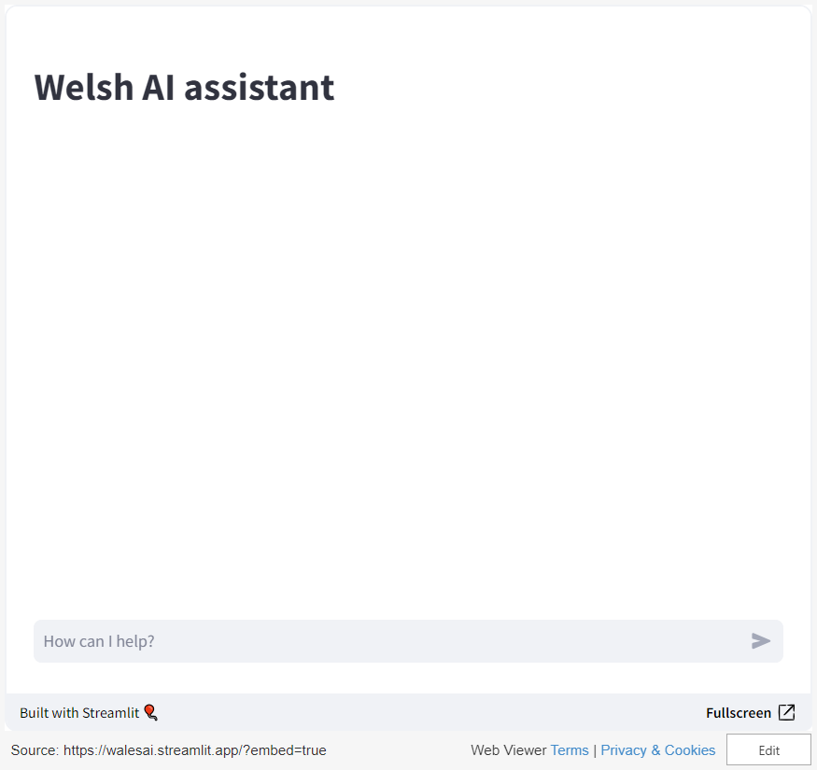
Explainable ai assistant

Slide 19
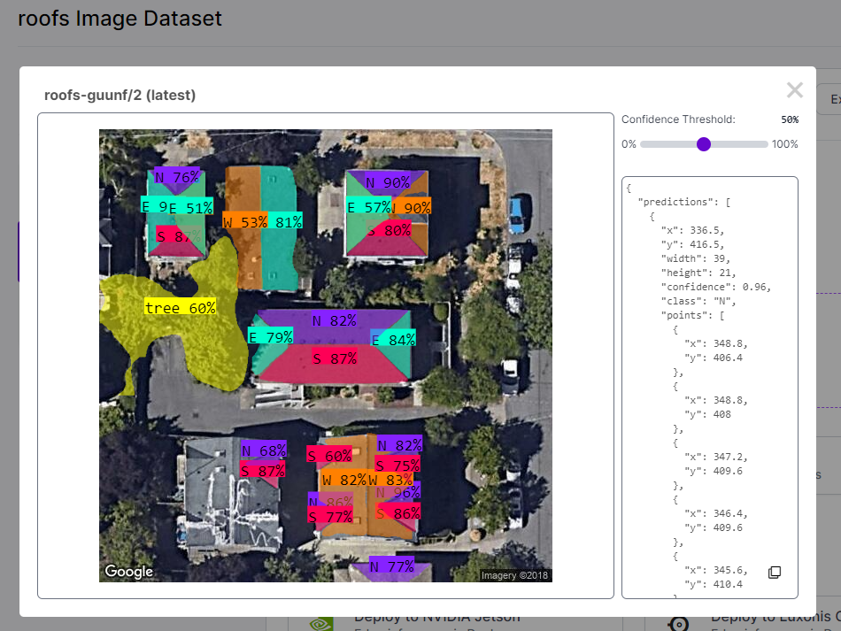
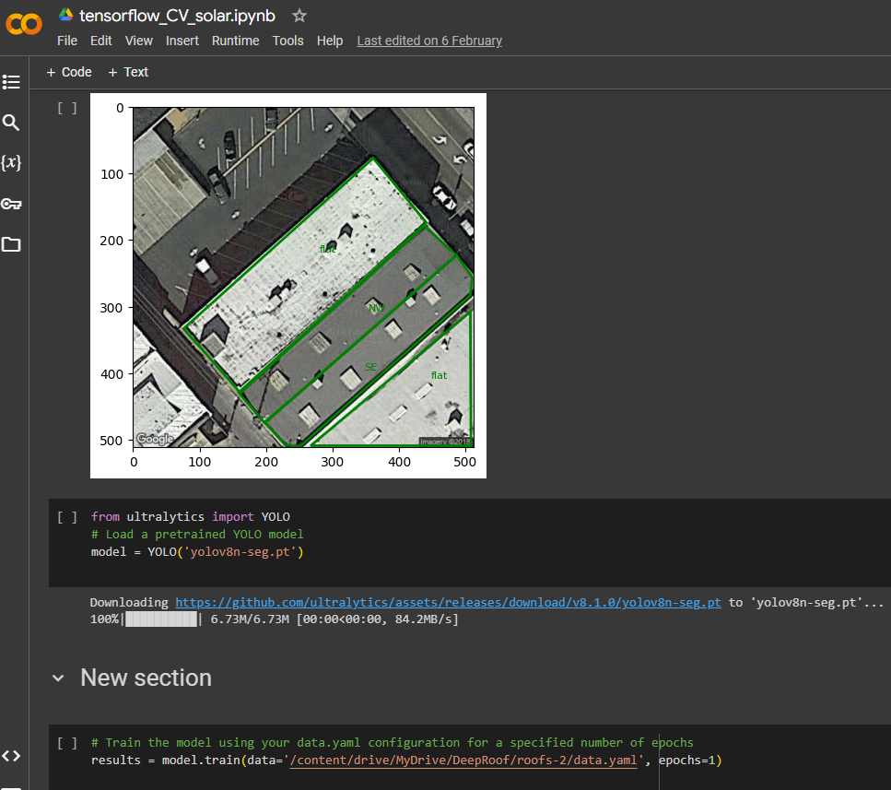
Computer vision & machine learning

