Slide 1
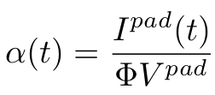
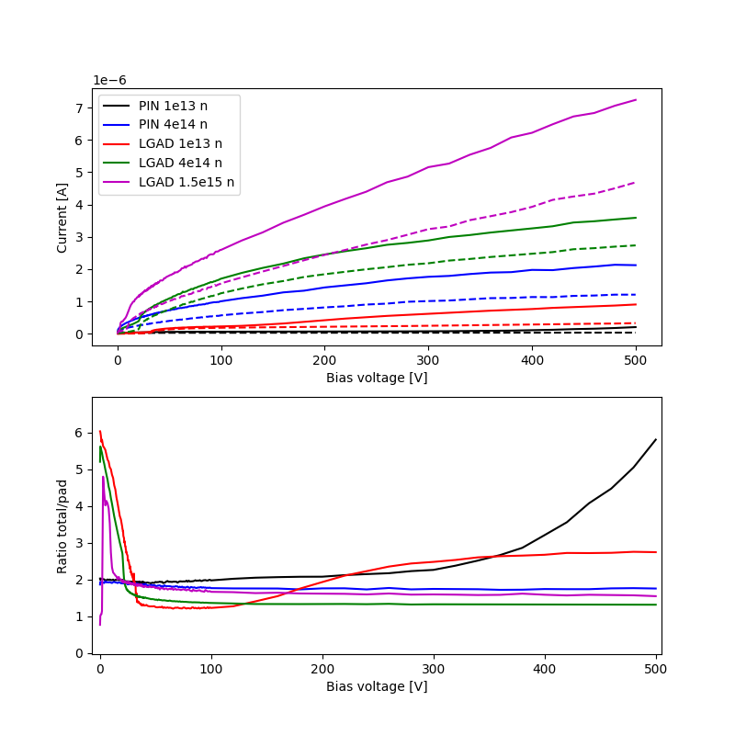
The Problem
Goal: Calculate α(t) for irradiated LGADs for different annealing times → Deviation from theory?
Pad and guard ring current were only measured after irradiation+80min annealing
Only the total current (floating guard ring) was measured after further annealing
Is it possible to correct for the guard ring contribution?

Slide 2
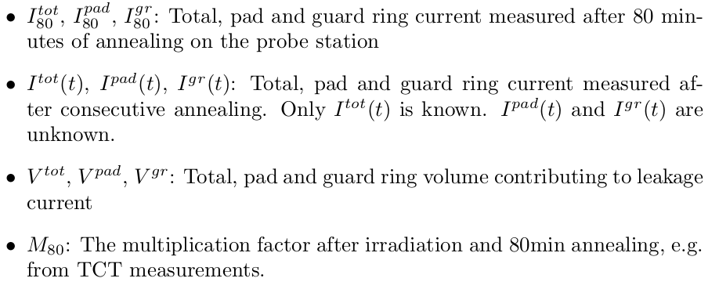
Variables

Slide 3
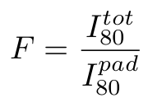
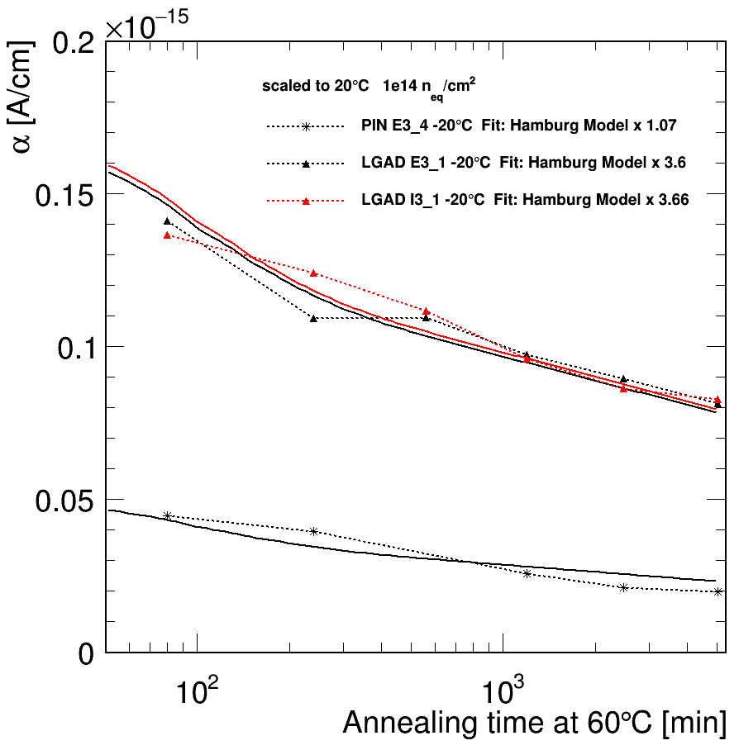
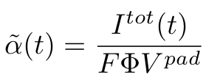
Approach I
- Current measurement (-20C) scaled to +20C.
- Hamburg Model multiplied with LGAD gain
→ good agreement
Define:
Calculate
Assumption: F is constant throughout annealing.
Not true, if e.g. gain layer is affected differently than bulk

Slide 4
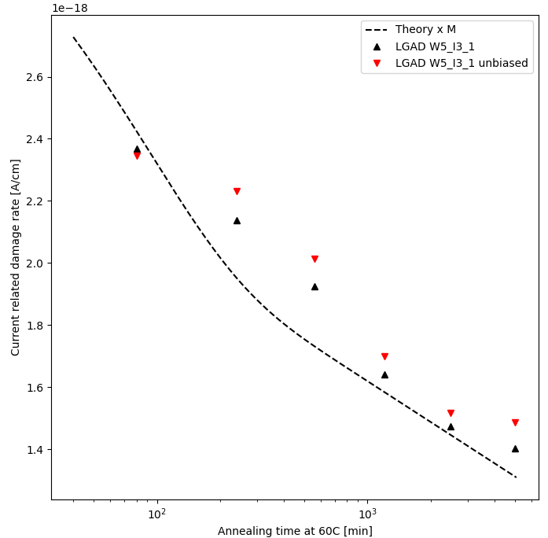


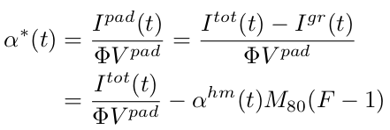
Approach II
Assumption 1: Currents are bulk generated, only pad current is multiplied and volumes are constant:
Assumption 2: Guard ring current follows
Calculate
overestimated current from pad volume with unknown annealing behavior
correction for guard ring current with ‘known’ annealing behavior
Theory (Hamburg model) scaled to -20C and multiplied with LGAD gain
→ different values than on previous slide
black marker: Approach I (previous slide)
red marker: Approach II (this slide)
→ good agreement between different approaches

Slide 5
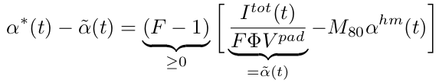
Difference between I and II
Approach II – Approach I:
This is unlikely
If approach I is in agreement with theory, approach II gives the same results, which makes sense
Conclusions:
- Deviations from theory might be better visible with approach II (see prev. slide),
even more so for large F (small pad current compared to total current)
But approach II depends on M and α^{hm}
- One should always connect the guard ring
- ROOT makes nicer plots than Python

