Slide 1

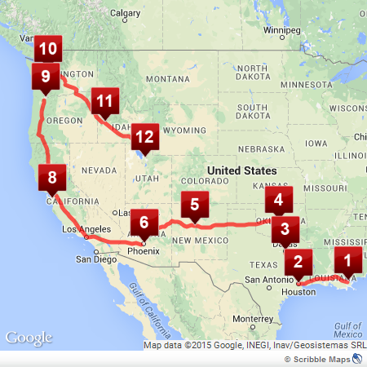
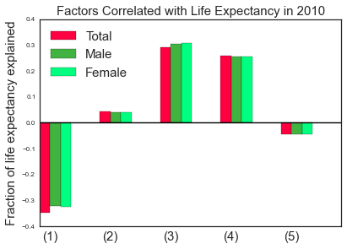
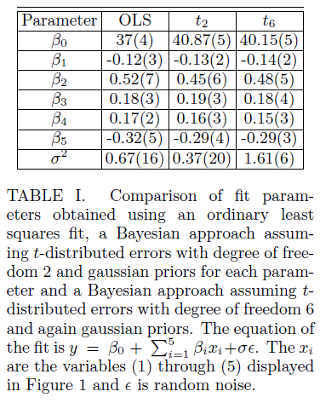
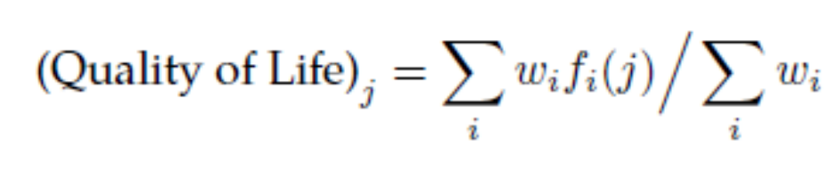

Predicting Mortality and Solving the Traveling Post-Graduate Problem
Rodrick Kuate and Mobolaji Williams
rkuatedefo@fas.harvard.edu, mwilliams@physics.harvard.edu
AM207 – Stochastic Optimization
Spring 2015
For this project we used a Bayesian analysis to predict the life expectancy of individuals living in various countries and we used the classical simulated annealing algorithm to solve the “traveling post-graduate problem” (a stylized combination of the classic traveling salesman and knapsack problems).
Introduction
Our project came in two parts. First ,we sought to determine the factors which influence life expectancy and the degree to which they do so. After having determined the dominant factors, we optimized the fit for predictive power using a Bayesian analysis.
For the next part we posited the following scenario. Say you just graduated from college and after years of internships and working semester-jobs you have saved enough money to spend a year traveling to various countries. You want to know which countries to travel to in order to maximize the total “Quality of Experience” of the entire trip while ensuring you remain within budget.
Finding such a travel route involves simultaneously solving variants of the knapsack problem and the traveling salesman. The combination of these two problems can be solved with combinatorial optimization techniques.
blah blah blah
Data
For the traveling PG, the results are the customizable trips which are defined according to the value system of the traveler. An example out put of such a trip with distinct starting and ending points is shown below.
Our main data files were drawn from data.worldbank.com and consisted of factors we could roughly define as quality of life statistics (e.g., percent of internet users in a country, per capita spending on health care, etc.) These quality of life factors formed the collection of independent variables with which we defined our life expectancy model.
From numbeo.com, we collected other “coarse-grained” statistics on quality of life. We used these statistics to rank various countries according to the quality of life they provide to a person with a particular value system.
Figure 2. Sample Road Trip with Differing Starting and Ending Points
Approach
Results
Discussion/Conclusions
Bayesian Life Expectancy Analysis: The first part of this analysis was to determine which factors combined to explain the greatest portion of the trend in life expectancy. We looked at 57 different factors and used simulated annealing with the (negative) coefficient of multiple correlation as the energy. After determining the factors, a Bayesian analysis was used to optimize the predictive power of a multilinear fit.
Traveling Post-Graduate (TPG) w/Simulated Annealing: The traveling post graduate problem was treated as a combination of the knapsack problem and the traveling salesman problem. We imagined we had a post graduate who wanted to travel to a dozen countries over the span of the year, and the post-graduate wanted to maximize her quality of life in each place while minimizing the costs of living in and traveling to the places she visited.
The quality of life of being in each place the post-graduate visited was determined by computing a weighted sum of the contributing factors like crime or affordability of goods.
The weights were defined by how much value the post-graduate placed on each factor. For example, a post graduate who placed a higher weight on safety may net a different quality of life in one country than one who placed a higher weight on quality health care.
For the first part of this project we used simulated annealing to determine which factors best explained the trend in total life expectancy. We next used a Bayesian analysis to optimize the multilinear fit for predictive power. We found that rather than being optimized for a t distribution of the noise with degree of freedom 6, the fit was optimized for a t distribution of the noise with degree of freedom 2.
In this project we also used basic simulated annealing techniques to plan the route a post-graduate may take for a year long road trip. The simulated annealing implementation was sufficiently basic as to be easy to implement. As an extension to the analysis, and for the final report we would like to employ the generalized simulated annealing algorithm developed by Tsallis and Strialo to this problem.
Poverty headcount ratio at $1.25 a day (PPP) (% of population)
Employment to population ratio, 15+, total (%)
Internet users (per 100 people)
Literacy rate, youth female (% of females ages 15-24)
Labor force participation rate, female (% of female population ages 15+)
Figure 1. Relative weights of the five most important factors in explaining life expectancy, of those factors examined. Negative bars indicate that the factor is negatively correlated with life expectancy while positive bars indicate the opposite.
Citations and Links
“OECD Better Life Index.“ http://www.oecdbetterlifeindex.org/, 2015. [Online; accessed 10-April-2015].
“World Bank Data." http://data.worldbank.org/, 2015. [Online; accessed 10-April-2015].
“The Lottery of Life." http://www.economist.com/news/21566430-where-be-born-2013-lottery-life, 2015. [Online; accessed 10-April-2015].
School of Engineering and Applied Sciences • Institute for Applied Computational Science

