Slide 1
THREAD
Thread is a light weight ,independent unit of execution with in a program

Slide 2
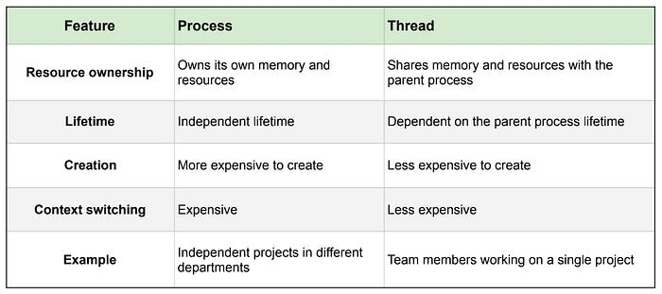
Difference between process and thread

Slide 3
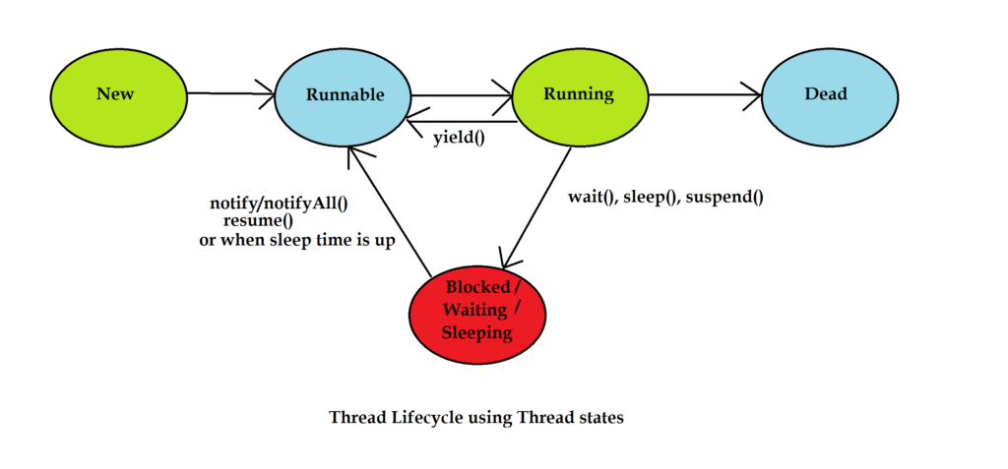
Thread life cycle

Slide 4
No of way to create a thread
Main in two ways
1.extendi thread class (thread running using thread class )
2.by implementing runnable interface (thread running using runnable interface )
3. using lambda expression (with runnable)

Slide 5
Thread scheduler
Two types of thread scheduler
1.preemptive scheduler ( 1.jvm decides which thread runs 2. a higher priority thread can interrupt ( stop) a lower priority thread.
2.time slicing
Each thread gets a small amount of CPU time
After time is over .next thread gets chance
All threads share CPU equally
Thread priority in java
1.min priority =1
2.norm priority=5(default)
3.max priority=10

Slide 6
Synchronization: methods ,static
Synchronization is used in multithreading to control access to shared resources.
1.synchronization method (instance method)
When a method is declared synchronized only one thread at a time
2.synchronized block
Instead of locking the whole method we can lock only a specific block
3.static synchronized method
Used when shared resource is static (class level variable )

Slide 7
Race condition
🔹 Race Condition (in Java / Multithreading)
A race condition occurs when two or more threads access shared data at the same time,

Slide 8
Dead lock
🔒 Deadlock in Java
Deadlock is a situation where two or more threads are blocked forever, waiting for each other to release resources.
👉 In simple words:
Thread 1 is waiting for Thread 2, and Thread 2 is waiting for Thread 1 — so both stop working permanently.
🧠 Real-Life

Slide 9
Thread pool
thread Pool (Java)
A Thread Pool is a collection of pre-created threads that are reused to execute multiple tasks.

Slide 10
Executer framework
executer framework
Executor Framework in Java
The Executor Framework is part of java.util.concurrent,,package.
It is used to manage and control threads easily instead of creating threads manually.

Slide 11
Thank you

