Slide 1
INFORMATICA GRAFICA – SSD ING-INF/05
Sistemi di elaborazione delle informazioni a.a. 2007/2008
LEZIONE PRATICA
OpenGL Graphics

Slide 2
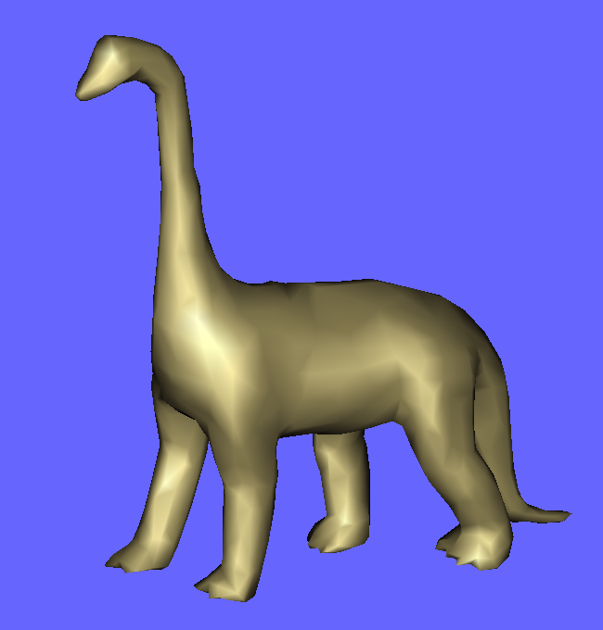
Simpleviewer.c
Costruiamo il nostro primo vero viewer.
Utilizziamo due strumenti software
PLY library
  E’ una libreria multiplatform che legge/scrive files in formato PLY
  File PLY? Semplicemente un file in formato testo/binario basato sugli attributi
Quaternions
  E’ un modo per costruire una camera molto intuitiva per ruotare la scena
http://www.cc.gatech.edu/projects/large_models/ply.html
http://graphics.stanford.edu/data/3Dscanrep/
run

Slide 3
PLY file format
The PLY file format is a simple object description that was designed as a convenient format for researchers who work with polygonal models.
Early versions of this file format were used at Stanford University and at UNC Chapel Hill.
A PLY file consists of a header followed by a list of vertices and then a list of polygons.
The header specifies how many vertices and polygons are in the file, and also states what properties are associated with each vertex, such as (x,y,z) coordinates, normals and color.
The polygon faces are simply lists of indices into the vertex list, and each face begins with a count of the number of elements in each list.
Source code for programs that read and write PLY files can be found in the PLY code archive. This archive includes programs to transform polygonal objects, calculate surface normals, flip faces and determine the spatial bounds of an object.

Slide 4
PLY limitations
PLY is mean to be a simple, easily parsable file format and hence only conveys basic geometry information.
Only one object definition can be specified per PLY file. Hence, an entire 3D scene may require more than one PLY file to be exported.
No material definitions are standardized in the PLY format.
No lights, cameras, hierarchy, animation are provided by the PLY file format

Slide 5
PLY file format. Esempio
ply
format ascii 1.0
element vertex 927
property float32 x
property float32 y
property float32 z
property float32 nx
property float32 ny
property float32 nz
element face 1850
property list uint8 int32 vertex_indices
end_header
41.0563 -24.4616 34.5653 -0.339027 0.053809 -0.939237
33.6719 -27.4709 35.3084 0.048363 -0.00276073 -0.998826
…
3 805 703 721
3 758 763 776
3 703 754 742
3 773 790 755
3 811 714 715
Numero di vertici
L’indice del vertici

Slide 6
Quaternioni. Introduzione
Un quaternione e’ composto da:
  le componenti (x,y,z) che rappresentano un asse di rotazione
  una componente w che rappresenta di quanti gradi devo ruotare intorno all’asse.
Con questi quattro numeri e’ possibile costruire una matrice che rappresenta le rotazioni perfettamente.
Tecnicamente questo non e’ completamente vero. Un quaternione e’ un punto su una sfera 4-dimensionale.
Un quaternione e’ definito come:
q= w + x*i +y*j + z*k
dove i=j=j=sqrt(-1)
Cosi’ come le normali, anche i quaternioni devono essere normalizzati:
float magnitude = sqrt(w*w + x*x + y*y + z*z)
w = w / magnitude
x = x / magnitude
y = y / magnitude
z = z / magnitude

Slide 7
Quaternioni. Introduzione
Definiamo l’operazione di prodotto di quaternioni come (w1,x1,y1,z1) (w2,x2,y2,z2):
(Q1 * Q2).w = (w1w2 - x1x2 - y1y2 - z1z2)
(Q1 * Q2).x = (w1x2 + x1w2 + y1z2 - z1y2)
(Q1 * Q2).y = (w1y2 - x1z2 + y1w2 + z1x2)
(Q1 * Q2).z = (w1z2 + x1y2 - y1x2 + z1w2)
Se i quaternioni in ingresso sono normalizzati, il quaternione in uscita e’ normalizzato.
Se riprendiamo il concetto di asse di rotazione normalizzato (x,y,z) ed angolo fAngle, si puo’ convertire in un quaternione local_rotation con:
local_rotation.w = cosf( fAngle/2)
local_rotation.x = axis.x * sinf( fAngle/2 )
local_rotation.y = axis.y * sinf( fAngle/2 )
local_rotation.z = axis.z * sinf( fAngle/2 )

Slide 8
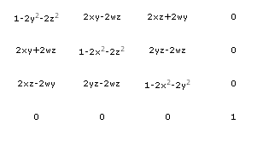
Quaternioni. Conclusioni
Per usare i quaternioni:
  Ogni volta che abbiamo una rotazione creiamo un quaternione temporaneo, che dice quale e’ la rotazione locale da applicare
  Moltiplichiamo il quaternione temporaneo con quello globale della scena
  Si ottiene un quaternione che applica in sequenza le due trasformazioni
total = local_rotation * total (NOTARE l’ordine!)
La matrice di rotazione espressa da un quaternione e’:

Slide 9
Simpleviewer.c
#include "ply.h"
/* definition of a triangle as 3 indices to a vector of float containing vertices infos */
struct triangle_t
{
int i0,i1,i2;
struct triangle_t* next;
};
struct vertex_t
{
float x,y,z; /* world coordinates */
float nx,ny,nz; /* normal */
};
struct
{
int numvertices; /* number of vertices */
struct vertex_t* vertices; /* pointer to vertices */
struct triangle_t* triangles; /* pointer to first triangle */
}
mesh;
#define swap_int(a,b) {int _tmp=(a);(a)=(b);(b)=_tmp;}
#define min2(a,b) (((a)<=(b))?(a):(b))
#define max2(a,b) (((a)>=(b))?(a):(b))

Slide 10
Simpleviewer.c
static void draw_triangles()
{
struct triangle_t* cursor=mesh.triangles;
glBegin( GL_TRIANGLES );
while (cursor)
{
struct vertex_t* v0=mesh.vertices + cursor->i0;
struct vertex_t* v1=mesh.vertices + cursor->i1;
struct vertex_t* v2=mesh.vertices + cursor->i2;
glNormal3f(- v0->nx, - v0->ny, - v0->nz);
glVertex3f (v0->x ,v0->y ,v0->z);
glNormal3f( -v1->nx, - v1->ny, - v1->nz);
glVertex3f (v1->x ,v1->y ,v1->z);
glNormal3f(-v2->nx,-v2->ny,-v2->nz);
glVertex3f (v2->x ,v2->y ,v2->z);
cursor=cursor->next;
}
glEnd();
}
Indici del triangolo

Slide 11
OpenGL: disegnare linee sopra poligoni
Problema. Difficile disegnare primitive coplanari in OpenGL
Problemi di errore round-off dei nuomeri float/double possono generare depth values diversi per pixels che si sovrappongono.
Ad esempio se disegno due poligoni, alcuni pixel del primo coprono il secondo, alcuni del secondo coprono il primo.
Il problema e’ ancora piu’ evidente quando ho un poligono e delle linee: i calcoli che si fanno per calcolare il depth test delle due primitive sono diverse (equazione del piano o interpolazione lineare).
Soluzione. Diciamo ad OpenGL che il depth value (!!!) dei poligoni deve essere cambiato, in modo da mandare il poligono un po’ “dietro”.

Slide 12
Simpleviewer.c
void display_ply(int viewmode) /* viewmode 0==filled face 1==filled+wireframe 2=wireframe */
{
glDisable( GL_POLYGON_OFFSET_FILL );
if (viewmode==1) //filled+wireframe
{
glPolygonOffset(1,1);
glEnable( GL_POLYGON_OFFSET_FILL );
draw_triangles();
glDisable(GL_LIGHTING);
glDisable(GL_POLYGON_OFFSET_FILL);
glColor3f(0,0,0);
glPolygonMode( GL_FRONT_AND_BACK , GL_LINE );
draw_triangles();
glPolygonMode(GL_FRONT_AND_BACK, GL_FILL );
glEnable(GL_LIGHTING);
}
else if (viewmode==0) // filled face (default mode)
draw_triangles();
else if (viewmode==2) // wireframe
{
glDisable(GL_LIGHTING);
glColor3f(0,0,0);
glPolygonMode( GL_FRONT_AND_BACK , GL_LINE );
draw_triangles();
glPolygonMode(GL_FRONT_AND_BACK, GL_FILL );
glEnable(GL_LIGHTING);
}
}
filled
Filled+wire
wire

Slide 13
Simpleviewer.c
void set_normals()
{
int k;float len ,x,y,z ,x0,y0,z0, x1,y1,z1;
struct triangle_t* cursor=mesh.triangles;
/* settto a zero le normali */
for (k=0;k<mesh.numvertices;k++)
{
struct vertex_t* v=mesh.vertices+k;
v->nx=v->ny=v->nz=0;
}
while (cursor)
{
struct vertex_t* v0=mesh.vertices+ cursor->i0;
struct vertex_t* v1=mesh.vertices+ cursor->i1;
struct vertex_t* v2=mesh.vertices+ cursor->i2;
/* cross product */
x0 = v2->x - v0->x; y0 = v2->y - v0->y; z0 = v2->z - v0->z;
x1 = v1->x - v0->x; y1 = v1->y - v0->y; z1 = v1->z - v0->z;
x = y0 * z1 - z0 * y1;
y = z0 * x1 - x0 * z1;
z = x0 * y1 - y0 * x1;

Slide 14
Simpleviewer.c
len = (float)sqrt(x*x + y*y + z*z);
x/=len;y/=len;z/=len;
v0->nx+=x ; v1->nx+=x ; v2->nx+=x;
v0->ny+=y ; v1->ny+=y ; v2->ny+=y;
v0->nz+=z ; v1->nz+=z ; v2->nz+=z;
cursor=cursor->next;
}
for (k=0;k<mesh.numvertices;k++)
{
struct vertex_t* v=mesh.vertices+k;
len=(float)sqrt(v->nx*v->nx+v->ny*v->ny+v->nz*v->nz);
v->nx /= len;
v->ny /= len;
v->nz /= len;
}

Slide 15
Simpleviewer.c
void open_ply(const char* filename)
{
int h,k,cont ,clockwise ,numvertices,numproperties,numtriangles,numstrips,numfaces;
struct {int nverts,*verts;} face;
float maxdim;
PlyProperty vert_prop[3]={ /* attributi che mi interessano dei vertici */
{ "x", Float32, Float32, /* offset */ 0, 0, 0, 0, 0},
{ "y", Float32, Float32, /* offset */ 4, 0, 0, 0, 0},
{ "z", Float32, Float32, /* offset */ 8, 0, 0, 0, 0}
};
PlyProperty face_prop={"vertex_indices", Int32, Int32, /* offset */ 4,PLY_LIST, Int32, Int32, 0};
PlyProperty** props=NULL;
FILE* file = fopen( filename, "rb" );
PlyFile* ply = read_ply(file);
struct triangle_t* t=0;
struct triangle_t** cursor=&(mesh.triangles);
format ascii 1.0
element vertex 927
property float32 x
property float32 y
property float32 z
property float32 nx
property float32 ny
property float32 nz
element face 1850
property list uint8 int32 vertex_indices
end_header
cursor
Mesh.triangles
triangle

Slide 16
Simpleviewer.c
/* bounding box */
float x1=+1e18f , x2=-1e18f;
float y1=+1e18f , y2=-1e18f;
float z1=+1e18f , z2=-1e18f;
props = get_element_description_ply (ply, "vertex", &numvertices, &numproperties);
mesh.vertices=(struct vertex_t*) malloc( sizeof(struct vertex_t)*numvertices );
mesh.numvertices=numvertices;
format ascii 1.0
element vertex 927
property float32 x
property float32 y
property float32 z
property float32 nx
property float32 ny
property float32 nz
element face 1850
property list uint8 int32 vertex_indices
end_header
struct vertex_t
{
float x,y,z;
float nx,ny,nz;
};

Slide 17
Simpleviewer.c
get_element_setup_ply(ply, "vertex", /* numero proprietà da restituire */ 3, vert_prop );
for( k=0;k<numvertices; ++k)
{
struct vertex_t* v=mesh.vertices+k;
get_element_ply( ply, (void*)v); /* scarica in v il vertice */
x1=min2(x1,v->x) ; x2=max2(x2,v->x);
y1=min2(y1,v->y) ; y2=max2(y2,v->y);
z1=min2(z1,v->z) ; z2=max2(z2,v->z);
}
/* normalize to unit box to [-1,+1],[-1,+1],[-1,+1] mantaining proportions */
maxdim=max2(x2-x1 ,y2-y1);
maxdim=max2(maxdim,z2-z1);
for( k=0;k<numvertices; ++k)
{
struct vertex_t* v=mesh.vertices+k;
v->x= 2*((v->x-x1) / maxdim-0.5f);
v->y= 2*((v->y-y1) / maxdim-0.5f);
v->z= 2*((v->z-z1) / maxdim-0.5f);
}
numtriangles=0;

Slide 18
Simpleviewer.c Caso “Face”
ply
  format ascii 1.0
  comment modified by normalsply
  element vertex 927
    property float32 x
    property float32 y
    property float32 z
    property float32 nx
    property float32 ny
    property float32 nz
  element face 1850
  property list uint8 int32 vertex_indices
end_header
41.0563 -24.4616 34.5653 -0.339027 0.053809 -0.939237
33.6719 -27.4709 35.3084 0.048363 -0.00276073 -0.998826
27.117 -34.6973 34.6356 0.330479 0.00449139 -0.943803
….
3 3 45 44
4 55 4 16 18
3 78 35 20
6 61 7 24 1 2 3
4 20 14 22 10
triangolo
quadrato

Slide 19
Simpleviewer.c
Prova a vedere se i poligoni sono semplici facce
(== liste di indici ai vertici)
/* caso di faces indipendenti */
if (props = get_element_description_ply( ply, "face", &numfaces, &numproperties))
{
get_element_setup_ply( ply, "face", /* numero di proprietà ==lista */ 1, &face_prop);
for(h=0; h<numfaces; h++ )
{
get_element_ply( ply, (void*)&face);
for(k=2; k<face.nverts;++k)
{
t=(struct triangle_t*) malloc(sizeof(struct triangle_t));
t->i0=face.verts[0 ];
t->i1=face.verts[k-1];
t->i2=face.verts[k ];
t->next=0;
(*cursor)=t;
cursor=&(t->next);
}
free(face.verts);
}
}
struct {
int nverts,*verts;
} face;
Es. 6 p0 p1 p2 p3 p4 p5
p1
p2
p0
p3
0 1 2
0 2 3
0 3 4
0 4 5
p5
p4

Slide 20
Simpleviewer.c Caso “tristrips”
Ply
format binary_little_endian 1.0
element vertex 4800
property float x
property float y
property float z
element tristrips 1
property list int int vertex_indices
end_header
41.0563 -24.4616 34.5653 -0.339027 0.053809 -0.939237
33.6719 -27.4709 35.3084 0.048363 -0.00276073 -0.998826
27.117 -34.6973 34.6356 0.330479 0.00449139 -0.943803
…
10 0 1 2 3 4 -1 5 6 7 8
…
Definisce i triangoli
(0,1,2) (1,2,3) (2,3,4) (5,6,7) (6,7,8)
A meno di orientamenti…

Slide 21
Simpleviewer.c
else /* caso di trianglestrip */
{
props = get_element_description_ply( ply, "tristrips", &numstrips, &numproperties)
get_element_setup_ply(ply,"tristrips",1,&face_prop);
for(k=0; k<numstrips;++k )
{
get_element_ply( ply, (void*)&face);
clockwise=1;
for (int I=2;I< face.nverts; I++)
{
if (face.verts[I] == -1) {I += 2;clockwise = 1;}
else
{
t=(struct triangle_t*)malloc(sizeof(struct triangle_t));
t->i0=face.verts[I-2];
t->i1=face.verts[I-1];
t->i2=face.verts[I ];
if (!clockwise) swap_int(t->i1,t->i2);
t->next=0;
(*cursor)=t;cursor=&(t->next);
clockwise = 1-clockwise;
}
}
free(face.verts);
}
}
struct {
int nverts,*verts;
} face;
p4
p2
p5
p3
0 1 2
1 2 3 -> 1 3 2
2 3 4
3 4 5 -> 3 5 4
p0
p1

Slide 22
Simpleviewer.c
close_ply( ply );
fclose(file);
set_normals(); /* calculate normal */
}

Slide 23
Simpleviewer.c
/* actual operation */
static int scaling;
static int moving;
static int panning;
static int beginx,beginy; /* starting "moving" coordinates */
static float curmat[4][4]; /* current transformation matrix */
float ortho_left,ortho_right,ortho_bottom,ortho_top; /* ortho */
static float scalefactor; /* current scale factor */
/* viewmode 0==filled face 1==filled+wireframe 2=wireframe */
int viewmode=0;
/* trackball data */
static float curquat[4],lastquat[4];

Slide 24
Simpleviewer.c
void main()
{
GLfloat light_ka[]={0,0,0,1};
GLfloat light_kd[]={1,1,1,1};
GLfloat light_ks[]={1,1,1,1};
GLfloat material_ka[]={0.16f,0.12f,0.11f,1.00f};
GLfloat material_kd[]={0.61f,0.57f,0.36f,1.00f};
GLfloat material_ks[]={0.56f,0.55f,0.44f,1.00f};
GLfloat material_ke[]={0.00f,0.00f,0.00f,0.00f};
GLfloat material_se[]={16};
glutInitDisplayMode(GLUT_DEPTH|GLUT_RGB|GLUT_DOUBLE);
glutInitWindowSize(800,800);
glutCreateWindow("Simple OpenGL viewer");
glEnable(GL_DEPTH_TEST);
glEnable(GL_NORMALIZE);
glDepthFunc(GL_LESS);
glClearColor(0.4f,0.4f,1.0f,1.0f);

Slide 25
Simpleviewer.c
glutReshapeFunc (reshape);
glutKeyboardFunc(keydown);
glutDisplayFunc (display);
glutMouseFunc (mouse);
glutMotionFunc (motion);
glLightfv(GL_LIGHT0,GL_AMBIENT,light_ka);
glLightfv(GL_LIGHT0,GL_DIFFUSE,light_kd);
glLightfv(GL_LIGHT0,GL_SPECULAR,light_ks);
glEnable(GL_LIGHT0);
glMaterialfv(GL_FRONT_AND_BACK ,GL_AMBIENT ,material_ka);
glMaterialfv(GL_FRONT_AND_BACK ,GL_DIFFUSE ,material_kd);
glMaterialfv(GL_FRONT_AND_BACK ,GL_SPECULAR ,material_ks);
glMaterialfv(GL_FRONT_AND_BACK ,GL_EMISSION ,material_ke);
glMaterialfv(GL_FRONT_AND_BACK ,GL_SHININESS,material_se);
glLightModelf(GL_LIGHT_MODEL_TWO_SIDE,0);
glEnable(GL_LIGHTING);
glEnable(GL_POINT_SMOOTH);
glEnable(GL_DEPTH_TEST);

Slide 26
Simpleviewer.c
scaling = false;
moving = false;
panning = false;
beginx = 0;
beginy = 0;
matident(curmat);
scalefactor=1;
trackball(curquat , 0.0f, 0.0f, 0.0f, 0.0f); /* quaternione locale */
trackball(lastquat, 0.0f, 0.0f, 0.0f, 0.0f); /* quaternione globale */
add_quats(lastquat, curquat, curquat); /* lastquat+curquat ->curquat */
build_rotmatrix(curmat, curquat); /* curmat <- curquat */
open_ply("mesh/dinosaur.ply");
glutMainLoop();
}

Slide 27
Simpleviewer.c
void keydown(unsigned char key, GLint x, GLint y)
{
switch(key)
{
case 'l':case 'L':
viewmode++;
break;
case 27:
exit(0);
return;
case 'F':
glutFullScreen();
break;
case 's':case 'S': //reset matrix
matident(curmat);
break;
}
glutPostRedisplay();
}

Slide 28
Simpleviewer.c
void display()
{
glClear(GL_COLOR_BUFFER_BIT | GL_DEPTH_BUFFER_BIT);
glMatrixMode(GL_PROJECTION);
glLoadIdentity();
glOrtho(ortho_left, ortho_right, ortho_bottom, ortho_top, -10, +10); /* panning */
glMatrixMode (GL_MODELVIEW);
glPushMatrix();
{
glLoadIdentity();
glMultMatrixf(&(curmat[0][0])); /* matrice di rotazione data dal quaternione */
glScalef(scalefactor,scalefactor,scalefactor);
display_ply(viewmode % 3);
}
glPopMatrix();
glMatrixMode(GL_PROJECTION);
glMatrixMode(GL_MODELVIEW);
glutSwapBuffers();
}

Slide 29
Simpleviewer.c
void mouse(GLint button, GLint state, GLint x, GLint y)
{
if (state==GLUT_UP)
{
moving=scaling=panning=0;
glutPostRedisplay();
return;
}
switch(button)
{
case GLUT_RIGHT_BUTTON : scaling=1 ;break;
case GLUT_LEFT_BUTTON : moving=1 ;trackball(lastquat, 0, 0, 0, 0) ;break;
case GLUT_MIDDLE_BUTTON: panning=1 ;break;
}
beginx = x;beginy = y;
glutPostRedisplay();
}

Slide 30
Simpleviewer.c
void motion(GLint x, GLint y){
int W=glutGet(GLUT_WINDOW_WIDTH ), H=glutGet(GLUT_WINDOW_HEIGHT);
float dx=(beginx-x)/(float)W, dy=(y-beginy)/(float)H;
if (panning){
ortho_left +=dx; ortho_right +=dx;
ortho_bottom+=dy; ortho_top +=dy;
}
else if (scaling)
scalefactor *= (1.0f+dx);
else if (moving) {
trackball(lastquat, /* quaternione locale */
(2.0f * beginx - W) / W, /* numeri tra -1,+1 */
(H - 2.0f * beginy) / H,
(2.0f * x - W) / W,
(H - 2.0f * y) / H
);
add_quats(lastquat, curquat, curquat); /* aggiungi quaternione locale a quaternione globale */
build_rotmatrix(curmat , curquat); /* crea matrice rotazione da quaternione globale */
}
if (panning || scaling || moving)
{beginx = x;beginy = y;glutPostRedisplay();}
}

Slide 31
ESEMPIO: Aggiunta Texture 1d
int enable_texture=0;
GLuint mytexture1d=(GLuint )0; /* identificativo */
GLubyte palette[3*256]; /* vettore di colori RGB */
/* carico la palette */
void setPalette()
{
int buf[256]={
0x7e0000, 0x830000, 0x870000, …, 0x9b0000, 0x00007d
}
for (int i=0;i<256;i++)
{
palette[i*3+0]=(buf[i] ) & 0xff;
palette[i*3+1]=(buf[i]>>8 ) & 0xff;
palette[i*3+2]=(buf[i]>>16) & 0xff;
}
}
run

Slide 32
Aggiunta Texture 1d
glGenTextures(1,&mytexture1d);
setPalette();
glBindTexture(GL_TEXTURE_1D, mytexture1d);
glTexImage1D(
GL_TEXTURE_1D, /* sto operando con texture 1d */
0, /* livello, sempre 0 */
3, /* 3 componenti di colore: RGB */
256, /* dimensione della texture */
0, /* no border */
GL_RGB, /* tipo della texture */
GL_UNSIGNED_BYTE, /* ogni componente e’ ubyte */
palette /* vettore della texture */
);

Slide 33
Aggiunta texture 1d
void keydown(unsigned char key, GLint x, GLint y)
{
switch(key)
{
…
case 't':case 'T':
enable_texture=1-enable_texture;
break;
…
}
glutPostRedisplay();
}

Slide 34
Aggiunta texture 1d
void display()
{
[…]
if (enable_texture)
{
glBindTexture(GL_TEXTURE_1D, mytexture1d);
glTexParameterf(GL_TEXTURE_1D, GL_TEXTURE_WRAP_S, GL_CLAMP );
glTexParameterf(GL_TEXTURE_1D, GL_TEXTURE_WRAP_T, GL_CLAMP );
glTexParameterf(GL_TEXTURE_1D, GL_TEXTURE_MAG_FILTER, GL_NEAREST);
glTexParameterf(GL_TEXTURE_1D, GL_TEXTURE_MIN_FILTER, GL_NEAREST);
glTexEnvf(GL_TEXTURE_ENV, GL_TEXTURE_ENV_MODE, GL_MODULATE);
glEnable(GL_TEXTURE_1D);
}
display_ply(viewmode % 3);
if (enable_texture) glDisable(GL_TEXTURE_1D);
[….]
}

Slide 35
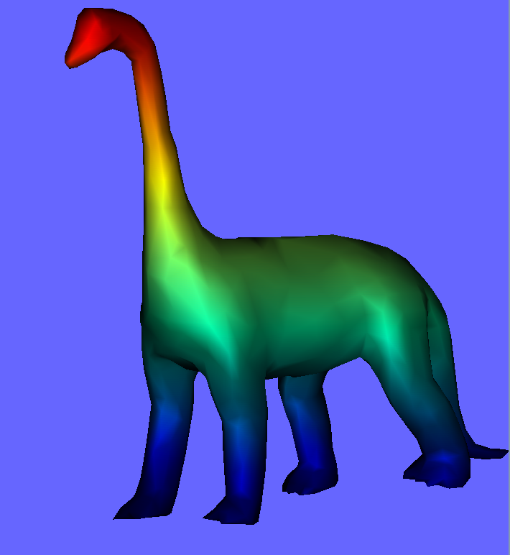
Aggiunta texture 1d
run
static void draw_triangles()
{
struct triangle_t* cursor=mesh.triangles;
glBegin(GL_TRIANGLES);
while (cursor)
{
struct vertex_t* v0=mesh.vertices+cursor->i0;
struct vertex_t* v1=mesh.vertices+cursor->i1;
struct vertex_t* v2=mesh.vertices+cursor->i2;
glNormal3f(-v0->nx,-v0->ny,-v0->nz); glTexCoord1f(0.5*(v0->y+1)); glVertex3f(v0->x,v0->y,v0->z);
glNormal3f(-v1->nx,-v1->ny,-v1->nz); glTexCoord1f(0.5*(v1->y+1)); glVertex3f(v1->x,v1->y,v1->z);
glNormal3f(-v2->nx,-v2->ny,-v2->nz); glTexCoord1f(0.5*(v2->y+1)); glVertex3f(v2->x,v2->y,v2->z);
cursor=cursor->next;
}
glEnd();
}

