Slide 1
INFORMATICA GRAFICA – SSD ING-INF/05
Sistemi di elaborazione delle informazioni a.a. 2007/2008
LEZIONE DI “TEORIA”
Introduzione al PLaSM

Slide 2
PLaSM
NOTA: Se i lucidi non sono chiari…
    Rif. CAP 1 Informatica Grafica e Cad,
    Ed Hoepli, Aut. Paoluzzi

Slide 3
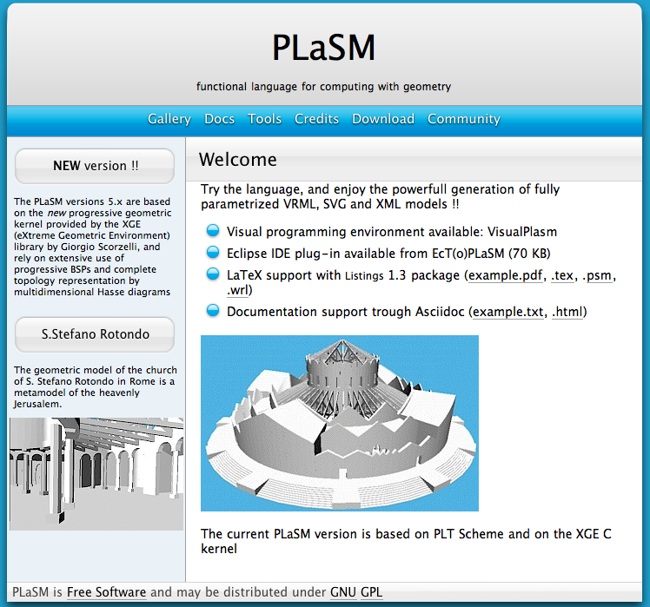
Plasm
URL www.plasm.net
TUTORIAL http://www.plasm.net/cplasm/plasm1.html#plasm-summary
DOWNLOAD http://www.plasm.net/download/

Slide 4
PLaSM
L’attuale interprete PLaSM è scritto nei linguaggi Scheme e C++, usando una implementazione Scheme multipiattaforma chiamata PLT Scheme.

Slide 5
PLaSM
L’interprete PLaSM è disponibile gratuitamente come software libero multipiattaforma all’indirizzo di rete
  http://www.plasm.net/download/
L’utente tipico normalmente preferirà scaricare un installer dei binari eseguibili per l’ambiente di calcolo preferito (Windows, Linux o MacOSX).
Al contrario, un utente avanzato potrà preferire il download dei sorgenti, da ricompilare sulla sua macchina personale.

Slide 6
PLaSM editor
Un editor integrato non è strettamente necessario, in quanto un editor standard di testo (per esempio WordPad) sarebbe sufficiente, ma sarà molto utile
Un editor specializzato per PLaSM è denominato Xplode, il cui nome significa “Is a PLasm Open Design Environment ”
Xplode provvede alla colorazione della sintassi e fornisce un accesso a menu alle funzioni e librerie disponibili, alla documentazione in linea e alla valutazione su richiesta di funzioni, espressioni e sottoespressioni selezionate dall’utente.
Xplode viene automaticamente installato dall’installer contenuto nel package binario scaricato dal sito

Slide 7
PLaSM viewer
L’ambiente PLaSM non offre attualmente un visualizzatore grafico integrato per i modelli generati.
Esportare i modelli generati dal linguaggio in qualche formato grafico per il web, per esempio nel formato VRML (Virtual Reality Modeling Language) per la grafica 3D, oppure nei formati vettoriali SVG (Scalable Vector Graphics) o Flash per la grafica 2D.
I plug-ins per visualizzare file .svg (SVG) e .swf (Flash) in un browser possono essere scaricati dai siti Adobe e Macromedia rispettivamente.

Slide 8
Come iniziare
Instructions
  PLT Scheme
    Download the installer
    Double click on it
    Follow the instructions
    Install it to C:\Program Files\PLT
  Plasm
    Download the installer
    Double click on it
    Follow the instructions
    The installer will create a folder named C:\Program Files\plasm
  Xplode
    Download the installer
    Double click on it
    Follow the instructions
    The installer will add a shortcut to Xplode in the Start menu

Slide 9
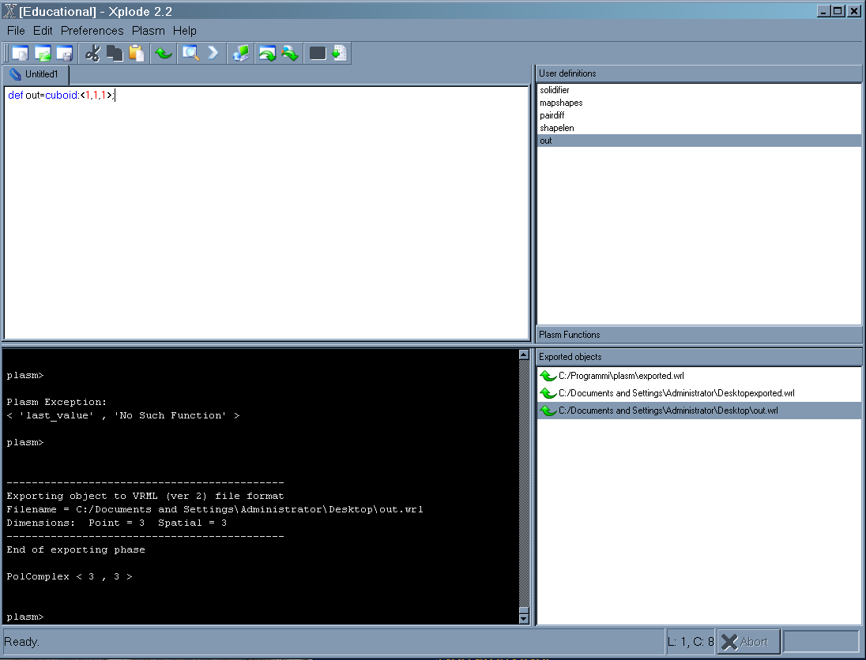
Come iniziare
Nota: se avete problemi spostate
c:\Programmi\PLT -> c:\Program Files\PLT

Slide 10
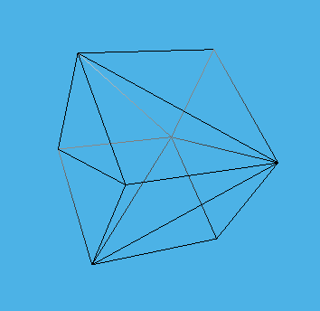
Come iniziare
(plasm “DEF mycube = CUBOID:<1,1,1>;mycube;”)
  ==================
  mycube DEFINED
  ==================
  PolComplex < 3 , 3 >
(plasm “VRML: mycube: 'out.wrl';”)
  --------------------------------------------
  Exporting object to VRML (ver 2) file format
  Filename = d:\scorzell\software\cpp\plasm.old\distrib\out.wrl
  Dimensions: Point = 3 Spatial = 3
  --------------------------------------------
  End of exporting phase
  PolComplex < 3 , 3 >

Slide 11
Come iniziare
Salvo un file mycube.psm
-----------------------------------------------------
  (plasm "
  DEF mycube = CUBOID:<1,1,1>;
  mycube;
  VRML: mycube: 'out.wrl';
  ")
-----------------------------------------------------
(load “mycube.psm”)
  ==================
  mycube DEFINED
  ==================
  PolComplex < 3 , 3 >
  --------------------------------------------
  Exporting object to VRML (ver 2) file format
  Filename = d:\scorzell\software\cpp\plasm.old\distrib\out.wrl
  Dimensions: Point = 3 Spatial = 3
  --------------------------------------------
  End of exporting phase
  PolComplex < 3 , 3 >

Slide 12
PLaSM
The design language PLaSM is a geometry-oriented extension of a subset of the FL language
FL (programming at Function Level) is an advanced language for functional programming developed by the Functional Programming Group of IBM Research Division at Almaden (USA)

Slide 13
FL
programs are easily combined, so that new programs are obtained in a simple and elegant way;
one may find simpler equivalent programs, both at design and at compilation times.
Great advantages are so obtained in style and efficiency of program prototyping.

Slide 14
PLaSM
PLaSM, (the Programming LAnguage for Solid Modeling) is a ``design language", developed by the CAD Group at the Universities of Roma ``La Sapienza" and ``Roma Tre"

Slide 15
PLaSM
Among the strong points of PLaSM we cite
the functional approach, which allows to compute with geometries as well with numbers and functions
the dimension-independent implementation of geometric data structures and algorithms.

Slide 16
PLaSM
very natural and powerful approach to parametric geometry
combinatorial engine of the FL language, gives an amazing descriptive power when computing with geometry.

Slide 17
Functional languages
Functional programming enjoies several good properties:
  The set of rules is very small
  Each rule is very simple
  Program code is concise and clear
  The meaning of a program is well understood (no state)
  Functions both as programs and as data
  Programs connected by concatenation and nesting

Slide 18
PLaSM
a complex shape is an assembly of components, highly dependent from each other
each part results from computations involving other parts
a generating function is associated to each part
geometric expressions appear as actual parameters

Slide 19
FL objects
Primitive objects
  characters, numbers and truth values
Expressions
  primitive objects, functions, applications and sequences
Sequences
    expressions separated by commas and contained within a pair of angle brackets:
    <5, fun>

Slide 20
Application
Sintassi:
exp1:exp2
applies the function resulting from the evaluation of exp1 on the argument resulting from the evaluation of exp2.
Binary functions can also be used in infix form:
  +:<1,3> = 1 + 3 = 4

Slide 21
Application
Application associates to left:
  f:g:h = (f:g):h
Application binds stronger than composition:
f:g ~ h = (f:g) ~ h

Slide 22
FL combining forms and functions:
The construction combining form CONS
  allows to apply a sequence of functions to an argument producing the sequence of applications:
CONS:< f1,...,fn >:x
= [f1,...,fn]:x
= < f1:x,...,fn:x >

Slide 23
CONS
CONS:<+,->, written also [+,-], when applied to the argument <3,2> gives the sequence of applications:
  CONS:<+,->:<3,2>
  =[+,-]:<3,2>
  = < + : <3,2> , - : <3,2> >
  = <5,1>;

Slide 24
Apply to all (AA)
The apply-to-all combining form AA
  applies a function to a sequence of arguments giving a sequence of applications:
  AA:f:< x1,...,xn > = < f:x1,...,f:xn >;
  Ex.
  aa:+:<<1,2>,<2,3>>=
  <+:<1,2>,+:<2,3>>=
  <3,5>;

Slide 25
Identity (ID)
The identity function ID
  returns its argument unchanged:
  ID:x = x;
  Ex.
  ID:<1,2,3,4>=<1,2,3,4>;

Slide 26
Constant
The constant function K
  is evaluated, for whatever x2, as:
  K:x1:x2 = x1;
Ex.
K:<1,2>:<2,3>
=<1,2>

Slide 27
Binary composition
Binary composition ~ of functions
  is defined as
  (f ~ g):x = f:(g:x);
  Ex
  (- ~ (aa:-) ) : < <3,2> , <1,0> >
  = -: ( <-:<3,2> , -:<1,0> >)
  = -: (<1,1>)
  = 0

Slide 28
N-ary composition
N-ary composition COMP of functions
  is also allowed:
  COMP:< f,h,g >:x
  = (f ~ h ~ g):x
  = f:(h:(g:x));

Slide 29
Conditional
IF:< p,f,g >:x =
  if p:x = TRUE -> f:x
  if p:x = FALSE -> g:x
Ex.
IF:< EQ, K:’True’, K:’False’ >:<10, 20>
essendo EQ:<10,20>==false quindi
= k:‘False’:<10,20>
= ‘False’
IF:< EQ, K:’True’, K:’False’ >:<20, 20>
essendo EQ:<20,20>==true quindi
= k:‘False’:<10,20>
=‘False’
if:<-,+,->:<3,3>= - : <3,3> = 0 (false) quindi -:<3,3>=0
if:<+,+,->:<3,3>= +:<3,3> = 1 (false) quindi +:<3,3>=6

Slide 30
Insert
The insert right and insert left combining forms (INSR and INSL)
  allow to apply a binary function on a sequence of arguments of any length:
  INSR : f :< x1,x2,... ,xn > = f:< x1, INSR:f:< x2,...,xn > >
  INSL : f :< x1,...,xn-1,xn > = f:< INSL:f:< x1,...,xn-1 >, xn >,
NOTA applicazione su lista di un elemento:
  INSR:f:< x > = x
  INSL:f:< x > = x
Ex:
    insr:+:<1,2,3>
    =+:<1, insr :+:<2,3>>
    =+:<1,+:<2, insr :+:<3>>>
    =+:<1,+:<2,3>>
    =+:<1,5> =6
    insl:-:<1,2,3>
    = -:< insl :-:<1,2> ,3>
    = -:< -: < insl :-:<1>,2> ,3 >
    = -:< -: <1,2>, 3>
    = -:<-1,3> = -4

Slide 31
Concatenate
The catenate function CAT
  appends any number of input sequences creating a single output sequence:
  CAT:<< a,b,c >,< d,e >,...,< x,y,z >>
  = < a,b,c,d,e,...,x,y,z >
Ex:
cat:<<1,2,3>,<4,5>>
=< 1 , 2 , 3 , 4 , 5 >

Slide 32
Distribute
The distribute right and distribute left functions (DISTR, DISTL) generate a sequence of pairs:
  DISTR:<< a,b,c >, x> = << a,x >, < b,x >, < c,x >>
  DISTL:< x,< a,b,c >> = << x,a >, < x,b >, < x,c >>
Ex
distr:<<1,2,3>,0>
= < < 1 , 0 > , < 2 , 0 > , < 3 , 0 > >
distl:<0,<1,2,3>>
= < < 0 , 1 > , < 0 , 2 > , < 0 , 3 > >

Slide 33
Selection
SEL : 2 : <13, 4.5, ID> = 4.5

Slide 34
Apply in composition (AC)
AC : f : <x1, . . . ,xn>
= f:x1~ f:x2 ~ … ~f:xn
Ex.
AC:SEL:< 3,1 >:<< 1,3,8,7 >, 89, fun>
= (SEL:3 ~ SEL:1):<< 1,3,8,7 >, 89, fun>
= SEL:3: (SEL:1:<<1,3,8,7>,89,fun>)
= SEL:3: (<1,3,8,7>)
= 8

Slide 35
Apply in sequence (AS)
AS : f : <x1, . . . ,xn>
= [f:x1, . . . ,f:xn]
Ex.
AS:SEL:< 3,1 >:<< 1,3,8,7 >, 89, fun>
  = [SEL:3, SEL:1]:<< 1,3,8,7 >, 89, fun>
  = < SEL:3:<< 1,3,8,7 >, 89, fun> , SEL:1 :<< 1,3,8,7 >, 89, fun> >
  = < fun, < 1,3,8,7 >>

Slide 36
Others
repetition operator allows for instancing n times any expression:
  #:3:expr = < expr,expr,expr >
catenation of repeated sequences repeats and catenates sequences:
  ##:3:< a,b,c > = < a,b,c, a,b,c, a,b,c >
FROMTO operator generates integer sequences between two given extremes:
  FromTo:<2,5> = 2..5 = <2,3,4,5>
INTSTO operator generates integer sequences with a given end:
  INTSTO:5 = <1,2,3,4,5>

Slide 37
Function definition
Definition:
  DEF fun1 (a::type1) = ….
  DEF fun2 (a1,...,an::type2) = ….
  DEF fun3 (a1::type1)(a2::type2) = ….
  DEF fun4 (a1::type1; a2::type2) = ….
instancing:
fun1 : x
fun2 : < x1, ... , xn >
fun3 : x1 : x2
fun4 : < x1, x2 >

Slide 38
Local functions
DEF global (p1::IsType1; p2::IsType2) (q1,q2::IsType3) =
….body che fa riferimento a local1 e local2…
WHERE
local1 (p3::IsType3) = ….body….,
local2 = …. body che fa riferimento a local 21….
WHERE
local21 = …body….
END
END;

Slide 39
Esempio: lunghezze
DEF length = + ~ AA:(K:1);
Ex.
length:<3,*,1,AA>
= (+ ~ AA:(K:1)):<3,*,1,AA>
= +: (AA:(K:1):<3,*,1,AA>)
= +:<(K:1):3, (K:1):*, (K:1):1, (K:1):AA>
= +:<1,1,1,1>
= 4

Slide 40
Esempio: fattoriale
DEF fact = * ~ INTSTO;
Ex
fact:n
= (* ~ INTSTO):4
= *:(INTSTO:4)
= *:<1,2,3,4>
= 24

Slide 41
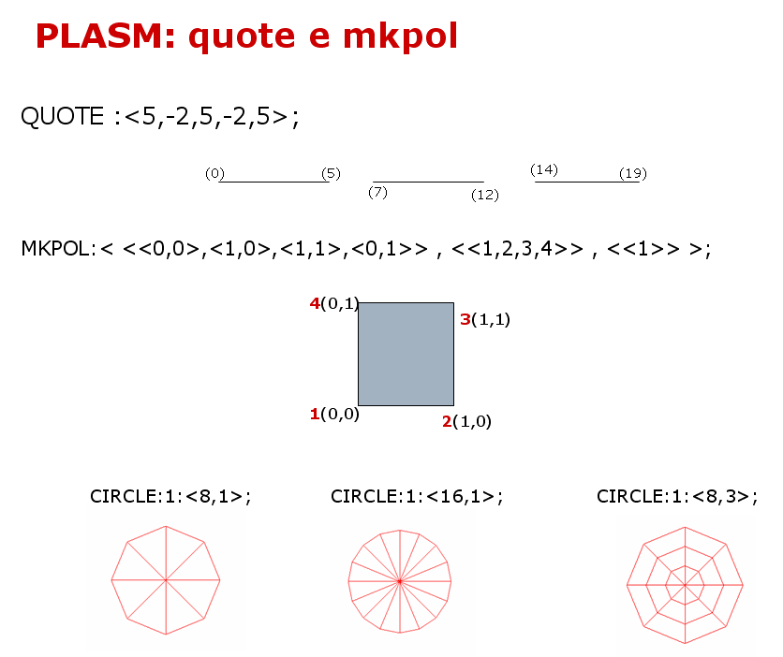

Slide 42
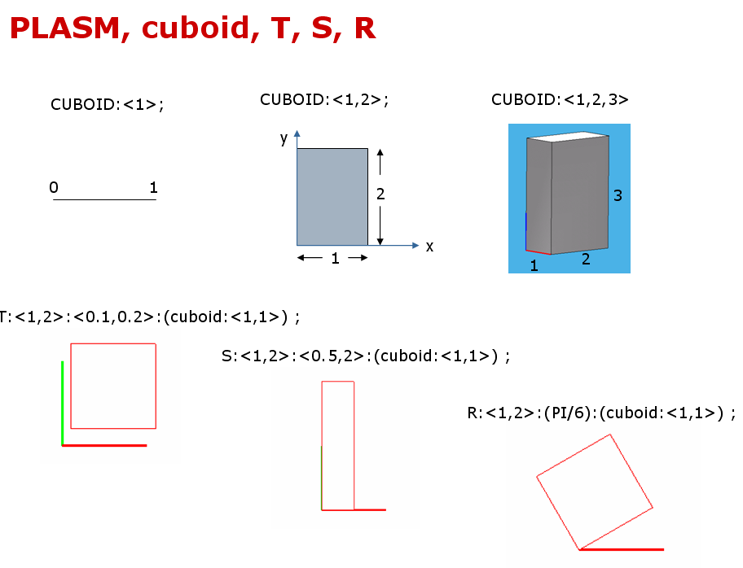

Slide 43
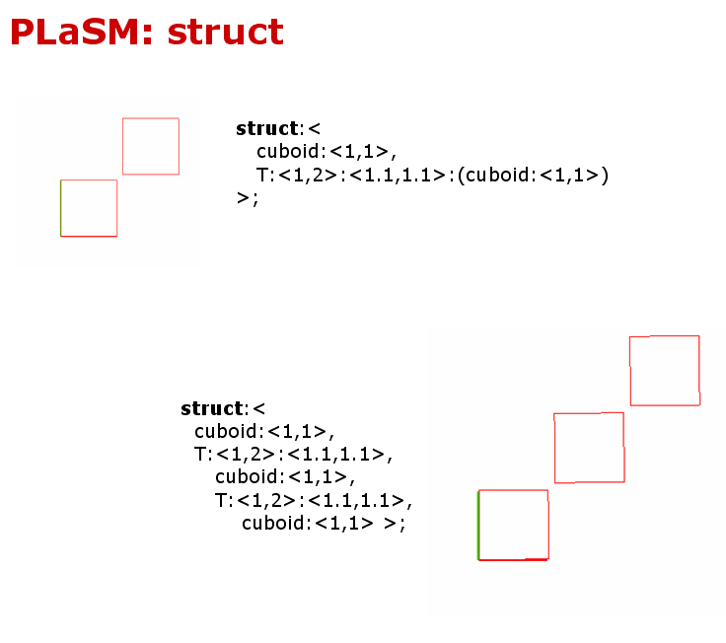

Slide 44
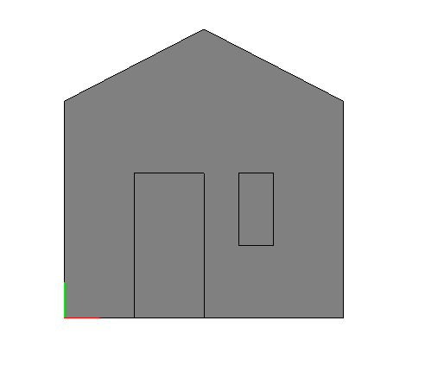
PLASM, mkpol e translate
(plasm"
DEF House2D = STRUCT:< wall, T:1:2:door, T:<1,2>:<5,2>:window >
WHERE
wall = MKPOL:<<<0,0>,<8,0>,<0,6>,<8,6>,<4,8>>,<<1,2,3,4,5>>,<<1>>>,
door = CUBOID:<2,4>,
window = CUBOID:<1,2>
END;
VRML:(House2D):'out.wrl';
“)
T:<1,2>:<5,2>:(Cuboid:<1,2>)
4 (4,8)
VRML plugin
T:1:2:(Cuboid<2,4>)
5 (0,6)
3 (8,6)
**************************************************
* Welcome in *
* PLaSM *
* *
* [Programming LAnguage for Solid Modeling] *
* *
* Version: 4.2.0 *
* Date: 24 Nov 2004 *
* *
**************************************************
plasm> (load "out.psm")
1 (0,0)
2 (8,0)

