Slide 1
INFORMATICA GRAFICA – SSD ING-INF/05
Sistemi di elaborazione delle informazioni a.a. 2007/2008
LEZIONE DI “TEORIA”
Introduzione al PLaSM, 2/2
Esempi…

Slide 2
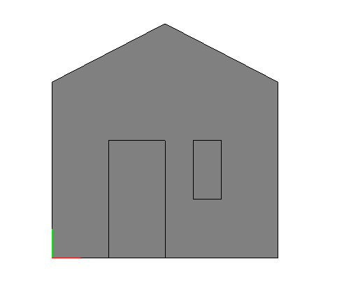
PLASM, mkpol e translate
(plasm"
DEF House2D = STRUCT:< wall, T:1:2:door, T:<1,2>:<5,2>:window >
WHERE
wall = MKPOL:<<<0,0>,<8,0>,<0,6>,<8,6>,<4,8>>,<<1,2,3,4,5>>,<<1>>>,
door = CUBOID:<2,4>,
window = CUBOID:<1,2>
END;
“)

Slide 3
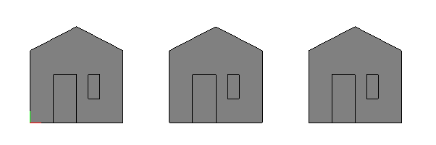
PLaSM, mkpol e translate
DEF triplet (Object::IsPol) = STRUCT:<
Object,
transl:Object,
(transl ~ transl):Object >
WHERE
transl = T:1:12
END;
VRML:(triplet:house2d):'out.wrl';
Alternative?
1. STRUCT:<Object,Transl,Object,Transl,Object>
2. (STRUCT ~ ##:n) : <Object, Transl>
y
x

Slide 4
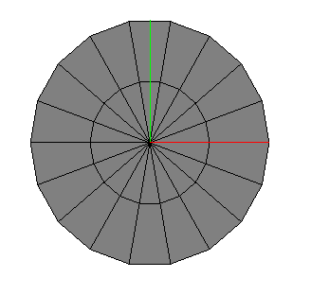
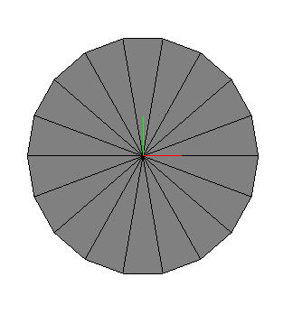
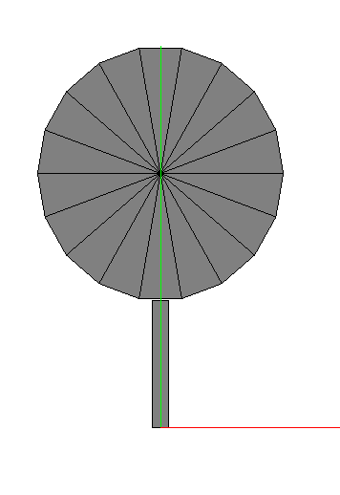
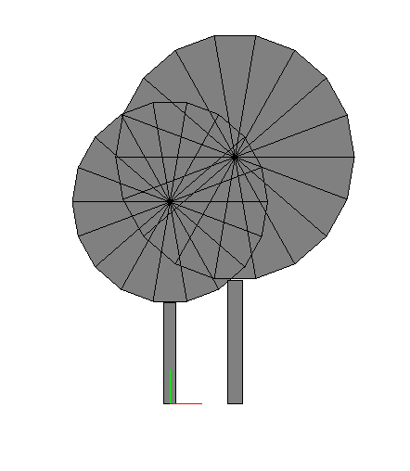
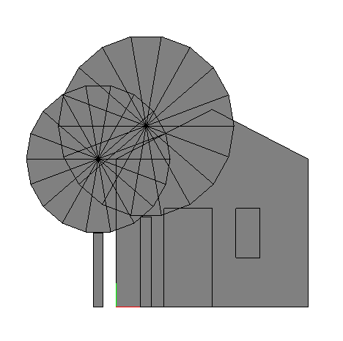
PLaSM, esempio
Leaves:3
(Circle:1:<18,2>)
DEF Leaves (radius::IsReal) = Circle:radius:<18,1>;
DEF Albero (h::IsReal) = STRUCT:<
T:1:(-:h/48):(CUBOID:<h/24,h/3>),
T:2:(2*h/3):(Leaves:(h/3))
>;
DEF Alberi = STRUCT:< Albero :9, (T:1:2 ~ Albero ):11 >;
DEF HouseTrees = STRUCT:< House2D, T:1:-0.75:Alberi >;
(Albero:1)
Alberi
HouseTrees

Slide 5
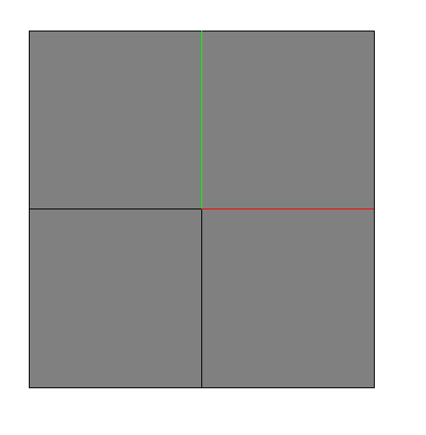

PLaSM, mirror
DEF Mirror (d::IsIntPos)(Obj::IsPol) = (STRUCT ~ [S:d:-1, ID]):Obj;
DEF out1=Mirror:1:(cuboid:<1,1>);
DEF out2=Mirror:2:out1;
scalamento
out1
out2

Slide 6
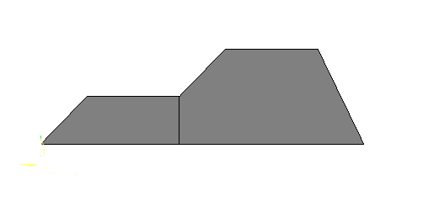
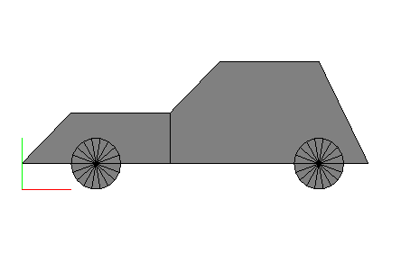
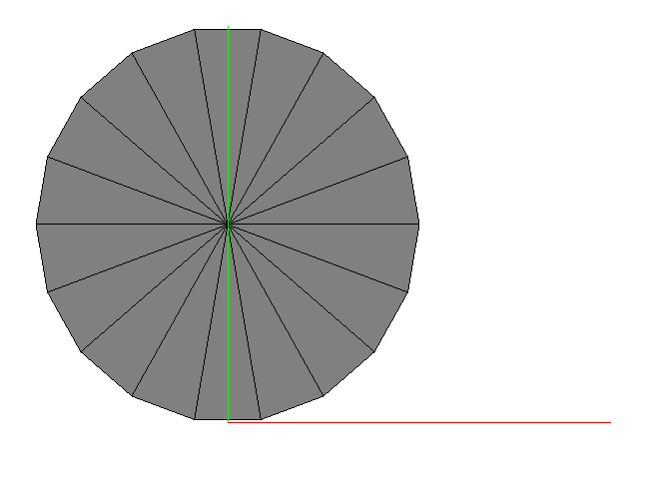
PLASM, car
body
car
5 (4,2)
4 (6,2)
7 (1,1)
6 (3,1)
1 (0,0)
2 (3,0)
3 (7,0)
DEF car = (T:2:0.5 ~ STRUCT):< body, T:1:1.5:wheel, T:1:6:wheel >
WHERE
body = MKPOL:<verts, cells, pols>,
verts = <<0,0>,<3,0>,<7,0>,<6,2>,<4,2>,<3,1>,<1,1>>,
cells = <<1,2,6,7>,<2,3,4,5,6>>,
pols = <<1,2>>,
wheel = S:<1,2>:<0.5,0.5>:(Circle:1:<18,1>)
END;
wheel = Circle:0.5:<18,1>
wheel

Slide 7
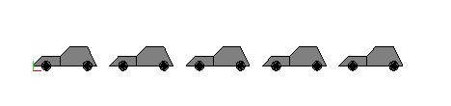
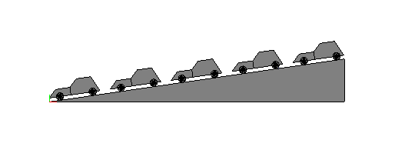
PLaSM, rotated car
##:3:<'a'> == < 'a' , 'a' , 'a' >
##:3:<'a','b'> == < 'a' , 'b' , 'a' , 'b' , 'a' , 'b' >
DEF carQueue (n::IsInt) = (STRUCT ~ ##:n):< car, T:1:(1.2*SIZE:1:car) >;
DEF rotatedCarQueue (n::IsInt)(degrees::IsReal) =
STRUCT:< basis, R:<1,2>:alpha:(carQueue:n) >
WHERE
basis = MKPOL:<<<0,0>,<x,0>,<x,y>>,<<1,2,3>>,<<1>>>,
x = (SIZE:1:(carQueue:n)) * (COS:alpha),
y = (SIZE:1:(carQueue:n)) * (SIN:alpha),
alpha = degrees * PI/180
END;
carQueue:5
<car, T:1…, car, T:1…,car,T:1…>
DEF rotatedCarQueue (n::IsInt)(degrees::IsReal) =
STRUCT:< basis, R:<1,2>:alpha:ncars >
WHERE
basis = MKPOL:<<<0,0>,<x,0>,<x,y>>,<<1,2,3>>,<<1>>>,
n_cars = carQueue:n
size_1 = SIZE:1: n_cars
x = size_1 * (COS:alpha),
y = size_1 * (SIN:alpha),
alpha = degrees * PI/180
END;
rotatedCarQueue:5:8
(x,y)
Il codice di rotatedCarQueue e’ ottimizzato?

Slide 8
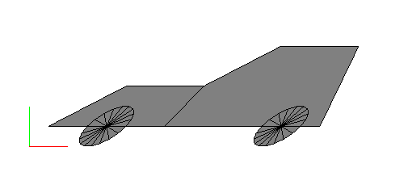
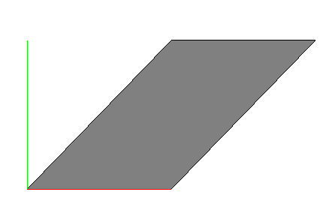
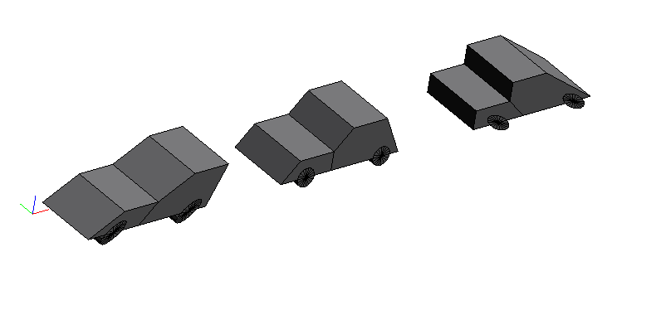
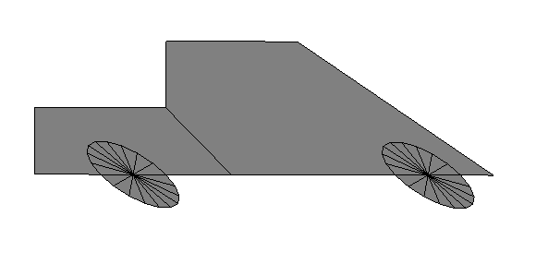
PLaSM, storyboard 3d
MatHom:<<1,b>,<0,1>>:=
<< 1 , 0 , 0 > ,
< 0 , 1 , b > ,
< 0 , 0 , 1 > >
1 -> 1
x -> x+by
y -> y
Hy:1:car
DEF Hy (b::IsReal) = (MAT ~ MatHom):<<1,b>,<0,1>>;
DEF story = STRUCT:< Hy:1:car, T:1:12:car, (T:1:24 ~ Hy:-1):car >;
DEF story3D = (Story * QUOTE:<3.5>);
(T:1:24 ~ Hy:-1):car
story3D

Slide 9
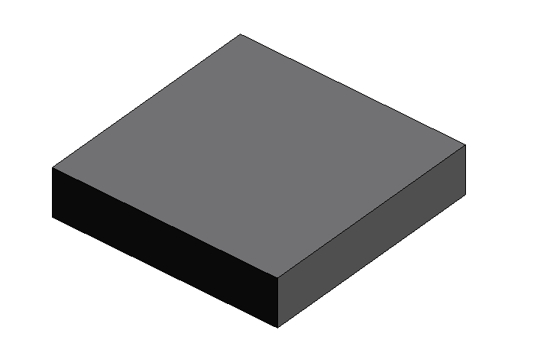
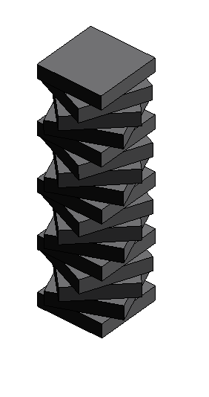
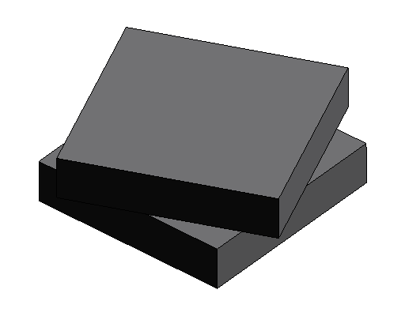
PLaSM, rotation
DEF element =
(T:<1,2>:<-5,-5> ~ CUBOID):<10,10,2>;
DEF pair = STRUCT:<
element,
(T:3:2 ~ R:<1,2>:(PI/8)):element
>;
DEF column = (STRUCT ~ ##:17):
< element, T:3:2, R:<1,2>:(PI/8) >;
element
column
pair

Slide 10

PLaSM, boolean operations
DEF cubo1=cuboid:<1,1>;
DEF cubo2=T:<1,2>:<0.5,0.5>:cubo1;
DEF obj1=cubo1 + cubo2;
DEF obj2=R:<1,2>:(0.3):obj1;
DEF seq =<obj1, obj2>;
DEF base =STRUCT:seq;
DEF bsp_union =+:seq;
DEF bsp_difference =-:seq;
DEF bsp_intersection =&:seq;
DEF bsp_xor =^:seq;
obj1
obj2

Slide 11
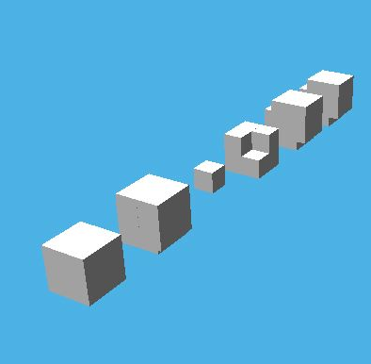
PLASM, Boolean operations
DEF obj1=cuboid:<1,1,1>;
DEF obj2=T:<1,2,3>:<0.5,0.5,0.5>:obj1;
DEF seq=<obj1, obj2>;
DEF base = STRUCT:seq;
DEF bsp_union=+:seq;
DEF bsp_difference=-:seq;
DEF bsp_intersection=&:seq;
DEF bsp_xor=^:seq;

Slide 12
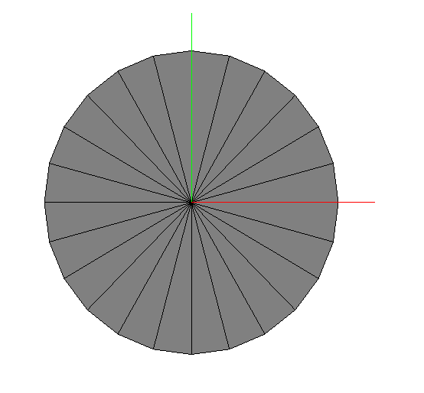
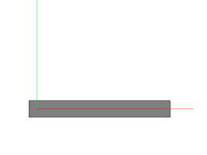
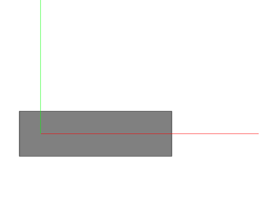
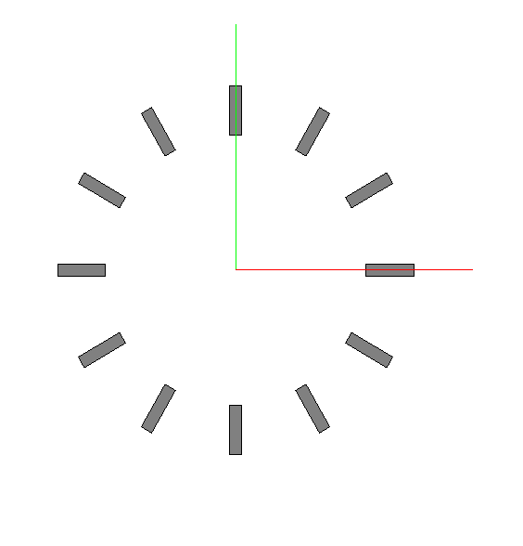
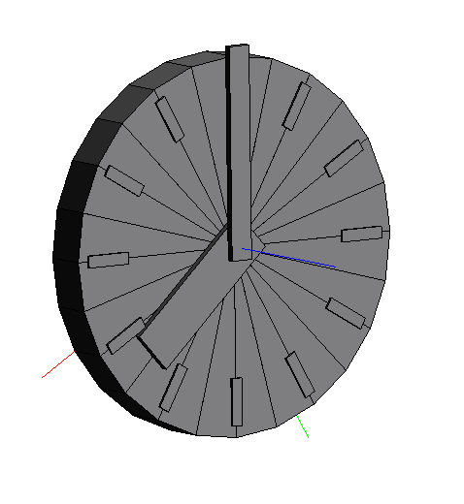
PLaSM, clock
DEF background = Circle:0.8:<24,1>;
DEF minute = (T:<1,2>:<-0.05,-0.05> ~ CUBOID):<0.9,0.1>;
DEF hour = (T:<1,2>:<-0.1,-0.1> ~ CUBOID):<0.7,0.2>;
DEF tick = (T:<1,2>:<-0.025,0.55> ~ CUBOID):<0.05,0.2>;
DEF ticks = (STRUCT ~ ##:12):< tick, R:<1,2>:(PI/6) >;
DEF clock3D (h,m::IsInt) = STRUCT:<
background * Q:0.2 ,
T:3:0.2,
ticks * Q:0.01,
R:<1,2>:( PI/2 - (h + m/60)* (2*PI/12) ):(hour * Q:0.03),
T:3:0.03,
R:<1,2>:( PI/2 - m*(2*PI/60) ):(minute * Q:0.03)
>;
background
minute
hour
ticks
clock3D

Slide 13
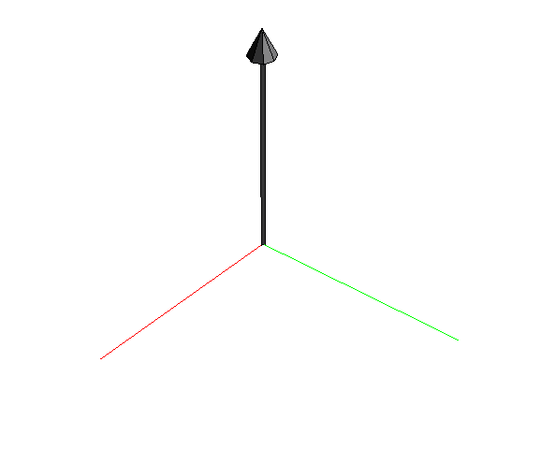
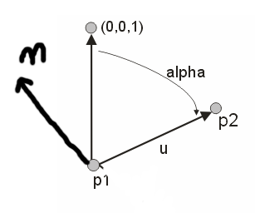
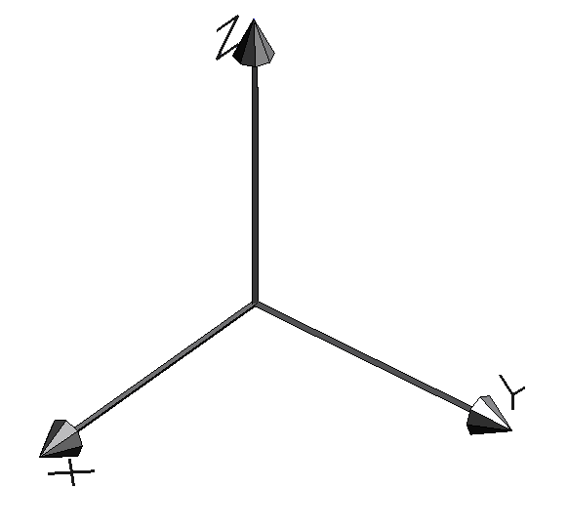
PLaSM, mkframe
DEF MKversork =
CYLINDER:<1/100,7/8,3> TOP (Cone:<1/16,1/8,8>);
DEF MKvector (p1::IsPoint)(p2::IsPoint) =
(Tr ~ Rot ~ Sc):MKversork
WHERE
u = p2 VectDiff p1,
b = VectNorm:u,
n = <0,0,1> VectProd u,
alpha = ACOS:(<0,0,1> innerProd UnitVect:u),
Tr = T:<1,2,3>:p1,
Rot = Rotn:< alpha, n >,
Sc = S:<1,2,3>:<b,b,b>
END;
DEF MKframe = STRUCT:<
MKvector:<0,0,0>:<1,0,0>,
MKvector:<0,0,0>:<0,1,0>,
MKvector:<0,0,0>:<0,0,1>>;

Slide 14
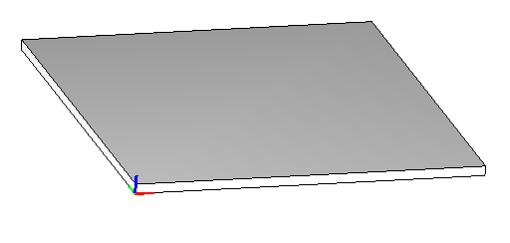
PLaSM, pyramid
(AA:/ ~ DISTR):<REVERSE:((side-nStep+1)..side),side>
con side=18 e nSteps=12
= (AA:/) : (DISTR: <REVERSE:7..18,18>)
= (AA:/) : (DISTR: << 18 , 17 , …. 7 >,18>)
=(AA:/) : < < 18 , 18 > , < 17 , 18 > , < 16 , 18 > , … < 7 , 18 > >
= < 18/18 , 17/18 , 16/18 ,…, 7/18 >
DEF AztecaPyramid (hStep::IsReal; side,nStep::IsInt) =
(T:<1,2>:<side/2,side/2> ~ STRUCT ~ CAT ~ DISTR):
< ( (CONS~AA:(S:<1,2>)):((TRANS~[ID,ID]):ScalingParams) ):ScaledBox,
T:3:hStep>
WHERE
ScalingParams = (AA:/ ~ DISTR):<REVERSE:((side-nStep+1)..side),side>,
ScaledBox = T:<1,2>:<-:(side/2),-:(side/2)>:basis,
basis = CUBOID:<side,side,hStep>
END;
DEF out =(AztecaPyramid:< 0.5, 18, 12>);
TRANS~[ID,ID]
Trasforma la matrice da 2xn a 12xn
(quando applicata a una sequenza di n reali)
Vedi slide successiva
hSteps,side,nSteps

Slide 15
PLaSM, pyramid
ScalingParams=< 18/18, 17/18, … 7/18>
(CAT ~ DISTR) : < <G1,G2,…Gn>, T:3:hStep>
= CAT: (< <G1,T:3:hStep>, <G2,T:3:hstep> ….>)
= < G1, T:3:hStep, G2, T:3:hStep, ….>
(TRANS~[ID,ID]):ScalingParams
= TRANS: <ScalingParams,ScalingParams>
= < <18/18,18/18>, <17/18,17/18>, … <7/18,7/18> > := matrice
DEF AztecaPyramid (hStep::IsReal; side,nStep::IsInt) =
(T:<1,2>:<side/2,side/2> ~ STRUCT ~ CAT~DISTR):
<( (CONS~AA:(S:<1,2>) ) : ( (TRANS~[ID,ID]):ScalingParams) ):ScaledBox, T:3:hStep>
WHERE
….
END;
(CONS~AA:(S:<1,2>)): matrice
=CONS:( < S:<1,2>:<18/18,18/18>, S:<1,2>:<17/18,17/18>, … S:<1,2>:<7/18,7/18> >)
= [S:<1,2>:<18/18,18/18>, S:<1,2>:<17/18,17/18>, S:<1,2>:<7/18,7/18> ] : =
Definisco l’applicazione di tutti questi scalamenti come < G1,G2,…Gn>

Slide 16
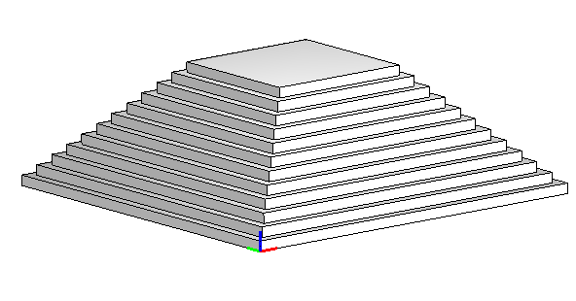
PLaSM, pyramid

Slide 17
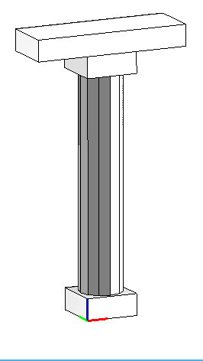
PLaSM temple 1/6
DEF Column (r,h::IsRealPos) =
basis TOP trunk TOP capital TOP beam
WHERE
basis = CUBOID:< 2*r*1.2, 2*r*1.2, h/12 >,
trunk = CYLINDER:< r, (10/12)*h >: 12,
capital = basis,
beam = S:1:3:capital
END
Column:<1,12>
Usando operatori binari di pari precedenza in forma infissa l’associazione e’ a sinistra:
a OP b OP c = (a OP b) OP c
N.B. tutte le funzioni binarie, predefinite o utente, si possono usare in forma infissa, ma
a TOP b RIGHT c <> a TOP (b RIGHT c)

Slide 18
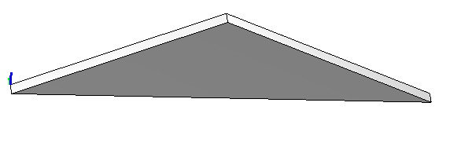
PLaSM temple 2/6
DEF Gable (radius,h::IsReal; n::IsInt) =
R:<2,3>:(PI/2):(triangle * QUOTE:<radius*1.2>)
WHERE
triangle = MKPOL:<<<0,0>,<lastX,0>,<lastX/2,h/2>>,<<1,2,3>>,<<1>>>,
lastX = n*3*(2*radius*1.2)
END;
z
y
x
Gable:<1,12,4>

Slide 19
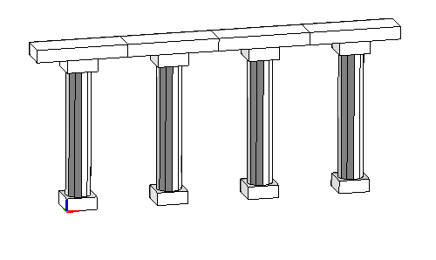
PLaSM temple 3/6
DEF ColRow (n::IsIntPos) = (INSR:RIGHT ~ #:n):(Column:<1, 12>);
(INSR:RIGHT ~ #:n):Obj
= (INSR:RIGHT): (<Obj,Obj,…, Obj>)
= RIGHT:<Obj, (INSR:RIGHT):<Obj,…Obj> >
= ….
= RIGHT:<Obj, RIGHT:<…. RIGHT:<Obj, Obj> >>
Equivalente a
=OBJ RIGHT (OBJ RIGHT OBJ …)
Colrow:4

Slide 20
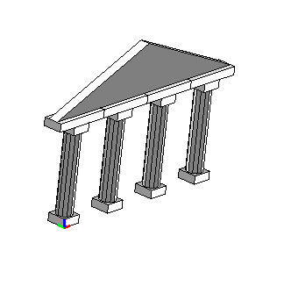
PLaSM temple 4/6
DEF ColRowAndGable = ColRow:4 TOP Gable:<1,12,4>;

Slide 21
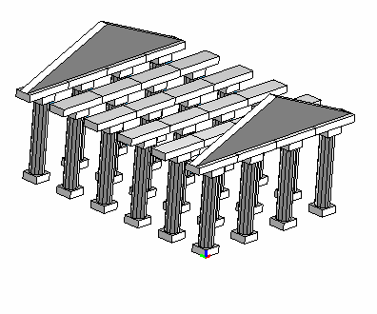
PLaSM temple 5/6
DEF InnerStruct= (STRUCT ~ CAT):
<
<ColRowAndGable, T:2:6>,
##:4:< ColRow:4, T:2:6 >,
<ColRowAndGable>
>;
InnerStruct =(STRUCT ~ CAT):
<
<ColRowAndGable, T:2:6>,
< ColRow:4, T:2:6 , ColRow:4, T:2:6 , ColRow:4, T:2:6 , ColRow:4, T:2:6 >,
< ColRowAndGable>
>
= STRUCT:<
ColRowAndGable, T:2:6,
ColRow:4, T:2:6 , ColRow:4, T:2:6 , ColRow:4, T:2:6 , ColRow:4, T:2:6,
ColRowAndGable>

Slide 22
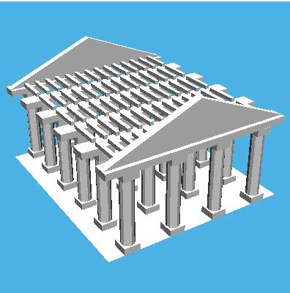
PLaSM temple 6/6
Esempio completo
Aggiunge le travi,
Il pavimento etc

Slide 23
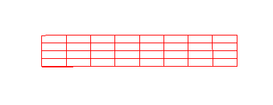
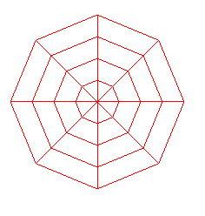
PLaSM, map
DEF Intervals (a::IsRealPos)(n::IsIntPos) = (QUOTE ~ #:n):(a/n);
Ex.
Intervals: 1.0 : 4
=QUOTE: (#:4: (1.0/4) )
=QUOTE: <0.25,0.25,0.25,0.25>
= 4 segmenti di lunghezza 0.25 uno dopo l’altro!
DEF Circle (r::IsReal)(n,m::IsIntPos) =
MAP:([S2 * COS ~ S1, S2 * SIN ~ S1]):
(Intervals:(2*PI):n * Intervals:(r):m);
MAP:([s1, s2]):(Intervals:(2*PI):8 * Intervals:(1):4)
circle:1:<8,4>
Leggi come:
x=r*cos(alpha)
Y=r*sin(alpha)
Griglia bidimensionale regolare di n*m di dimensioni [0,2*PI]*[0,r]

Slide 24

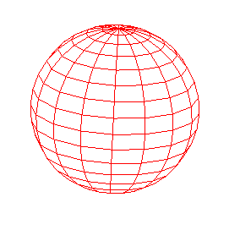
PLaSM, map
DEF Sphere (radius::IsRealPos)(n,m::IsIntPos)
= MAP:[fx,fy,fz]:domain
WHERE
fx = K:radius * - ~ SIN ~ S2 * COS ~ S1,
fy = K:radius * COS ~ S1 * COS ~ S2,
fz = K:radius * SIN ~ S1,
domain = T:1:(PI/-2):(Intervals:PI:n * Intervals:(2*PI):m)
END;
Leggi come:
X= r * sin(alpha) * cos(beta)
Y= r * cos(beta) * cos(alpha)
Z= r * sin(beta)
Griglia regolare bidimensionale di n*m vertici
Parametri (beta,alpha)
Dimensioni [0,PI]*[0,2PI]
sphere:1:<16,16>

