Slide 1
Plasm XML viewer
Come creare modelli in Plasm
e utilizzarli in OpenGL

Slide 2
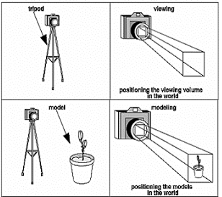
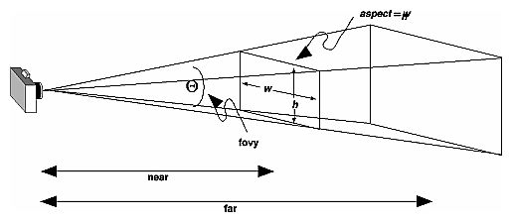
Plasmgl.h / camera
typedef struct
{
float position [3]; /* position */
float direction [3]; /* normalized */
float vup [3]; /* normalized */
float right [3]; /* normalized */
float aspect;
float fov;
float Near,Far;
float viewMatrix [16];
float projectionMatrix[16];
}
plasm_camera_t;

Slide 3
Plasmgl.h / texture
typedef struct
{
unsigned int id; // GLuint OpenGL, dal generate…
char filename[256]; // nome del file caricato
int bpp; // bit per pixel (es 24bit)
int width;
int height;
};
plasm_texture_t;

Slide 4
Plasmgl.h / graph
typedef struct
{
int refcount; // la geometria puo’ essere condivisa…
int nvertices ; // numero di vertici
int ntriangles; // numero di triangoli
float *vertices ; // puntatori agli array
int *triangles;
}
plasm_graph_t;

Slide 5
Plasmgl.h / node
typedef struct __plasm_node_t
{
char name[256]; /* the name */
float *mat; /* transformation matrix in opengl format */
int hidden; /* visible or not */
float *material; /* the material to set
ambient[4] +diffuse[4] + specular[4]+ emission[4]+ shininess*/
char* texture;
int texture_repeat_s, texture_repeat_t;
float* texture_mat;
unsigned int texture_id;
plasm_graph_t *graph; /* pointer to the graph*/
struct __plasm_node_t* child; /* first child node*/
struct __plasm_node_t* next ; /* link to next “brother” */
float* boundaries; /* boundaries (xmin,ymin,zmin) (xmax,ymax,zmax)*/
};
plasm_node_t;

Slide 6
Plasmgl.h / esempio di gerarchia
matrix
material
Root
Root.Child
matrix
matrix
Child 1
Child1.next
Child 2
Child2.next
Child 3
Child1.Child
[…]
[…]
matrix
material
Child 1-1
Child1-1.next
Child 1-2
Child 1-2.next
Child 1-3
Child1-1.graph
Graph 1
refcount=2

Slide 7
Plasmgl.h / metodi
plasm_texture_t* plasm_texture_load_tga (const char *filename);
// da chiamare ogni volta che la camera viene spostata
void plasm_camera_refresh(plasm_camera_t* camera);
// per debugging
void plasm_camera_print (plasm_camera_t* camera);
void plasm_camera_set (plasm_camera_t* camera,
float pos[3],float dir[3],float vup[3],
float aspect,
float fov,
float Near,float Far);
void plasm_camera_move (plasm_camera_t* camera,float dir[3], float howmuch);
void plasm_camera_rotate (plasm_camera_t* camera,int dx, int dy);
void plasm_camera_gltransf (plasm_camera_t* camera);
void plasm_camera_display (plasm_camera_t* camera);

Slide 8
Plasmgl.h / metodi
plasm_node_t* plasm_node_load(const char* filename);
void plasm_node_destroy (plasm_node_t* node);
void plasm_finilize (plasm_node_t* node);
void plasm_draw_node (plasm_node_t* node);
void plasm_draw_graph (const plasm_graph_t* graph);
void plasm_draw_boundaries (plasm_node_t* node);
void plasm_set_default_material (plasm_node_t* node,float R,float G,float B);
void plasm_add_node (plasm_node_t* parent,plasm_node_t* child);

Slide 9
PlasmViewer.c / codice
static int beginx=0,beginy=0;
static float walk_speed=0.2f;
static int bFullScreen=0;
static plasm_node_t* model=0;
static GLuint DLmodel=0; // display list OpenGL
static plasm_camera_t camera;
enum
{
VIEWMODE_FILL=0,
VIEWMODE_LINE=1,
VIEWMODE_END=2
};
static short curviewmode=VIEWMODE_FILL;

Slide 10
PlasmViewer.c / keydown
-
+
w
static void keydown (unsigned char key, int x, int y)
{
switch(key)
{
case 'a': plasm_camera_move (&camera,camera.right ,-1*walk_speed);break;
case 'd': plasm_camera_move (&camera,camera.right ,+1*walk_speed);break;
case 'w': plasm_camera_move (&camera,camera.direction,+1*walk_speed);break;
case 's': plasm_camera_move (&camera,camera.direction,-1*walk_speed);break;
case '+': plasm_camera_move (&camera,camera.vup ,+1*walk_speed);break;
case '-': plasm_camera_move (&camera,camera.vup ,-1*walk_speed);break;
case 'v': curviewmode=(curviewmode+1)%VIEWMODE_END; break;
case 'f': glutFullScreen();break;
case 27:exit(0);
}
glutPostRedisplay();
}
a
s
d

Slide 11
PlasmViewer.c / special key
static void special (int k, int x, int y)
{
switch(k)
{
case GLUT_KEY_LEFT :
  plasm_camera_move(&camera,camera.right ,-1*walk_speed);break;
case GLUT_KEY_UP:
  plasm_camera_move(&camera,camera.direction,+1*walk_speed);break;
case GLUT_KEY_RIGHT:
  plasm_camera_move(&camera,camera.right ,+1*walk_speed);break;
case GLUT_KEY_DOWN :
  plasm_camera_move(&camera,camera.direction,-1*walk_speed);break;
}
glutPostRedisplay();
}

Slide 12
PlasmViewer.c / mouse e motion
void mouse (int button, int state, int x, int y)
{
beginx=x;beginy=y;
glutPostRedisplay();
}
void motion (int x, int y)
{
plasm_camera_rotate (&camera,x-beginx,y-beginy);
beginx=x;beginy=y;
glutPostRedisplay();;
}

Slide 13
PlasmViewer.c / reshape
static void reshape (int W,int H)
{
glViewport(0, 0, W,H);
plasm_camera_set(
    &camera,camera.position,
    camera.direction,
    camera.vup,
    (GLfloat)W/H,
    camera.fov,
    camera.Near,camera.Far
    );
glutPostRedisplay();
}
static void idle (void)
{glutPostRedisplay();}

Slide 14
PlasmViewer.c / display
void display (void)
{
GLfloat light_pos0 [4];
GLfloat white[]={+1.00f,+1.00f,+1.00f,+1.00f};
glClear(GL_COLOR_BUFFER_BIT | GL_DEPTH_BUFFER_BIT);
glEnable(GL_NORMALIZE);
glEnable(GL_LIGHTING);
glShadeModel(GL_SMOOTH);
glLightModelf(GL_LIGHT_MODEL_TWO_SIDE,0);
glLightModelf(GL_LIGHT_MODEL_LOCAL_VIEWER,0);
glLightfv(GL_LIGHT0,GL_AMBIENT ,white);
glLightfv(GL_LIGHT0,GL_DIFFUSE ,white);
glLightfv(GL_LIGHT0,GL_SPECULAR,white);
light_pos0 [0]=camera.position[0];
light_pos0 [1]=camera.position[1];
light_pos0 [2]=camera.position[2];
light_pos0 [3]=+1.00f;
….

Slide 15
PlasmViewer.c / display
glEnable(GL_LIGHT0);
glLightfv(GL_LIGHT0,GL_POSITION,light_pos0);
plasm_camera_gltransf (&camera);
if (curviewmode==VIEWMODE_FILL)
glPolygonMode(GL_FRONT_AND_BACK ,GL_FILL);
else
glPolygonMode(GL_FRONT_AND_BACK ,GL_LINE);
glCallList(DLmodel); //OpenGL display List
glutSwapBuffers();
}

Slide 16
PlasmViewer.c / main
int main (int nargs,char** args)
{
float dims[3];
float maxdim;
float pos[3],dir[3],vup[3];
GLfloat backgroundColor[]={0.80f, 0.80f, 1.00f, 0.00f};
if (nargs!=2)
{
printf("Syntax error. Use %s <filename.xml>\n",args[0]);
return -1;
}
glutInit(&nargs, args);
glutInitDisplayMode(GLUT_DEPTH|GLUT_RGB|GLUT_DOUBLE);
standard_window_width =1024;
standard_window_height=1024;

Slide 17
PlasmViewer.c / main
glutInitWindowSize(standard_window_width,standard_window_height);
glutCreateWindow("PLaSM Viewer");
glutReshapeFunc (reshape);
glutKeyboardFunc(keydown);
glutDisplayFunc (display);
glutSpecialFunc(special);
glutMouseFunc (mouse);
glutMotionFunc (motion);
glutIdleFunc (idle);
glClearDepth(1.0f);
glEnable(GL_DEPTH_TEST);
glEnable(GL_NORMALIZE);
glClearColor( backgroundColor[0],backgroundColor[1],backgroundColor[2],backgroundColor[3] );

Slide 18
PlasmViewer.c / main
model=plasm_node_load(args[1]);
if (!model->mat) plasm_set_default_material(model,0.5,0.5,0.5);
plasm_finilize(model);
dims[0]=model->boundaries[3]-model->boundaries[0];
dims[1]=model->boundaries[4]-model->boundaries[1];
dims[2]=model->boundaries[5]-model->boundaries[2];
maxdim=dims[0];
if (dims[1]>maxdim) maxdim=dims[1];
if (dims[2]>maxdim) maxdim=dims[2];
walk_speed=maxdim/200.0f;
pos[0]=maxdim*2; dir[0]=0-pos[0]; vup[0]=0;
pos[1]=maxdim*1; dir[1]=0-pos[1]; vup[1]=1;
pos[2]=maxdim*2; dir[2]=0-pos[2]; vup[2]=0;
plasm_camera_set(&camera,pos,dir,vup,1,65,walk_speed,1e8*walk_speed);

Slide 19
PlasmViewer.c / main
  DLmodel=glGenLists(1);
glNewList(DLmodel, GL_COMPILE);
glPushMatrix();
plasm_draw_node(model);
glPopMatrix();
glEndList();
glutMainLoop();
return 0;
}

Slide 20
Plasmgl.cpp / geometry utilities
static void unify (GLfloat res[3])
{
GLfloat magnitude = (GLfloat)sqrt(res[0]*res[0] + res[1]*res[1] + res[2]*res[2]);
res[0]/=magnitude;
res[1]/=magnitude;
res[2]/=magnitude;
}
void crossproduct (GLfloat res[3],GLfloat a[3], GLfloat b[3])
{
res[0] = (a[1] * b[2] - a[2] * b[1]);
res[1] = (a[2] * b[0] - a[0] * b[2]);
res[2] = (a[0] * b[1] - a[1] * b[0]);
unify(res);
}

Slide 21
Plasmgl.cpp / geometry utilities
// handle OpenGL column major mode
void multiply (GLfloat _ret[16],const GLfloat a[16],const GLfloat b[16])
{
GLfloat ret[16];
ret[ 0]=a[0]*b[ 0]+a[4]*b[ 1]+a[ 8]*b[ 2]+a[12]*b[ 3];
ret[ 1]=a[1]*b[ 0]+a[5]*b[ 1]+a[ 9]*b[ 2]+a[13]*b[ 3];
ret[ 2]=a[2]*b[ 0]+a[6]*b[ 1]+a[10]*b[ 2]+a[14]*b[ 3];
ret[ 3]=a[3]*b[ 0]+a[7]*b[ 1]+a[11]*b[ 2]+a[15]*b[ 3];
ret[ 4]=a[0]*b[ 4]+a[4]*b[ 5]+a[ 8]*b[ 6]+a[12]*b[ 7];
ret[ 5]=a[1]*b[ 4]+a[5]*b[ 5]+a[ 9]*b[ 6]+a[13]*b[ 7];
ret[ 6]=a[2]*b[ 4]+a[6]*b[ 5]+a[10]*b[ 6]+a[14]*b[ 7];
ret[ 7]=a[3]*b[ 4]+a[7]*b[ 5]+a[11]*b[ 6]+a[15]*b[ 7];
ret[ 8]=a[0]*b[ 8]+a[4]*b[ 9]+a[ 8]*b[10]+a[12]*b[11];
ret[ 9]=a[1]*b[ 8]+a[5]*b[ 9]+a[ 9]*b[10]+a[13]*b[11];
ret[10]=a[2]*b[ 8]+a[6]*b[ 9]+a[10]*b[10]+a[14]*b[11];
ret[11]=a[3]*b[ 8]+a[7]*b[ 9]+a[11]*b[10]+a[15]*b[11];
ret[12]=a[0]*b[12]+a[4]*b[13]+a[ 8]*b[14]+a[12]*b[15];
ret[13]=a[1]*b[12]+a[5]*b[13]+a[ 9]*b[14]+a[13]*b[15];
ret[14]=a[2]*b[12]+a[6]*b[13]+a[10]*b[14]+a[14]*b[15];
ret[15]=a[3]*b[12]+a[7]*b[13]+a[11]*b[14]+a[15]*b[15];
memcpy(_ret,ret,sizeof(ret));
}

Slide 22
Plasmgl.cpp / geometry utilities
// handle OpenGL column major mode
static void inverse (GLfloat a[16])
{
GLfloat Det=
a[3] * a[6] * a[9] * a[12]-a[2] * a[7] * a[9] * a[12]-a[3] * a[5] * a[10] * a[12]+a[1] * a[7] * a[10] * a[12]+
a[2] * a[5] * a[11] * a[12]-a[1] * a[6] * a[11] * a[12]-a[3] * a[6] * a[8] * a[13]+a[2] * a[7] * a[8] * a[13]+
a[3] * a[4] * a[10] * a[13]-a[0] * a[7] * a[10] * a[13]-a[2] * a[4] * a[11] * a[13]+a[0] * a[6] * a[11] * a[13]+
a[3] * a[5] * a[8] * a[14]-a[1] * a[7] * a[8] * a[14]-a[3] * a[4] * a[9] * a[14]+a[0] * a[7] * a[9] * a[14]+
a[1] * a[4] * a[11] * a[14]-a[0] * a[5] * a[11] * a[14]-a[2] * a[5] * a[8] * a[15]+a[1] * a[6] * a[8] * a[15]+
a[2] * a[4] * a[9] * a[15]-a[0] * a[6] * a[9] * a[15]-a[1] * a[4] * a[10] * a[15]+a[0] * a[5] * a[10] * a[15];
GLfloat a00 = (a[6]*a[11]*a[13] - a[7]*a[10]*a[13] + a[7]*a[9]*a[14] - a[5]*a[11]*a[14] - a[6]*a[9]*a[15] + a[5]*a[10]*a[15]) / Det ;
GLfloat a01 = (a[3]*a[10]*a[13] - a[2]*a[11]*a[13] - a[3]*a[9]*a[14] + a[1]*a[11]*a[14] + a[2]*a[9]*a[15] - a[1]*a[10]*a[15]) / Det ;
GLfloat a02 = (a[2]*a[7 ]*a[13] - a[3]*a[ 6]*a[13] + a[3]*a[5]*a[14] - a[1]*a[ 7]*a[14] - a[2]*a[5]*a[15] + a[1]*a[ 6]*a[15]) / Det ;
GLfloat a03 = (a[3]*a[6 ]*a[9 ] - a[2]*a[ 7]*a[ 9] - a[3]*a[5]*a[10] + a[1]*a[ 7]*a[10] + a[2]*a[5]*a[11] - a[1]*a[ 6]*a[11]) / Det ;
GLfloat a10 = (a[7]*a[10]*a[12] - a[6]*a[11]*a[12] - a[7]*a[8]*a[14] + a[4]*a[11]*a[14] + a[6]*a[8]*a[15] - a[4]*a[10]*a[15]) / Det ;
GLfloat a11 = (a[2]*a[11]*a[12] - a[3]*a[10]*a[12] + a[3]*a[8]*a[14] - a[0]*a[11]*a[14] - a[2]*a[8]*a[15] + a[0]*a[10]*a[15]) / Det ;
GLfloat a12 = (a[3]*a[6 ]*a[12] - a[2]*a[ 7]*a[12] - a[3]*a[4]*a[14] + a[0]*a[ 7]*a[14] + a[2]*a[4]*a[15] - a[0]*a[ 6]*a[15]) / Det ;
GLfloat a13 = (a[2]*a[7 ]*a[8 ] - a[3]*a[ 6]*a[ 8] + a[3]*a[4]*a[10] - a[0]*a[ 7]*a[10] - a[2]*a[4]*a[11] + a[0]*a[ 6]*a[11]) / Det ;
GLfloat a20 = (a[5]*a[11]*a[12] - a[7]*a[ 9]*a[12] + a[7]*a[8]*a[13] - a[4]*a[11]*a[13] - a[5]*a[8]*a[15] + a[4]*a[ 9]*a[15]) / Det ;
GLfloat a21 = (a[3]*a[9 ]*a[12] - a[1]*a[11]*a[12] - a[3]*a[8]*a[13] + a[0]*a[11]*a[13] + a[1]*a[8]*a[15] - a[0]*a[ 9]*a[15]) / Det ;
GLfloat a22 = (a[1]*a[7 ]*a[12] - a[3]*a[ 5]*a[12] + a[3]*a[4]*a[13] - a[0]*a[ 7]*a[13] - a[1]*a[4]*a[15] + a[0]*a[ 5]*a[15]) / Det ;
GLfloat a23 = (a[3]*a[5 ]*a[8 ] - a[1]*a[ 7]*a[ 8] - a[3]*a[4]*a[ 9] + a[0]*a[ 7]*a[ 9] + a[1]*a[4]*a[11] - a[0]*a[ 5]*a[11]) / Det ;
GLfloat a30 = (a[6]*a[9 ]*a[12] - a[5]*a[10]*a[12] - a[6]*a[8]*a[13] + a[4]*a[10]*a[13] + a[5]*a[8]*a[14] - a[4]*a[ 9]*a[14]) / Det ;
GLfloat a31 = (a[1]*a[10]*a[12] - a[2]*a[ 9]*a[12] + a[2]*a[8]*a[13] - a[0]*a[10]*a[13] - a[1]*a[8]*a[14] + a[0]*a[ 9]*a[14]) / Det ;
GLfloat a32 = (a[2]*a[5 ]*a[12] - a[1]*a[ 6]*a[12] - a[2]*a[4]*a[13] + a[0]*a[ 6]*a[13] + a[1]*a[4]*a[14] - a[0]*a[ 5]*a[14]) / Det ;
GLfloat a33 = (a[1]*a[6 ]*a[8 ] - a[2]*a[ 5]*a[ 8] + a[2]*a[4]*a[ 9] - a[0]*a[ 6]*a[ 9] - a[1]*a[4]*a[10] + a[0]*a[ 5]*a[10]) / Det ;
a[ 0]=a00; a[ 1]=a01; a[ 2]=a02; a[ 3]=a03;
a[ 4]=a10; a[ 5]=a11; a[ 6]=a12; a[ 7]=a13;
a[ 8]=a20; a[ 9]=a21; a[10]=a22; a[11]=a23;
a[12]=a30; a[13]=a31; a[14]=a32; a[15]=a33;
}

Slide 23
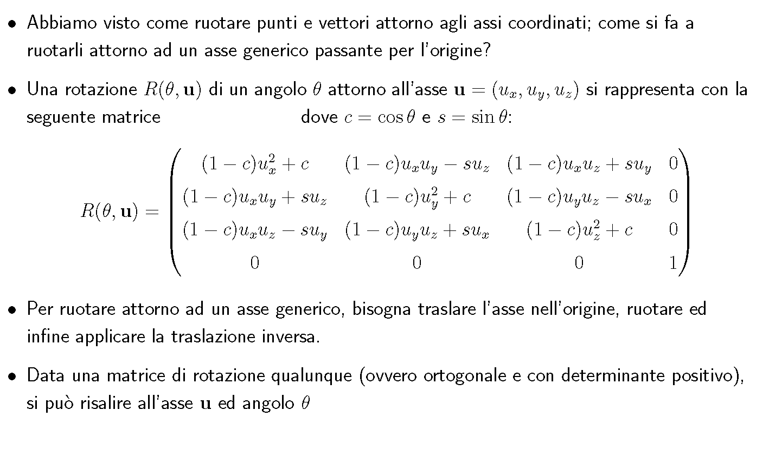
Richiamo: 01_cap3_trasformazioniaffini

Slide 24
Plasmgl.cpp / rotate
static void rotate (GLfloat view[3], GLfloat angle, GLfloat x, GLfloat y, GLfloat z)
{
GLfloat c = (GLfloat)cos(angle) ;
GLfloat s = (GLfloat)sin(angle);
GLfloat new_x =
(x*x*(1-c) + c) * view[0] +
(x*y*(1-c) - z*s) * view[1] +
(x*z*(1-c) + y*s) * view[2];
GLfloat new_y =
(y*x*(1-c) + z*s) * view[0] +
(y*y*(1-c) + c ) * view[1] +
(y*z*(1-c) - x*s) * view[2];
GLfloat new_z =
(x*z*(1-c) - y*s) * view[0] +
(y*z*(1-c) + x*s) * view[1] +
(z*z*(1-c) + c ) * view[2];
view[0] = new_x;view[1] = new_y;view[2] = new_z;
unify(view);
}

Slide 25
Plasmgl.cpp / carica tga
plasm_texture_t* plasm_texture_load_tga (const char *filename)
{
plasm_texture_t* ret=(plasm_texture_t*)malloc(sizeof(plasm_texture_t));
…
ret->width = …;
ret->height = …;
ret->bpp = …;
…
GLuint imageSize= (ret->width)*(ret->height)*bytesPerPixel;
unsigned char* imageData=(GLubyte *)malloc(imageSize);
glGenTextures(1,&ret->id);
glBindTexture(GL_TEXTURE_2D, ret->id);
glTexParameteri(GL_TEXTURE_2D, GL_TEXTURE_MIN_FILTER, GL_LINEAR);
glTexParameteri(GL_TEXTURE_2D ,GL_TEXTURE_MAG_FILTER, GL_LINEAR);
gluBuild2DMipmaps(GL_TEXTURE_2D, 3,
ret->width, ret->height, GL_RGB, GL_UNSIGNED_BYTE, imageData);
free(imageData);
return ret;
}

Slide 26
Plasmgl.cpp / print camera
void plasm_camera_print (plasm_camera_t* camera)
{
printf("GLfloat position []={%f,%f,%f};",
    camera->position[0],camera->position[1],camera->position[2]);
printf("GLfloat direction[]={%f,%f,%f};",
    camera->direction[0],camera->direction[1],camera->direction[2]);
printf("GLfloat vup []={%f,%f,%f};",
camera->vup[0],camera->vup[1],camera->vup[2]);
printf("GLfloat fov =%f;",camera->fov);
printf("GLfloat Near =%f;",camera->Near);
printf("GLfloat Far =%f;",camera->Far );
}

Slide 27
Plasmgl.cpp / refresh camera
void plasm_camera_refresh (plasm_camera_t* camera)
{
GLfloat lookAt[3]={
camera->position[0]+camera->direction[0],
camera->position[1]+camera->direction[1],
camera->position[2]+camera->direction[2]
};
unify(camera->direction);
unify(camera->vup);
crossproduct( camera->right , camera->direction,camera->vup);
glPushMatrix();glLoadIdentity();
gluLookAt(
camera->position [0], camera->position[1], camera->position[2],
lookAt[0], lookAt [1], lookAt[2],
camera->vup[0], camera->vup[1], camera->vup[2]
);
glGetFloatv(GL_MODELVIEW_MATRIX, camera->viewMatrix);
glPopMatrix();
glPushMatrix();glLoadIdentity();
gluPerspective (camera->fov,camera->aspect, camera->Near, camera->Far);
glGetFloatv(GL_MODELVIEW_MATRIX, camera->projectionMatrix);
glPopMatrix();
}

Slide 28
Plasmgl.cpp / set camera
void plasm_camera_set ( plasm_camera_t* camera,
  GLfloat pos[3],GLfloat dir[3],GLfloat vup[3],
  GLfloat aspect,GLfloat fov,
  GLfloat Near,GLfloat Far)
{
camera->position[0]=pos[0];
camera->position[1]=pos[1];
camera->position[2]=pos[2];
camera->direction[0]=dir[0];
camera->direction[1]=dir[1];
camera->direction[2]=dir[2];
camera->vup[0]=vup[0];
camera->vup[1]=vup[1];
camera->vup[2]=vup[2];
camera->aspect=aspect;
camera->fov=fov;
camera->Near=Near;
camera->Far=Far;
plasm_camera_refresh (camera); //importante!
}

Slide 29
Plasmgl.cpp / muovi camera
void plasm_camera_move(plasm_camera_t* camera,
GLfloat _dir[3], GLfloat howmuch)
{
GLfloat dir[3]={_dir[0],_dir[1],_dir[2]};
unify(dir);
camera->position[0]+=howmuch*dir[0];
camera->position[1]+=howmuch*dir[1];
camera->position[2]+=howmuch*dir[2];
plasm_camera_refresh (camera); //importante!
}

Slide 30
Plasmgl.cpp / mouse rotate
void plasm_camera_rotate (plasm_camera_t* camera,
  GLint dx, GLint dy) //movimento del mouse in dx e dy
{
GLfloat sensitivity=0.005f;
GLfloat rot_axis[3];
rotate (camera->direction, -(GLfloat)dx * sensitivity, 0.0f, 1.0f, 0.0f);
y
Camera->direction
Camera->position
Si gira su se stesso….

Slide 31
Plasmgl.cpp / mouse rotate
rot_axis[0] = -camera->direction[2];
rot_axis[1] = 0.0f;
rot_axis[2] = +camera->direction[0];
unify(rot_axis);
rotate (camera->direction,
-(GLfloat)dy * sensitivity, rot_axis[0],rot_axis[1],rot_axis[2]);
plasm_camera_refresh(camera);
}
z
Direction’
Direction
x
Guarda in alto e in basso

Slide 32
Plasmgl.cpp / set OpenGL mat
void plasm_camera_gltransf (plasm_camera_t* camera)
{
glMatrixMode(GL_PROJECTION);
glLoadIdentity();
gluPerspective (camera->fov, camera->aspect, camera->Near,camera->Far);
glMatrixMode(GL_MODELVIEW);
glLoadIdentity();
gluLookAt
(
camera->position[0],
camera->position[1],
camera->position[2],
camera->position[0] + camera->direction[0],
camera->position[1] + camera->direction[1],
camera->position[2] + camera->direction[2],
camera->vup[0],
camera->vup[1],
camera->vup[2]
);
}

Slide 33
Plasmgl.cpp / disegna wire cube
void drawWireCube (float x1,float y1,float z1,float x2,float y2,float z2)
{
glBegin(GL_LINE_LOOP);
glVertex3f(x1,y1,z1);glVertex3f(x2,y1,z1);glVertex3f(x2,y2,z1);glVertex3f(x1,y2,z1);
glEnd();
glBegin(GL_LINE_LOOP);
glVertex3f(x1,y1,z2);glVertex3f(x2,y1,z2);glVertex3f(x2,y2,z2);glVertex3f(x1,y2,z2);
glEnd();
glBegin(GL_LINES);
glVertex3f(x1,y1,z1);glVertex3f(x1,y1,z2);
glVertex3f(x2,y1,z1);glVertex3f(x2,y1,z2);
glVertex3f(x2,y2,z1);glVertex3f(x2,y2,z2);
glVertex3f(x1,y2,z1);glVertex3f(x1,y2,z2);
glEnd();
}

Slide 34
Plasmgl.cpp / set material
void plasm_set_default_material (plasm_node_t* node,
GLfloat R,GLfloat G,GLfloat B)
{
GLfloat* m=(GLfloat*)malloc(sizeof(GL_FLOAT)*17);
m[ 0]=m[ 1]=m[ 2]=+0.05f; m[ 3]=+1.00f; /* very little ambient */
m[ 4]=R ;m[ 5]=G; m[ 6]=B; m[ 7]=+1.00f; /* diffuse */
m[ 8]=m[ 9]=m[10]=0; m[11]=+1.00f; /* NO specular */
m[12]=m[13]=m[14]=0; m[15]=+1.00f; /* NO emission */
m[16]=45; /* shininess */
node->material=m;
}

Slide 35
Plasmgl.cpp / crea gerarchia
void plasm_add_node (
plasm_node_t* parent,
plasm_node_t* child)
{
child->next=parent->child;
parent->child=child;
}
Prima…
NewChild
Root
Root.Child
OldChild
Dopo…
Root
Root.Child
NewChild
OldChild

Slide 36
Plasmgl.cpp / disegna graph
void plasm_draw_graph (const plasm_graph_t* graph)
{
GLint* p;
int ntriangles=graph->ntriangles;
glBegin(GL_TRIANGLES);
for (p=graph->triangles;ntriangles;--ntriangles,p+=3)
{
float *p1=graph->vertices+p[0]*3;
float *p2=graph->vertices+p[1]*3;
float *p3=graph->vertices+p[2]*3;
float x1=p1[0], y1=p1[1], z1=p1[2];
float x2=p2[0], y2=p2[1], z2=p2[2];
float x3=p3[0], y3=p3[1], z3=p3[2];
float nx=y1*(z2 - z3) + y2*(z3 - z1) + y3*(z1 - z2);
float ny=z1*(x2 - x3) + z2*(x3 - x1) + z3*(x1 - x2);
float nz=x1*(y2 - y3) + x2*(y3 - y1) + x3*(y1 - y2);
glNormal3f (nx,ny,nz);
glVertex3f(x1,y1,z1);
glVertex3f(x2,y2,z2);
glVertex3f(x3,y3,z3);
}
glEnd();
}
typedef struct
{
int refcount;
int nvertices ;
int ntriangles;
float *vertices ;
int *triangles;
}
plasm_graph_t;

Slide 37
Plasmgl.cpp / disegna bounding box
void plasm_draw_boundaries (plasm_node_t* node)
{
plasm_node_t* child;
if (node->hidden)
return;
drawWireCube (
node->boundaries[0],node->boundaries[1],node->boundaries[2],
node->boundaries[3],node->boundaries[4],node->boundaries[5]);
/* iterate to subnodes */
for (child=node->child;child;child=child->next)
plasm_draw_boundaries(child);
}

Slide 38
Plasmgl.cpp / disegna node
void plasm_draw_node_inner (plasm_node_t* node)
{
….
if (node->material)
{
glPushAttrib(GL_LIGHTING_BIT); //salvo I materiali….
float* ambient=&node->material[0];
glMaterialfv(GL_FRONT_AND_BACK ,GL_AMBIENT ,ambient);
float* diffuse=&node->material[4];
glMaterialfv(GL_FRONT_AND_BACK ,GL_DIFFUSE ,diffuse);
float* specular=&node->material[8];
glMaterialfv(GL_FRONT_AND_BACK ,GL_SPECULAR ,specular);
float* emission=&node->material[12];
glMaterialfv(GL_FRONT_AND_BACK ,GL_EMISSION ,emission);
float shininess =node->material[16];
glMaterialf (GL_FRONT_AND_BACK ,GL_SHININESS, shininess);
}
}

Slide 39
Plasmgl.cpp / disegna node
//applico la matrice di trasformazione
if (node->mat)
{
glPushMatrix();
glMultMatrixf(node->mat);
}
if (node->graph)
plasm_draw_graph(node->graph);
for (child=node->child;child;child=child->next)
plasm_draw_node_inner(child);
if (node->mat)
glPopMatrix();
if (node->material)
glPopAttrib();

Slide 40
Plasmgl.cpp / disegna node
void plasm_draw_node (plasm_node_t* node)
{
plasm_draw_node_inner(node);
}

Slide 41
Plasmgl.cpp / navigazione gerarchia
matrix
material
Root
Root.Child
matrix
matrix
Child 1
Child1.next
Child 2
Child2.next
Child 3
Child1.Child
[…]
[…]
matrix
material
Child 1-1
Child1-1.next
Child 1-2
Child 1-2.next
Child 1-3
Child1-1.graph
Graph 1
refcount=2

Slide 42
Plasmgl.cpp / finalizzazione
void plasm_finilize (plasm_node_t* node)
{
glPushMatrix();
glLoadIdentity();
plasm_finilize_inner(node);
glPopMatrix();
}

Slide 43
Plasmgl.cpp / finalizzazione
void plasm_finilize_inner (plasm_node_t* node)
{
plasm_node_t* child;
bool bGood=false;
int i;
float *v;
float X,Y,Z,T0,TX,TY,TZ;
GLfloat cm[16];
if (!node->boundaries)
node->boundaries=(float*)malloc(sizeof(float)*6);
node->boundaries[0]=node->boundaries[1]=node->boundaries[2]=+1e18f;
node->boundaries[3]=node->boundaries[4]=node->boundaries[5]=-1e18f;
if (node->mat)
{
glPushMatrix();
glMultMatrixf(node->mat);
}

Slide 44
Plasmgl.cpp / finalizzazione
for (child=node->child;child;child=child->next)
{
plasm_finilize_inner(child); //recursive call
node->boundaries[0]=min2(node->boundaries[0],child->boundaries[0]);
node->boundaries[1]=min2(node->boundaries[1],child->boundaries[1]);
node->boundaries[2]=min2(node->boundaries[2],child->boundaries[2]);
node->boundaries[3]=max2(node->boundaries[3],child->boundaries[3]);
node->boundaries[4]=max2(node->boundaries[4],child->boundaries[4]);
node->boundaries[5]=max2(node->boundaries[5],child->boundaries[5]);
}

Slide 45
Plasmgl.cpp / finalizzazione
if (node->graph)
{
glGetFloatv(GL_MODELVIEW_MATRIX, cm);
for (i=0;i<node->graph->nvertices;i++)
{
v=node->graph->vertices+i*3;
T0=1;
X=TX=v[0];
Y=TY=v[1];
Z=TZ=v[2];
const int mi[]={15,3,7,11,12,0,4,8,13,1,5,9,14,2,6,10};
T0=cm[mi[ 0]]*1+cm[mi[ 1]]*X+cm[mi[ 2]]*Y+cm[mi[ 3]]*Z;
TX=cm[mi[ 4]]*1+cm[mi[ 5]]*X+cm[mi[ 6]]*Y+cm[mi[ 7]]*Z;
TY=cm[mi[ 8]]*1+cm[mi[ 9]]*X+cm[mi[10]]*Y+cm[mi[11]]*Z;
TZ=cm[mi[12]]*1+cm[mi[13]]*X+cm[mi[14]]*Y+cm[mi[15]]*Z;
TX/=T0;TY/=T0;TZ/=T0;
node->boundaries[0]=min2(node->boundaries[0],TX);
node->boundaries[1]=min2(node->boundaries[1],TY);
node->boundaries[2]=min2(node->boundaries[2],TZ);
node->boundaries[3]=max2(node->boundaries[3],TX);
node->boundaries[4]=max2(node->boundaries[4],TY);
node->boundaries[5]=max2(node->boundaries[5],TZ);
}
}
if (node->mat) glPopMatrix();
}

Slide 46
Plasmgl.cpp / load OBJ
plasm_graph_t* plasm_load_obj (const char* filename)
{
plasm_graph_t* g=0; //la struttura che verra’ restituita
char buf[2048];
FILE* file=fopen(filename,"rt");
if (!file) return; //errore!
while (fscanf(file, "%s", buf) != EOF)
{

Slide 47
Plasmgl.cpp / load OBJ
case 'v’: //vertex!
{
float X,Y,Z;
fscanf(file, "%e %e %e", &X, &Y, &Z);
…
//assumo che l’array di vertici sia grande abbastanza
g->vertices[g->nvertices*3+0]=X;
g->vertices[g->nvertices*3+1]=Y;
g->vertices[g->nvertices*3+2]=Z;
g->nvertices++;
break;
}

Slide 48
Plasmgl.cpp / load OBJ
case 'f': //face!
{
int v0,v1,v2;
fscanf(file,"%d %d %d",&v0,&v1,&v2);
…
//assumo che l’array di triangoli sia grande abbastanza
g->triangles[g->ntriangles*3+0]=v0;
g->triangles[g->ntriangles*3+1]=v1;
g->triangles[g->ntriangles*3+2]=v2;
g->ntriangles++;
break;
}

Slide 49
Plasmgl.cpp / deallocazione
void plasm_graph_destroy (plasm_graph_t* graph)
{
if (!graph) return;
--(graph->refcount);
if (!graph->refcount)
{
free(graph->vertices);
free(graph->triangles);
free(graph);
}
}
typedef struct
{
int refcount;
int nvertices ;
int ntriangles;
float *vertices ;
int *triangles;
}
plasm_graph_t;

Slide 50
Plasmgl.cpp / deallocazione
void plasm_node_destroy (plasm_node_t* node)
{
for (plasm_node_t* child=node->child,*next;child;child=next)
{
next=child->next;
plasm_node_destroy(child);
}
if (node->texture_id ) glDeleteTextures(1,&node->texture_id);
if (node->mat ) free(node->mat);
if (node->material ) free(node->material);
if (node->boundaries ) free(node->boundaries);
if (node->texture ) free(node->texture);
if (node->texture_mat) free(node->texture_mat);
plasm_graph_destroy(node->graph);
free(node);
}
typedef struct __plasm_node_t
{
char name[256];
float *mat;
int hidden;
float *material;
char* texture;
int texture_repeat_s, texture_repeat_t;
float* texture_mat;
unsigned int texture_id;
plasm_graph_t *graph;
struct __plasm_node_t* child;
struct __plasm_node_t* next ;
float* boundaries;
};
plasm_node_t;

Slide 51
Plasmgl.cpp / load da file
plasm_node_t* plasm_node_load (const char* filename)
{
char gfilename[1024];
sprintf(gfilename,"%s.obj",filename);
// carica il file OBJ (geometria)
plasm_graph_t* obj=plasm_load_obj (gfilename);
// carica il file XML (gerarchia)
TiXmlDocument doc(filename);
if (!doc.LoadFile()) return 0;
plasm_node_t* ret=plasm_node_load_inner (&doc);
…
return ret;
}

Slide 52
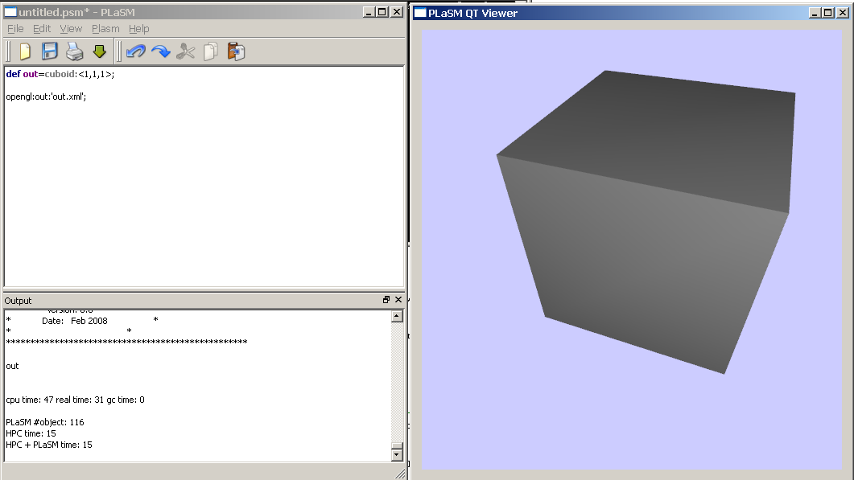
Esempio…

Slide 53
Cuboid -> Out.xml
<hpc name='out' >
  <hpc geometry='graph_0' />
</hpc>

Slide 54
Cuboid -> Out.xml.obj
g graph_0
v 1 0 0
v 0 0 0
v 0 0 1
v 1 0 1
v 0 1 1
v 1 1 1
v 1 1 0
v 0 1 0
f 3 2 1
f 3 1 0
f 1 7 6
f 0 1 6
f 6 5 3
f 6 3 0
f 2 4 7
f 1 2 7
f 5 4 2
f 5 2 3
f 4 5 6
f 4 6 7

Slide 55
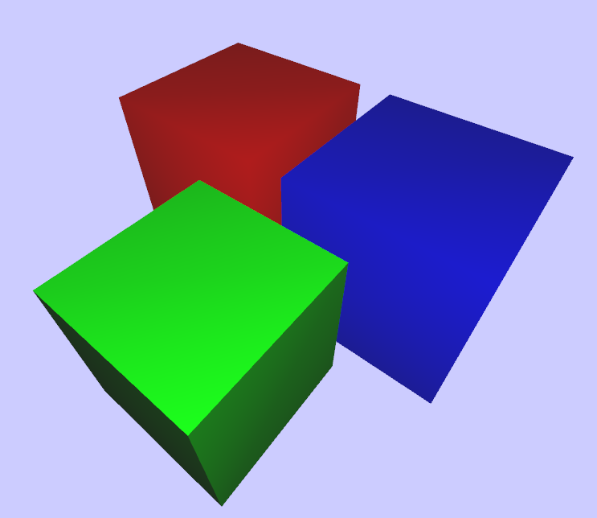
Esempio con colori…
DEF mycube = CUBOID:<1,1,1>;
DEF out = STRUCT:
<
mycube color RED,
T:1:1.2,
mycube color BLUE,
T:<1,2,3>:<-0.6,-0.3,1>,
mycube color GREEN
>;
opengl:out:'out.xml';

Slide 56
Out.xml
<hpc name='out' >
<hpc color='1 0 0' name='mycube' >
<hpc geometry='graph_0' />
</hpc>
<hpc color='0 0 1' name='mycube' >
<hpc glmat=‘…' geometry='graph_0' />
</hpc>
<hpc color='0 1 0' name='mycube' >
<hpc glmat='…' geometry='graph_0' />
</hpc>
</hpc>

Slide 57
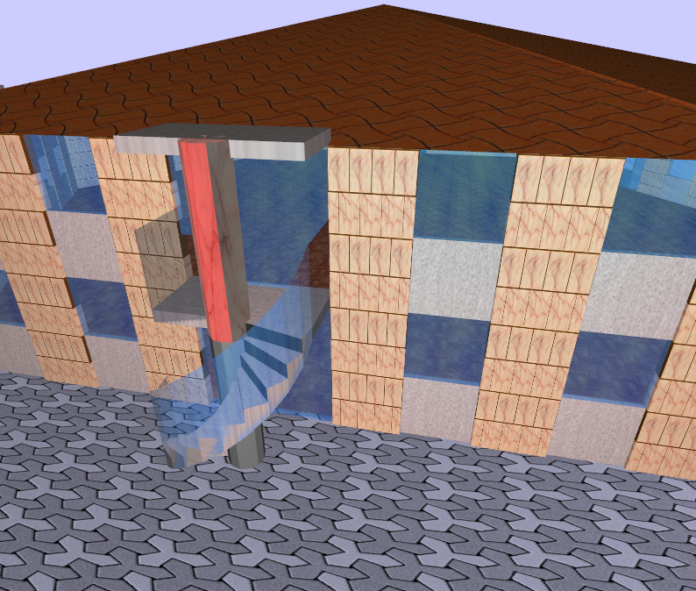
Building.psm con textures…

Slide 58
Dal sito: plasm.opengl.viewer.zip
Glut viewer
  main.c (==plasmviewer.c)
Kernel del viewer
  plasmgl.h
  plasmgl.cpp
Per leggere XML (la piu’ piccola libreria disponibile in C++):
  tinystr.h tinyxml.h tinystr.cpp tinyxml.cpp tinyxmlerror.cpp tinyxmlparser.cpp
Esempio di modello esportato:
  palazzo.xml.obj
  palazzo.xml
Makefile

Slide 59
Makefile
….
OBJ= tinystr.o tinyxml.o tinyxmlparser.o tinyxmlerror.o plasmgl.o main.o
ifeq ($(OSTYPE),Linux)
LDFLAGS+= -lglut -lGL -lGLU
Endif
ifeq ($(OSTYPE),Darwin)
LDFLAGS+= -framework OpenGL -framework GLUT -framework Carbon
endif
ifeq ($(OSTYPE),CYGWIN_NT-5.1)
LDFLAGS+= -lglut32 -lopengl32 -lGLU32
endif
viewer: $(OBJ)
$(CXX) -o $@ $^ $(LDFLAGS)
clean:
rm -f *~ viewer *.o *.bak viewer.exe

