Slide 1
OFFICIAL PATENT SPECIFICATION & FORMAL DRAWINGS
Zero-Trust Data Sanitization & In-Memory Tokenization System
Formal Patent Figures (Sheets 1–6), Algorithmic Mechanics, Reference Numerals Legend
and Claim Boundary Delineation for Patent Office Examination (ILPO, USPTO, EPO, JPO)
STATUTORY PATENT PROSECUTION DOSSIER
• Basic Patent Application: Israel Patent App IL 331905 (Filing Date: 14/09/2026)
• International Priority: Paris Convention / PCT | WIPO DAS Access Code: B17B (Valid through 14/09/2027)
• Applicant & Sole Inventor: Ilya Sibiryakov (100% Pre-Cliford Proprietary Core Architecture)
• Target Jurisdictions: Israel (ILPO), United States (USPTO), European Patent Office (EPO), Japan (JPO)
• Word Mark Priority: Israel Trademark Application #397119 (Order #182655957, Classes 9 & 42; 20/09/2026)

Slide 2
IP ARCHITECTURE & INVENTORSHIP PROTECTION
Strategic Patent Claim Architecture & Boundary Definition
Sole Inventor: Ilya Sibiryakov
App: IL 331905 | WIPO DAS: B17B
INDEPENDENT CLAIMS 1 & 6 (100% SOLE INVENTOR)
Applicant & Sole Inventor: Ilya Sibiryakov (Core In-Memory Architecture)
Covers the fundamental client-side architecture in its entirety:
• Invariant 1 (FIG. 1): Pre-network volatile memory interception before any network socket (TCP/WebSocket) or TLS handshake occurs.
• Bidirectional Lifecycle (FIG. 2): Full tokenization, external inference, in-RAM rehydration, and cryptographic zeroization (explicit_bzero).
• High-Throughput Lexer (FIG. 3): Parallel compiled DFA pattern matchers producing character coordinate spans without catastrophic backtracking.
• Descending Offset Sorter (FIG. 4): Algorithmic sort of entities by descending character index (O(N log N)) enabling right-to-left reverse splicing to prevent variable-length token displacement.
• Multi-Topology Hooks (FIG. 5): Browser DOM monkeypatch, Local MCP stdio proxy (Claude/Cursor), and Headless RAG SDK.
OPTIONAL DEPENDENT CLAIMS ONLY (DOWNSTREAM EMBODIMENT)
Hardware Enclave & Attestation Verification (FIG. 6)
Strict Legal & Academic Boundary Management:
• Hardware Enclave Isolation (FIG. 6): Relates strictly to deploying the pre-existing ZTDS engine inside an AWS Nitro Enclave or AMD SEV hardware boundary.
• Post-Cliford Academic Work: Cliford Fanyuy's contribution was exclusively academic benchmarking on AWS Nitro EC2 (c6i.xlarge) and TikZ diagrams for an academic paper drafted after Sep 14, 2026.
• Zero Claim to Independent Claims: Because the core invention (FIGS. 1–5) was fully created, reduced to practice, and operating in PrivacyScrubber prior to academic contact, Cliford has NO inventorship claim on the primary patent.
• Claim Drafting & Legal Boundary Protection: Place Enclave/Nitro mechanisms strictly in dependent claims (Claims 15-20) as optional server-side deployments, insulating independent claims from co-inventorship issues.

Slide 3
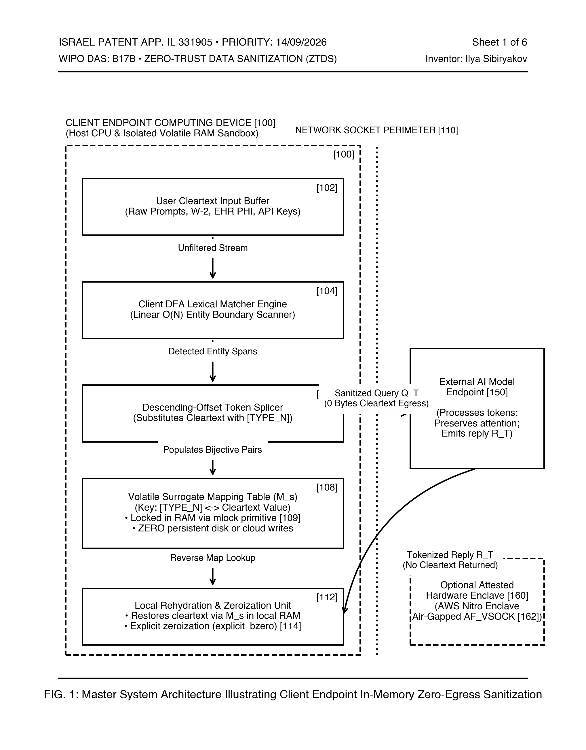
PATENT DRAWING SHEET 1 OF 6
FIG. 1 — Dual-Plane Zero-Egress Architecture (Core Invariant 1)
Sole Inventor: Ilya Sibiryakov
App: IL 331905 | WIPO DAS: B17B
[INDEPENDENT CLAIMS 1 & 6 — SOLE INVENTOR (ILYA SIBIRYAKOV)]
WHAT IS BEING PATENTED (ACCESSIBLE EXPLANATION)
Establishes a physical isolation boundary between the client computing environment and the untrusted external network. Outgoing user prompts and payloads are intercepted in client volatile memory BEFORE any network socket (TCP/WebSocket) or TLS handshake is initialized. Sensitive data is substituted with synthetic surrogates so raw confidential data physically never crosses the network perimeter.
REFERENCE NUMERALS LEGEND (FOR SPECIFICATION & CLAIMS)
• [100] Client Computing Plane (Local trusted execution perimeter)
• [102] Client Application / Web Browser / IDE Agent Input Buffer
• [104] Pre-Egress Interception Hook & DFA Lexical Matcher Engine
• [106] Descending-Offset Token Splicer (In-memory substitution)
• [108] Ephemeral State Map (Volatile RAM lookup table M_s, mlock)
• [110] Network Socket Perimeter (Strict 0 bytes cleartext egress)
• [112] Local Rehydration & Zeroization Unit (explicit_bzero)
• [150] External Cloud LLM Host / Third-Party Server
PRIOR ART & NOVELTY DIFFERENTIATION
Prior art DLP systems (Symantec, Zscaler, Cloudflare) operate as inline proxies, network tap devices, or cloud gateways that inspect traffic AFTER network transmission has started. ZTDS operates entirely pre-network inside client application volatile RAM, eliminating third-party subprocessor data breach liability.

Slide 4
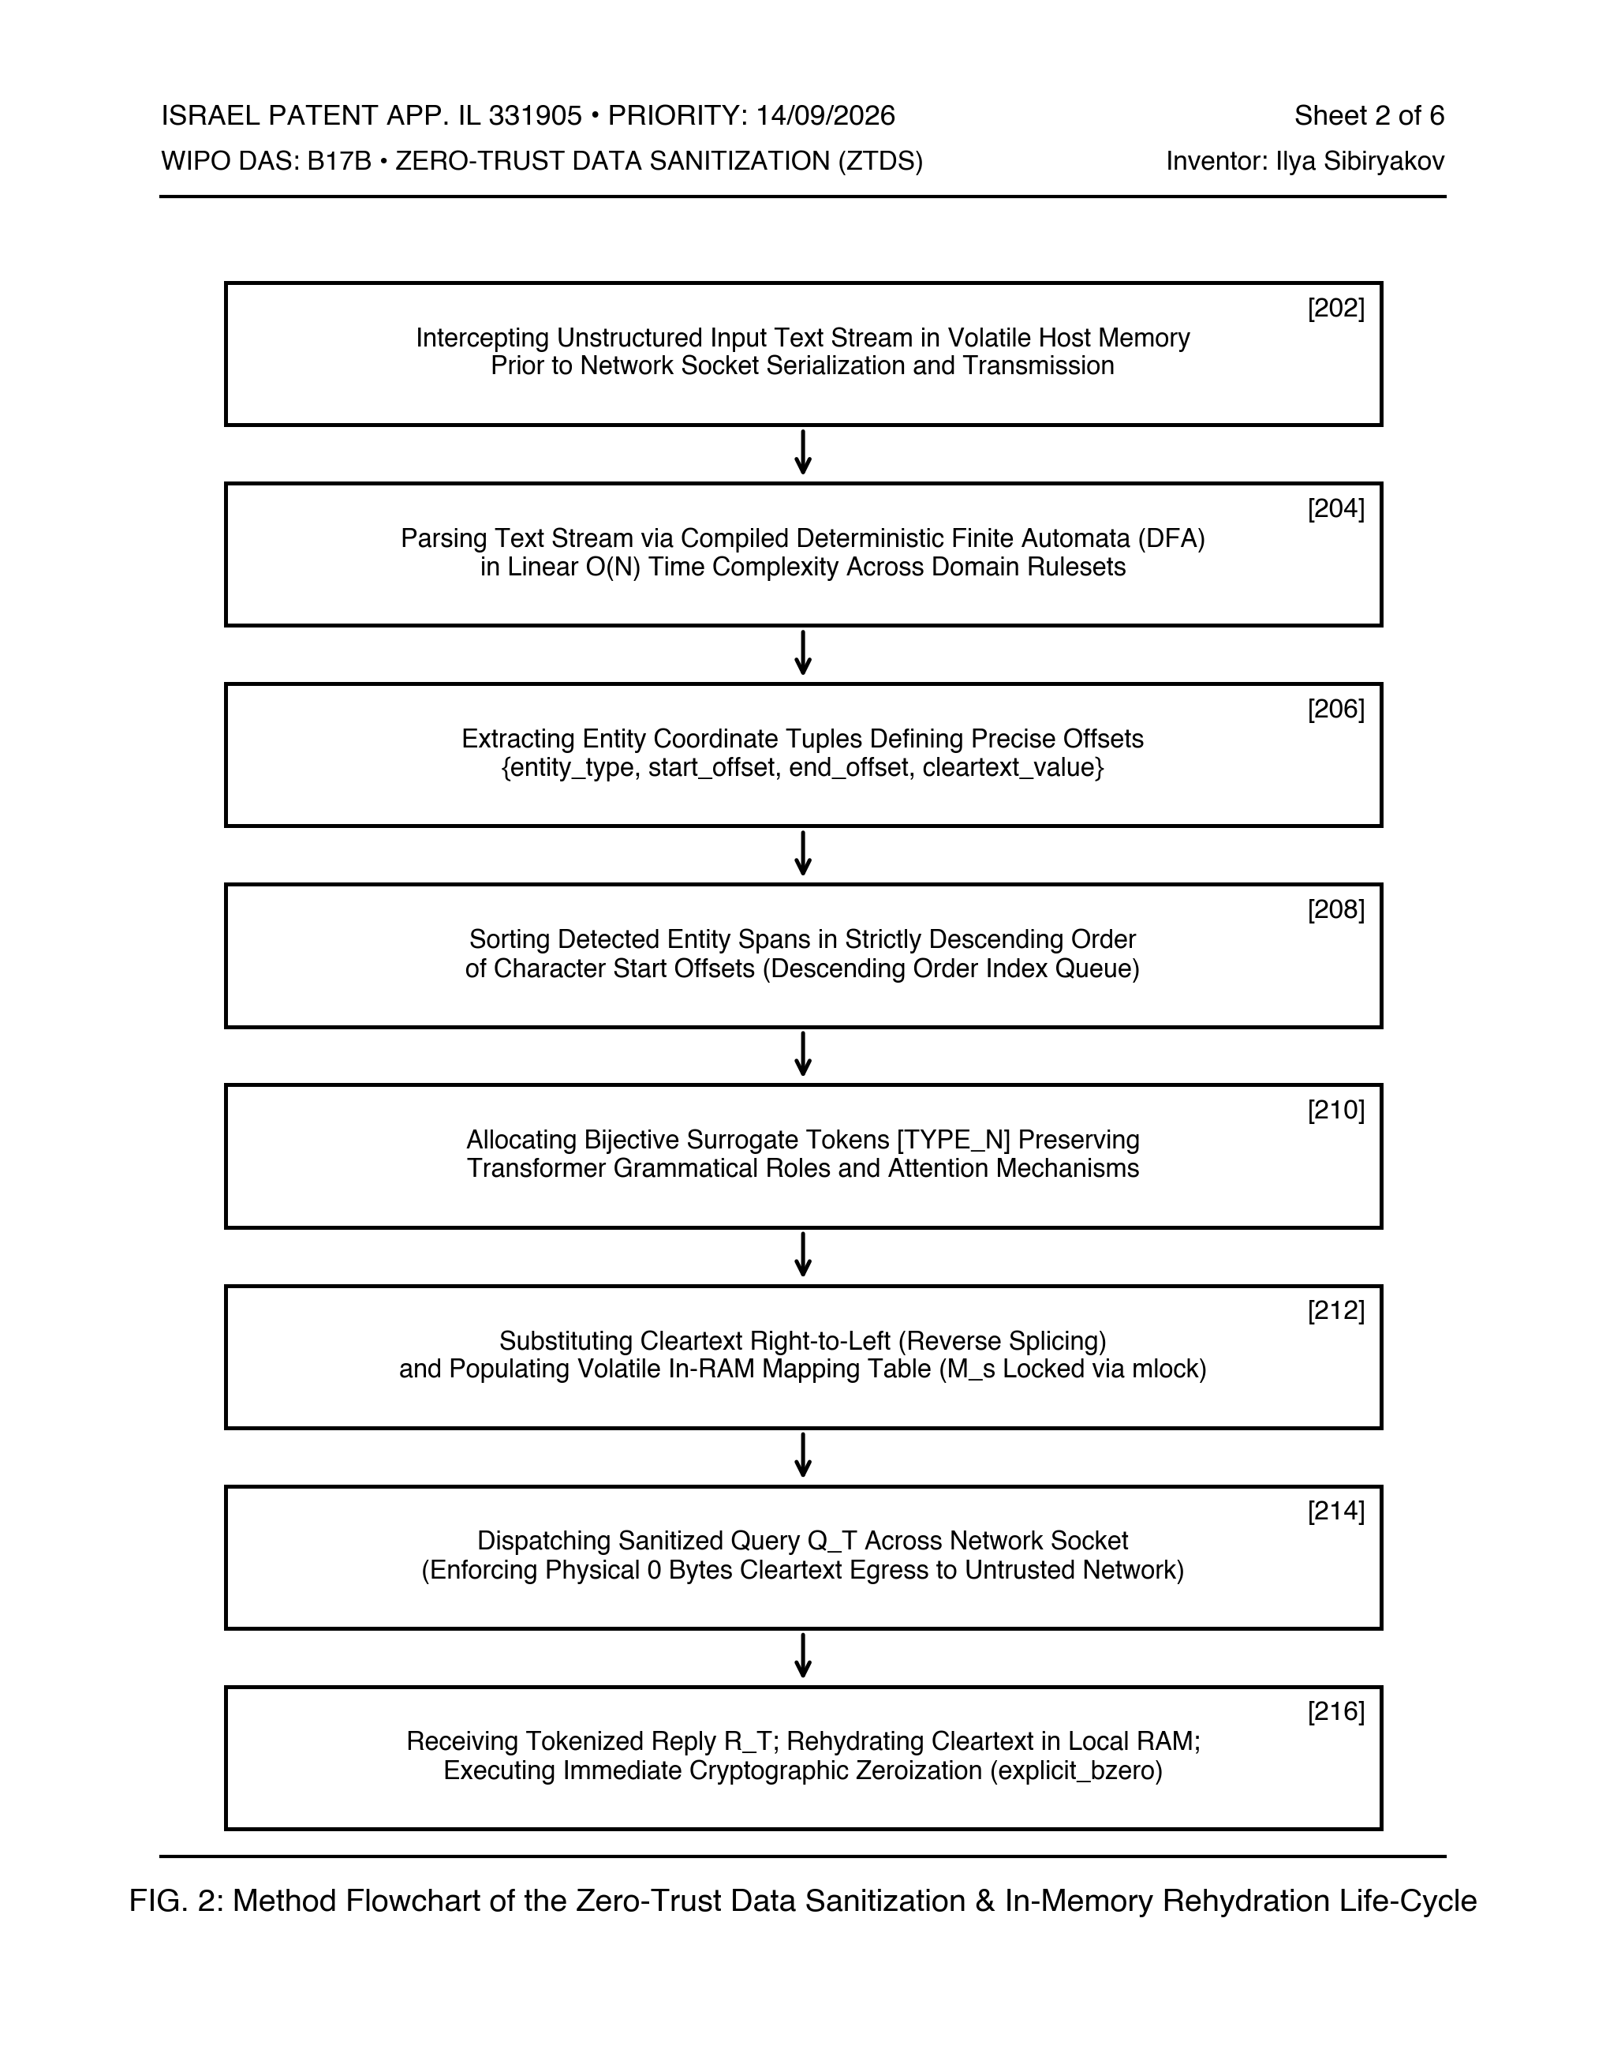
PATENT DRAWING SHEET 2 OF 6
FIG. 2 — End-to-End Cryptographic Sanitization & Rehydration Lifecycle
Sole Inventor: Ilya Sibiryakov
App: IL 331905 | WIPO DAS: B17B
[INDEPENDENT CLAIMS 1 & 6 — SOLE INVENTOR (ILYA SIBIRYAKOV)]
WHAT IS BEING PATENTED (ACCESSIBLE EXPLANATION)
Defines the complete closed-loop lifecycle of sensitive data handling: from initial client ingestion, through lexical pattern identification and in-RAM surrogate mapping, across third-party untrusted AI processing, back to client-side reverse substitution (rehydration), concluding with immediate cryptographic zeroization (explicit_bzero) of the ephemeral mapping table.
REFERENCE NUMERALS LEGEND (FOR SPECIFICATION & CLAIMS)
• [202] Ingestion of raw prompt/payload into volatile host memory
• [204] Parsing text stream via DFA in linear O(N) time complexity
• [206] Extracting entity tuples {type, start_offset, end_offset, value}
• [208] Sorting detected entity spans in descending order of offsets
• [210] Allocating bijective surrogate tokens [TYPE_N]
• [212] Substituting cleartext right-to-left; populating volatile RAM map
• [214] Dispatching sanitized query Q_T (Enforcing 0 bytes egress)
• [216] Ingress reception of response; in-RAM rehydration; explicit_bzero
PRIOR ART & NOVELTY DIFFERENTIATION
Unlike one-way anonymization (hashing/redaction) which destroys AI reasoning, or centralized tokenization vaults that store plaintext maps on remote databases, ZTDS maintains reversible mapping strictly inside volatile client RAM without any external key exchange or server dependency.

Slide 5
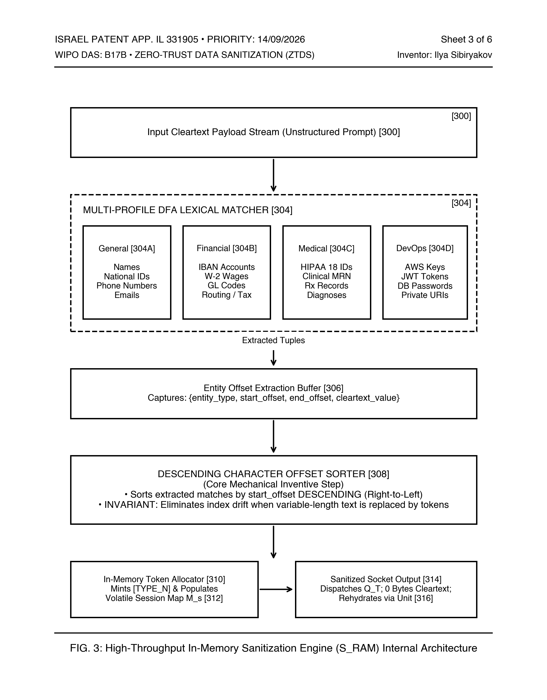
PATENT DRAWING SHEET 3 OF 6
FIG. 3 — High-Throughput In-Memory Sanitization Engine (S_RAM)
Sole Inventor: Ilya Sibiryakov
App: IL 331905 | WIPO DAS: B17B
[INDEPENDENT CLAIMS 1 & 6 — SOLE INVENTOR (ILYA SIBIRYAKOV)]
WHAT IS BEING PATENTED (ACCESSIBLE EXPLANATION)
Discloses the internal multi-matcher architecture of the S_RAM engine. Input text is parsed concurrently across multiple specialized profile rulesets (General, Finance, Medical, DevOps) using parallel compiled Deterministic Finite Automata (DFA). Matches are emitted as exact character coordinate records and routed through a Descending Character Offset Sorter before reverse string splicing.
REFERENCE NUMERALS LEGEND (FOR SPECIFICATION & CLAIMS)
• [300] High-Throughput Input Payload Stream (Unstructured Prompt)
• [302] Parallel Compiled DFA Pattern Matchers (O(N) linear time)
• [304] Multi-Profile Lexical Matcher (304A General, 304B Finance, 304C Medical, 304D DevOps)
• [306] Entity Offset Extraction Buffer ({type, start, end, value})
• [308] Descending Character Offset Sorter (Core inventive step)
• [310] In-Memory Token Allocator & Bijective Map Generator
• [312] Volatile Session Map M_s (Stored in mlock pinned memory)
• [314] Sanitized Socket Output Buffer & Rehydration Unit [316]
PRIOR ART & NOVELTY DIFFERENTIATION
Traditional regular expression engines suffer from catastrophic backtracking (ReDoS) and perform naive forward replacements that corrupt buffer indices. S_RAM combines linear DFA execution with descending offset sorting to achieve sub-millisecond execution and 100% replacement integrity.

Slide 6
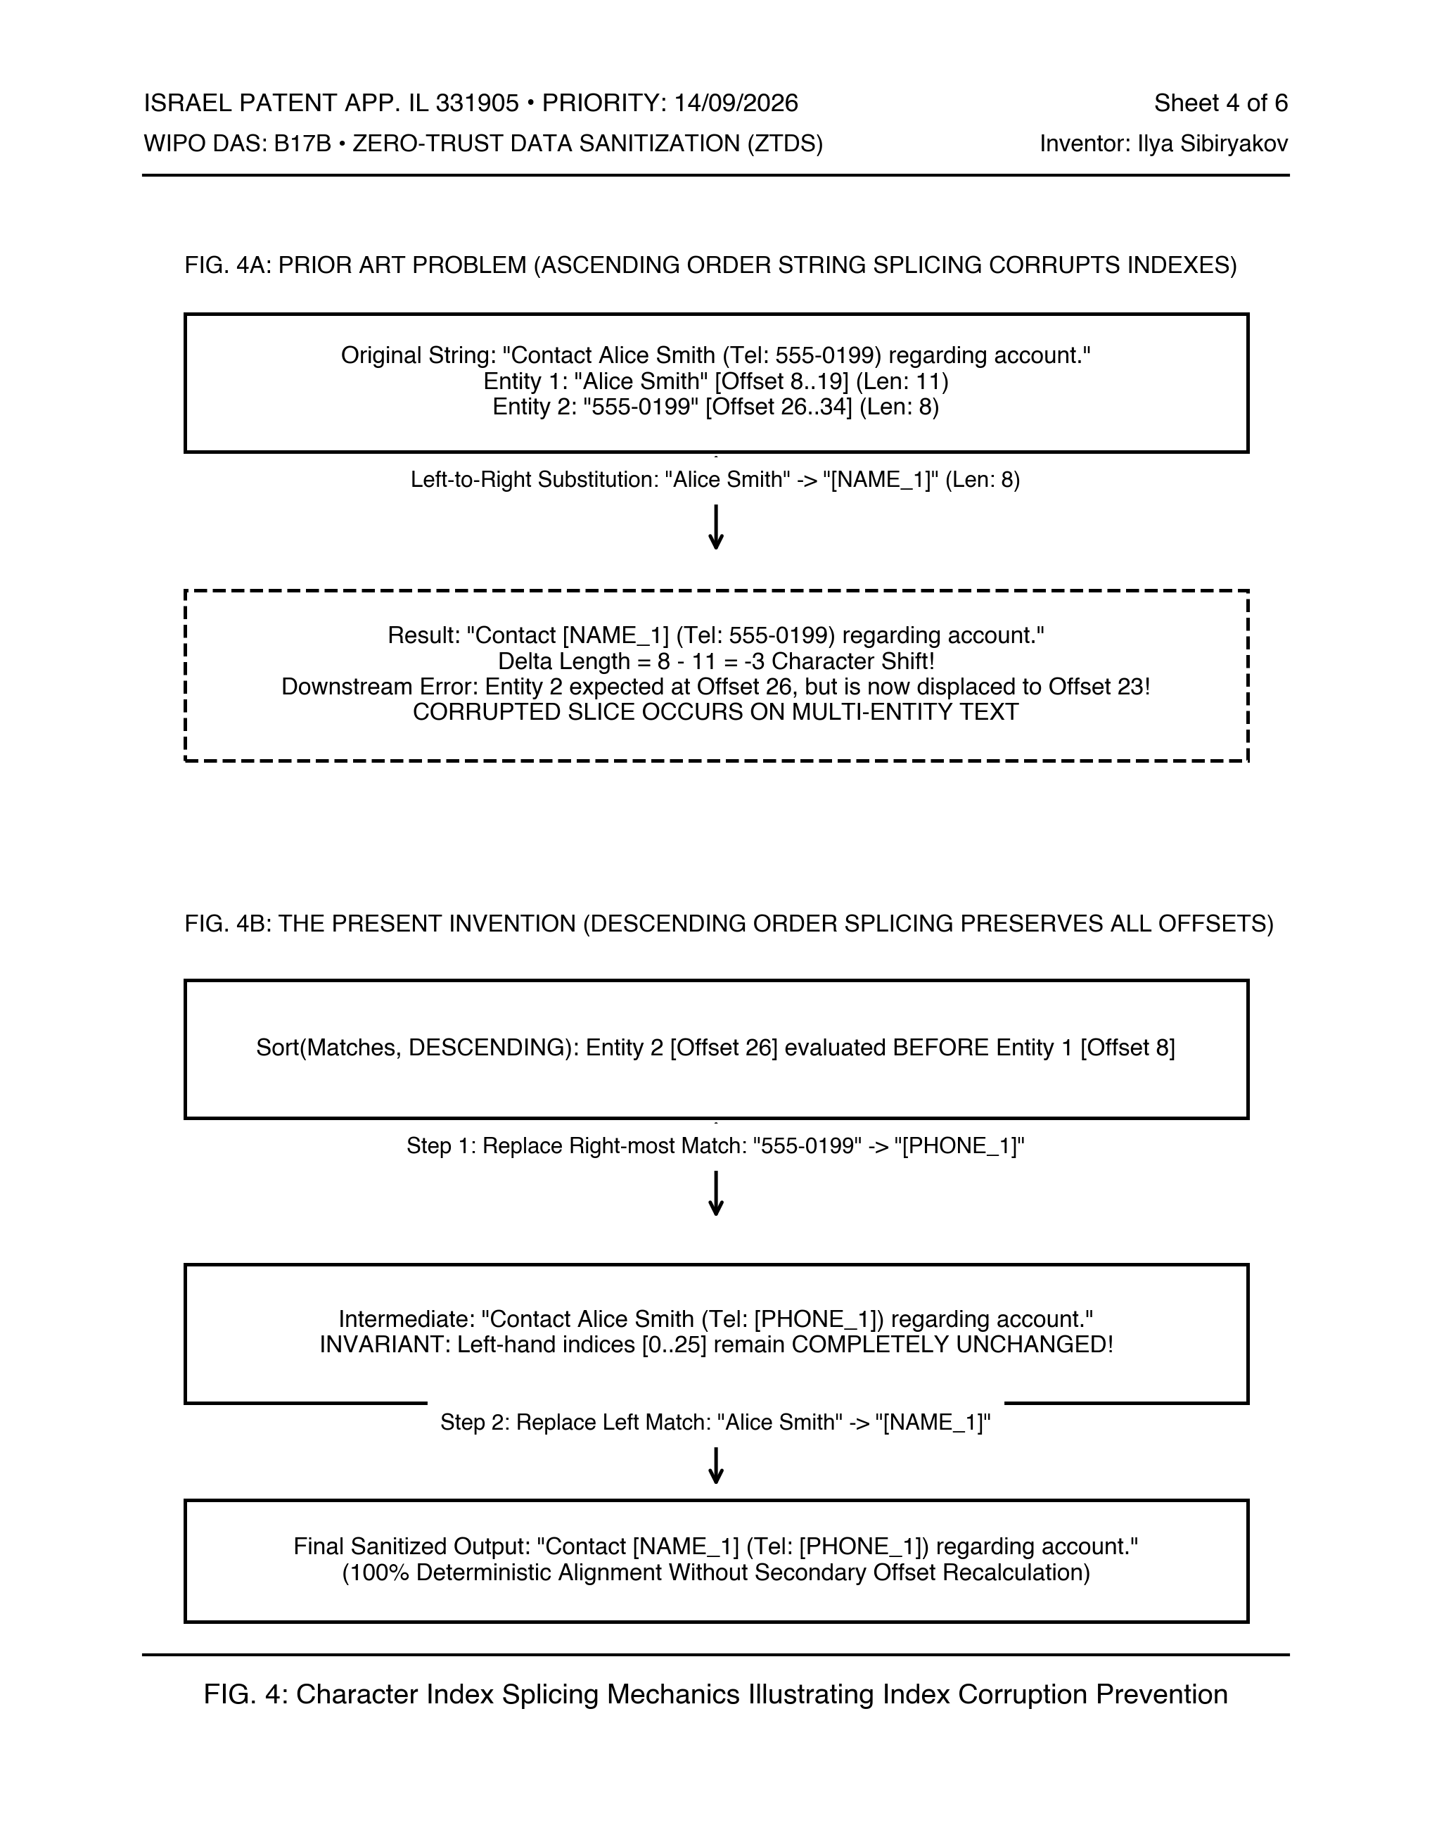
PATENT DRAWING SHEET 4 OF 6
FIG. 4 — Descending Character Index Splicing Mechanics
Sole Inventor: Ilya Sibiryakov
App: IL 331905 | WIPO DAS: B17B
[INDEPENDENT CLAIMS 1 & 6 — SOLE INVENTOR (ILYA SIBIRYAKOV)]
WHAT IS BEING PATENTED (ACCESSIBLE EXPLANATION)
Illustrates the critical algorithmic mechanism that solves variable-length token displacement. When multiple entities of differing lengths exist in a string buffer, replacing entities from left to right causes index drift, causing all subsequent replacement coordinates to point to wrong characters. ZTDS sorts all matches in descending order and splices from right to left, leaving upstream indices completely stable.
REFERENCE NUMERALS LEGEND (FOR SPECIFICATION & CLAIMS)
• [400] Input String Buffer containing multiple sensitive entities
• [402] Entity Match A (Located at character offsets 8 to 19, Len: 11)
• [404] Entity Match B (Located at character offsets 26 to 34, Len: 8)
• [406] Ascending Replacement Failure (Prior Art: -3 char index shift corrupts Entity 2)
• [408] Descending Sorter: Entity 2 evaluated BEFORE Entity 1
• [410] Step 1: Replace rightmost Match B; upstream indices [0..25] remain unchanged
• [412] Step 2: Replace leftmost Match A; deterministic alignment without re-indexing
PRIOR ART & NOVELTY DIFFERENTIATION
Solves a fundamental limitation of multi-entity string replacement algorithms. Guarantees deterministic, collision-free substitution in a single linear pass without allocating intermediate string copies or recalculating index offsets after each substitution.

Slide 7
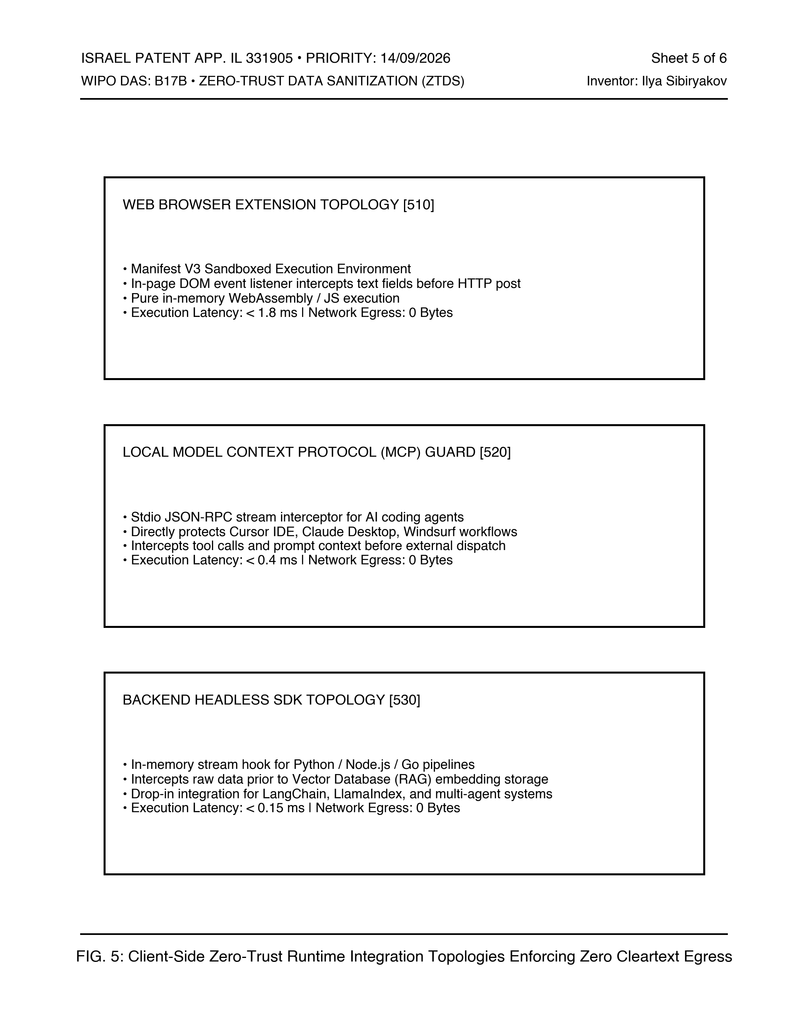
PATENT DRAWING SHEET 5 OF 6
FIG. 5 — Client-Side Execution Topologies & Interception Hooks
Sole Inventor: Ilya Sibiryakov
App: IL 331905 | WIPO DAS: B17B
[INDEPENDENT CLAIMS 1 & 6 — SOLE INVENTOR (ILYA SIBIRYAKOV)]
WHAT IS BEING PATENTED (ACCESSIBLE EXPLANATION)
Discloses three distinct physical deployment embodiments of the client-side sanitization system: (1) Web Browser Extension hooking DOM events and monkeypatching window.fetch; (2) Local Model Context Protocol (MCP) Guard proxying stdio JSON-RPC messages for desktop IDE agents (Claude Desktop, Cursor); and (3) Headless Backend/Edge SDK wrapping API clients.
REFERENCE NUMERALS LEGEND (FOR SPECIFICATION & CLAIMS)
• [510] Embodiment 1: Web Browser Extension / WebAssembly Runtime
- DOM event listener intercepts text fields before HTTP post
- Latency: < 1.8 ms | Network Egress: 0 Bytes
• [520] Embodiment 2: Local Stdio MCP Tool Guard for AI Agents
- Stdio JSON-RPC interceptor protecting Cursor IDE & Claude Desktop
- Latency: < 0.4 ms | Network Egress: 0 Bytes
• [530] Embodiment 3: Backend Headless SDK Integration
- In-memory stream hook for Python/Node.js/Go RAG pipelines
- Latency: < 0.15 ms | Network Egress: 0 Bytes
PRIOR ART & NOVELTY DIFFERENTIATION
Broad apparatus claim coverage demonstrating that the core in-RAM sanitization engine operates identically and independently across browser runtimes, desktop developer tools (MCP stdio), and serverless RAG pipelines without requiring changes to underlying applications.

Slide 8
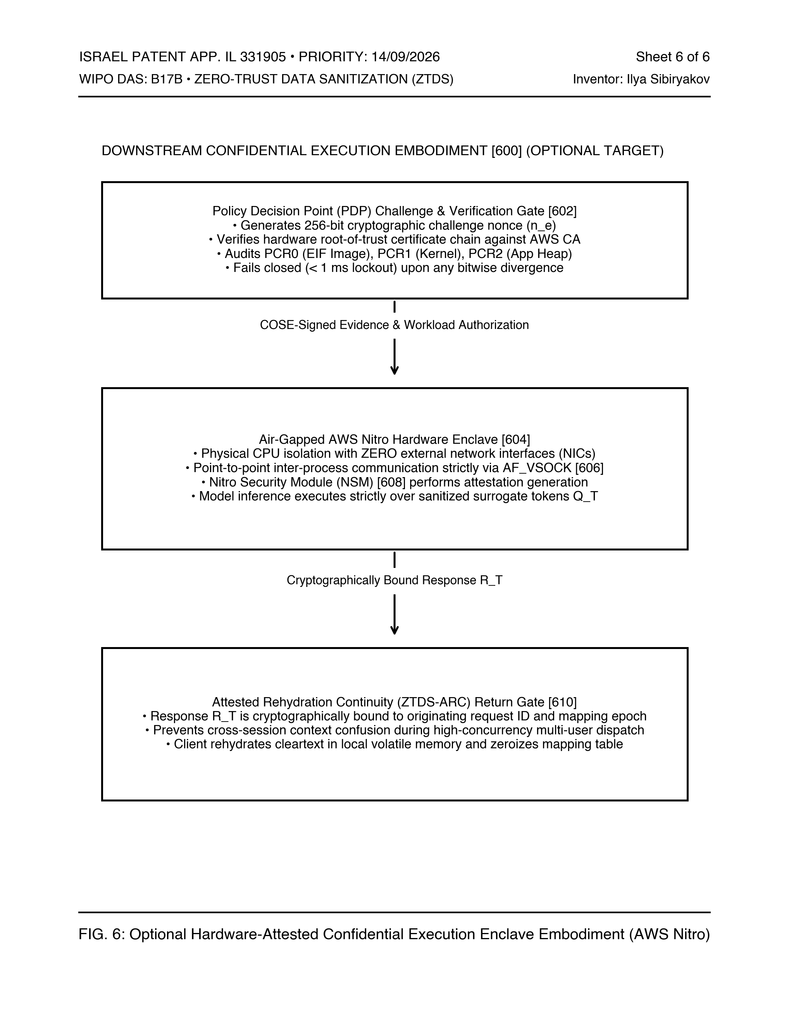
PATENT DRAWING SHEET 6 OF 6
FIG. 6 — Optional Hardware Enclave Verification & Egress Blocker
Sole Inventor: Ilya Sibiryakov
App: IL 331905 | WIPO DAS: B17B
[OPTIONAL DEPENDENT EMBODIMENT — DOWNSTREAM ENCLAVE]
WHAT IS BEING PATENTED (ACCESSIBLE EXPLANATION)
Discloses an optional, downstream hardware embodiment where the ZTDS engine is deployed within an isolated hardware security enclave (e.g., AWS Nitro Enclave, AMD SEV, Intel SGX). The hypervisor enforces cryptographic attestation (COSE/CBOR with Platform Configuration Registers) and physically disables all external network interfaces, restricting communication to a local vsock socket.
REFERENCE NUMERALS LEGEND (FOR SPECIFICATION & CLAIMS)
• [600] Downstream Confidential Execution Boundary (Zero external networking)
• [602] Policy Decision Point (PDP) Challenge & Verification Gate (256-bit nonce)
• [604] Air-Gapped AWS Nitro Hardware Enclave (Physical CPU isolation)
• [606] AF_VSOCK Local Inter-Process Channel (No external NICs)
• [608] Nitro Security Module (NSM) Cryptographic Attestation Generator
• [610] Attested Rehydration Continuity (ZTDS-ARC) Return Gate
• [612] Parent Host EC2 Instance (Untrusted host environment)
PRIOR ART & NOVELTY DIFFERENTIATION
INVENTORSHIP & PRIOR ART ISOLATION DEFENSE: This enclave implementation represents downstream academic benchmarking (Post-Cliford) and is strictly confined to DEPENDENT claims. Even if third parties cite hardware enclave prior art, the core independent claims (FIGS. 1–5) remain 100% valid and solely owned by Ilya Sibiryakov.

Slide 9
STATUTORY CALENDAR & EXAMINATION STRATEGY
Patent Prosecution Roadmap & Statutory Schedule
Sole Inventor: Ilya Sibiryakov
App: IL 331905 | WIPO DAS: B17B
1. STATUTORY TIMELINES & DEADLINES
• Basic Israel Application:
IL 331905 filed 14/09/2026.
• WIPO DAS Code:
Access code B17B active for automated priority retrieval.
• Madrid TM Priority Bar:
20/03/2027 (Month 6) for Trademark App #397119 across US, EU, UK, JP.
• PCT International Deadline:
14/09/2027 (Month 12) strict statutory deadline via ePCT.
• International Search Authority:
Designate ISA/EP (European Patent Office) or ISA/IL.
2. CLAIMS STRUCTURE DIRECTIVES
• Independent Claims 1 & 6:
Confined strictly to client-side in-RAM pre-socket interception, descending offset sorting, and ephemeral mapping.
• Sole Inventorship Integrity:
Ilya Sibiryakov is 100% sole inventor of the core method and apparatus.
• Academic Research Segregation:
Hardware Enclave / Nitro mechanisms (FIG. 6) must remain strictly in dependent claims.
• Apparatus Claim Breadth:
Cover Browser DOM, Local MCP stdio, and Headless SDK topologies.
3. FORMAL FILING DELIVERABLES
• Master Patent Drawings PDF:
6 sheets, 300 DPI vector lines, WIPO/ILPO compliant.
File: 03_Clean_Patent_Drawings_ZTDS_IL331905.pdf
• Editable Working PPTX Presentation:
9 slides in accessible English for examiner presentation.
File: 03_Clean_Patent_Drawings_ZTDS_IL331905.pptx
• Technical Engineering Guide:
Full technical treatise & claim reference guide.
File: ZTDS_PATENT_ENGINEERING_SPECIFICATION_GUIDE_EN.md

