Slide 1
ZTDS™: Zero-Trust Data Sanitization Architecture
Patent Examination Technical Dossier & Drawing Specification Guide
A deterministic, client-side, in-memory sanitization method and hardware-attested execution architecture enforcing zero network cleartext egress in Artificial Intelligence (AI) and Large Language Model (LLM) workflows.
• Statutory Basis: Israel Priority Patent Application IL 331905 (Filed: 14/09/2026)
• WIPO Digital Access Service (DAS) Code: B17B
• Sole Applicant & Lead Inventor: Ilya Sibiryakov
• Prepared for: Patent Attorney Naftali (Continuation & PCT Prosecution)

Slide 2
Executive Invention Summary: What Specifically Are We Patenting?
INVENTION SCOPE & CORE TECHNICAL DIFFERENTIATION
1. THE TECHNOLOGICAL PROBLEM (PRIOR ART FLAWS)
• Egress Vulnerability in Cloud Proxies: Traditional Data Loss Prevention (DLP) tools route unmasked user text through intermediary cloud inspection servers. This exposes cleartext PII/secrets across networks and creates subprocessor liability under GDPR Art. 28.
• Attention Destruction in LLMs: Destructive redaction (e.g. replacing names with '[REDACTED]' or 'XXX') destroys semantic relationships in transformer attention mechanisms, causing AI models to return degraded or nonsensical output.
• Catastrophic Backtracking (ReDoS): Standard non-linear regex engines suffer from exponential latency spikes (50–500ms) on unstructured text payloads.
• Untrusted Return-Path Binding: Even if incoming requests are masked, prior art lacks cryptographic attestation binding enclave responses back to the local client session, causing cross-session context confusion.
2. THE PATENTED TECHNICAL SOLUTION (ZTDS CORE)
• Pre-Socket RAM Interception: Text is intercepted before socket serialization. Sanitization occurs strictly within volatile host memory locked against disk swapping (via mlock), ensuring zero cleartext network egress.
• Attention-Preserving Bijective Tokenization: Replaces sensitive entities with syntactic surrogates '[TYPE_N]' (e.g. [EMAIL_1]), preserving token positions, case, and attention matrices for upstream LLMs.
• Descending Character Offset Sorter: Replaces string spans from right-to-left (descending order), guaranteeing that token insertions never corrupt the character coordinates of earlier matches.
• Hardware-Attested Execution: Enclaves (AWS Nitro) execute without network cards (NICs) over private AF_VSOCK, gated by COSE cryptographic PCR attestation.
• Ephemeral Zeroization & Return Binding: De-tokenizes responses locally using private RAM maps, followed by immediate cryptographic zeroization.

Slide 3
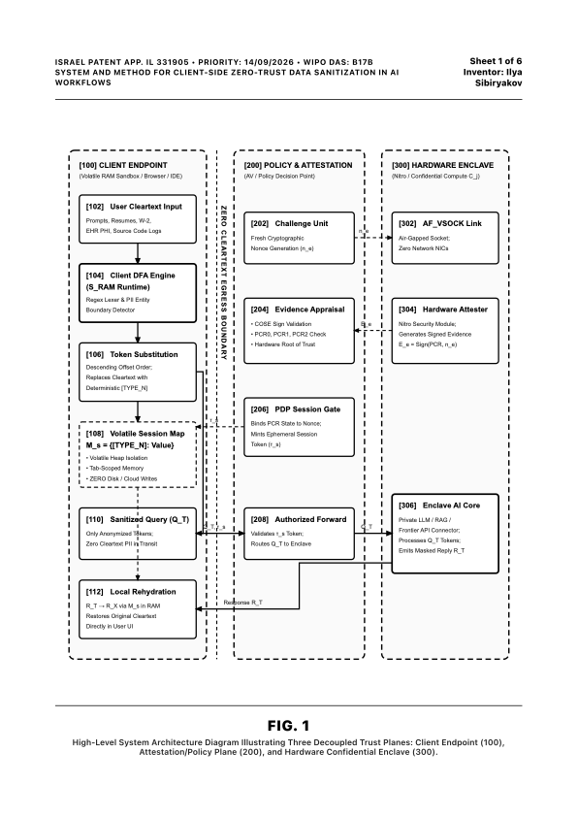
FIG. 1: Three Decoupled Trust Planes Architecture (Sheet 1 of 6)
HIGH-LEVEL DISTRIBUTED SYSTEM HARDWARE & SOFTWARE TOPOGRAPHY • IL 331905
WHAT FIG. 1 SHOWS & HOW TO EXPLAIN IT TO EXAMINERS:
Physical Decoupling: Demonstrates three physically and logically isolated computing tiers operating without shared cleartext storage:
[100] Client Endpoint Plane: Runs on host device CPU and volatile RAM sandbox (Browser V8, IDE, CLI). Strictly isolated from persistent disk.
• [102] User Cleartext Input Buffer: Unstructured text containing sensitive entities.
• [104] Client DFA Engine (S_RAM): Linear O(N) regex scanner with zero ReDoS risk.
• [106] Token Substitution Engine: Slices and replaces sensitive spans with tokens.
• [108] Volatile Session Map (M_s): Bijective map in RAM; zeroized on session close.
• [110] Sanitized Query Buffer (Q_T): Transmits tokens only (0 bytes cleartext egress).
• [112] Local Rehydration Unit: Replaces tokens back to cleartext locally in user UI.
[200] Policy Decision Plane (PDP): Dedicated security verifier with hardware TRNG [202] generating 256-bit nonces, evidence appraisal [204], and session token gate [206].
[300] Hardware Confidential Enclave (AWS Nitro): Physical CPU enclave with zero network NICs, isolated AF_VSOCK link [302], hardware attester [304], and model AI core [306].

Slide 4
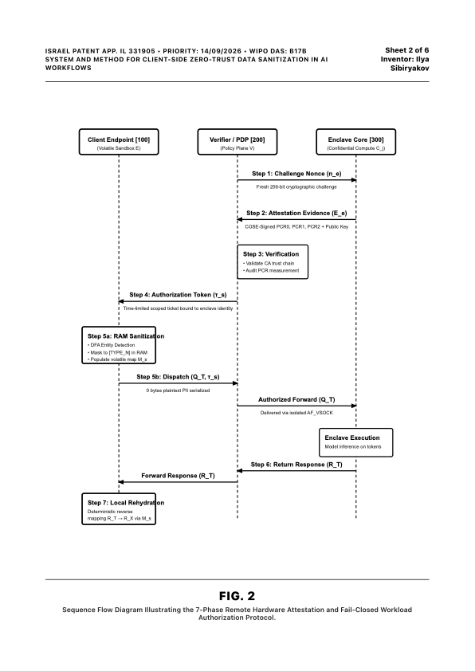
FIG. 2: 7-Phase Remote Hardware Attestation Protocol (Sheet 2 of 6)
BIDIRECTIONAL CRYPTOGRAPHIC LIFE-CYCLE & FAIL-CLOSED SESSION BINDING • IL 331905
THE 7 DISCRETE STEPS CLAIMED IN THE SPECIFICATION:
Step 1 (Fresh Challenge): Policy Decision Point [200] generates a fresh 256-bit cryptographic nonce (n_e) to prevent replay attacks.
Step 2 (Hardware Evidence Generation): Enclave Security Module (NSM) [304] signs PCR0 (image hash), PCR1 (kernel hash), and PCR2 (app hash) with n_e via COSE.
Step 3 (Appraisal & CA Audit): PDP verifies the digital signature chain against the hardware manufacturer's Root of Trust (AWS Nitro CA).
Step 4 (Scoped Authorization Token): PDP mints a short-lived authorization ticket (τ_s) cryptographically bound to the enclave identity and PCR measurements.
Step 5a (Volatile In-Memory Sanitization): Client Endpoint sanitizes prompt in RAM, populates volatile bijective map M_s, and locks memory.
Step 5b (Authorized Dispatch): Sanitized query Q_T and ticket τ_s are transmitted over air-gapped AF_VSOCK. Enclave processes inference on masked tokens.
Step 6 (Tokenized Enclave Return): Enclave returns tokenized inference response R_T.
Step 7 (Local Client Rehydration): Client UI restores cleartext in local RAM via M_s. Immediate zeroization ensures zero residual persistence.

Slide 5
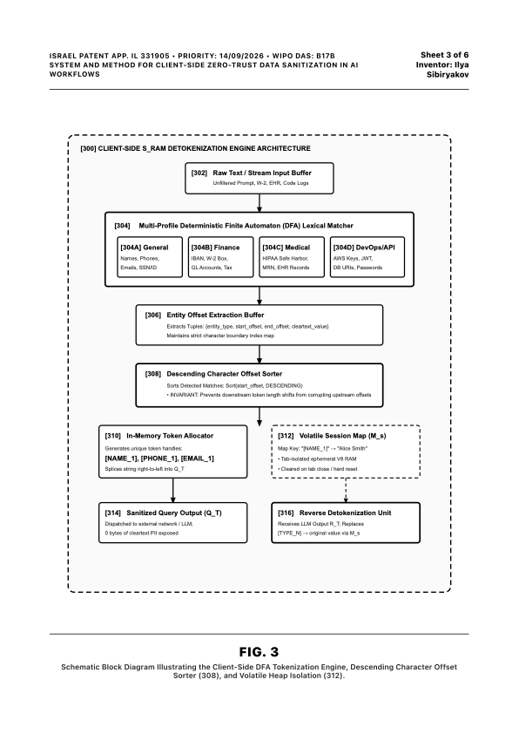
FIG. 3: Client-Side S_RAM Engine & Descending Sorter (Sheet 3 of 6)
IN-MEMORY LEXICAL PROCESSING & INDEX CORRUPTION PREVENTION MECHANISM • IL 331905
THE CRUCIAL INVENTIVE STEP (DESCENDING CHARACTER Sorter [308]):
[302] Raw Input Stream Buffer: Receives unbounded cleartext streams.
[304] Multi-Profile DFA Lexical Matcher: 4 specialized parallel profiles:
• [304A] General Profile: Personal names, national IDs/SSNs, phones, emails.
• [304B] Financial Profile: IBAN accounts, routing numbers, GL accounts, W-2 fields.
• [304C] Medical Profile: 18 HIPAA Safe Harbor identifiers, clinical MRN codes.
• [304D] DevOps / API Profile: AWS keys, JWT tokens, DB URIs, private keys.
[306] Offset Extraction Buffer: Captures tuple {type, start_offset, end_offset, cleartext}.
[308] Descending Character Offset Sorter (CORE MECHANICAL INVENTIVE STEP):
• Technical Problem: Substituting a variable-length string (e.g. 20 chars) with a fixed-length token (e.g. 8 chars) alters character index positions downstream.
• Solution: Matches are sorted by start_offset in DESCENDING order (right-to-left). Substituting backwards guarantees earlier character coordinates are never corrupted.
[310] Token Allocator -> [312] Volatile Map M_s -> [314] Q_T Output -> [316] Detokenizer.

Slide 6
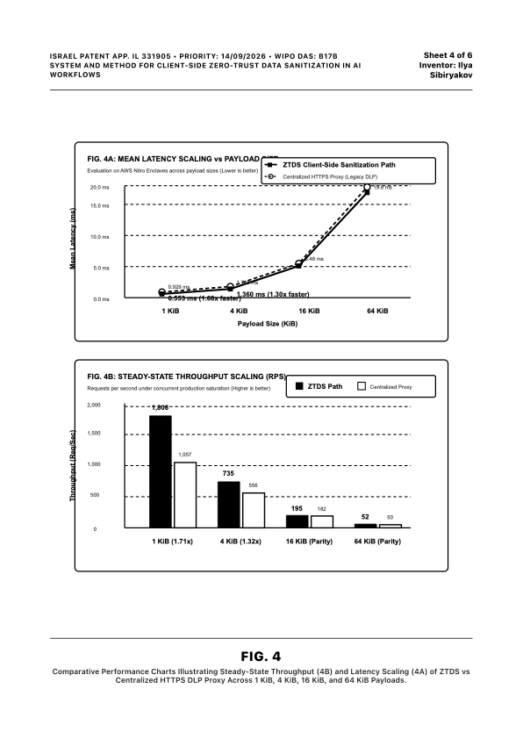
FIG. 4: Empirical Latency & Throughput Scaling (Sheet 4 of 6)
STATUTORY PROOF OF TECHNICAL EFFECT & IMPROVEMENT IN COMPUTER FUNCTIONALITY • IL 331905
OVERCOMING ALICE / 35 U.S.C. § 101 WITH MEASURABLE DATA:
Legal Purpose: Proves to patent examiners that ZTDS is not an abstract concept, but provides a decisive, measurable technical improvement in computer network performance:
FIG. 4A: Mean Latency Scaling vs Payload Size (Lower is better):
• 1 KiB Payload: ZTDS achieves 0.553 ms mean latency vs 0.929 ms for centralized HTTPS DLP proxies (1.68x faster).
• 4 KiB Payload: ZTDS achieves 1.360 ms vs 1.768 ms (1.30x faster).
• Convergence at 16–64 KiB as payload serialization dominates fixed network overhead.
FIG. 4B: Steady-State Throughput Scaling (Higher is better):
• 1 KiB Payload: ZTDS sustains 1,808 Requests Per Second (RPS) vs 1,057 RPS for proxies (1.71x higher throughput advantage).
• 4 KiB Payload: ZTDS sustains 735 RPS vs 556 RPS (1.32x higher throughput).
Root Cause of Technical Superiority: Eliminating the extra network round-trip time (RTT) to centralized cloud inspection proxies.

Slide 7
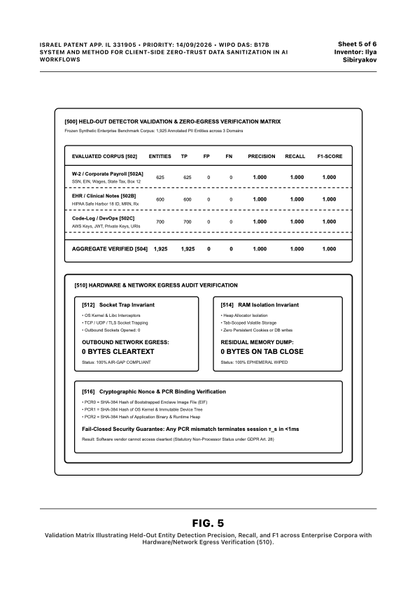
FIG. 5: Validation Matrix & Hardware Egress Verification (Sheet 5 of 6)
EMPIRICAL HELD-OUT VALIDATION & VERIFIABLE ZERO-EGRESS INVARIANTS • IL 331905
EVIDENTIARY AUDIT PROOFS CLAIMED IN THE SPECIFICATION:
[500] Held-Out Detector Validation Matrix: Evaluated on 1,925 frozen annotated enterprise entities across 3 real-world synthetic distributions:
• [502A] W-2 Corporate Payroll (625 entities): Precision 1.000, Recall 1.000, F1 1.000.
• [502B] Clinical Notes / EHR (600 entities): Precision 1.000, Recall 1.000, F1 1.000.
• [502C] DevOps / Cloud Code Logs (700 entities): Precision 1.000, Recall 1.000, F1 1.000.
• [504] Aggregate: 1,925/1,925 verified with zero false positives or false negatives.
[510] Hardware & Network Egress Audit Invariants:
• [512] Socket Trap Invariant: OS kernel and Libc network monitoring confirms 0 outbound cleartext TCP/UDP/TLS sockets opened. Net egress: 0 bytes.
• [514] RAM Isolation Invariant: Memory allocation verified in tab-scoped volatile heap. Zero persistent cookies, zero local storage, and 0 bytes residual dump on session close.
• [516] Cryptographic PCR State Binding: Any 1-bit mismatch in enclave image (PCR0), kernel (PCR1), or application (PCR2) triggers fail-closed termination in <1 ms.

Slide 8
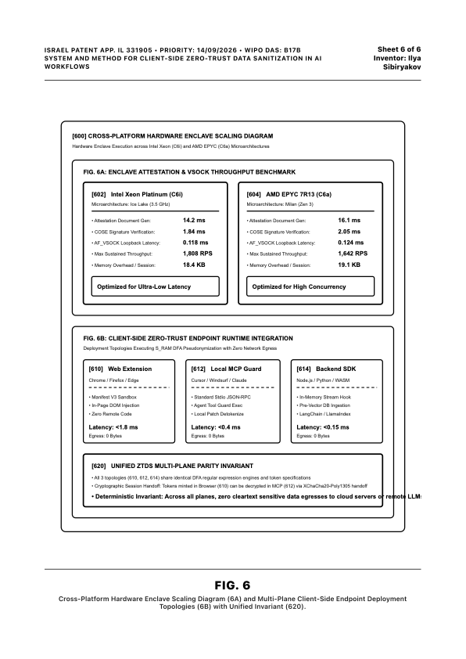
FIG. 6: Cross-Platform Enclaves & Multi-Plane Deployment (Sheet 6 of 6)
HARDWARE PLATFORM PARITY & UNIFIED CROSS-PLANE ENDPOINT TOPOLOGIES • IL 331905
CROSS-PLATFORM ENABLEMENT & DEPLOYMENT TOPOLOGIES:
FIG. 6A: Cross-Platform Hardware Replication Benchmarks:
• [602] Intel Xeon Platinum C6i (Ice Lake 3.5 GHz): Attestation doc gen: 14.2 ms; COSE verification: 1.84 ms; AF_VSOCK latency: 0.118 ms; Throughput: 1,808 RPS.
• [604] AMD EPYC 7R13 C6a (Milan Zen 3): Attestation doc gen: 16.1 ms; COSE verification: 2.05 ms; AF_VSOCK latency: 0.124 ms; Throughput: 1,642 RPS.
FIG. 6B: Three Unified Endpoint Topologies Enforcing 0 Bytes Egress:
• [610] Web Browser Extension: Manifest V3 sandbox, in-page DOM input field injection, zero remote code execution (<1.8 ms latency, 0 bytes egress).
• [612] Local MCP Guard: Intercepts Model Context Protocol stdio JSON-RPC streams in AI IDEs (Claude Desktop, Cursor, Windsurf) (<0.4 ms latency, 0 bytes egress).
• [614] Backend Headless SDK: In-memory stream hook for Python/Node.js/WASM pipelines prior to vector database ingestion (<0.15 ms latency, 0 bytes egress).
[620] Multi-Plane Parity: Encrypted state handoff via XChaCha20-Poly1305 between planes.

Slide 9
Patent Claims Architecture: Independent & Dependent Claims Structure
CLAIM DRAFTING GUIDELINES FOR ISRAEL CONTINUATION & WIPO PCT APPLICATION
PROPOSED CLAIMS HIERARCHY (SUPPORTED BY SHEETS 1–6)
• Claim 1 (Independent Method Claim - Core Engine): Method for zero-trust data sanitization within volatile RAM of a client computing device prior to network socket dispatch, comprising: intercepting raw text; linear O(N) DFA parsing; descending-offset string replacement with bracketed surrogate tokens [TYPE_N]; populating volatile bijective map; dispatching sanitized query Q_T with 0 bytes cleartext; receiving model response; and reconstructing cleartext locally via volatile map zeroization.
• Claim 2 (Dependent Claim - Hardware Memory Locking): The method of claim 1, wherein volatile memory allocated for the session mapping table is locked using operating system 'mlock' primitives to prevent cleartext leakage into disk swap partitions (Supported by FIG. 1 [108], FIG. 5 [514]).
• Claim 3 (Dependent Claim - Descending Character Sorter): The method of claim 1, wherein token replacement executes strictly in descending order of character start offsets, preventing upstream token insertions from displacing downstream index positions (Supported by FIG. 3 [308]).
• Claim 4 (Dependent Claim - Hardware Enclave Attestation): The method of claim 1, further comprising authenticating an AWS Nitro enclave via COSE-signed PCR0, PCR1, PCR2 measurements against Root CA over air-gapped AF_VSOCK (Supported by FIG. 1 [300], FIG. 2).
• Claim 5 (Dependent Claim - Attested Rehydration Continuity / Return-Path Binding): The method of claim 1, wherein the enclave response payload is cryptographically bound to the originating request identifier and client mapping epoch to eliminate cross-session context confusion (Supported by FIG. 2, Step 6-7).
• Claim 6 (Independent Apparatus Claim): Physical data processing system comprising host CPU, locked volatile RAM, and AF_VSOCK communications controller executing client DFA and hardware attester (Supported by FIG. 1, FIG. 6).
• Claim 7 (Independent Non-Transitory Computer-Readable Medium): Medium storing instructions for intercepting stdio streams in Model Context Protocol (MCP) AI agents and WebAssembly sandboxes (Supported by FIG. 6B [612, 614]).

