Slide 1

Statistic analysis of the impact of environmental temperature on the growth rate of cases infected by Covid-19
Ya Wang, Beyza Ozen, and Santatra Rafidison Rakotondrasoa
Master of Data Science,
University of Luxembourg

Slide 2
Outline
Introduction and Background
Statistic Model and Problem Formulation
Examples in Belgium and Luxembourg
Other factors
Conclusions

Slide 3
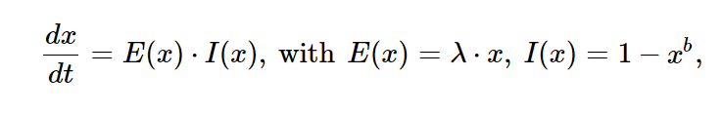
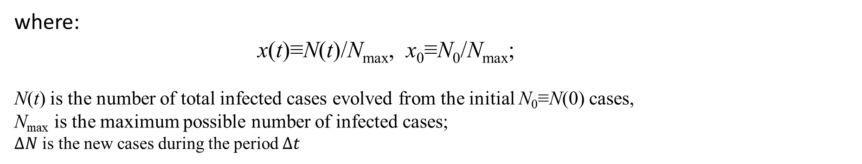

Background
standard model for the evolution of the infected cases by viruses^{[1]}
where:
x(t)≡N(t)/N_{max}, x₀≡N₀/N_{max};
N(t) is the number of total infected cases evolved from the initial N₀≡N(0) cases,
N_{max} is the maximum possible number of infected cases;
$∆N$ is the new cases during the period $∆t$
$$∆t=C\left(constant number\right) λ=\frac{\log\left(∆N\right)}{c}$$
[1] Livadiotis G. Statistical analysis of the impact of environmental temperature on the exponential growth rate of cases infected by COVID-19[J]. PLoS one, 2020, 15(5): e0233875.

Slide 4

1. Introduction

Slide 5
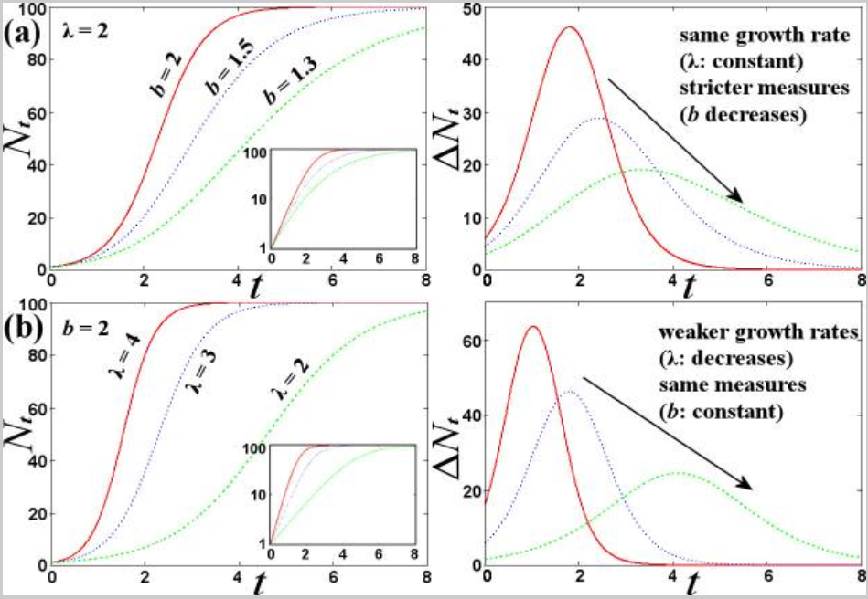
Main factors influencing the infection growth rate
λ is the exponential growth rate
The direct factor affecting infection grow rate
Environmental conditions
Population density
Age distribution
The indirect factor affecting the infection grow rate
Lockdown Policy
Culture in social activity
b is the component of other factors
e.g. strict {loose} measures correspond to smaller {larger} values of b

Slide 6
Goal
In their letter to the White House, members of a National Academy of Sciences committee said that "There is some evidence to suggest that [coronavirus] may transmit less efficiently in environments with higher ambient temperature and humidity; however, given the lack of host immunity globally, this reduction in transmission efficiency may not lead to a significant reduction in disease spread without the concomitant adoption of major public health interventions" ^{[2]}
We perform a statistical analysis for understanding the effect of the environmental temperature on the exponential growth rate of the cases infected by COVID-19 for Belgium and Luxembourg regions.
【2】Relman D. A. Rapid Expert Consultation on SARS-CoV-2 Survival in Relation to Temperature and Humidity and Potential for Seasonality for the COVID-19 Pandemic. The National Academies Press. 2020; https://doi.org/10.17226/25771

Slide 7

2. Statistic Model

Slide 8
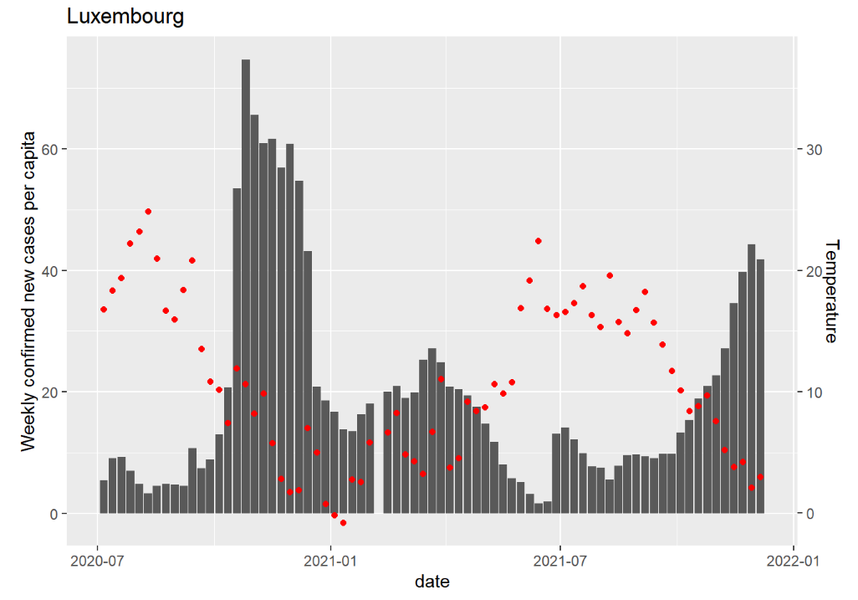
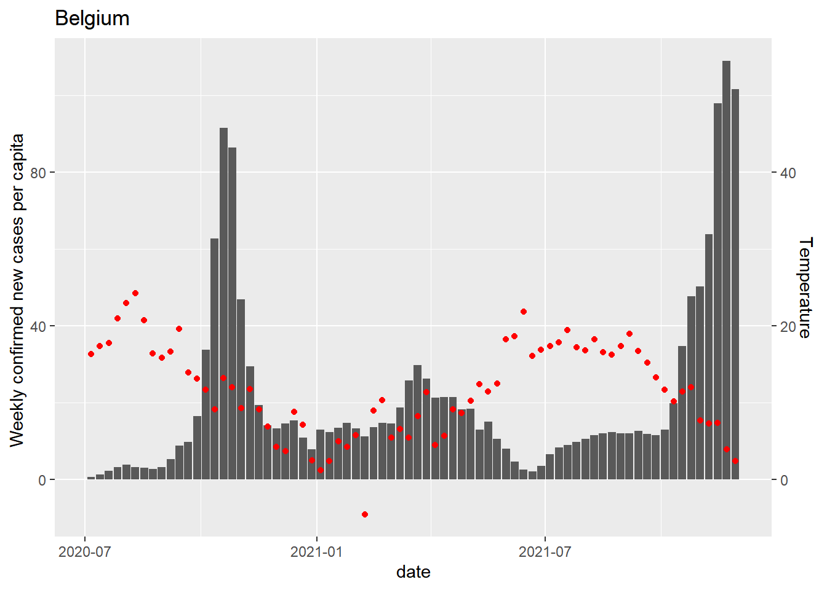
Collecting Data
Assumption:
The log data of weekly new cases varies linearly with temperature T;

Slide 9

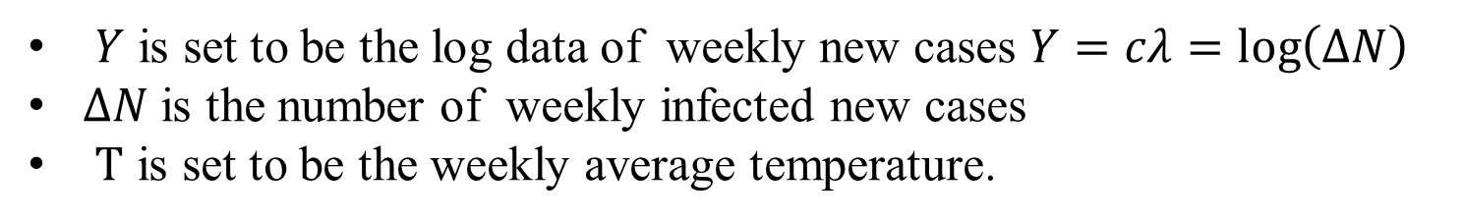

Statistical model
Assumption
The log data of weekly new cases 𝑌 varies linearly with temperature $T$
Statistical model
$$\text{Y}=β_{0}+β_{1}T+ε， where ε\sim N(0，σ^{2})$$
$$\text{Y}\sim N(β_{0}+β_{1}T，σ^{2})$$
$Y$ is set to be the log data of weekly new cases $Y=cλ=\log\left(∆N\right)$
$∆N$is the number of weekly infected new cases
$T$ is set to be the weekly average temperature.
Hypothesis

Slide 10

3 Examples in Belgium and Luxembourg

Slide 11
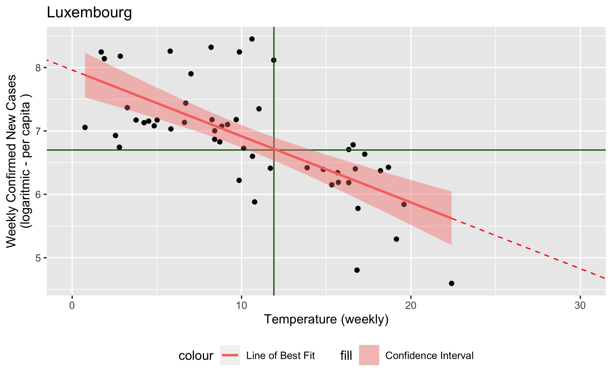

Luxembourg case
Estimated Model:
$\hat{Y}$ = 7.96 - 0.105 ∙T
𝑅² = 0.59
Data:
$\overline{T}$ = 11.91
$\overline{Y}$ = 6.7
Cor(T,Y) = -0.71

Slide 12
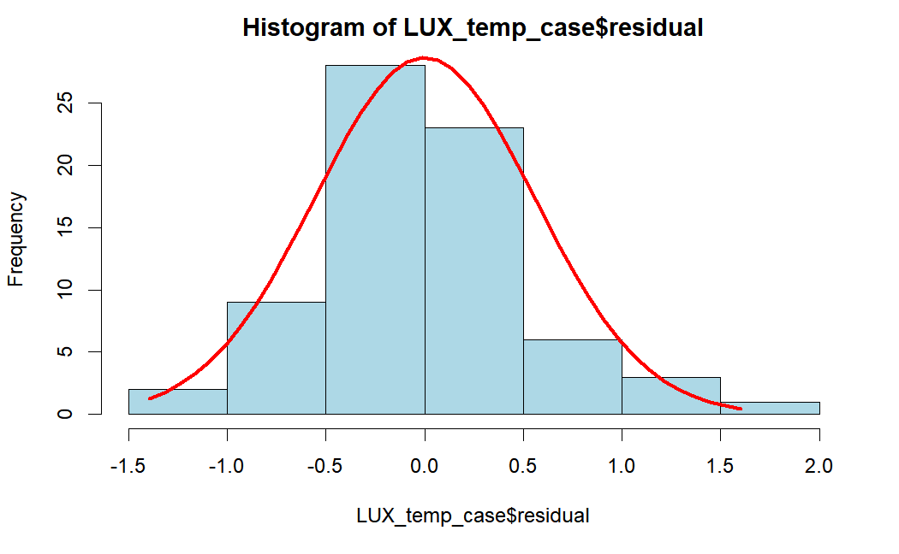
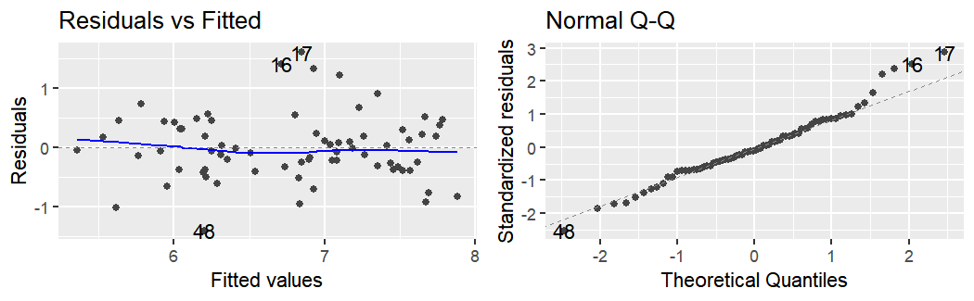

Mean Square Error
$$residual: \left(Y−\hat{Y}\right)\sim N(0,σ^{2})$$
$$\text{Y}=β_{0}+β_{1}T+ε$$

Slide 13
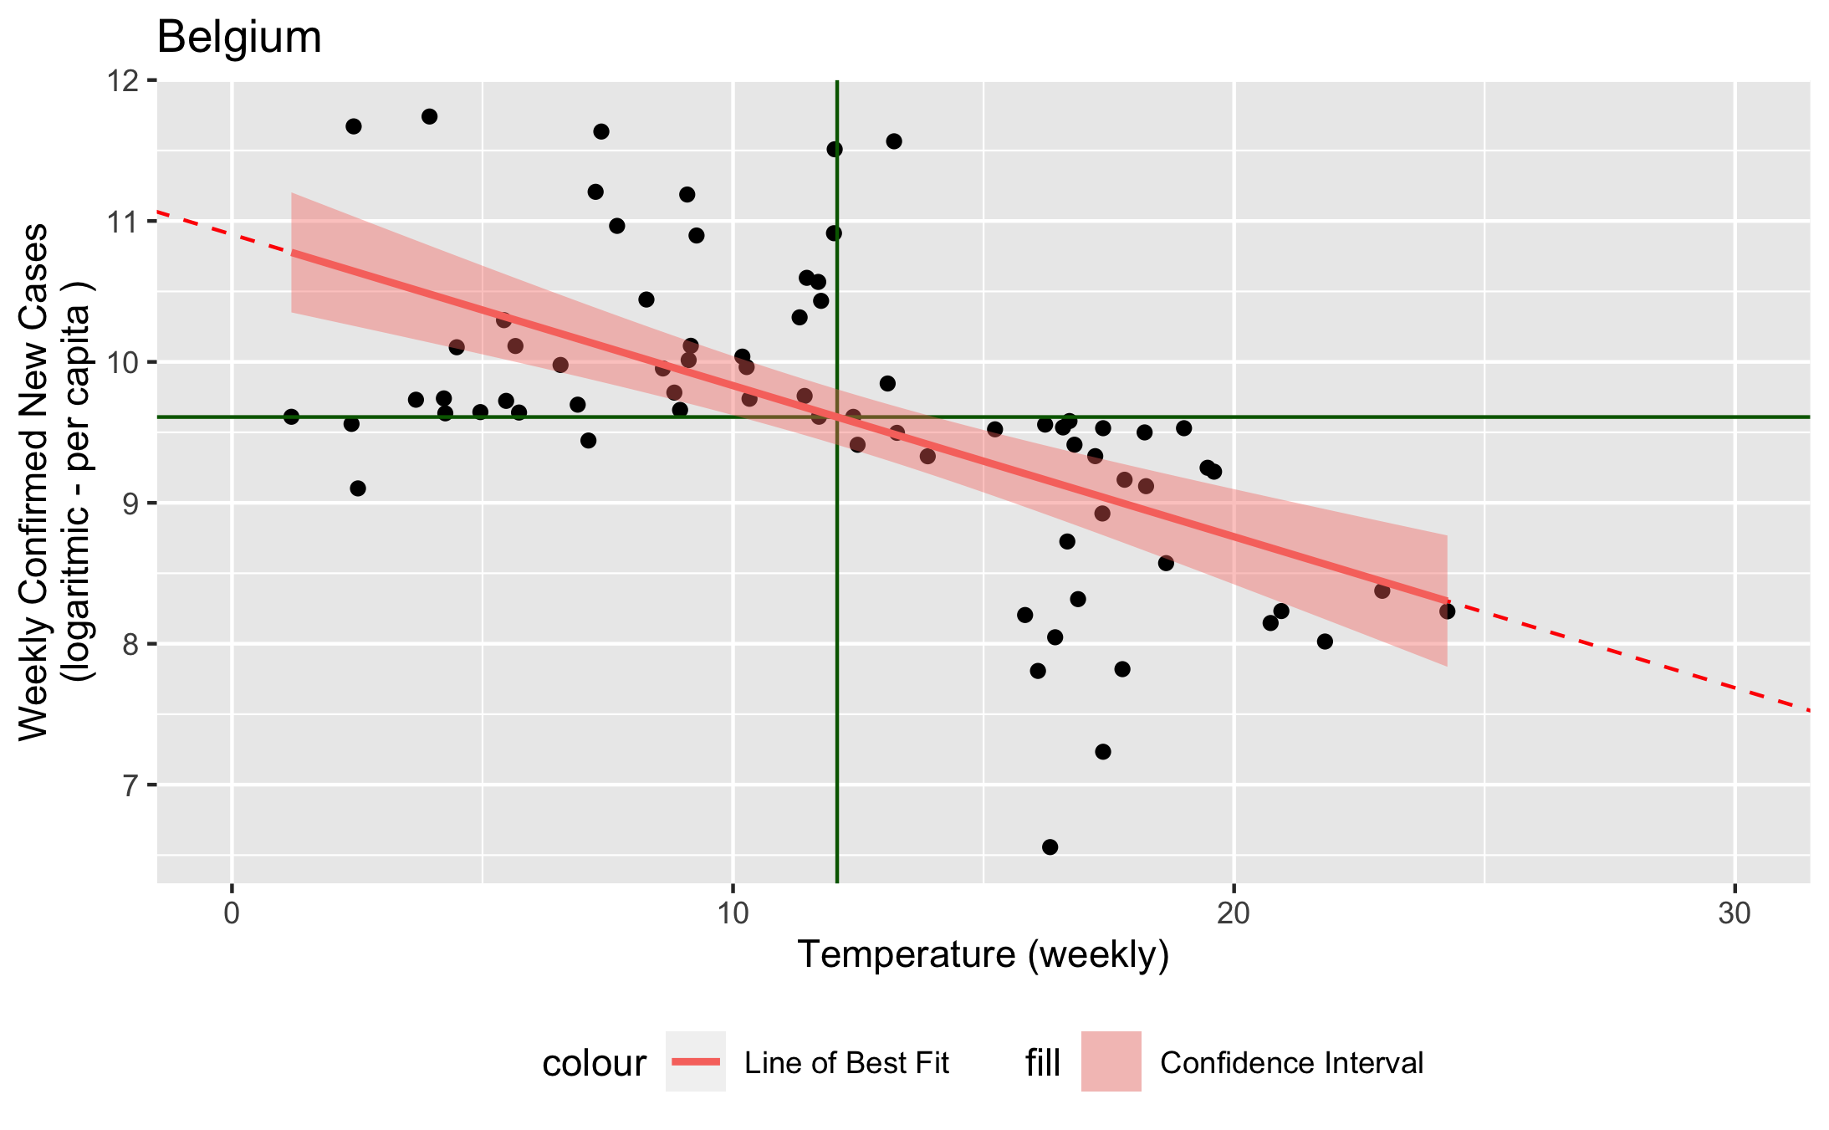

Belgium case
Estimated Model :
$\hat{Y}$= 10.9 - 0.107 $∙$T
𝑅² = 0.35
Data:
$\overline{T}$ = 12.08
$\overline{Y}$ = 9.61
Cor(T,Y) = -0.55

Slide 14
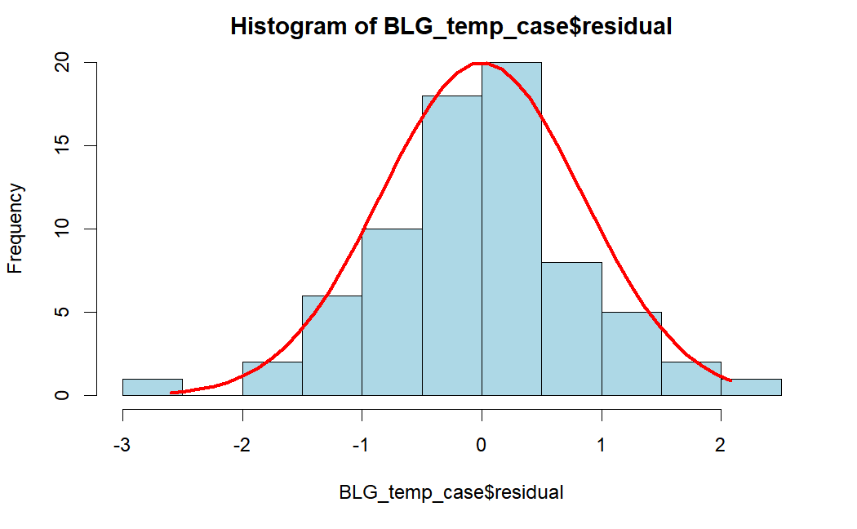
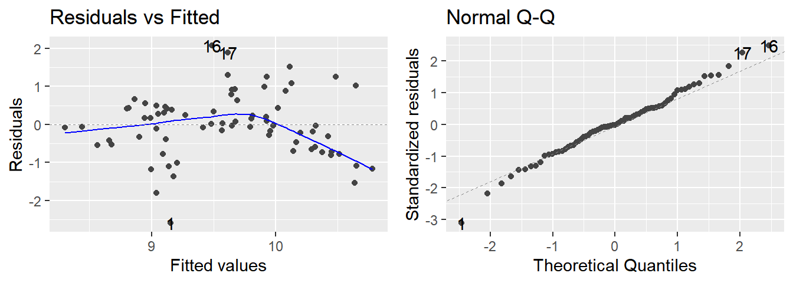

Mean Square Error
$$residual: \left(Y−\hat{Y}\right)\sim N(0,σ^{2})$$
$$\text{Y}=β_{0}+β_{1}X+ε$$

Slide 15
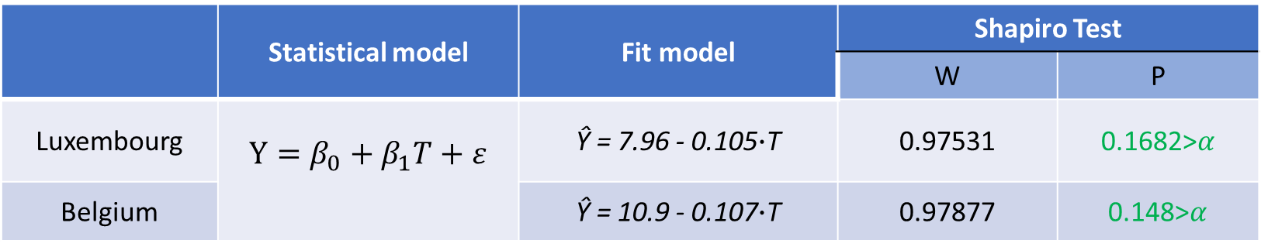
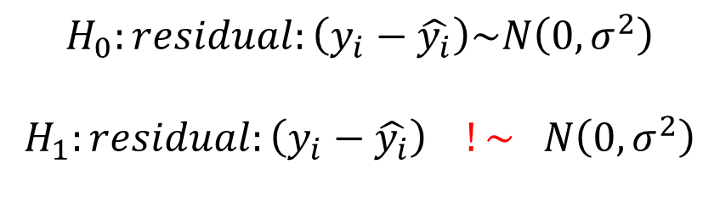

Hypotheses Tests – Shapiro Test
Shapiro Test
$$H_{0}:residual:\left(y_{i}−\hat{y_{i}}\right)\sim N\left(0,σ^{2}\right)$$
$$H_{1}:residual:\left(y_{i}−\hat{y_{i}}\right) !\sim N\left(0,σ^{2}\right)$$
we will use a significance level of
$$α=0.05,$$
 | Statistical model | Fit model | Shapiro Test
 |  |  | W | P
Luxembourg | $$\text{Y}=β_{0}+β_{1}T+ε$$ | Ŷ = 7.96 - 0.105$∙$T | 0.97531 | 0.1682>$α$
Belgium |  | Ŷ = 10.9 - 0.107$∙$T | 0.97877 | 0.148>$α$

Slide 16
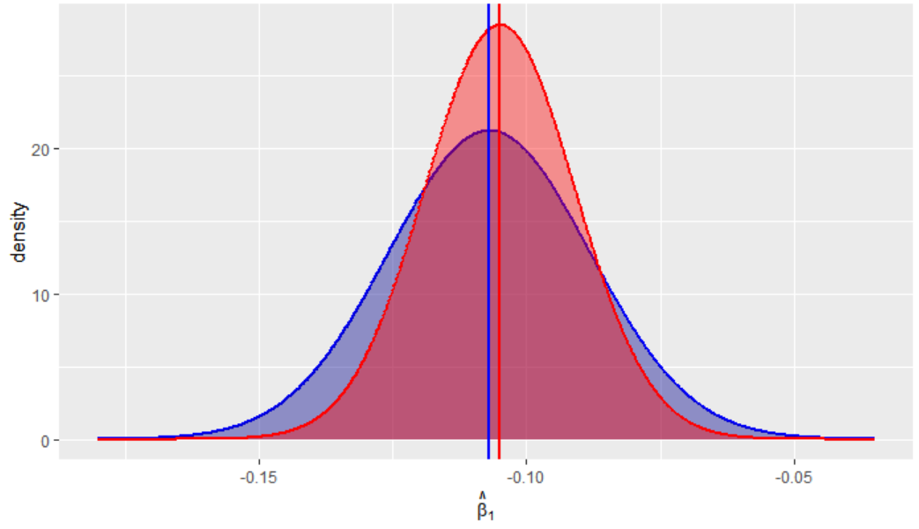

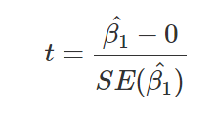
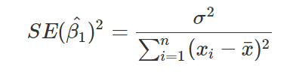
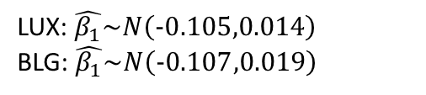

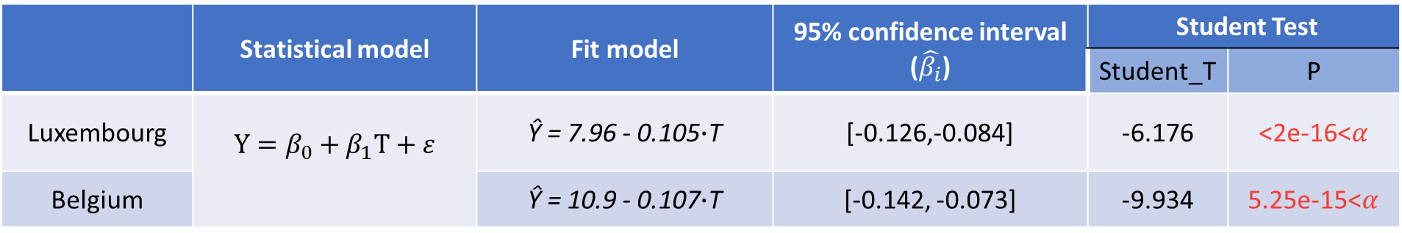
Hypotheses Tests-Student Tesr
LUX: $\hat{β_{1}}\sim N\left(−0.105,0.014\right)$
BLG: $\hat{β_{1}}\sim N\left(−0.107,0.019\right)$
Student Test
we will use a significance level of
$$α=0.05,$$
 | Statistical model | Fit model | 95% confidence interval ($\hat{β_{i}}$) | Student Test
 |  |  |  | Student_T | P
Luxembourg | $$\text{Y}=β_{0}+β_{1}T+ε$$ | Ŷ = 7.96 - 0.105$∙$T | [-0.126,-0.084] | -6.176 | <2e-16<$α$
Belgium |  | Ŷ = 10.9 - 0.107$∙$T | [-0.142, -0.073] | -9.934 | 5.25e-15<$α$

Slide 17

4. Other factors

Slide 18
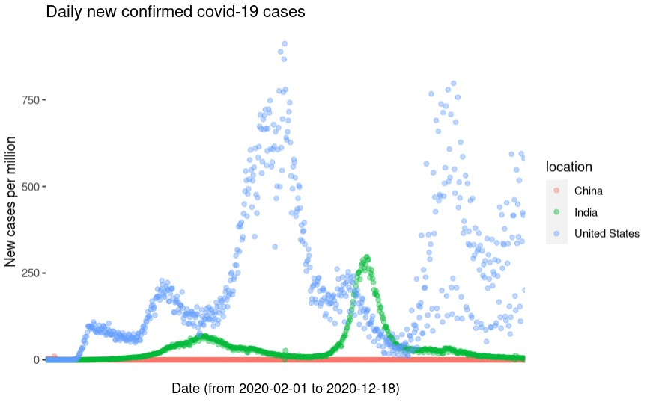
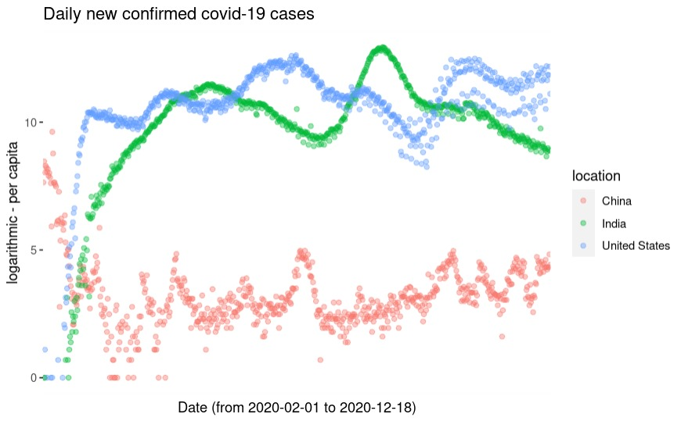
Other factors
Daily New confirmed Covid-19 Cases
Daily New confirmed Covid-19 Cases (log data)
The daily number of new cases infected by COVID-19 is currently exponentially growing for most countries affected by the virus. However, this exponential growth rate varies significantly for different regions over the globe.
Some factors like vaccination, lock- down policy, social distancing measures and virus mutation should be considered

Slide 19
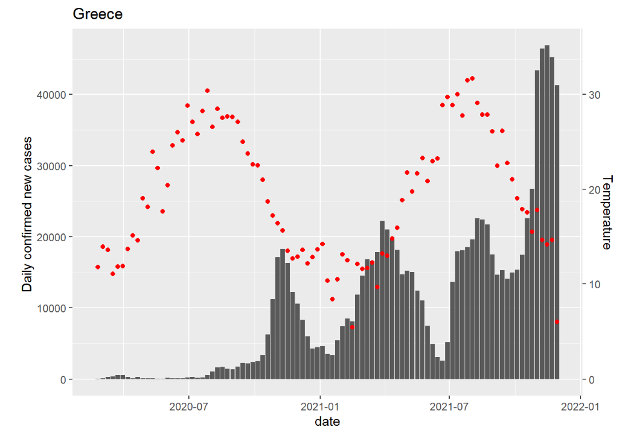
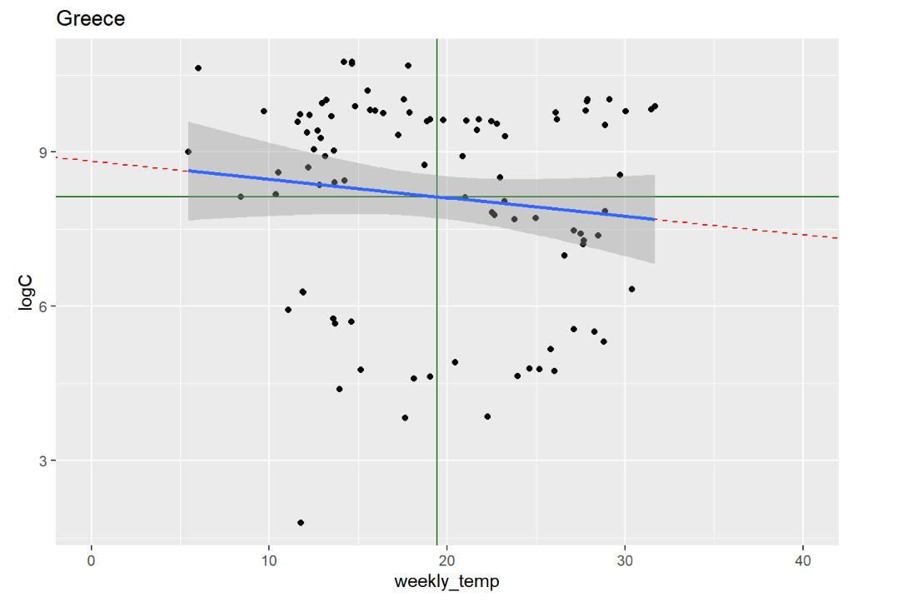
Factors for further research
The number of confirmed cases is generally much lower than actual number of people that have been infected with COVID-19
Comparisons of case numbers over time and between different regions need to consider differences in practices with regards to testing.
the Covid data may be delayed from when the test was made to when the test result came back, especially if there are testing backlogs
Some factors like vaccination, lock- down policy, social distancing measures and virus mutation should be considered

Slide 20


5. Conclusions

Slide 21
Conclusions
Environmental temperature is negatively correlated with the COVID-19 exponentially growing rate
Other factors like lockdown policies and social distancing measures play an important role in COVID-19 infection control
Based on the resulting high statistical confidence, we suggest relax social distancing measures when the temperature is high in summer, and strict social distancing measures when the temperature is low in winter

Slide 22
Thanks for your listening

