Slide 1
PANDA Status/Next Steps LLVM/Taint
Ryan Whelan
BW Lightning talk
0x51FAB030
Notes:
1
1

Slide 2
Recent Progress
Taint support for all LLVM instructions in all relevant helper functions nearing completion for x86/64
Many thanks to Sam and Nate from NU
Same infrastructure/process can be used for new architectures, likely without much work
Some simple tests have been written to verify new taint models, and so far they are working as expected
Sam ported iFerret’s CPUID label/query mechanism to PANDA

Slide 3
TODO: Taint
Run tests prepared by Sam and Nate of user-level IPC in whole-system mode, copying tainted data between processes
First step for whole-system taint
Run on target platforms: Windows 7/8, Linux, 32/64 bit, eventually ARM Linux
Try out taint with record/replay
Schedule a hackathon to port iFerret’s disk/IO taint mechanisms to PANDA
Cry about how slow it is

Slide 4
TODO: LLVM
OPTIMIZE!!!

Slide 5
LLVM Optimization
Problems:
IR is translated from TCG poorly, in such a way that LLVM’s optimizations are unable to improve it
Obviously many accesses to CPU state, and these accesses don’t appear to be promoted to register accesses
Taint operations operate at the byte level, and within basic blocks of taint operations, we can likely perform dead code elimination, etc.
Using Tim’s taint op symbolic executor!

Slide 6
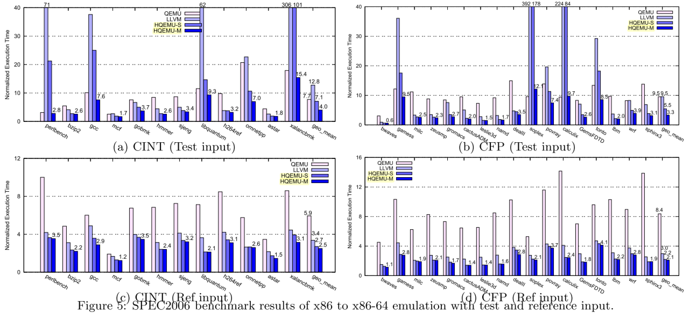
LLVM Optimization: Hopes
Hong, et al. HQEMU. CGO ‘12.

Slide 7
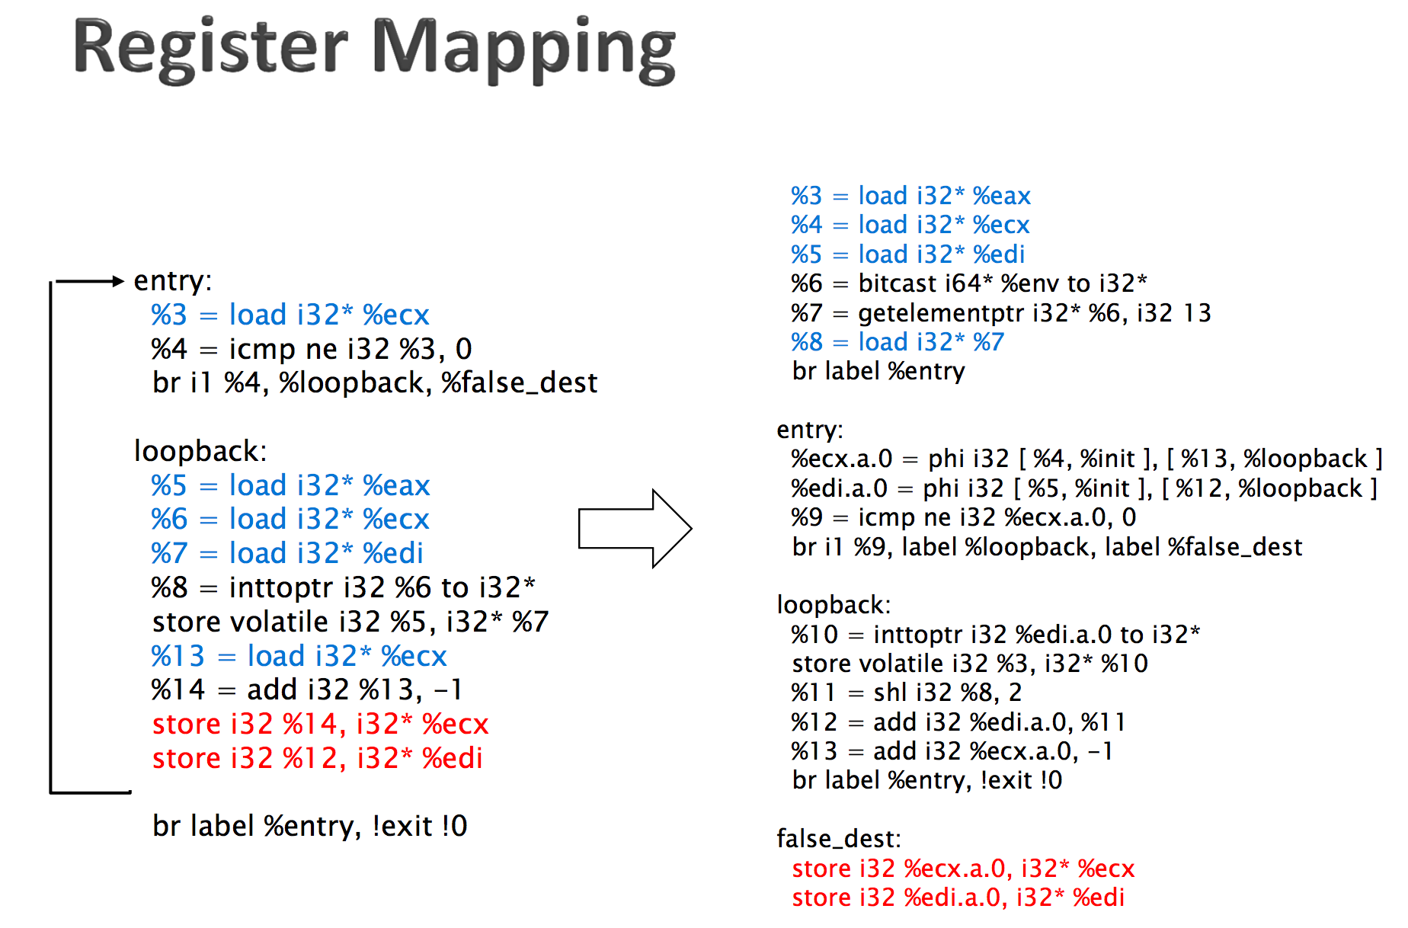
LLVM Optimization: Implementation
Thanks to Ding-Yong Hong

Slide 8
LLVM Optimization: Implementation
Generate LLVM IR in such a way that register promotion can be used
Allocate guest registers to stack space and promote, rather than treating registers as memory addresses
Might require a significant rewrite of TCG->LLVM translator, but hopefully it’s worth it
Perform inlining of common helper functions into translated code
…
Profit! (Hopefully)

Slide 9
Thanks!
Questions?

