Slide 1
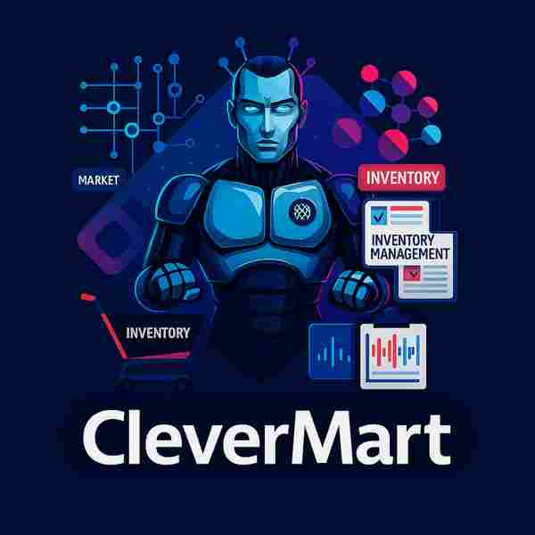
🛒 CleverMart
AI-Powered Smart Shop Management Solution
Revolutionizing Retail with End-to-End AI Intelligence
CleverMart| 22 July 25 | AI Geeks

Slide 2
The Solution
Modern retail management offers significant improvements.
📦 Efficient Inventory Management
Automated tracking ensures optimal stock levels and maximizes revenue opportunities.
😊 Enhanced Customer Experience
Reduced wait times, comprehensive assistance, and personalized service.
📊 Revenue Optimization
Data-driven insights capture all sales opportunities and optimize pricing.
⚙️ Streamlined Operations
Automated processes free up time for strategic growth initiatives.

Slide 3
CleverMart Solution
Complete AI-driven retail management ecosystem
🤖 AI Chatbot Assistant
24/7 intelligent customer support and business operations management
📈 Smart Analytics
Real-time insights and predictive analytics for better decisions
⚡ Automated Operations
Streamlined processes from inventory to customer management
🎯 End-to-End Management
Complete solution covering every aspect of shop operations

Slide 4
Current Features
Powerful capabilities already transforming retail operations
🛍️ Inventory Management
AI-powered stock tracking, automatic reorder points, and real-time inventory updates across all channels
📊 Sales Analytics
Comprehensive reporting dashboard with sales trends, performance metrics, and profit analysis
🏪 Store Operations
Staff scheduling, task management, and operational workflow optimization
📱 Mobile Management
Complete mobile app for on-the-go store management and monitoring

Slide 5
Upcoming Features
The future of intelligent retail management
Q3 2025
🔮 Predictive Analytics
Demand forecasting and market trend prediction
Q4 2025
🛒 Smart Shopping
AR product visualization and virtual shopping assistant
Q1 2026
🌐 Multi-Store Chain
Centralized management for multiple locations
🎯 Dynamic Pricing
AI-driven pricing optimization based on demand, competition, and market conditions
🚚 Supply Chain Integration
Direct supplier connections and automated procurement workflows
👥 Customer Loyalty AI
Personalized loyalty programs and targeted marketing campaigns
💳 Payment Processing
Integrated payment solutions with multiple payment methods and fraud detection
💬 Customer Service Chatbot
Intelligent customer support handling inquiries, orders, and providing personalized recommendations

Slide 6
Ready to Transform Your Retail Business?
Join the AI revolution in retail management
CleverMart: Where Intelligence Meets Commerce
Schedule Demo
Get Started
or
📧 contact@clevermart.ai
🌐 www.clevermart.ai

