Slide 1
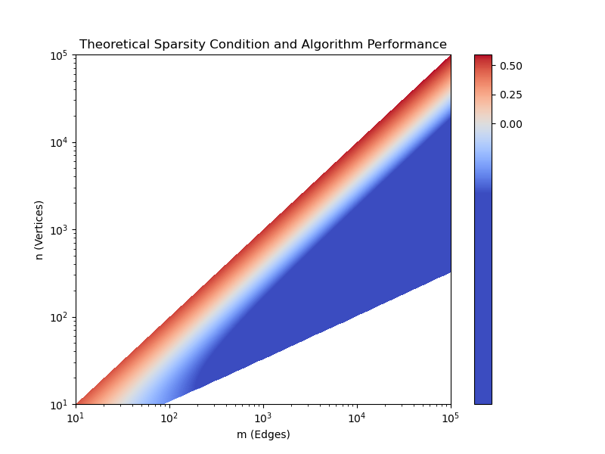
50%
Performance Improvement
25%
0%

