Slide 1
[0,0] | [0,1] | [0,2] | [0,3] | [0,4]
[1,0] | [1,1] | [1,2] | [1,3] | [1,4]
[2,0] | [2,1] | [2,2] | [2,3] | [2,4]
[3,0] | [3,1] | [3,2] | [3,3] | [3,4]
[4,0] | [4,1] | [4,2] | [4,3] | [4,4]
[5,0] | [5,1] | [5,2] | [5,3] | [5,4]
[6,0] | [6,1] | [6,2] | [6,3] | [6,4]
[7,0] | [7,1] | [7,2] | [7,3] | [7,4]
[8,0] | [8,1] | [8,2] | [8,3] | [8,4]
[9,0] | [9,1] | [9,2] | [9,3] | [9,4]
[10,0] | [10,1] | [10,2] | [10,3] | [10,4]
[11,0] | [11,1] | [11,2] | [11,3] | [11,4]
Region | Abr. | Pop. | Sq. Km.
Midwest | MW | 2000000 | 45

Slide 2
Created using Officegen version 0.6.3
Fast position
Full line
Office generator
Hello World!
Two
lines

Slide 3
Office generator

Slide 4
Red line
Red box 1
Red box 2

Slide 5


Slide 6
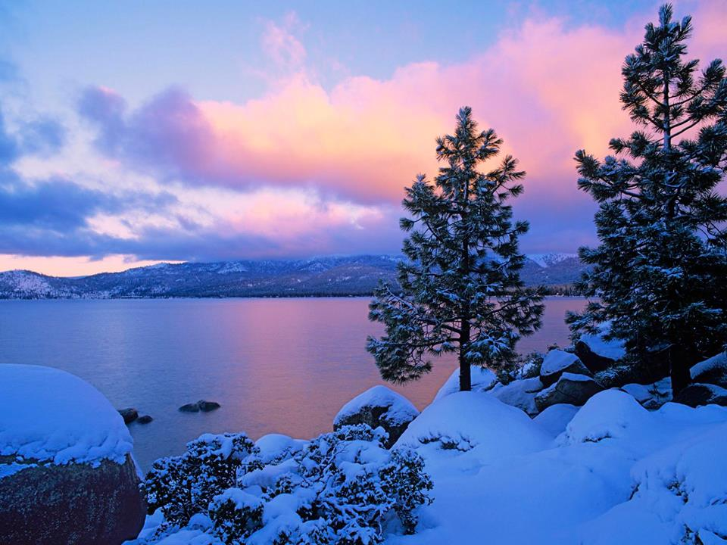

Slide 7
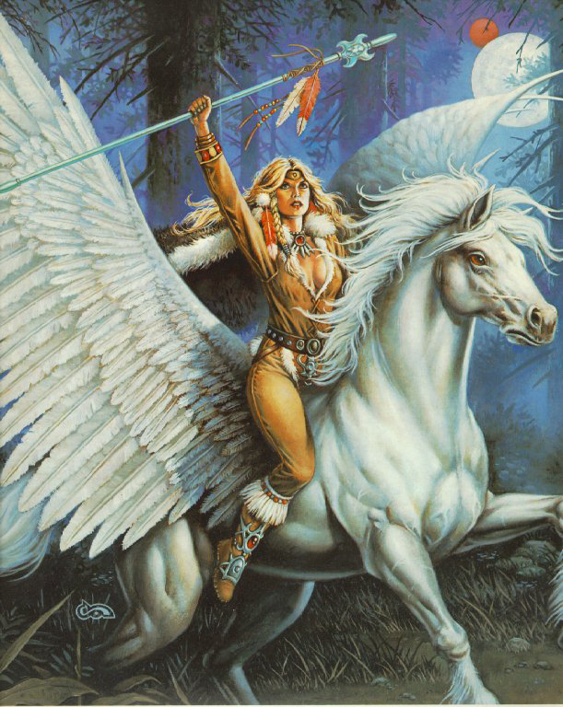

Slide 9



Slide 10



