Slide 1

Age calculator
Project submission

Slide 2

Introduction :
Our project name is Age calculator.
It’s design by Android studio
And code working by java language.

Slide 3
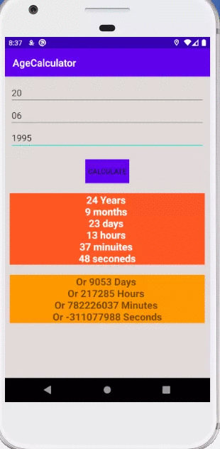
How it work :
In our age calculator if we input birth date,month and
year then we get the present age as output with hour,
minute and also second.

Slide 4
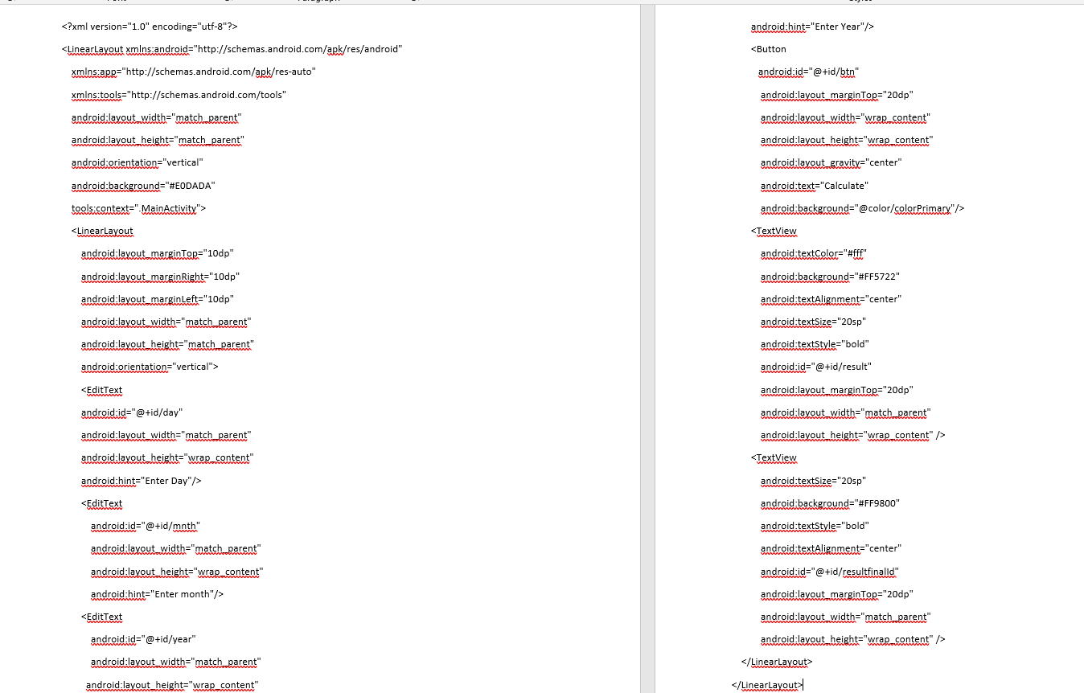
Xml code :

Slide 5
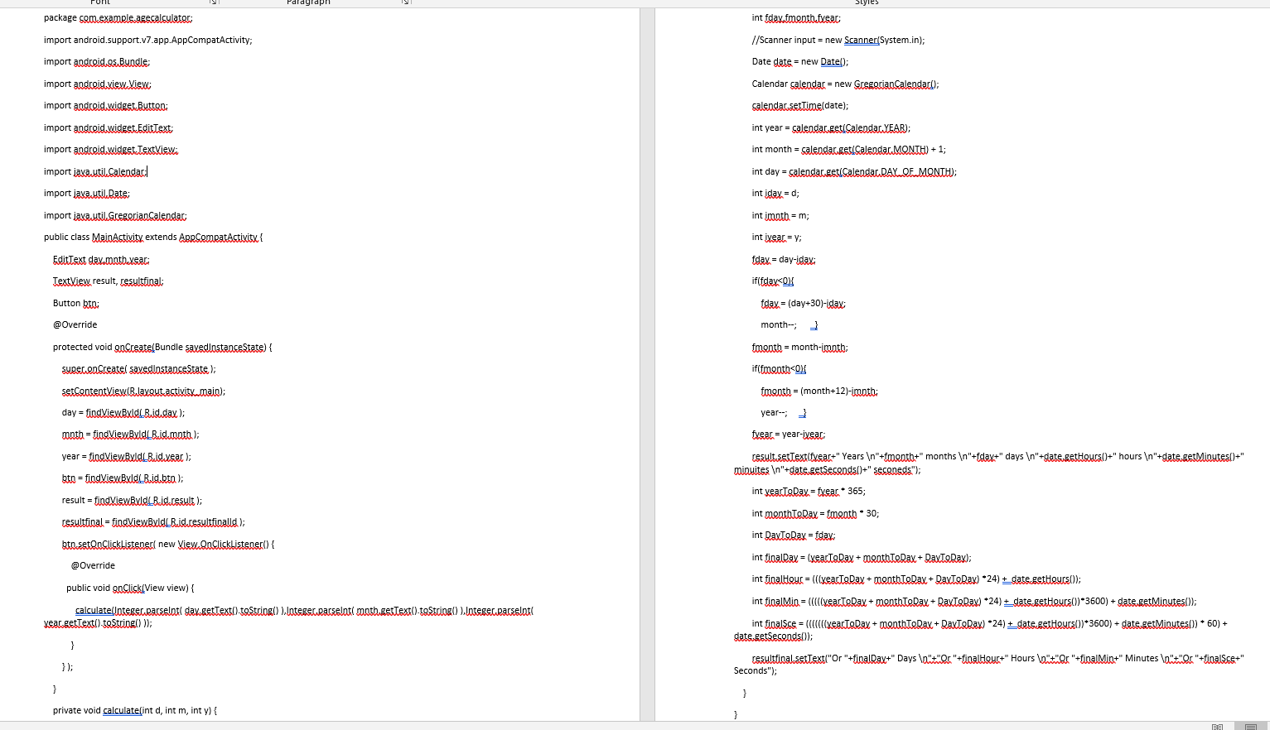
Main code :

Slide 6
Future Plan :
In future we add here more feature like -
If someone’s birthday in leap year we can count his/her age.
It also show according someone’s age, what is the accurate weight etc.

