Slide 1
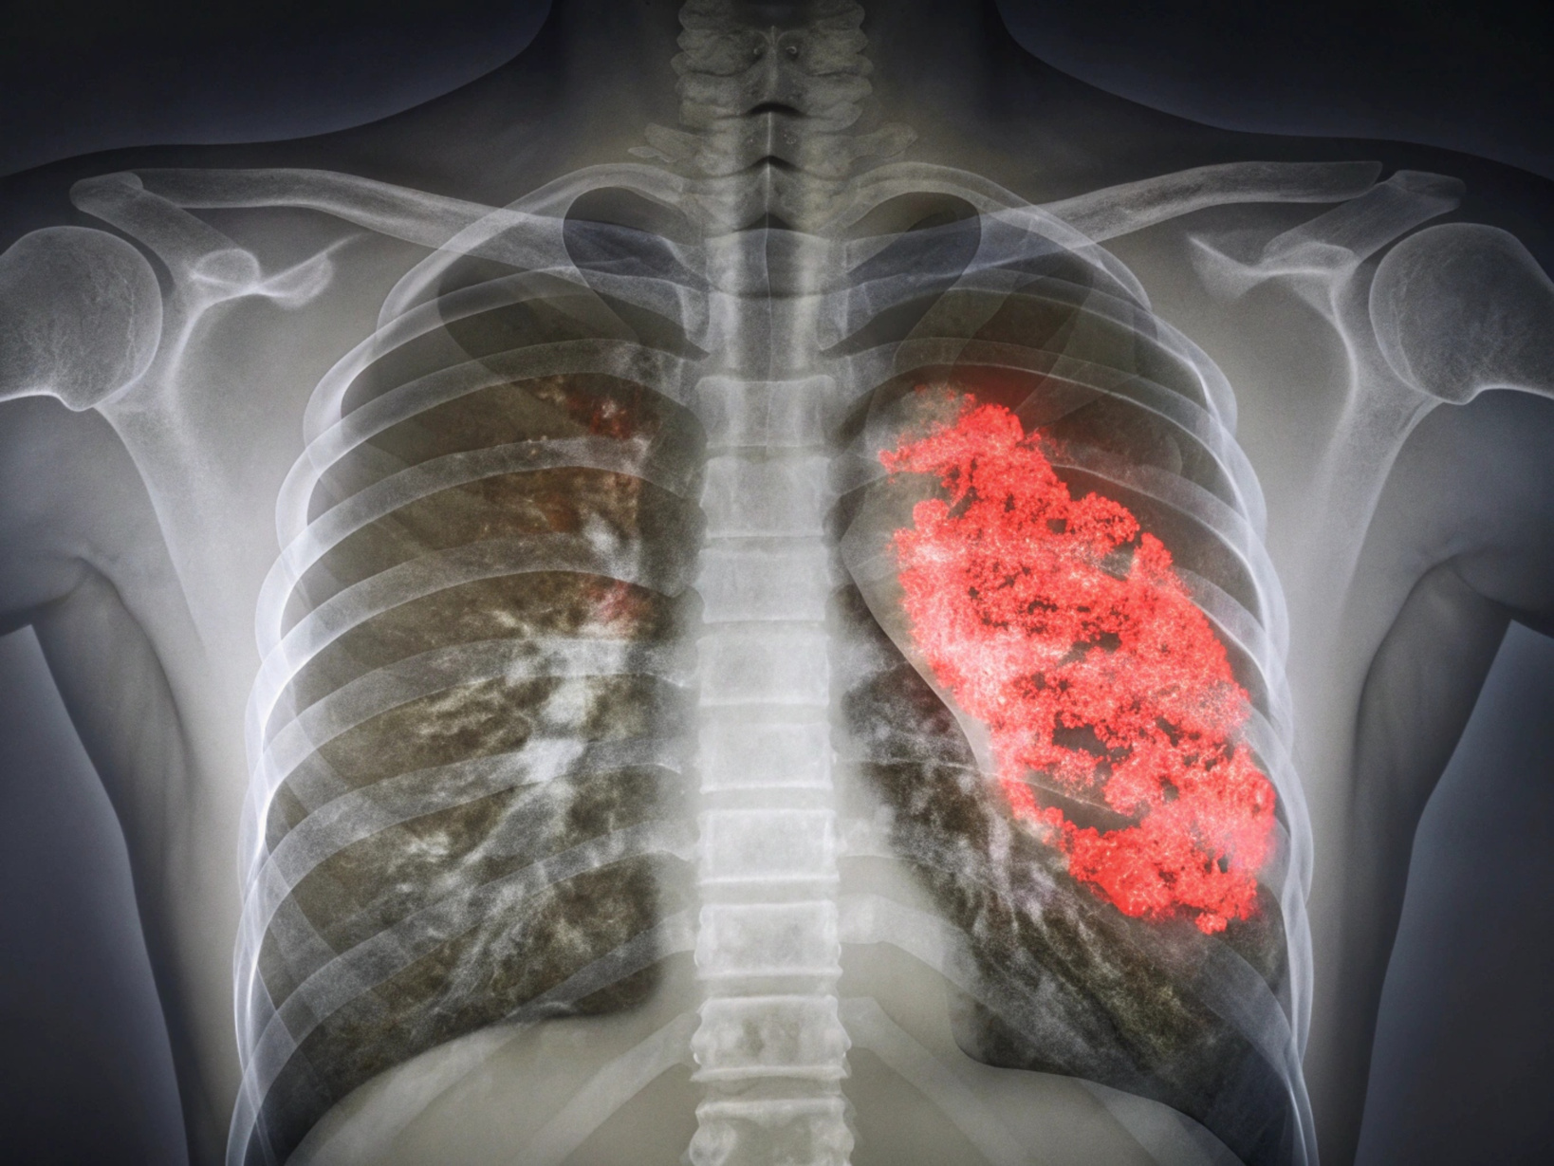

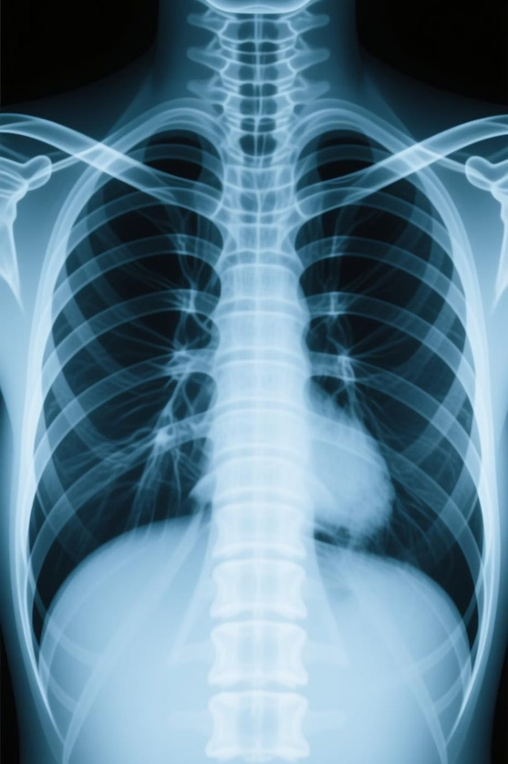
Pneumonia Detection Using Optimized Deep Learning Technique
Ahmed M.Moussa, Sandy S.Samir, Fatma M.Talaat
New Mansoura University . Computer Science and Engineering
IC-FTAI 2025 | Alexandria, Egypt

Slide 2
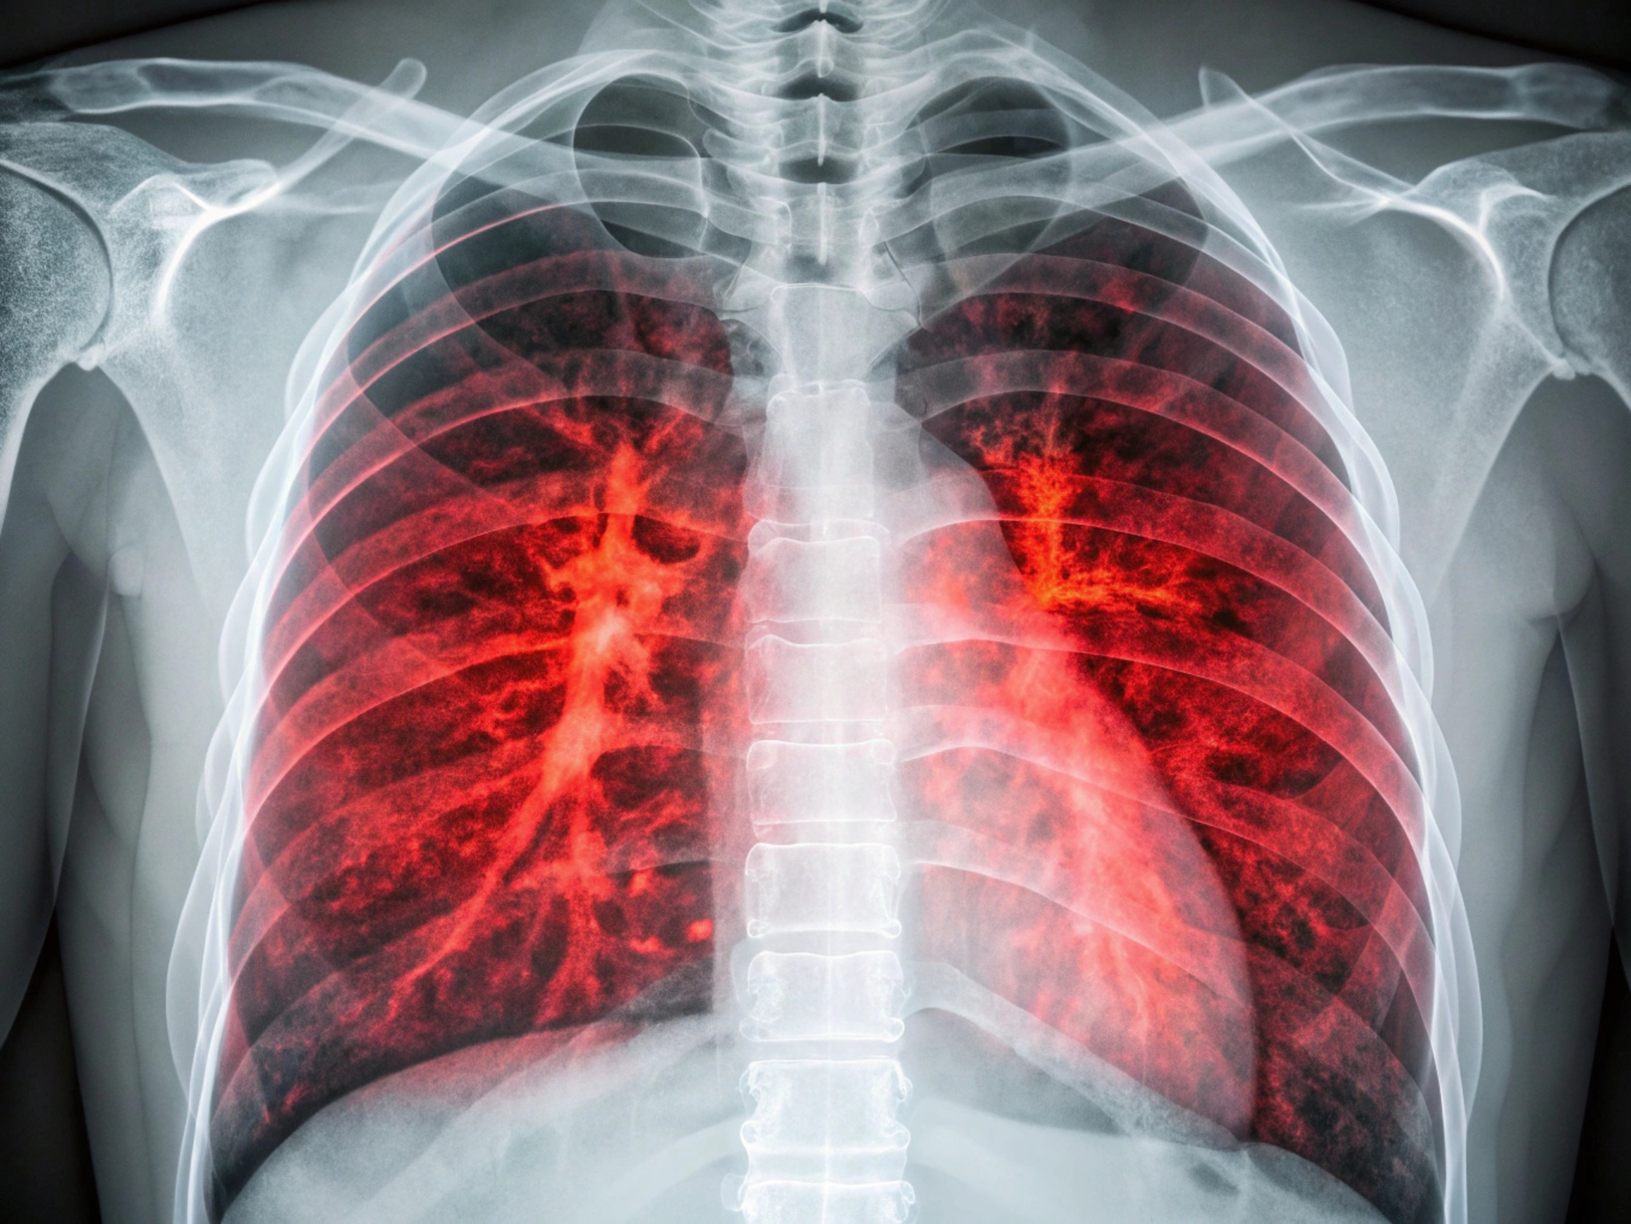
Research Objective
Goal
Make pneumonia detection More Reliable in real-world application using Genetic Algorithm-optimized VGG16 convolutional neural networks.
Challenge
Overcome overfitting in deep
learning models and optimize weights for clinical
deployment.
Impact
Enable rapid, accurate pneumonia diagnosis to support early intervention
and reduce diagnostic delays in resource-constrained settings.

Slide 3

The Clinical Problem
Global Disease Burden
Pneumonia remains a leading infectious cause of death in
children and adults worldwide, with millions of cases annually. Early detection is critical for treatment efficacy and patient survival.
Diagnostic Delays
Manual radiological review creates bottlenecks, delaying treatment initiation and patient care decisions.
CNN Overfitting
Hyperparameter Optimization
Deep neural networks often overfit
to training data, reducing generalization and clinical reliability in real-world deployments.
Traditional optimization methods
fail to efficiently navigate high- dimensional parameter spaces inherent to modern deep learning architectures.

Slide 4
Optimization Methods Comparison
Method | Speed(sec) | Accuracy | Robustness | Local Optima
Particle Swarm | 24.04 | Excellent | Moderate | Vulnerable
GA-PYGAD | 24.55 | Excellent | Very High | Avoids
GA-DEAP | 23.84 | High | Good | Avoids
Ant Colony | 23.87 | Excellent | High | Avoids
Bayesian | 23.99 | High | Good | Moderate
Grey Wolf | 23.38 | High | Moderate | Moderate
Excellent
Very High
High
Good
Moderate
Low
Genetic Algorithm selected for superior balance of convergence, robustness, and escape from local optima in high-dimensional CNN parameter spaces.

Slide 5

Proposed Methodology
Input Images
VGG16 Model
Chest X-ray dataset
Choosing Best Parent and Looping until weight finalization
GA Optimization
Selection, crossover,
mutation
Cloning model architecture and fitting
Detection Output
+
Classified pneumonia
result
GA-Optimized VGG16 Technique: Genetic algorithms optimize the weights of the model across many evolutionary generations. Each population candidate represents a distinct weight configuration evaluated against validation accuracy. Selection preserves elite performers, crossover generates offspring configurations, and mutation introduces exploration within the parameter space.

Slide 6

Dataset & Preprocessing Pipeline
01
Data Source
Kaggle ChestX-ray Dataset: 5,857 images (4273 pneumonia-positive, 1584 normal)
02
Augmentation
Random rotation(±10°), horizontal flip, brightness/contrast adjustment
(±20%) and cropping to increase effective dataset size and model robustness.
03
Normalization
Pixel values scaled to [0,1] range; ImageNet statistics applied for transfer
learning compatibility with pre-trained VGG16 weights.
04
Split Strategy
Training(70%),validation (15%), test (15%) stratified split ensuring balanced
class representation across all subsets.

Slide 7
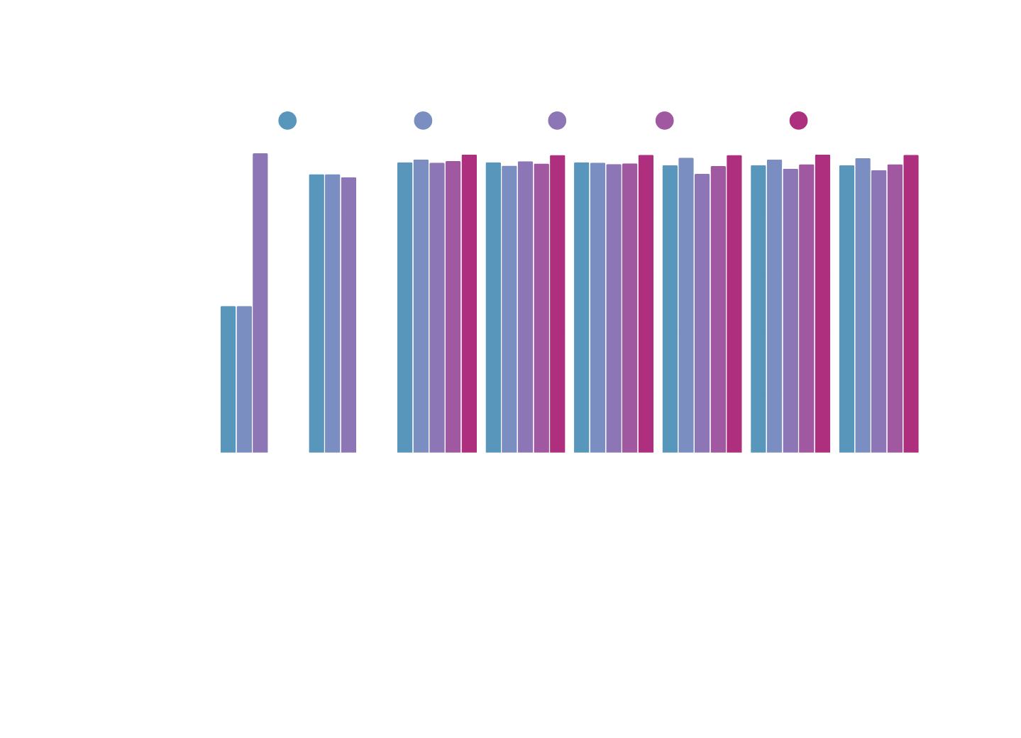
Experimental Results
Accuracy Comparison Across Optimization Methods:
Key Finding: GA-optimized VGG16 achieved 96.57% accuracy with superior generalization metrics (specificity 97.3%, sensitivity 95.8%), outperforming unoptimized baselines and demonstrating significant overfitting reduction on test data.

Slide 8
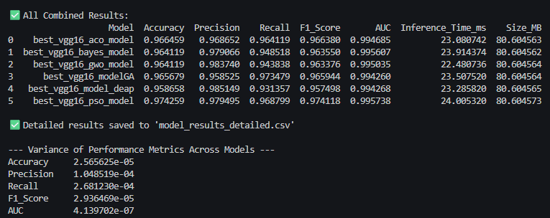

Slide 9
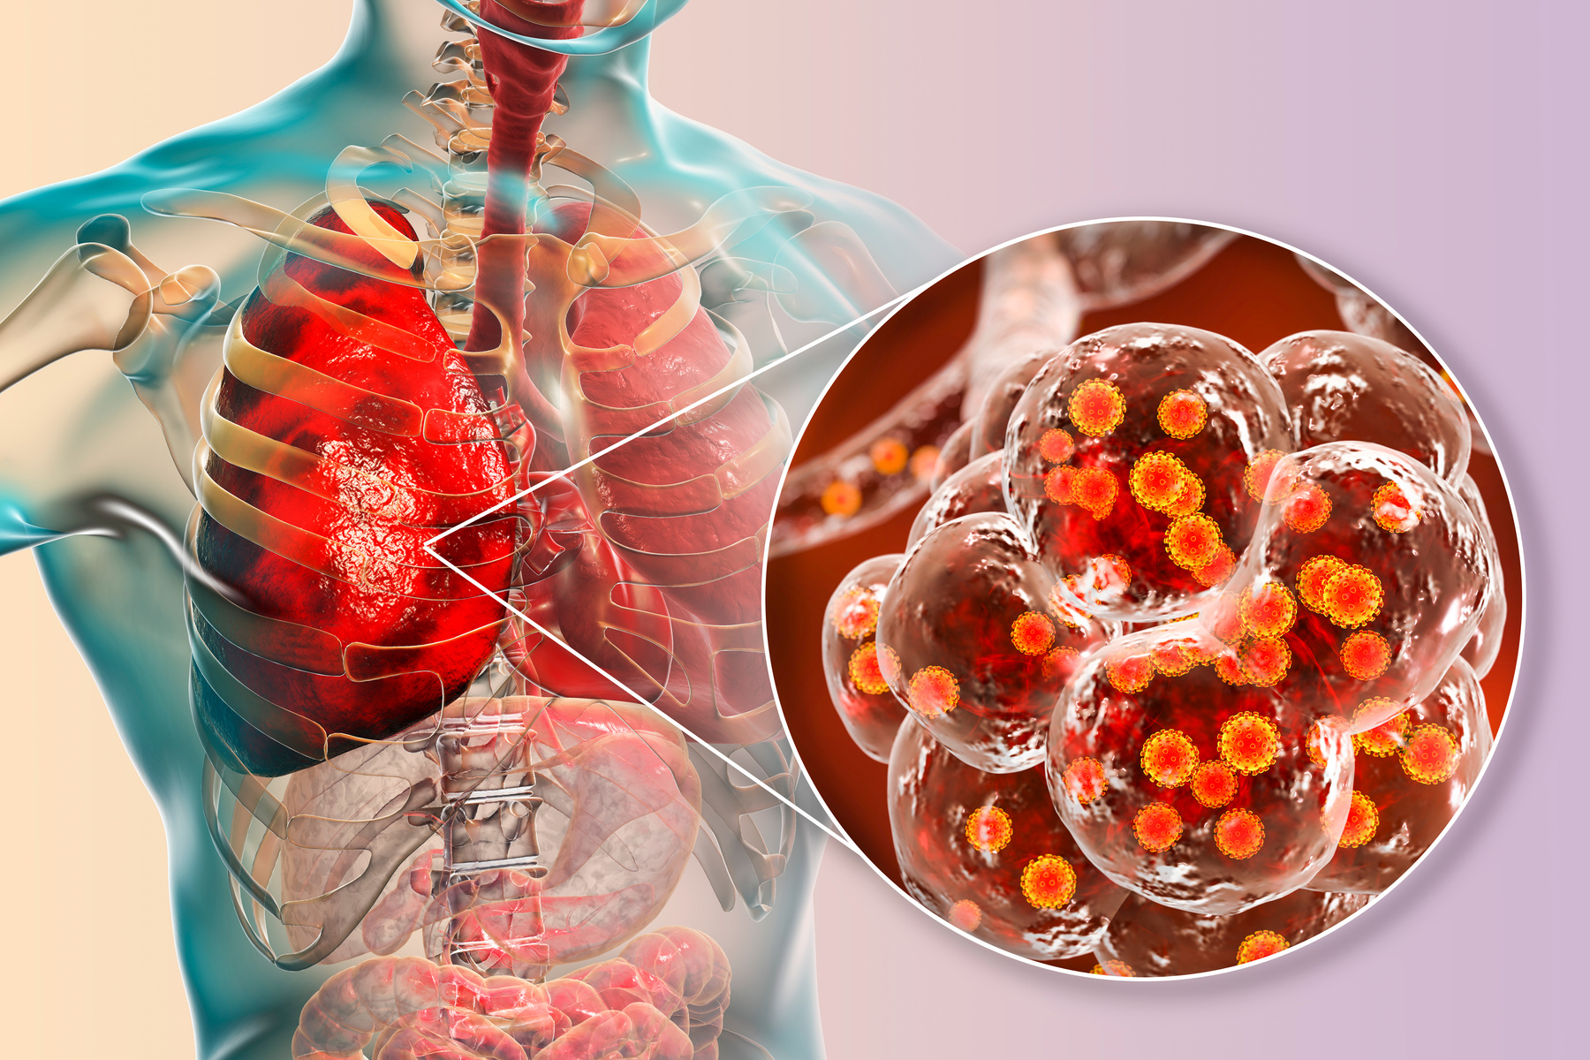
Performance Analysis & Clinical Insights
Strengths of GA
Practical Healthcare Implications
Optimization
Effective escape from local optima through population- based search
Robust parameter
configuration transferable
across datasets
Reduced overfitting: 3.36%
improvement over unoptimized
VGG16
Balanced sensitivity-specificity
trade-off for clinical deployment
Near-radiologist-level performance enabling decision support systems
Reduced false positives
minimize unnecessary antibiotic
prescriptions
Enables rapid classification in resource-limited settings
Foundation for real-time
diagnostic assistants in clinical
workflows

Slide 10

Conclusion & Future Directions
Key Findings
Hybrid Approaches
Future work will investigate ensemble methods combining GA with PSO, reinforcement learning for further accuracy gains, using up to date methods like Cross-validation for harsher testing and increasing compute to stress test overfitting.
Genetic Algorithm optimization significantly improves CNN generalization for pneumonia detection, with strong clinical metrics and practical deployment
readiness.
Real-World Translation
Integration intohospital PACS systems and mobile diagnostic platforms
for rapid deployment in clinical and remote settings, validated through prospective studies.

Slide 11

Acknowledgments & Contact
2025 International Conference on Future Telecommunications and Artificial Intelligence Alexandria, Egypt
Corresponding Author:
Ahmed M. Moussa
New Mansoura University
ahmedmoussa.dev@gmail.com
We acknowledge the support of our institutions and the medical imaging
community for dataset sharing and clinical guidance.

