Slide 1



outline to get started
In this presentation we going to show our project Vending Machine Arduino Based
Done by:
Mohammed Sameeh Zaloom
Mohammed Abdullah Haswah
Hamza Waseem Nasser
Supervised by:
Dr. Bilal Zahran
See more: Open the Documentation below for more information.

Slide 2
Vending Machine Arduino Based

Slide 3







Coding
Project Overview
Implement a small vending machine using: Arduino Mega, servo motors, keypad, LCD, wood, and various other components.
Circuit
3D Design
Coin Detection System

Slide 4
Project Overview
Project Overview
Coding
3D Design
Circuit
Coin Detection System

Slide 5
Project Overview
Coding
Project Overview
3D Design
Circuit
Coin Detection System

Slide 6
Project Overview
Coding
Project Overview
3D Design
Circuit
Coin Detection System

Slide 7
Project Overview
Project Overview
Coding
3D Design
Circuit
Coin Detection System

Slide 8
Project Overview
Project Overview
3D Design
Coding
Coin Detection System
Circuit

Slide 9
Project Overview
Project Overview
3D Design
Coding
Coin Detection System
Circuit

Slide 10
Project Overview
Project Overview
Coding
3D Design
Circuit
Coin Detection System

Slide 11
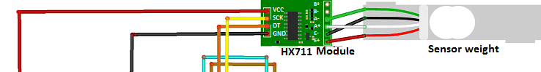
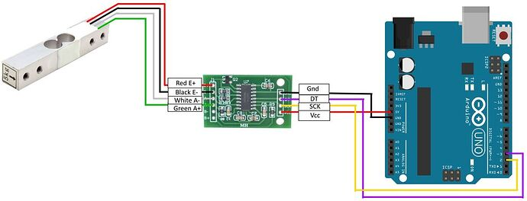
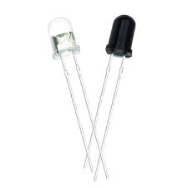
Project Overview
Project Overview
Coding
Coin Detection System
3D Design
Circuit

Slide 12
Project Overview
Project Overview
Coding
3D Design
Circuit
Coin Detection System

Slide 13
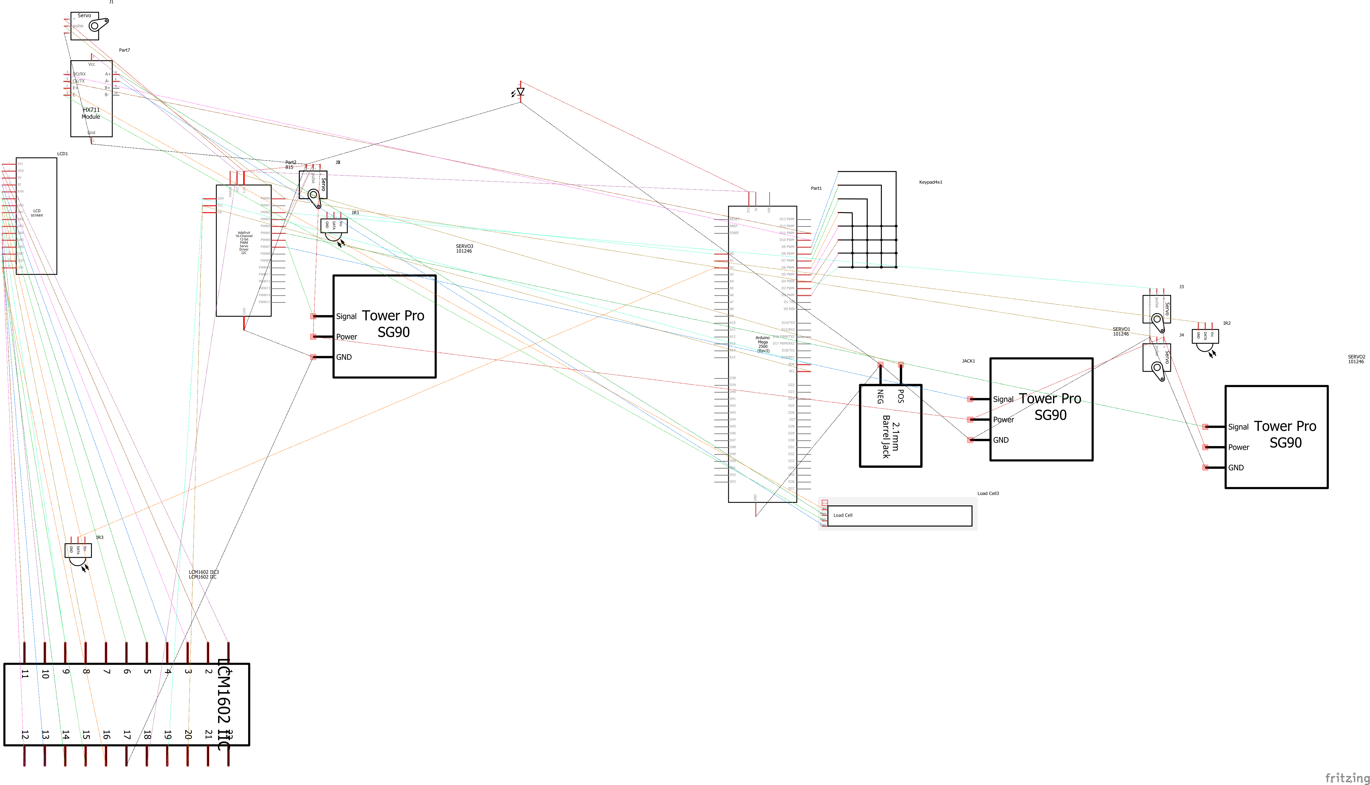
Project Overview
Coin Detection System
Project Overview
3D Design
Circuit
Coding

Slide 14
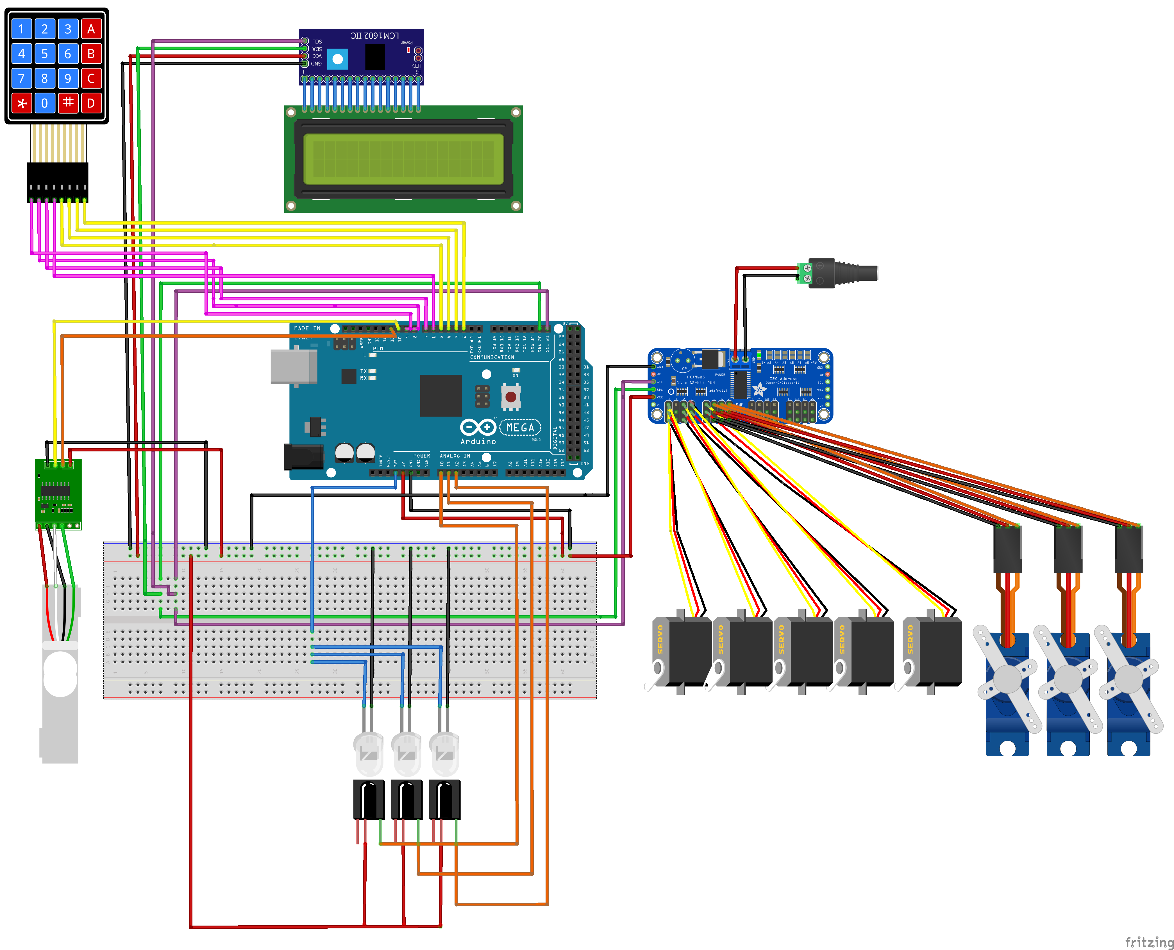
Project Overview
Coin Detection System
Project Overview
3D Design
Circuit
Coding

Slide 15
Project Overview
Coin Detection
Circuit
3D Design

Slide 16
Project Overview
Coin Detection
Circuit
3D Design

Slide 17
Project Overview
Coin Detection
Circuit
3D Design

Slide 18
Project Overview
Circuit
Coin Detection
3D Design

Slide 19

Project Overview
See more: Open the Documentation below for more information about the Project

Slide 20
Project Overview
Special Thank to:
Dr. Aryaf Al-adwan

Slide 21
Project Overview
Thank you ☺

