Slide 1
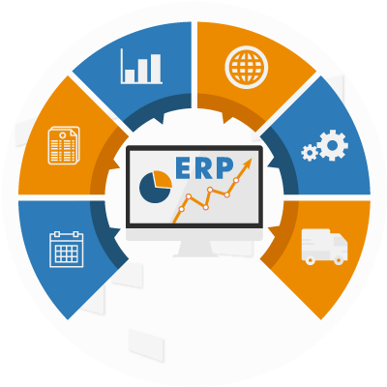
ERP Solution for Trading & Manufacturing Groups
“One platform to manage your entire business!”

Slide 2

Agenda
ERP Overview
Reporting & Insights
System Strengths
Why Choose Our ERP
Closing / Q&A
One platform, key modules, and system benefits
Modules & Features
Sales, Inventory, Accounts, Procurement, Manufacturing
Dashboards, real-time reports, case study
Reliability, backup, security, multi-business control
ROI, proven success, cost-effectiveness
Call to action, next steps

Slide 3
Introduction Understanding Your Business Challenges
Multi-plant operations
Depot challenges
Stock mismatch
Manual reporting
Collection delays
Slow decisions
Data gaps
Market pressure
Multi-branch manufacturing and sales create complexity
Difficulty tracking purchase, sales, inventory, profit-loss in real-time
Manual reporting slows decision-making and increases errors
ERP can unify all operations under one platform

Slide 4
ERP Overview Our ERP Solution
Programming
Software Framework
Database & Reporting
Java
Spring Boot
MS SQL Server
Spring Cloud
Operating System
Windows Server
Web Server
Apache
IIS
Bootstrap 5
SAP Crystal Report
One platform to manage Sales, Inventory, Accounts, Procurement, and Manufacturing
Real-time visibility across branches and depots
Multi-company, multi-department support & 150+ reports
Device-responsive: access from PC, tablet, or mobile
Proven for manufacturing groups for 3+ years

Slide 5
Core Modules Purchase & Procurement
Purchase Order
Order to GRN
Direct Purchase
Purchase Return
Pending Items
Costing
Efficiency
Control
GRN Return
Streamline supplier management with automated purchase processes
Partial/Full GRN and pending items
GRN and return tracking ensure accurate stock updates
Procurement efficiency reduces costs and improves control
Purchase Order
Order to GRN
AP/GL Process
Direct Purchase
Inventory Process
Pending Items

Slide 6
Core Modules Sales & Distribution
Sales orders
Item pricing
Undelivery report
Invoicing options
Quick Invoice
Fast order-to-invoice process
Track Challan, Invoice, and Gate pass
Undelivered goods reporting → reduce losses
Quick & additional invoice generation
Sales Order
Invoice
AR/GL Process
Inventory Process
Additional Invoice

Slide 7
Core Modules Inventory Management
Stock receive
Stock issue
Stock transfer
Item ledger
Item ageing
Movement frequency
Warehouse control
Depot management
Stock accuracy
Real-time stock visibility across depots and plants
Inventory ageing → reduce dead/slow-moving stock
Item transfer, issue, and return tracking
Item movement frequency → informed sourcing decisions

Slide 8
Core Modules General Accounting
Chart of accounts
Vouchers
Posting & unposting
Year-end processing
Day book
Cash/Bank book
Trial balance
P&L statement
Balance sheet
Integrated chart of accounts linked to sales, purchase & inventory
Auto trial balance, P&L, and Balance Sheet
Year-end processing simplified
No duplicate entries → fewer errors

Slide 9
System Strengths Reliability & Security
Java based
MSSQL reliable
High availability
Scalable system
Data backup
Disaster recovery
Multi-organization
User friendly
Server Monitoring
Built on Java + MSSQL → scalable and reliable
Device responsive → access anywhere
Automated backups & high availability
Multi-business and multi-organization control
Role-based access & audit logs

Slide 10
Reporting & Insights Management Reports & Analytics
Daily, monthly, and yearly sales reports
Invoice wise gross profit reports
Pending and undelivered reports
Inventory ageing and movement frequency
MIS accounting reports
Ledger, Cash/Bank Book
Balance Sheet, Trial Balance
Inventory Valuation Report
Invoice profit/loss
KPI dashboards
System audit
Profit & Loss
MIS Reports
Case Study
Collection efficiency ↑ 20%
Stock mismatch ↓ 30%
Decision-making time reduced from weeks → hours

Slide 11
Closing / Call to Action Let’s Modernize Your Business
One system → one truth → one control
Consolidated view of sales, inventory, and finances
Ready to implement with minimal disruption
Proposal: Start with a pilot and scale across all businesses
One system
Unified view
Real-time reports
Faster decisions
Reduce leakage
Improve collection
Scale easily
Proven success
Let’s begin

Slide 12
Implementation & Support Smooth Deployment & Ongoing Assistance
Start with one company or department, scale gradually
Data migration and legacy system integration
Hands-on training for staff
Local support team for troubleshooting and updates
Pilot start
Gradual rollout
Data migration
Training
Manuals
Local support
Remote support
Customization
Smooth transition

Slide 13
Thank you
“Our ERP isn’t just software — it’s your partner in business growth”

