Slide 1
P2PS: a Peer-to-Peer Development Platform
Valentin Mesaros¹, Bruno Carton², and Peter Van Roy¹
¹ Université catholique de Louvain, Belgium
{valentin, pvr}@info.ucl.ac.be
² CETIC, Belgium
bruno.carton@cetic.be

Slide 2
Peer-to-peer computing/systems
Equality between the entities involved in a common action
  no centralized control → no single point of failure
  identical responsibility and capabilities (e.g, client, server, and router)
  symmetric communication.
Form overlay (logical) networks at the application level.
Location-independent naming.
High (fully) decentralization, robustness, scalability, high-availability.
Appropriate for systems with dynamic topologies: self-organization.

Slide 3
“Structured” peer-to-peer systems
Emphasize on lookup efficiency and provided guaranties
  find any item, out of N, in at most H_{max} hops, given max R_{max} links per node
  usually H_{max} = O(logN) and R_{max} = logN
Every node is ‘‘imposed’’ a well defined set of neighbors.
Provide a distributed hash table - like API
  data items are associated keys, and each node is responsible for a subset
  insert(key, data) , lookup(key) , remove(key)
Build the routing table adaptively.

Slide 4
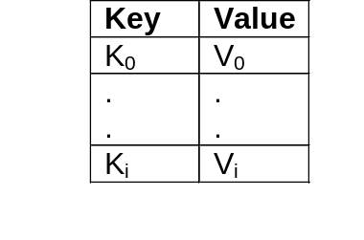

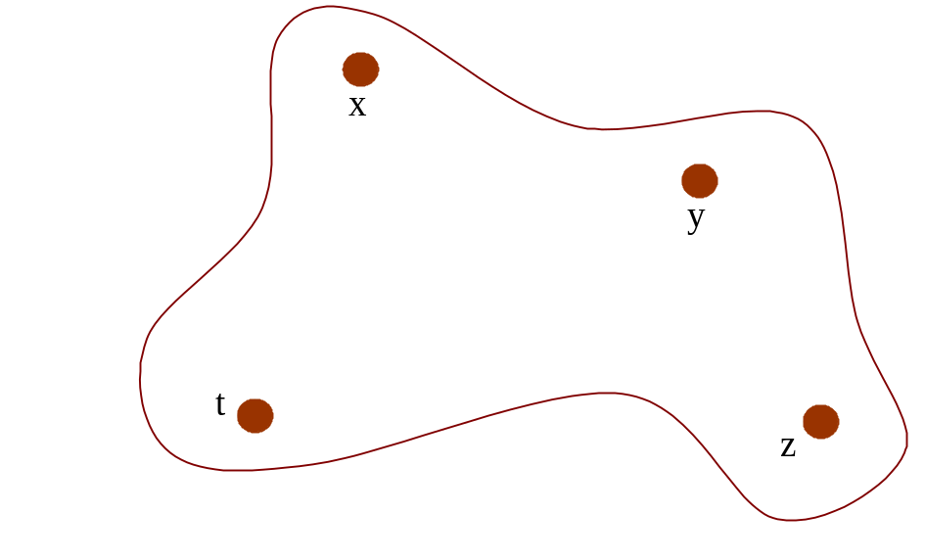
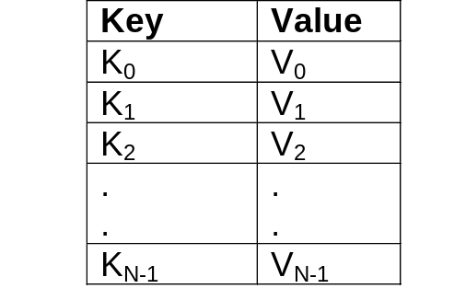
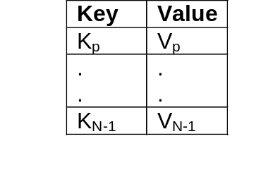

Distributed Hash Table (DHT)
network
local view
distributed view

Slide 5
What is P2PS?
P2PS is a library/platform for developing peer-to-peer (P2P) applications.
P2PS provides the programmer with the ability to easily write and work with P2P applications.
It offers different P2P primitives and services such as, efficient data lookup, group communication, and fault-resilience.
It implements the Tango algorithm. Like DKS, Tango is a generalization of Chord but it scales better.
P2PS is written in Mozart/Oz .

Slide 6
P2PS’ functionality
Create a peer-to-peer network
  create the first node of the P2P network
  set up the P2P network characteristics (e.g., max net size, fault-tolerance)
  create an access point for this node.
Join and leave a peer-to-peer network
  given an access point, join a node to the P2P network
  at join, create an access point for this node
  a node can leave P2PS gracefully or ungracefully (i.e., it just fails)
  after a join or a leave the P2P network will self-organize to remain efficient.

Slide 7
P2PS’ functionality (cont)
Message sending and receiving
  the communication is done over the overlay network and it is based on the efficient key-based routing algorithm of Tango
  P2PS offers one-to-one and one-to-many (i.e., explicit multicast and broadcast) communication primitives.
Monitoring
  an application can be notified when the node or the network status has changed
  one has access to statistics at a node (e.g., nr. of sent or forwarded messages).

Slide 8
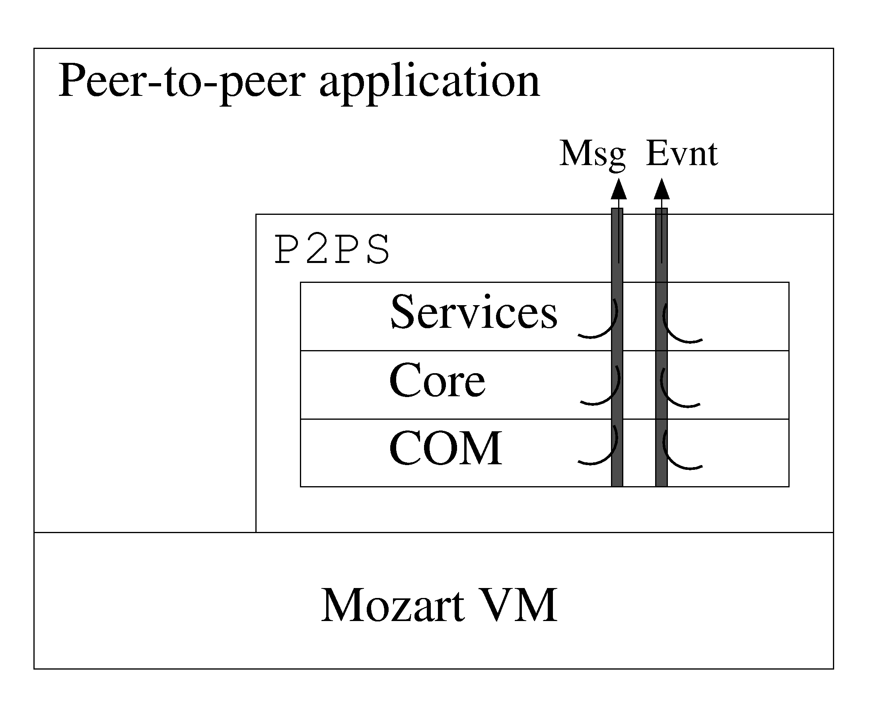
P2PS: internals of a node

Slide 9
P2PS: internals (cont)
COM layer
  access point (AP) creation
  connection establishment
  offer basic communication primitives
  fault (detection and) handling
Core layer
  implement the Tango protocol
  joining/leaving the P2P network
  message routing
  topology maintenance
Services layer
  act like a wrapper, building up the raw primitives offered by Core
  offer more specialized services such as reliable communication.

Slide 10
P2PS’ simple API
A node in P2PS can be initiated :
  either as the first node in the P2P network,
createNet (netConfig: +NetC <= NetConfig
nodeConfig: +NodeC <= NodeConfig
apConfig: +APC <= APConfig
msgStrm: ?MS <= _
evntStrm: ?ES <= _ )
  or as a regular node joining a P2P network
  joinNet (remoteAP: +RemAP
nodeConfig: +NodeC <= NodeConfig
apConfig: +APC <= APConfig
msgStrm: ?MS <= _
evntStrm: ?ES <= _ )

Slide 11
P2PS’ simple API (cont)
Sending and receiving are asynchronous
  nodes and keys are identified by positive integers
  any Oz value can be a message
  a message can be sent to a particular node or to the responsible of a key
  incoming messages are available on the message stream.
send (dst: +NodeId multicast (dst: +LNodeId
msg: +Msg msg: +Msg
toResp: +TR <= false ) toResp: +TR <= false )
broadcast (msg: +Msg sendToSucc (msg: +Msg
toMyself: +TM <= false ) nrSucc: +N )

Slide 12
P2PS’ simple API (cont)
Changes in the status of the node and network are available on the event stream. Some examples of possible events:
  connected
  alone
  newpred
  newsucc
Get statistics: getStatistics (?Stat)
  number of data messages sent and forwarded
  number of control messages sent and forwarded
  the current number of in/out links
  …

Slide 13
An Example using P2PS : node1
declare
[P2PS] = {Module.link ['x-ozlib://cetic_ucl/p2ps/P2PS.ozf']}
MS
% Create first node (with id 1) in a P2PS network. Set the port# to 3001.
OP2PS = {New P2PS.p2pServices
createNet(nodeConfig: nodeConfig(nodeId:1)
apConfig: apConfig(pn:3001)
msgStrm: MS)}
% Display each message received on the message stream.
for M in MS do
{Show M}
end

Slide 14
An Example using P2PS : node2
declare
% Construct the access point token of a node (here, node 1) in the P2PS network.
RemAP = {P2PS.address2ap "206.102.118.78" 3001}
% Create a node with id 16 and join the network, using the token RemAP.
OP2PS = {New P2PS.p2pServices
joinNet(remoteAP: RemAP
nodeConfig: nodeConfig(nodeId:16)
apConfig: apConfig(pn:3002))}
% Get the message stream and display each received messages.
for M in {OP2PS getMsgStrm($)} do
{Show M}
end

Slide 15
An Example using P2PS : node3
declare
% Construct the access point token of a node (here, node 2).
RemAP = {P2PS.address2ap "192.227.140.1" 3002}
% Create a node and join the network, using the token RemAP.
% The choice of the node id and local port # is left to the system.
OP2PS = {New P2PS.p2pServices joinNet(remoteAP: RemAP)}
% Send a message to the responsible of key 42.
{OP2PS send(dst:42 msg:anOzValue toResp:true)}
% Multicast a message to nodes with id 1 and 16.
{OP2PS multicast(dst:[1 16] msg:hello)}

Slide 16
P2PS is ready to be deployed
P2PS offers means for developing peer-to-peer applications:
  scalable and fault-tolerant, with efficient communication
  P2PS is easy to understand and straightforward to use.
There is ongoing work to enhance its functionality (e.g., object transactions).
P2PS library was released last fall on MOGUL
http://www.mozart-oz.org/mogul/info/cetic_ucl/p2ps.html
P2PS is used to build different applications
  PostIt: a decentralized collaborative application for group message exchange
  CommunityPanel: a decentralized tool for real-time collaboration software edition
  Some graduation thesis are using P2PS as distribution middleware.
We’re working at deploying and testing P2PS on PlanetLab.
  Just use it! … and let us know about your opinions.

