Slide 1

PEPITO
Improving and Generalizing Chord
Valentin Mesaros, Bruno Carton,
and Peter Van Roy
Global Computing, Rovereto-Italy Feb. 2003

Slide 2
PEPITO
Contents
Context of the problem
Chord overview
Using symmetry to improve lookup in Chord
Generalization of symmetry in Chord

Slide 3
PEPITO
Context of the problem
what is p2p?
- a system where the components are “equal”
- there is no central point of failure
- virtual (overlay) network at the application level
- ...
why p2p?
- increase system scalability
- avoid single point of failure
- achieve better load balancing
- enable resource aggregation

Slide 4
PEPITO
Examples of p2p systems
R = N-1 (hub)
R = 1 (others)
H = 1
hybrid (client/server)
- Napster
“pure” p2p
- Gnutella
Distributed Hash Table (DHT)
- Chord
R = ? (variable)
H = 1…7
(but no guarantee)
R = log N
H = log N
(with guarantee)

Slide 5





PEPITO
Chord: overview
Chord is a p2p system based on binary search
the search space is organized as a virtual ring of size N
- an entity is assigned an m-bit identifier,
- a node has a well determined place within the virtual ring
- a node has a predecessor and a successor
- a node has log₂N fingers (= entries in routing table):
finger start
finger node
- a node stores the keys between its predecessor and itself

Slide 6
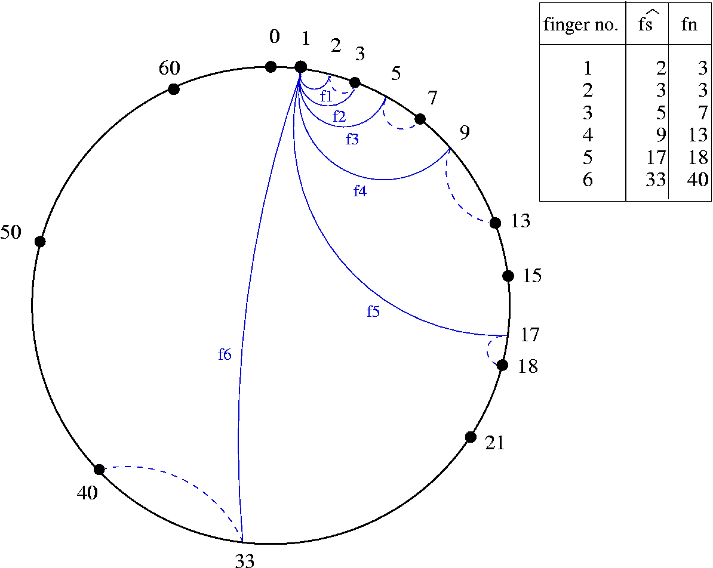
The fingers at node 1 in a poorly populated Chord system of size 64

Slide 7
PEPITO
Chord: scalable lookup
given a system of size N with each node having a routing table of size log₂N, resolve any key in max log₂N hops
to look for key k at node n
- check whether k is found between n and the successor of n
- otherwise, forward the request to the closest finger preceding k

Slide 8
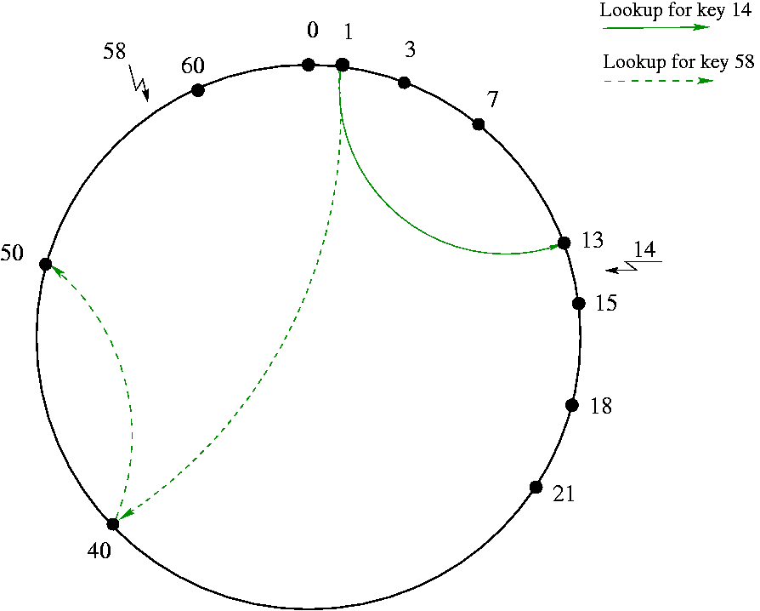
Path queries for keys 14 and 58, starting node 1, in a poorly populated Chord system of size 64

Slide 9
PEPITO
Chord: drawbacks
weak support for full-duplex protocols/applications
- due to the asymmetric routing cost : nr_of_hops( p → n ) ≠ nr_of_hops( n → p )
a node can not make in-place notifications (joining/leaving)
- due to the asymmetric organization the routing
- this can lead to lookup failures
exploiting the underlying network proximity is not straightforward
- the choice for the nearest neighborhood is not flexible
- each node must connect the right corresponding predecessor and successor

Slide 10
PEPITO
Using symmetry to improve Chord
S-Chord: possible solution to some of the drawbacks of Chord
- introduce symmetry in the routing organization
* routing cost symmetry : nr_of_hops( p → n ) ≈ nr_of_hops( n → p )
* routing entry symmetry : if n points to p then p points to n
improve lookup efficiency
- for the same size of the routing table, resolve a key in 25% less hops for the
worst case, and in 10% less hops in average

Slide 11









PEPITO
S-Chord: the finger table
S-Chord is based on Chord
the search space is organized as a virtual ring of size N
- a node has a predecessor and a successor
- a node stores the keys between its predecessor and itself
- a node has 2*m fingers (where m = )
finger start
finger node

Slide 12
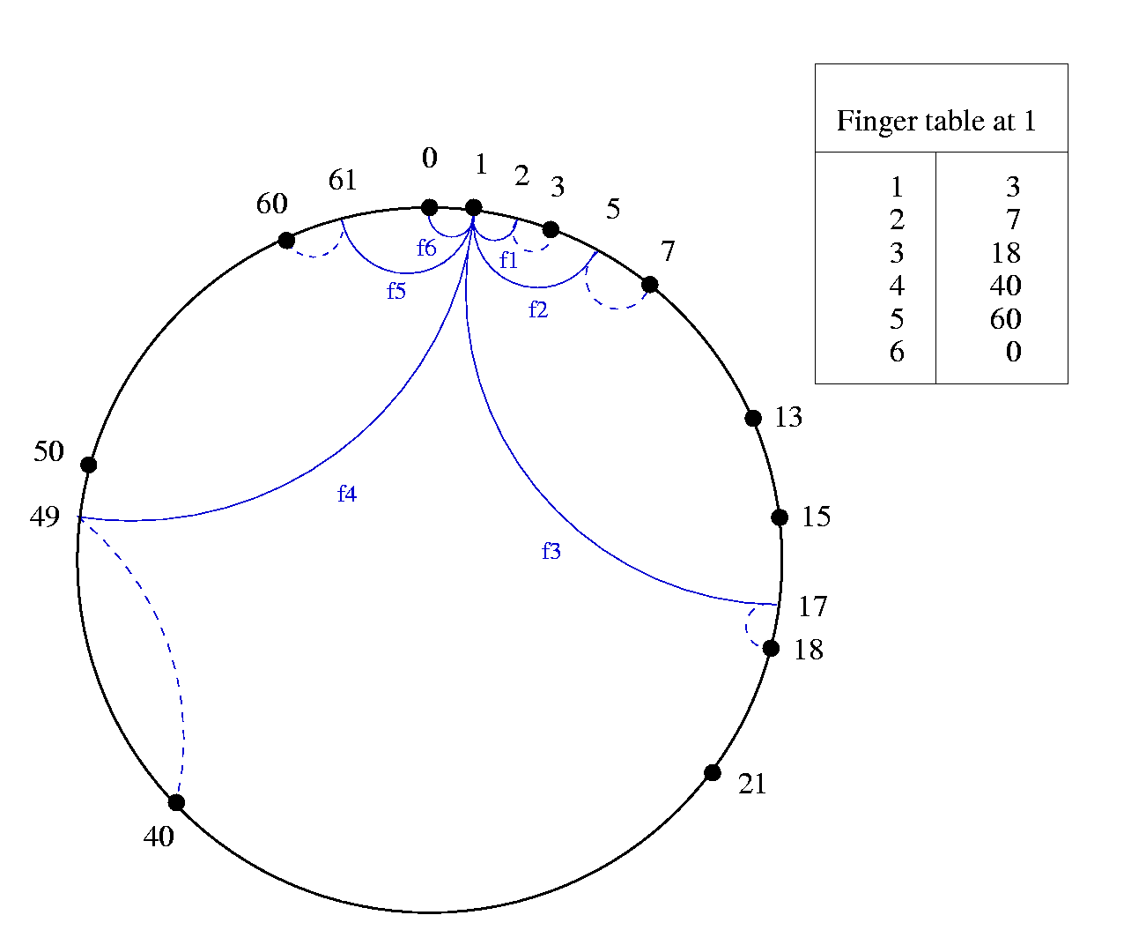
The fingers at node 1 in a poorly populated S-Chord system of size 64

Slide 13
PEPITO
S-Chord: the finger responsibility
the finger responsibility is used when routing the queries
the search space at a node is split among its fingers
a finger is situated inside the domain it is responsible for

Slide 14
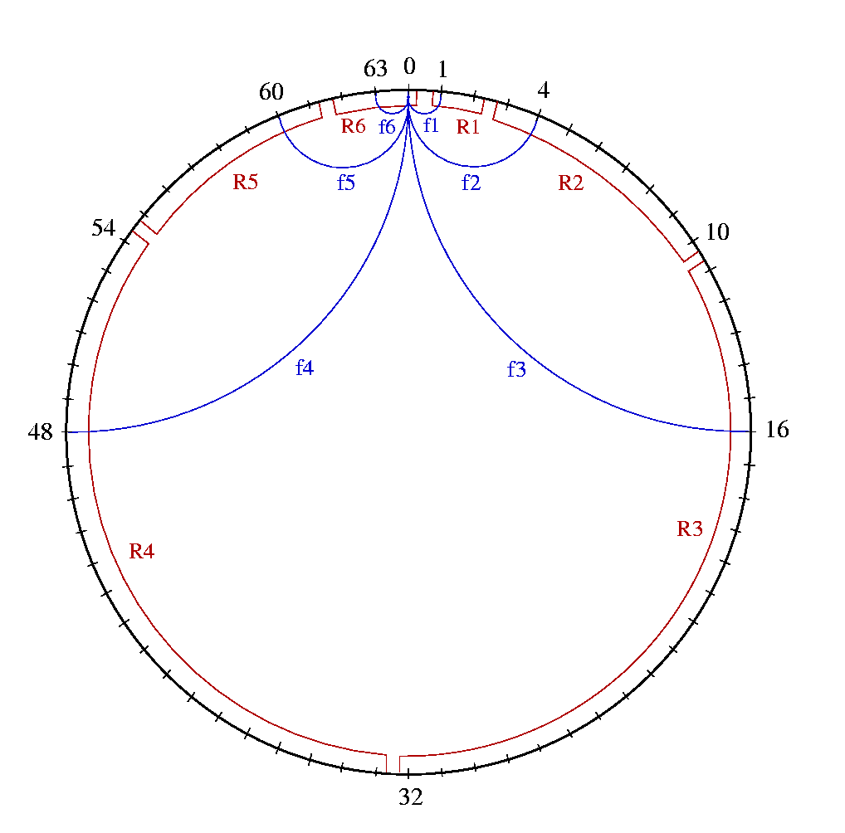
The fingers and their responsibilities at node 0 in a fully populated S-Chord system of size 64
The responsibility of finger i of a node starts from the half way point between it and finger i-1, and ends at the half way point between it and finger i+1

Slide 15
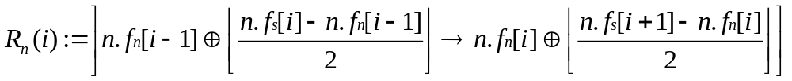

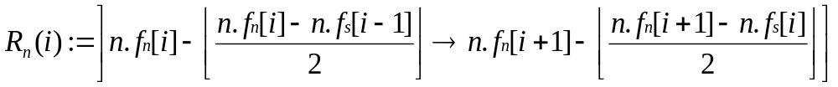




PEPITO
S-Chord : the finger responsibility (insights)
for we have:
for we have:
we consider:
for
and
for n = 0

Slide 16
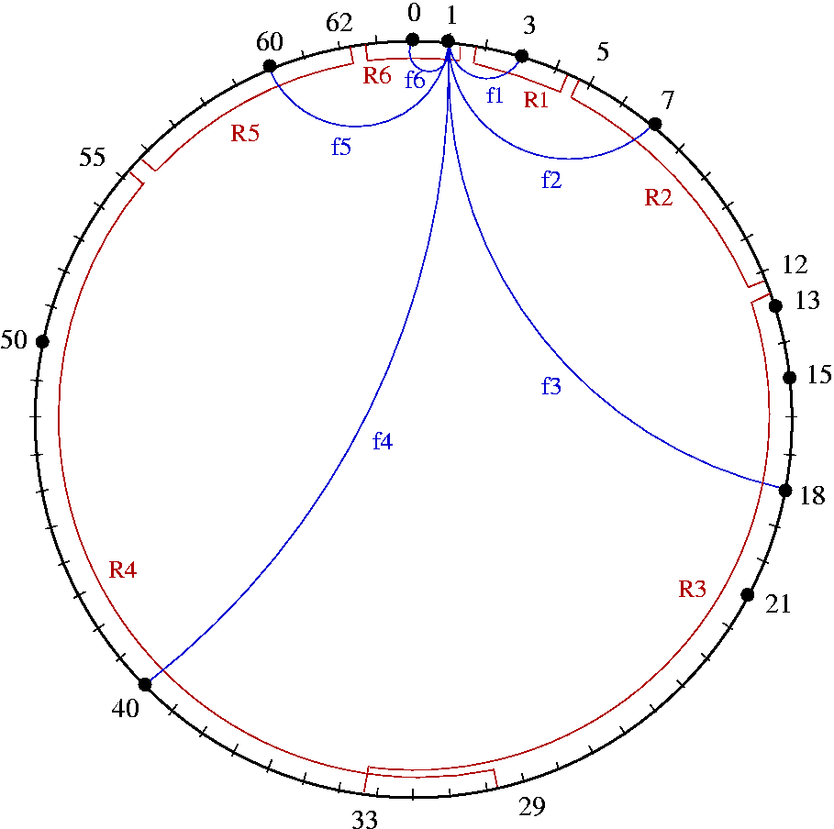
The fingers and their responsibilities at node 1 in a poorly populated S-Chord system of size 64

Slide 17
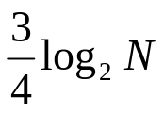
PEPITO
S-Chord: scalable lookup
to look for key k at node n
- check whether k is found between the predecessor and successor of n
- otherwise, forward the request to the finger whose responsibility includes k
resolve any key in max hops (i.e., 25% better than log₂N in Chord)
at each suite of three steps the distance to the node storing the key is reduced by a factor of 16, while in Chord it’s reduced by 8
e.g., in S-Chord the distance is reduced by 256 in 6 hops, rather than in 8 hops in Chord

Slide 18
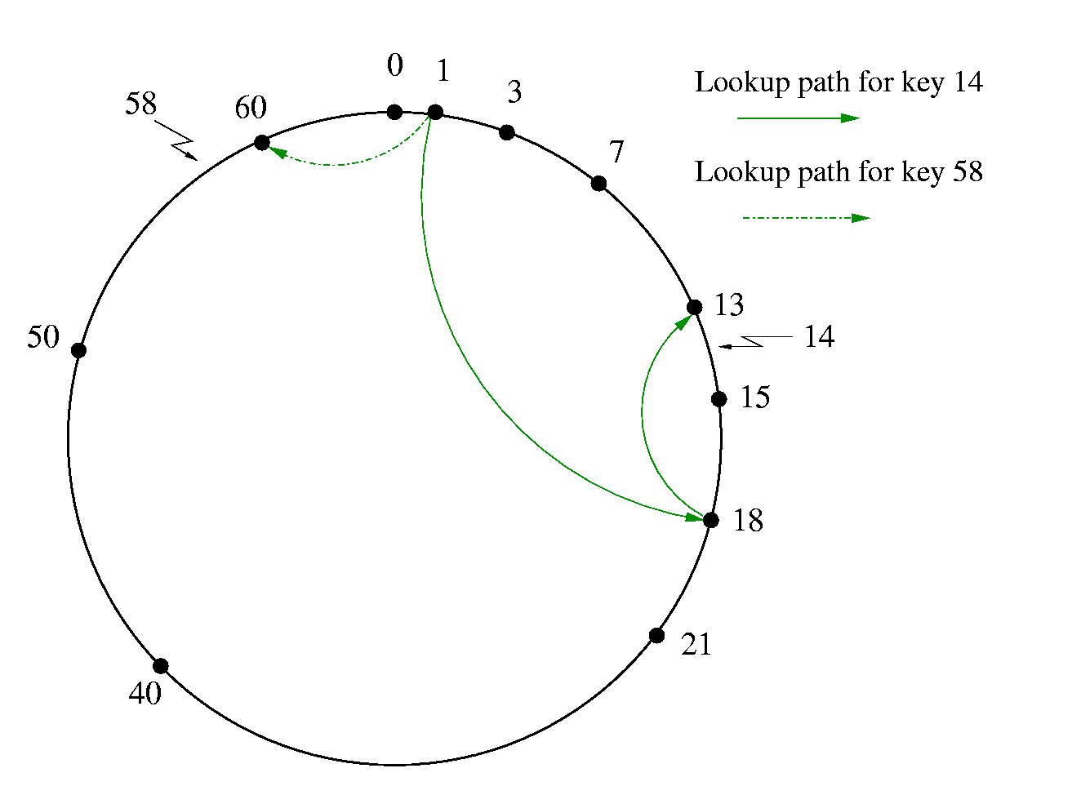
R₁(3) | ]12→33]
R₁₈(5) | ]8 →15]
R₁(5) | ]55→63]
Path queries for keys 14 and 58, starting node 1, in a poorly populated S_Chord system of size 64

Slide 19
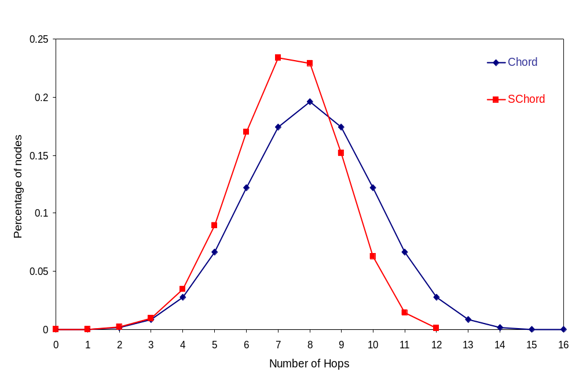
PEPITO
S-Chord: simulation (III)
distribution of the path length in Chord and S-Chord for N = 2¹⁶

Slide 20
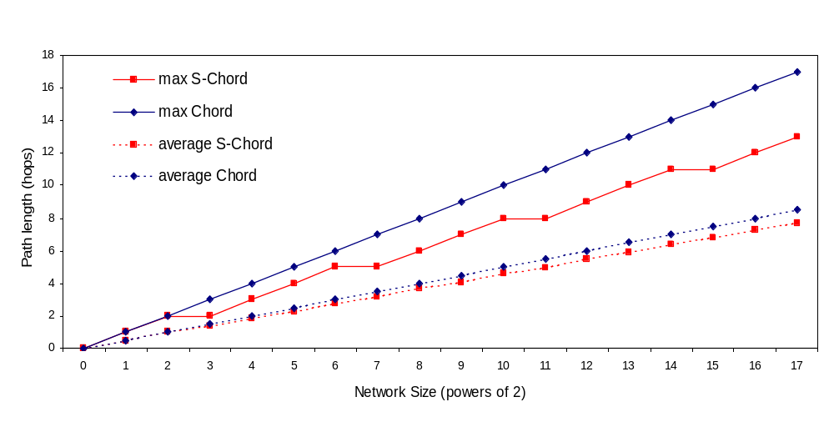
PEPITO
S-Chord: simulation (II)
worst case and average path length function the network size for Chord and S-Chord (fully populated)

Slide 21
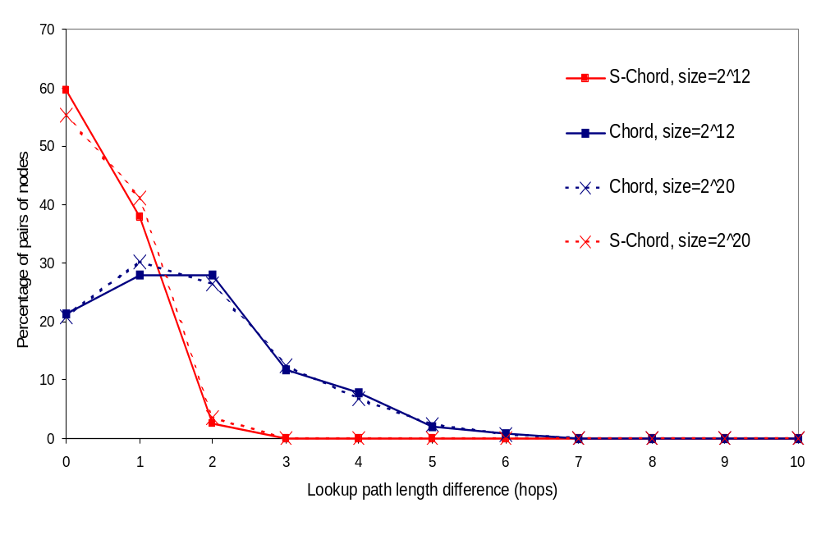
PEPITO
S-Chord: simulation (II)
distance variation between pairs of nodes in Chord and S-Chord, measured for two poorly populated (1024 nodes) systems of size 2¹² and 2²⁰

Slide 22
PEPITO
Generalization of symmetry in Chord (GS-Chord)
Objective
- given N,a network size, and L, a length (in hops), compute a finger table such that the length of any lookup in the network is below L.
A possible solution
- Distributed k-ary search - DkS (Onana, El-Ansary, Brand, Haridi)
Another solution: inductive construction using symmetry
- build the finger table inductively
- without generalization, the finger table is function of N, i.e. FT = ƒ(N)
- with generalization, FT = ƒ(N, j) , where j is a finger density indicator

Slide 23
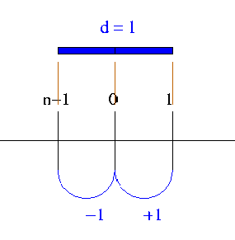
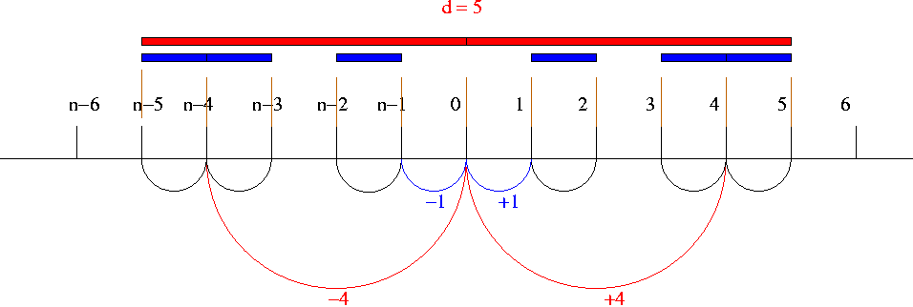
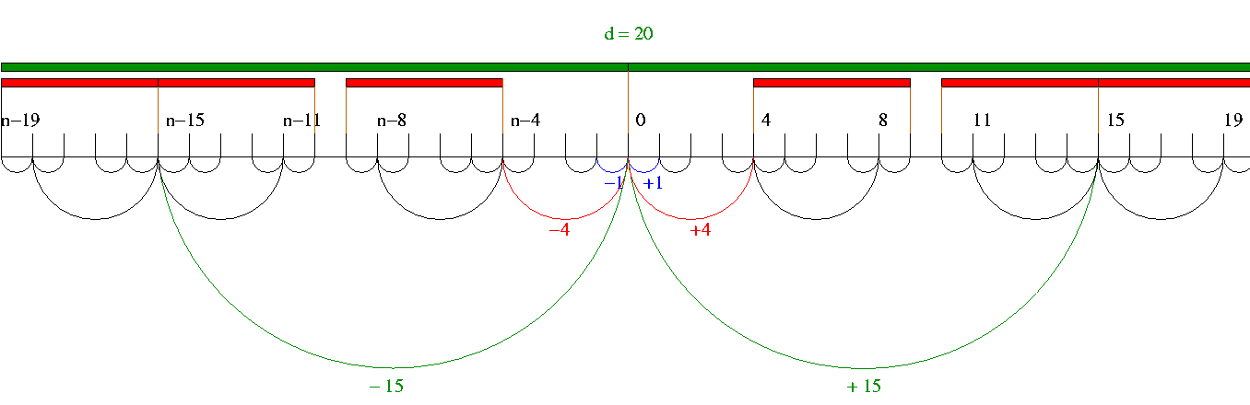
PEPITO
GS-Chord (finger density factor j=1)

Slide 24
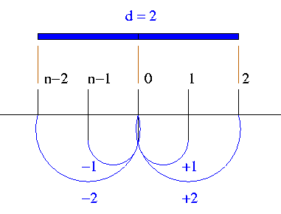
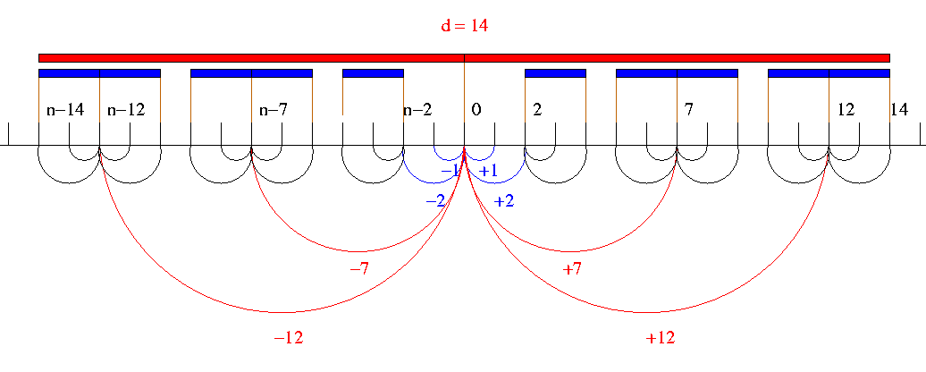
PEPITO
GS-Chord (finger density factor j=2)

Slide 25
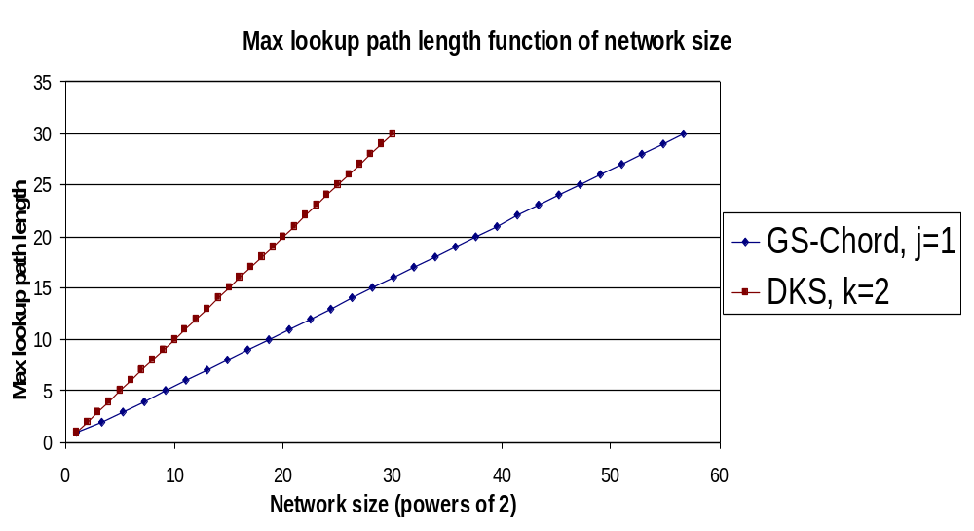
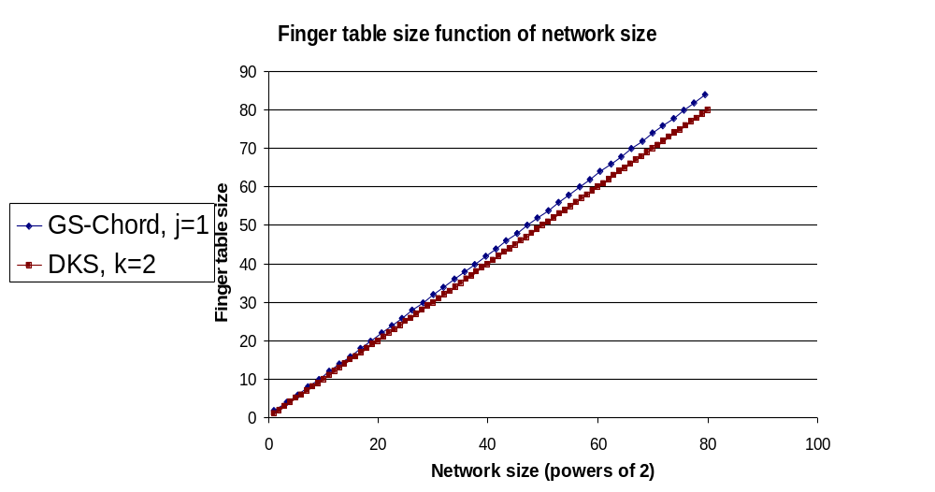
Generalization results (I)
PEPITO

Slide 26
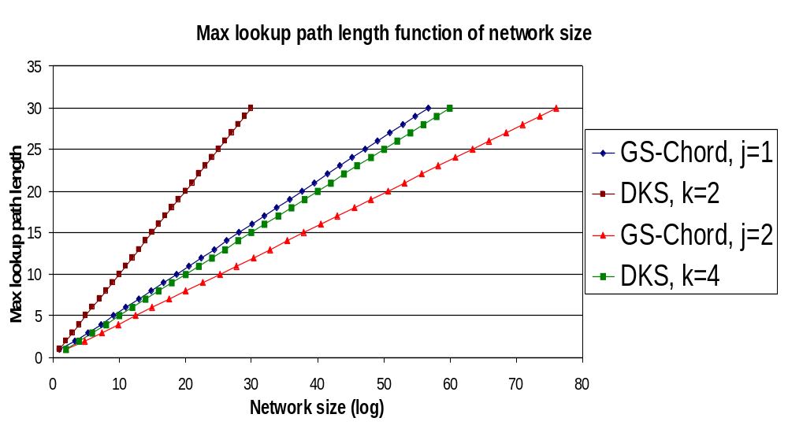
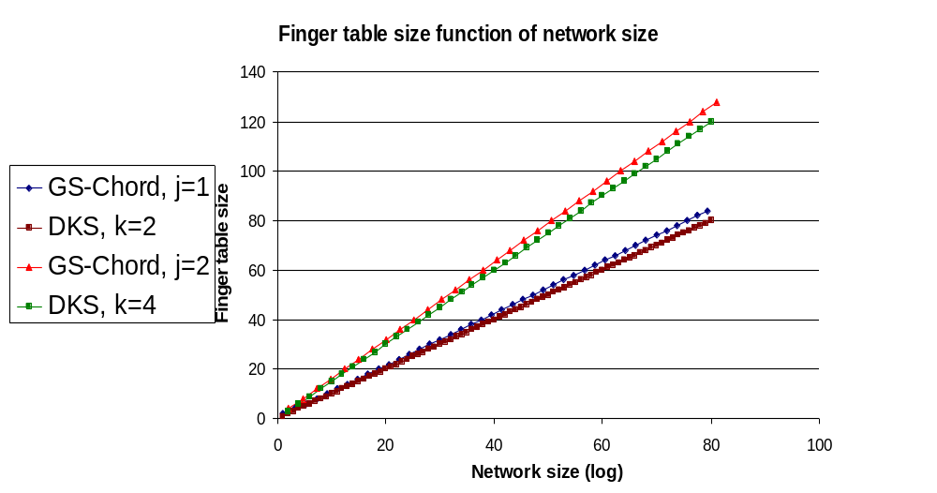
Generalization results (II)
PEPITO

Slide 27
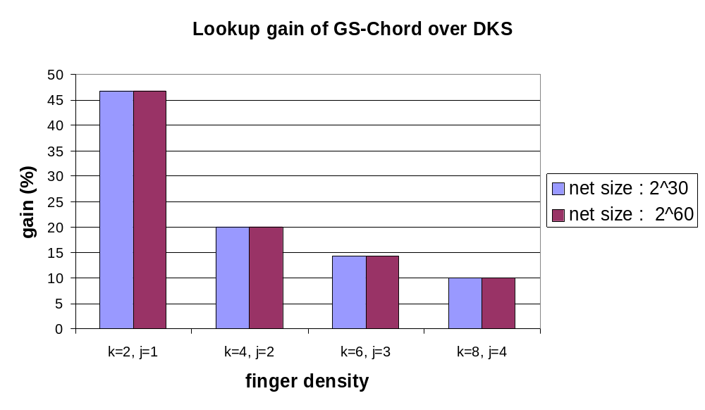

PEPITO
GS-Chord: simulation (III)

Slide 28
PEPITO
Conclusions: Symmetric DkS?
GS-Chord keeps the same guarantees as Chord
- system correctness remains the same
symmetry is good for improving lookup efficiency
- GS-Chord does 45% better than Chord / DkS(k=2) (in worst-case)
- for large k, DkS approaches GS-Chord in lookup efficiency
- GS-Chord has better routing cost symmetry than DkS
the low cost update approaches of DkS can be applied to GS-Chord
- atomic join / leave and correction-on-use
future work: use of symmetry in multicast
- in DkS, all nodes of spanning tree must store state
- in GS-Chord, only the group members need to store state

