Slide 1
A peer-to-peer approach to enhance middleware connectivity
E. Klinkskog , V. Mesaros , Z. El Banna , P. Brand , and S. Haridi

Slide 2
Introduction
Distribution SubSystem – middleware providing transparent distribution for programming languages
Many consistency protocols give different distribution behaviors
Efficient and simple-to-use messaging components needed for consistency protocols

Slide 3
Outline
A middleware library supporting many protocols
DSites – process abstraction to simplify protocol development
Division of labor
P2P approach to enhance inter-process connectivity
Evaluation

Slide 4
Contribution
Simple-to-use process abstraction
  separate name from address
  hide details of underlying network and connections
Design allowing for customization
  address representation
  connection procedure
  failure detection
P2P system to improve inter-process connectivity
  overcome asymmetric connections
  support mobile hosts

Slide 5
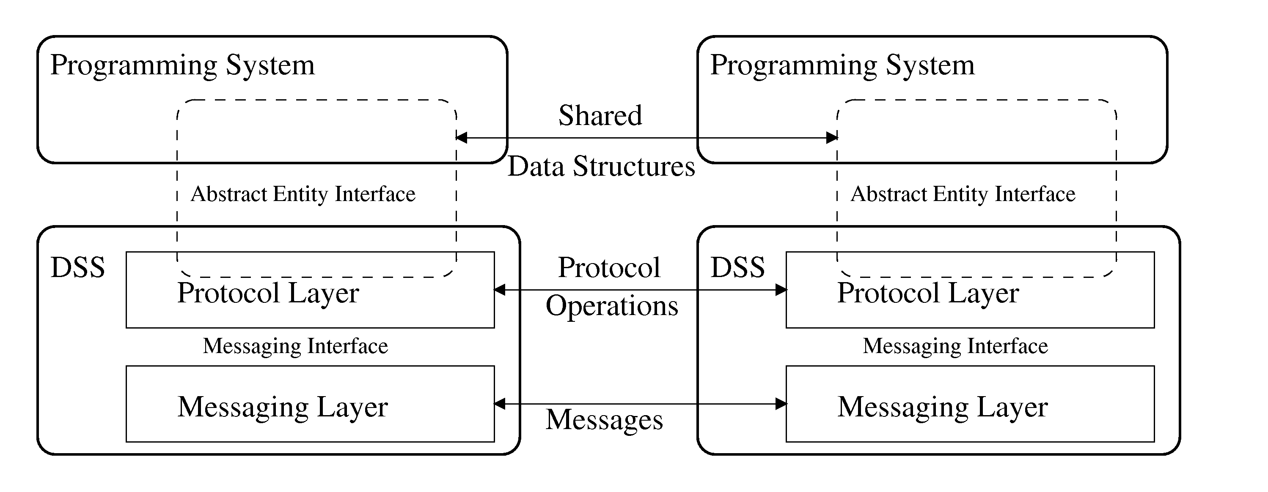
The Distribution SubSystem - DSS
Middleware for providing distribution to high-level programming system
Shared state distribution – Abstract Entities
  abstract entities preserve semantics of language entities
  several consistency protcols per abstract entity type
Notes:
DSS-node is an application that uses the DSS for its distribution
Support for many consistency protocols per abstract entity gives different distribution behavior for the same abstract entity.
Using the proposed process abstraction development of protocols is greatly simplified
Protocol layer could also be called the coordination layer since all protocols for upholding consistency over a coordination network resides here

Slide 6
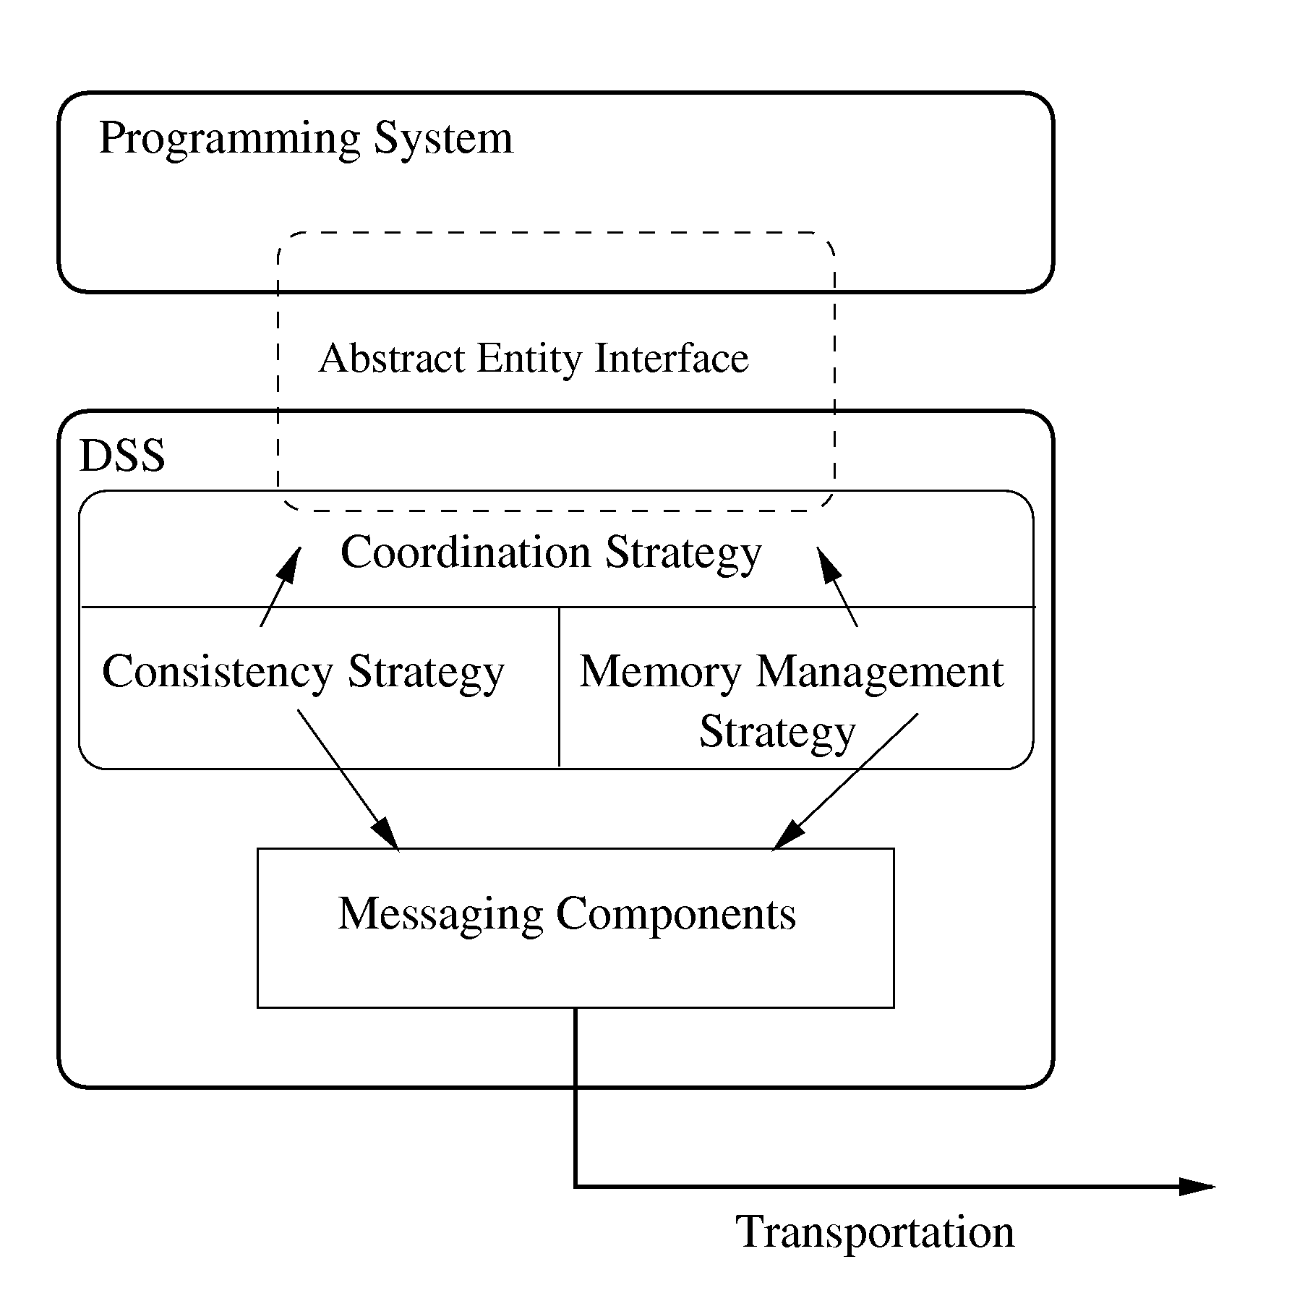
The Distribution SubSystem (cont.)
Division of DSS library into two layers
  Consistency Protocol layer
  Messaging layer with inter-process service
Notes:
Needs efficient abstraction for process representation and messages

Slide 7
DSite – Process representation
The abstraction managing all process interaction for protocols
Part of the inter-process service
Separation of tasks: name / addressing / transportation
Interface towards protocol layer
  seamless connection service
  asynchronous reliable messaging
  asynchronous failure detection
Notes:
DSite used together with message abstraction to handle all communication. DSite provides perceived fault state and can be used for equality test.
Establishment of connections - later shown how this is done
Asynch messaging due to transmission control in the session layer
Fault states are of course detected by an external algorithm, as a part of the curtomization

Slide 8
Division of labor
Structuring to improve customization
  Session tasks: reliable, in-order messaging
  Environment tasks: connection establishment and fault detection
  Link / Channel tasks: OS calls for sockets
Dynamic structure depending on usage – allows for resource management and compact representation
Notes:
The DSite is represented as an aggregation of objects, each one performs one of these tasks.
Reliable means as long as crash failure doesn’t occur
Session – deciding on connections and so on, the DSS library
Env – addressing located here, controls link establishment and route detection for instance. Hands a channel abstration to the DSite
Link – socket management basically, i.e. an I/O handler
Dynamic structure referes to the fact that a DSite is built up by identity/address, session object when messages are scheduled for delivery and transportation when a channel is established

Slide 9
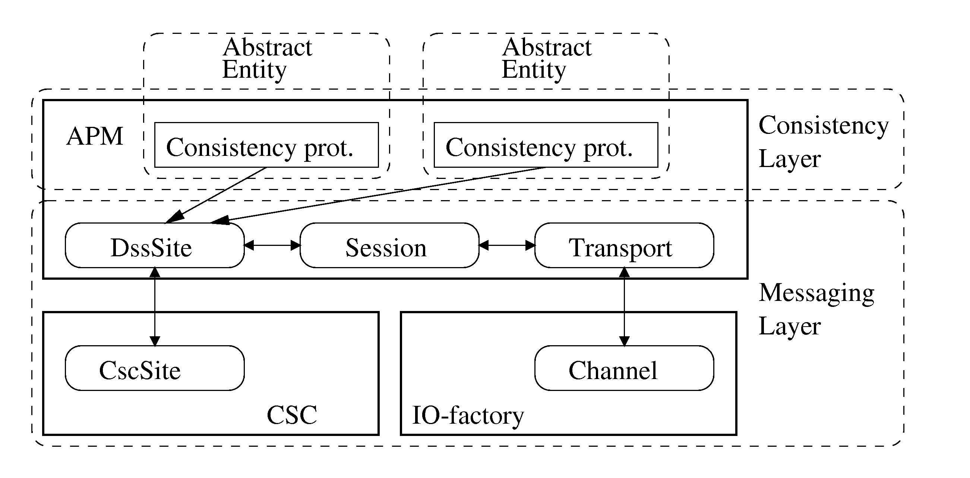
Structured representation
DssSite (APM) – identity
CscSite (CSC) – address
Session (APM) – connection session and reliable delivery
Transport (APM) – serialization of messages
Channel (I/O) – end-to-end transportation
Notes:
- Identity and address used by protocols and connection establishment, always needed (since it can be used for equality test or plain location representation)
- Session negotiates a connection and ensures FIFO, reliable delivery
Transport serializes a message onto a channel
Channel can be seen as a socket representation

Slide 10
DSite – properties
Three-state accessibility representation
  no problem
  transient communication problem
  crash failure – permanent for identity
Two kinds of connections
  direct channel
  virtual circuit
Process A
Message
Process B
Process A
Process B
Message
Message
Process C
Notes:
The route is identified within the DSS-nodes much like a TCP path, transportation reuses the existing links along the path.
PICTURE?

Slide 11
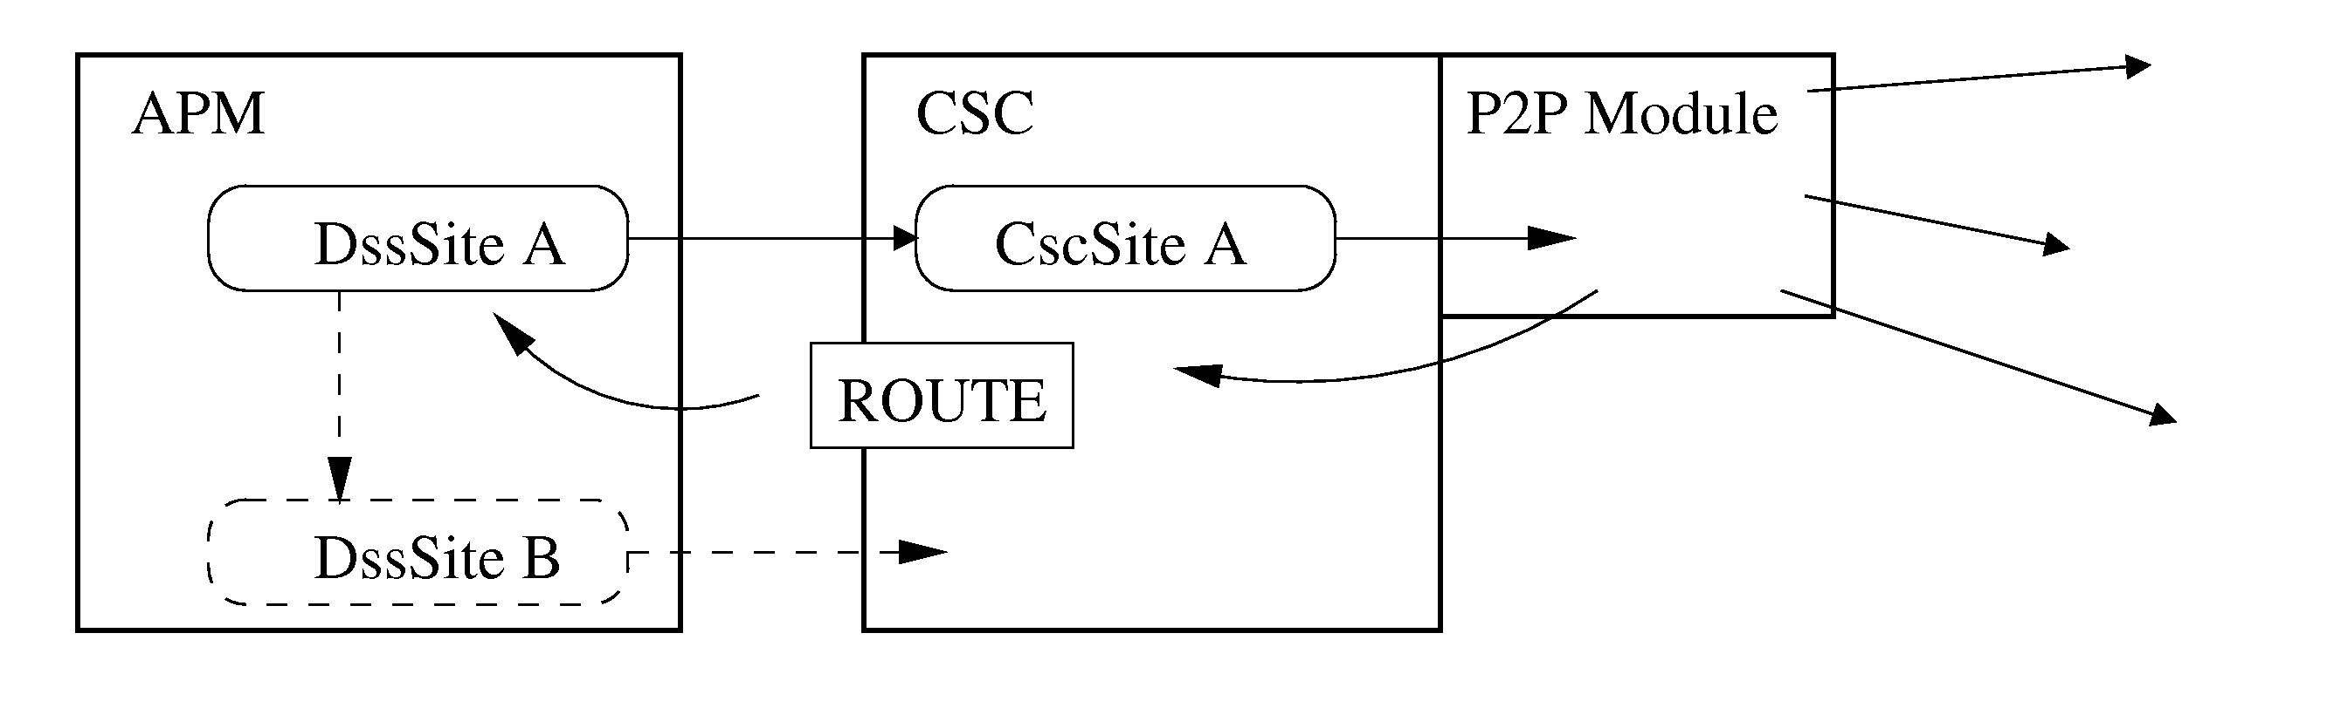
Connection establishment
DssSite asks CSC to connect using the CscSite
CSC tries connecting directly using address
P2P module used if direct connection impossible
Route description or Channel given to DssSite
Session component negotiates connection settings
DSite can start to deliver messages

Slide 12
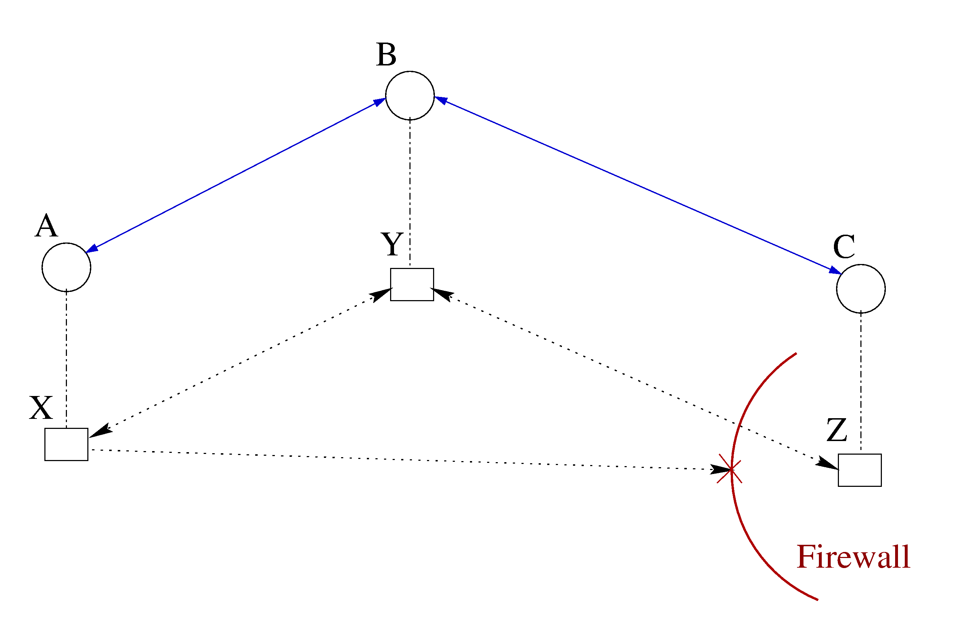
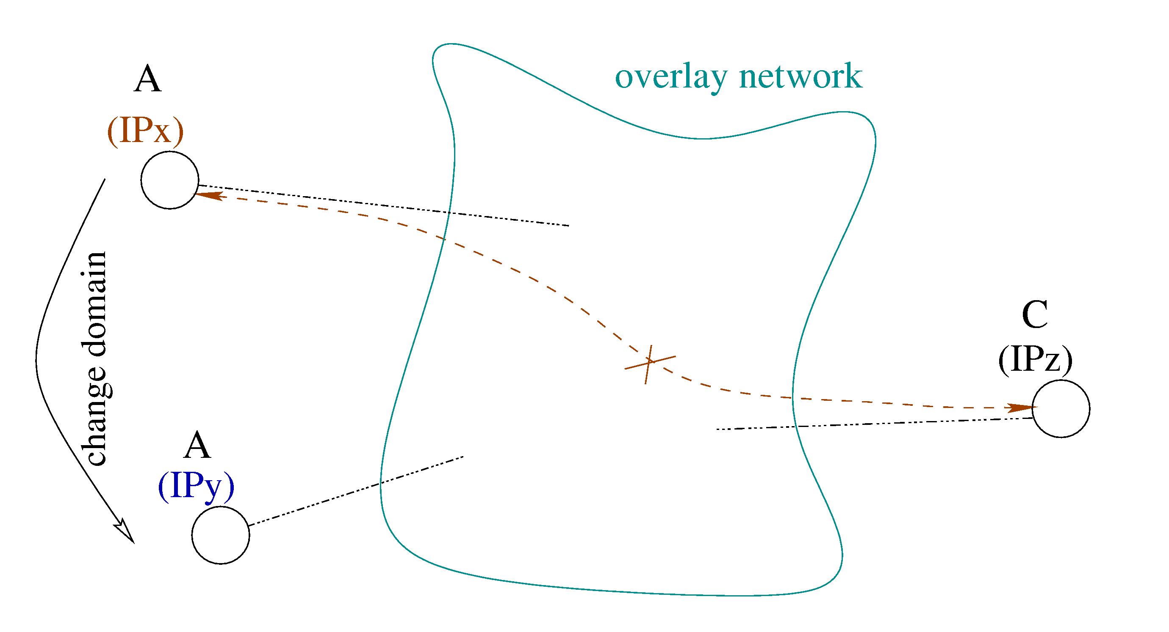
Connectivity problems
asymmetric connections
mobile hosts

Slide 13
Increase connectivity
Organize the participating processes into a P2P system
  make DSS nodes form an overlay network
  provide DSS nodes with routing capability
  use the key lookup primitive
Provide name-to-address service
  given a DssSite, find the address of the corresponding process
Provide name-to-valid-route service
  given a DssSite, find a valid path to the corresponding process

Slide 14
Add a P2P module
Located at the CSC level
  APM decides when a connection is needed
  CSC decides how and actually does the connection establishment
Implements a P2P algorithm
  employ a lookup primitive
  provide name-to-address and name-to-valid-route services
Has partial control over the communication channels
  structure the DSS nodes into a self-organized system

Slide 15
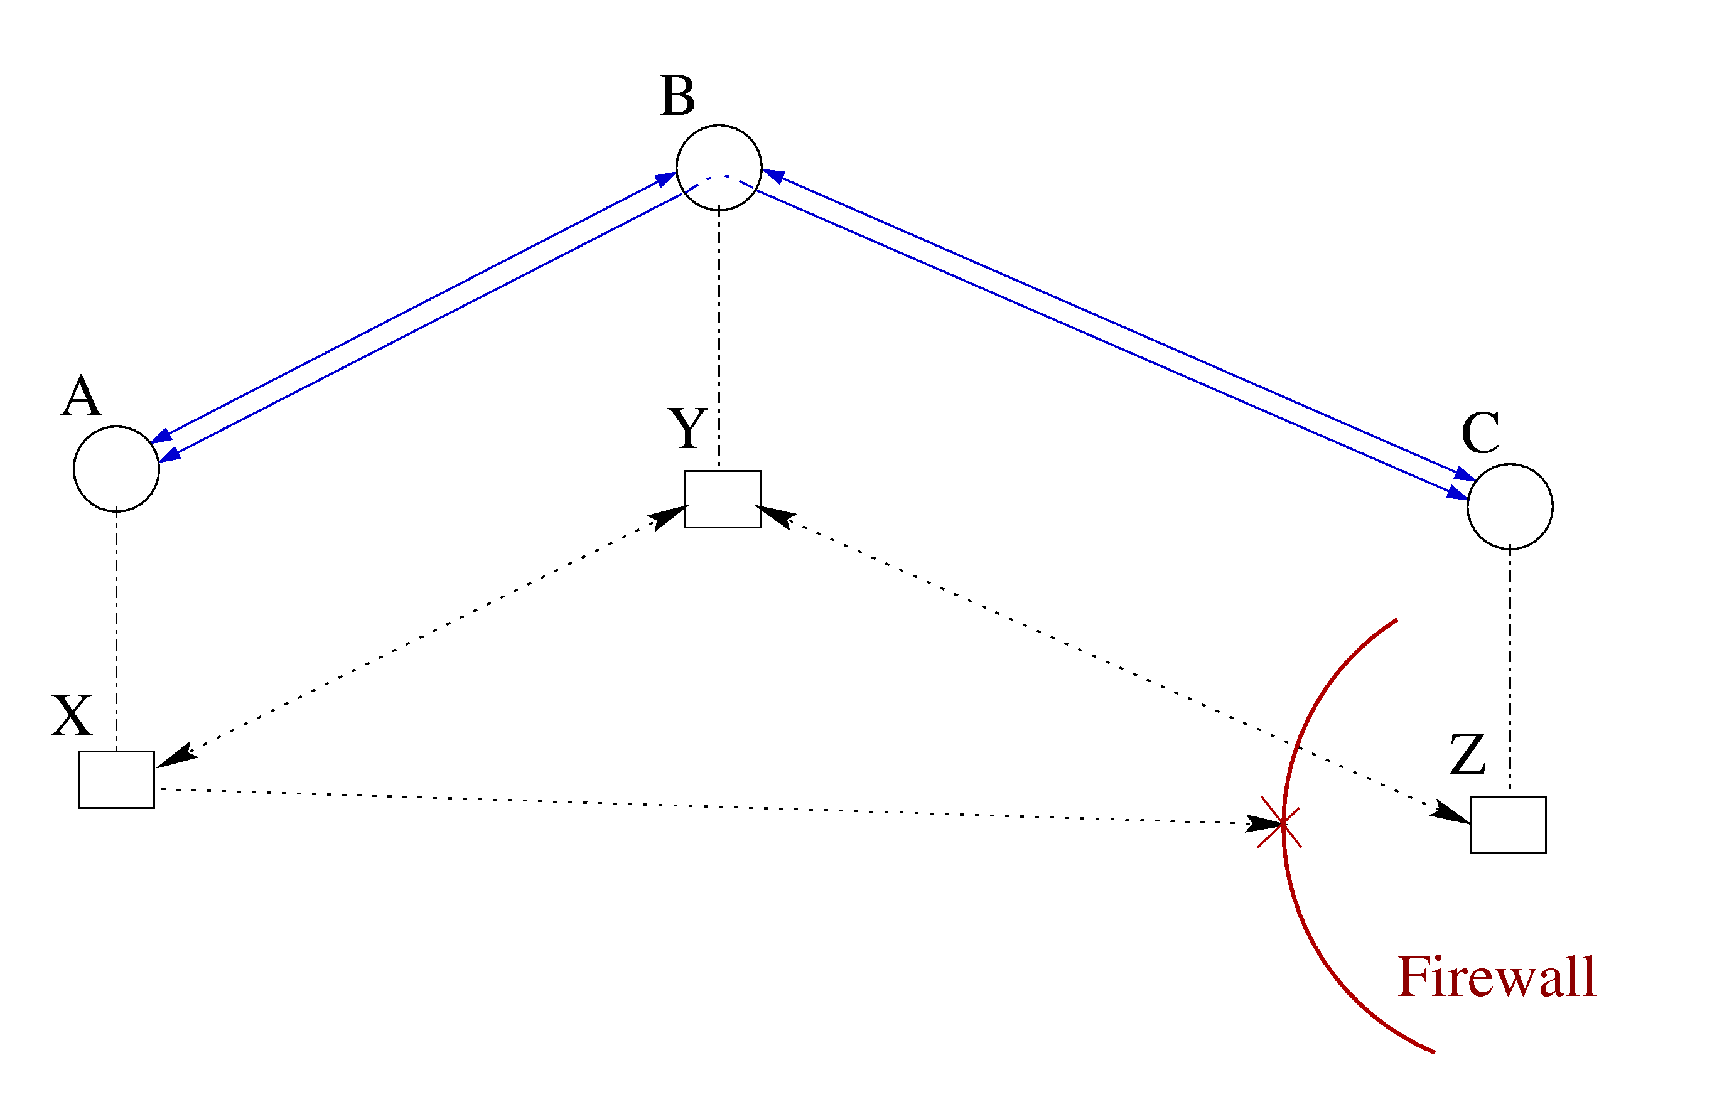
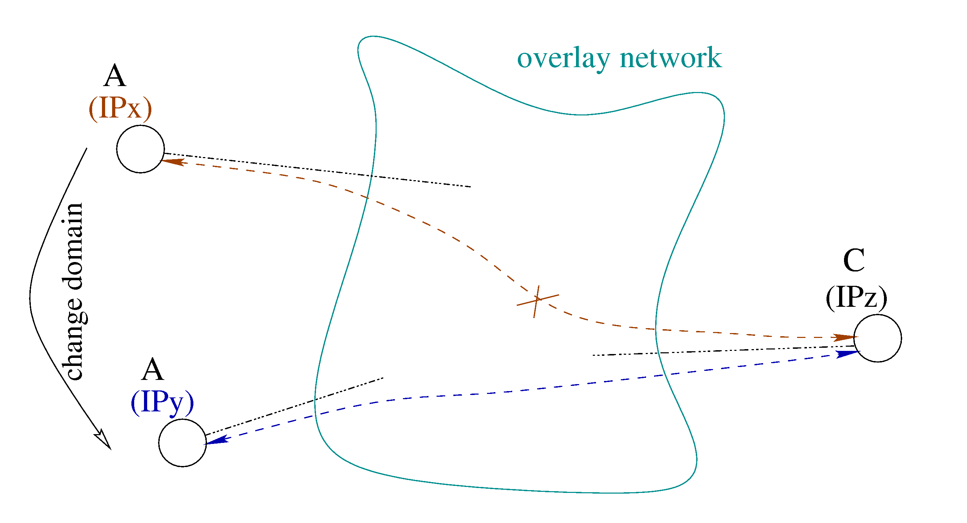
Connectivity enhanced
overcome asymmetric connections
support for mobile hosts

Slide 16
Evaluation
Measurement
  plain messaging speeding
  overhead of routing (with one hop)
Simple client/server application connected to DSS
  the overhead of messaging layer is small
  the overhead of routing is low
Configuration | Socket | DSS - channel | DSS – virtual circuit
100 Mbit LAN | 1.0 | 1.26 | 2.51
Internet | 1.0 | 1.0 | 1.04
Notes:
Small application establish a connection either directly if address available or through a route if no direct connection possible
Socket program is simple TCP program
Channels are TCP sockets in DSS applications
Values are normalized against Socket application
Set up is:
cluster – normal connections between nodes on a cluster
Internet – sweden to belgium : the hop is taken through a swedish town
Overhead is low since we really don’t need routing on a cluster…

Slide 17
Further possibilities
Scalability with respect to the nr. of connections
  use the existing connections to build the overlay network
Additional communication primitives
  multicast
  broadcast

Slide 18
Conclusions
Messaging model based on a first class notion of remote process (DSite)
  hide details of the underlying network
  separate process’s name from its address
  extendable
DSS combined with a P2P module results into an increase of connectivity
  organize the DSS nodes into a P2P overlay network
  use key lookup primitive to provide name-to-address and name-to-valid-path services

