Slide 1
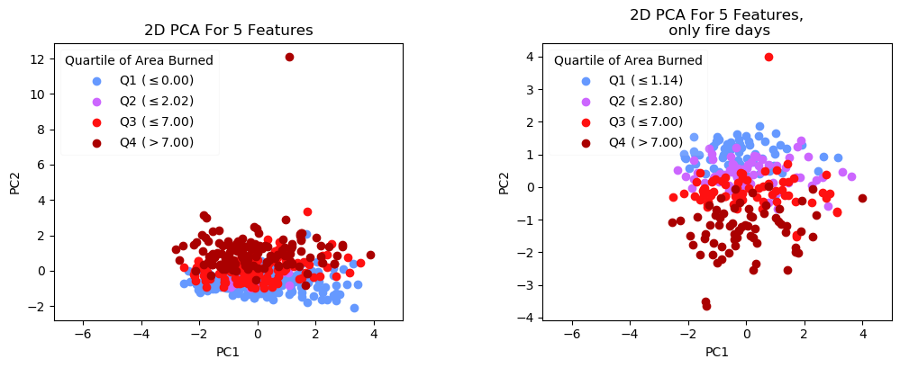
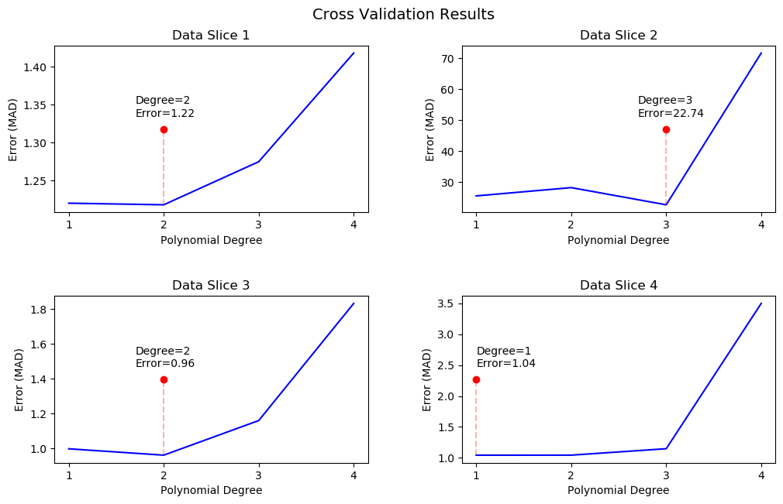
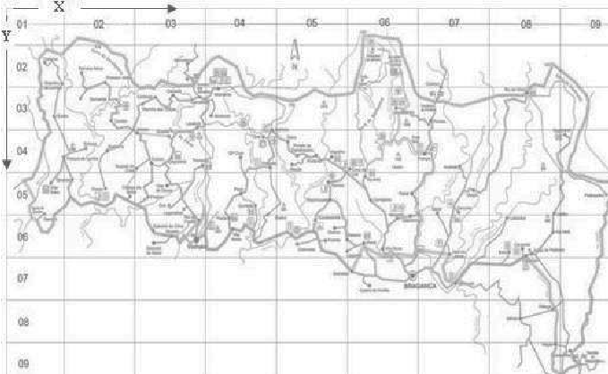
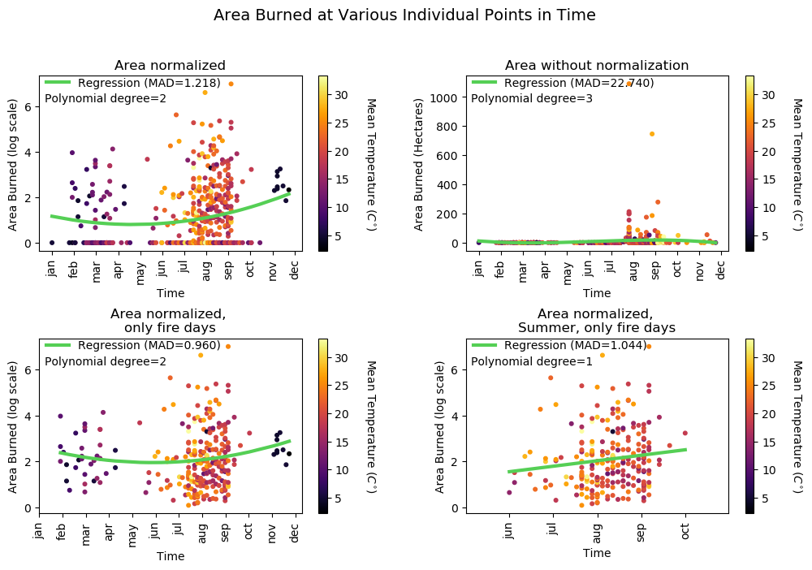
Preparing your poster for printing:
Go to File > Save As. Under Save as type (Windows) or Format (OS X), select PDF.
Open the PDF in Adobe Photoshop. Go to File > Save As. Under Format, select JPEG or TIFF. Choose a location and file name for your file and click Save. Click OK on the default save settings.
DO NOT SAVE TO A JPEG OR TIFF FROM POWERPOINT!
Data Mining Meteorological Data to Predict Forest Fires
Christopher de Freitas, Pranav Rajan
Preprocessing and Modeling
Technique II: Dimensionality Reduction
Background
Natural Weather Features were used for preprocessing
Burn area normalized with ln(y + 1)
Removed days with no fires for training
Time attribute standardized into scalar values between 0 and 1
Project 5 features: Temperature, Humidity, Rain and Burn Area to 2 and 3 dimensions
PCA used on all the data and the days fires occurred
Revealed a negative correlation between PC 2 and Burn Area Size
One major environmental cause of climate change is the rising frequency of forest fires
Recent forest fires exacerbated by climate change include the 2019-2020 Australia Bushfires, the Amazon Fires of 2019-2020 and crop burning fires in Indonesia
Goal: Determine which two factors are most important for predicting forest fires
Technique I: Regression
Polynomial Regression
Cross-Validation with 70-30 random split
Error Metric: MAD(Mean Average Deviation)
Data
517 distinct forest fires occurring between January 2000-December 2003
Data Features: Location, Time, Natural Weather Features, Burn Area, Canadian Fire Weather Index components
Slice 1: Full normalized data using Cortez et. al preprocessing methods
Slice 2: Full dataset without normalized burn area
Slice 3: Normalized burn area on the days fires occurred
Slice 4: Sub-slice of Slice 3 of fires between June-October
CONCLUSIONS
Grid Based Map of fire data collected
Collinearity and non-linear relationships in data affected model
Difficult to determine the importance of different weather features
Normalizing data for PCA affected relationships between features
Other techniques such as PC Regression may produce a better model
REFERENCES
[Cortez and Morais, 2007] P. Cortez and A. Morais. A Data Mining Approach to Predict Forest Fires using Meteorological Data. In J. Neves, M. F. Santos and J. Machado Eds., New Trends in Artificial Intelligence, Proceedings of the 13th EPIA 2007 - Portuguese Conference on Artificial Intelligence, December, Guimarães, Portugal, pp. 512-523, 2007. APPIA, ISBN-13 978-989-95618-0-9

