Slide 1
Ethically Visualizing Aggregated Community Data
(Document your visualizations!)
David Christensen | Seattle Public Library

Slide 2
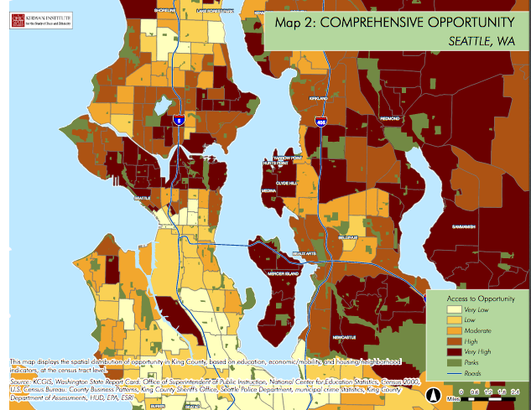
Origin story: update Kirwan map

Slide 3
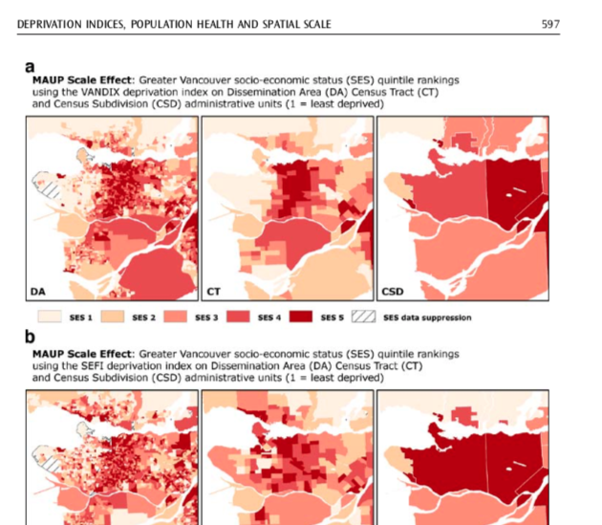
Modifiable Areal Unit Problem (MAUP)

Slide 4
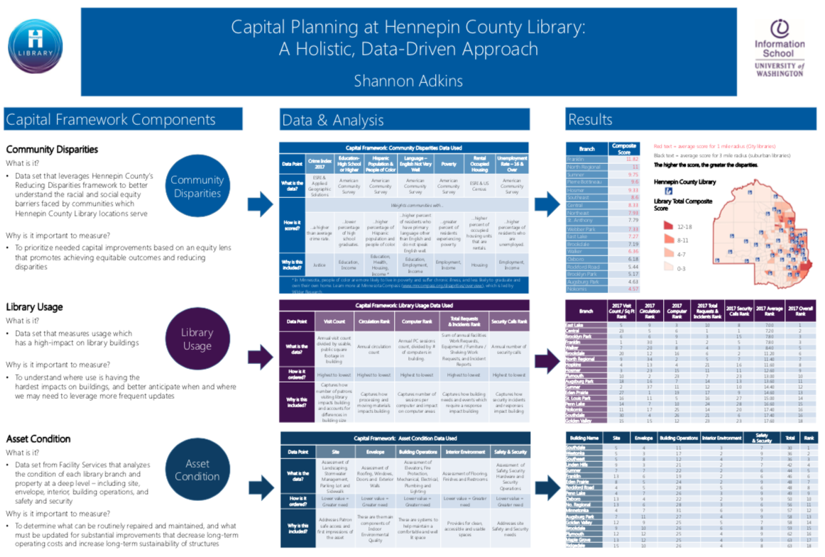

Slide 5
Housing Voucher Supplement (Seattle Housing Authority)
(See handout)

Slide 6
Thus far… documentation checklist in 4 categories
Disclosure
Contingency
Plurality
Empowerment

