Slide 1
Exploring, visualizing, and challenging the city open data portal
Zoë Wilkinson Saldaña
Social Science and Geospatial Data Librarian
Cornell University

Slide 2
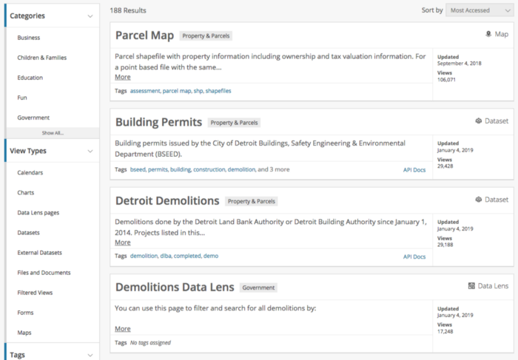
City of Detroit’s Open Data Portal

Slide 3
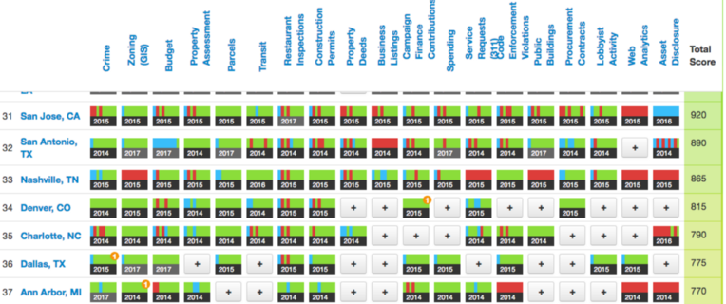
2017 US Open Data Census

Slide 4
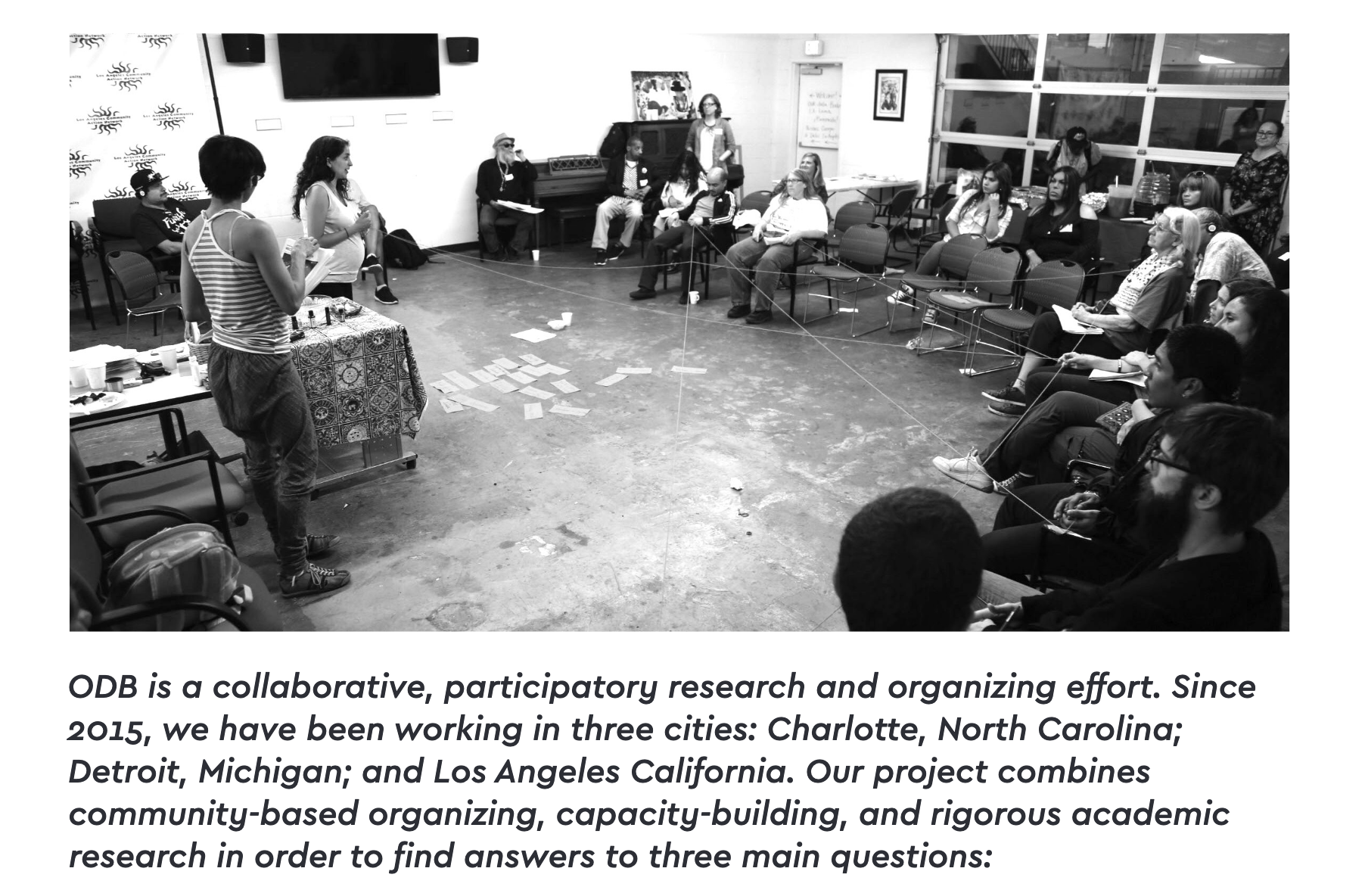
Our Data Bodies Playbook (2019)

Slide 5
Guiding questions
What would it look like to teach the skills for challenging and critiquing open data alongside data retrieval itself?

Slide 6
Guiding questions
What would it look like to teach the skills for challenging and critiquing open data alongside data retrieval itself?
How do we help learners understand their data visualization praxis in the context of issues of power, exclusion, and representation?

Slide 7
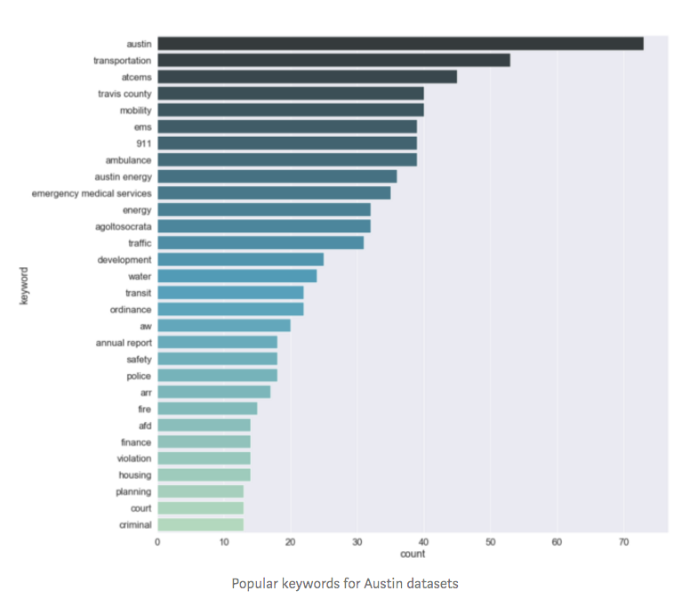
What’s included? What’s excluded? Why?

Slide 8
Output
In this project, I propose creating a short bookdown text.
I will focus on a few key areas:
Exclusion and representativeness in datasets
Strategies for visualizing bias and ambiguity
Incorporating voices from community activism, e.g. counter-portals
Visualizing questions of bodies and gender.

Slide 9


bookdown
“The bookdown package is an open-source R package that facilitates writing books and long-form articles/reports with R Markdown.”

Slide 10
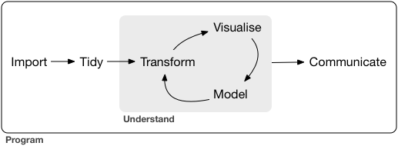
Output: Exploratory data analysis

