Slide 1
Restaurant Segmentation Analysis
Presentors: Eric Tsai, Xinru Lu, Morris Zhao, Chen Lin
Mentor: Gittu George
May 5th, 2023

Slide 2
Overview
Summary
Data Overview
3 Objectives:
Smoothie King
Subway USA
Subway Canada
Initial EDA
Data Science Techniques Overview
Timeline

Slide 3
What’s most important for owning a business?

Slide 4

Introduction
Sitewise Analytics
SaaS company
Specialize in site selection for restaurants, retailers, service providers
Feature selection and statistical analysis to find drivers of sales performance

Slide 5
Summary: the Problem
What drives traffic to an area depends on many factors:
Demographic around an area
Population density
Consumer behavior
Identify clusters of similar restaurant locations
Find factors that drive traffic to a particular location category
e.g. home, work, shopping mall, etc.
Help stores seeking to expand find success
Notes:
The main problem for our project is determining what factors drive traffic to an area, given that there could be different factors for drivers to different locations. For example, in a predominantly shopping area the main drivers of traffic could be young people, while the drivers for an area with a lot of office buildings could be people at work. Our goal is to identify clusters of similar restaurant locations by various features and use those features to determine the main factors that drive traffic to a location. This can help stores identify their main marketing audience and expand their business successfully.

Slide 6
Data
3 different restaurants: Smoothie King, Subway (USA), Subway (Canada)
Demographic Variables
Population of people in different age range
Number of people with income level USD
etc.
Point of Interest Variables
Gross leasable area
Number of hospital beds nearby
Public school enrollment count
etc.
Store Information
Latitude/longitude
Market size (e.g. large city, small town, etc)
etc.

Slide 7
Goal: 3 Machine Learning Data Pipelines
Supervised machine learning model using Smoothie King data
Unsupervised machine learning model using Subway USA data
Unsupervised machine learning model using Subway Canada data
Want human-interpretable results
What features determine the classification of a location?

Slide 8
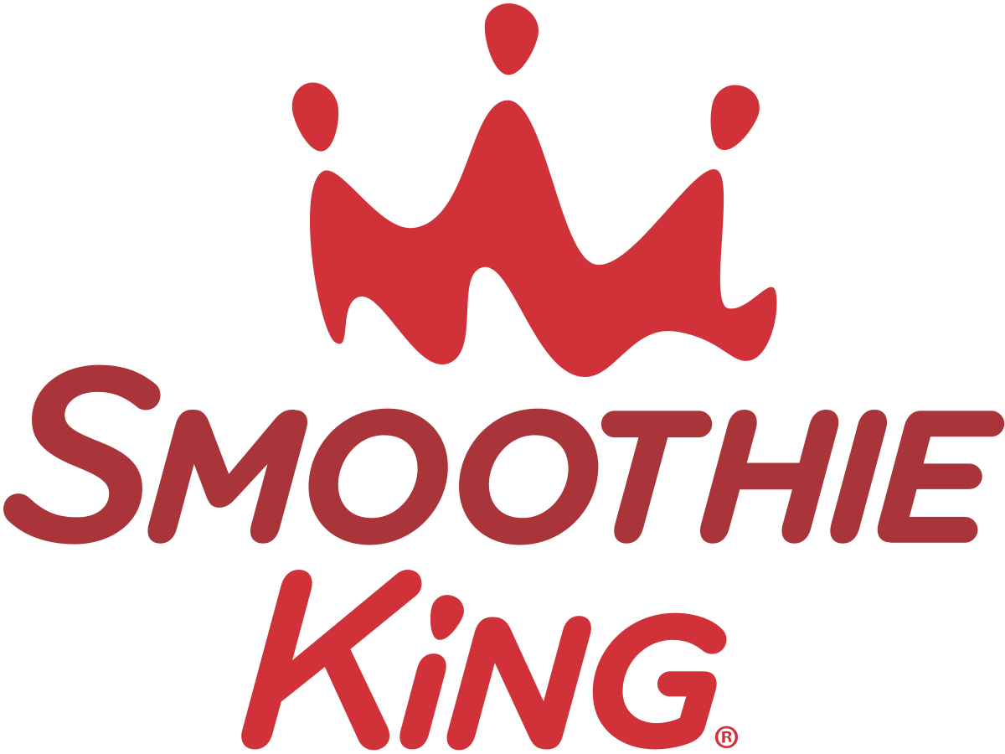

Slide 9
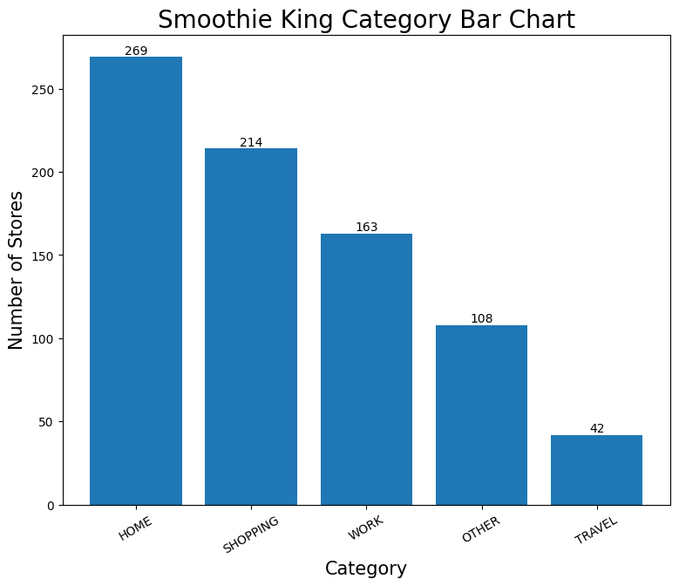
Visualize Category
Data collection:
Mobile devices tracking through geo fencing over 12 months, to determine the category of Smoothie King store
Other category:
Church, Gym, Hospital, School, etc.
Notes:
The smoothies knig’s data is collected from Mobile devices tracking through geo fencing over 12 months.
If you are not familiar with geo fencing.
Geo fencing is to set up a visual boundary, and then track the mobile devices that enter the boundary. Then collect the information we needed.
Form the information collected during the process, we have our target column named “category”.
We use the bar chart to visualize it.
The home category has the largest counts.

Slide 10
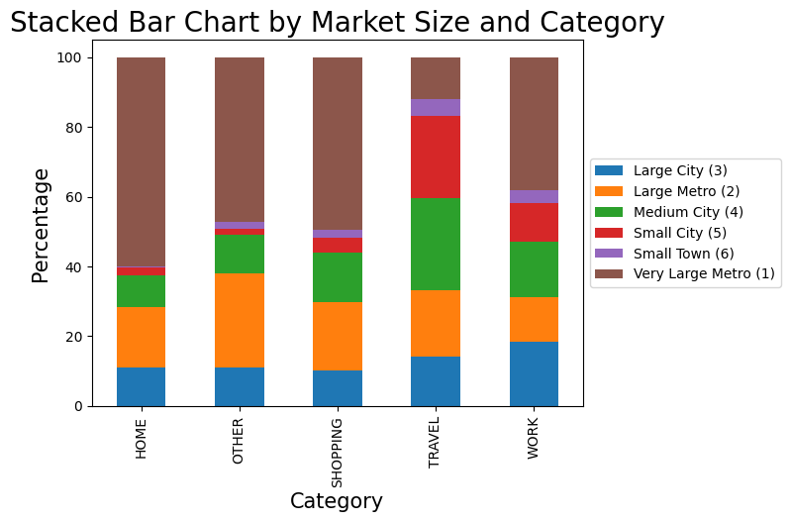
Visualize Category and Market Size
The highest portion among categories are very large metro.
Home has a high percentage of very large metro.
Travel has a high percentage of small city.
Notes:
The highest portion among categories are very large metro.
Home has a high percentage of very large metro.
Travel has a high percentage of small city.

Slide 11
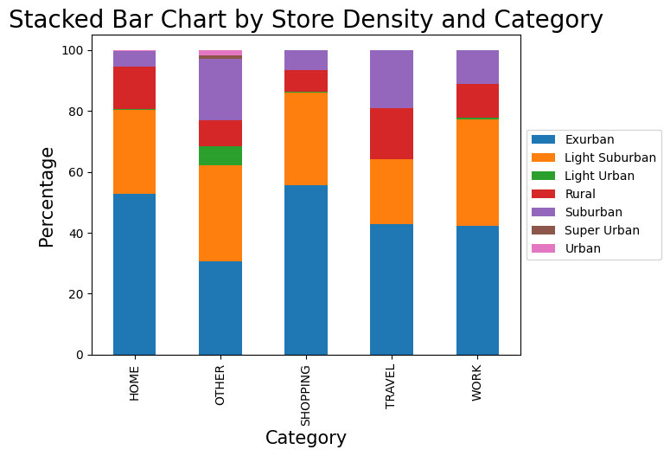
Visualize Category and Store Density
Rural
Exurban
Suburban
Light Suburban
Light Urban
Urban
Super Urban
Notes:
For most of the stores are located in exurban and light suburban.
As the diagram shown on the right, it shows the area size for each level of the store density.
The only category has the store density of light urban is other. The reason is that the other category contain church, which mostly located in light urban areas.

Slide 12
Data Science Techniques
Over 1100 features with goal of predicting store location category
(Home, Shopping, Work, Travel, Other)
Possible reduce dimension approaches:
Principal Component Analysis(PCA)
Recursive Feature Elimination (RFE)
Use LGBMClassifier
Handles multi-class prediction
Performs well on high-dimension data
Fast
Evaluate result using accuracy score
Use SHAP to interpret results
Notes:
For Smoothie King, there are over one thousand features for surrounding population demographic, consumer behaviour, and store information for the 796 US store locations.
Among these features, many of them are highly correlated to one another. Therefore, it is important to start with feature selection and dimensionality reduction process. Other than manually analyzing the data columns, we are planning to use Principal Component Analysis (PCA) to reduce the dimension and Recursive Feature Elimination method to select the most important features.
With the data and the supervised classification objective, we propose to use an LGBMClassifier as it effectively trains high-dimensional datasets and usually leads to relatively high accuracy for the multi-class problems.
With the labeled data, we can evaluate the model by its accuracy score. The score would indicate if the model is capable of detecting the most important traffic driving factor to a store. The result can be interpreted with SHAP plots where we can visualize which features drive the decision of a particular category assignment for a certain store.

Slide 13

Subway USA
🇺🇸

Slide 14
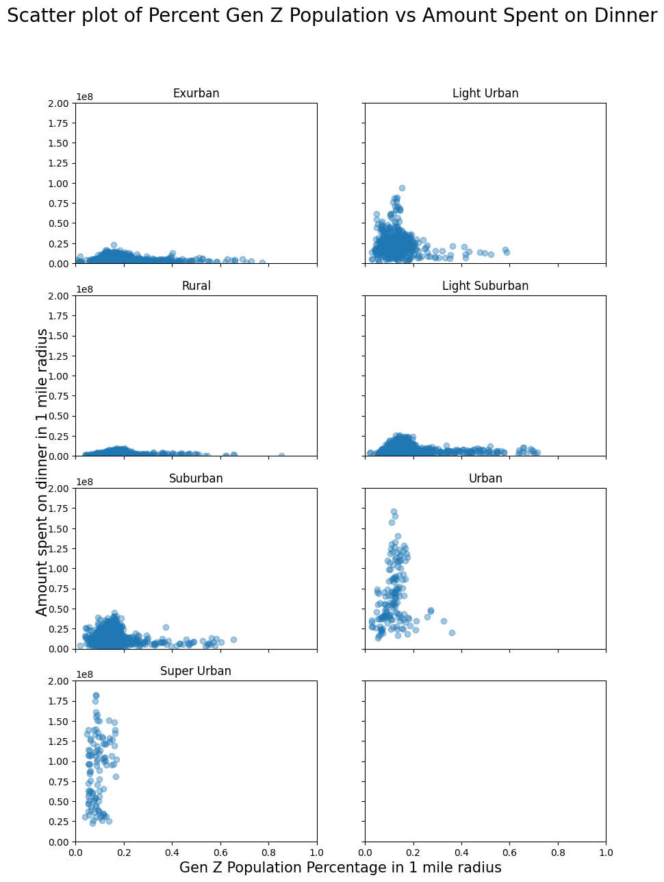
Gen Z Population Percentage
VS
Amount spent on dinner
(1 mile radius)
Notes:
x-axis: gen Z population %
y-axis: amount spent on dinner (10 million USD)

Slide 15
Data Science Techniques
890 features combined with similar information as the Smoothie King,
For approximately 14,000 stores across the US.
Main Goal: Cluster the stores into different clusters
Stores share similar features within the same cluster.
Perform PCA/RFE in advance for dimensionality reduction.
Perform a Hierarchical clustering
Evaluate result
Silhouette Coefficient score
Check Google Maps/Sitewise Internal App to visualize store locations information cluster by cluster

Slide 16
Subway Canada
🇨🇦

Slide 17
Data Science Techniques
Only 53 features, contain similar information to the other datasets.
For approximately 1800 stores across Canada
PCA/RFE may not be necessary
Evaluate result
Silhouette Coefficient score
Check Google Maps to visualize store locations information cluster by cluster
Notes:
For Subway Canada, the corresponding dataset has relatively fewer features (53 features combined with similar information as mentioned above for Smoothie King, for approximately 1800 stores in Canada) in comparison to the other 2 restaurant chains. The implementation of PCA is optional. We will take a similar approach to Subway US and evaluate the result.
If the performance is not ideal, consider removing the PCA step and running clustering to evaluate the result again with the Silhouette Coefficient score and check Google Maps.

Slide 18
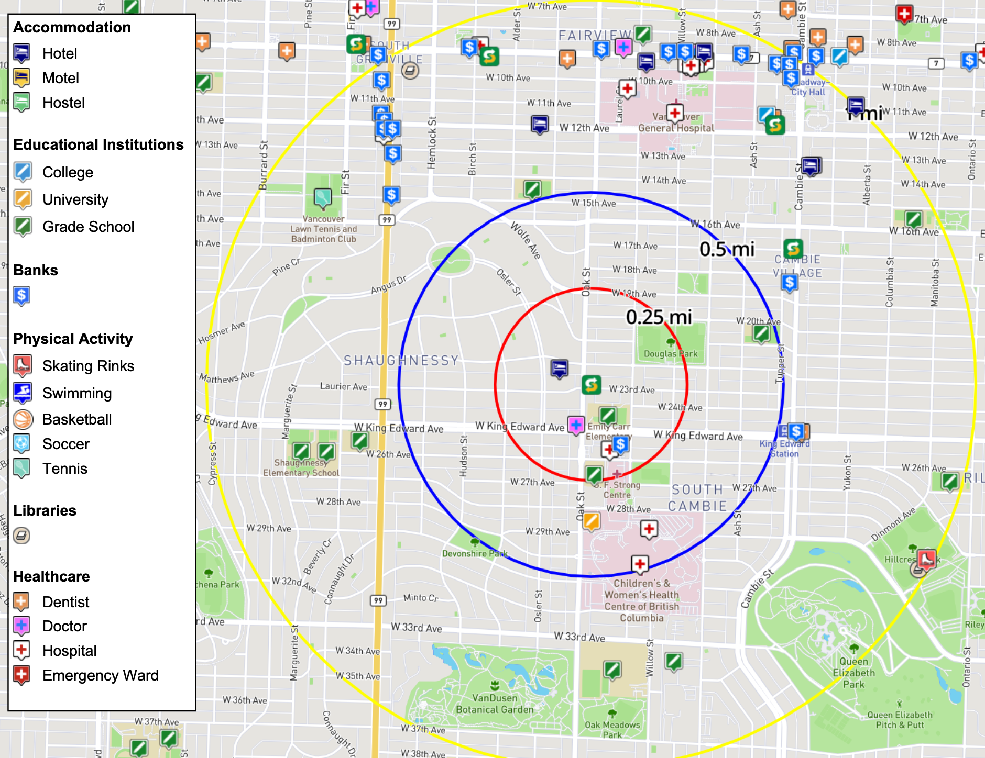
Clustering
Result
Validation

Slide 19
Timeline
Week 1
Week 2
Week 3
Week 4
Week 5
Week 6
Week 7
Week 8
5/1 - 5/7
5/8 - 5/14
5/15 - 5/21
5/22 - 5/28
5/29 - 6/4
6/5 - 6/11
6/12 - 6/18
6/19 - 6/28
EDA
& Proposal
Feature Selection
Supervised Model
Unsupervised Model (Part I)
Unsupervised Model (Part II)
Model Tuning & Parameter Optimization
Final Presentation
Final Product & Reflection

Slide 20
Thanks

Slide 21
Q&A

