Slide 1
Fighting The Landlord Game AI with Minimax Search
Team Member: Zizhuo Wang, Jinrui Wang,
Xiner Xu, Suan Xia , Wenyi Li

Slide 2
Introduction
A 3-player game
Stochastic environment
Partially observable
---- each player receives cards randomly
---- players can only observe the discarded cards and the cards on their own hands

Slide 3
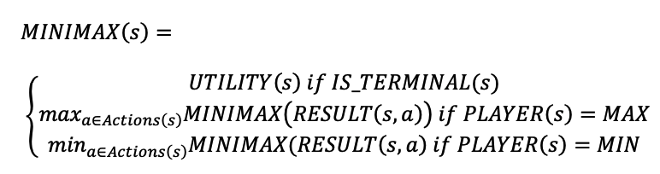
Main Idea
Minimax Algorithm
Three agents
For the landlord agent: the landlord is a maximizer and the two farmers are minimizers
For the farmer agent: two farmer are the maximizers and the landlord is the maximizer

Slide 4

Main idea
In the beginning, each state has more than 50 successors, which means the agent needs to go through ${50}^{3}$ states at depth 3
Simplify with Alpha-beta pruning

Slide 5
Main idea

Slide 6
Implementation
Define legal combinations of cards an agent can play
Single, pair, trio, chain, pairs chain, 3+1, 3+2, bomb, king bomb……

Slide 7
Implementation
Define the utility function

Slide 8
Implementation
When the game terminates, the agent receives 1000 points if it wins and -1000 if it loses

Slide 9
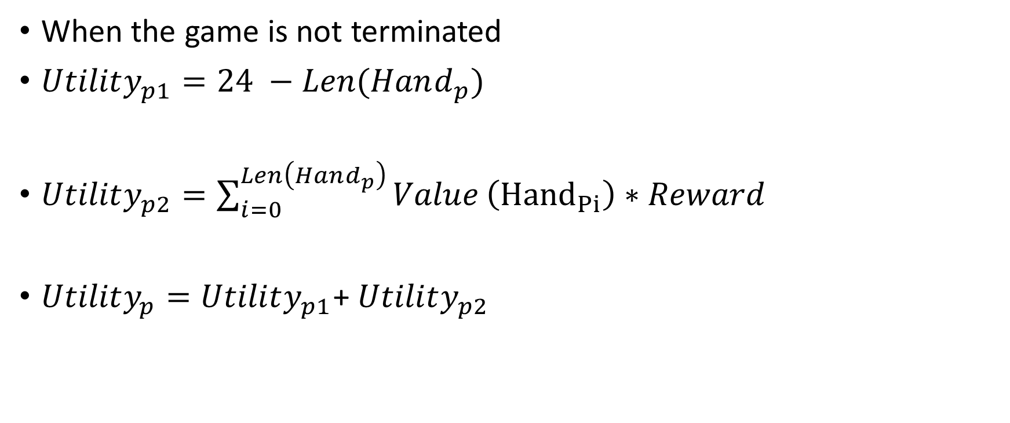
Implementation
When the game is not terminated
$Utility_{p1}=24 −Len(Hand_{p})$
$Utility_{p2}=\sum_{i=0}^{Len\left(Hand_{p}\right)}{Value}\left({Hand}_{Pi}\right)∗Reward$
$Utility_{p}=Utility_{p1}$+ $Utility_{p2}$
---- ensure the agent plays longest combination first
---- ensure the agent plays least ranked cards first
---- combine two parts by adding them together

Slide 10
Implementation
Value of card
3 | 4 | 5 | 6 | 7 | 8 | 9 | 10 | J | Q | K | A | 2 | Black Joker | Red Joker
-7 | -6 | -5 | -4 | -3 | -2 | -1 | 0 | 1 | 2 | 3 | 4 | 5 | 6 | 7

Slide 11
Implementation
Reward function
Better combination of card get higher value
Single | pair | trio | chain | pairs chain | bomb | king bomb
1 | 1.1 | 1.2 | 1.2 | 1.3 | 1.4 | 1.4

Slide 12
Result
AlphaBetaAgent vs. Random Agent: 95%
AlphaBetaAgent vs. Human Player1: 14/30 win
AlphaBetaAgent vs. Human Player2: 17/30 win

Slide 13
More things to do
Improve the utility function
More effective/advanced method of search
Better cooperation of farmers
Deal with special cases in end-game

