Slide 1
Image Colorization
陈平豪 黄萱茂 王子卓 张一凯 江昌浩

Slide 2
Content
Background
Input & Output
Related Works

Slide 3
Content
Background
Input & Output
Related Works

Slide 4
Background

Slide 5
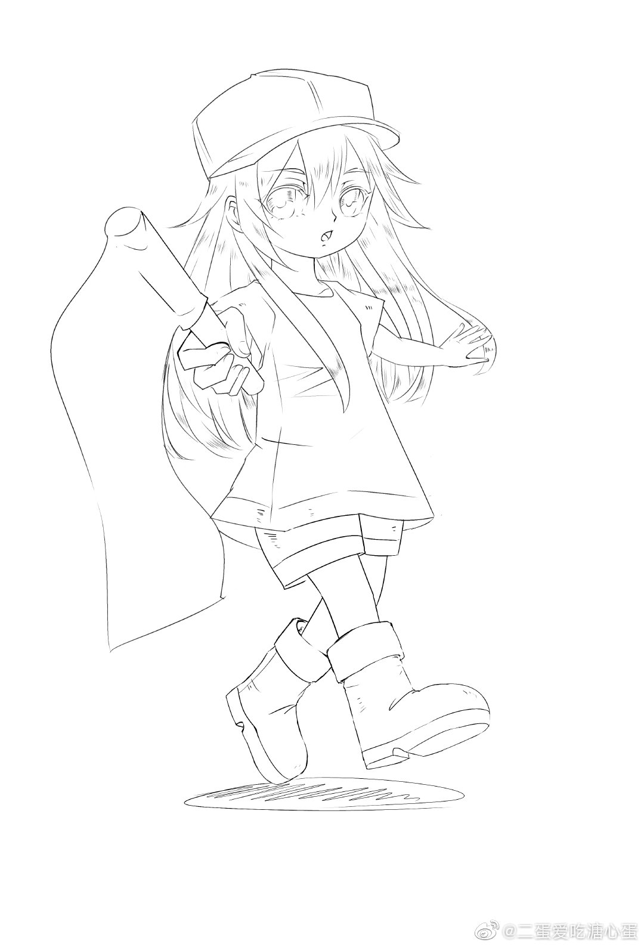
Background
Notes:
画师的工作

Slide 6
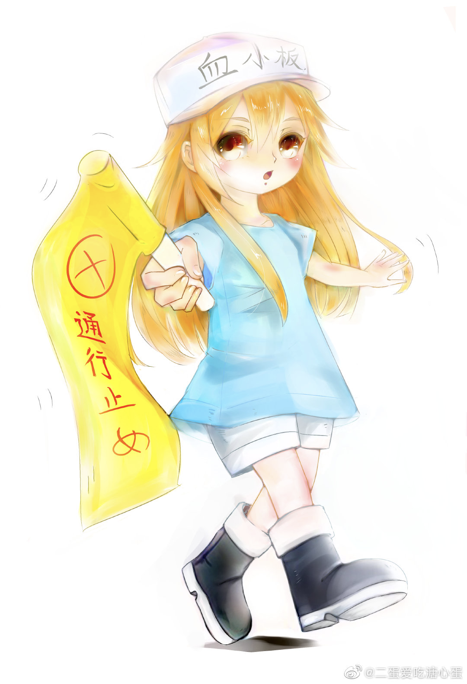
Background
Notes:
画师助手的工作

Slide 7
Background
Image
Colorization
Notes:
微博瓜 - 减轻画师助手的工作量
其他可能的应用：1. 恢复黑白图片

Slide 8
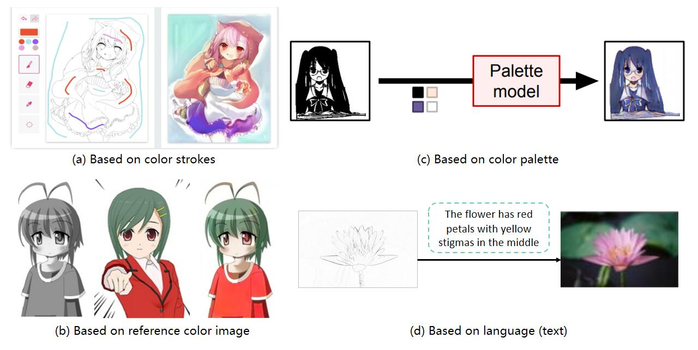
Background - Image Colorization
Notes:
（a）（c）不好：限制比较多，一张图被卡死在几个颜色上，一张图就要重新弄一次
（d）：和线稿上色关系不太大
（b）好：可重复性（漫画对同一人物上色），灵活（模板颜色多种多样）

Slide 9
Content
Background
Input & Output
Related Works

Slide 10
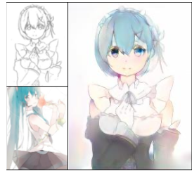
Input & Output
Sketch
Colored Sketch
Reference
image

Slide 11
Input & Output
Input:
Gray scale image
Reference colored image
Output:
Colored version of gray scale image

Slide 12
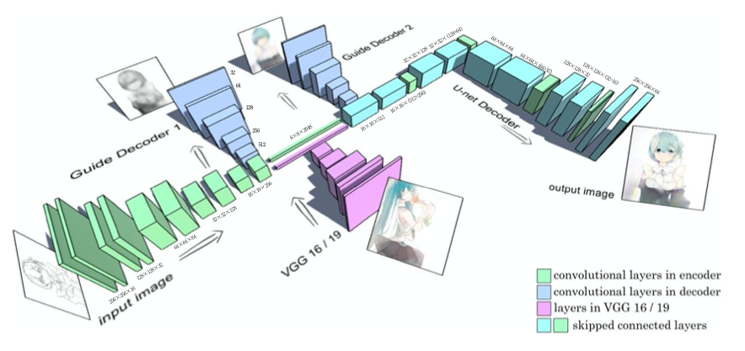
Input & Output
Lvmin Zhang, Yi Ji and Xin Lin. Style Transfer for Anime Sketches with Enhanced Residual U-net and Auxiliary Classifier GAN, 2017

Slide 13
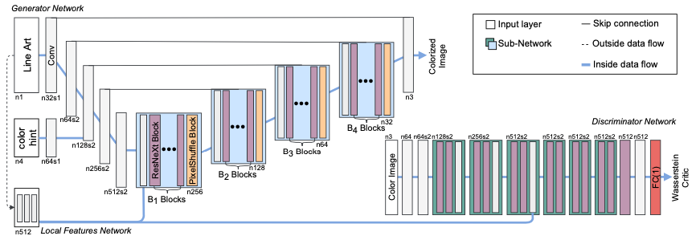
Input & Output
Yuanzheng Ci, Xinzhu Ma, et al. User-Guided Deep Anime Line Art Colorization with Conditional Adversarial Networks, 2018

Slide 14
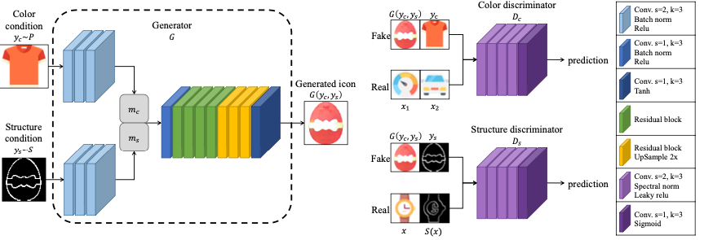
Input & Output
Tsai-Ho Sun, Chien-Hsun Lai, et al. Adversarial Colorization Of Icons Based On Structure And Color Conditions, 2019
Notes:
尽管网络的架构各不相同，但基本的idea是通过神经网络对输入进行处理来得到输出图像

Slide 15
Content
Background
Input & Output
Related Works

Slide 16
Related Works
Lvmin Zhang, Yi Ji and Xin Lin. Style Transfer for Anime Sketches with Enhanced Residual U-net and Auxiliary Classifier GAN, 2017
Yuanzheng Ci, Xinzhu Ma, et al. User-Guided Deep Anime Line Art Colorization with Conditional Adversarial Networks, 2018
Tsai-Ho Sun, Chien-Hsun Lai, et al. Adversarial Colorization Of Icons Based On Structure And Color Conditions, 2019

Slide 17
Thanks

