Slide 1
Software Testing With Testopia http://mozilla.org/projects/testopia
Greg Hendricks
IS&T Engineering Tools
ghendricks@novell.com

Slide 2

Welcome to Testopia
Testopia is a test case management extension to the Bugzilla bug tracking system.
It is an open source project licensed under the Mozilla Public License.
The project home page is http://mozilla.org/projects/testopia
Testopia allows developers and testers to work in a single environment to produce better software.

Slide 3
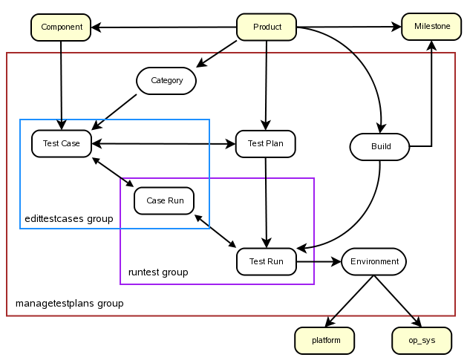
Testopia Big Picture

Slide 4
Test Plans
Test plans are the glue of testopia
Each plan may belong to one Product and Product version
A test plan contains the document detailing what type of testing is to be performed and gives an overview of acceptable parameters.

Slide 5
Creating a Test Plan
Click the “New Plan” link in the footer
Enter a name for the plan
Select a product and version
Select a type
Add details to the plan document
Click “Add”

Slide 6
Viewing a Test Plan
Overview – displays details about the plan
Command buttons – Various commands for a test plan
Categories and Tags – Add categories, builds and tags
Test Cases – View a table of test cases associated with this plan
Test Runs – View a table of test runs of this plan
Attachments – View a list of attachments to this plan
Reports – a list of reporting options for this plan
Attributes and Document – edit the plan

Slide 7
Access Controls
Testers group has all rights
Individuals can be added to plans one at a time or via regular expression

Slide 8
Creating Categories
Categories are used to classify test cases. They are associated with a product which means you can add them or edit them in any plan in that product and see them in all plans for that product. You must have at least one category before creating test cases.
Click “Add” under categories
Give your category a name
Provide a description
Click “Submit”

Slide 9
Creating Builds
Builds are periodic snapshots of your project. When running tests you will typically run them against a particular build. Each build can be associated with a Target Milestone. You must have at least one build defined before creating runs.
Click “Add” under Builds
Enter a name or build string
Select a milestone
Provide a description of the build
Click “Submit”

Slide 10
Creating Environments
Environments are the set of conditions within which you run your tests. Environments are global so you can reuse environments across products. You must have at least one environment defined before creating a run.
Click “Environments” in the footer
Click “Create”
Enter a name for your environment
Click “Submit”
Drag and drop elements

Slide 11
Creating a Test Case
Click the “Create a New test Case” link on the plan page or the “New Case” link in the footer.
Enter a summary
  The summary is a short description of the test case
Enter a default tester
  This defaults to you, the one creating the test case, however you can enter any Bugzilla user here.
Alias (optional)
  The alias field is a globally unique string that can be used in place of the case id to find your test case.

Slide 12
Creating a Test Case (continued)
Select a status
  PROPOSED – Not yet ready to be included in runs
  CONFIRMED – Can be included in runs
  DISABLED – No longer relevant for use in runs.
Set the Priority
  Same list as bug priority
Select a category
  Defined from the plan page
Enter a requirement (optional)
  An id for a requirement in an external requirement tracking system.

Slide 13
Creating a Test Case (continued)
Select Manual or Automatic
  If automatic, space is provided for a path to a script and related arguments which the tester would then need to run.
Depends on (optional)
  a list of test case ids that this test case requires to have tested before this one can be
Blocks (optional)
  A list of test case ids that this test case prevents from being tested until this one is tested.

Slide 14
Creating a Test Case (continued)
Action
  The list of steps the tester would go through during a run to test the feature or bug this test case represents.
Effect
  The list of expected results or outcomes that the tester uses to verify that the feature or bug this test case is for works as intended.
Setup
  The things that need to be done before the case is run.
Breakdown
  Steps to reset this case for the next run
Click “Add”

Slide 15
Viewing a Test Case
Overview – displays details about this test case
Command buttons – Executes different options for this test case
Components
  Each test case can have zero or more Bugzilla components associated with it. The list comes from the plans' products this case is linked to.
Case Run History
  A table listing the outcomes of this test case in each run it has been included in.

Slide 16
Attachments
Test cases and test plans can have files attached to them.
  Click the browse button and select a file to attach
  Enter a description for the attachment
  Click “Attach”
You can edit the details of an attachment by clicking the edit link
If the site administrator has allowed it, you can delete attachments by clicking the delete link

Slide 17
Test Runs
Test runs are the actual place where testing happens.

Slide 18
Creating a Test Run
Click the “Create a New Test Run” link on the plan page or the “New Run” link in the footer.
Select the test cases to include in the run.
  Check the boxes next to each test case to be included or use the select all link at the top to grab all of them.
Select a product version for this run.
Select a plan version
  This is the version of the plan document that is to be used for this run.
Enter a plan manager
  This can be anyone with a Bugzilla account.

Slide 19
Creating a Test Run (continued)
Select an environment
Set the status
  Running – can change the status on test case-runs in this run
  Stopped – Updates of test case-runs are not allowed.
Select a build
  This will be the default build for all case-runs in this run. You can edit builds on the plan page.
Enter a summary
  A quick description of this run
Notes (optional)
  Allows you to make notes about this run

Slide 20
Viewing a Test Run
Overview – same as before
CC list
  You can add people to the notification list for this run
Coverage
  Lists how many test cases are in each state in this run
Test Case Run Logs
  Displays one entry for each of the test cases selected when creating the run
Attributes
  Allows you to update the fields of this run as well as add notes.

Slide 21
Running Tests
Test Case-Runs
  For each test case selected in a run an entry is made in the test case-run. This is where you will pass and fail test cases.
Expand the test case-run form
  Click on the black triangle or the status icon in the row you wish to update
Select a Build
  If the build I am testing against is not the same as the one chosen for the test run, select the appropriate one now.
Perform the action and verify the effect
  Follow the instructions in the action and compare the results to those listed in the effect as expected outcomes.

Slide 22
Running a Test Run (continued)
Select a status
  IDLE – Test case has not been run
  PASSED – Expected results were obtained
  FAILED – Did not perform as expected
  RUNNING – Test is in progress
  PAUSED – Test was started but is not actively running
  BLOCKED – Test is blocked by the failure of a dependent test case
Add notes (optional)
  You can make a note about this test case

Slide 23
Running a Test Run (continued)
Attach bugs
  If a test case failed you may wish to attach one or more bugs to this test case-run. Click the new button to log a new bug or enter the bug id of the existing bug(s) you wish to associate and click attach. If you log a new bug, the bug will automatically be associated even though you will not see it in the bug list until you refresh the test run.
Reassign the test case-run
  You can assign this test case in this run to a different person by entering their Bugzilla login name here and clicking assign.
Adding additional test cases
  Click the “Add Cases” link to add further test cases to this run

Slide 24
Tags
Tags are user defined text strings that can be used to further classify your test cases, runs and plans
To add a tag to an object type the tag into the tag field and click add
To remove a tag click the X next to the tag in the list

Slide 25
Viewing History
You can view the history of changes to Test cases, runs and plans by clicking the History buttons in their respective pages
A table of what changes were made by whom and when will be displayed
On the test case and test plan history pages you can view a diff of changes to the documents for these objects.

Slide 26
Cloning
Test cases, runs and plans can all be cloned.
A clone is an exact replica of the object
Runs can be cloned within a plan.
Plans can be cloned with their associated test cases being brought forward
Cases can be cloned or linked to additional test plans
  in the case of a link, the case is associated with multiple test plans. Updating the test case in one will mean it is updated everywhere.

Slide 27
Searching
You can search for test cases, plans, and runs individually.
Testopia uses the Bugzilla search engine which makes detailed searches possible.
Results are paginated and sortable

Slide 28
Updating Multiple Objects at Once
Lists of test cases, runs, plans, and case-runs can be updated at once from their respective search results pages.
Select the objects you wish to update and fill in the form data at the bottom then hit “Commit”

Slide 29
Reporting
Reports can be run on cases, runs, plans, or case-runs
Generic reports
Specific reports
Work in progress

Slide 30
Testopia Project
http://mozilla.org/projects/testopia
Developers and Contributors
  Greg Hendricks <ghendricks@novell.com>
  Vance Baarda <vrb@novell.com>
  Justin DeVries <judevries@novell.com>
  Ed Fuentetaja <ed.fuentetaja@gmail.com>

