Slide 1
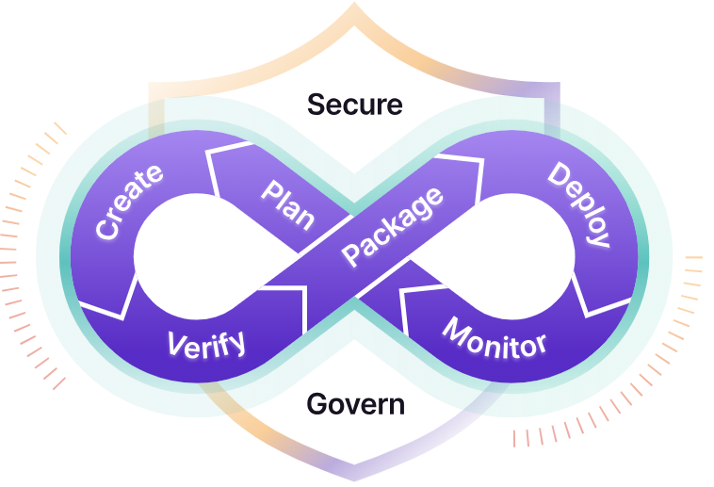
What is DevOps
DevOps is a collaborative approach that combines software development and IT operations to deliver applications faster, more reliably, and with continuous improvement. It emphasizes automation, communication, and shared responsibility across the entire software lifecycle from planning to deployment and monitoring.
DevOps, CI/CD & Deployment Processes
Assessment of Current Delivery, Automation & IaC for:
Sitecore
Legacy
Associated Infrastructure & AVD (Terraform)

Slide 2
Workshop Objectives
Review of current Azure DevOps pipelines and their configuration
Understand existing branching strategy for Sitecore, Legacy, AVD
Assess Infrastructure as Code (Terraform) usage and governance
Identify application release processes for Sitecore & Legacy
Document pain points, gaps, risks & improvement opportunities
Provide input for modernization roadmap & standardization

Slide 3
DevOps Topics in Scope
Azure DevOps Repos & Branching
Build & Release Pipelines (CI/CD)
Infrastructure as Code (Terraform)
Deployment Automation for Applications
Security & Governance in DevOps

Slide 4
Azure DevOps Overview
Is the Azure DevOps environment hosted in Azure DevOps Services (cloud) or Azure
DevOps Server (on-premises)
How many projects exist for Sitecore, Legacy, and AVD
What is the repository structure, mono-repo or multi-repo
Are pipeline libraries, YAML templates, or variable groups used in the CI/CD pipelines
Is the pipeline integrated with Azure Key Vault for managing secrets
What API connections are used, and which identity model (service principal or
managed identity) is implemented
Notes:
Questions:
1) Are pipelines fully YAML-based or classic UI-based?
2) Are shared templates used across teams?

Slide 5
Azure Repos & Branching Strategy
Which Git branching model should be used for Sitecore, Legacy and AVD
- GitFlow
- Release Flow
- Trunk-based development
How are hotfixes managed in the workflow
What is the pull request process and how are approvals handled
What branch protection rules are applied
What commit policies are enforced, including linting, security scanning, and tests
Notes:
Questions:
How many environments you have (e.g., Dev → QA → UAT → Prod)
How often each system deploys
Whether hotfixes are common

Slide 6
CI Pipeline (Build)
How are builds triggered? (CI, PR validation)
What outputs are produced by the build? (artifacts, packages, images)
Are automated test and code quality checks part of the build process
Is the pipeline implemented as a YAML pipeline or a Classic (visual designer) pipeline

Slide 7
CD Pipeline (Release)
How are deployments performed: automated using CI/CD pipelines or manually
What is the process for promoting applications between environments (e.g., Dev, QA, Production)
What approvals or deployment gates are in place for the pipeline or environment
Are there any pain points in the deployment process, such as downtime, long deployment times, or frequent rollbacks

Slide 8
Infrastructure as Code (Terraform)
How is the Terraform code organized—using modules or a flat structure
How is the Terraform state file stored and managed
How are Terraform workflows executed within CI/CD pipelines through automated, manual triggers, or approval-based

Slide 9
Terraform Deployment Pipeline
What is the deployment workflow? For example: plan → approval → apply
How are environments separated using Terraform workspaces, folder structures, or environment specific variables
Are there any issues such as configuration drift, failed Terraform applies, or manual intervention required

Slide 10
Application Release
Sitecore
How is Sitecore deployed to different environments (e.g., Dev, QA, Production)
Does the deployment process require any manual interventions before or after execution
Does the system rely on external integrations or database connections that need to be managed during deployment
Legacy
What is the deployment method used—Virtual Machines, App Service, or containers
Describe the process for handling database changes, including schema updates, migrations, and version control etc.
Notes:
Questions:
What is the promotion path? (Dev → Test → UAT → Prod)
Are approvals automated or manual?
How are rollbacks handled?

Slide 11
DevOps Security
How are secrets and sensitive information stored—using Azure Key Vault, pipeline variables, or other methods
Describe the authentication mechanism used by pipelines to access Azure, such as service principals, managed
identities, or Azure AD tokens
Describe any code quality, static analysis, or dependency vulnerability scanning processes in place
Monitoring & Pipeline Health
How are pipeline failures monitored and reported
What is the deployment success rate across environments
Are there any existing dashboards or reports for monitoring pipelines, deployments, or application health

