Slide 1
Agenda
Requirements Gathering Sessions for Azure Baseline Deployment
  Billing Account Types
  Azure Regions Overview and Selection
  Subscription Design and Democratization
  Azure Enterprise Scale Landing Zone Architecture
  Overview of Cloud Operating Models
  Cloud Authentication and Authorization
  Azure RBAC Best Practices
  Azure Naming and Tagging

Slide 2
Billing Accounts
Billing accounts are created when you sign up to use Azure
Used to manage invoices, payments, and track costs
Can have access to multiple billing accounts
Types:
  Microsoft Online Services Program
  Enterprise Agreement
  Microsoft Customer Agreement
  Microsoft Partner Agreement

Slide 3
Billing Accounts
Billing accounts are created when you sign up to use Azure
Used to manage invoices, payments, and track costs
Can have access to multiple billing accounts
Types:
  Microsoft Online Services Program
  Enterprise Agreement
  Microsoft Customer Agreement
  Microsoft Partner Agreement

Slide 4
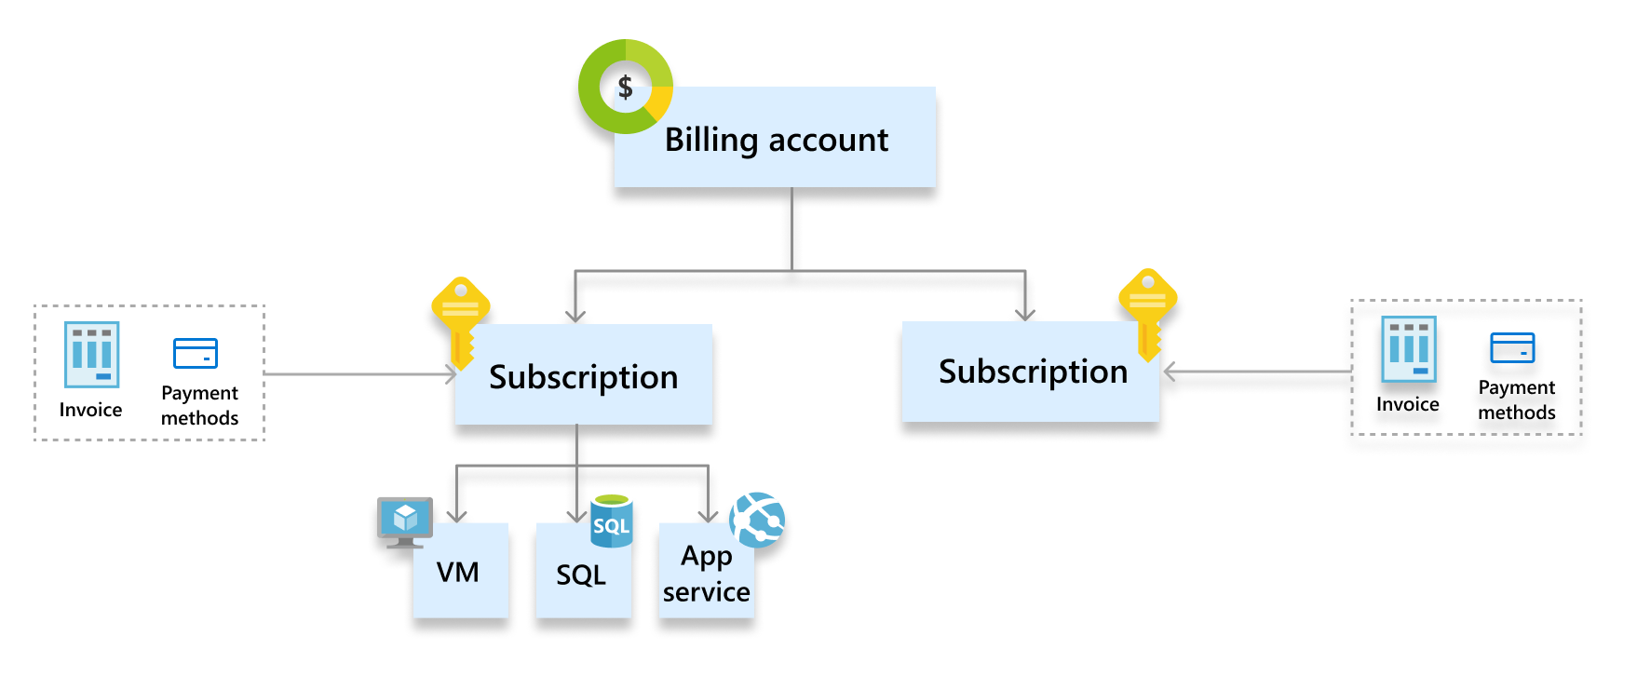
Microsoft Online Services Program
Notes:
Scope Definition
Billing account : Represents an agreement that a customer accepts to use Azure. It contains one or more subscriptions.
Subscription: Represents a grouping of Azure resources. Invoice is generated at this scope. Other billing information such as payment methods and usage address is associated to this scope.

Slide 5
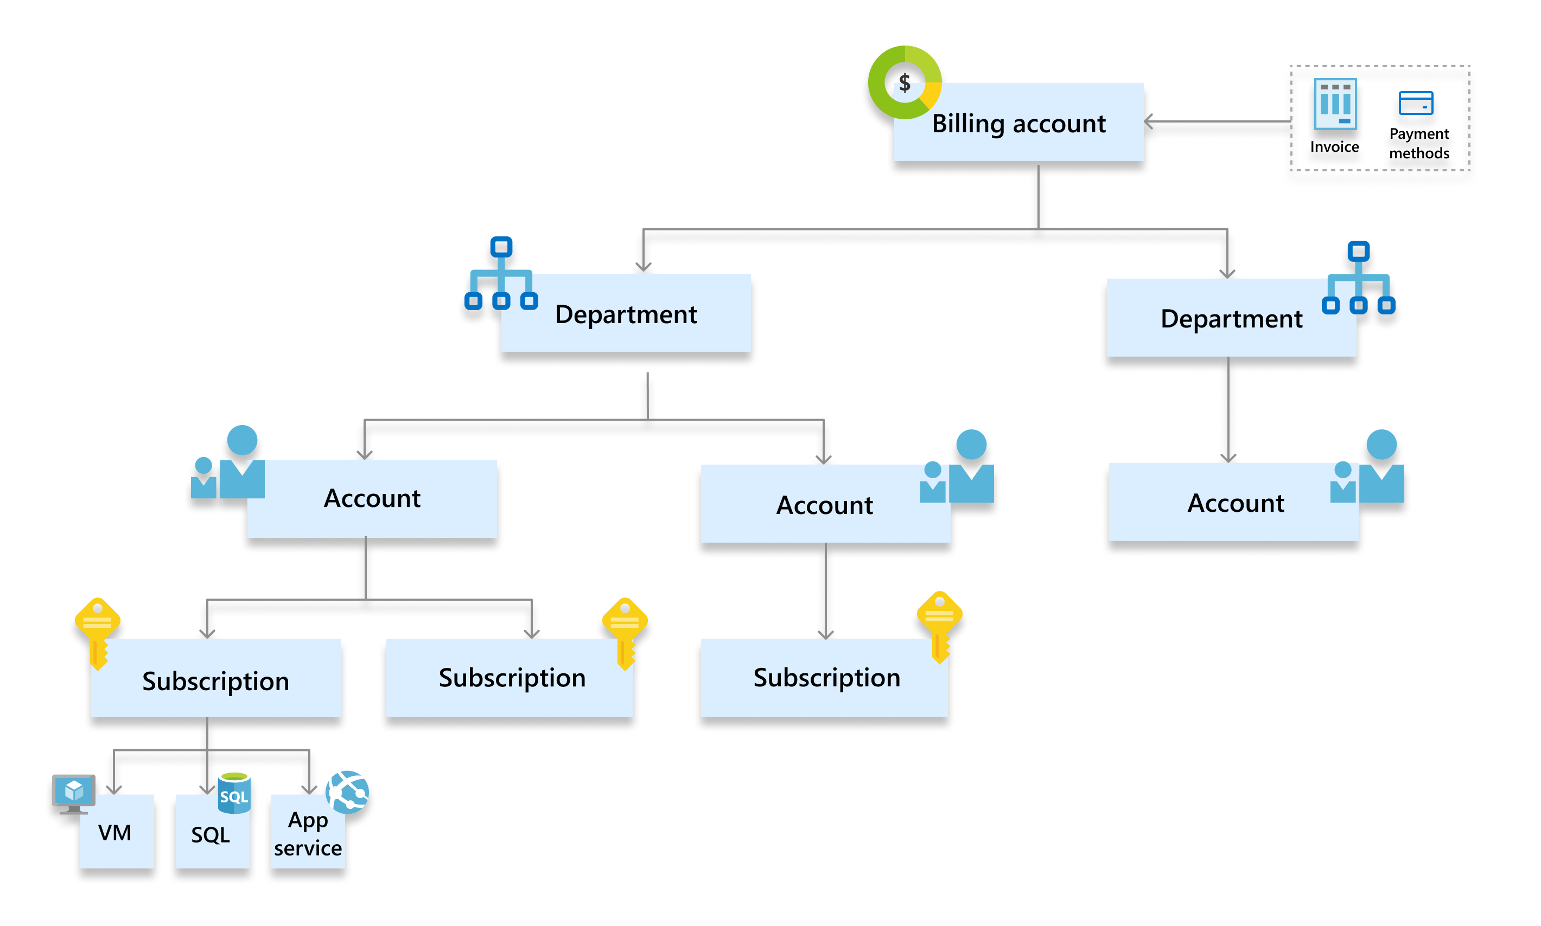
Enterprise Agreement
Notes:
Scope Definition
Billing account: Represents an Enterprise Agreement enrollment. It contains one or more departments and accounts. Invoice is generated at this scope.
Department: Optional grouping of accounts to segment costs into logical groupings and set budget.
Account: Represents a single account owner. Account owners have permissions to create and manage Azure subscriptions that are billed to the enrollment.

Slide 6
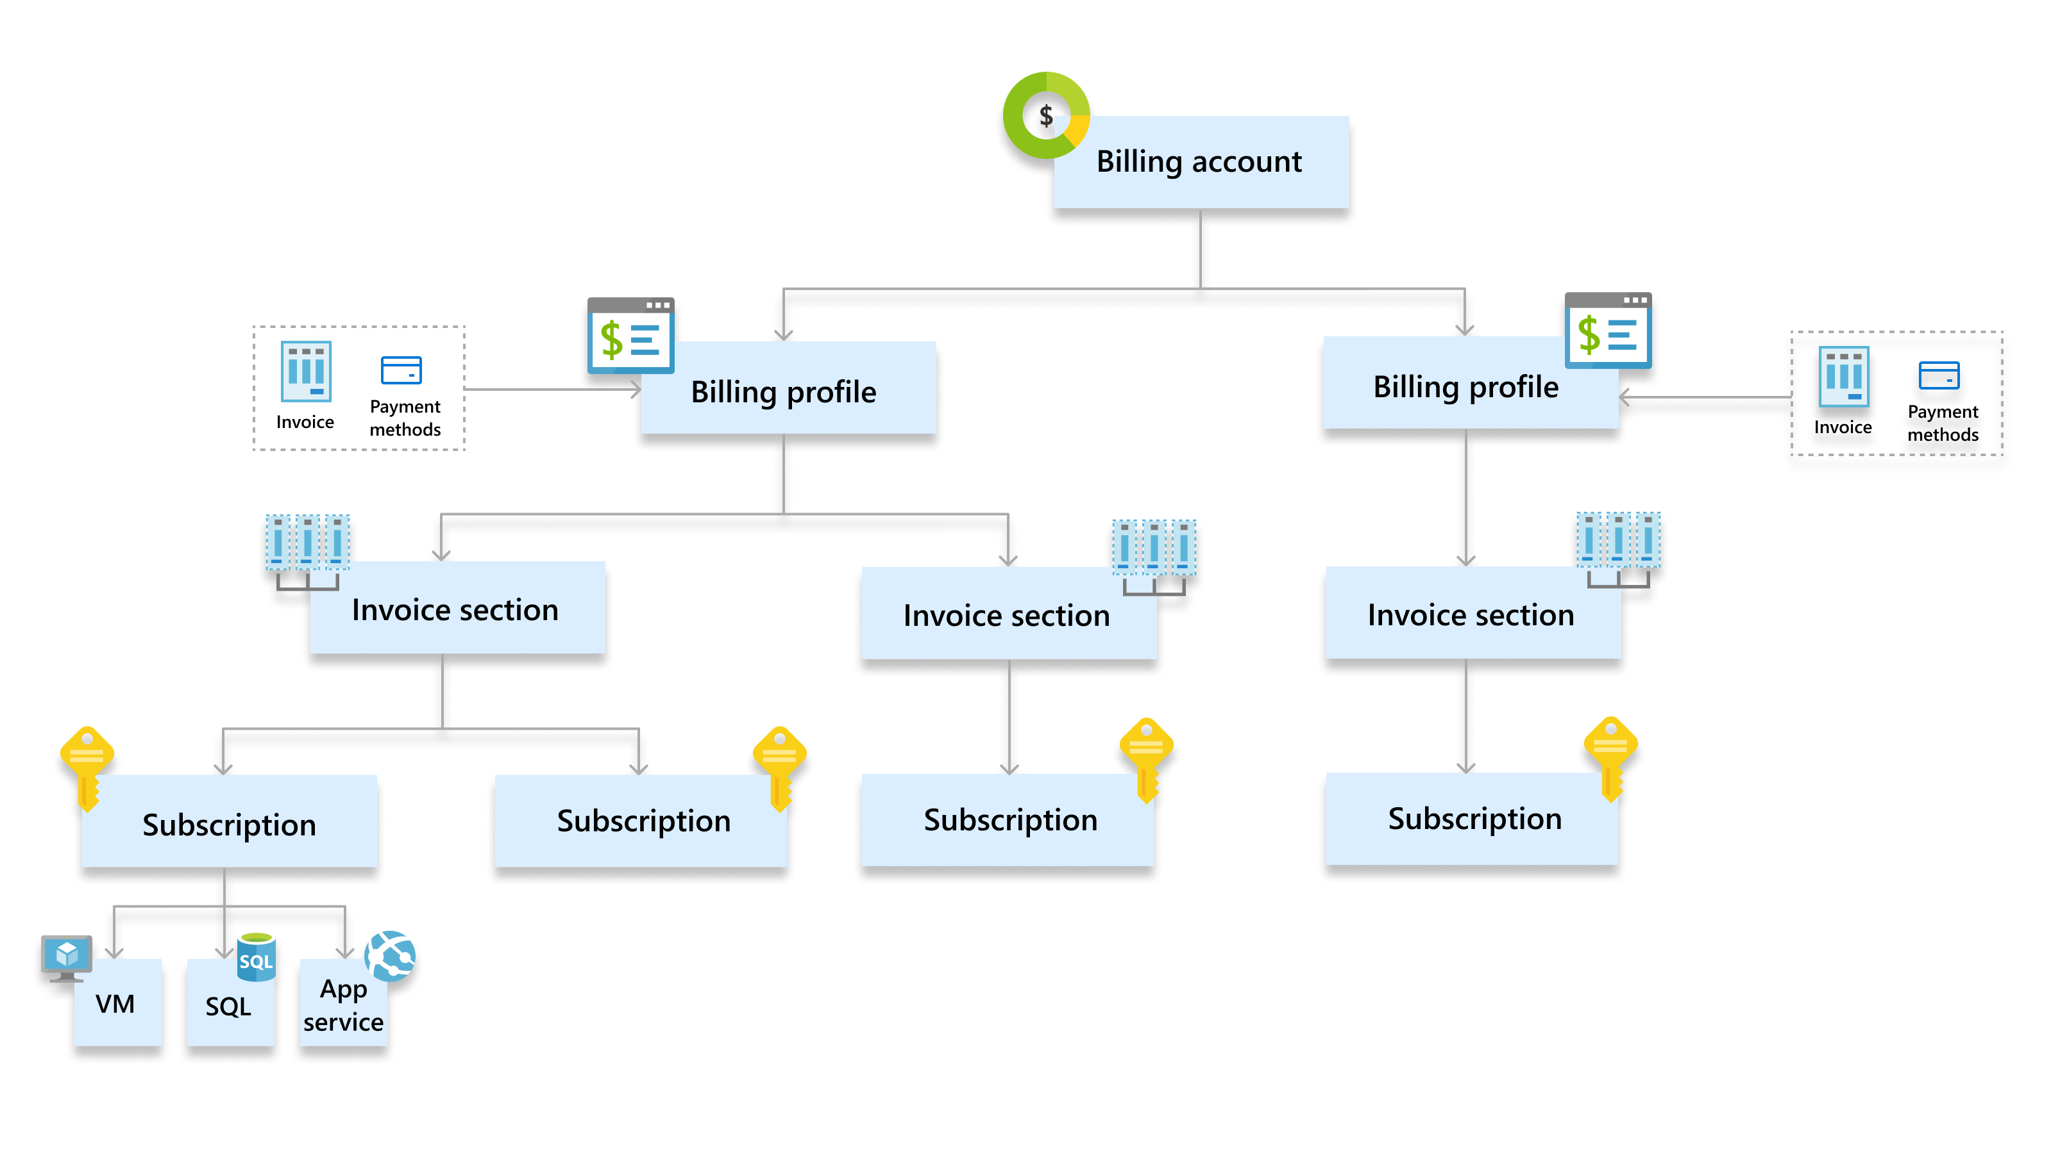
Microsoft Customer Agreement
Notes:
Scope Tasks
Billing account : Represents an agreement that a customer accepts to use Microsoft products and services. It contains one or more billing profiles.
Billing profile: Represents an invoice and the related billing information such as payment methods and billing address. It contains one or more invoice sections.
Invoice section: Represents a grouping of costs in an invoice. Azure subscriptions and other purchases such as Azure Marketplace and App source products are associated to this scope.

Slide 7
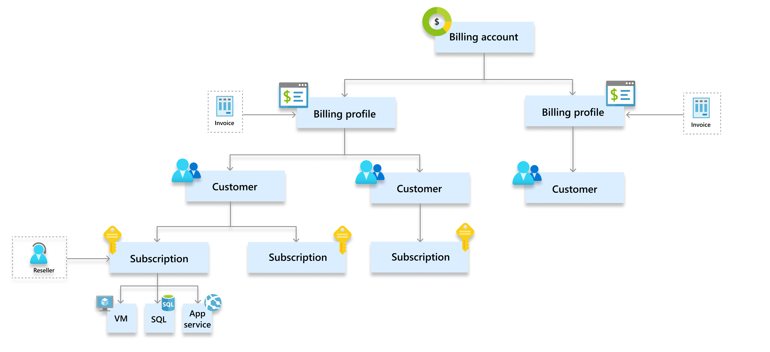
Microsoft Partner Agreement
Notes:
Scope Tasks
Billing account : Represents a partner agreement to manage customers' Microsoft products and services in the new commerce experience. It contains one or more billing profiles and customers.
Billing profile: Represents an invoice for a currency.
Customer: Represents a customer for a Cloud Solution Provider (CSP) partner. Azure subscriptions and other purchases such as Azure Marketplace and App source products are associated to this scope.
Reseller: Reseller that provides services to a customer. It's an optional field for a subscription and is applicable only for Indirect providers in the CSP two-tier model.

Slide 8
Azure Region Selection

Slide 9
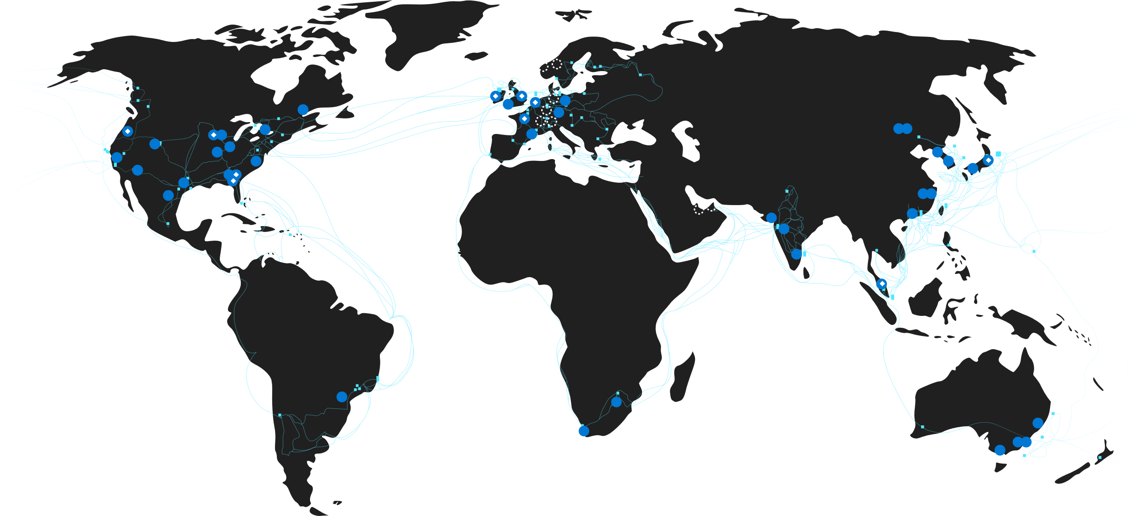
More regions than any other cloud provider
Available region
Announced region
Availability zones
Edge sites
WAN links
70+
Regions worldwide
130K+
Miles of fiber and subsea cable
160+
Edge
sites
200+
ExpressRoute
partners
Notes:
Reminder of all the regions in Azure.
Video: https://learn.microsoft.com/en-us/azure/reliability/regions-overview
REQUIREMENT: Are there data sovereignty concerns/requirements?
REQUIREMENT: What is the primary Azure region that will be used?
REQUIREMENT: What is the secondary Azure region that will be used?

Slide 10
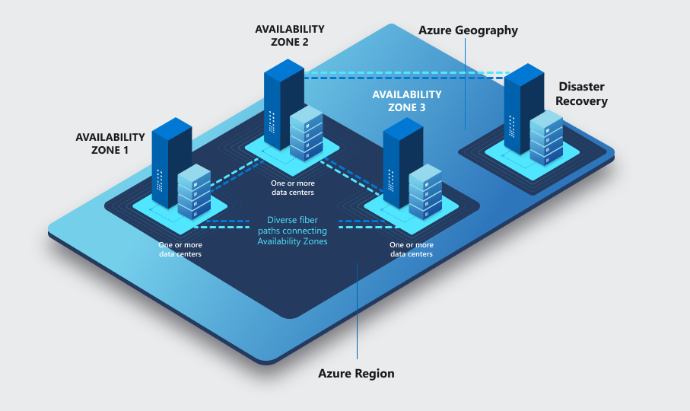
Azure Region Overview
Every region is contained within a single geography that serves as a fixed data residency boundary
If you have data residency requirements, it's important that you select regions within the required geography
Each geography has at least one region equipped with availability zones.

Slide 11
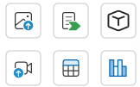
Factors Related to Region Selection
Compliance and Data Residency
Service Availability + Availability Zones
Latency
Pricing
Notes:
https://www.azurespeed.com/Azure/Latency
https://azure.microsoft.com/en-us/explore/global-infrastructure/products-by-region/table?msockid=18220fb2b721618c0c521aa0b69660a8

Slide 12
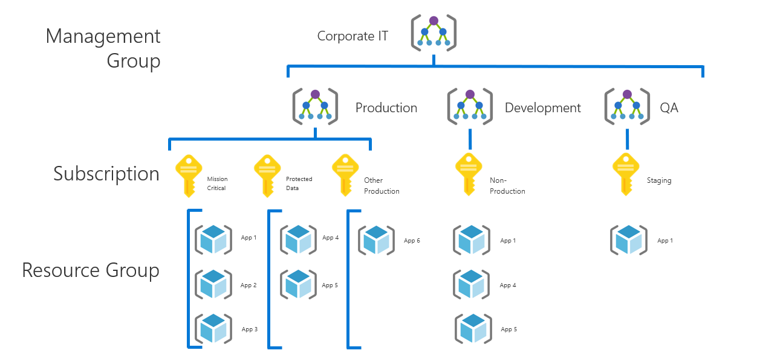
Azure Resource Organization
Notes:
https://www.azurespeed.com/Azure/Latency
https://azure.microsoft.com/en-us/explore/global-infrastructure/products-by-region/table?msockid=18220fb2b721618c0c521aa0b69660a8

Slide 13
Management Groups
A Management Group is a container of:
  Other Management Groups, and/or;
  Subscriptions
Analogous to an OU in Active Directory
Management Groups are used to apply Azure Policy and RBAC to all MG’s and Subscriptions that are contained within them
There is a root Management Group that is always there
You can nest MG’s 6 levels deep, and subscriptions sit below the last (6th) tier
Notes:
https://www.azurespeed.com/Azure/Latency
https://azure.microsoft.com/en-us/explore/global-infrastructure/products-by-region/table?msockid=18220fb2b721618c0c521aa0b69660a8

Slide 14
Management Groups Best Practices
Design your hierarchy based on the design of your organization;
The root MG is for global configuration
  Be careful with MG level assignments as they will cascade through large chunks of your hierarchy
Try not to repeat yourself. Assign common policies and RBAC higher up in your hierarchy
Built-in RBAC roles for MGs (MG contributor, MG reader)
Need subscription owner access to move to another MG
Deploy a “company root” MG under the Microsoft MG
Notes:
https://www.azurespeed.com/Azure/Latency
https://azure.microsoft.com/en-us/explore/global-infrastructure/products-by-region/table?msockid=18220fb2b721618c0c521aa0b69660a8

Slide 15
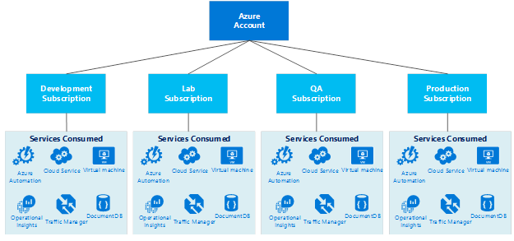
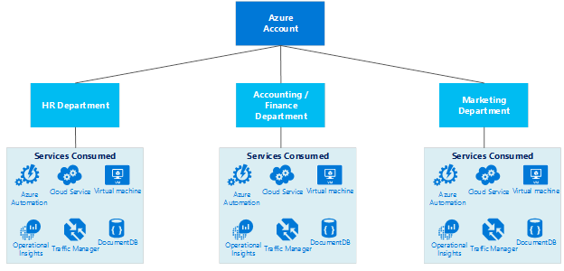
Subscription | Design considerations
Develop the Subscription, Network, Storage, Availability and Administrative models together in order to have a cohesive approach
Service (Process) Design Model
Organizational Unit Design Model
Items to look at when designing the subscription model
Business Requirements
Accountability
Audit/Compliance
Performance
Availability & Recoverability
Technical Requirements
Network Connectivity (shared or dedicated)
Active directory requirements, clustering, identity, management tools
Security Requirements
Who are the subscription administrators
Least privilege model
Scalability Requirements
Growth plans
Allocation of limited resources
Evolution over time (users, shared access, resource limits)
Notes:
Who will be responsible for creating subscriptions?
What resources will be in a subscription by default?

Slide 16
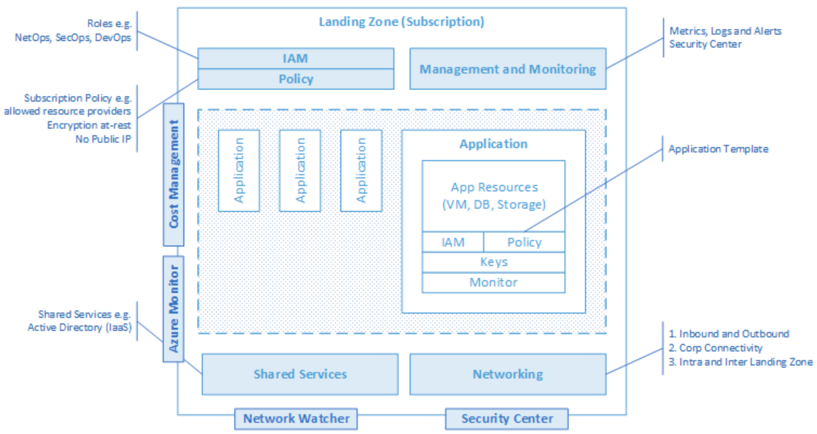
Subscription Democratization
Subscriptions should be used as a unit of management and scale aligned with business needs and priorities, to support business areas and portfolio owners to accelerate application migrations and new application development
Notes:
Subscriptions should be used as a unit of management and scale aligned with business needs and priorities.
Democratization, Business can choose when they move, we want agility and velocity bult into the platform to accelerate an organizations journey.
Democratisation: Subscriptions, aligned with the platform architecture, must be unblocked and provided to business lines for the design and dev/test of migrating workloads.
How: tools like Azure Policy and IaC (Azure Blueprints or other tools e.g Terraform) make this possible to ensure that Subscriptions are created with appropriate controls and baseline resources (including e.g vnet peerings to central vnets that business users otherwise don’t and shouldn’t have permissions to modify)

Slide 17
What is an Azure Landing Zone?
An Azure Landing Zone is a set of guidelines, design principles, and resources that provide a secure, scalable, and well-governed foundation for deploying workloads in Microsoft Azure.
It ensures that all Azure environments are built consistently following best practices for security, compliance, networking, and identity.

Slide 18
Azure Landing Zone Architecture

Slide 20
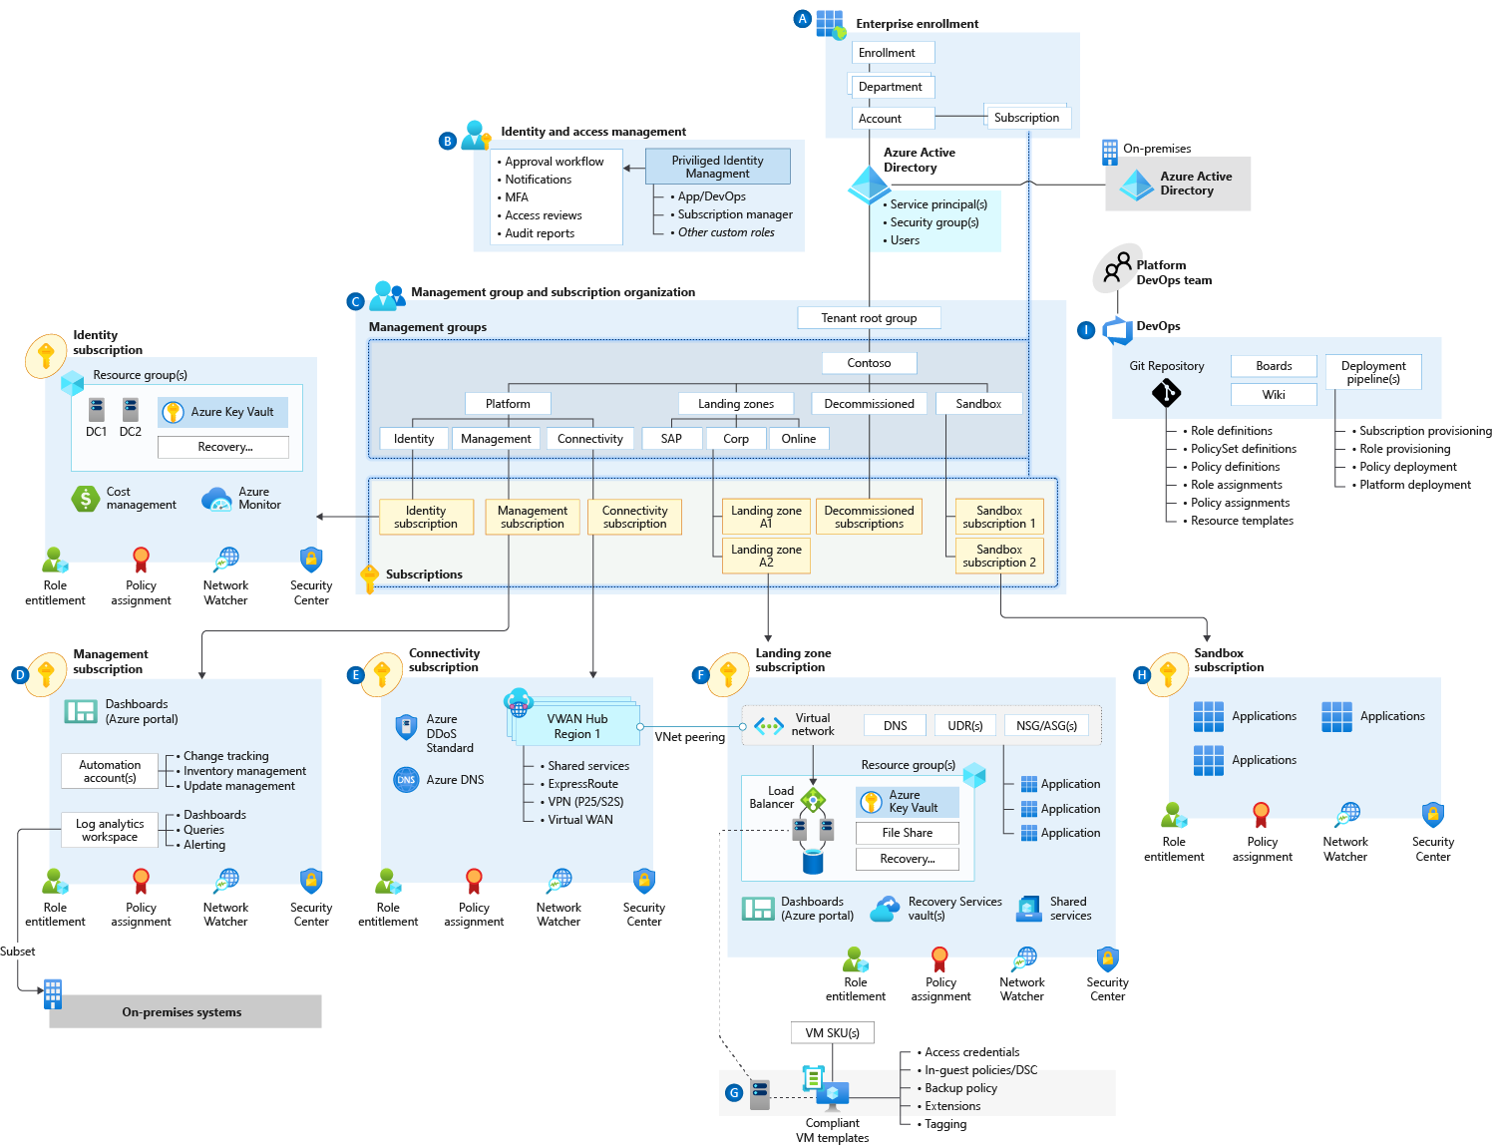
Enterprise-scale Design Principles
Subscription Democratization
Policy Driven Governance
Single Control and Management Plane
Application Centric and Archetype-Neutral
Azure Native Design and Platform Roadmap Alignment
Subscriptions are to be used as a unit of management and scale aligned with business needs and priorities, to support business areas and portfolio owners to accelerate application migrations and new application development.
Notes:
Democratization is the action of making something accessible to everyone.
Subscription democratization is therefore the action of making subscriptions accessible and available to anyone who requests one.
Microsoft: “Subscriptions should be used as a unit of management and scale aligned with business needs and priorities, to support business areas and portfolio owners to accelerate application migrations and new application development.”
Subscriptions should be used as a unit of management and scale aligned with business needs and priorities.
Democratization, Business can choose when they move, we want agility and velocity bult into the platform to accelerate an organizations journey.
Democratization: Subscriptions, aligned with the platform architecture, must be unblocked and provided to business lines for the design and dev/test of migrating workloads.
Subscription democratisation across the regions Equinor 1 resource group – fill and spill, Pinning subscription to region. Big can start small.
Agree at the top Level Criteria for a File>New Subscription and Requirements
Plan Top down Management and unit of Management is the Subscription. This helps to address things such as subscription Limits, maybe for a workload or service we need multiple subscriptions.

Slide 21
Enterprise-scale Design Principles
Subscription Democratisation
Policy Driven Governance
Single Control and Management Plane
Application Centric and Archetype-Neutral
Azure Native Design and Platform Roadmap Alignment
Azure Policy should be used to provide the guard-rails and ensure the continued compliance of the customer platform and applications deployed onto it, whilst also providing application owners sufficient freedom and a secure unhindered path to cloud.
Notes:
Azure Policy should be used to provide the “guard-rails” and ensure the continued compliance of the customer platform and applications deployed onto it, whilst also providing application owners sufficient freedom and a secure unhindered path to cloud.
Rule Sets, and Governance should be in code to set guard-rails. Declare the intent of the policy, Audit only vs deny designed into platform. Deploy if not exist, for configuration drift.
No Public Endpoints – deny policy, enable Audit Logging – Deploy if not exist.
Policy – VM Provisioning
The intent of Enterprise Scale to address VM configuration drift with policy to vNet with connectivity back to Corp. Ensure VM is connected to a certain OU and domain joined.

Slide 22
Enterprise-scale Design Principles
Subscription Democratisation
Policy Driven Governance
Single Control and Management Plane
Application Centric and Archetype-Neutral
Azure Native Design and Platform Roadmap Alignment
The Enterprise-scale architecture should not consider any abstraction layers such as customer developed portals or tooling and should provide a consistent experience for both AppOps (centrally managed operation teams) and DevOps (dedicated application operation teams).
Notes:
Avoid dependency on abstraction layers, such as customer-developed portals or tooling. Having a consistent experience for both Central Operations and Workload Operations is highly recommended. Azure provides a unified and consistent control plane which is subject to role-based access and policy-driven controls. This applies across all Azure resources and provisioning channels. Azure can be used to establish a standardized set of policies and controls for governing the entire enterprise estate.
Impact of deviation
Increased complexity of integration—Choosing a multi-vendor approach to operate control and management planes might introduce complexity of integration and feature support. Replacing individual components to achieve a "best of breed" design or multi-vendor operations tooling might have limitations and could cause unintended errors due to inherent dependencies.
For customers who are bringing an existing tooling investment to operations, security, or governance, a review of the Azure services and any dependencies is recommended.
User Provisioning have native access to Azure CLI, API’s, and Portal.

Slide 23
Enterprise-scale Design Principles
Subscription Democratisation
Policy Driven Governance
Single Control and Management Plane
Application Centric and Archetype-Neutral
Azure Native Design and Platform Roadmap Alignment
We should focus on application centric migrations and development rather than a pure infrastructure "lift and shift" migration (i.e. movement of virtual machines) and should not differentiate between old/new applications or IaaS/PaaS applications.
Notes:
The enterprise-scale architecture should focus on application centric migrations and development rather than a pure infrastructure “lift and shift” migration (i.e. movement of virtual machines) and should not differentiate between old/new applications or IaaS/PaaS applications.
Application Centric Migration and Agility: Support both existing application migrations and net-new application development, without discrimination between IaaS or PaaS, all while providing a consistent experience for both AppOps (centrally managed apps) and DevOps (dedicated teams) across the design and architecture outlined above
App Centric – PaaS/DbaaS
Application and workload specific design focus. Centralize Application components. Not assigned by Who needs access based on roles.

Slide 24
Enterprise-scale Design Principles
Subscription Democratisation
Policy Driven Governance
Single Control and Management Plane
Application Centric and Archetype-Neutral
Azure Native Design and Platform Roadmap Alignment
The Enterprise Scale architecture approach advocates the use of native platform services and capabilities whenever possible, which should be aligned with Azure platform roadmaps to ensure new capabilities are made available within customer environments.
Notes:
The Enterprise-scale architecture strongly advocates the use of native platform services and capabilities wherever possible, which should be fully aligned with Azure platform roadmaps from the offset to ensure new capabilities are swiftly made available within customer environments.
Native Design – H&M – PA NVA to Azure Firewall and Terraform and provider

Slide 25
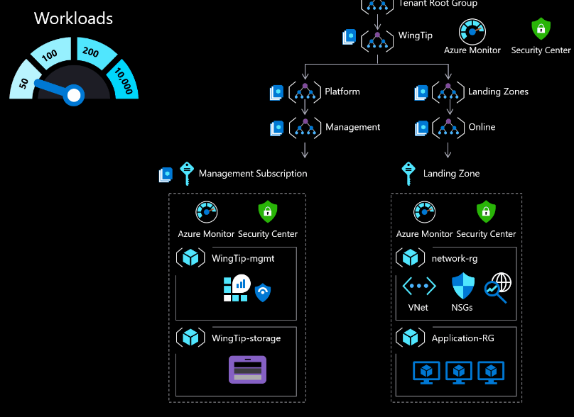
ALZ for 50 Workloads

Slide 26
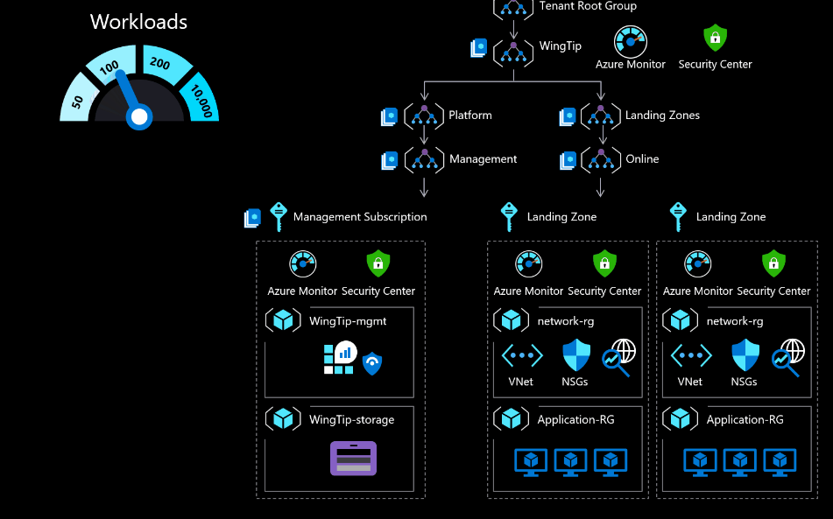
ALZ for 100 Workloads

Slide 27
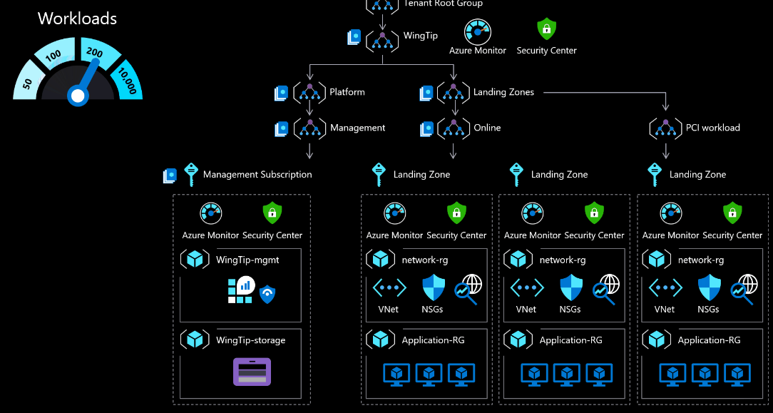
ALZ for 200 Workloads

Slide 28
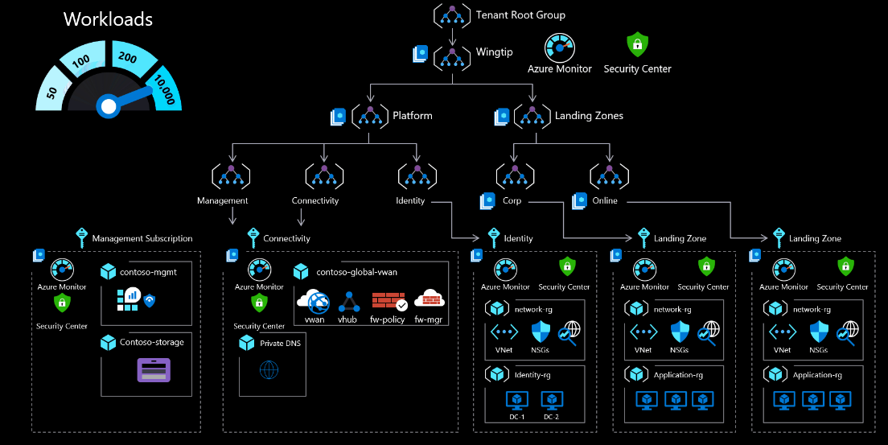
ALZ for 10,000 Workloads

Slide 29
Cloud Operating Model

Slide 30
Cloud Operating Models
Operations approach | Best for | Responsibilities | Pros | Cons
Centralized | Startups, single-cloud estates | One cloud team manages every function | Simpler control, uniform standards | One team becomes a bottleneck as scale grows
Shared Management | Mid-size or enterprise estates, hybrid, or multicloud | Platform teams build the platform landing zones, manages shared services, and governance guardrails. Workload teams work autonomously within guardrails | Balances standards with team agility | Requires clear responsibilities and strong coordination
Decentralized | Tech-savvy startups, innovation programs | Each team owns every cloud task | High speed and autonomy | Weaker standardization, higher risk of security gaps

Slide 31
Cloud Authorization and Authentication

Slide 32
Entra Directory Services
Microsoft Entra ID (free) -> Azure, Office 365
Microsoft Entra ID B2C -> Customer Identity and Access Management (CIAM)
Microsoft Entra ID Domain Services - > DC as a Service
Microsoft Entra ID Basic/Premium (EMS/M365) -> IDaaS
Notes:
REQUIREMENT: Is Azure AD Connect installed on prem and syncing?

Slide 33
Identity Management Patterns
 | Cloud Baseline (Azure AD) | Directory Synchronization | Cloud-hosted domain services | Active Directory Federation Services
When to use | Organization lacks an on-premises identity solution, and plans on migrating workloads to be compatible with cloud-based authentication mechanisms | For organizations with existing on-premises Active Directory infrastructure; best solution for preserving existing user and access management | Workloads that depend on claims-based authentication using legacy protocols such as Kerberos or NTLM, and they cannot be refactored to accept modern authentication protocols such as SAML or OAuth and OpenID Connect. | Identity federation establishes trust relationships across multiple identity management systems to allow common authentication and authorization capabilities.
Assumptions | Cloud-based resources will not have dependencies on on-premises directory services or Active Directory servers Workloads being migrated either support authentication mechanisms compatible with Azure AD Existing workloads that depend on legacy authentication methods such as Kerberos might need to be refactored | You need to maintain a common set of user accounts and groups across your cloud and on-premises IT infrastructure. Your on-premises identity services support replication with Azure AD. | Your workloads depend on claims-based authentication using protocols like Kerberos or NTLM. Your workload virtual machines need to be domain-joined for management or application of Active Directory group policy purposes. | You need single sign on capability across multiple identity management systems
Notes:
1) Do you have Azure Active Directory deployed?
2) What is your Company Full Name i.e. Contoso Corporation?
3) What is your Company Short Name i.e. Contoso?
4) What is your Tenant Name (Verified domain name i.e. contoso.com)?
5) What is your Tenant Name (Primary domain name i.e. contoso.onmicrosoft.com)?
6) Is Azure AD being synced from on premises?
7) What sync mode is being used?

Slide 34
Role Based Access Control (RBAC)

Slide 35
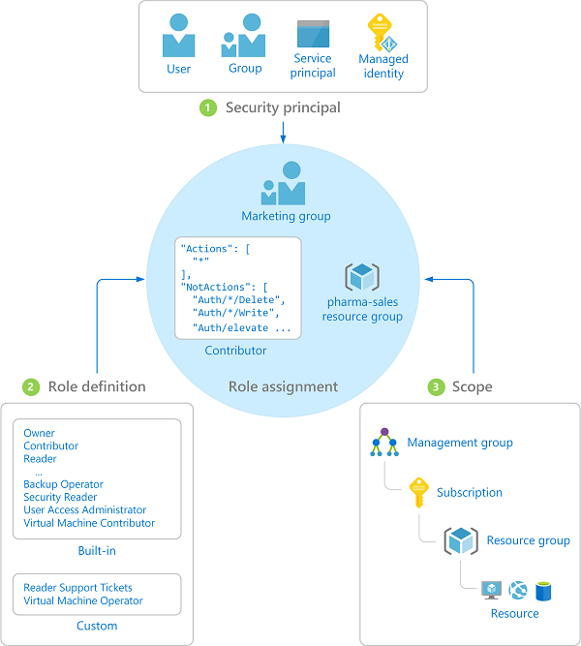
Azure Role-Based Access Control (RBAC)
Fine-grained access control to Azure “control plane”
Grant access by assigning Security Principal a Role at a Scope
      Security Principal: User, group, or service principal
      Role: Built-in or custom role
      Scope: Subscription, resource group, or resource
Assignments are inherited down the resource hierarchy
Notes:
1) What RBAC roles will be used and how will they map to AD groups?
Using RBAC, you can segregate duties within your team and grant only the amount of access to users that they need to perform their jobs. Instead of giving everybody unrestricted permissions in your Azure subscription or resources, you can allow only certain actions at a particular scope.
Security principal
A security principal is an object that represents a user, group, service principal, or managed identity that is requesting access to Azure resources.
- Service principal - A security identity used by applications or services to access specific Azure resources. You can think of it as a user identity (username and password or certificate) for an application.
Managed identity - An identity in Azure Active Directory that is automatically managed by Azure. You typically use managed identities when developing cloud applications to manage the credentials for authenticating to Azure services.
Role definition
A role definition is a collection of permissions. It's sometimes just called a role. A role definition lists the operations that can be performed, such as read, write, and delete. Roles can be high-level, like owner, or specific, like virtual machine reader. You can create custom roles if none of the existing built-in roles don't meet the specific needs of your organization.
Scope
Scope is the boundary that the access applies to. When you assign a role, you can further limit the actions allowed by defining a scope. This is helpful if you want to make someone a Website Contributor, but only for one resource group.

Slide 36
Azure Role-Based Access Control (RBAC)
“Use minimum role assignments to get normal work done.”
 | Reader | Resource-specific or Custom role | Contributor | Owner
Management Group
Subscription
Resource Group
Resource
Observers
People doing real work
Top Level Admin
Automation or Targeted Debug
Notes:
We discussed RBAC in Base Deployment, but here’s a brief review. Importance in this slide deck is a reminder of the principle of least privilege.

Slide 37
Custom RBAC Roles
Administrative role or area | Description | Actions | NotActions
Subscription Owner | Delegated role for the subscription owner | * | Microsoft.Authorization/*/write, Microsoft.Network/vpnGateways/*, Microsoft.Network/expressRouteCircuits/*, Microsoft.Network/routeTables/write, Microsoft.Network/vpnSites/*
Application Owner (DevOps, App operations) | Contributor role for the application or operations team at the subscription scope | * | Microsoft.Authorization/*/write, Microsoft.Network/publicIPAddresses/write, Microsoft.Network/virtualNetworks/write, Microsoft.KeyVault/locations/deletedVaults/purge/action
Network management (NetOps) | Manages platform-wide global connectivity, such as virtual networks, UDRs, NSGs, NVAs, VPNs, Azure ExpressRoute, and others | */read, Microsoft.Network/*, Microsoft.Resources/deployments/*, Microsoft.Support/*
Security operations (SecOps) | Security Administrator role with a horizontal view across the entire Azure estate and the Key Vault purge policy | */read, */register/action, Microsoft.KeyVault/locations/deletedVaults/purge/action, Microsoft.PolicyInsights/*, Microsoft.Authorization/policyAssignments/*, Microsoft.Authorization/policyDefinitions/*, Microsoft.Authorization/policyExemptions/*, Microsoft.Authorization/policySetDefinitions/*, Microsoft.Insights/alertRules/*, Microsoft.Resources/deployments/*, Microsoft.Security/*, Microsoft.Support/*

Slide 38
Best Practices for Locking Down Access
Make sure people automatically lose access when they leave
Use multi-factor authentication for all Azure users
Use “break glass” accounts for Account & Service Admins
Give people minimum access needed for day-to-day work
Use Managed Identities and KeyVault to keep credentials out of code or broadly-acceptable configurations
Notes:
Synchronized identities/single sign-on; when disabled in one place, it disables everywhere
MFA or passwordless
Already discussed
RBAC, least-privilege, and JIT
MI, SP’s, and keyvault; e.g. use keyvault to store the SP key for an app services parameter

Slide 39
Naming and Tagging

Slide 40
Considerations for Naming and Tagging
Naming
  Resource management
Tagging
  Resource management
  Cost management and optimization (ROI, cost tracking, budgets, alerts)
  Operations management
  Security
  Governance/regulatory compliance
  Automation
  Workload optimization

Slide 41
Cloud Adoption Framework Says...
Scope is critical
  On prem scope is usually “entire org” but cloud usually isn’t
Generally
  <type>-[<component1>]-[<component2>]-…-[<componentN>]-[<###>]
  Components:
    Business unit (fin, mktg, product, it, corp)
    Subscription type (prod, shared, client, devtest)
    App or service name (sharepoint, navigator, hadoop)
    Environment (prod, dev, qa, stage, int, test)
    Region (westus, eastus, cancent)
  Components can be in any order that makes sense
Use the minimum number of components possible
Standardize on lowercase names

Slide 42
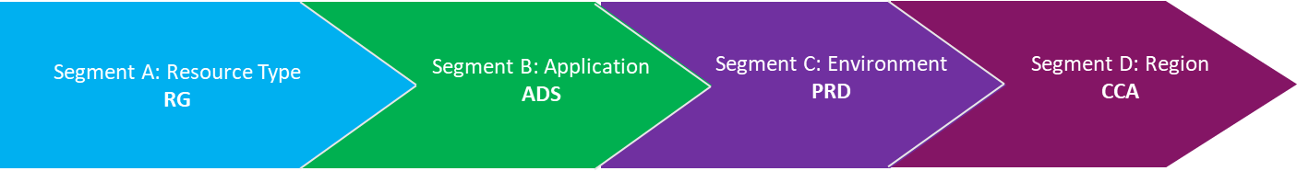
Naming Convention Example
Divide naming into segments
Segment A | Segment B | Segment C | Segment D
3 characters Resource type | 3 – 5 characters application name abbreviation | 3 – 4 characters Environment type or name | Region and numeric sequence for deployment
Environments | Applications | Objects
prd: Production | ads: Active directory services | ilb: Internal load balancer
pprd: pre-production | dbs: database services | pip: Public IP Address
qa: quality assurance | ctx: citrix | str: Storage Account
Create abbreviations for environments
and resources
RG-ADS-PRD-CCA001
Notes:
https://learn.microsoft.com/en-us/azure/cloud-adoption-framework/ready/azure-best-practices/resource-abbreviations

Slide 43
Microsoft Best Practices
https://docs.microsoft.com/en-us/azure/cloud-adoption-framework/ready/azure-best-practices/naming-and-tagging
Cloud Adoption Framework -> Ready -> Best Practices -> Resource Organization
Notes:
REQUIREMENT: Do you have an existing naming convention? If so please provide details.
Otherwise we will provide a recommended naming convention

Slide 44
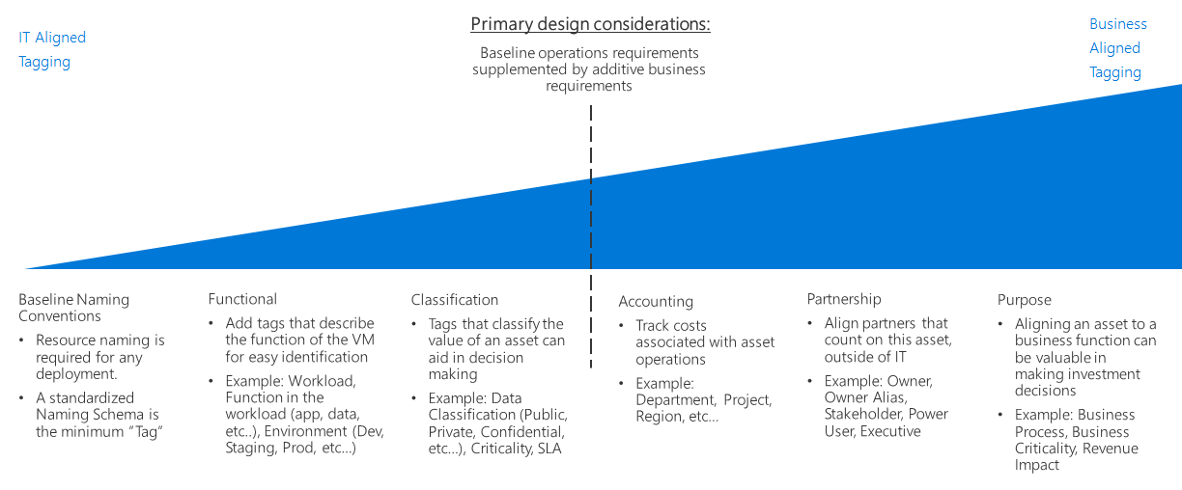
Tagging Decision Guide

Slide 45
Potential Tags
Tag Name | Description | e.g. Value | Required?
Environment | Environment | (one of) prod, test, dev | Yes
BusinessUnit | Business unit to whom this workload belongs | (any) IT | Yes
ApplicationName | A roll-up application name for all resources | (any) SharePoint, Business App 1 | Yes
ServiceLevel | A description of the service level that this app receives (synonymous with SLA) | (one of) critical, gold, silver, bronze | Yes
Owner | An app owner email address | (any) jsmith@contoso.com | No
CostCode | A chargeback code | 12-5785 | No

