Slide 1
PRIME FACTORIZATION
ALGORITHMS
Metehan OZSOY

Slide 2
IN THIS PRESENTATION
What is Prime Factorization Problem?
Prime Factorization and RSA
Three algorithms for Prime Factorization
Pollard-Strassen Algorithm
Hiary's Algorithm
Costa's Algorithm
Conclusion

Slide 3
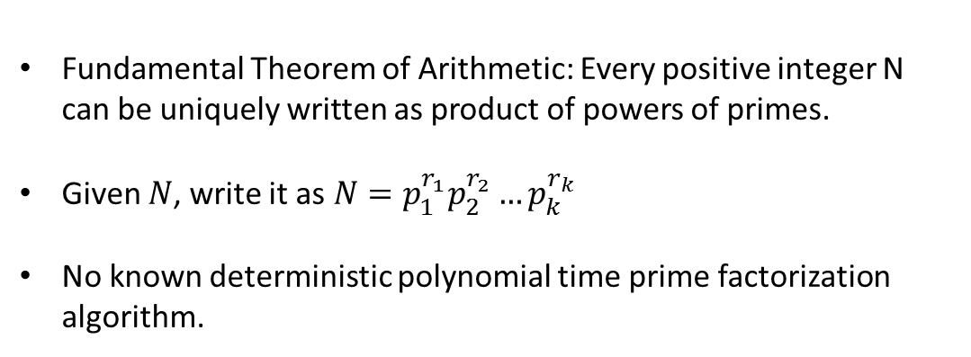
What is Prime Factorization Problem?
Fundamental Theorem of Arithmetic: Every positive integer N can be uniquely written as product of powers of primes.
Given $N$, write it as$N=p_{1}^{r_{1}}p_{2}^{r_{2}}…p_{k}^{r_{k}}$
No known deterministic polynomial time prime factorization algorithm.

Slide 4
Prime Factorization and RSA
RSA critically depend on the fact that prime factorization of large numbers takes a long time.
The hardest instance of the problem: semiprimes, the product of two prime numbers.
RSA public key is based on product of two large primes i.e. a semiprime!

Slide 5
Can make $$$ !!!
RSA Laboratories pays for factoring N
RSA Number | Decimal digits | Binary digits | Cash prize offered | Factored on | Factored by
RSA-100 | 100 | 330 | US$1,000^{[4]} | April 1, 1991^{[5]} | Arjen K. Lenstra
RSA-110 | 110 | 364 | US$4,429^{[4]} | April 14, 1992^{[5]} | Arjen K. Lenstra and M.S. Manasse
RSA-120 | 120 | 397 | $5,898^{[4]} | July 9, 1993^{[6]} | T. Denny et al.
RSA-129 [**] | 129 | 426 | $100 USD | April 26, 1994^{[5]} | Arjen K. Lenstra et al.
RSA-130 | 130 | 430 | US$14,527^{[4]} | April 10, 1996 | Arjen K. Lenstra et al.
RSA-140 | 140 | 463 | US$17,226 | February 2, 1999 | Herman te Riele et al.
RSA-155 | 155 | 512 | $9,383^{[4]} | August 22, 1999 | Herman te Riele et al.
RSA-576 | 174 | 576 | $10,000 USD | December 3, 2003 | Jens Franke et al., University of Bonn
RSA-640 | 193 | 640 | $20,000 USD | November 2, 2005 | Jens Franke et al., University of Bonn
RSA-704 [*] | 212 | 704 | $30,000 USD | July 2, 2012 | Shi Bai, Emmanuel Thomé and Paul Zimmermann
RSA-768 [*] | 232 | 768 | $50,000 USD | December 12, 2009 | Thorsten Kleinjung et al.
RSA-2048 | 617 | 2048 | $200,000 USD
-Table by https://en.wikipedia.org/wiki/RSA_Factoring_Challenge

Slide 6
Three Major Algorithms
Pollard-Strassen Algorithm
Hiary's Algorithm
Costa's Algorithm

Slide 7
Pollard-Strassen Algorithm
Input:
N: Number to be prime factorized
g(x): A polynomial computed mod N
Output:
Either a non-trivial factor of N, or failure.

Slide 8
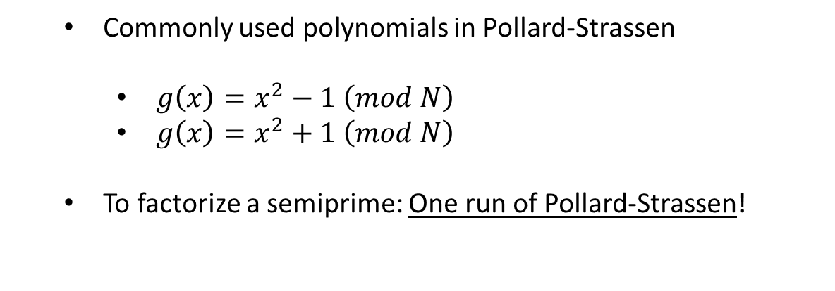
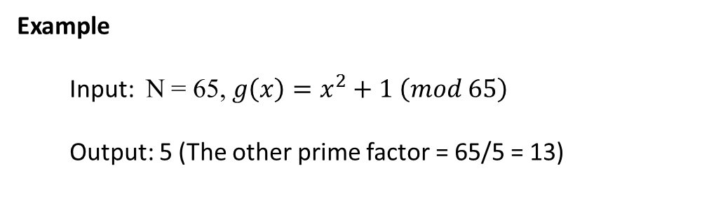
Pollard-Strassen Algorithm
Commonly used polynomials in Pollard-Strassen
$g\left(x\right)=x^{2}−1 \left(mod N\right)$
$g\left(x\right)=x^{2}+1 \left(mod N\right)$
To factorize a semiprime: One run of Pollard-Strassen!
Example
Input: N = 65, $g\left(x\right)=x^{2}+1 \left(mod 65\right)$
Output: 5 (The other prime factor = 65/5 = 13)

Slide 9
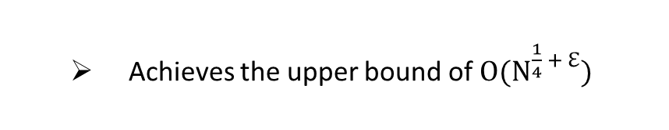
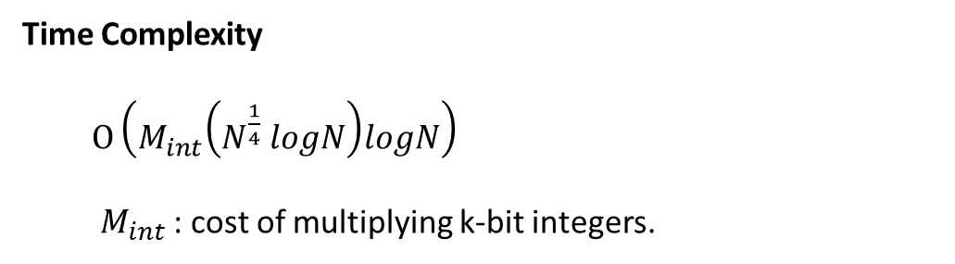
Pollard-Strassen Algorithm
Time Complexity
$O\left(M_{int}\left(N^{\frac{1}{4}} logN\right)logN\right)$
$M_{int}$ : cost of multiplying k-bit integers.
Achieves the upper bound of $O(N^{\frac{1}{4} + ℇ})$

Slide 10
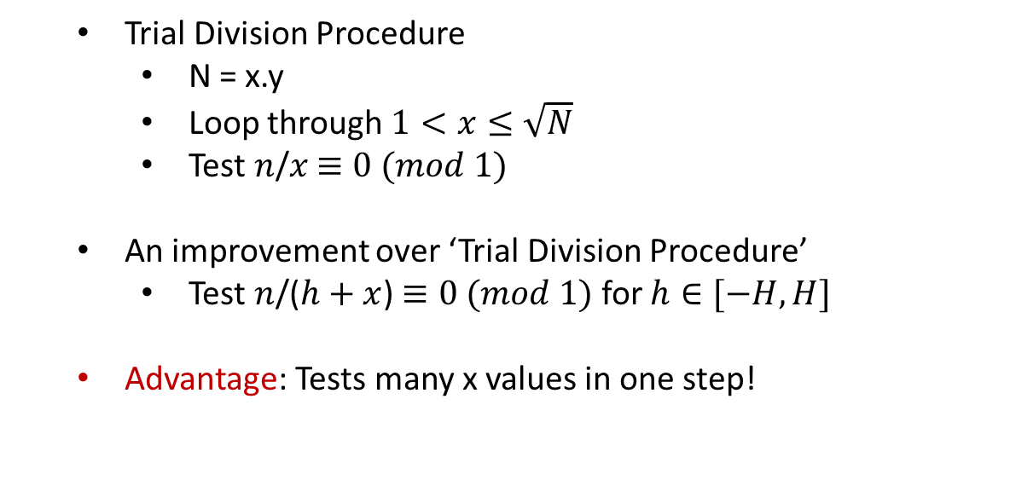
Hiary’s Algorithm
Trial Division Procedure
N = x.y
Loop through $1<x≤\sqrt{N}$
Test $n$/$x$ $≡0 (mod 1)$
An improvement over ‘Trial Division Procedure’
Test $n$/($h+x$) $≡0 (mod 1)$ for $h∈[−H,H]$
Advantage: Tests many x values in one step!

Slide 11

Hiary’s Algorithm
Why is it a ‘Good Algorithm’ ?
Uses Linear Approximation of Calculus for $f\left(x\right)=\frac{1}{x+h}$ with rational coefficients
Linearity leads to the speed up!
Time Complexity: $O(N^{\frac{1}{3} + ℇ})$

Slide 12
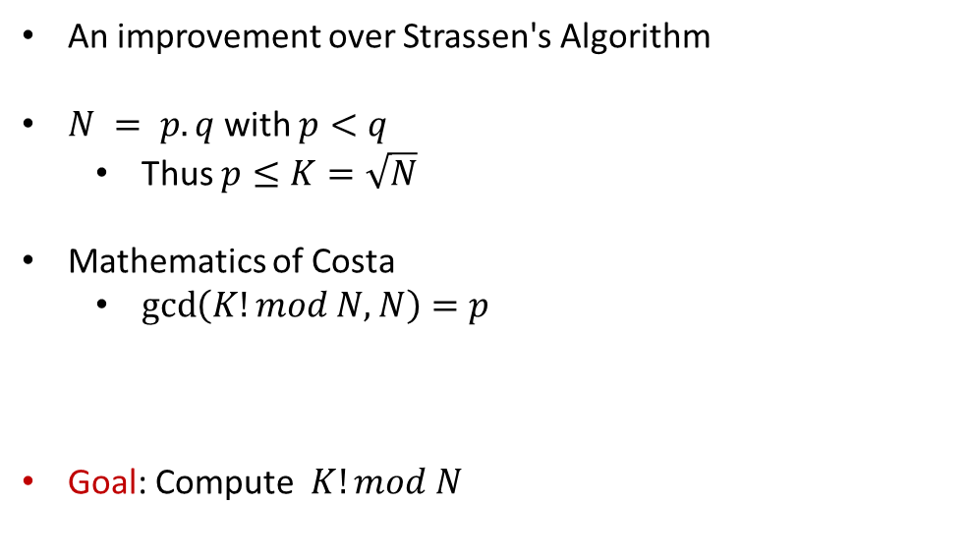
Costa’s Algorithm
An improvement over Strassen's Algorithm
$N = p.q$with $p<q$
Thus $p≤K=\sqrt{N}$
Mathematics of Costa
$\gcd\left(K!mod N, N\right)=p$
Goal: Compute $K!mod N$

Slide 13
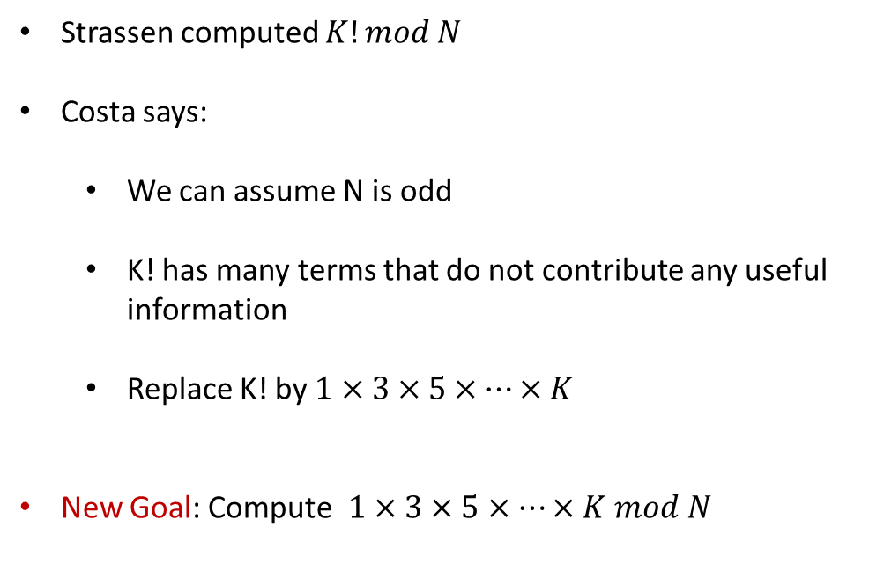
Costa’s Algorithm
Strassen computed $K!mod N$
Costa says:
We can assume N is odd
K! has many terms that do not contribute any useful information
Replace K! by $1×3×5×…×K$
New Goal: Compute$1×3×5×…×K mod N$

Slide 14
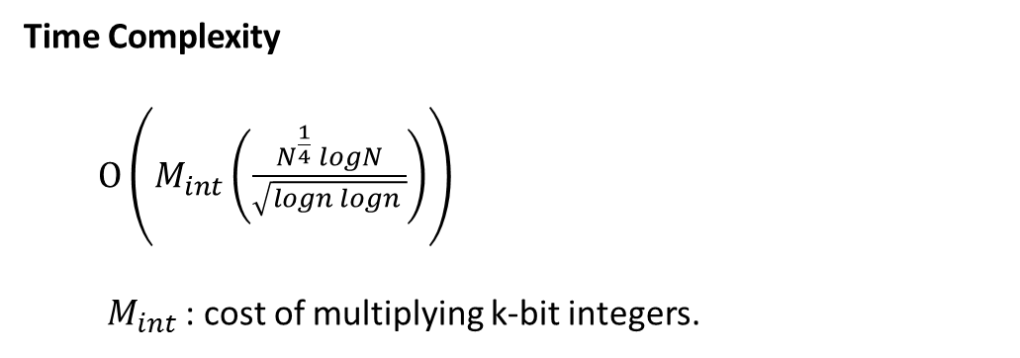
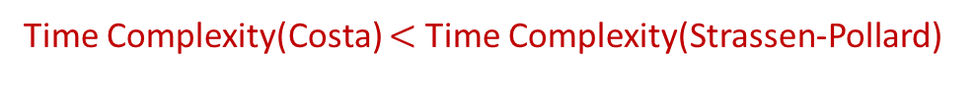
Costa’s Algorithm
Time Complexity
$O\left(M_{int}\left(\frac{N^{\frac{1}{4}} logN}{\sqrt{logn logn }}\right)\right)$
$M_{int}$ : cost of multiplying k-bit integers.
Time Complexity(Costa) $<$ Time Complexity(Strassen-Pollard)

Slide 15
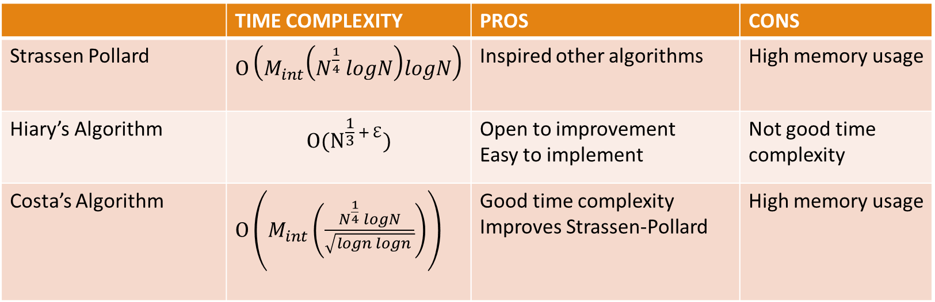
Table of Three Algorithms
 | TIME COMPLEXITY | PROS | CONS
Strassen Pollard | $O\left(M_{int}\left(N^{\frac{1}{4}} logN\right)logN\right)$ | Inspired other algorithms | High memory usage, Probabilistic
Hiary’s Algorithm | $$O(N^{\frac{1}{3} + ℇ})$$ | Open to improvement Easy to implement Not probabilistic | Not good time complexity,
Costa’s Algorithm | $O\left(M_{int}\left(\frac{N^{\frac{1}{4}} logN}{\sqrt{logn logn }}\right)\right)$ | Good time complexity Improves Strassen-Pollard | High memory usage, Probabilistic

Slide 16
Bibliography
[1] Edgar Costa and David Harvey. Faster deterministic integer factorization. arXiv:1201.2116, 2011.
[2] Ghaith A. Hiary. A deterministic algorithm for integer factorization. Integers 13 (2013), Paper No. A12, 20. MR 3083474, 2014.
[3] Nidhi Lal, Anurag Prakash Singh, and Shishupal Kumar. Modified trial division algorithm using knj-factorization method to factorize rsa public key encryption. Wireless Communication and Computing, Indian institute of Information Technology, 2015.

Slide 17
QUESTIONS ???

