Slide 1
Pattern Analysis and Machine Intelligence
Deep Learning for Ship Detection
Hesam Ghavami, Iurri Mozzhorin, Hevin Özmen
Frankfurt, October 2, 2018
Goethe-Universität Frankfurt am Main
Practice Module: Pattern Analysis and Machine Intelligence
Summer Semester2018
Betreuer: Dr. Kai Schubert
Professor: Prof. Ramesh

Slide 2
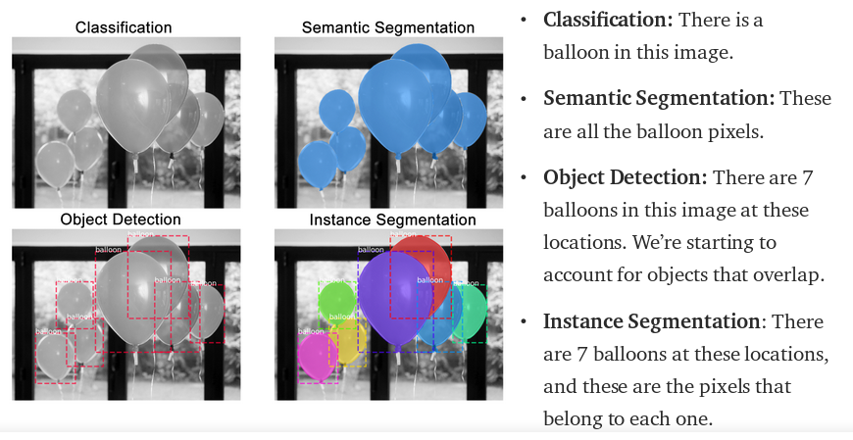
Mask R-CNN Introduction

Slide 3
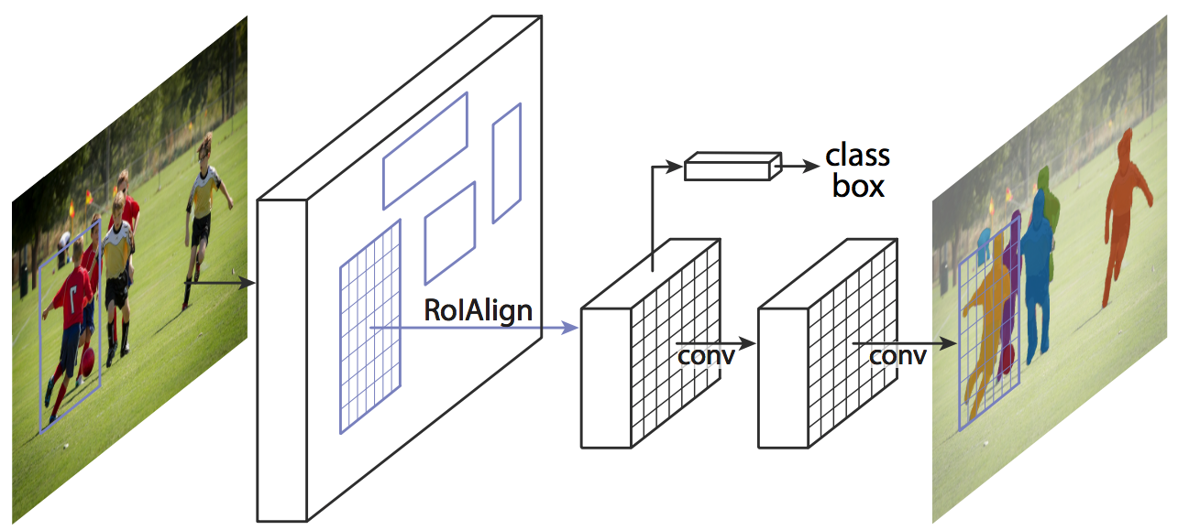
Mask R-CNN Introduction
Mask R-CNN (Region-based Convolutional Neural Network) is a two stage framework which was introduced by Kaiming et al., 2017:
The first stage scans the image and generates proposals
The second stage classifies the proposals and generates bounding boxes and masks.
Pattern Analysis and Machine Intelligence Practice – Summer Semester 2018

Slide 4
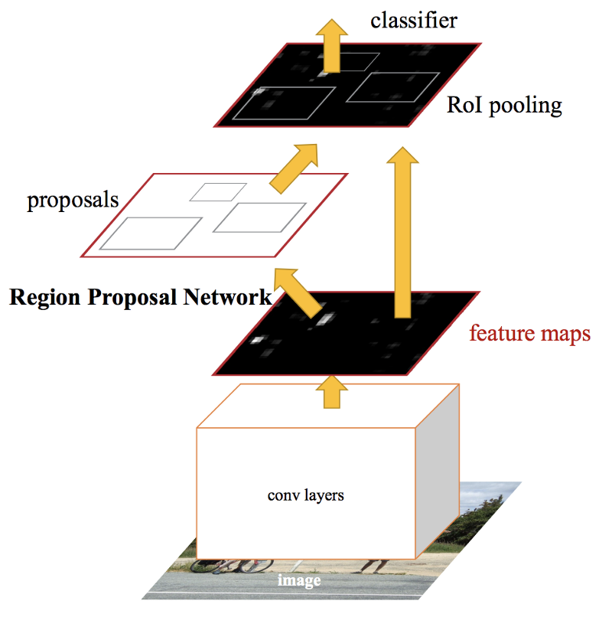
Mask R-CNN Introduction – Just an extended Faster R-CNN
Faster R-CNN Framework
Pattern Analysis and Machine Intelligence Practice – Summer Semester 2018

Slide 5
Mask R-CNN Implementation
The implementation of the framework is provided by Abdulla W. from Engineering Matterport over his Github:
https://github.com/matterport/Mask_RCNN
Pattern Analysis and Machine Intelligence Practice – Summer Semester 2018

Slide 6
Mask R-CNN Components
Backbone This is a standard convolutional neural network ResNet50 or ResNet101 that serves as a feature extractor. The type of network can be configured in code.
Region Proposal Network (RPN) which uses to sliding-window method to generate the Region of Interests or RoIs. Each region has many anchors, each anchor has a class (BG/FG) and Bounding Box Refinement
ROI Classifier which runs over RoIs from last layer and generates two outputs. Class which can classifies objects like car, tree, balloon or ship, Bounding Box Refinement
ROI Pooling: because of the bounding box refinement, the RoIs become boxes with different sizes. RoI pooling helps to resize them to a fix size
Segmentation Masks this makes this framework distinguishable from Faster R-CNN and generates a binary mask in parallel to bounding box of the object
Pattern Analysis and Machine Intelligence Practice – Summer Semester 2018

Slide 7
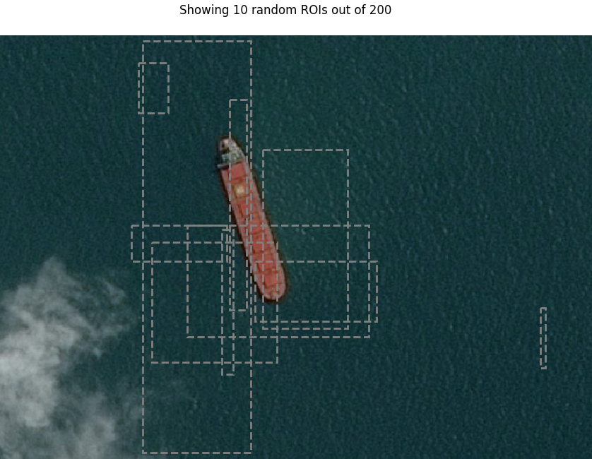
Mask R-CNN Components - RoIs
Pattern Analysis and Machine Intelligence Practice – Summer Semester 2018

Slide 8
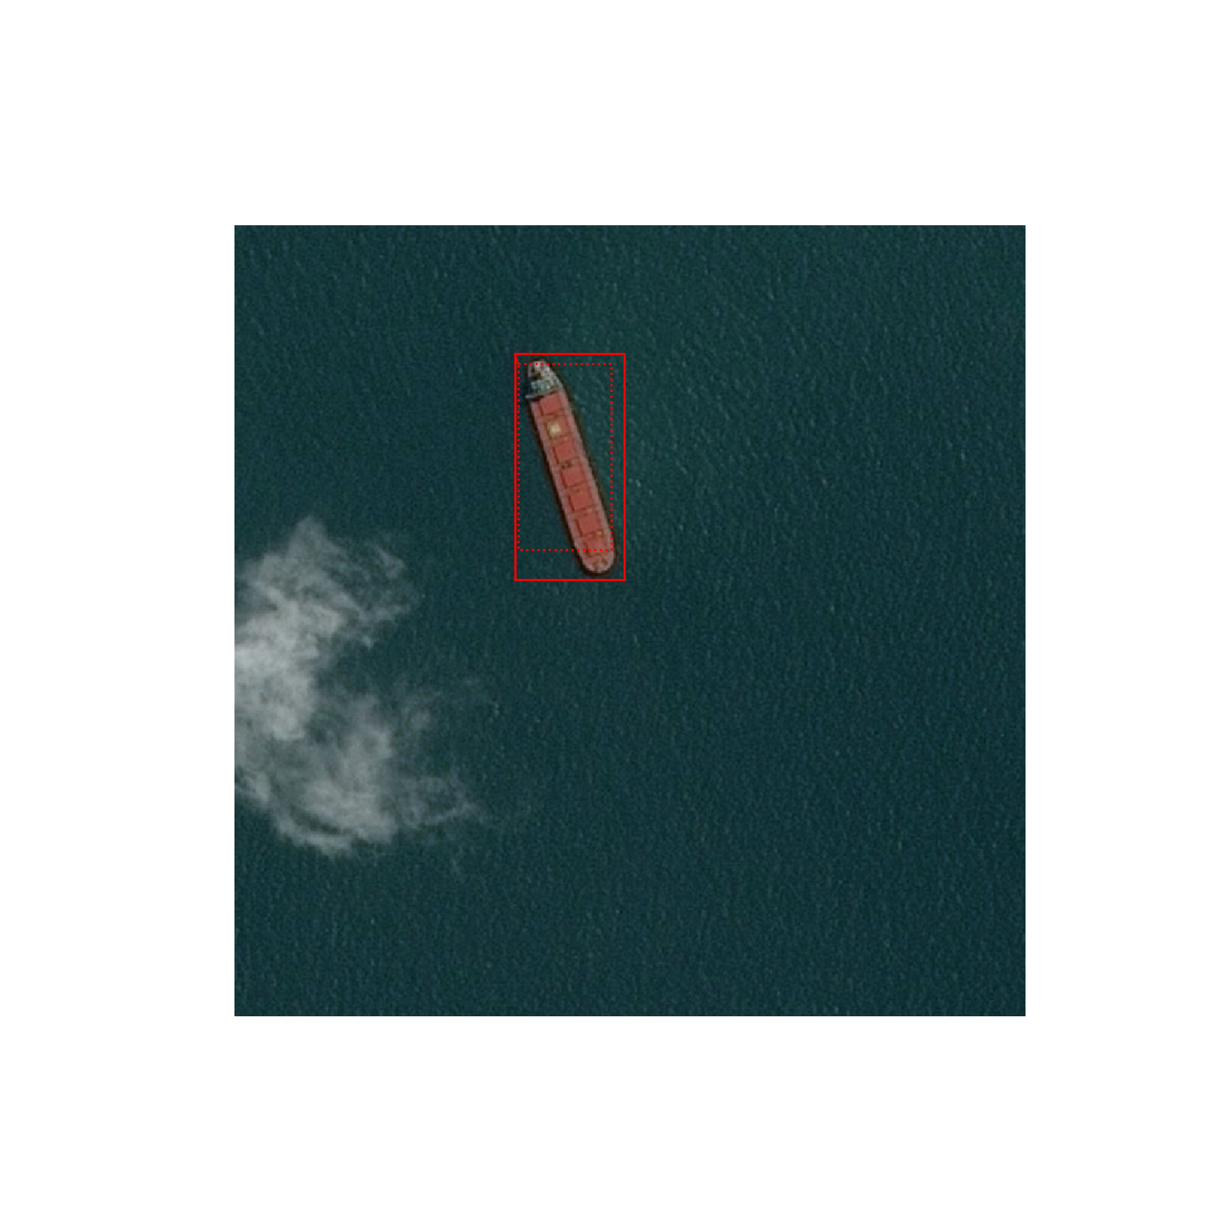
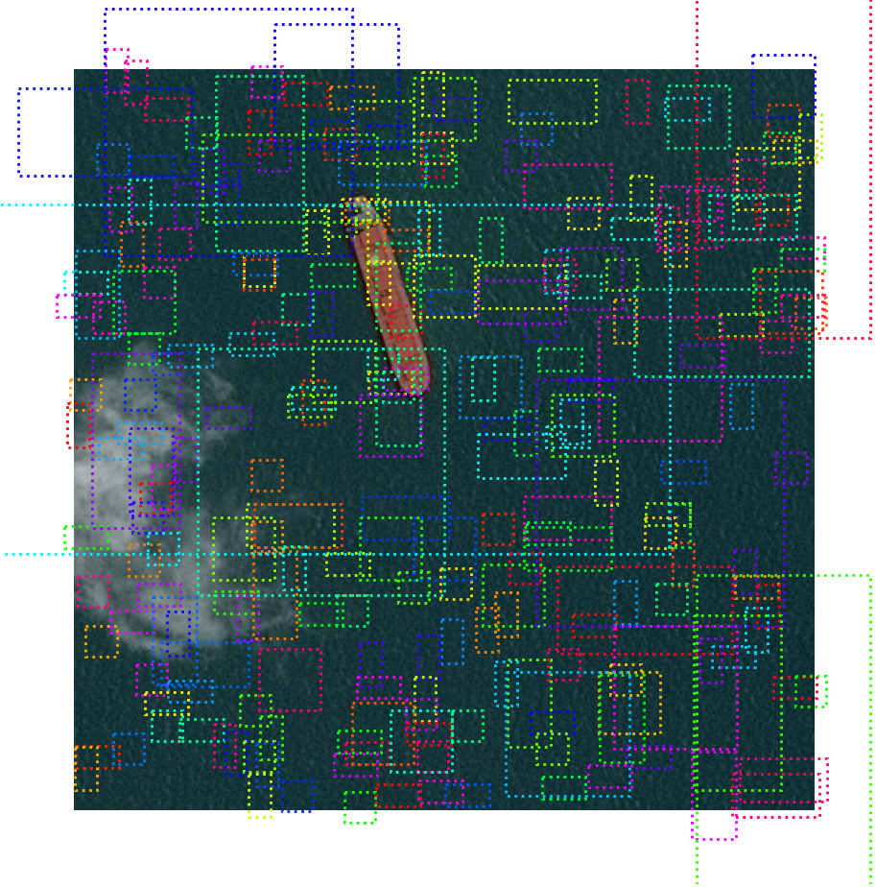
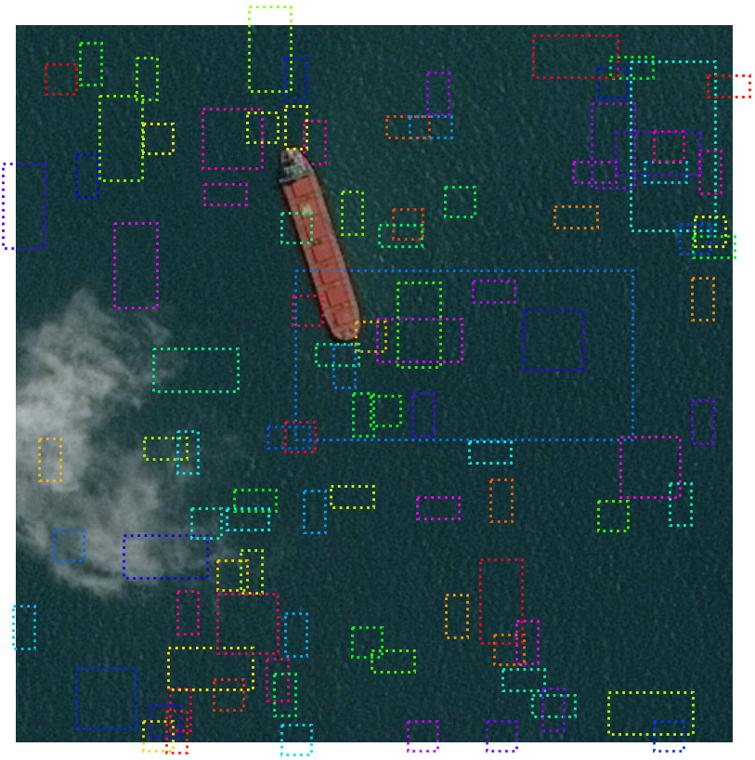
Mask R-CNN Components
Pattern Analysis and Machine Intelligence Practice – Summer Semester 2018

Slide 9
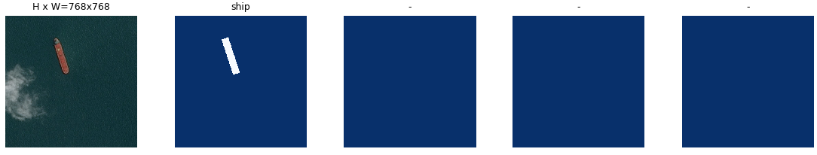
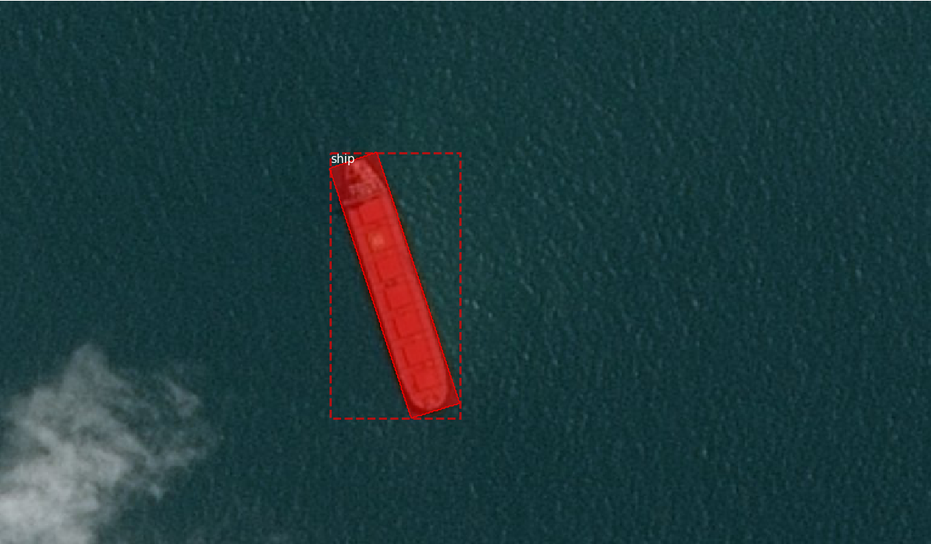
Mask R-CNN Components – Output Mask and Bounding Box
Pattern Analysis and Machine Intelligence Practice – Summer Semester 2018

Slide 10
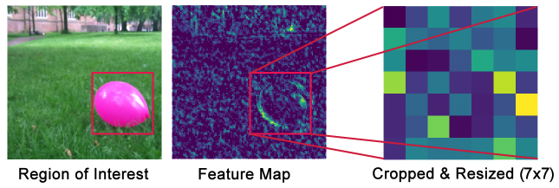
Mask R-CNN Components – RoI Pooling
Pattern Analysis and Machine Intelligence Practice – Summer Semester 2018

Slide 11
Mask R-CNN Training
The complete network with all of its layer which is configurable
30 Epochs and 1000 Steps per Epoch
Batch size 1 or 1 image per GPU due to size of the images(768x768)
Tranfer Learning weights of pre-trained model on MS-COCO dataset
Training Data: 104070 Satellite images
Divided into
Train data: 90% or 93663 images
Evalutaion data: 10% or 10407 images
Computer Specs:
CPU: Intel 4 Cores 4.4 GHz (Hyper-Threading enabled)
GPU: Nvidia GTX 1080 ti with 11 GB Video Memory
RAM: DDR3 16 GB 2400 MHz
Training Duration: 4 Hours 37 Minutes
Pattern Analysis and Machine Intelligence Practice – Summer Semester 2018

Slide 12
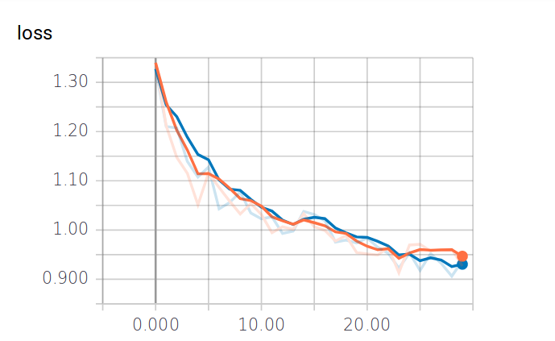
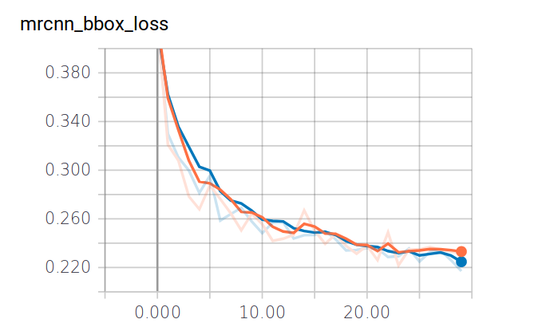
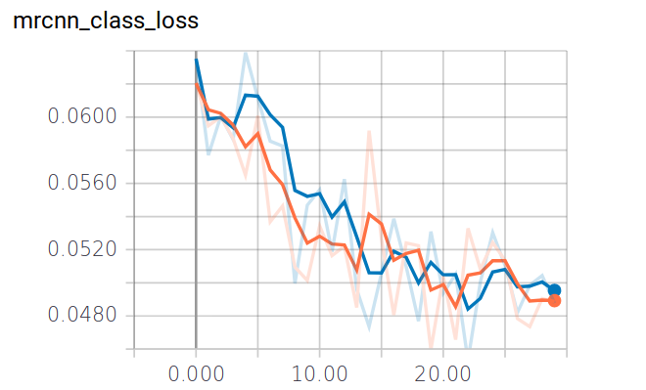
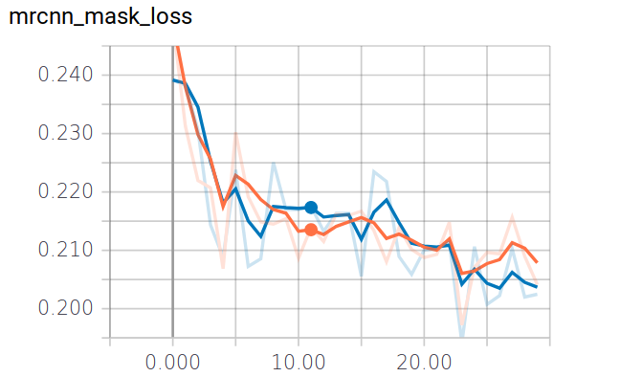
Mask R-CNN Training
Pattern Analysis and Machine Intelligence Practice – Summer Semester 2018

Slide 13
Mask R-CNN Detection & Evaluation
Evaluation without Pre-Classification
Test data: 88500 Satellite images
Detection Duration: 7 Hours 20 Minutes or 26400 Seconds
Evaluation with Pre-Classification
Test data: 53749 images (61%)
Detection Duration: 4 Hours 28 Minutes or 16104 Seconds
Pattern Analysis and Machine Intelligence Practice – Summer Semester 2018

Slide 14
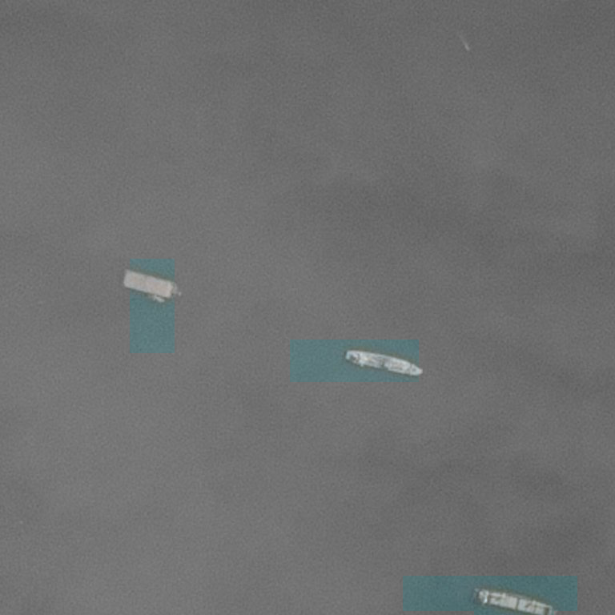
Mask R-CNN Detection Examples
Pattern Analysis and Machine Intelligence Practice – Summer Semester 2018

Slide 15
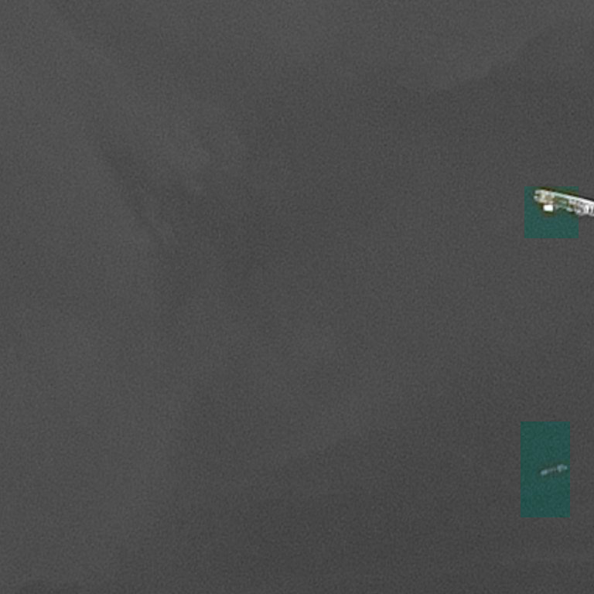
Mask R-CNN Detection Examples
Pattern Analysis and Machine Intelligence Practice – Summer Semester 2018

Slide 16
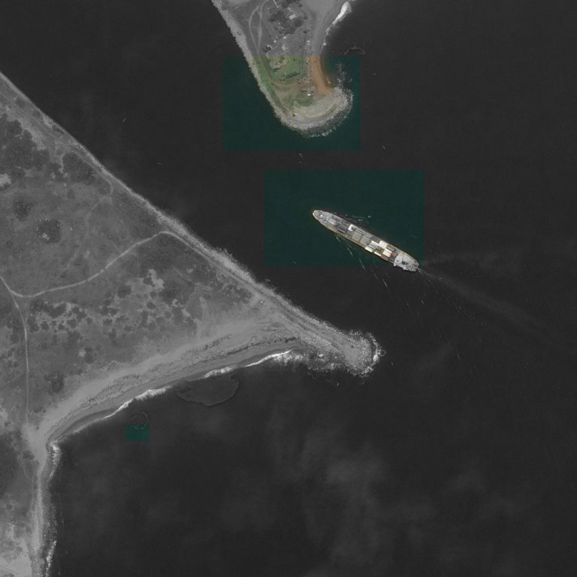
Mask R-CNN Detection Examples
Pattern Analysis and Machine Intelligence Practice – Summer Semester 2018

Slide 17
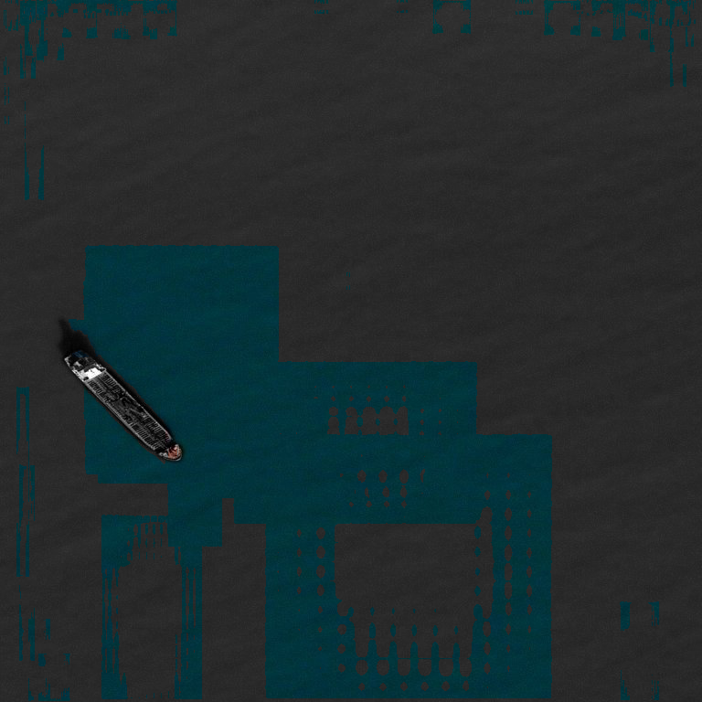
Mask R-CNN Components
Pattern Analysis and Machine Intelligence Practice – Summer Semester 2018

Slide 18
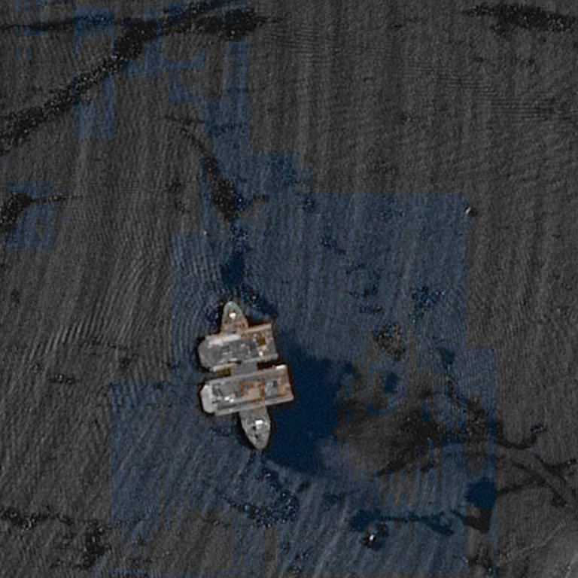
Mask R-CNN Detection Examples
Pattern Analysis and Machine Intelligence Practice – Summer Semester 2018

Slide 19
Mask R-CNN
Sincere thanks for your attention and patience
Pattern Analysis and Machine Intelligence Practice – Summer Semester 2018

Slide 20
Mask R-CNN Bibliography
Kaiming He, Georgia Gkioxari, Piotr Dollár, and Ross B. Girshick. Mask R-CNN. CoRR, abs/1703.06870, 2017.
Waleed Abdulla. Mask r-cnn for object detection and instance segmentation on keras and tensorflow. https://github.com/matterport/Mask_RCNN, 2017.
Shaoqing Ren, Kaiming He, Ross B. Girshick, and Jian Sun. Faster R-CNN: towards real-time object detection with region proposal networks. CoRR, abs/1506.01497, 2015.
K.V. Kale, S.C. Mehrotra, R.R. Manza, and R.R. Manza. Computer Vision and
Information Technology: Advances and Applications. I.K. International Publishing House Pvt. Limited, 2010.
Pattern Analysis and Machine Intelligence Practice – Summer Semester 2018

