Slide 1
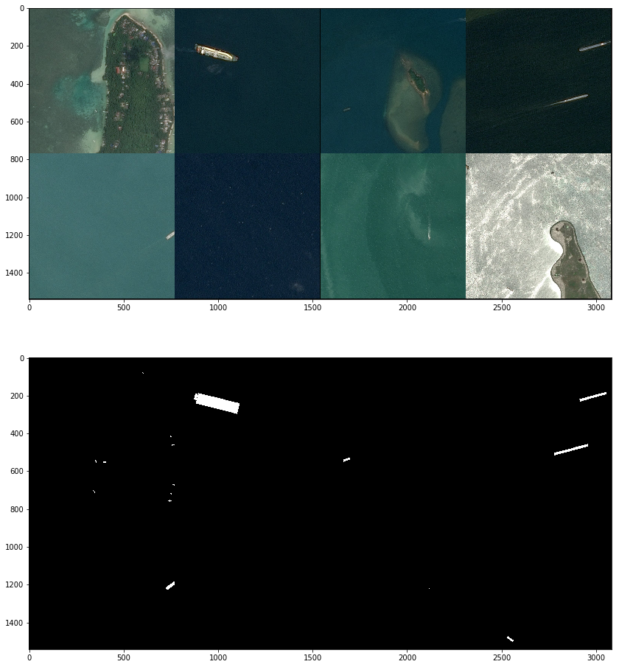
Data understanding
Resolution: 768x768 px.
Images contain:
clouds,
haze,
wakes behind the ship,
coastal areas,
docks,
marinas,
reflections,
waves,
other floating objects,
image cutting artifacts
No location or time data.
No overlapping (False).

Slide 2
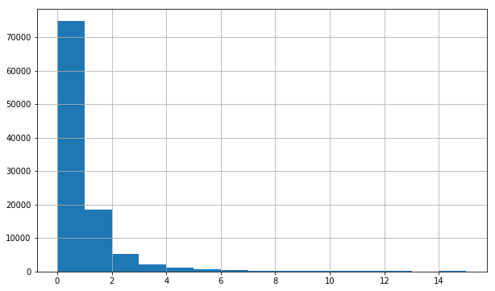
Data understanding
 | # Images | # Ships | Contain ships
Train | 104,700 | 131,030 | 39%
Test | 88,486 | 25,693 | 29%
*15 corrupted images
Number of ships on non-empty images

Slide 3
Methodology
Models:
Preclassification
CNN
Cascade classifier (HAAR, LBP)
Localization
U-net
Mask R-CNN

Slide 4
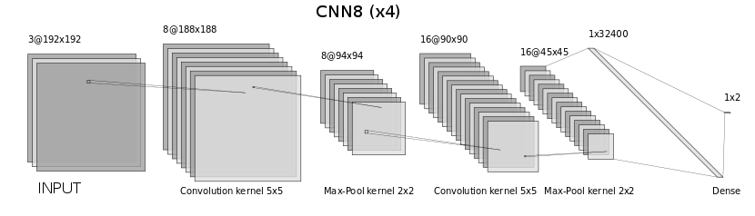
Preclassification
CNN models (two convolution layers):
8 & 16 features (CNN8)
32 & 64 features (CNN32)
Cross-entropy loss function
Stochastic gradient descent optimizer
Learning rate 0.001
Momentum 0.9
Weight decay 0.0005

Slide 5
Preclassification
Data preparation:
resize
augmentation
drop small (<40 Kb) and corrupted images
reserve 10% of train data for validating
Resize factor:
x2 (384x384 px)
x4 (192x192 px)
x8 (96x96 px)
Data balancing:
not balanced (100% empty images)
balanced (30% empty images)

Slide 6
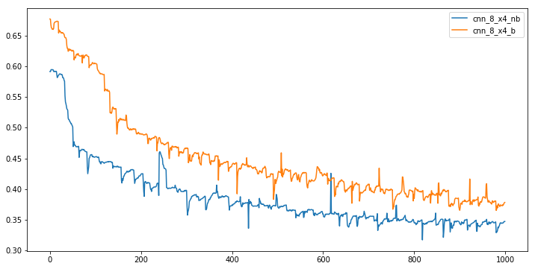
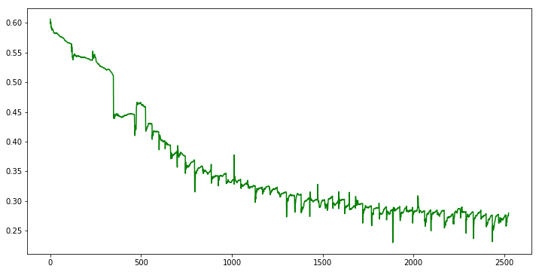
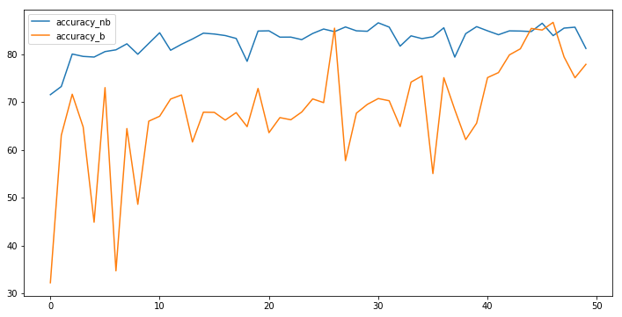
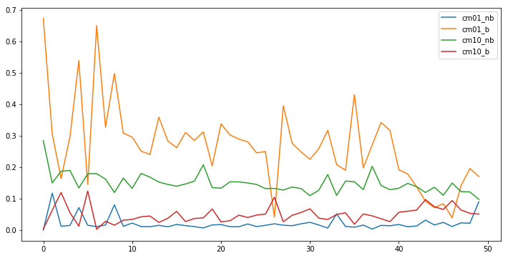
Training
Loss function (cross-entropy)
CNN8 (b/nb) CNN32 (nb)
Accuracy (CNN8) Errors (CNN8)

Slide 7
Confusion matrices
Predicted |  | CNN8_nb | CNN8_b | CNN32_nb
 |  | 0 | 1 | 0 | 1 | 0 | 1
True | 0 | 0.62 | 0.09 | 0.54 | 0.17 | 0.69 | 0.02
1 | 0.10 | 0.19 | 0.05 | 0.23 | 0.11 | 0.17

Slide 8
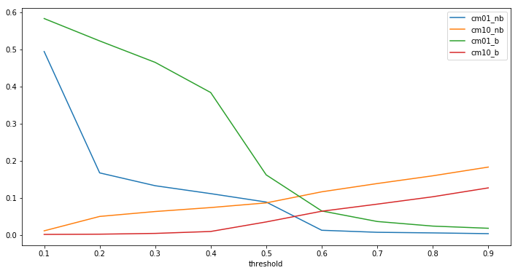
Softmax threshold

Slide 9
Predictions (CNN8_b x2)
Threshold | Ships are lost | Rejected images | Performance improvement
0.4 | 5% | 35% | x 1.53
0.5 | 12% | 60% | x 2.5
Test hardware specification (AWS p2.xlarge):
4 Core CPU (Intel Xeon E5‑2686 v4 Broadwell)
61 GB RAM
1 GPU (NVIDIA K80 with 2496 cores and 12 GB memory)
Run time:
9:25 (m:s)

