Slide 1
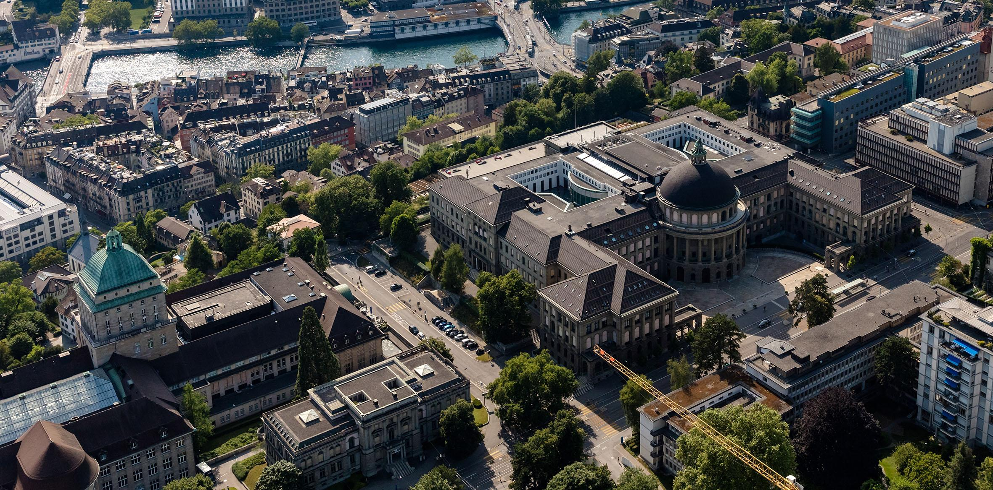
Efficient Execution of Transformers in RISC-V Vector Machines with Custom HW Acceleration
Integrated Systems Laboratory
Students: Xiaorui Yin
Advisors: Matteo Perotti, Victor Jung, Renzo Andri
Prof. Dr. Luca Benini

Slide 2

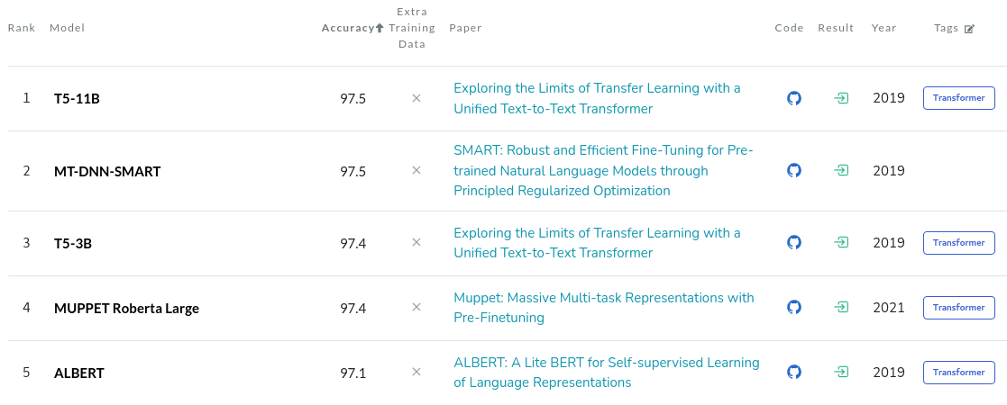
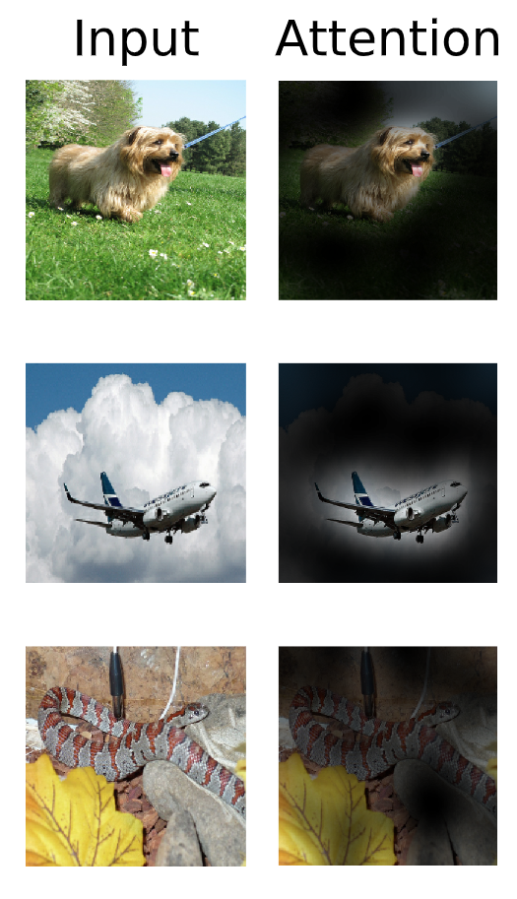
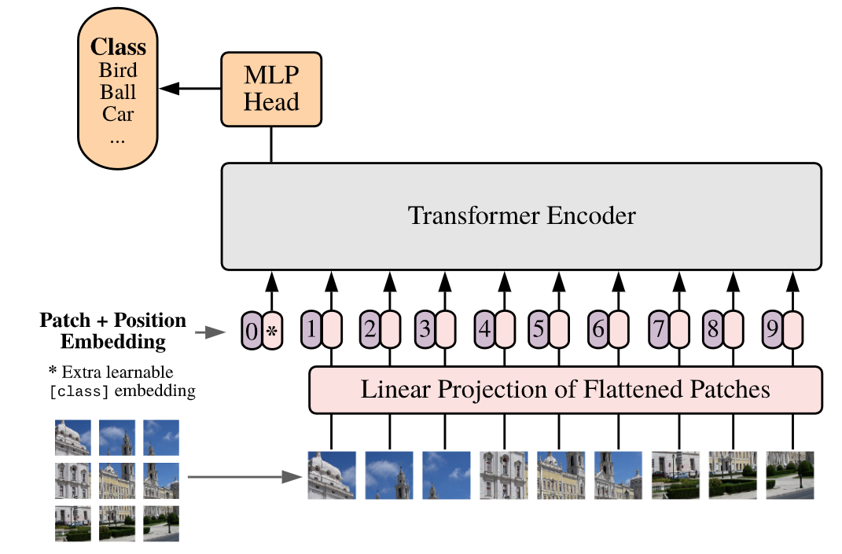
Transformer is Everywhere
1. From Natural Language Processing
2. To Images Processing
1. PaperWithCode 2. by Jim Clyde Monge (https://medium.com/geekculture/openai-released-chatgpt-an-incredibly-smart-chatbot-889b59968383)
3. 4. ViT paper
Notes:
简要介绍transformer的重要性，举例如ChatGPT

Slide 3
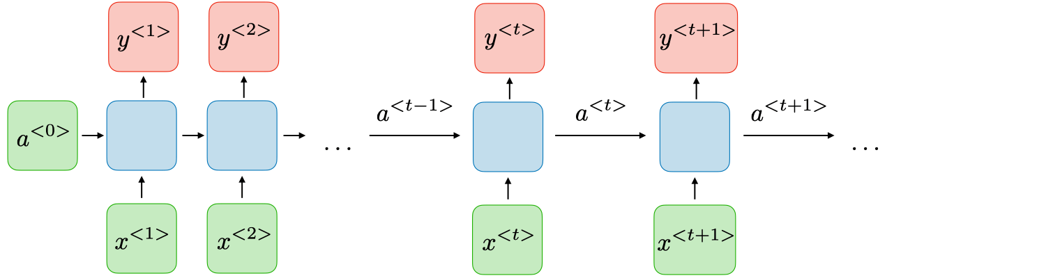
RNN vs Transformers
RNN: y<t> depends on a<0>, …, a<t-1>
Vanishing gradient (chain rule)
Example:
I am a student at ETH. (Cryptocurrency ?)
Struggle to extract long-term dependencies
Slow inference & training
Transformers: all tokens are equidistant
Parallel processing
Effectively handle long-term dependencies
Add positional encoding to the input tokens

Slide 4
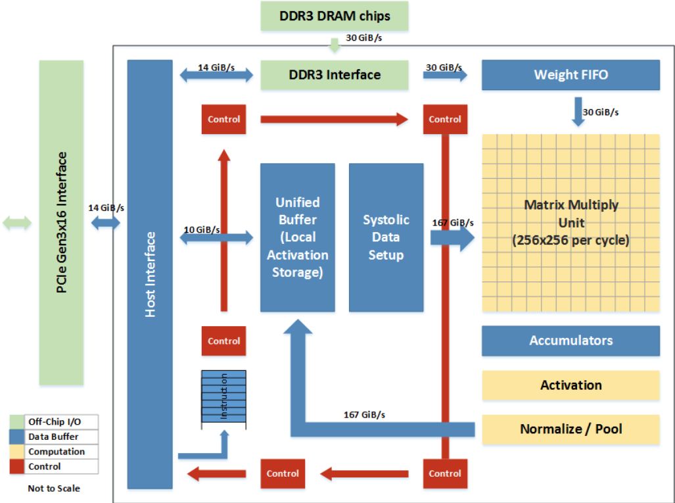
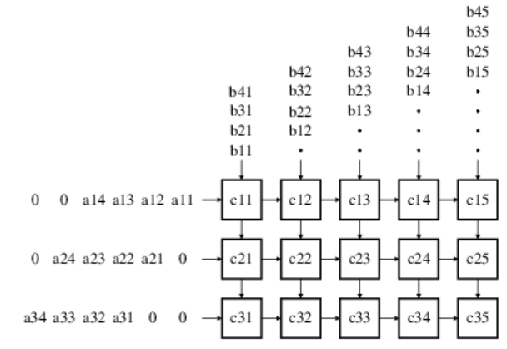
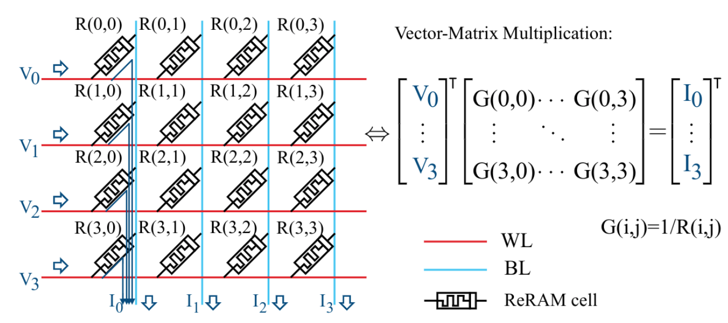
Transformer Accelerator
Specialized Accelerators
Best performance for a specific task/model
Lack of flexibility
DNNs evolve rapidly!!!
Vector Processor
General-purpose, easy programmable
Parallel computing, SIMD
Popular in supercomputing
Ara: RISC-V Vector Extension 1.0
Systolic Array
Reuse data across one row/column
Goal:
Explore the capabilities and challenges of vector processors in running the transformer model
Optimize performance from both hardware and software aspects
Memristor Crossbar Array
Kirchhoff’s Current Law
1. TPU 2. Chapter 16. Systolic Systems (https://gyires.inf.unideb.hu/KMITT/a52/ch04.html)
Notes:
Motivation：尽管有专用的加速器，但他们缺乏灵活性，我们想试试用通用处理器来加速transformer会有什么效果，困难，已经寻找可能的解决办法

Slide 5
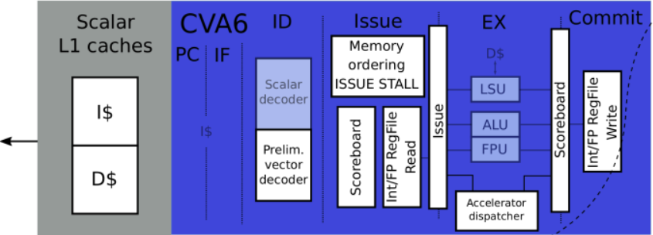
Vector Processor Ara
Scalar Core:
Send vector instructions to the vector unit
Notes:
一个简短的向量处理器以及Ara的介绍

Slide 6
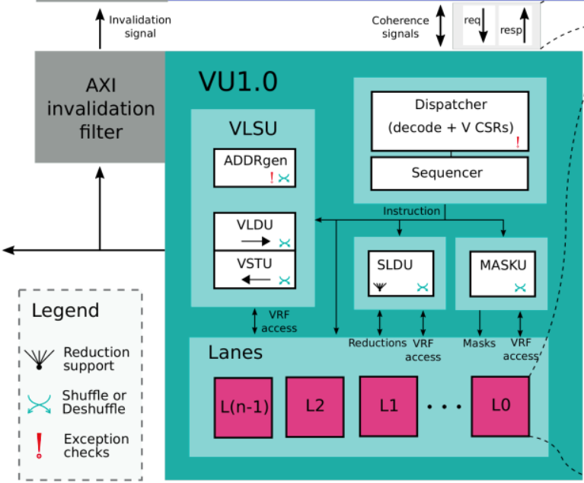
Vector Processor Ara
Dispatcher & Sequencer:
Decoding, CSRs, Hazard, Issue
Notes:
一个简短的向量处理器以及Ara的介绍

Slide 7
Vector Processor Ara
VLSU:
memory ←→VRF
Notes:
一个简短的向量处理器以及Ara的介绍

Slide 8
Vector Processor Ara
SLDU & MASKU:
vector permutation & mask manipulation
Notes:
一个简短的向量处理器以及Ara的介绍

Slide 9
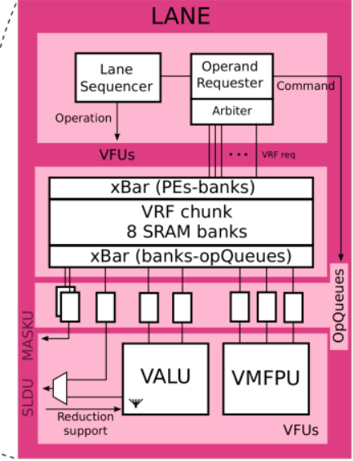
Vector Processor Ara
VRF:
Store a portion of the vector
Notes:
一个简短的向量处理器以及Ara的介绍

Slide 10
Vector Processor Ara
Integer and Floating-Point Processing Units
Notes:
一个简短的向量处理器以及Ara的介绍

Slide 11
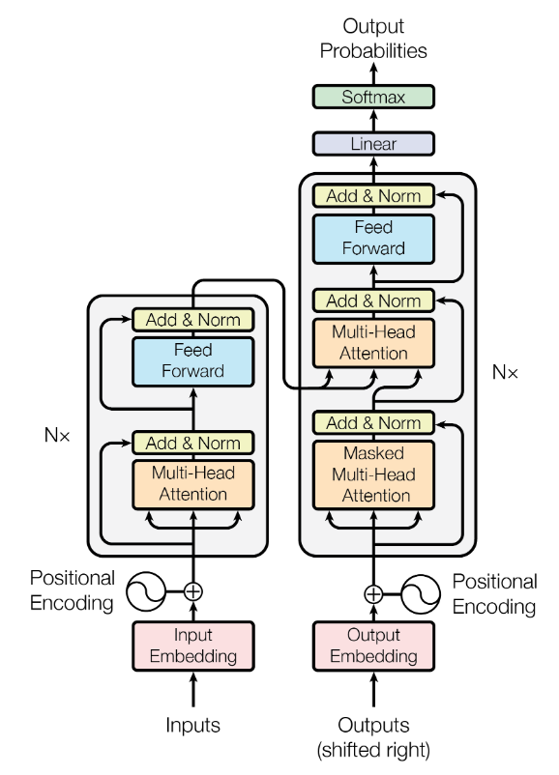
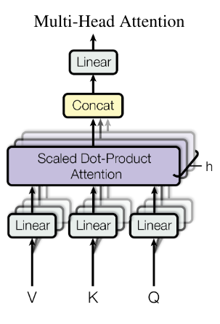
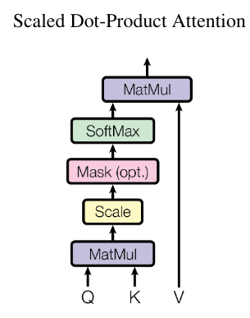
Transformer’s Architecture
Benchmark
Notes:
Transformer模型结构大致的介绍

Slide 12
Transformer Vectorization: Multihead Attention
weight matrices (d_model x d_model)
768x768
Q, K, V (n x d_model)
64x768
weight matrix (d_model x d_model)
768x768
Q
Wo
Wq
MatMul
Bias
h
Output to Feed Forward (n x d_model)
64x768
input tokens or output from the previous layer (n x d_model)
64x768
Self-Attention
Self-Attention
K^T
Self-Attention
MatMul
Bias
Residual
Wk
MatMul
Bias
Transpose
Self-Attention
Dropout
LayerNorm
y
x
n * d_model * d_model MAC
2 * n * d_model ADD
MatMul
Bias
Wv
V
Dropout: n * d_model Op
LayerNorm: 7 * n * d_model + 4 * n Op
n * d_model * d_model MAC
n * d_model ADD
Another Option (Multicore System):
Split Wq/Wk/Wv, calculate Q(i), K(i), V(i) of each head individually

Slide 13
Transformer Vectorization: Multihead Attention
weight matrices (d_model x d_model)
768x768
Q, K, V (n x d_model)
64x768
weight matrix (d_model x d_model)
768x768
Q
Wo
Wq
MatMul
Bias
h
Output to Feed Forward (n x d_model)
64x768
input tokens or output from the previous layer (n x d_model)
64x768
Self-Attention
Self-Attention
K^T
Self-Attention
MatMul
Bias
Residual
Wk
MatMul
Bias
Transpose
Self-Attention
Dropout
LayerNorm
y
x
n * d_model * d_model MAC
2 * n * d_model ADD
MatMul
Bias
Wv
V
Dropout: n * d_model Op
LayerNorm: 7 * n * d_model + 4 * n Op
n * d_model * d_model MAC
n * d_model ADD
Q(i)
S (n x n)
64x64
MatMul
Softmax
S
self-attention (n x dk)
64x64
Q, K, V (n x dk)
64x64
n * dk * n MAC
n * n * 91 Op
K(i)^T
MatMul
SA(i)
V(i)
n * n* dk MAC

Slide 14
Transformer Vectorization: Feed Forward
Weight matrix 1 (d_model x d_ff)
768x3072
Weight matrix 2 (d_ff x d_model)
3072x768
W1
W2
Temp matrix (n x d_ff)
64x3072
Output to the next block (n x d_model)
64x768
MatMul
Bias
y’
MatMul
Bias
Residual
ReLU
Dropout
LayerNorm
O
output of Multihead Attention (n x d_model)
64x768
n * d_model * d_ff MAC
n * d_ff ADD
n * d_ff Op
n * d_model * d_ff MAC
2 * n * d_model ADD
Dropout: n * d_model Op
LayerNorm: 7 * n * d_model + 4 * n Op
y

Slide 15
Transformer Vectorization: Individual Kernels
Dropout & ReLU:
Softmax & LayerNorm:

Slide 16
Runtime Distribution
Transformer
Multihead Attention
Feed Forward
35.5%
64.5%
63,176,959 clock cycles
MatMul
Self-Attention x 12
MatMul
Multihead Attention
Feed Forward
89.6%
8.0%
98.4%
LayerNorm+Dropout 2.4%
LayerNorm+ReLU+Dropout 1.6%
MatMul > 95%
MatMul
Softmax
Self-Attention
60%
40%

Slide 17
Notes:
Feed Forward

Slide 18
Notes:
Low utilization of softmax and layernorm, small matmul, matmul if qkv for each head

Slide 19
Notes:
Transpose the matrix

Slide 20
Notes:
接上

Slide 21
Notes:
A new way of executing the MatMul

Slide 22
Notes:
new instructions

Slide 23
Notes:
hardware support 1: bc_buffer

Slide 24
Notes:
hardware support 2: broadcast path

Slide 25
Notes:
hardware support 3: FPU control

Slide 26
Notes:
Floorplan optimization, flat mode

Slide 27
Notes:
Performance Improvement 1 Each kernel
MatMul

Slide 28
Notes:
Performance Improvement 2 QKV

Slide 29
Notes:
Power Estimation Transformer FLOPS/W different MatMul

Slide 30
Notes:
Backend TC: 1GHz, WC: Area

Slide 31
Notes:
Conclusion Future Work

