Slide 1

SSVEP BCI System in MATLAB
The BCI with SSVEPs we used for the Neurovision Hackathon
A Quick Overview & Where we are at

Slide 2
Overview
1. What does it look like?
2. What The System Does
How does it do it?
Potential Optimisations
3. Project Structure
Folder Layout Key Entry Points
4. How to Run
5. Frequency Change: Why 15/20 Hz
6. Known Issues & Next Steps

Slide 3
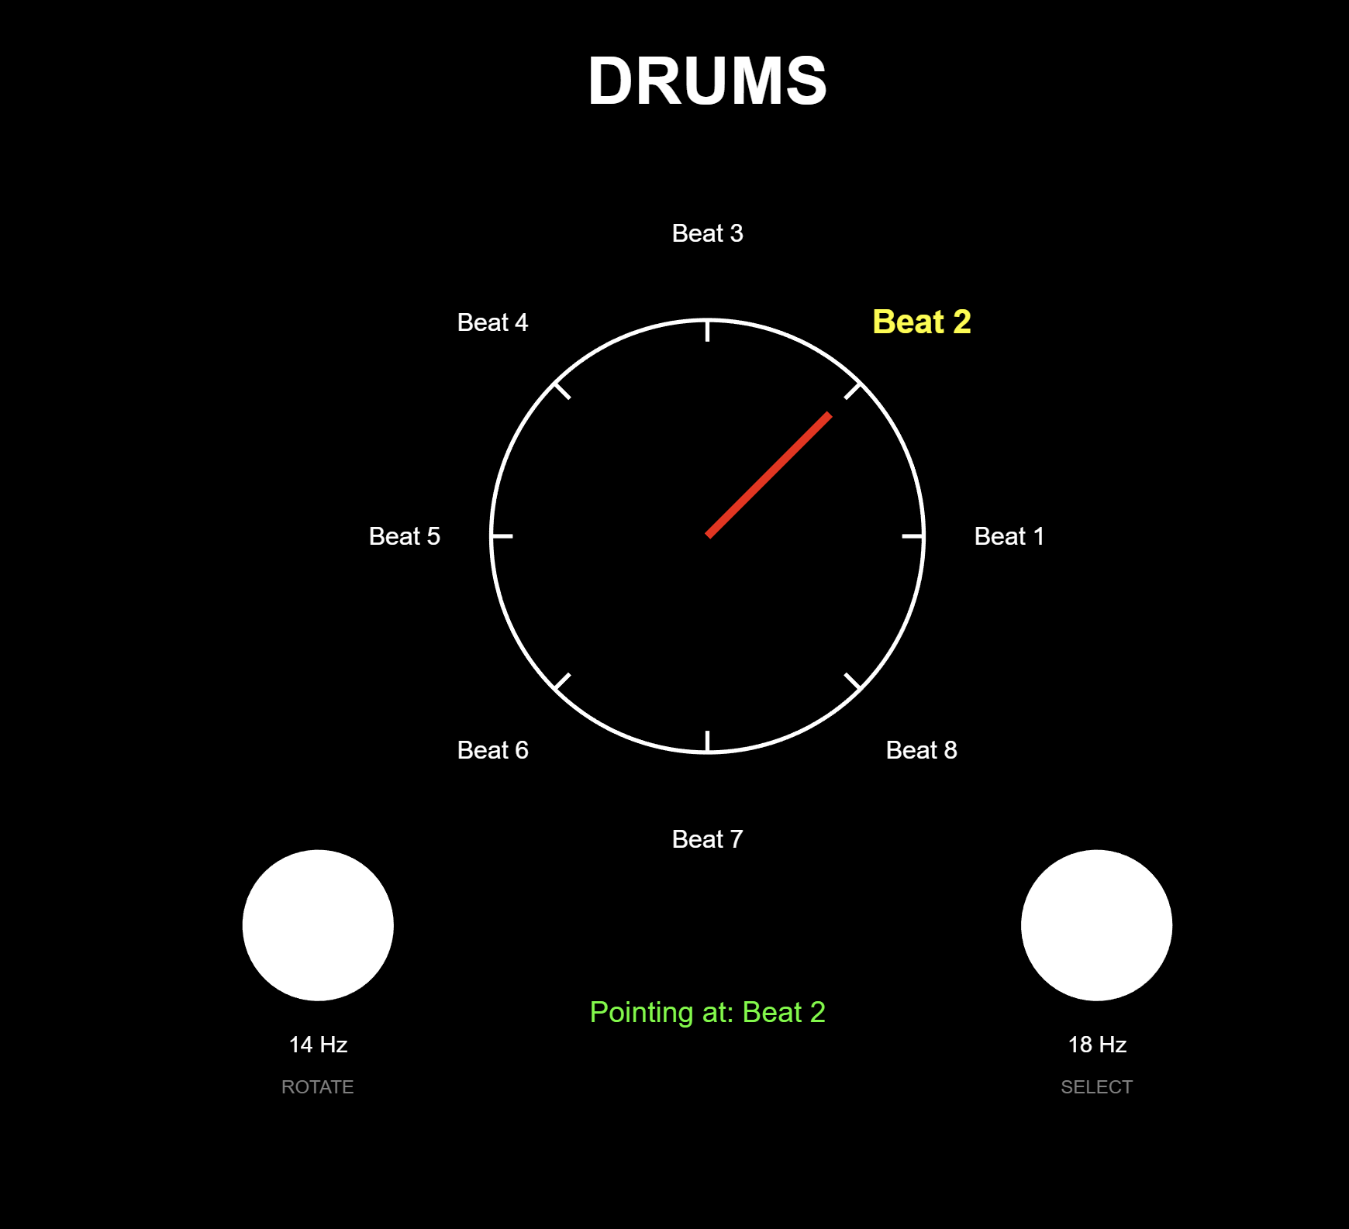
What Does it Look Like When it is run?
Example presentation of our BCI
I’ll show the live version after I’m done here

Slide 4
What This System Does
A Real-Time BCI That lets Users Control on-screen Elements by Looking at Flickering Visual Stimuli.
PsychToolbox presents two flickers (15 Hz & 20 Hz).
Unicorn interface records EEG from dry channels.
Visual evoked potentials from attending to either stimuli creates EEG signals which drives a 'knob' for music instrument selection.
This technique is known as Steady-State Visual Evoked Potentials (SSVEPs)
Our Classifier
To classify the SSVEPs, we use a Support Vector Machine (SVM) in the training phase to classify which stimulus (15 Hz & 20 Hz), the user is attending to.
Notes:
SVM is a machine learning classifier which finds the best "dividing line" (or surface, in higher dimensions) between two groups of data points.
It picks the line that sits as far as possible from the nearest points of each group → those nearest points are the "support vectors.“
If the data isn't cleanly separable with a straight line, it uses a trick (kernel function) to project the data into a higher dimension where a clean split becomes possible.

Slide 5
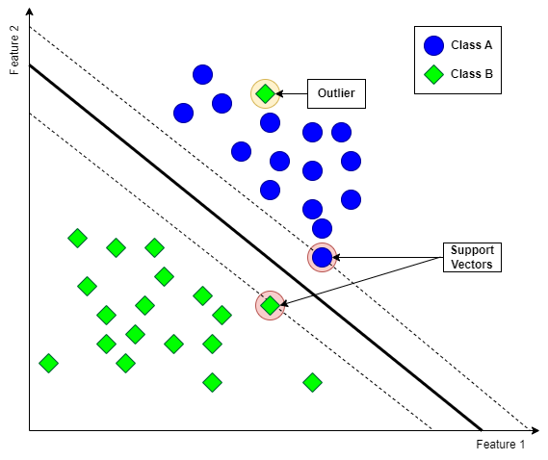
What is SVM?
→ SVM finds the best line which divides between two groups of data points (e.g. 15hz wave & 20hz wave).
→ Picks a line that tries to partition the data so that the gap between the line and the closest data point on either side of the line are as wide as possible.
→ If the data can’t separate cleanly with a straight line it uses a trick (known as a kernel function) to project the data onto a higher dimension where a clean split is possible.
Can we Make Optimisations for our Classifier Model?
Given Finnegan’s expertise we could potentially use PCA to strip out noisy components before it goes into the SVM (or another ML classifier).
Notes:
SVM is a machine learning classifier which finds the best "dividing line" (or surface, in higher dimensions) between two groups of data points.
It picks the line that sits as far as possible from the nearest points of each group → those nearest points are the "support vectors.“
If the data isn't cleanly separable with a straight line, it uses a trick (kernel function) to project the data into a higher dimension where a clean split becomes possible.

Slide 6
Intro to the MATLAB Folder Structure
openBCI_EEG_stream/
Key Entry Points
Python LSL streamers for Cyton & Unicorn headsets
BCI_main.m
openBCI_game/Presentation/
Primary entry point → trains SVM, launches display, classifies
MATLAB: visual stimuli, knob display, game rendering
SSVEP_Display_Fig.m
MATLAB figure-based knob display (no PTB needed)
openBCI_game/Processing/
realtimeEEGClassifier_CSV.m
MATLAB: EEG acquisition, SVM training, classification
CSV-based classifier (no Python/LSL needed)
openBCI_game/SharedFiles/
trainSSVEP_SVM.m
Text files for inter-process communication
Trains linear SVM on 15 Hz vs 20 Hz features
generateSyntheticSSVEP.m
openBCI_game/Libraries/
Auto-generates demo data if CSVs missing
Psychtoolbox, liblsl-Matlab, EEG_Analyses_v3
See also README.

Slide 7
How to Run (MATLAB)
How to run with the synthetic data:
Step 1: cd to the Presentation folder
cd('.../SSVEP_Demo_Sel/SSVEP_Demo_Sel/openBCI_game/Presentation')
Step 2: Run BCI_main
>> BCI_main
Step 3: Watch the demo
SVM trains on synthetic data → knob display opens → classifier drives the pointer
If training CSVs are not found, the script auto-generates 30s of synthetic SSVEP data that I made for presentation purposes. MODE = 'csv' by default, we need to change to 'lsl' for live EEG recording.

Slide 8
Frequency Change: 14/18 Hz → 15/20 Hz
The original system used 14 Hz and 18 Hz stimulus frequencies.
Later we realised that these do not divide evenly into the display’s 120Hz refresh rate, resulting in uneven flicker timing which ↓ signal detection due to uneven visual evoked potentials.
Before (14/18 Hz)
After (15/20 Hz)
• 14 Hz: 120/14 = 8.57 frames/cycle
• 18 Hz: 120/18 = 6.67 frames/cycle
→
• 15 Hz: 120/15 = 8 frames/cycle
• 20 Hz: 120/20 = 6 frames/cycle

Slide 9
Known Issues & What Needs Fixing
Missing Training CSV Files
The original unicorn recorder csvs from Dhruv’s computer, are not on my PC.
→ Regardless of whether I had these csvs, we need to retrain the SSVEP (if we decide to use it) to match 15/20hz instead of 14/18hz which it was originally trained on for signal detection accuracy.
Flicker Timing (MATLAB Figures)
SSVEP_Display_Fig.m uses a ~60 Hz timer which I realise in hindsight was not frame-locked (and also was not matched to the refresh rate of my PC which we did our original demo on).
→ This was fine for our original demo, but realistically it was not precise enough for optimal decoding.

