Slide 1
Investigating the impact and severity of Covid-19 in the UK, while considering the effect of vaccines during the pandemic.
Author: B924007
Module: 22COP511
Notes:
Title

Slide 2
Research Objectives
Investigate the distribution of Covid-19 Cases throughout the UK.
Present a timeline of key Covid-19 stages throughout the pandemic.
Analyse the number of cases and deaths (as well as their spread over time) due to Covid in the UK.
Understand the relationship between Covid cases, deaths, and vaccinations in different UK countries, as well as the UK as a whole.
Identify and visualise any trends or patterns between these parameters (cases, vaccinations, deaths) and between the countries (England, Scotland, Wales, Northern Ireland).
Notes:
Objectives

Slide 3
Justification of data compilation
Data is collected for each country in the UK from Gov.uk, ensuring reliability and accuracy [1].
The timeline for Covid-19’s key events is compiled from online sources [2].
The following data has been obtained:
Cases data by date for all countries in the UK.
Death data by date for all countries in the UK.
Vaccination data by date for all countries in the UK.
This collection of 12 datasets has been compiled as it will sufficiently answer the research question.
Notes:
Justification of data compilation

Slide 4
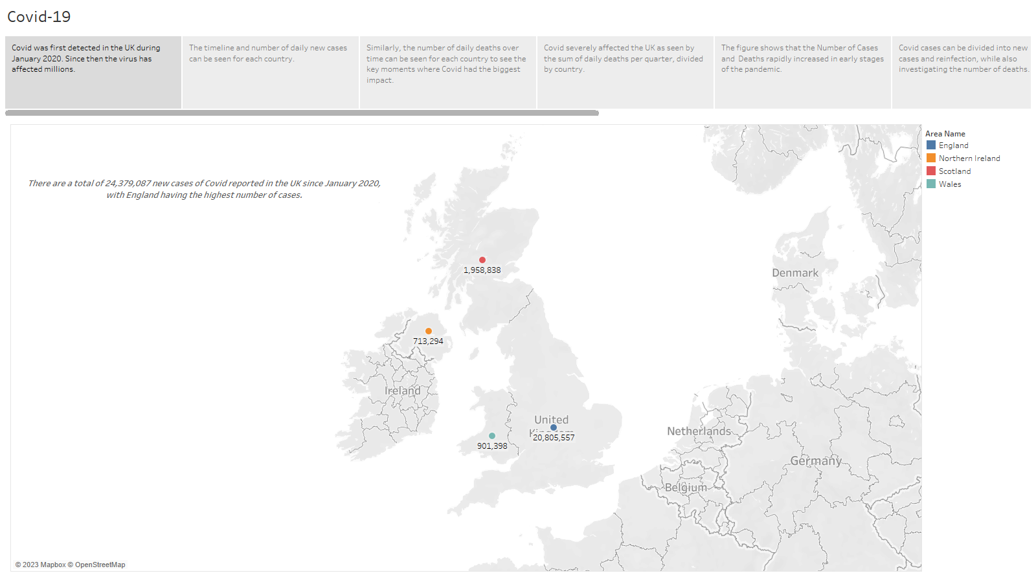
Notes:
Dataset Statistics/Analytics and Visualisations of findings

Slide 5
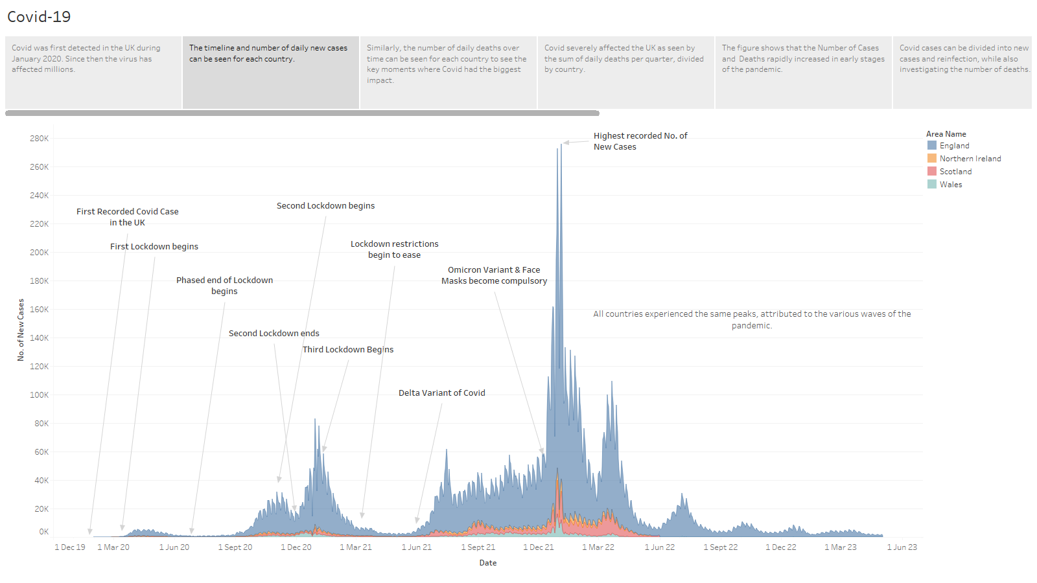
Notes:
Dataset Statistics/Analytics and Visualisations of findings

Slide 6
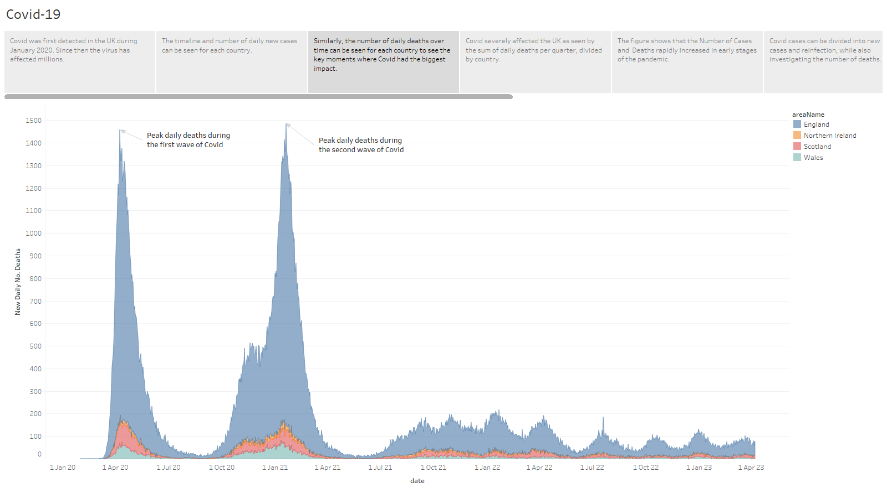
Notes:
Dataset Statistics/Analytics and Visualisations of findings

Slide 7
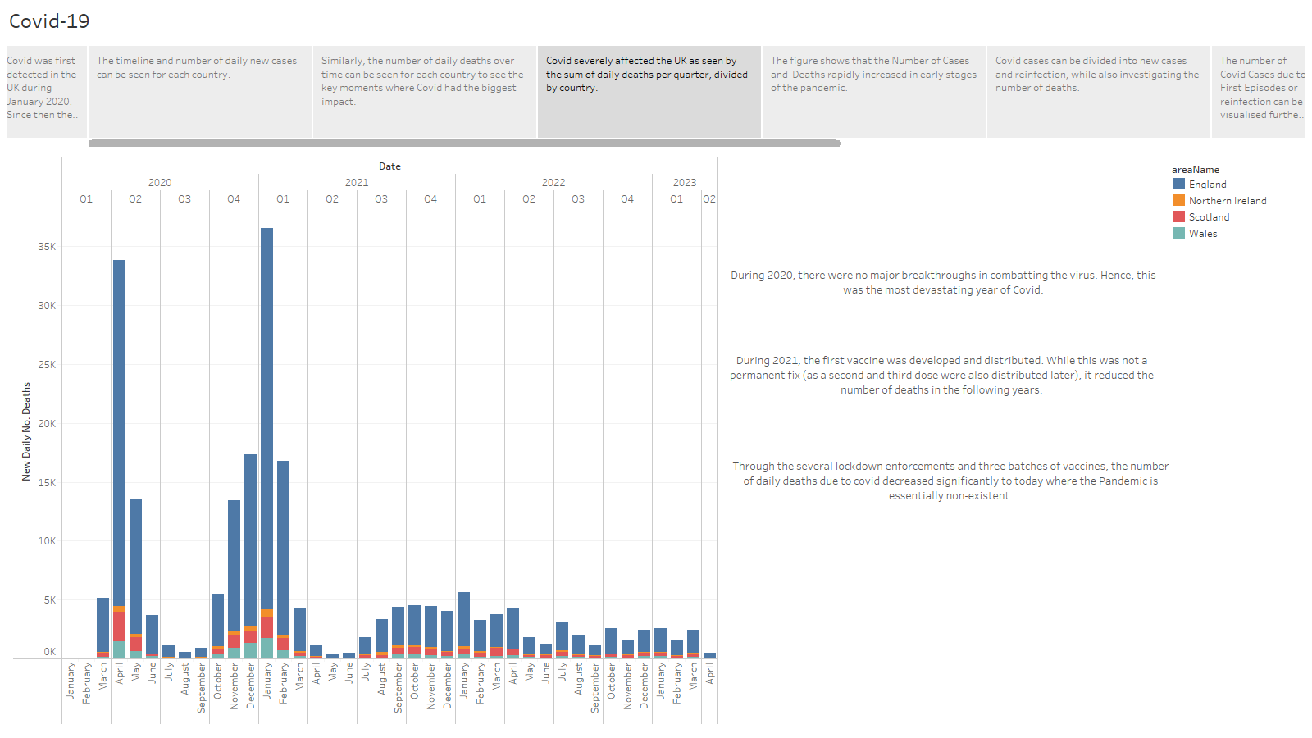
Notes:
Analytics and Visualisations of findings

Slide 8
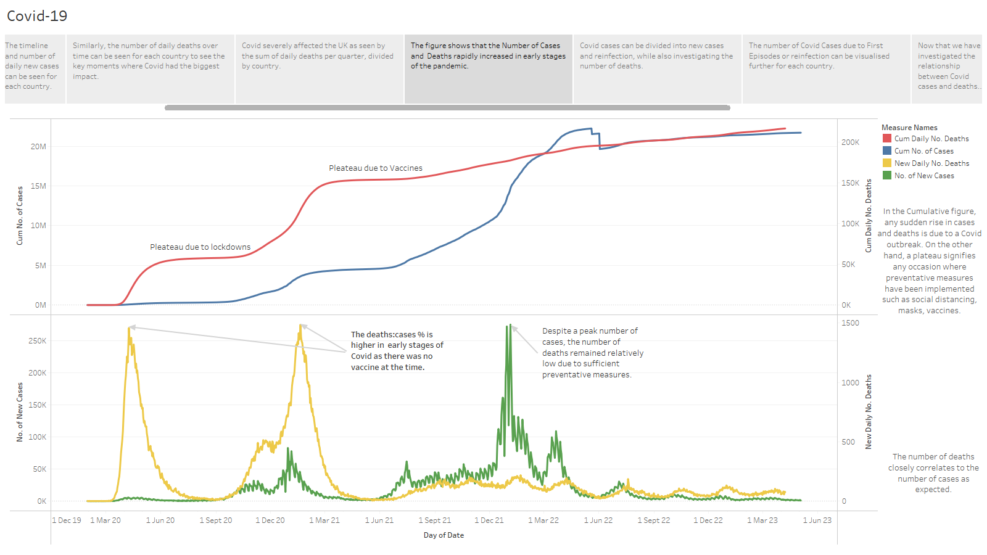
Notes:
Analytics and Visualisations of findings

Slide 9
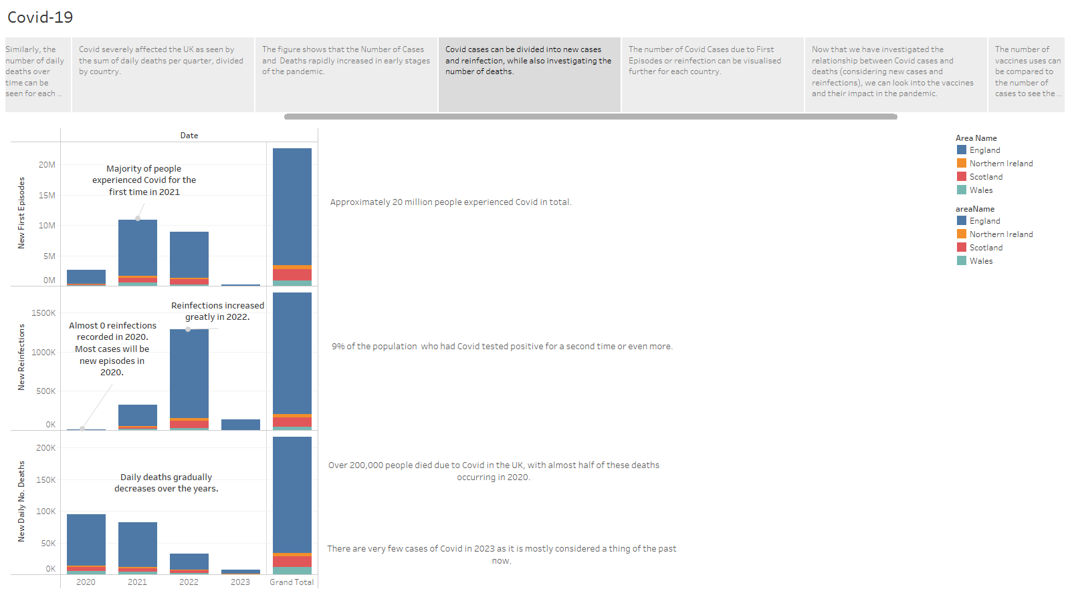
Notes:
Analytics and Visualisations of findings

Slide 10
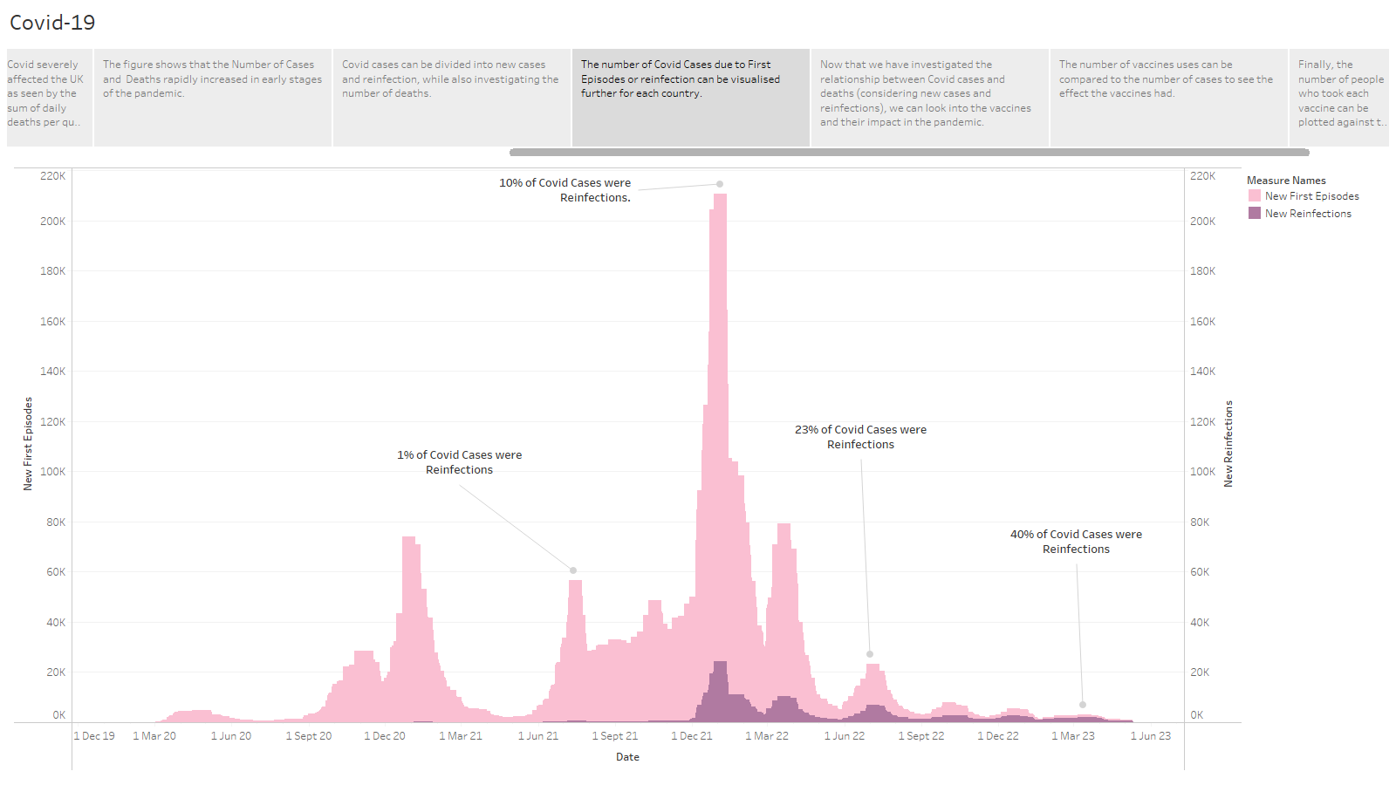
Notes:
Analytics and Visualisations of findings

Slide 11
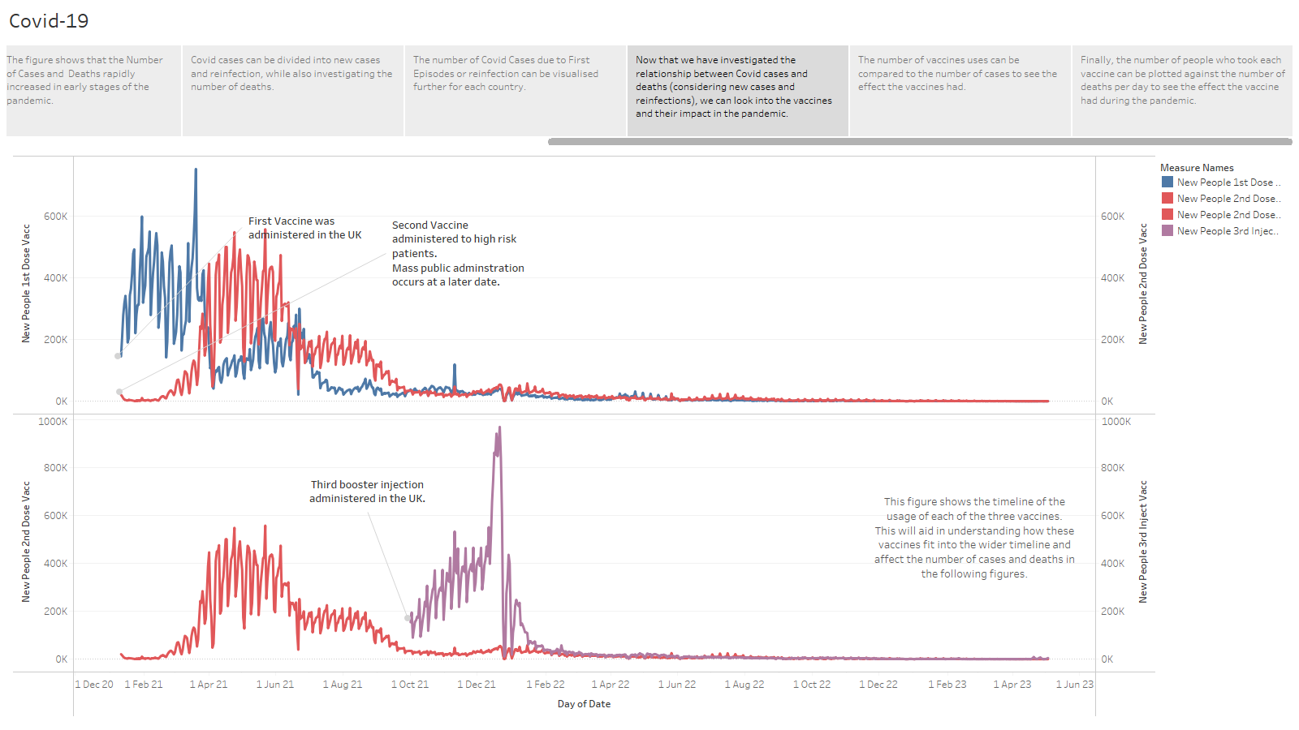
Notes:
Analytics and Visualisations of findings

Slide 12
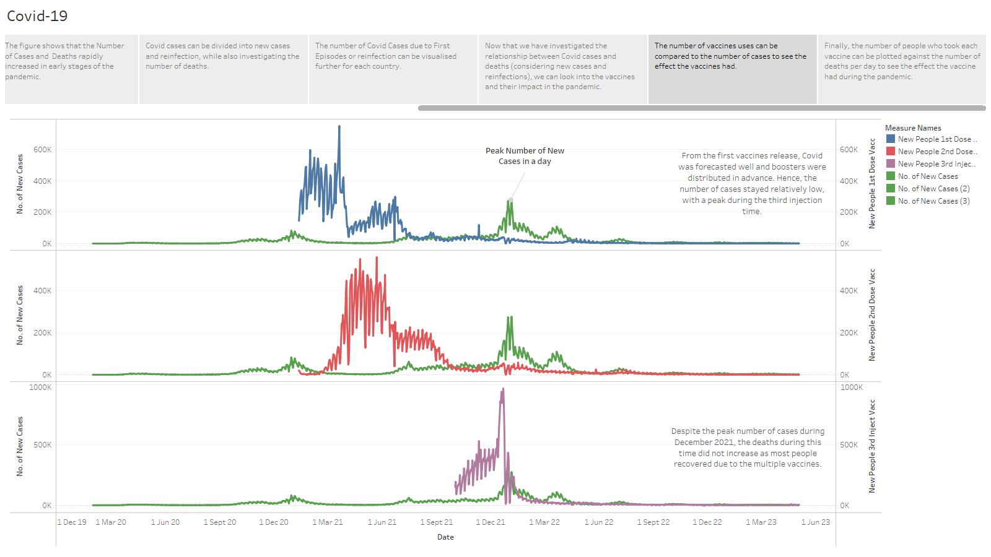
Notes:
Analytics and Visualisations of findings

Slide 13
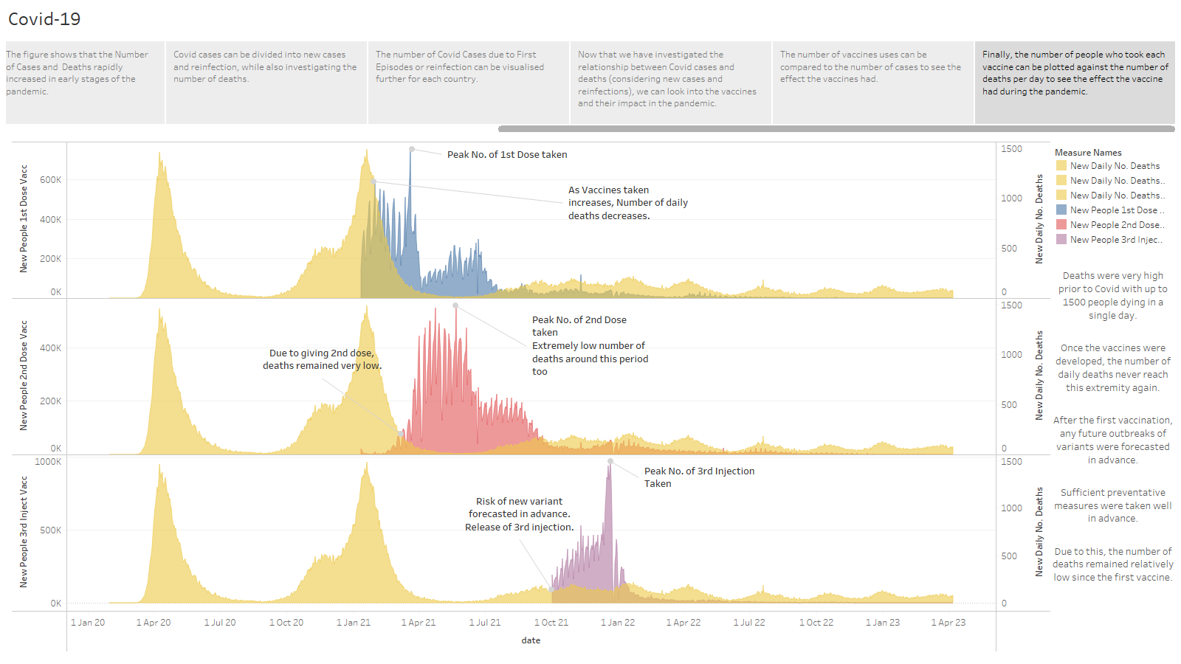
Notes:
Analytics and Visualisations of findings

Slide 14
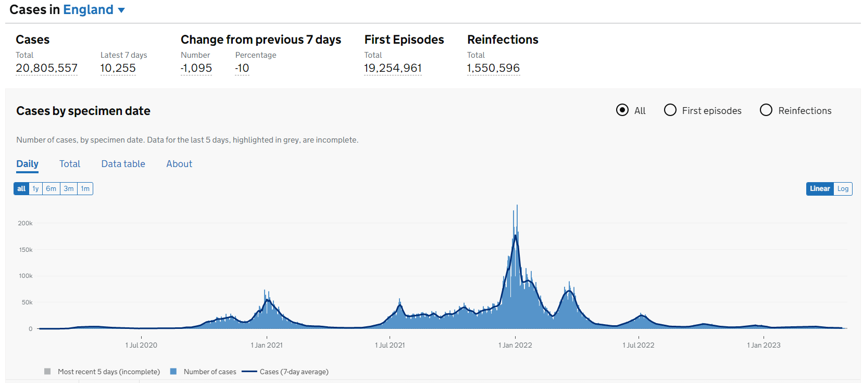
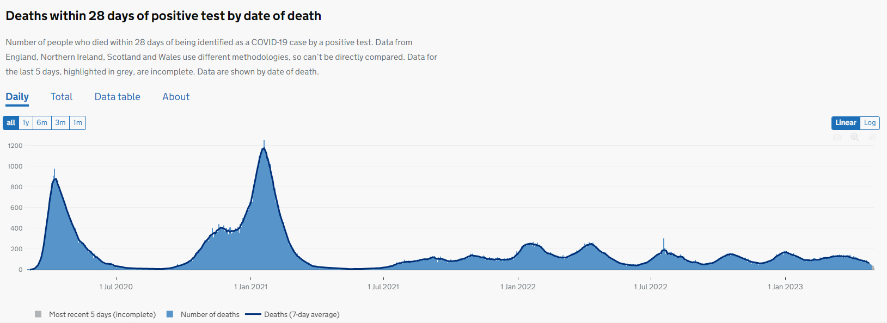
Analyses relation to media findings
The most reliable source of media visualisations of Covid-19 in the UK is gov.uk as this is where the data on Covid is collected.
The figures [1] show the number of daily cases & deaths in the UK. The figures follows a similar trend to those in previous slides, hence increasing the reliability and accuracy of the visualisations in this investigation.
The peak number of cases occurred during Jan 2022 and the two peaks of deaths occurred during 2020 as discussed during this investigation.
Notes:
How my findings relate to media.

Slide 15
Analyses relation to media findings
Gov.uk [3] & BFPG [4] have a record of key events during the pandemic such as:
First lockdown: 23/03/2020
Second lockdown: 5/11/2020
Third lockdown: 4/1/2021
Identifying these dates in any of the time series graphs will show that at these particular dates, the lockdown causes a reduce in number of Covid cases.
Every peak and drop in the figure can be explained through the timeline and key events that occurred to cause them, such as Omicron Variant causing a rapid increase in cases, followed by a rapid drop due to the booster vaccine being distributed.
Notes:
How my findings relate to media.

Slide 16
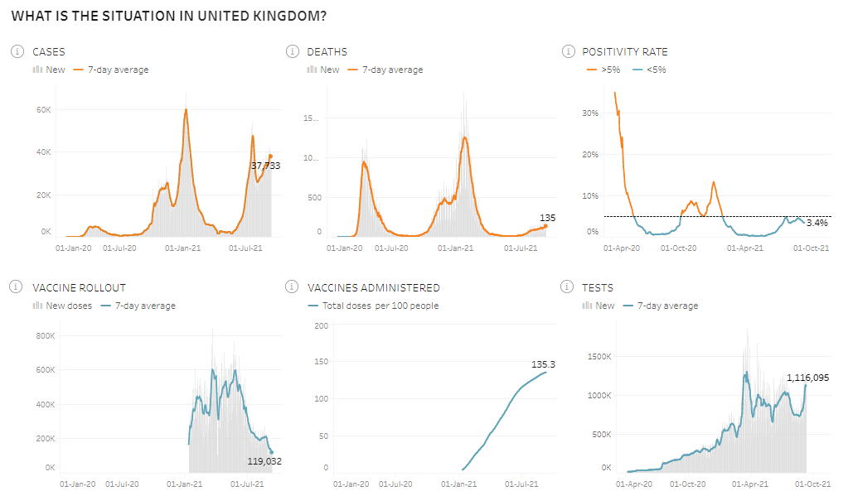
Analyses relation to media findings
Tableau has a COVID-19 Data Hub [5] which also presents very similar trends to those found above, further confirming the accuracy of the data and visualisations produced. The cases, death, and vaccine figures look very similar to those produced in this investigation as well as having similar figures.
Comparing the figures on the right show that the number of cases dropped as the vaccine rollout began, resulting in a decrease in number of deaths. This aligns with the key findings from this investigation.
Note: The tableau Covid-19 Hub only has data until 2021, whereas the investigation is using data up until 2023. Hence, the tableau data only shows the earlier trends of COVID in the UK.
Notes:
How my findings relate to media.

Slide 17
Summary of key findings in the investigation
Over 24 million people in the UK experienced Covid.
Majority of Covid related deaths occurred prior to the first vaccine rollout in Jan 2021 with over 100,000 deaths at this point.
Majority of Covid cases occurred during January 2022 at the same time the third booster vaccine was released to combat the Omicron Variant, as well as the lockdown restrictions being eased. Despite this, the number of deaths were very low due to good forecasting and preventative measures.
After the development of the first vaccine, the number of deaths never increased drastically again as we now had sufficient preventative methods and procedures (lockdowns, vaccines, face masks etc).
Over 9% of the population had been reinfected with Covid during 2022. In 2023, almost half the Covid cases are reinfection cases as the virus is mostly not considered an issue.
The most popular vaccine taken in the UK was the first vaccine. After this, the total number of people taking the new vaccines progressively decreased.
Notes:
Conclusion

Slide 18
Limitations of the data and analysis
Data collected is only obtained from Gov.uk, which may not include all the data available within the UK.
There is limited data in Ireland, Scotland, and Wales making it difficult to compare the effects of age and gender during the pandemic.
There is no hard data on the success rate caused by the vaccine, nor the number of people who experienced side effects due to the vaccine.
Vaccination data only shows data of vaccines administered within the UK. However, the overall vaccination rates in the UK could be higher if they have been vaccinated elsewhere.
Notes:
Conclusion

Slide 19
Future Recommendations
Download testing data to see how many people were taking PCR tests and their results. This can be linked to the ‘cases’ data.
Download healthcare data to see how many Covid patients were admitted to hospitals/ were in mechanical ventilation beds, and relate this to the ‘deaths’ data.
Since majority of the data lies in England, consider the research question on a more regional basis within England only to see how Covid affected different regions.
Download data on age and sex of people in the UK to see the correlation these had on the impact and severity (cases & deaths) of Covid. It is likely fewer younger people died in comparison to older people, meaning the virus was more severe to the elderly.
Consider gathering total population data in the UK so that the Covid data can be converted into a %. This is because England has a large population so dominates the figures in comparison to Northern Ireland, Scotland, and Wales. Converting the data into percentages will give a more representative figure where the severity of Covid in each country can be compared better.
Collect data for other countries to see how the UK’s Covid data compares to other countries with different approaches to combat the pandemic.
Notes:
Conclusion

Slide 20
References
[1] -https://coronavirus.data.gov.uk/#%23category%3Dnations%26map%3Drate
[2] - https://www.instituteforgovernment.org.uk/data-visualisation/timeline-coronavirus-lockdowns
[3] - https://gds.blog.gov.uk/2022/07/25/2-years-of-covid-19-on-gov-uk/
[4] - https://bfpg.co.uk/2020/04/covid-19-timeline/
[5] - https://www.tableau.com/en-gb/covid-19-coronavirus-data-resources
Notes:
References

Slide 21
Dr Zehra Turel: Applying Data Science in Real-World Scenarios
Zehra is a Clinical Research Associate and Data Analyst, undertaking a KTP (Knowledge Transfer Partnership) between University of Leicester (Knowledge Base Partner) and PJ Care (Company Partner). With a Psychology background, she became a KTP associate working on developing a new clinical assessment framework to assess Eudemonic wellbeing using data analytics and AI.
Currently Zehra is working with PJ Care to create a novel methodology to improve personal care planning and better respond to the needs of residents with neurological conditions. I was particularly interested by her discussion on how many nurses and carers were reluctant to the new clinical tests and data collection methods she developed as they didn’t want to learn something new when it didn’t affect their salary. Despite the initial pushback, she was able to overcome this by talking with the nurses to discuss their concerns.
Notes:
Guest Lecture

Slide 22
Dr Tony Adole: AimSmarter & Real-world Applications of Big Data
Tony (Data Scientist) works for AimSmarter, a UK-based company offering data services to businesses over a range of industries. They do this by providing insights in data the company provide to produce useful visualisations to make informed business decisions.
Tony discusses the importance of data analytics as it helps with strategic decision-making as the data can provide insights into business operations, optimising a business to the next level. Data analytics also helps identify potential growth in new markets, as well as predictive modelling to forecast trends, allowing a business to weigh out their risks and opportunities in advance.
What I found most interesting was the range of software he makes use of in his role, from Excel/SQL for data analysis, Tableau/Power BI for data visualisation, and AWS/Azure for cloud data. This emphasised to me the importance of being versatile and constantly adapt to the dynamic industry that is data science.
Notes:
Guest Lecture

Slide 23
Ayodeji Akiwowo: Data Science Life Cycle
Ayodeji works at Fujitsu, with an educational background in Systems Engineering. He talked about the role of data scientists as they handle data, after which he presented the agile DS Life Cycle. He presented a customer confusion matrix highlighting that a particular problem a customer has will be interpreted very differently by different role sectors such as the project leader, analyst, and programmer. This was interesting as he emphasised that good communication with the client will ensure the task is being carried out according to their desires.
He gave a personal story of where he assumed ‘NA’ was missing data on a country list, however the client explained NA was the abbreviation for Namibia, hence Ayodeji didn’t remove NA. He also explains that as a DS expert, we will not be educated in different business sectors, so sufficient research and communication is required to carry out a client’s task properly.
Notes:
Guest Lecture

Slide 24
Mary Wallace: Innovation & the Metaverse
Mary guides clients on IBM’s metaverse journey. The metaverse is a network of shared 3D experiences to increase immersivity and interactivity within businesses. While the metaverse exists vaguely today, it is an evolving journey that could change how data is exchanged.
I found it interesting how augmented reality and mixed reality could be used to overlay into the physical world to deepen a user’s experience. It is also interesting how Metaverse and Web 3.0 aims to give control of data and identity back to consumers, allowing them to have more privacy and control of their data.
She also highlights the goal for inclusivity within the development of the Metaverse as it prevents exclusion regardless of the quality of technology a user has. The innovation is very human-centric and ethical, aligning with human values to positively impact humans and society. This exciting concept has great potential in all aspects of technology.
Notes:
Guest Lecture

Slide 25
Eugenie Hunsicker: Data Science Careers
Eugenie is the Lead DS for a B2B company. Eugenie felt uneasy going to a B2C company due to the financial cost to privacy, such as Tesco with Clubcard’s as the customer gives up their privacy or faces a financial cost.
Eugenie discussed the 5 main sectors of DS, as well as the main tools used in these sectors. I found this really interesting as I asked her further questions on how future-proof she thinks the industry is. She explained that due to the agile nature of the industry and the diversity of data that is worked on, DS is a stable industry which is only growing in demand.
I was also interested in what she thought the main tools to learn were. She strongly advised I make a Git repository to showcase my skills, as well as gain experience in Spark to develop my skills in handling large data.
Notes:
Guest Lecture

