Slide 1
Oceana Grill Sentiment Analysis
Xueer Bai, Michael Panico, Yung Ting Lin

Slide 2
TABLE OF CONTENTS
01
02
03
04
05
06
07
Introduction
Expected Findings
Data Exploration
Data Preprocessing
Conclusion
Business Implication
Text Mining & Exploration

Slide 3
Introduction

Slide 4
Introduction
Utilize Yelp data to understand customer satisfaction dynamics to improve business outcomes.
Methodology:
Use VADER and FLAIR sentiment analyzers
Data preprocessing: tokenization, stemming, stop word removal.
Application modeling: logistic regression for prediction accuracy.
Result:
High accuracy in predicting mood, with marked emotional polarity and fewer neutral responses.
Positive reviews highlighted strengths such as service and atmosphere
Negative reviews often mentioned issues such as staff, wait times or food expectations.

Slide 5
Expected Findings

Slide 6
Expected Findings
Analyzing Yelp Data and Focusing on Oceana Grill
Using sentiment and review attributes to predict potential star ratings and anticipate customer satisfaction.
Monitor customer satisfaction trends and compare current performance to historical data.
Enhance marketing strategies and customer engagement based on review analysis.
It is expected that not only will customer satisfaction and loyalty increase, but also operational efficiency.

Slide 7
Data Exploration

Slide 8
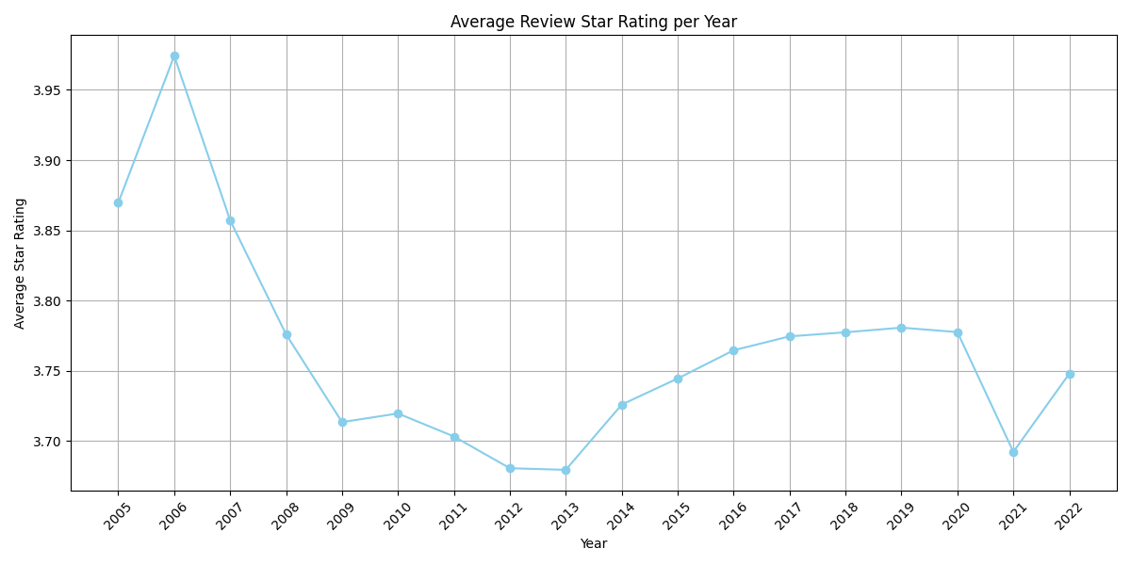
Business Star Rating (2005 - 2022)
Initial Ratings (2005): Average ~4.0 stars
Decline (2006-2011): Fell to approx. 3.7 stars
Consistent Ratings (2011-2020): Varied between 3.7 and 3.8 stars
Significant Decline (2021): Likely impacted by Covid-19
Investigating the causes of steady decline in star ratings

Slide 9
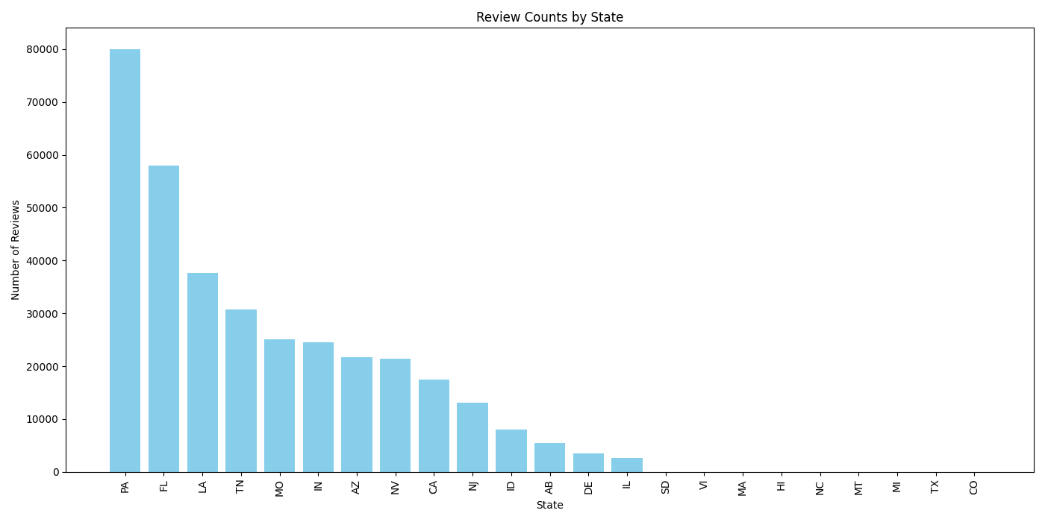
Review and Business Insights
High Review States: Pennsylvania, Florida, Louisiana
Identify top-reviewed businesses in these states
Gain insights into popular establishments and ensure availability of substantial review data

Slide 10
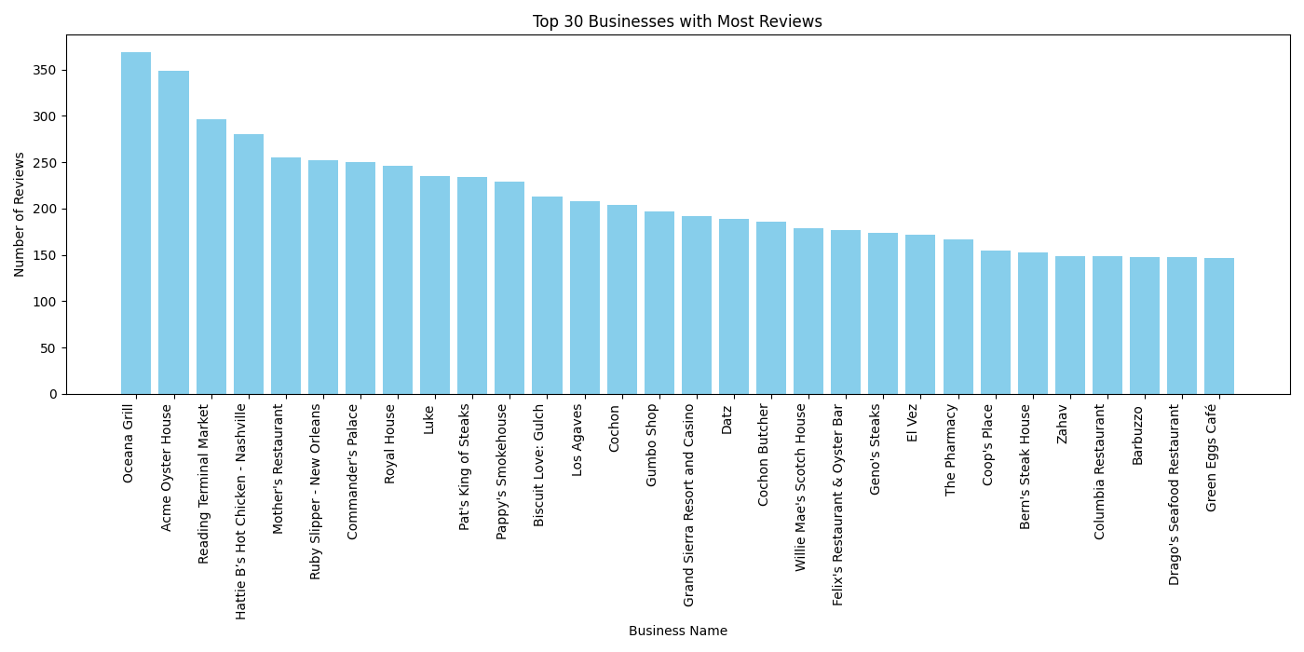
Top Business Analysis: Oceana Grill
Top Reviewed Business: Oceana Grill (LA)
Location: Louisiana, a top 3 reviewed state
Text sentiment analysis of reviews related to star ratings

Slide 11
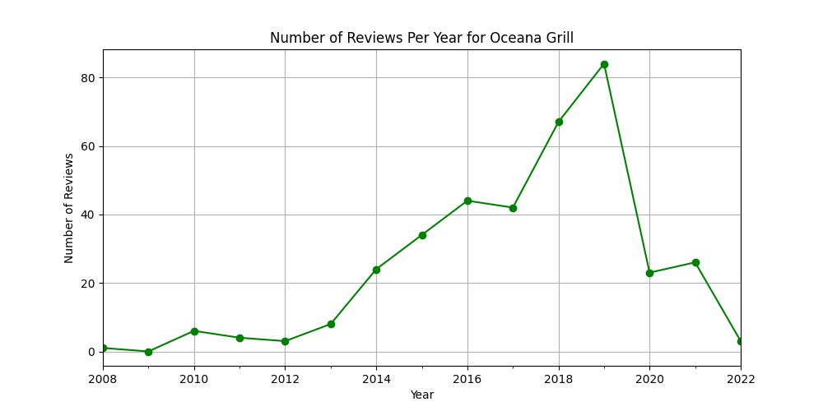
Oceana Grill: Reviews Over Time
Trends: Increase from 2012 to 2016
Significant decrease in reviews in recent years

Slide 12
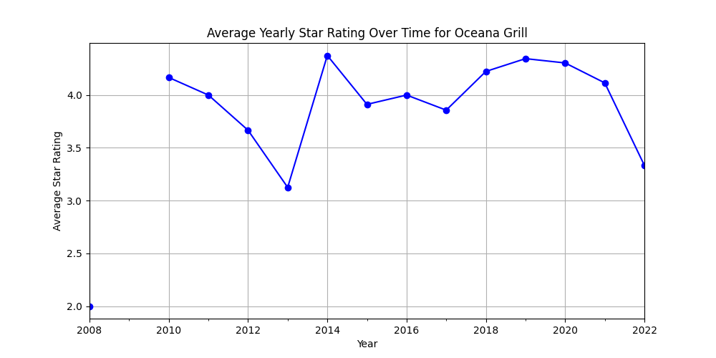
Average Star Rating
Initial Ratings: Exceeding 4 stars
Decline (2010-2013): Drop average ratings
Growth (2013-2014): Significant improvement
Stabilization (2014-2019): Ratings between 3.8 and 4.5 stars
Recent Decline (2019 - now): Aligns with decrease in reviews

Slide 13
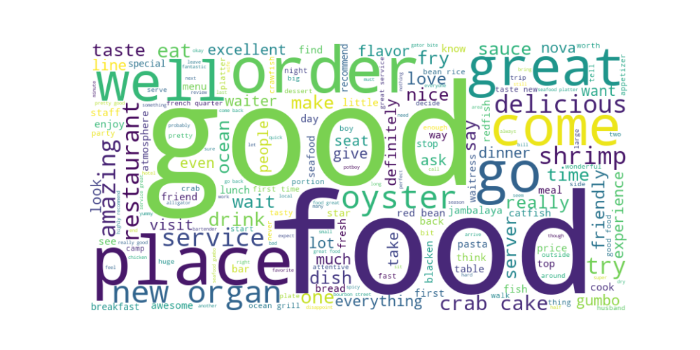
Word Cloud Analysis
Terms: good, food, well, great, delicious, order, oyster
Sentiment analysis to identify negative and positive feedback to improve

Slide 14
Data Preprocessing

Slide 15
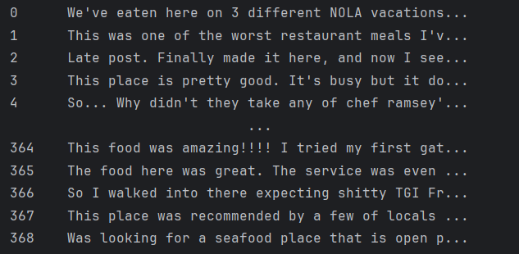
Text Preprocessing
Extract meaningful data from linguistically rich and colloquial text
Improves accuracy and efficiency of sentiment analysis and customer satisfaction research
Review original text to plan preprocessing steps

Slide 16
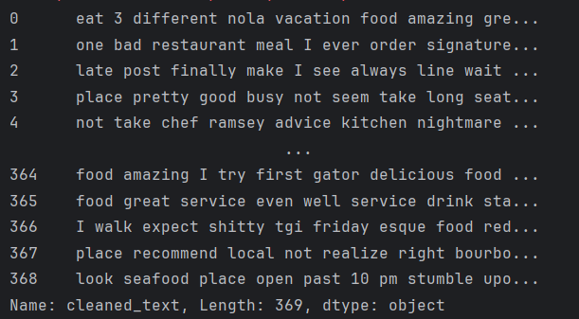
Text Normalization Techniques
Strip HTML Tags: removes unnecessary elements. eg. <a/>
Expand Contractions: converts to full forms for consistency. eg. “don’t” to “do not”
Remove Accented Characters: standardizes text. eg. "café" to “cafe”
Convert to Lowercase: ensures uniformity. eg. “When…” to “when…”
Lemmatization: Combines word forms.
Remove Special Characters: Reduces complexity. eg. “!”, “@”, “&”
Eliminate Stopwords: Removes common, non-informative words

Slide 17
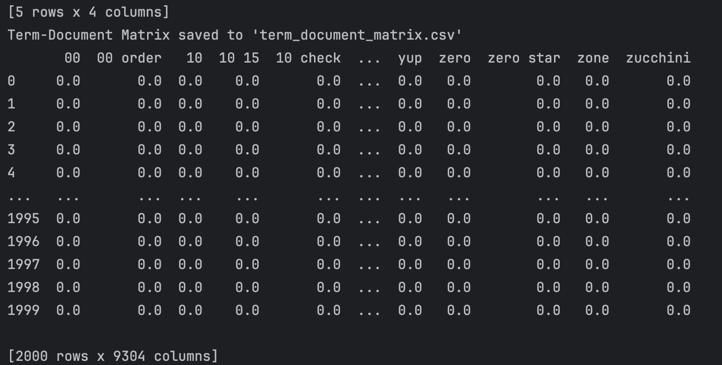
Term-Document Matrix
Structure: 2000 reviews x 9304 terms
Score: indicates term importance
Terms: "yup," "zero," "zone," "zero star," "zucchini"
Reduces complexity of text data
Highlights important terms
Improves accuracy and efficiency of text analysis

Slide 18
Text Mining & Evaluation

Slide 19
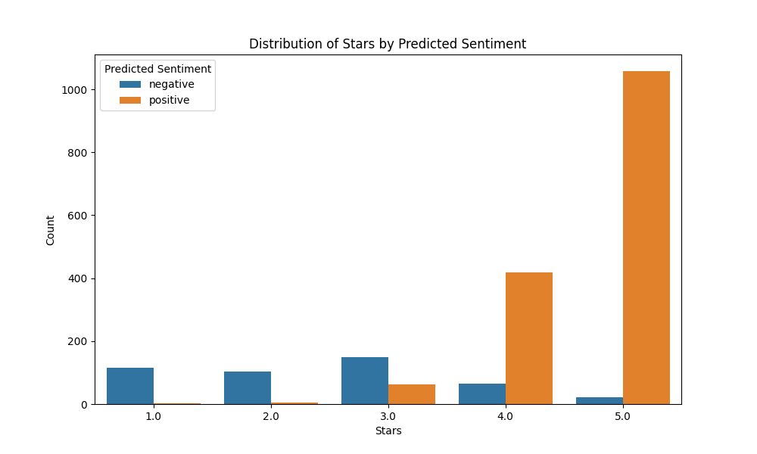
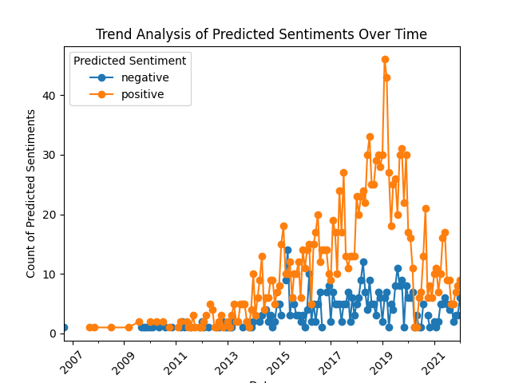
Sentiment Analysis
Run sentiment analysis to extract compound scores and categorize reviews
Notes:
Hello everyone. I will present the text mining and evaluation portion of our project pertaining to sentiment analysis and text mining of Yelp reviews for Oceana Grill specifically. To begin with the text mining part, our primary goal is to categorize customer reviews into sentiment categories using advanced sentiment analysis models FLAIR and VADER. We were left the distribution of either negative, or positive sentiment ratings across our sample of 2000 reviews specific to Oceana Grill. The VADER model, based on a lexicon and rule-based sentiment analysis tool, helps us capture the polarity of words used in the reviews. Flair, on the other hand, is a neural network-based model that provides a more nuanced understanding of sentiments. By using these models, we obtained compound sentiment scores for each review, which we then categorized into positive and negative sentiments. We will use the compound Flair sentiment score as a feature in our logistic regression with the target variable being the sentiment category of either negative or positive. Sentiment within user or customer reviews is extremely crucial for businesses to understand because this will allow them to seize important criticisms as soon as they appear as well as understand the infrastructure behind their positive reviews, which, as we will see later on, go hand and hand with high star rated reviews. BUT lets first dive into the next step in our process which is vectorizing our cleaned text data using TF-IDF Vectorization.

Slide 20
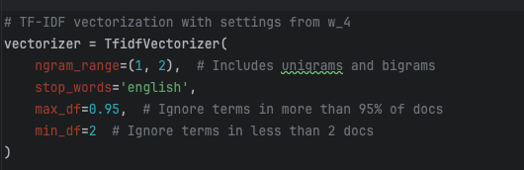
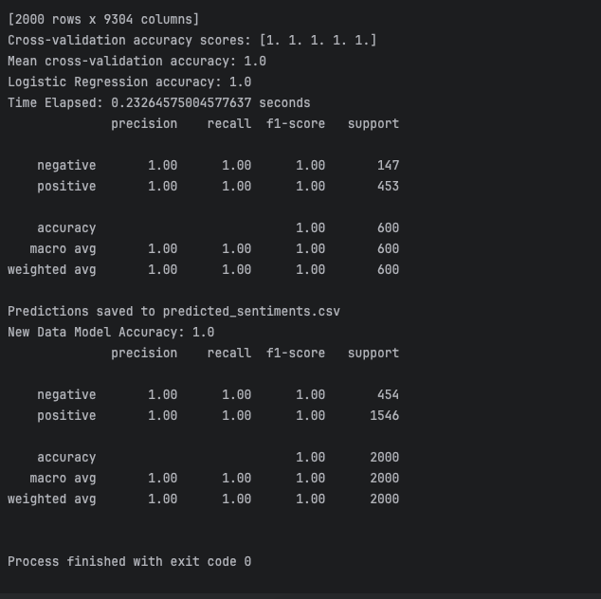
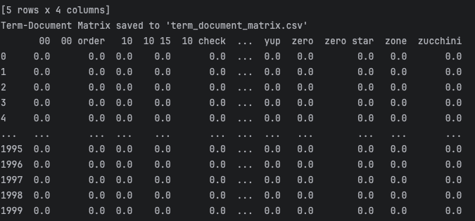
TF-IDF Vectorization
TF-IDF Vectorization
Term-Document Matrix
Combining of features
Train/Test and run Logistic Regression Model
Notes:
So, next we utilized our two compound sentiment scores from VADER and FLAIR as features in our logistic regression model alongside utilizing our TF-IDF vectorized text data, which we also turned into a term-document matrix, as features in our regression model. The TF-IDF Vectorizer is shown on the top left of this slide. We then of course implemented and trained and tested our regression model with a 70/30 split and evaluated the accuracy of our model. We ran our model many times and adjusted parameters on our categorization bins, n-grams, lemmatization and other preprocessing steps, target variable, feature limitation, feature exclusion, different train and test splits, and some more and as we can see our model predicted extremely accurately. This is expected as the model is trained on the Flair compound score and attempts to predict the sentiment category. However, we created a bin for the categorization of sentiments between -1 and 1 just like flair and vaders compound scores. We set this bin to be less than or equal to negative .05 is categorized as negative and greater than or equal to positive .05 is categorized as positive, if neither then it is neutral. As you can see, there were no negative reviews selected and this is because flairs compound score is a negative number if the sentiment is negative and positive if the sentiment is positive, however the value of this is dependant on how confident flair is and this is basically based on how much emotion is expressed within the text. With human reviews, especially of restaurants, the emotion expressed within the review text is almost always high and this is why we will not see many or any neutral categorizations. We can still utilize this as a safety net for potential hard to predict texts.
In order to assess our model, Cross-validation helped us evaluate the performance of our model. We utilized the logistic regression accuracy score, cross validation scores, and precision, recall, ad f1 scores. We achieved extreme high accuracy, precision, recall, and F1-scores, validating the robustness of our preprocessing and modeling techniques. The logistic regression model demonstrated an accuracy of 1.0, indicating its effectiveness in predicting sentiment categories. Next we will explore how the business of Oceana Grill can utilize our model and the categorization of sentiment in reviews within their business to enhance their operational efficiency and customer satisfaction.

Slide 21
Business Implications

Slide 22
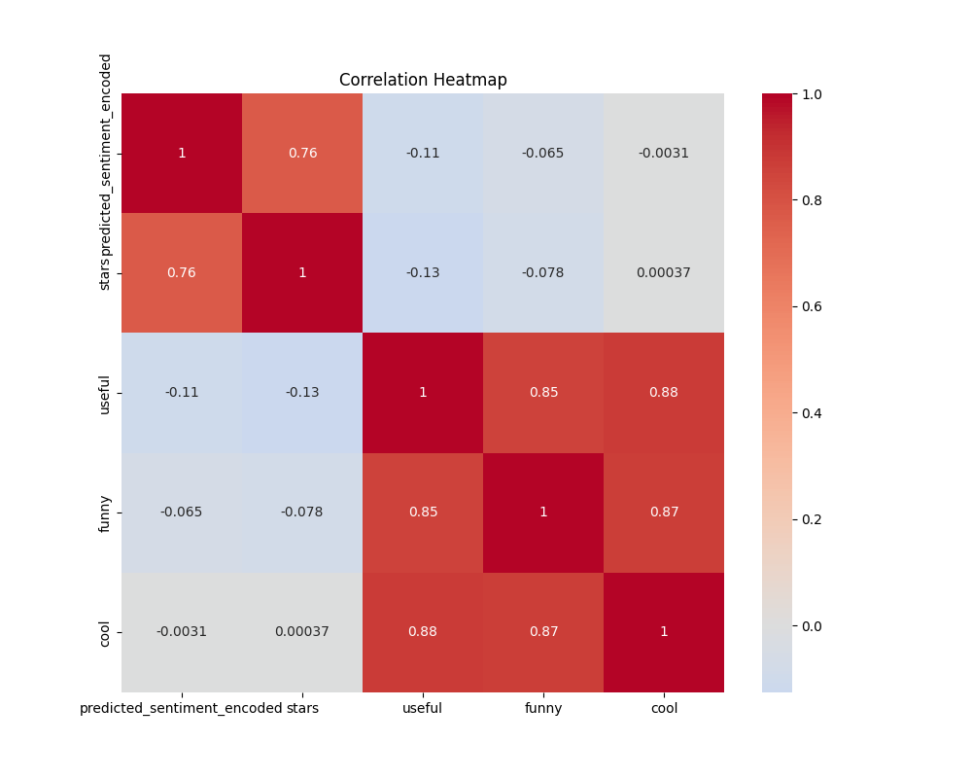
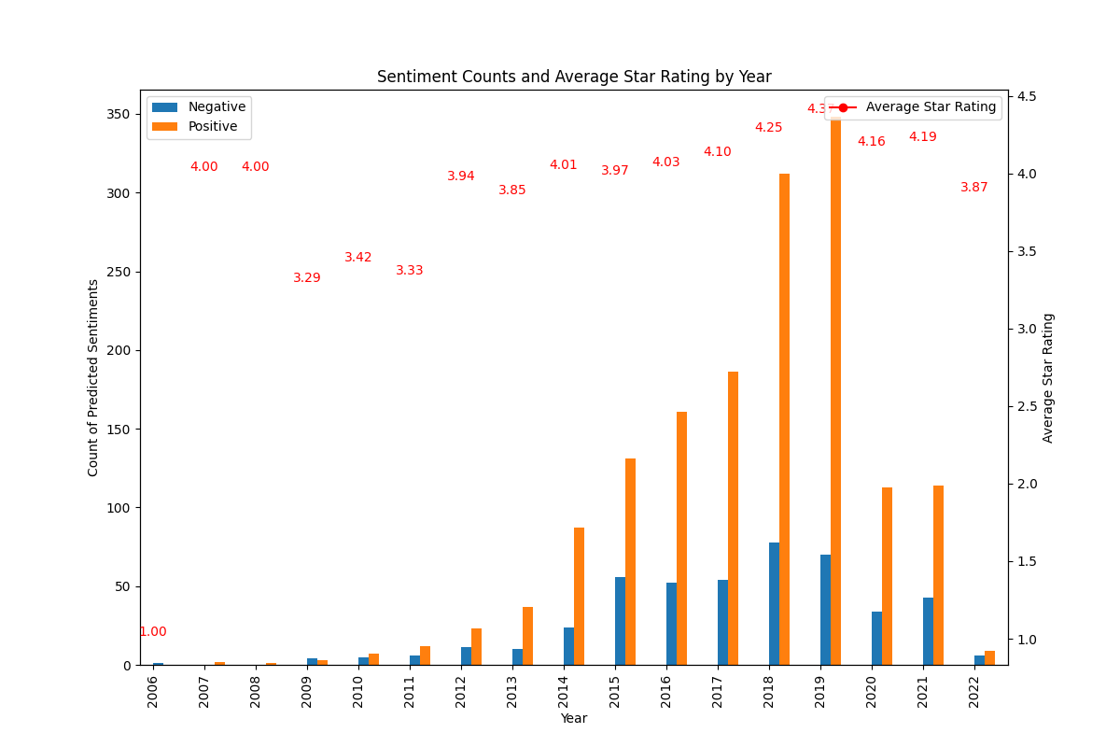
Utilizing New Data
Notes:
Moving on to the business implications of our findings, as seen in the correlation heatmap displayed on the left, our sentiment analysis revealed that predicted sentiment closely correlates with star ratings, with a correlation coefficient of 0.76. This suggests and confirms our expectations that sentiment analysis can be a reliable metric for customer satisfaction.
Seen in the clustered column chart on the right, we also observed that positive reviews are closely tied to higher star ratings. We can see, in a year like 2019, that when positive review counts were much larger than negative counts, star rating averages for the year were also larger. Additionally, our trend analysis indicated a steady increase in positive reviews until 2019, after which there was a noticeable decline. This is also true for star rating averages during the years following 2019. This temporal trend suggests potential operational changes that need to be addressed to improve customer satisfaction. During times of high positive review categorizations Oceana grill can study what operational techniques were being implemented and attempt to replicate this. On the other hand, Oceana grill can examine historical moments in time in which positive sentiment was less present within their reviews and negative sentiment was more present and examine the text within to understand what customers may be missing or expecting and why they were left unsatisfied to the point of leaving negative emotion in the form of an online business review. There are many more techniques that the business of Oceana Grill can use this data and new found model for that can allow them to increase their customer satisfaction. Next we will discuss some more strategic applications.

Slide 23
Strategic Applications:
Employee Training: Training in an interactive manner that customers find appealing and refraining from non appealing operational techniques, standards, or practices.
Marketing Customization: Develop marketing strategies to cater to localized customer segments and preferences and enhance regional customer response.
Operational Alignment: Adjusting operations to better meet customer expectations and utilizing real-time feedback to prevent declines in satisfaction.
Customer Relationship Management: Responding to feedback in real time can transform negative experiences, foster loyalty and enhance reputation.
Increase visibility: Positive reviews influence potential customers, increasing visibility and appeal on Yelp.
Business Benefits:
Notes:
Some strategic applications of this data can be represented on this slide. Examine positive reviews for subjects customers find appealing about the business and examine negative ones for subjects you should steer clear of and practices you should expunge immediately, etc. and Be sure to train your staff with these strategies in mind. Developing marketing strategies toward relevant information present within negative reviews vs positive reviews will also allow for insight into potential business operation enhancements. Providing real-time feedback toward reviews based on their sentiments, whether it be automated or manual, can also meet customers expectations better. And finally Monitoring these reviews regularly and implemented the present needed adjustments into the business can allow for Oceana Grill to increase their average star rating, grow and prosper at a much faster rate, and ultimately increase their overall market visibility, continue to satisfy satisfied customers, and remedy unsatisfied customers promptly.

Slide 24
Conclusion

