Slide 1

Machine Learning Models
CS-DS003
Christian Medina Armas Maite de La Roca
Introduction to Deep Learning

Slide 2
Overview of deep learning topics
Introduction to deep learning
Architecture of the perceptron
Architecture of simple neural network
Neural network tuning
Introduction recap
Important hyperparameters to optimize
Convolutional neural networks
Notes:
Base first lecture on this: https://www.youtube.com/watch?v=5v1JnYv_yWs
Course link: http://introtodeeplearning.com/

Slide 3
What is deep learning?
A subfield of Machine Learning focused on Artificial Neural Networks, which are loosely based on the structure of neurons in the human brain
Most of the concepts are 30+ years old but became popularized since 2012
Deep investment in this subfield from public and private sectors alike
Incredible variety in neural network forms: https://towardsdatascience.com/the-mostly-complete-chart-of-neural-networks-explained-3fb6f2367464

Slide 4
Why do we care about deep learning now?
Deep learning has the ability to find meaningful “features” from the data presented without us having to engineer each feature
We have way more data than we did when these concepts were invented
We have way more compute power than we did when these concepts were invented

Slide 5
Why do we care about deep learning now?
Building and deploying models has never been easier
Libraries like TensorFlow (2.0), Keras, and PyTorch allow us to create complex models in Python with relatively little code
Cloud providers like Google, Amazon, and Microsoft allow us to use intense compute power on demand and maintain endpoints easily

Slide 6
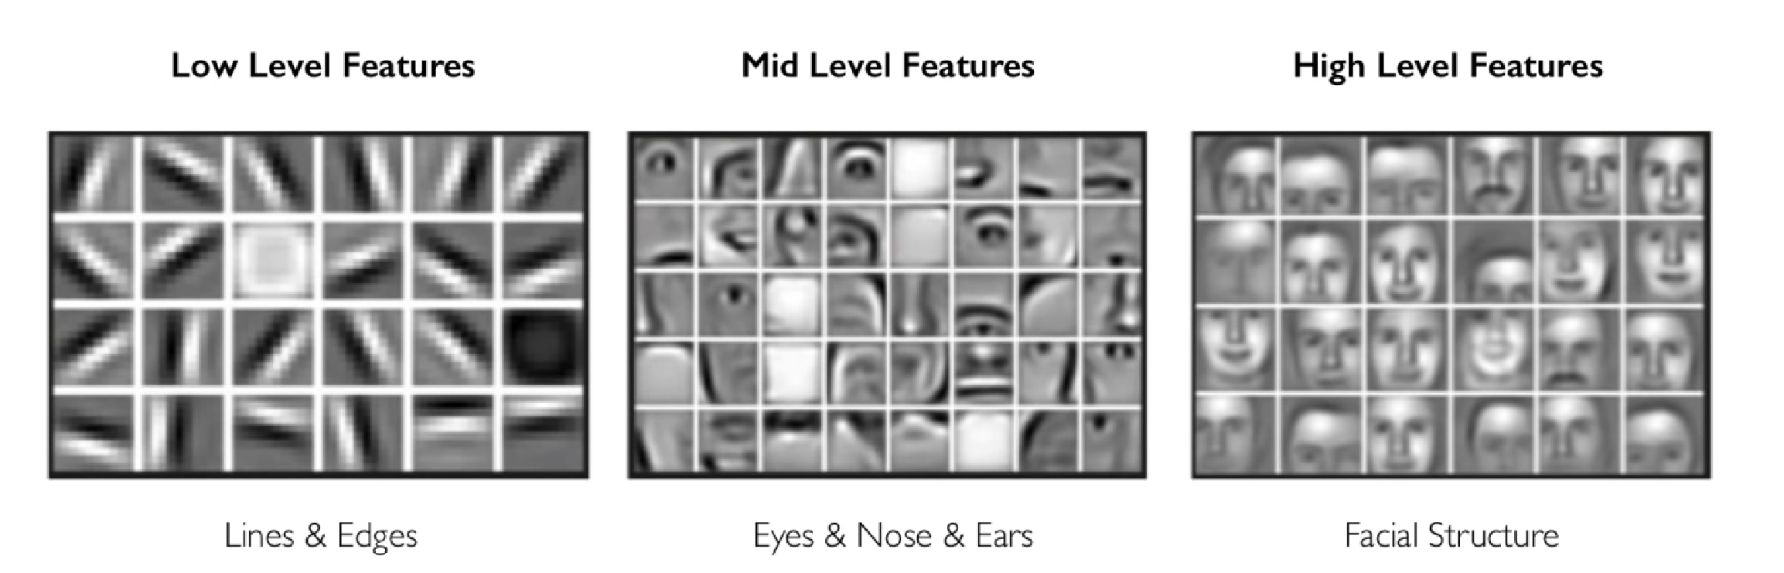
Quick example: face detection

Slide 7
Quick example: face detection
Advantages:
Much less time labeling features
Much less time doing feature creation
Underlying features detected by ANN may be better than what we could create

Slide 8
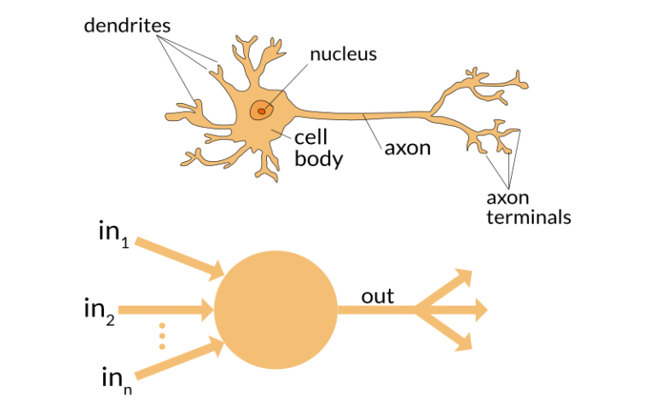
The perceptron: the lowest level building block of ANNs

Slide 9
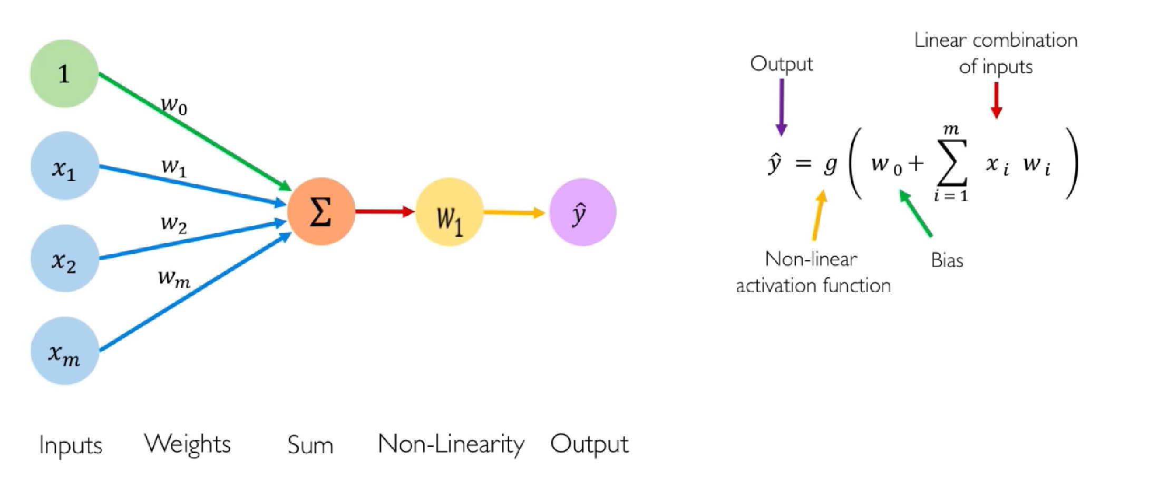
The perceptron: the lowest level building block of ANNs

Slide 10
The perceptron: bias term

Slide 11
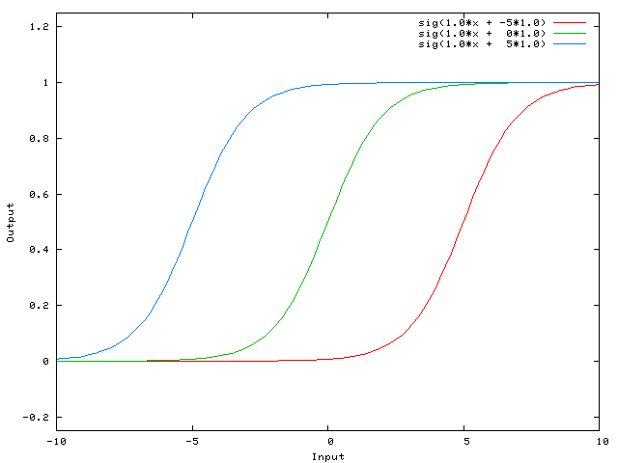
The perceptron: bias term
Somewhat similar to an intercept term in a regression equation
Adds flexibility to our model
Able to shift activation function, which may be better than changing shape alone
Notes:
Image source: https://stackoverflow.com/questions/2480650/role-of-bias-in-neural-networks

Slide 12
The perceptron: input features

Slide 13
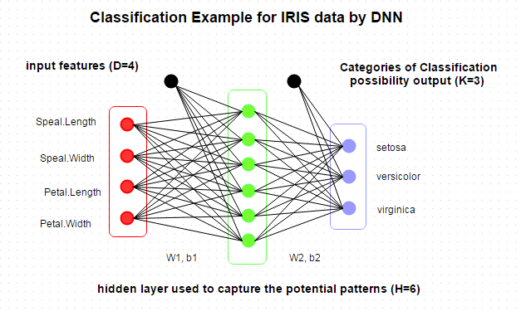
The perceptron: input features
For datasets we’ve worked with, features mean the same as before
Also include engineered features prior to input
For images/ videos, features usually consist of block of pixels
Notes:
Image source: http://www.parallelr.com/r-deep-neural-network-from-scratch/

Slide 14
The perceptron: feature weights

Slide 15
The perceptron: feature weights
Weight that we place on each input feature
Usually initialized (semi) randomly
Adding constraints can increase the chance that our model training converges (and doesn’t go to all zeroes)
Notes:
Image source: https://stackoverflow.com/questions/2480650/role-of-bias-in-neural-networks
Source for avoiding exploding/ vanishing gradients: https://hackernoon.com/how-to-initialize-weights-in-a-neural-net-so-it-performs-well-3e9302d4490f

Slide 16
The perceptron: sum

Slide 17
The perceptron: non-linearity

Slide 18
The perceptron: non-linearity
We apply a final function to transform the sum of our feature weights to our final output
Very important component of neural networks because it allows us to capture non-linear relationships
Many options that we’ll return to in a couple slides
Notes:
Image source: https://stackoverflow.com/questions/2480650/role-of-bias-in-neural-networks
Source for avoiding exploding/ vanishing gradients: https://hackernoon.com/how-to-initialize-weights-in-a-neural-net-so-it-performs-well-3e9302d4490f

Slide 19
The perceptron: output

Slide 20
The perceptron: output
Perceptron as entire model:
It’s your final prediction
Driven by the problem you’re trying to solve
Exactly like other models we’ve worked with
Perceptron as building block of ANN:
Final weight of one perceptron in one ANN layer
Notes:
Image source: https://stackoverflow.com/questions/2480650/role-of-bias-in-neural-networks
Source for avoiding exploding/ vanishing gradients: https://hackernoon.com/how-to-initialize-weights-in-a-neural-net-so-it-performs-well-3e9302d4490f

Slide 21
The perceptron: the lowest level building block of ANNs

Slide 22
Importance of non-linear activation functions
Big advantage of neural networks is that they are able to capture extremely complex relationships/ features that we wouldn’t be able to on our own
Able to approximate arbitrarily complex functions
This is only possible by introducing a nonlinear function to our ANN
Otherwise, our network would only capture linear relationships, even if it was stacked n layers deep

Slide 23
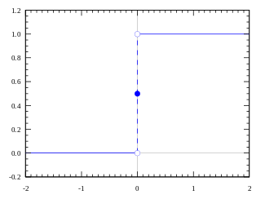
Simplest activation function: step function
Seems reasonable, easy to compute, each neuron is either off or on
Cons
If we have multiple outputs (ie classification types), this function might predict both types at once
Doesn’t allow for more gradual loss adjustments
Notes:
Source: https://medium.com/the-theory-of-everything/understanding-activation-functions-in-neural-networks-9491262884e0

Slide 24
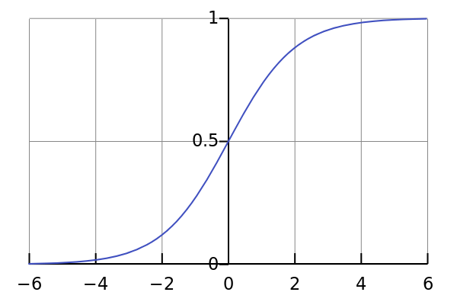
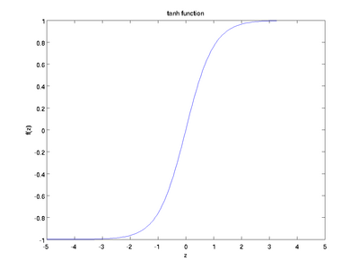
Common activation functions: sigmoid/tanh
Smooth, nonlinear, and bounded functions
Able to express confidence of classification and adjust more gradually
Cons
Less responsive to changes in tails, which can lead to a vanishing gradient
Sigmoid (0,1)
Tanh (-1,1)
Notes:
Vanishing gradient: network ceases to learn or only learns very slowly because changes to the weights don’t affect the output loss by much
Source: https://medium.com/the-theory-of-everything/understanding-activation-functions-in-neural-networks-9491262884e0

Slide 25
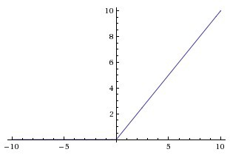
Common activation functions: ReLu
Potentially beneficial since this function can introduce sparsity and thus be much less computationally expensive
Cons
If neurons “die” prematurely, you may have too much information loss and produce a poor outcome
Notes:
Source: https://medium.com/the-theory-of-everything/understanding-activation-functions-in-neural-networks-9491262884e0

Slide 26
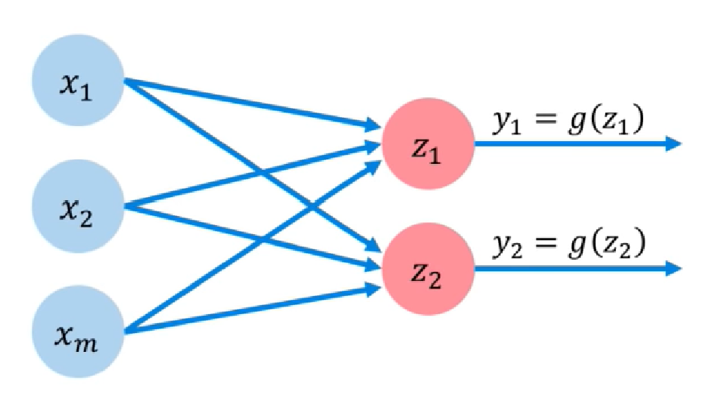
Multi output perceptron

Slide 27
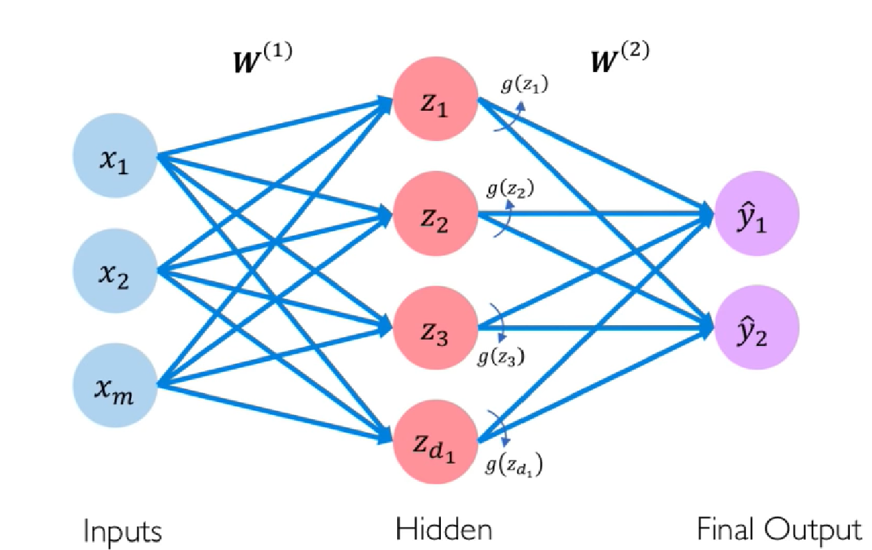
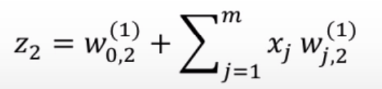
Building a single layer neural network
Don’t explicitly enforce any behavior on hidden layer
Activation function applied to output of each hidden layer

Slide 28
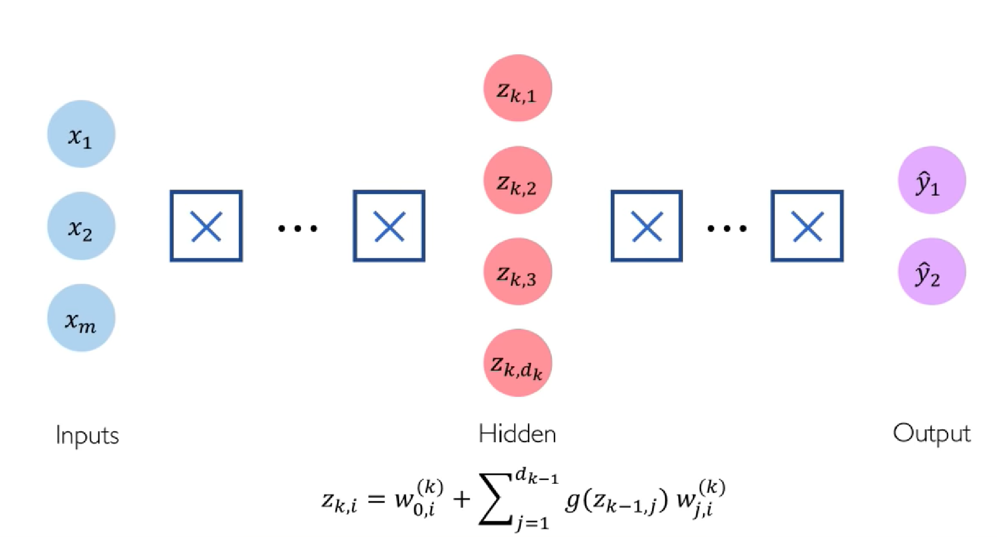
Deep neural networks
Notes:
X’s signify fully connected layers

Slide 29
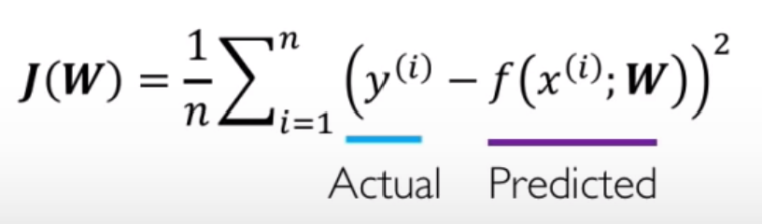
Loss optimization
Loss function:
To train: seek to minimize the squared errors on the training set (just as with minimizing MSE for other algorithms)
Goal: find all weights in network that minimize loss function

Slide 30
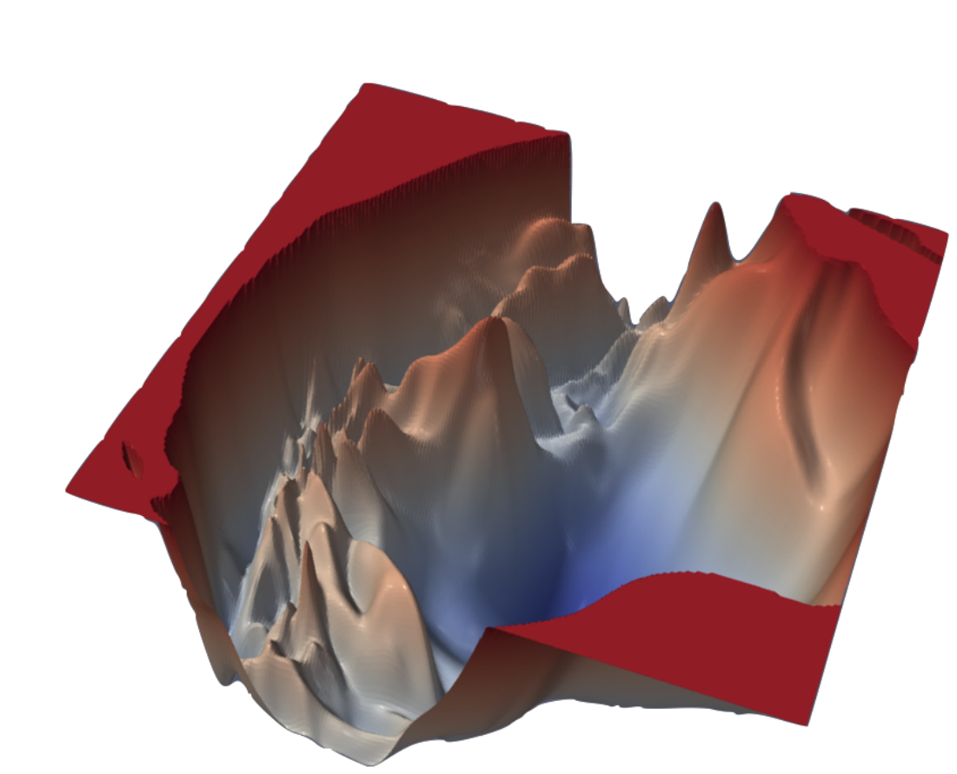
Loss landscape of neural networks
Notes:
Source paper: https://arxiv.org/pdf/1712.09913.pdf

Slide 31
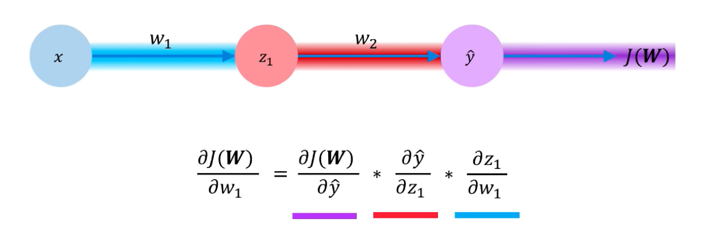
Backpropagation

Slide 32
Backpropagation
Mostly computationally costly part of neural networks
Backpropagating throughout entire network, which is often a very large space
Super important because it’s how the network learns during training

